Slide 1
John B. Holcomb, MD, FACS
COL (Ret) US Army
Professor of Surgery
University of Alabama at Birmingham and
Uniformed Services University of the Health Sciences

Slide 2
Disclosures
Decisio Health Founder and BoD
Zibrio BoD
QinFlow BoD
CCJ Medical BoD
WFIRM Consultant
Aspen Medical Consultant
Co-Inventor of the JETT Royalty from UT
DoD, NIH, DARPA and CSL Grants

Slide 3
Crystalloid Tangent
NS is poison
Good for dehydration
Boiling pasta
Diarrhea
Causes Hyperchloremic metabolic acidosis ….increased death and AKI
Tradition and Cheap and its Everywhere
God and Hurricanes have helped us!
Semler MW, et al. NEJM, 2017
https://www.axios.com/2024/10/01/hurricane-helene-iv-fluid-shortage-health-supply-chain

Slide 4
Unpublished data
Prehospital Blood Transfusions:
A Public Health Initiative to Reduce Motor Vehicle Crash Deaths
Christine Carico, Randall Schaefer, Eric A Bank, John B Holcomb, Zain G Hashmi
The objective of this study is to determine the trend of prehospital blood product use among patients injured in MVCs.
Methods: Patients >14 years of age injured in MVCs that were included in NEMSIS 2020-2023 were identified.
Patients were classified as eligible for transfusion if their shock index, calculated by dividing the patient’s heart rate (HR) by systolic blood pressure (SBP), was ≥1.

Slide 5
More Unpublished data
Results: 5.1 million trauma patients were included in our analysis. Of these, 294,523 patients had a shock index of ≥1 and were considered eligible for pre-hospital transfusion of blood product.
Only 0.62% of eligible trauma patients received pre-hospital blood product between 2020 and 2023.

Slide 6
More Unpublished data
Conclusions: Less than 1% of hemodynamically unstable trauma patients injured in MVCs received a prehospital blood transfusion during 2020-2023.
These data underscore the need to evaluate and resolve barriers to wider use of prehospital blood transfusions in patients experiencing traumatic injuries from MVCs.

Slide 7
Why so low?
Many reasons…..
Are we trying to use on only WB, when our best data and supply and cost and history is with plasma?
Logistics the same…. But wildly more available

Slide 8
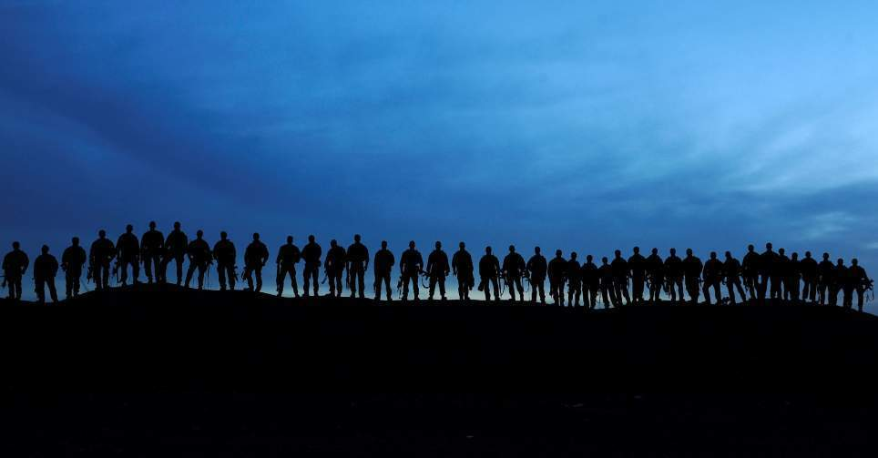
Thank You!
JBHolcomb@uabmc.edu
8

