Slide 1
Update - 1st Edition Scheduled Out of Hospital and Emergency Prehospital Transfusion Services
Audra L. Taylor – Committee Chair
THOR - Miami
7 October 2024

Slide 2
Who is AABB?
Association for the Advancement of Blood and Biotherapies.
Inception in 1947.
Core objectives to provide high standards of safety for patients, donors and facilities.
Governed by its Board of Directors.
Membership includes physicians, nurses, scientists, researchers, administrators, clinical laboratory scientists and other health care providers. AABB members are located in more than 80 countries and AABB accredits institutions in more than 50 countries.

Slide 3
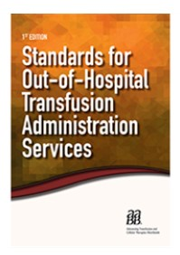
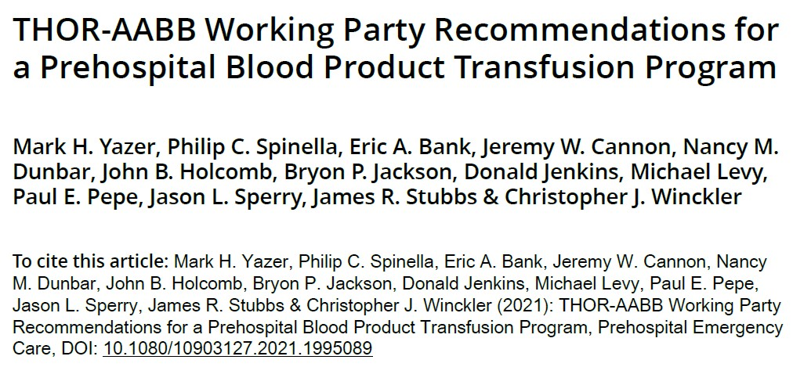
In The Beginning

Slide 4
Charge By Board of Directors
AABB released the first edition of Standards for Out of Hospital Transfusion Administration Services in 2018, while in 2022, in conjunction with members of THOR, staff worked on the Pillars of Prehospital Recommendations.
Throughout 2022 and early 2023 AABB has received queries from the membership surrounding prehospital and out of hospital concerning the need for standardization and the desire for accreditation.
AABB staff requests from the AABB Board of Directors approval to stand up a new standards committee focused on merging the Out of Hospital Transfusion Administration Standards with elements of the Pillars of Prehospital Recommendations into a cohesive document based on AABB’s updated quality system essentials for out of hospital and pre hospital accreditation.

Slide 5
Committee Members
Chair – Audra Taylor
Representatives
Eric Bank - International Association of Emergency Medical Services Chiefs
Victor Baum – FDA (OBRR)
Martin Schreiber – Trauma Centers of America
David Tan - National Association of EMS Physicians
Gerad Troutman - American Ambulance Association
Members
Shraddha Patel Babariya
Kevin Blaine
Dayand Borge
Alexandra Budhai
William Bullock
Members
William Bullock
Liz Carter
Rozalinde Christodoulos
Andres Elizondo III
Amanda Graham
Daniela Hermelin
John Holcomb
Courtney Hopkins
Donald Jenkins
Samantha Ngamsuntikul
Sandhya Panch
Nicholas Price
Jose Quesada
Randall Schaefer
Mark Yazer

Slide 6
What are Standards
Since 1957, AABB standards have been the backbone of AABB’s mission.
Combine the field’s leading quality management system essentials with technical requirements designed to ensure optimal quality and safety for donors, patients and staff.
AABB standards:
are currently applied to AABB-Accredited facilities in more than 50 countries and other facilities to advance their quality and safety measures.
combine internationally accepted quality management system requirements with relevant technical requirements for each discipline.
are based on AABB’s quality system framework which leads the field in quality standards worldwide.
incorporate both technical and quality systems standards
Each edition of AABB's Standards are based on best medical practice, scientific data, principles associated with good manufacturing practices and quality assurance, and applicable regulations.

Slide 7
What are Standards
All sets of AABB Standards are effective for two years and represent requirements that must be implemented by AABB-accredited facilities.
A requirement contains the word “shall,” which indicates that the statement is mandatory. Failure to meet the requirement would constitute a nonconformance under the AABB Accreditation Program.
There are rare instances in which a standard uses the term “may.” A statement that uses “may” is not a requirement.
When the pencil symbol precedes a standard, users are required to maintain a record of that activity in order to meet the standard.
A requirement in the AABB Standards may be associated with a requirement in the U.S. Code of Federal Regulations (CFR). Unless the standard specifically requires users to follow the requirements in the CFR, the reference is for information only.

Slide 8
Quality System Essentials (QSEs)
QSE 1 – Organization
QSE 2 – Resources
QSE 3 – Equipment
QSE 4 – Suppliers and Customers
QSE 5 – Process Control:
Out of Hospital Activities
Prehospital Activities
QSE 6 – Documents and Records
QSE 7 – Deviations, Nonconformances, and Adverse Events
QSE 8 – Internal and External Assessments
QSE 9 – Process Improvement
QSE 10 – Facilities and Safety
Glossary
*Guidance

Slide 9
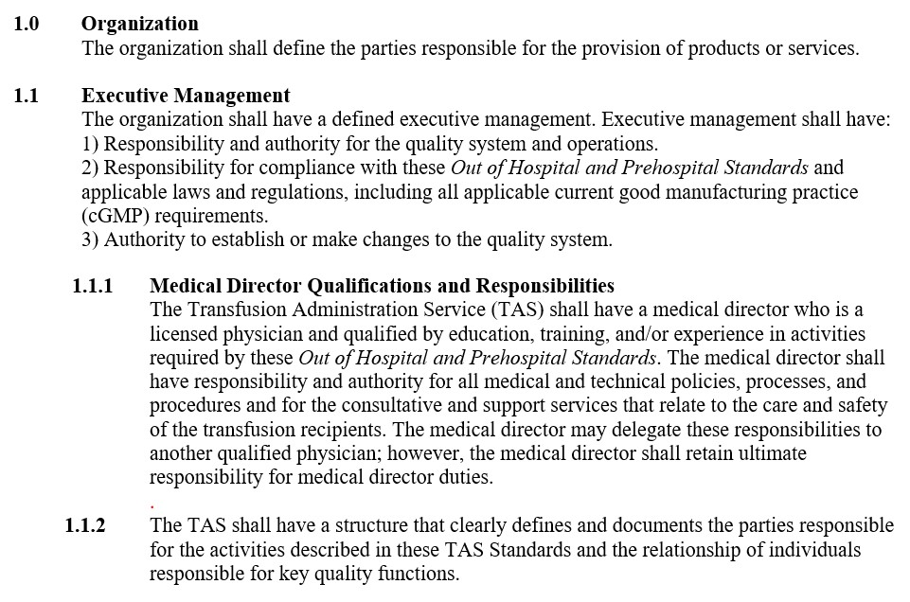
Transfusion Administration Service (TAS) – A service provider responsible for receiving and transmitting orders of blood for transfusion, transporting blood to the transfusion site, performing the transfusion, monitoring the patient during transfusion, reporting outcomes, and ensuring the traceability of the unit is maintained.

Slide 10
Timeline
September 2023
Committee Formation
Committee Chair
Q4 2023 – Q2 2024
Develop the Standards
Series of zoom calls
Q3 2024 - Present
Refine and Publish
Public Comment
Invite Committee Members
Equal representation – Out of hospital and Prehospital
One “in person” meeting – STB&T
AABB Staff Comments
AABB Board of Directors
Series of zoom calls

Slide 11
So……What’s Next?
To develop and update standards for out of hospital and prehospital services.
Obtain input and review existing requirements of the Standards for Out of Hospital Transfusion Administration and expand the Standards to include prehospital requirements.
In coordination with staff, develop guidance for the Standards and create records of rationales for changes existing requirements.
Update the Standards to reflect recommendations of the Donor History Questionnaire Task Force, Transfusion Transmitted Diseases Committee and the associated Accreditation Committee.
Review and respond to requests for clarification and variances to the Standards as needed.
Develop interim/emergent standards as needed for submission to the Board of Directors
Monitor the development of new technologies with potential application to cellular therapies and develop or modify standards when appropriate.

Slide 12
What is Accreditation?
AABB has been a leader in developing standards and accrediting facilities in the blood and biotherapies community since 1958.
AABB Accreditation promotes the highest standards of quality and safety for blood and biotherapies facilities.
The AABB Accreditation program is internationally recognized as a symbol of quality, and facilities that have achieved AABB Accreditation are known to provide quality products and services.
To become accredited, a facility must be in compliance with the current edition of Standards and adhere to other accreditation requirements.

Slide 13
Audra L. Taylor Vice President, Blood Operations at STB&T Audra.Taylor@southtexasblood.org
Thank You!

