Slide 1
Permissive Hypotension in Animal Models
THOR 25th June 2019
Dr Sarah Watts MRCVS
Dr Emrys Kirkman OBE
official

Slide 2
Disclaimer
All animal work done in accordance with A(SP)A 1986
Data presented has yet to have final verification
Data analysis still ongoing
  Treat as preliminary results
    DO PHOTOGRAPH or SHARE
official

Slide 3
Dstl resuscitation study for prolonged pre-hospital care
official

Slide 4
Remote Damage Control Resuscitation
Opinion piece
  Blood based resuscitation where possible
    “salt water is for cooking pasta” P Spinella
official

Slide 5
RDCR Principle
BLOOD BASED RESUSCITATION WHERE POSSIBLE
Delivering blood far forward
  Logistic constraints
    Prolonged timelines
      Finite resource?
        Supply and re-supply
    Mass casualties
      Not an infinite resource?
Administering blood far forward
  How and when?
official

Slide 6
Study Aim
Evaluate different fluid resuscitation strategies for prolonged pre-hospital care in a model of trauma and shock
  PRBC:FFP
  FWB (warm non-leukodepleted)
  FFP
  0.9% saline
  0.9% saline + noradrenaline
official

Slide 7
Methods
Terminally anaesthetised poly-trauma pig model
Instrumentation Phase
Injury Phase
(MSKI +
30% BV HGE + liver injury)
‘Buddy aid’ Phase (30min)
Resuscitation Phase (480min)
Target SBP 80mmHg
(3ml/kg fluid bolus)
Max 500ml SBP≥60mmHg 0.9% saline
Max NA dose 2μg/kg/hr
Max 4 units (blood products)
N = 9 each group
official

Slide 8
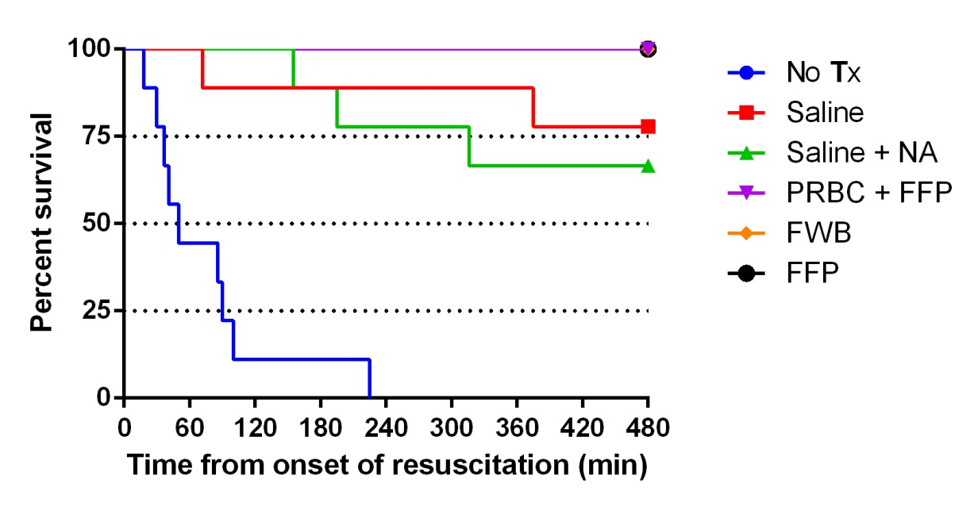
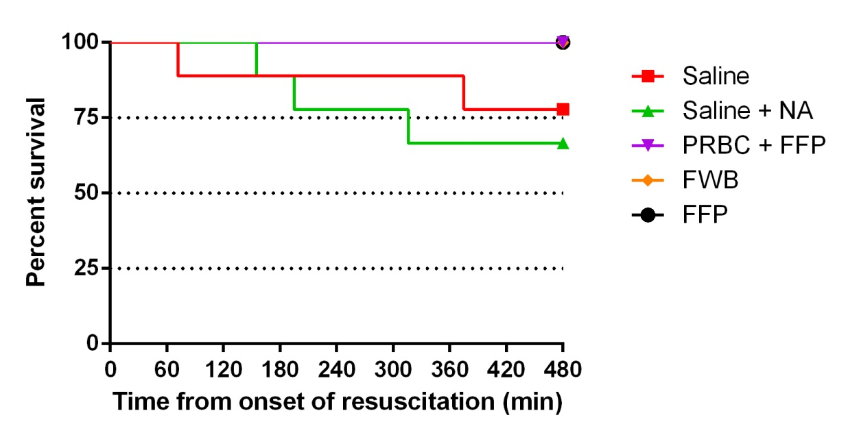
Results – Survival
No treatment significantly worse than Saline+NA P<0.001
No significant difference between Saline and Saline+NA
Over the 480 min of this study Saline significantly different to combined ‘blood’ groups P=0.017
“salt water is for cooking pasta”……
………… but “salt water is not cyanide”
official

Slide 9
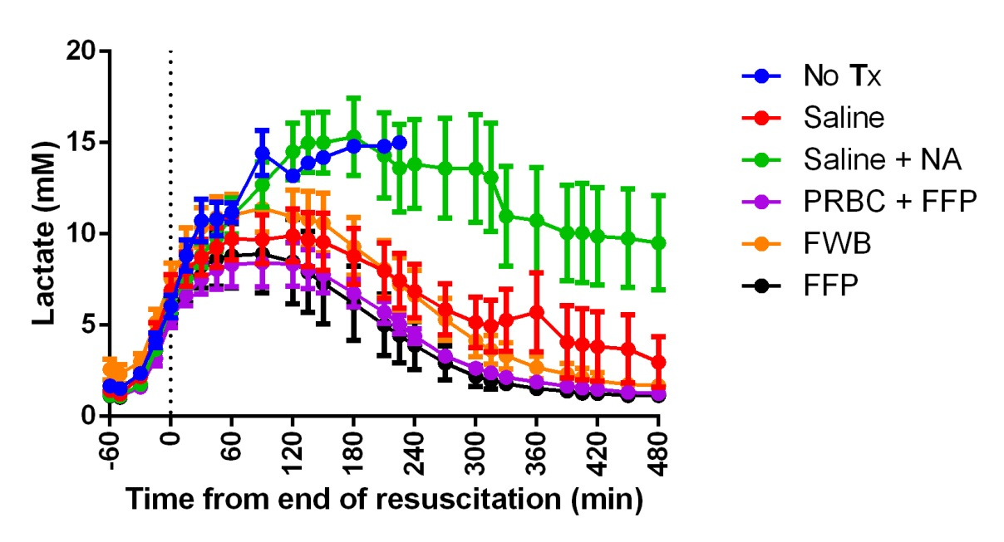
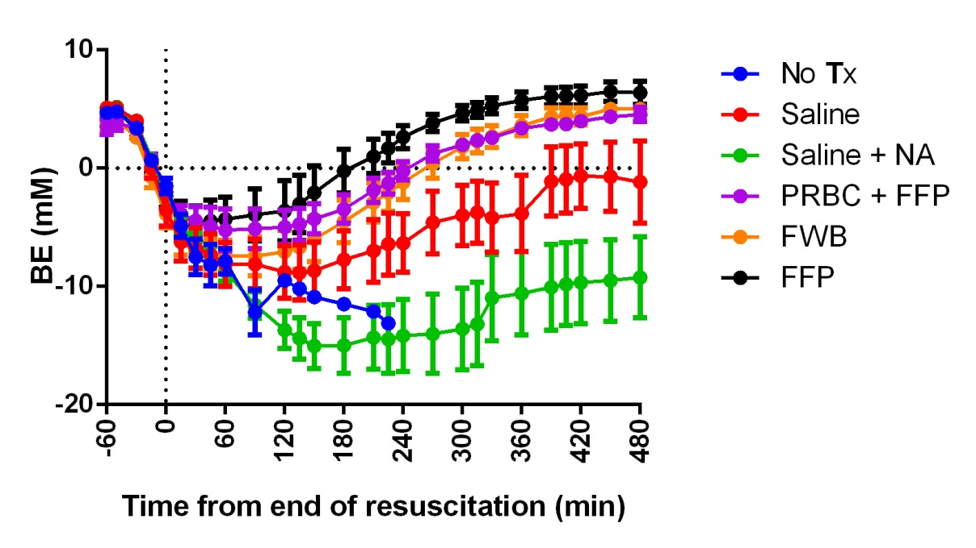
Results – ‘Burden’ of Shock
AUC
Injury Phase:
No sig diff between groups
Resuscitation Phase:
Sig diff between groups
Saline+NA diff to all other groups
AUC
Injury Phase:
no sig diff between groups
official

Slide 10
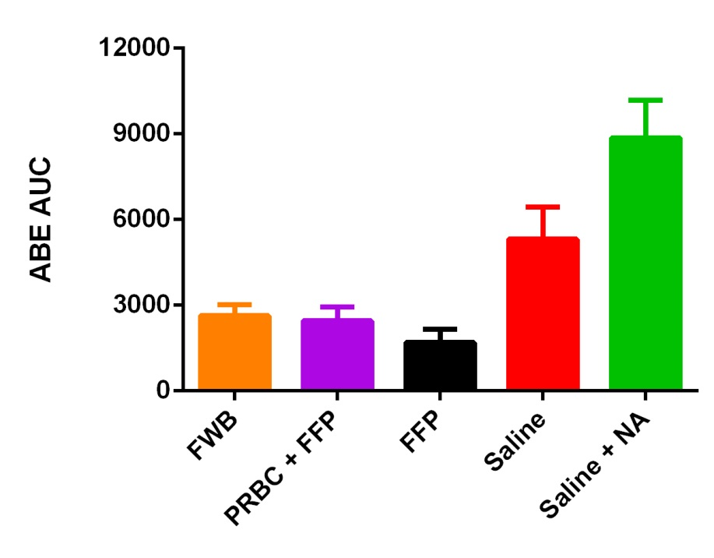
Results –’Burden’of Shock
AUC
Resuscitation Phase:
Saline+NA sig diff to other groups
Sal sig diff to FFP
official

Slide 11
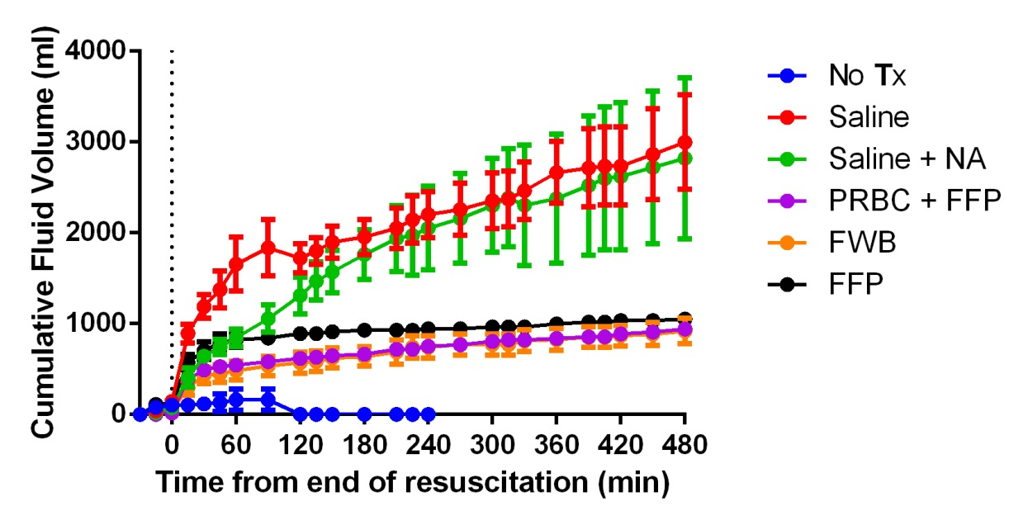
Results – Volume of Fluid
Shock Phase:
No sig diff between groups
Resuscitation Phase:
Sig diff between groups
Sig effect of time
Pattern sig diff between groups
Sig diff
  FFP v Saline
  FWB v Saline
  PRBC:FFP v Saline
  FWB v Saline+NA
official

Slide 12
Results – Volume of Fluid
Crystalloid Resuscitation
Saline v Saline+NA
Sig diff at 30 and 60 min
No sig diff at 120 and 480 min
official

Slide 13
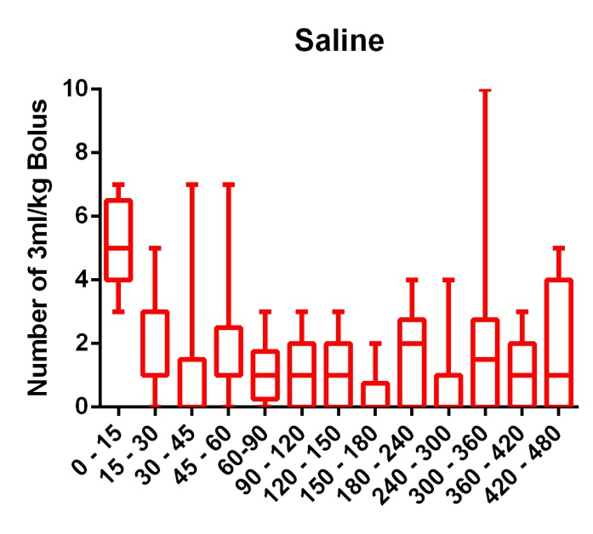
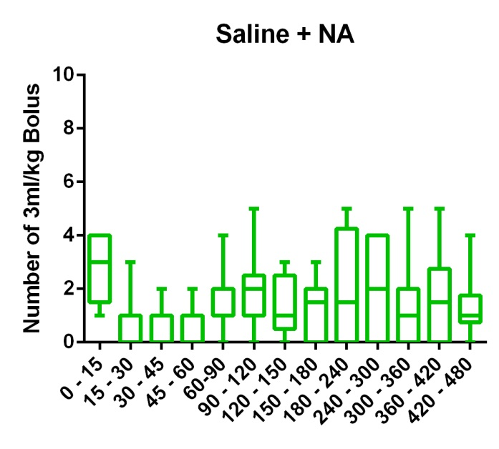
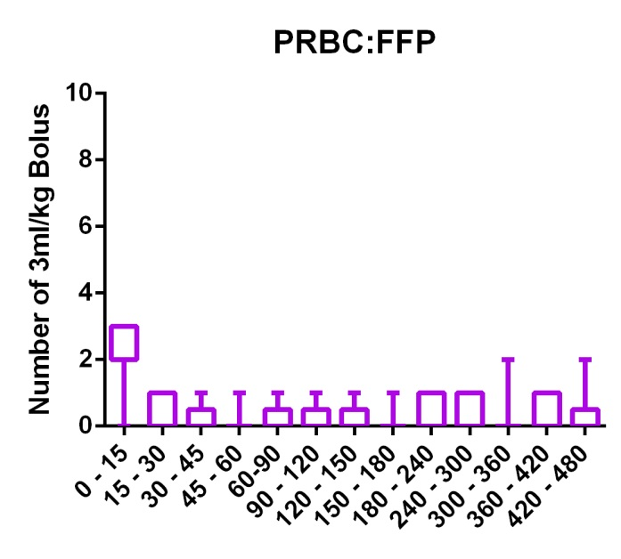
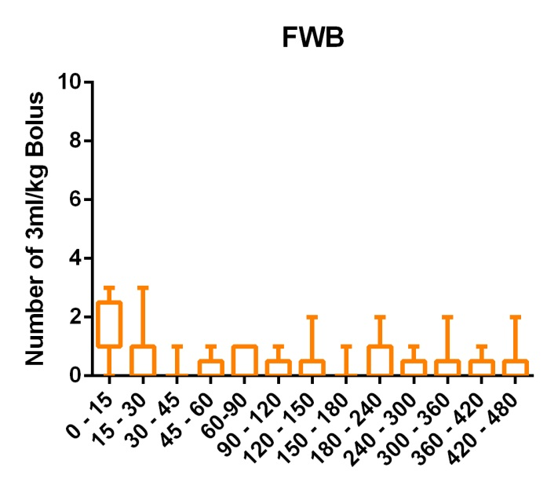
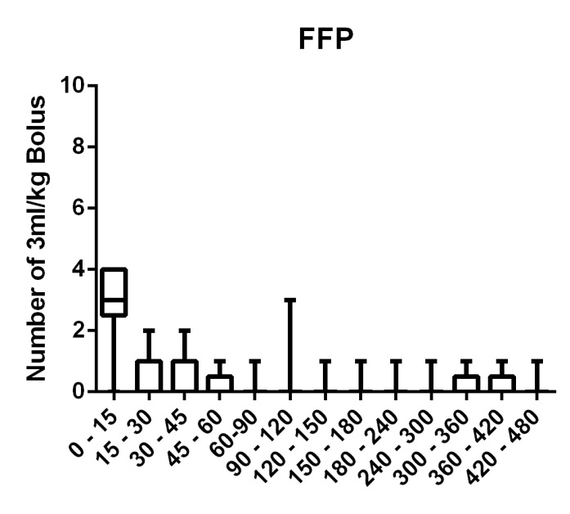
Results – When to give Fluid
official

Slide 14
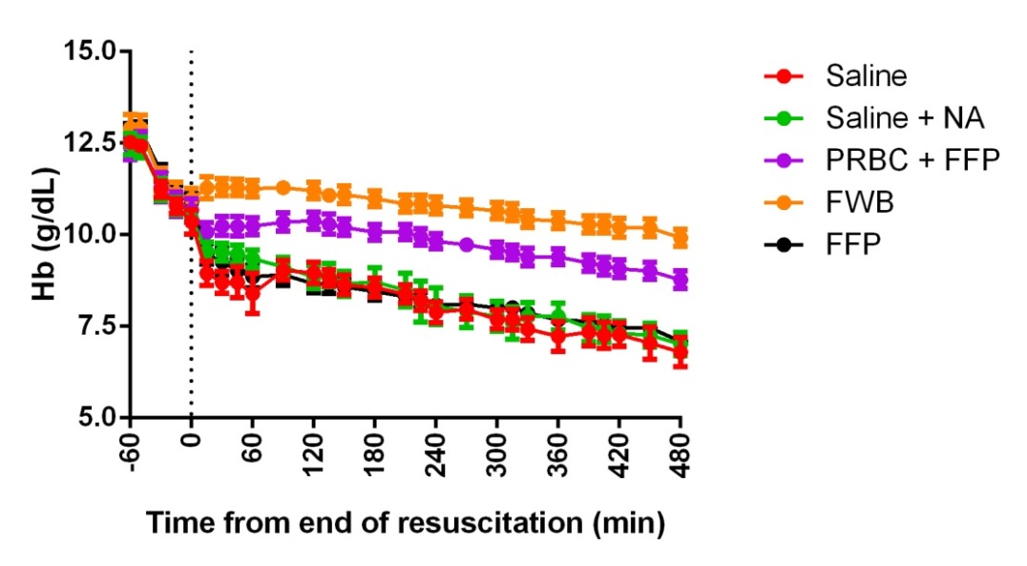
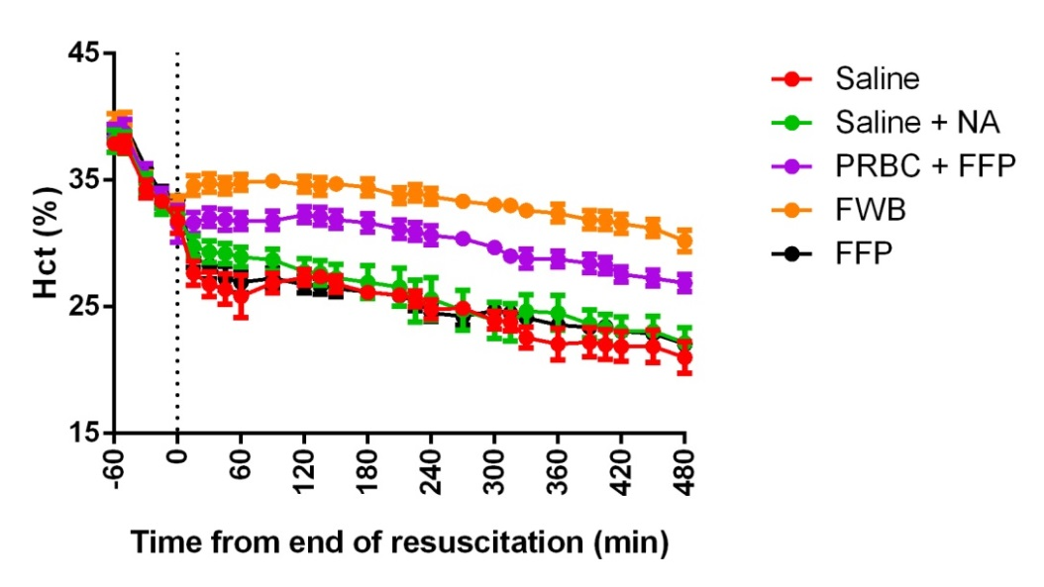
Results - haemodilution
Hb
Injury Phase:
No difference between groups
Sig diff over time P<0.000001
No diff in pattern between groups
Resuscitation Phase:
Sig diff between groups P<0.000001
Sig change over time P<0.000001
Sig diff in pattern between groups P=0.000001
Sig Diff
  FWB v FFP
  FWB v PRBC:FFP
  FWB v Saline
  FWB v Saline+NA
  PRBC:FFP V FFP
  PRBC:FFP v Saline
  PRBC:FFP v Saline+NA
official

Slide 15
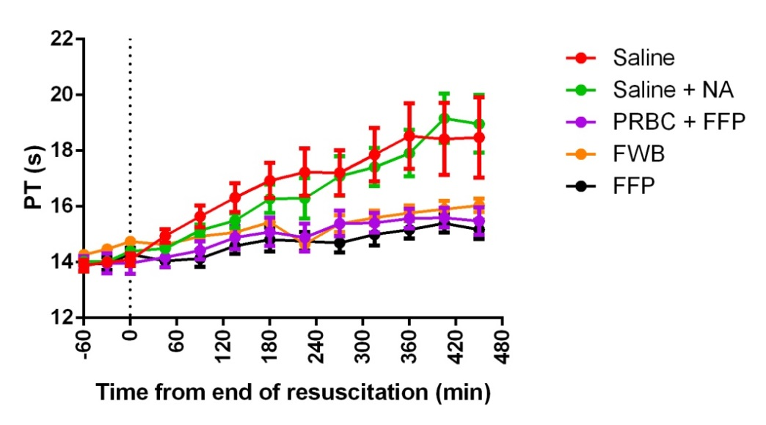
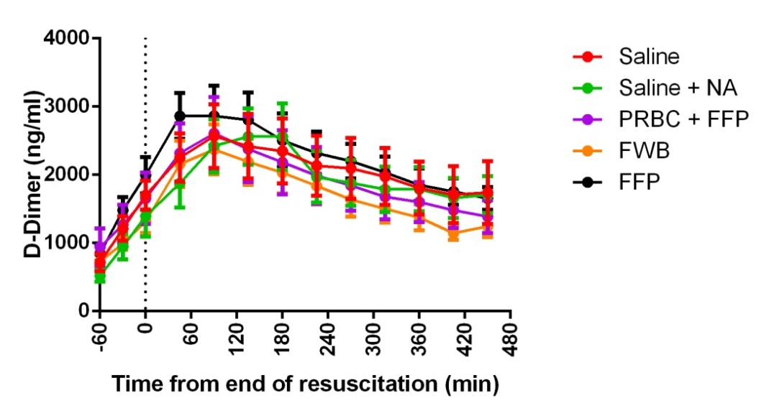
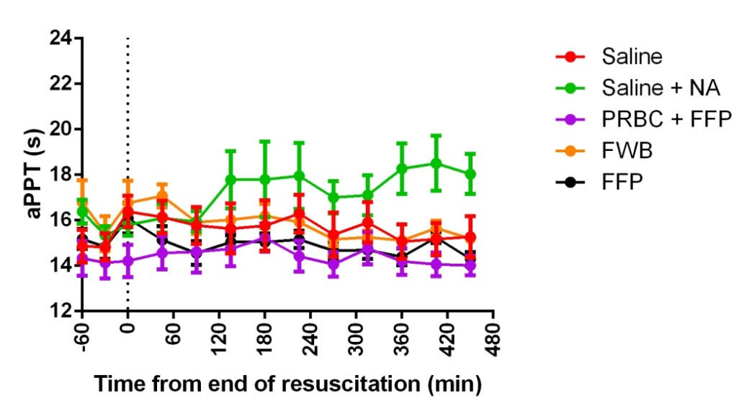
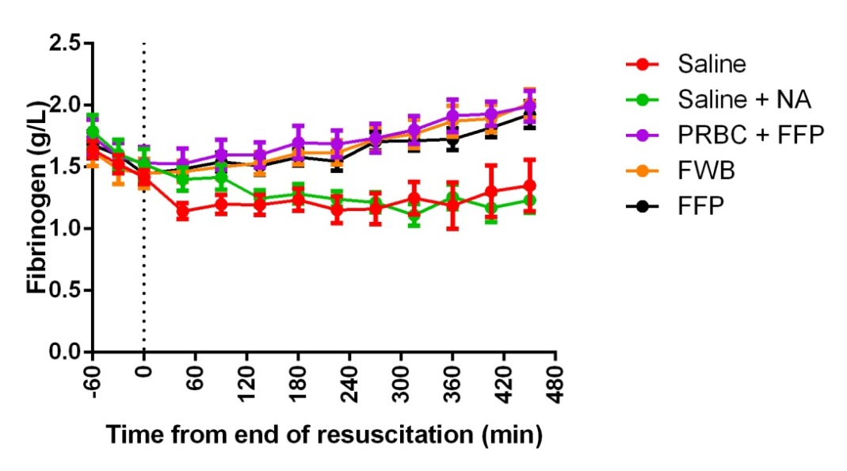
Results - Coagulation
official

Slide 16
Summary/conclusions
We have developed a poly-trauma model which is 100% lethal without resuscitation
  Limitations
    No ongoing bleeding (good clot on liver)
    No TBI
Fluid resuscitation resulted in significantly better survival
  Over 8 hours ‘blood’ resuscitation was significantly better than crystalloid
The burden of shock was highest in Saline+NA group
official

Slide 17
Summary/conclusions
Significantly more fluid was administered in the Saline group compared to the groups given a blood product
  Resulting in significantly more haemodilution compared to FWB and PRBC:FFP groups
    Least haemodilution in the FWB blood
There was significant saline volume sparing with the addition of noradrenaline during the first 60 min of resuscitation
  Effect was lost by 120 min
Lot of data yet to be analysed
Where next……..?
official

Slide 18
Notes:
This slide may be shown at the end of the presentation.

Slide 19
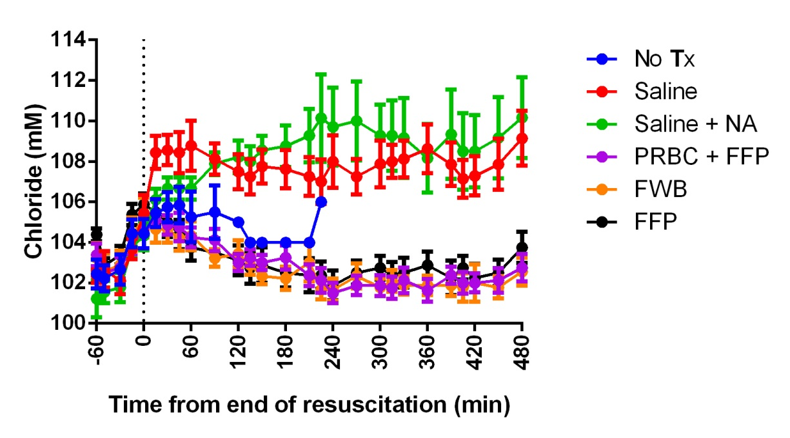
official

