Slide 1
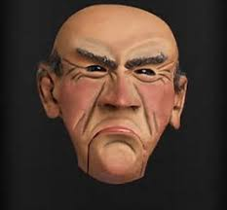
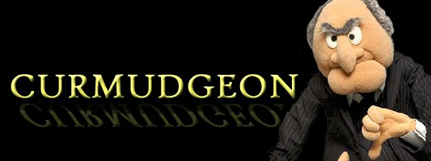
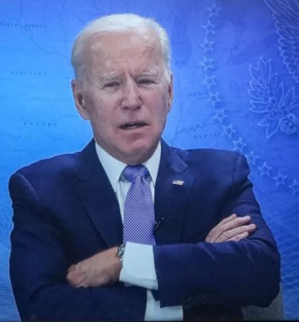
Reflections of a curmudgeon
Or maybe not

Slide 2
Disclosure(s)
THOR - thank you
I trashed my entire slide deck yesterday and rewrote last night
I am a little bit on the defensive because I would love to have a data driven argument….. But have precious little
This is meant to be a dialogue
I have concerns about certain procedures– this is one of them
I was a paramedic and firefighter in a civilian setting a long time ago
I do not pretend to have extensive operational experience in the forward or field environment – my deepest respect for you

Slide 3
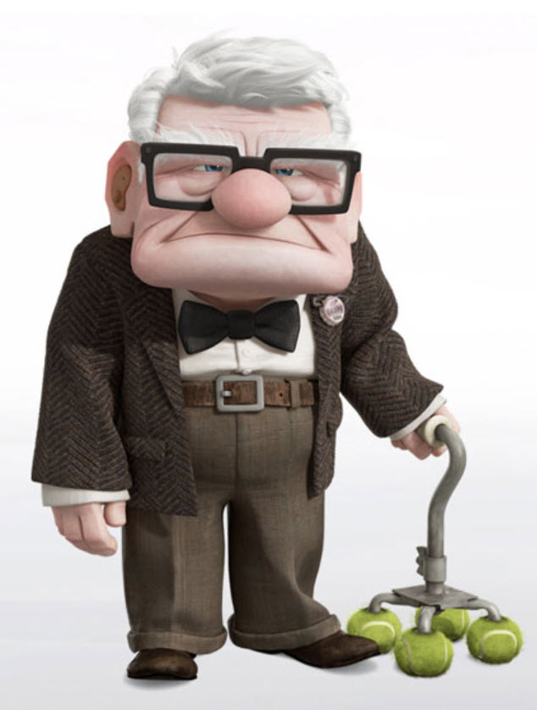
curmudgeon
Old, cranky, and more than a little stubborn, a curmudgeon is the gruff, grey-haired neighbor who refuses to hand out candy at Halloween and shoos away holiday carolers with a "bah humbug!“
Don't worry though, you’ll know a curmudgeon when you see one: He’ll be ill-tempered and miserly, eager to shake his fist and spout disagreeable opinions.
a crusty irascible cantankerous old person full of stubborn ideas
Perhaps I can convince you that there is a reason for concern for some of these stubborn ideas

Slide 4
OK So the other title for this little discourse
You stabbed who? With what????
Don’t just do something----stand there
Primum non nocere

Slide 6
Shoulda done it long ago

Slide 7
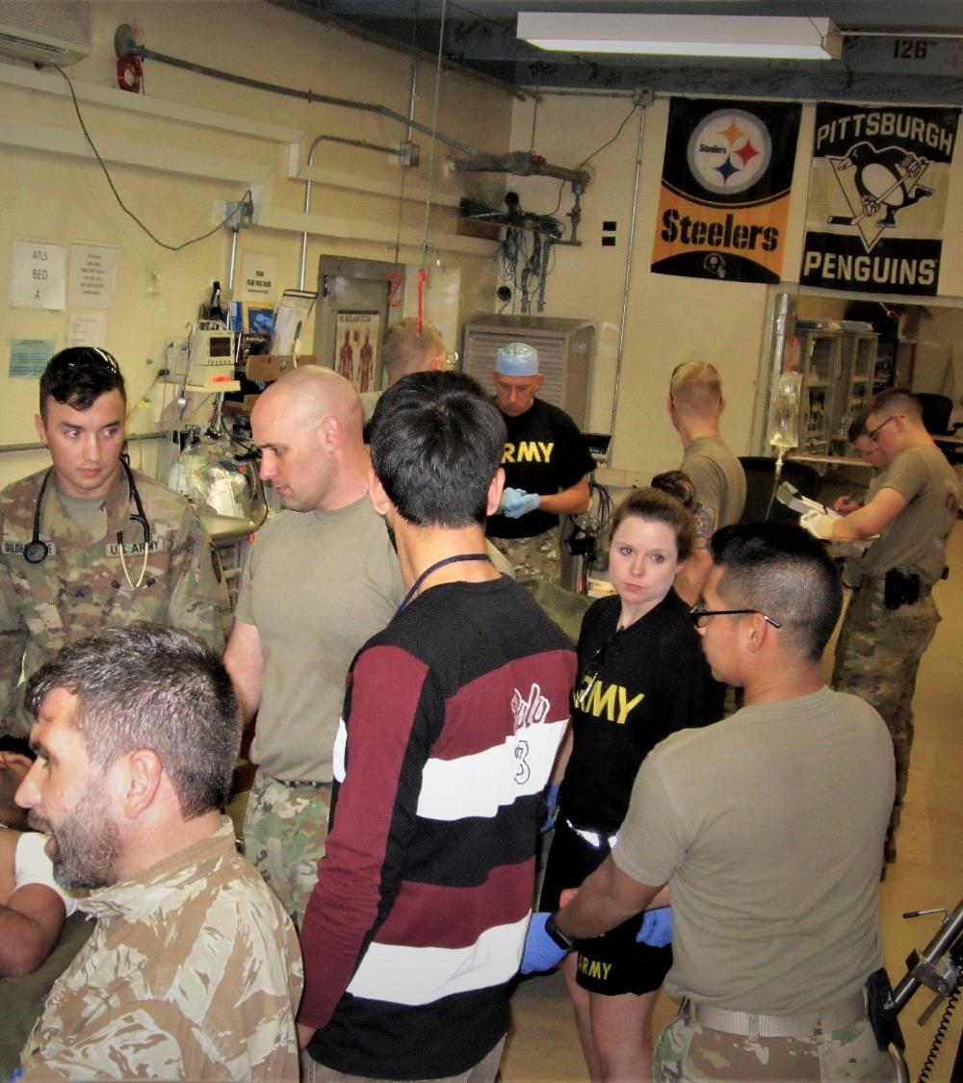
September to January
Ops tempo slower than in the past
Ten to fifteen critically injured patients
Significant TBI, torso injuries, penetrating injuries, GSW and fragmentary injuries
The usual mix

Slide 8
Observations – on “doing things” not documented by Records
Ten patients had advanced airway management
All were cryc’ed
Only one had any form of facial/cervical trauma that may have compromised visualization or led to airway obstruction
1/10 not in the airway
1/10 supraglottic
2/10 dislodged during transport; one successfully replaced, one not

Slide 9
Needle thoracostomy
Ubiquitous– almost every patient had needles placed
Finger thoracostomy– WTF?
One patient with large open chest wound at exit posteriorly, lung expanded and palpable through the exit wound

Slide 10
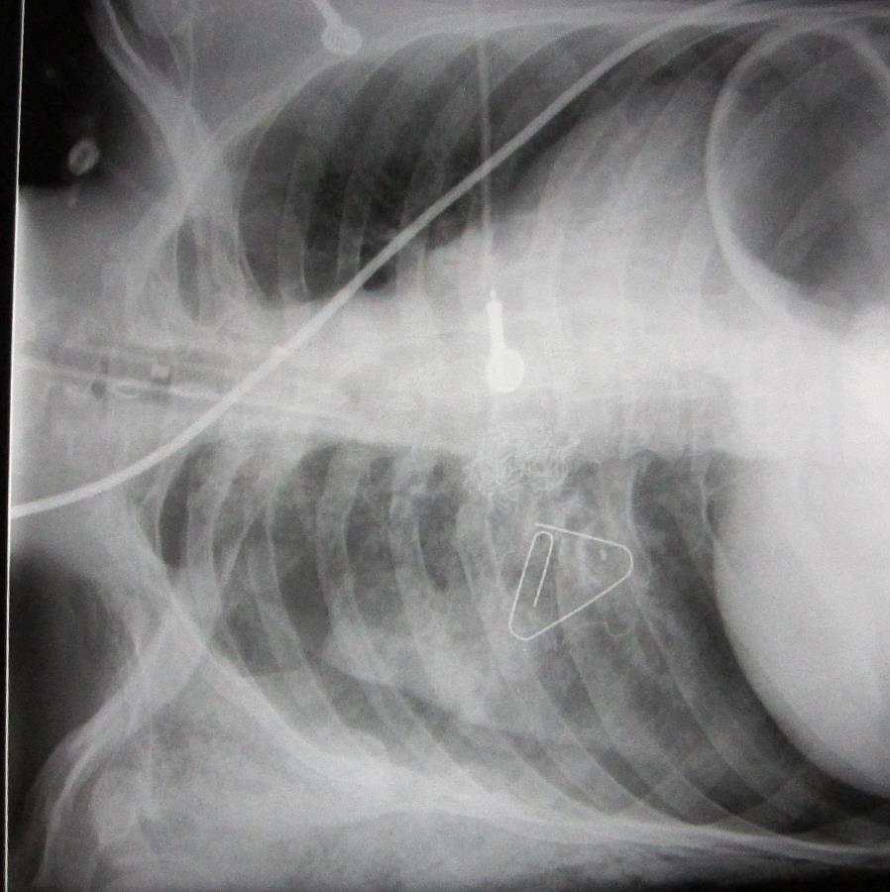
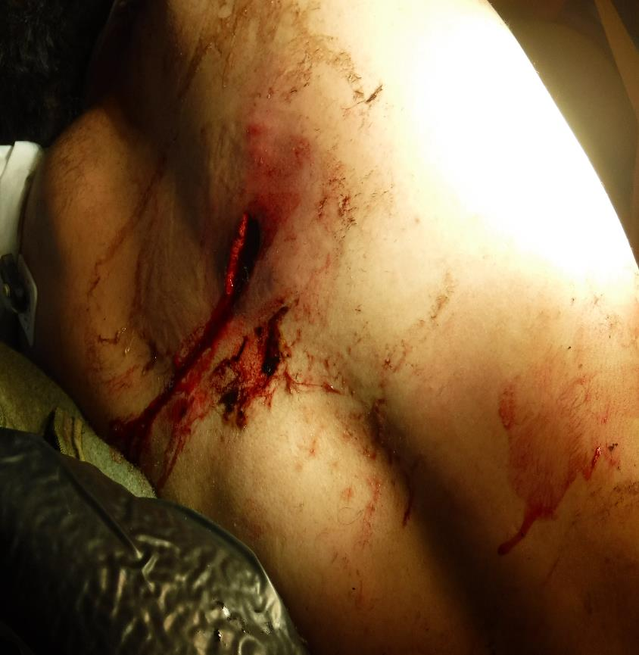
Finger Thoracostomy

Slide 11
Needle thoracostomy
Here come’s the curmudgeon part
If I think it is used too frequently in the deployed setting--- double that down in spades in my civilian practice
I wouldn’t allow this procedure to be done @ BAMC without a follow up CXR and follow up
There is no such thing as a free lunch
You won’t know if you don’t look
Data/record keeping non-existent in the deployed setting

Slide 12
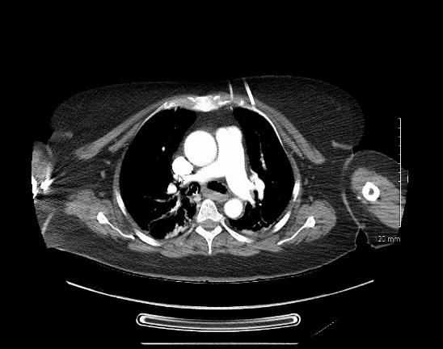
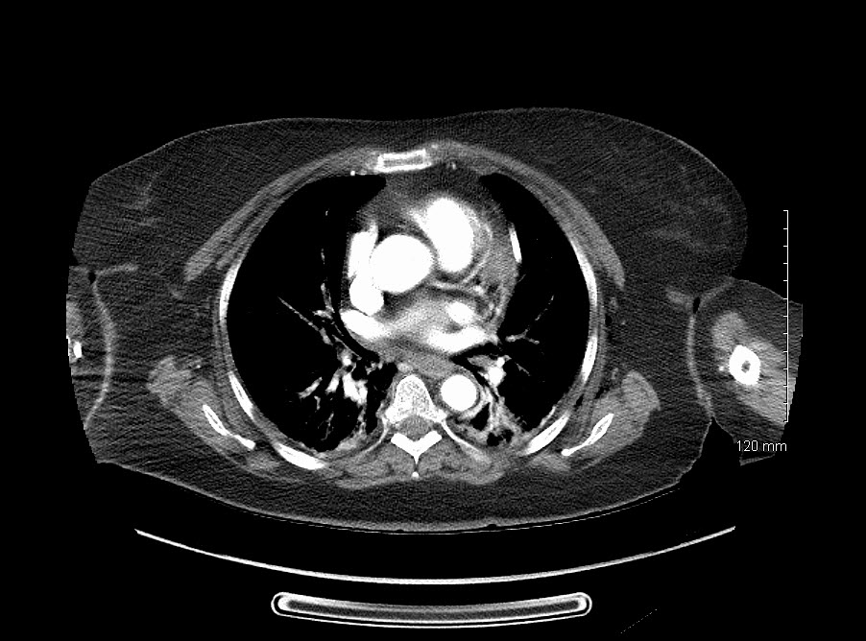
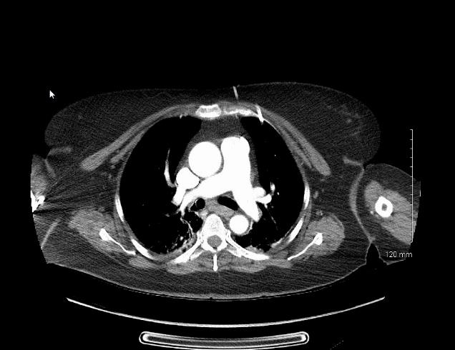
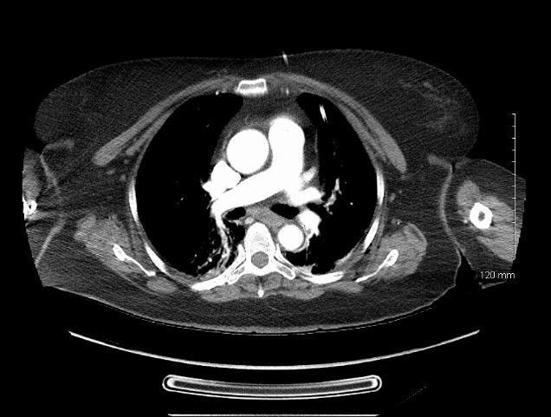
Shock and awe

Slide 13
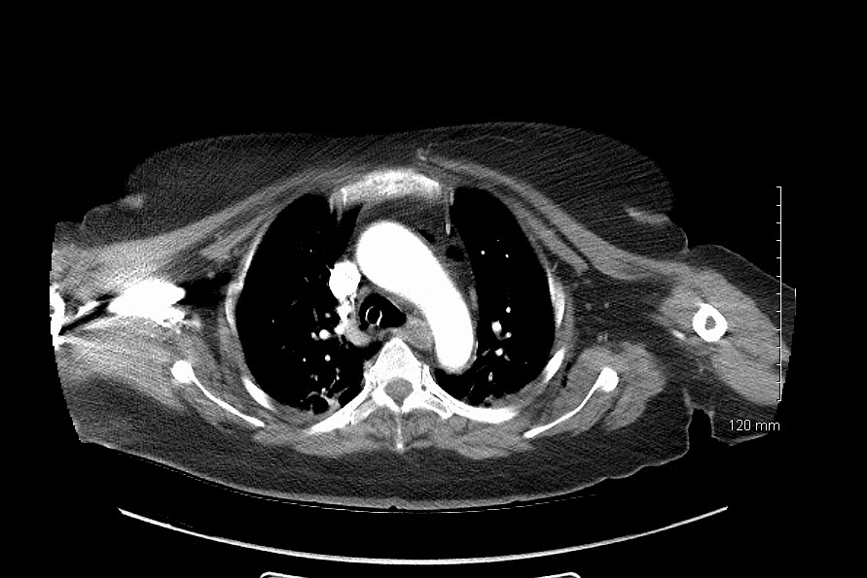
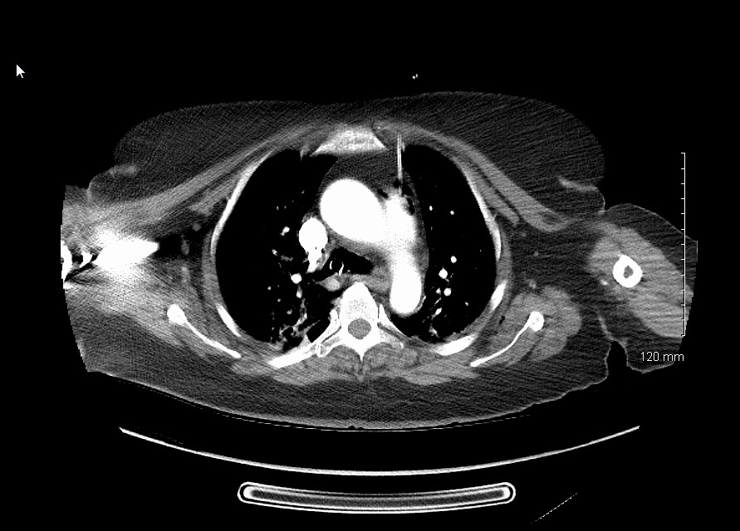
What about the other needle?

Slide 14
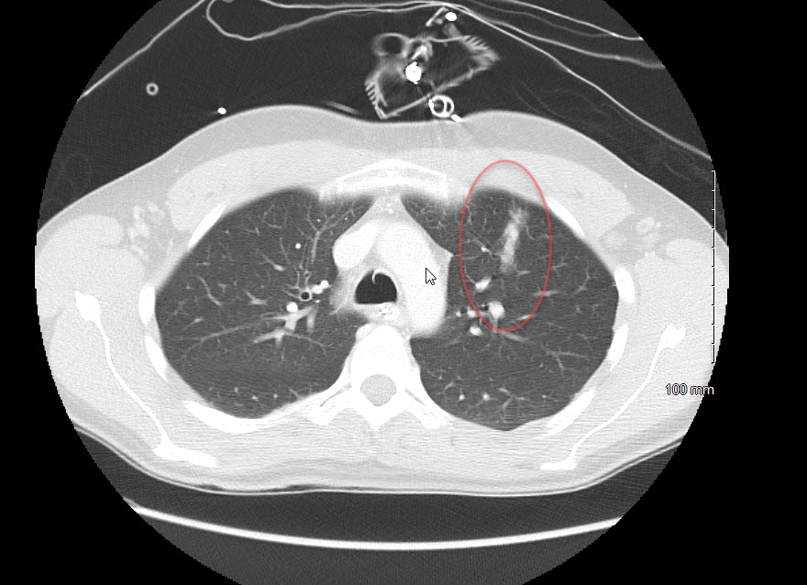

Slide 15
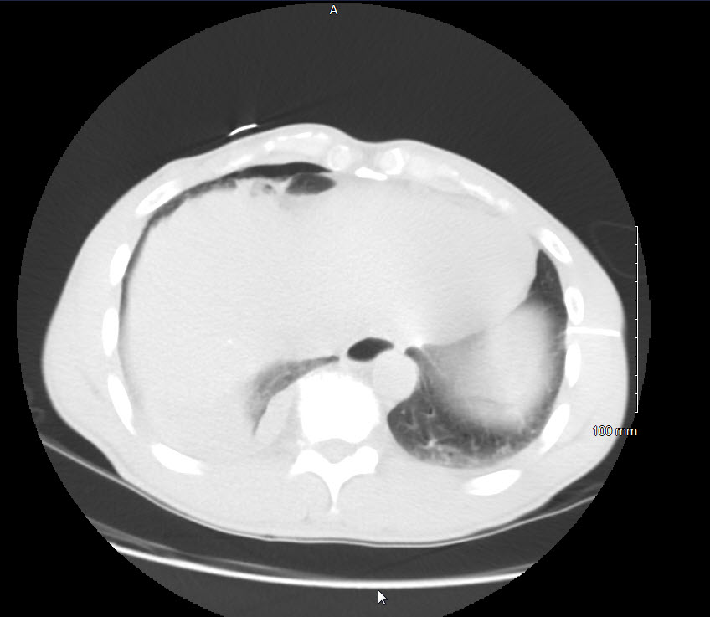
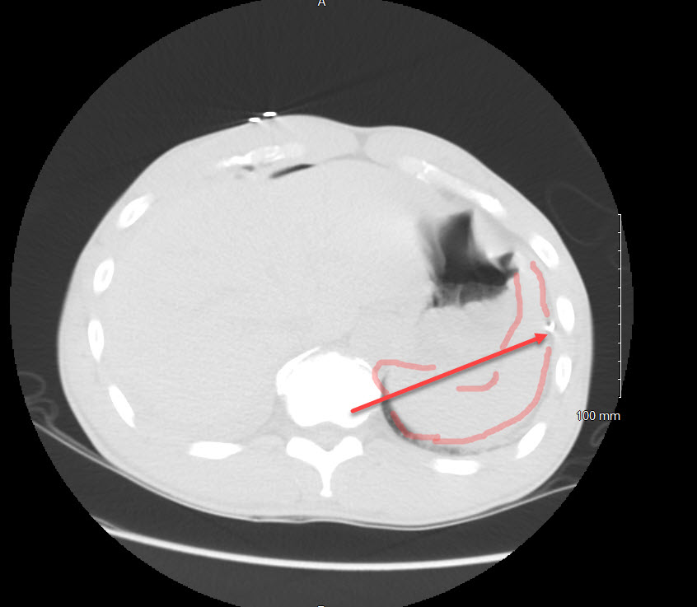

Slide 16
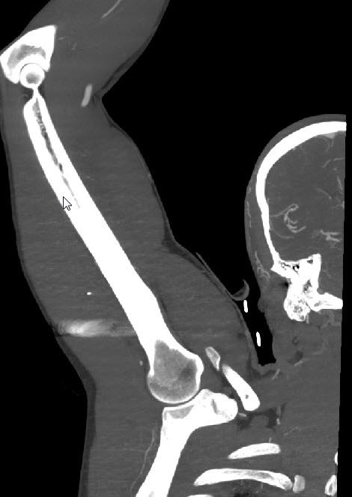
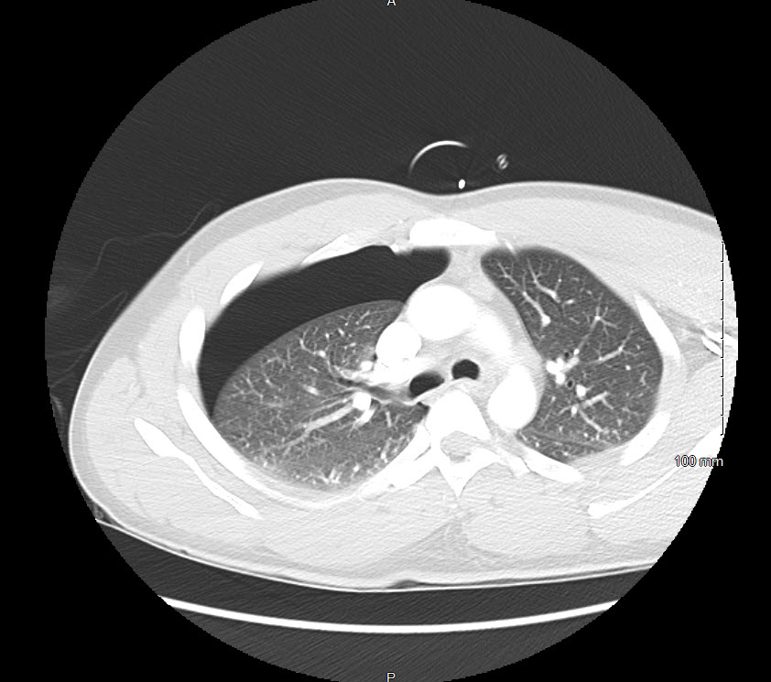

Slide 17
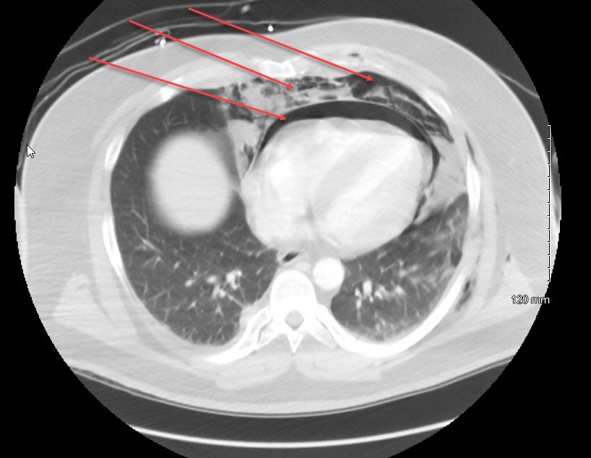
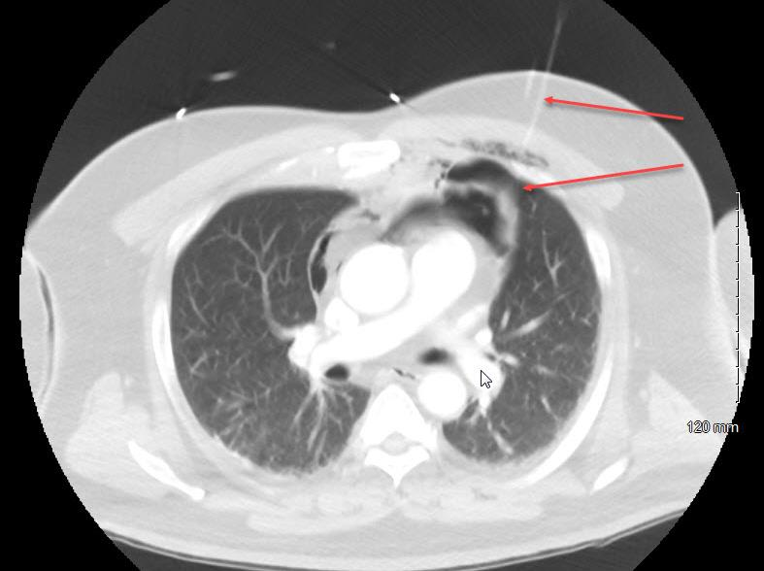

Slide 18
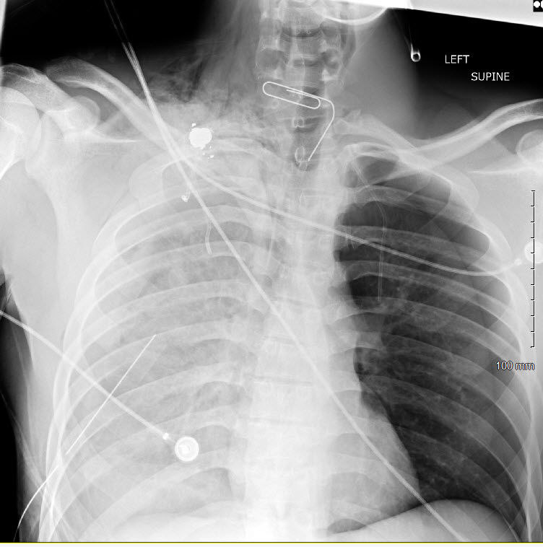

Slide 19
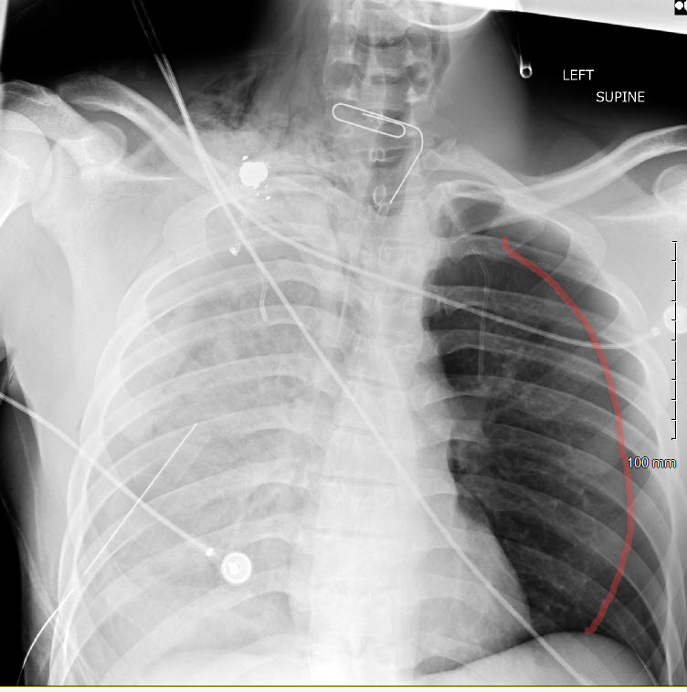

Slide 20
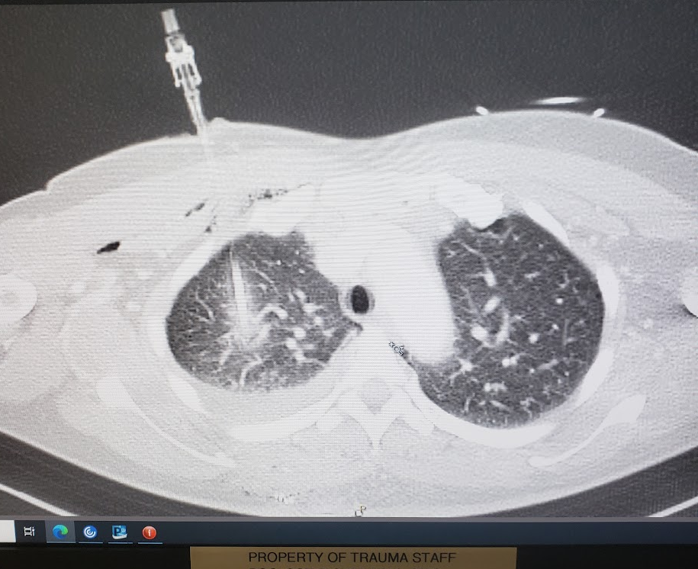
Shouldn’t we regard this as a stab wound to the chest?
Or a case of
Not so Friendly Fire?

Slide 21
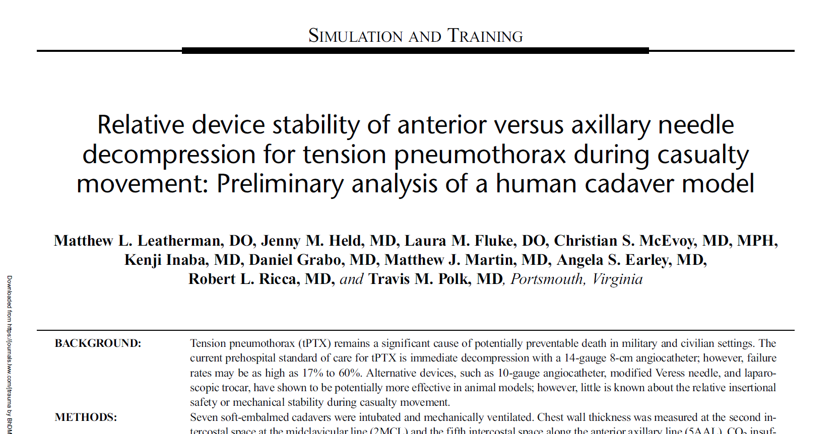
A recent interesting study

Slide 22
Food for Thought
Seven Fresh Cadavers
Four different types of devices
VATS to evaluate placement and to guide measurement of Chest wall thickness
“Casualties” (cadavers) placed on vents and then “transported” on NATO litters and log rolled

Slide 23
Fidnings

Slide 24
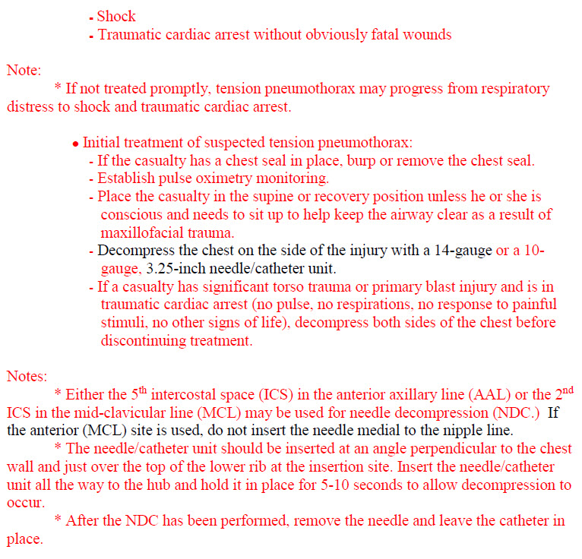
THE EVIL DOWNSIDE OF GUIDELINES
Absolve you of critical thinking ?
Absolve you as responsible for
the decision to intervene?

Slide 25
SHIFTING RESPONSIBILITY
LSI
Airway
LSI
Blood component(s)
LSI
Tension PTX
LSI
tourniquets
Point of Injury
LSI
surgery
advanced medical/surgical care
LSI
Hemorrhage control
LSI
LTOWB
En route Care/Transport
En route Care/Transport

Slide 26
Shouldn’t we be tracking this ?
THOR/CoTCCC and other communities have pushed advanced procedures to the prehospital setting
If these same procedures are done inside the hospital, are they tracked more effectively ?
I want to make a proposal to work with the CoTCCC to design the appropriate Prospective civilian trial to examine ALL needle decompressions in the field
What are the numerator and denominator?
How wide is the anatomic variation in placement?
Are there significant complications?
Is the incidence of lethal tension Pneumothorax still what we think it is?

Slide 27
Confessions of a catholic/surgeon/medic
Surgeons– certainly older ones; were submitted/subjected/participated in a unique confessional called Morbidity and Mortality conference
It is a unique way of forming a surgical conscience
I was taught of the “sacred privilege” of the knife

Slide 28
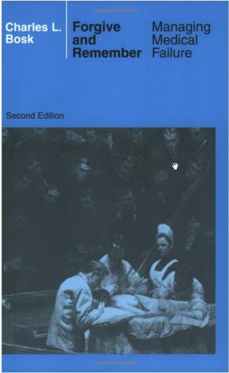
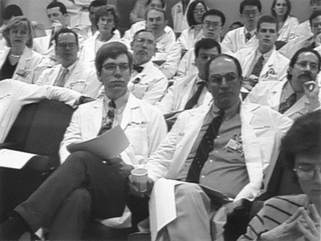
Truth and Consequences

Slide 29
Truth and Consequences
We owe it to our patients…..
and to our medics

Slide 30
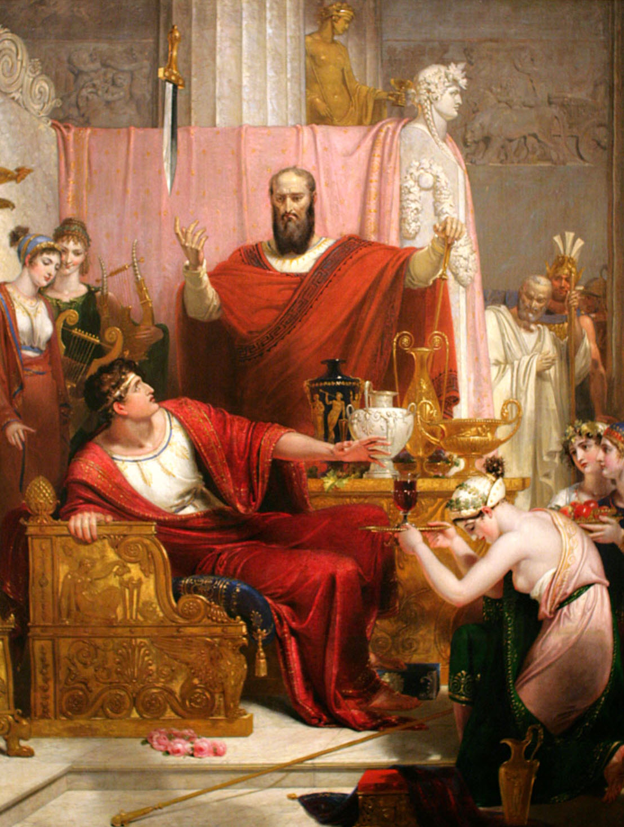
The sword of Damocles
With great power comes great responsibility
Voltaire
The price of greatness is responsibility
Winston Churchill
Would we allow this procedure to be done in the hospital without….
documentation
follow up
improvement plan

Slide 31
This guy is a genius--- I wish I had written this

Slide 32
Sometimes, the hardest thing in the world is to sit on your hands and watch, and do nothing
“Junior--- I want you to sit in a chair next to that patient’s bed; and sit on your hands and do nothing for the next five minutes”
James Hurst MD to Jay Johannigman -- many years ago

Slide 33
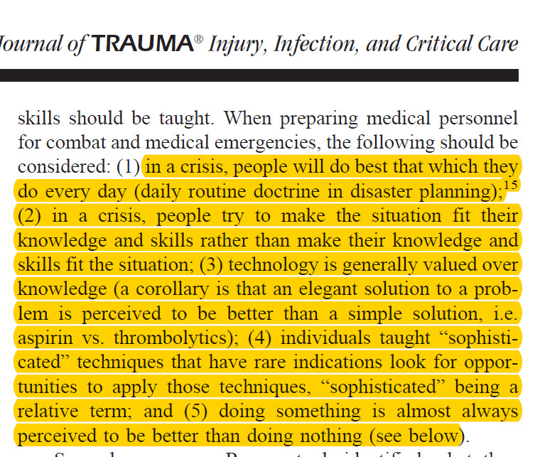

Slide 34
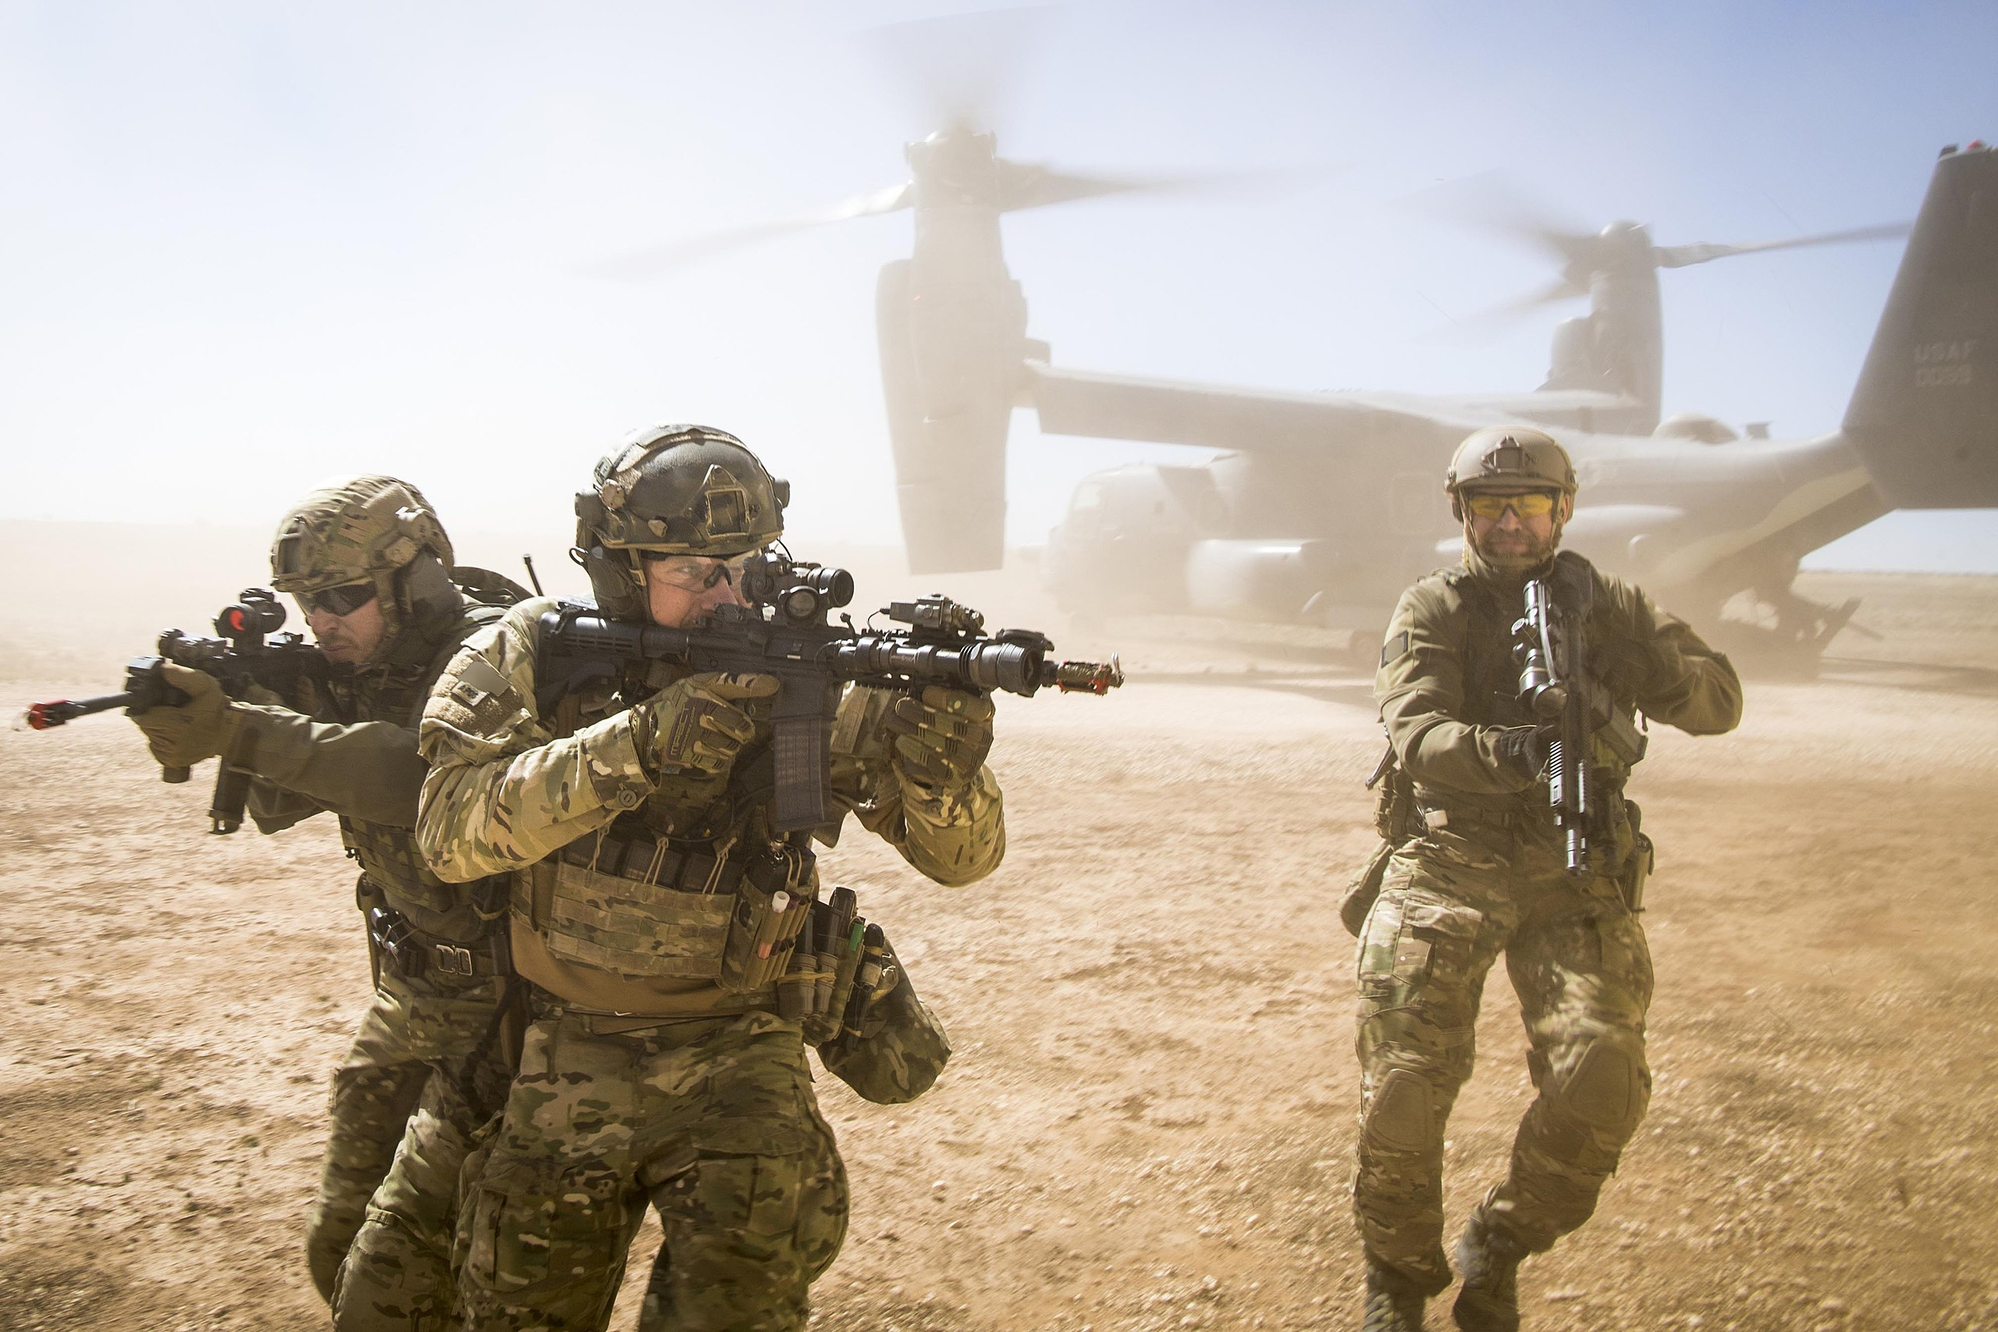
The “doer”
A highly skilled group who readily
achieve a fund of knowledge and
combine this with extraordinary
motor skills.
If they are told to put lead on target
There will be lead on target
If you tell them they should do
Something when they spot equivocal
findings– they will do something

Slide 35
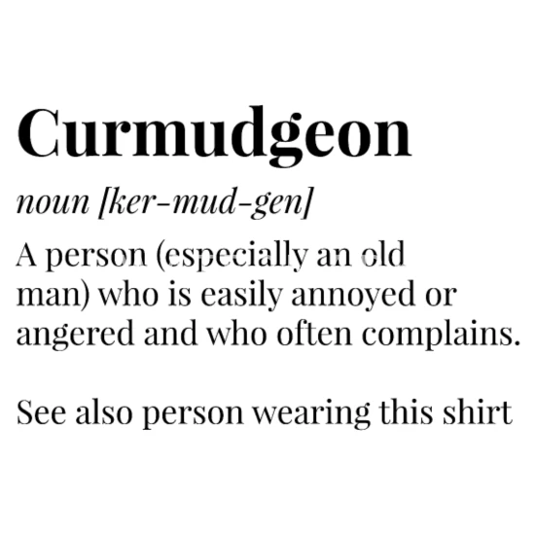
Am I there yet ?

Slide 36
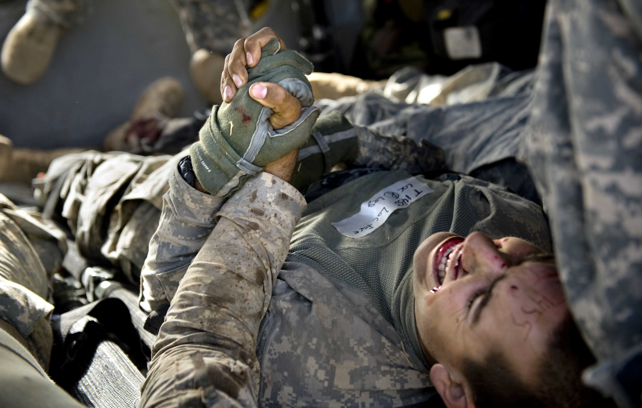
Religion is usually defined as a social-cultural system of designated behaviors and practices, morals, beliefs, worldviews, texts, sanctified places, prophecies, ethics, or organizations, that generally relates humanity to supernatural, transcendental, and spiritual elements

Slide 37
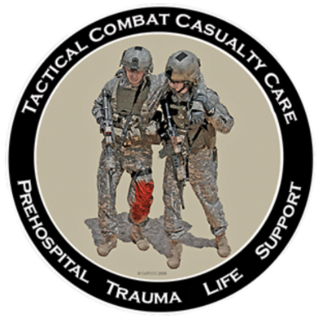
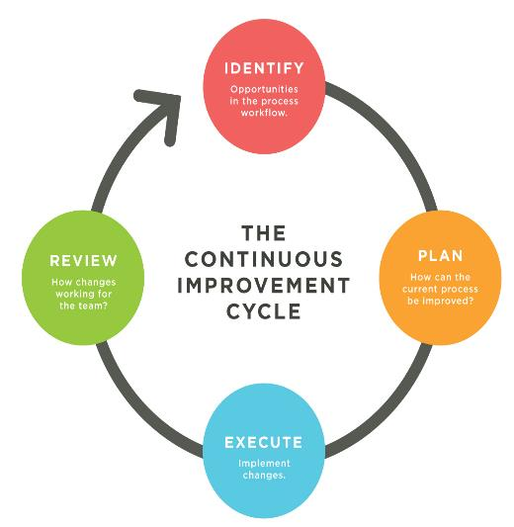
PROCEDURAL CONSCIENCE
doesn’t happen without data

Slide 38
Why
Why do we assume that doing something is better than doing nothing
We somehow think that technology trumps common sense
Sometimes the hardest thing in the world is to sit on your hands and watch

Slide 39
Stop placing needles in spontaneously breathing patients
BAN LEFT SIDED 5TH ACL APPROACH
Leave all prehospital needles in place until after CT scan
Collect data on all needles placed
CHALLENGE OUR EXISTING GUIDELINES THAT FOREGO CRITICAL THINKING

Slide 40
What we don’t know can hurt them
I am grateful to the THOR for allowing me to participate
I am awed by the exponential progress made
As we introduce increasingly invasive and advanced procedures to the far forward pre-hospital environment

Slide 41
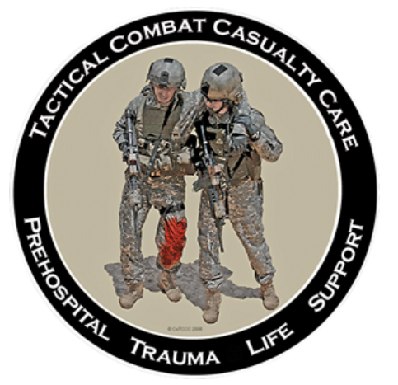
We must
Redouble our efforts to collect data
Is it time to rethink the entire data collection process
This is the one committee capable of doing it
Primum non Nocere
I thank you

