Slide 1
Evidence & Guidelines
Airway Management in haemorrhagic shock
Dr Tony Hudson
Consultant Emergency Physician
Royal Devon & Exeter Hospital
Peninsula Trauma Network Clinical Director
UK NHS

Slide 2
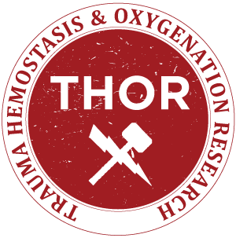
Declaration
The opinions or assertions contained herein are the private views of the author and are not to be construed as official or as reflecting the views of any given organisation
Conflicts of interest –
  Medical Director ATEM Ltd

Slide 3
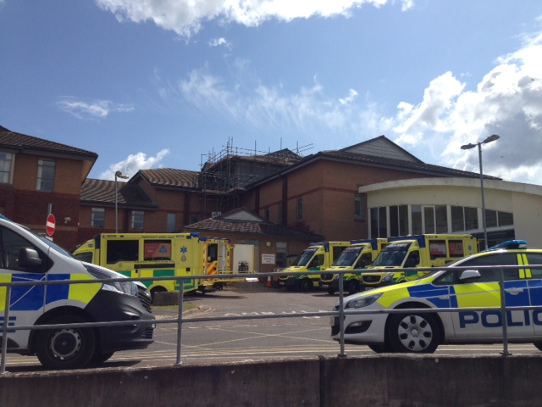
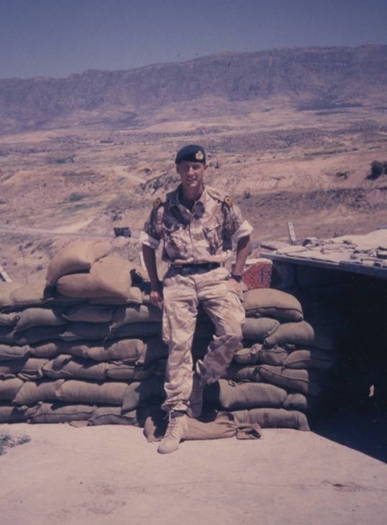

Slide 4
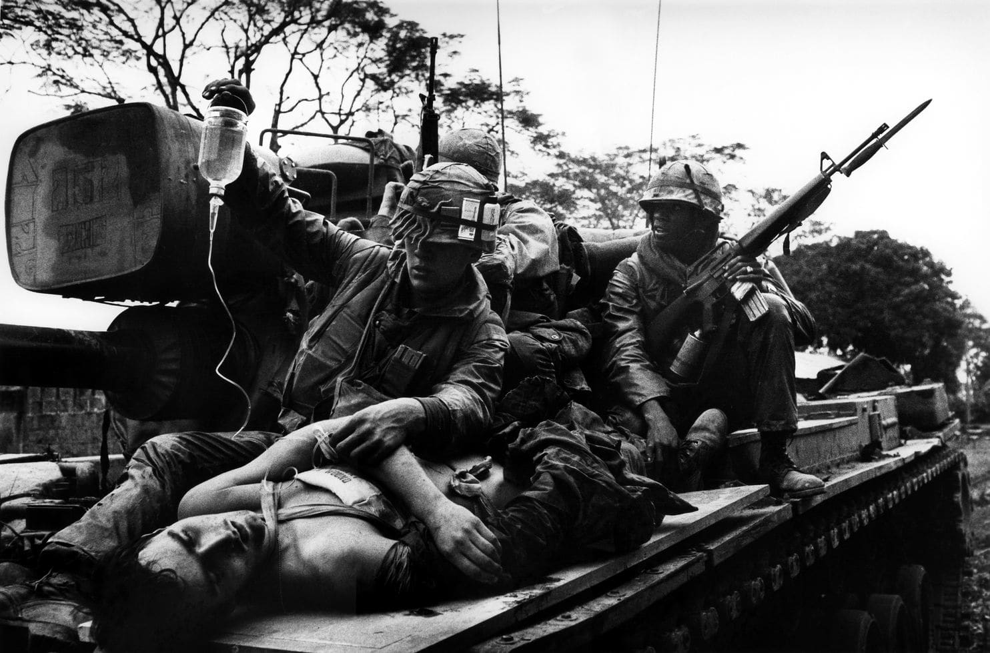
Does this patient need intubation?

Slide 5
Where’s the evidence?
“There are well-defined situations in which intubation is mandatory, for example airway obstruction, altered consciousness [Glasgow Coma Score (GCS) ≤8], haemorrhagic shock, hypoventilation or hypoxaemia”

Slide 6
What about guidelines?
Sydney HEMS PHEA Manual V3.0 2017
“Lack of a gag reflex or GCS <9 as described by EMST/ATLS or even GCS Motor score < 4 CANNOT be relied upon as the sole indicator of the need for intubation”

Slide 7
Where’s the evidence that it improves outcomes?

Slide 8
Median extended Glasgow Outcome Scale (GOSe) at 6/12
Pre-hospital RSI v standard treatment
Favourable neurological outcome (GOSe 5- 8) at 6/12 if RSI
  51% in RSI group v 39% in non RSI group
Median GOSe at 6/12 higher in RSI group (5) v non RSI (3)
  But not statistically significant
More cardiac arrests in RSI group (6.3% v 1.3%) but no significant difference in overall survival
NB: Proportionally more patients lost to follow up from non RSI group – if good outcomes inclusion may have confounded results

Slide 9
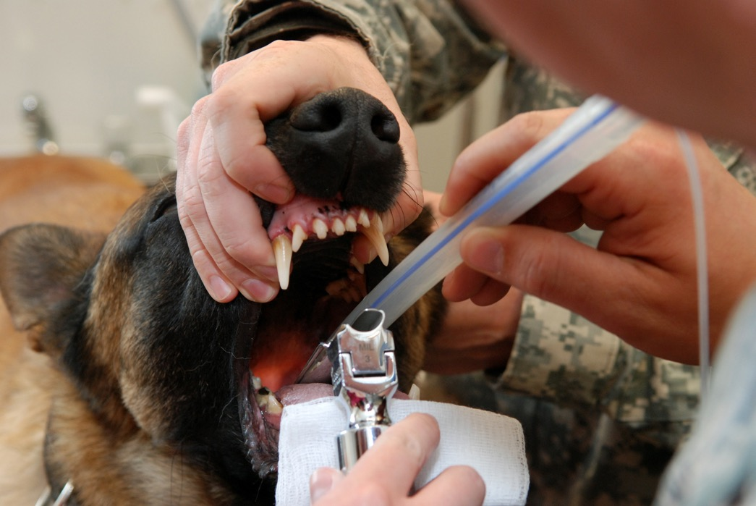
What are the risks?

Slide 10
Retrospective trauma database review
GCS 13 -15, age > 16, max AIS ≤ 3 per body region, no transfusion in ED, documented data regarding intubation.
Matched with 600 non intubated patients
Very similar groups in all parameters (age, ISS, mechanism, pattern of injuries, vital signs, probability of survival)
Intubated patients had prolonged pre-hospital times, higher volume fluid replacement, worse coagulation parameters, elevated sepsis rates and more prevalent multi-organ failure

Slide 11
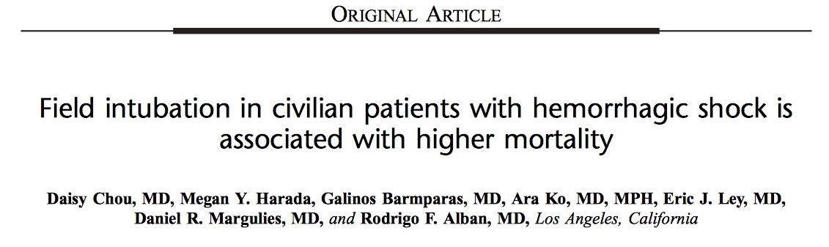
Retrospective trauma database review
552 trauma pts with haemorrhagic shock requiring massive transfusion (≥ 6 units first 24 hrs)
63 (11%) had field intubation (FI) v 489 (89%) no FI
FI group v Non FI group had lower median GCS (3 v 14), Systolic BP ( 86 v 104 mmHg) and higher ISS (41 v 29)
Mortality in FI group 83% v 43% in non FI group
“After adjusting for confounders FI group had increased odd of mortality: 2.89 (CI 1.08 – 7.78)”
“FI may be associated with higher mortality in pts with haemorrhagic shock”

Slide 12
“No amount of statistical adjustment can compensate for such a strong selection bias whereby members of the comparison group would not be considered candidates for the intervention under evaluation”
Floccare, D., Galvagno, S. (2016). Field intubation for hemorrhagic shock: A flawed syllogism. J Trauma Acute Care Surg, 81(3), 615

Slide 13
Retrospective trauma registry review
444 adult trauma patients undergoing Endotracheal Intubation in ED
Post Intubation Hypotension
    SBP ≤ 80 mmHg or decrease SBP ≥ 20% from baseline
    MAP ≤ 60 mm Hg
    If SBP ≤ 90 mmHg pre-intubation any SBP decrease > 5 mmHg
    Administration of vasopressor
PIH group older and more likely to have ISS ≥ 12
36.3% experienced post intubation hypotension
  PIH group in-hospital mortality 29.8%
  Non PIH group in-hospital mortality 15.9%

Slide 14
YES, but …..

Slide 15
Prospective observational study of patients undergoing prehospital RSI
  Shock index (Heart rate/Systolic BP) pre ketamine RSI
    SI > 0.9 predicts increased mortality and likely need for transfusion
Low shock index (ie <0.9) v high SI (≥0.9) groups
  Low SI group 1.4mg/kg v High SI group 1.2 mg/kg
More High Shock Index patients (26%) became hypotensive than low SI patients (2%)

Slide 16
SBP for Low and High SI groups pre and post RSI with ketamine:
Low Shock Index patients
High Shock Index patients

Slide 17
Positive pressure ventilation:

Slide 18
8 intubated pigs. Ventilated with 12 ml/kg tidal volume, FiO₂ 28%, haemorrhaged to SBP < 65mmHg, RR 12 bpm
RR changed every 10 mins to 6, 20, 30 then 6 bpm
RESULTS
  At RR 6 bpm all subjects maintained pH >7.25, SaO₂ > 99% and increased SBP (mean 65 -84 mmHg)
  At higher respiratory rates, SBP and cardiac output diminished
Conclusion
  After moderate haemorrhage animals maintain adequate oxygenation and acid base status with lower frequency respiratory rates whereas increasing respiratory rates impair haemodynamics

Slide 19
Influence of ventilation strategies on survival in severe controlled hemorrhagic shock
Porcine model, 65% reduction of blood volume. 24 subjects
3 ventilation strategies
  O cm H₂O PEEP, RR 14 bpm
  5 cm PEEP, RR 28, half Tidal Volume
  5 cm PEEP, RR 14
O, 14 group – all survived
5, 28 group – 6 of 7 died
5, 14 group – all died
Reduction of PEEP was most important ventilation strategy.
Herff H, Paal P, von Goedecke A, Lindner KH, Severing AC, Wenzel V. Influence of ventilation strategies on survival in severe controlled hemorrhagic shock. Crit Care Med. 2008;36(9):2613-20.

Slide 20
Results:
Median mortality rate 48% (8-94%) pre-hospital v 29% (6-67%) in ED
Conclusion:
“The rationale for wide and unspecific indications for pre-hospital intubation seems to lack support in the literature, despite several publications involving a relatively large number of patients. Pre-hospital intubation is a complex intervention where guidelines and research findings should be approached cautiously”.

Slide 21
Retrospective database review. SBP < 90 mmHg: GCS 13-15
236 patients identified
101 underwent PHEA: 15 died (14.9%). Non PHEA: 6 died (4.4%)
58 PHEA pts (57.4%) judged hypovolaemic. 14 (24%) of these died
43 PHEA pts (42.6%) not hypovolaemic. 1 (2%) died
Adjusted odds ratio for survival (age, injury mechanism, HR): 9.99 (1.69 – 58.98) p 0.01
“if pt awake and hypovolaemic at scene it might, where possible, be appropriate to delay induction of anaesthesia until hospital arrival”

Slide 22

What are the alternatives?
LAW 13. The delivery of good medical care is to do as much nothing as possible

Slide 23
Does intubation and manual ventilation confer survival advantage over BVM ventilation in haemorrhagic shock?
Swine model of exsanguinating haemorrhage
Propofol infusion + exsanguinating haemorrhage
Intubation + ventilation group versus bag valve mask ventilation alone group
No difference in time to death between groups
Greater blood loss from intubated group
Intubated animals more hypothermic
Higher lactate in intubated group at 10 mins (2.4 v 1.8)
Conclusion
  “Intubation does not confer survival advantage and may result in more profuse hemorrhage, worse hypothermia and higher lactate compared with BVM ventilation”

Slide 24
Is there a role for spontaneous ventilation?
Swine model of exsanguinating haemorrhage
  Propofol infusion + exsanguinating haemorrhage
  Group 1 – intubated + PPV (manually)
  Group 2 – PPV via BVM
  Group 3 – supplemental O₂ via facemask
Results:
  Mean survival time similar in all groups
  Physiological parameters:

Slide 27
Conclusions:
“PPV in severe hemorrhagic shock does not result in a survival advantage and may result in greater hemodynamic suppression when compared with passive ventilation by facemask”

Slide 28
Don’t forget ….
Simpler than RSI
Local anaesthetic technique (or no drugs)
May facilitate spontaneous (negative pressure) ventilation

Slide 29
Surgical airway success rates:
UK
  92%. Combat Medical Technicians or GDMOs. 24% survived to hospital discharge¹
Israeli
  93%. Paramedic or physician²
US
  68% (combat medic 67% v Dr/PA 85%)³
  82%. Combat medic or aeromed medic⁴

Slide 30
Guidelines:
Training
Checklists/ cognitive aids
Pre-oxygenation strategies
Apnoeic oxygenation
Induction agent choices and dose considerations
Neuromuscular blocking agent (NMBA)
Alternative drug strategies
Laryngoscopy technique/equipment
Cricoid pressure
Ventilation strategies
Governance/Quality Improvement

Slide 31
Hypothermia management pre-intubation
Establishment of a Massive Transfusion Protocol & effective communication with the blood bank
Standard induction agent doses should be reduced and titrated to balance induction of anaesthesia with haemodynamic changes
Succinylcholine 1mg/kg or Rocuronium 1 -1.2 mg/kg
Have a few, simple airway adjuncts available including gum elastic bougie. Video laryngoscopy may be useful
EtCO₂ monitoring/confirmation of placement
Consider low lung volume ventilation strategies (6ml/kg)
Performance improvement monitoring

Slide 35
Questions?

Slide 36
Adams BD, Cuniowski PA, Muck A, De Lorenzo RA. Registry of emergency airways arriving at combat hospitals. J Trauma. 2008;64(6):1548-54.
Barnard EB, Ervin AT, Mabry RL, Bebarta VS. Prehospital and en route cricothyrotomy performed in the combat setting: a prospective, multicenter, observational study. J Spec Oper Med. 2014;14(4):35-9.
Bernard SA, Nguyen V, Cameron P, Masci K, Fitzgerald M, Cooper DJ, Walker T, Std BP, Myles P, Murray L, et al. Prehospital rapid sequence intubation improves functional outcome for patients with severe traumatic brain injury: a randomized controlled trial. Ann Surg. 2010;252(6):959-65.
Chou D, Harada MY, Barmparas G, Ko A, Ley EJ, Margulies DR, Alban RF. Field intubation in civilian patients with hemorrhagic shock is associated with higher mortality. J Trauma Acute Care Surg. 2016;80(2):278-82.
Cournand A, Motley HL, et al. Physiological studies of the effects of intermittent positive pressure breathing on cardiac output in man. Am J Physiol. 1948;152(1):162-74.
Crewdson K, Lockey D, Voelckel W, Temesvari P, Lossius HM, Group EMW. Best practice advice on pre-hospital emergency anaesthesia & advanced airway management. Scand J Trauma Resusc Emerg Med. 2019;27(1):6.
Crewdson K, Rehn M, Brohi K, Lockey DJ. Pre-hospital emergency anaesthesia in awake hypotensive trauma patients: beneficial or detrimental? Acta Anaesthesiol Scand. 2018.
Fevang E, Perkins Z, Lockey D, Jeppesen E, Lossius HM. A systematic review and meta-analysis comparing mortality in pre-hospital tracheal intubation to emergency department intubation in trauma patients. Crit Care. 2017;21(1):192.
Floccare DJ, Galvagno SM, Jr. Field intubation for hemorrhagic shock: A flawed syllogism. J Trauma Acute Care Surg. 2016;81(3):615.
Green RS, Butler MB, Erdogan M. Increased mortality in trauma patients who develop post-intubation hypotension. J Trauma Acute Care Surg. 2017.
Herff H, Paal P, von Goedecke A, Lindner KH, Severing AC, Wenzel V. Influence of ventilation strategies on survival in severe controlled hemorrhagic shock. Crit Care Med. 2008;36(9):2613-20.
Hussmann B, Lefering R, Waydhas C, Ruchholtz S, Wafaisade A, Kauther MD, Lendemans S. Prehospital intubation of the moderately injured patient: a cause of morbidity? A matched-pairs analysis of 1,200 patients from the DGU Trauma Registry. Crit Care. 2011;15(5):R207.
Katzenell U, Lipsky AM, Abramovich A, Huberman D, Sergeev I, Deckel A, Kreiss Y, Glassberg E. Prehospital intubation success rates among Israel Defense Forces providers: epidemiologic analysis and effect on doctrine. J Trauma Acute Care Surg. 2013;75(2 Suppl 2):S178-83.
Kyle T, le Clerc S, Thomas A, Greaves I, Whittaker V, Smith JE. The success of battlefield surgical airway insertion in severely injured military patients: a UK perspective. J R Army Med Corps. 2016;162(6):460-4.
Lockey DJ, Crewdson K, Davies G, Jenkins B, Klein J, Laird C, Mahoney PF, Nolan J, Pountney A, Shinde S, et al. AAGBI: Safer pre-hospital anaesthesia 2017: Association of Anaesthetists of Great Britain and Ireland. Anaesthesia. 2017;72(3):379-90.
Mabry RL. An analysis of battlefield cricothyrotomy in Iraq and Afghanistan. J Spec Oper Med. 2012;12(1):17-23.
Miller M, Kruit N, Heldreich C, Ware S, Habig K, Reid C, Burns B. Hemodynamic Response After Rapid Sequence Induction With Ketamine in Out-of-Hospital Patients at Risk of Shock as Defined by the Shock Index. Ann Emerg Med. 2016;68(2):181-8.e2.
Morris C, Perris A, Klein J, Mahoney P. Anaesthesia in haemodynamically compromised emergency patients: does ketamine represent the best choice of induction agent? Anaesthesia. 2009;64(5):532-9.
Pepe PE, Lurie KG, Wigginton JG, Raedler C, Idris AH. Detrimental hemodynamic effects of assisted ventilation in hemorrhagic states. Crit Care Med. 2004;32(9 Suppl):S414-20.
Pepe PE, Roppolo LP, Fowler RL. The detrimental effects of ventilation during low-blood-flow states. Curr Opin Crit Care. 2005;11(3):212-8.
Rehn M, Hyldmo PK, Magnusson V, Kurola J, Kongstad P, Rognas L, Juvet LK, Sandberg M. Scandinavian SSAI clinical practice guideline on pre-hospital airway management. Acta Anaesthesiol Scand. 2016;60(7):852-64.
Rossaint R, Bouillon B, Cerny V, Coats TJ, Duranteau J, Fernandez-Mondejar E, Filipescu D, Hunt BJ, Komadina R, Nardi G, et al. The European guideline on management of major bleeding and coagulopathy following trauma: fourth edition. Crit Care. 2016;20:100.
Taghavi S, Jayarajan SN, Ferrer LM, Vora H, McKee C, Milner RE, Gaughan JP, Dujon J, Sjoholm LO, Pathak A, et al. "Permissive hypoventilation" in a swine model of hemorrhagic shock. J Trauma Acute Care Surg. 2014;77(1):14-9.
Taghavi S, Jayarajan SN, Khoche S, Duran JM, Cruz-Schiavone GE, Milner RE, Holt-Bright L, Gaughan JP, Rappold JF, Sjoholm LO, et al. Examining prehospital intubation for penetrating trauma in a swine hemorrhagic shock model. J Trauma Acute Care Surg. 2013;74(5):1246-51.

