Slide 1
BLOOD FAR FORWARD RESEARCH PROGRAM
Torunn Oveland Apelseth, MD, PhD
Project director, Blood Far Forward
Senior consultant
Department for Immunology and Transfusion Medicine
Haukeland University Hospital, Bergen, Norway

Slide 2
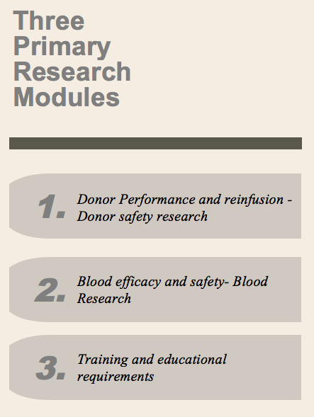
Blood Far Forward
Norwegian Naval Special Operation Commando
Norwegian Armed Forces Medical Services
Notes:
Blood Far Forward was initiated by the Norwegian Naval Special Operation Commando in 2010 and collaborators and participants today includes: Dep. of Immunology and Transfusion medicine Haukeland University Hospital, The Norwegian Armed Forces Medical Services, Norwegian Special Operation Command, Norwegian Army Special Operation Commando and US Army Institute of Surgical Research.

Slide 3
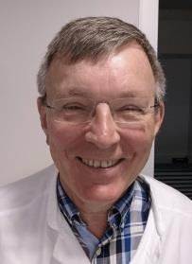
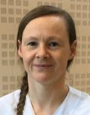
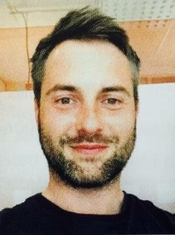
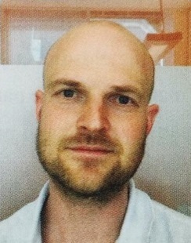
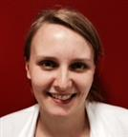
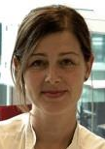
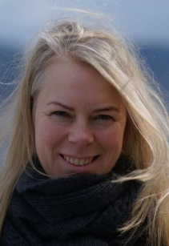
Blood Far Forward Research Group, Bergen
Geir
Tor
Einar
Hanne
Joar
Håkon
Theodor
Christopher
Kristin
Turid Helen
Torunn

Slide 4
What are our needs?

Slide 5
And what can we do about it as a team?

Slide 6
Aim
To improve battlefield survival by developing a safe method for pre-hospital whole blood transfusions.
Best blood available for all levels of civilian and military health care
Far forward military operations
Larger as well as smaller hospitals
Prehospital civilian health care
Off-shore oil installations and shipping
Blood preparedness

Slide 7
Blood efficacy and safety blood research
Laboratory studies
Clinical studies
Validation and quality control

Slide 8
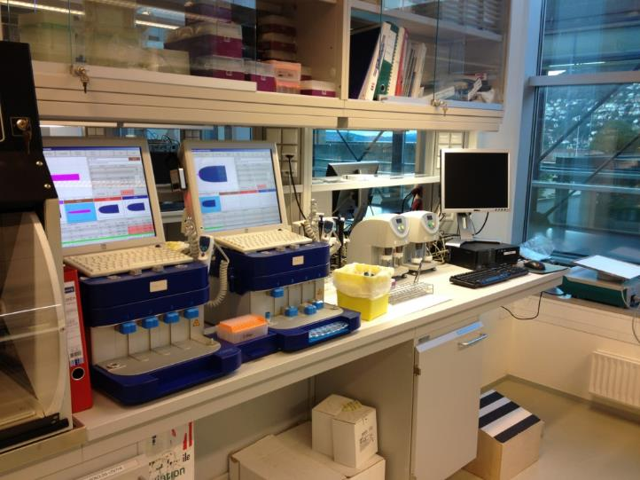
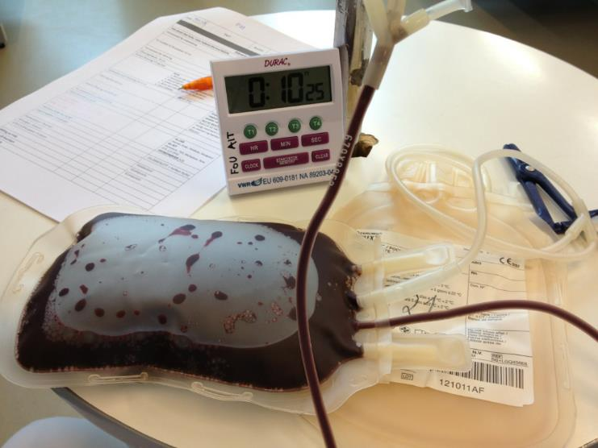
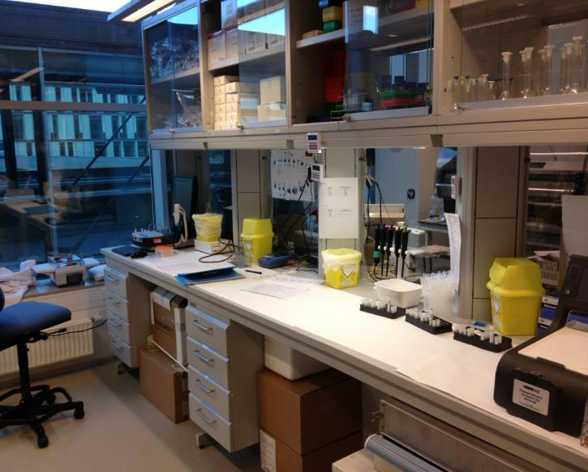
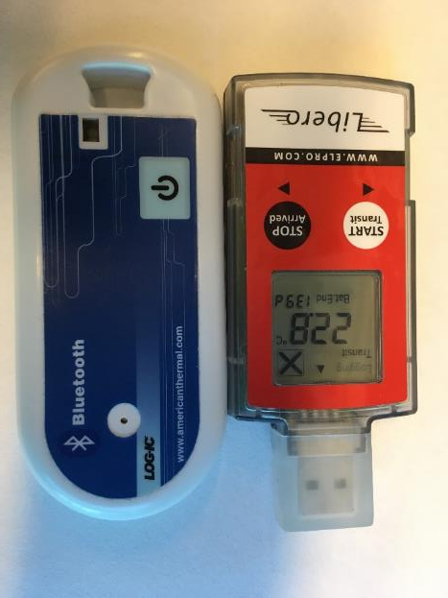
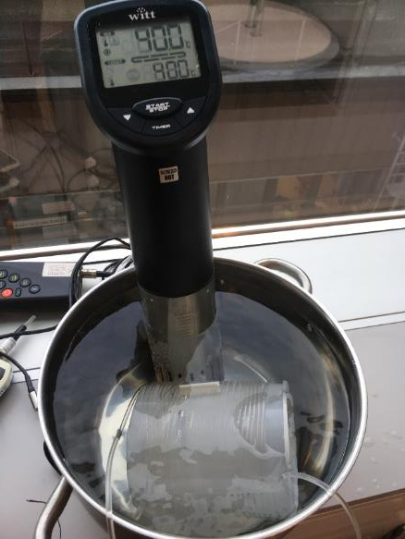
BFF
LAB

Slide 9
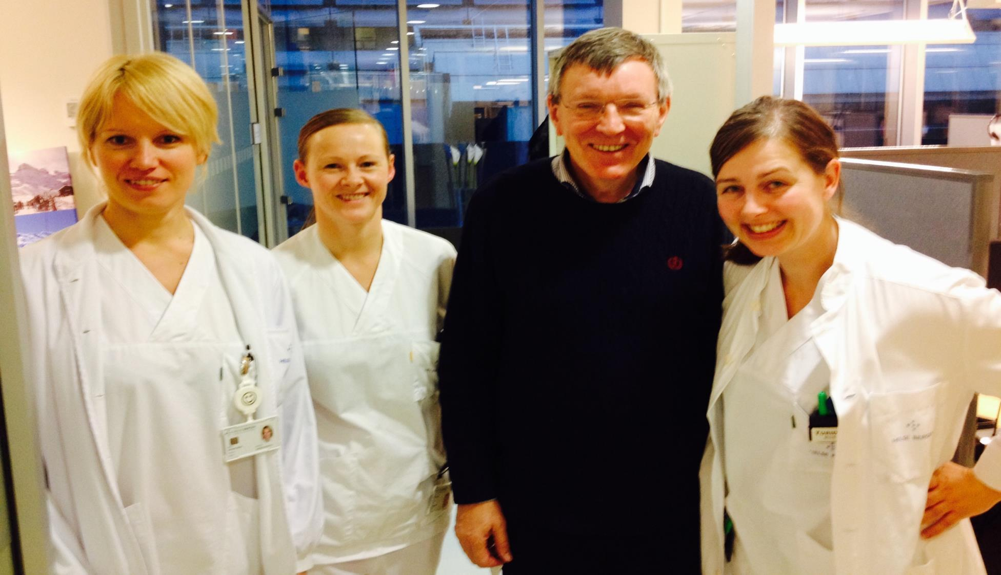

Slide 10
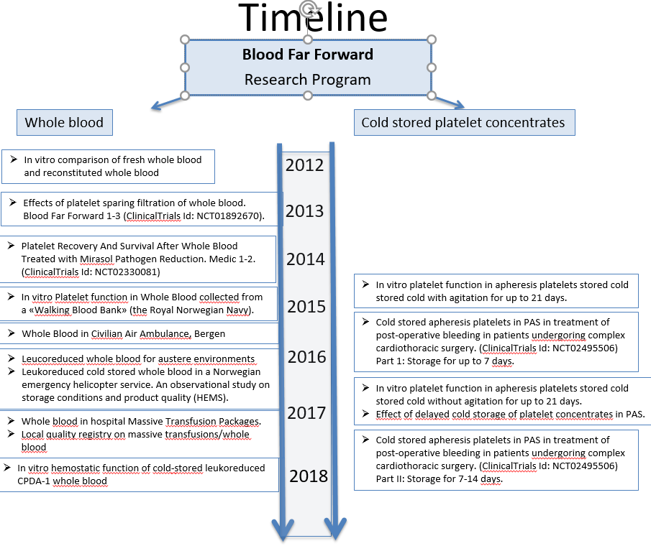

Slide 11
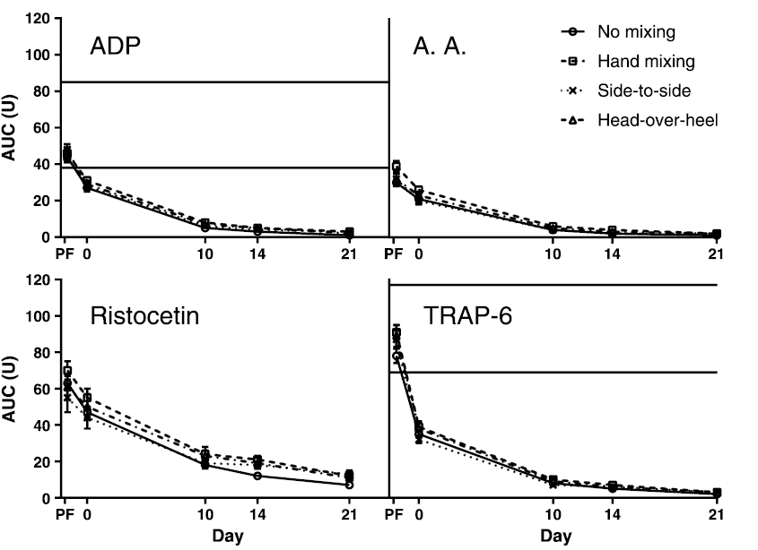
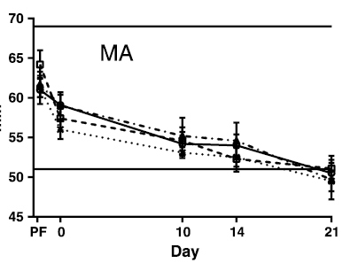
In vitro hemostatic function of cold stored leucoreduction CPD whole blood
Thromboelastography (TEG)
Multiplate

Slide 12
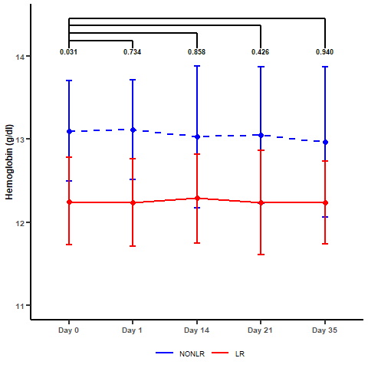
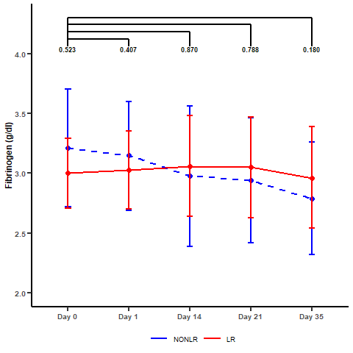
In vitro hemostatic function of cold stored leukoreduced CPDA-1 whole blood
Terumo CPDA-1 bag + Imuflex WB-SP filter
RESULTS:
<1×10⁶ residual white blood cells in all units
No difference in Hemoglobin or Fibrinogen levels during storage
Manuscript to be submitted.
Notes:
Last year at this conference we were challenged to perform an evaluation on the effect of leukoreduction with a platelet-sparing filter in CPDA-1 whole blood.
So we did: And we see no significant difference in platelet concentration or platelet funcion when evaluated by use of TEG MA.

Slide 13
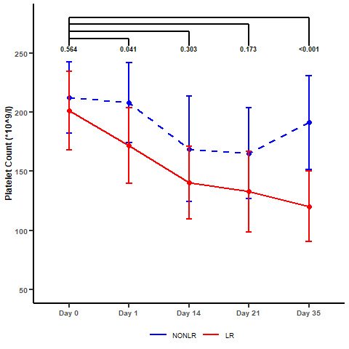
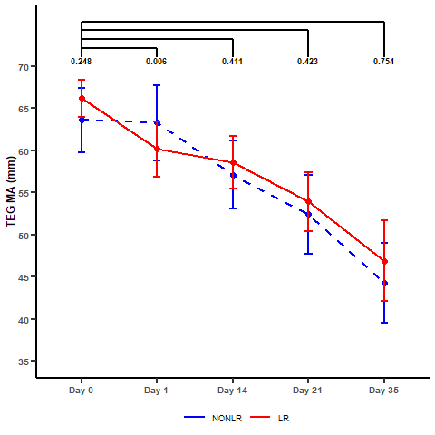
In vitro hemostatic function of cold stored leukoreduced CPDA-1 whole blood
Some loss of platelets in filtration. No differences during storage.
Some effect immediately after filtration. No effect on platelet function during storage
Gradual decrease in TEG MA in both groups (below normal range on day 35).
Manuscript to be submitted.
Notes:
Last year at this conference we were challenged to perform an evaluation on the effect of leukoreduction with a platelet-sparing filter in CPDA-1 whole blood.
So we did: And we see no significant difference in platelet concentration or platelet funcion when evaluated by use of TEG MA.

Slide 14
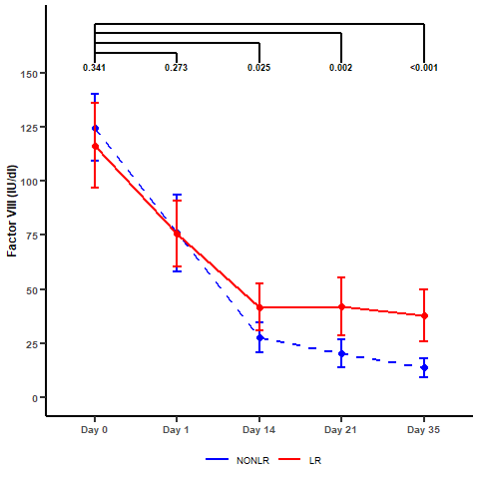
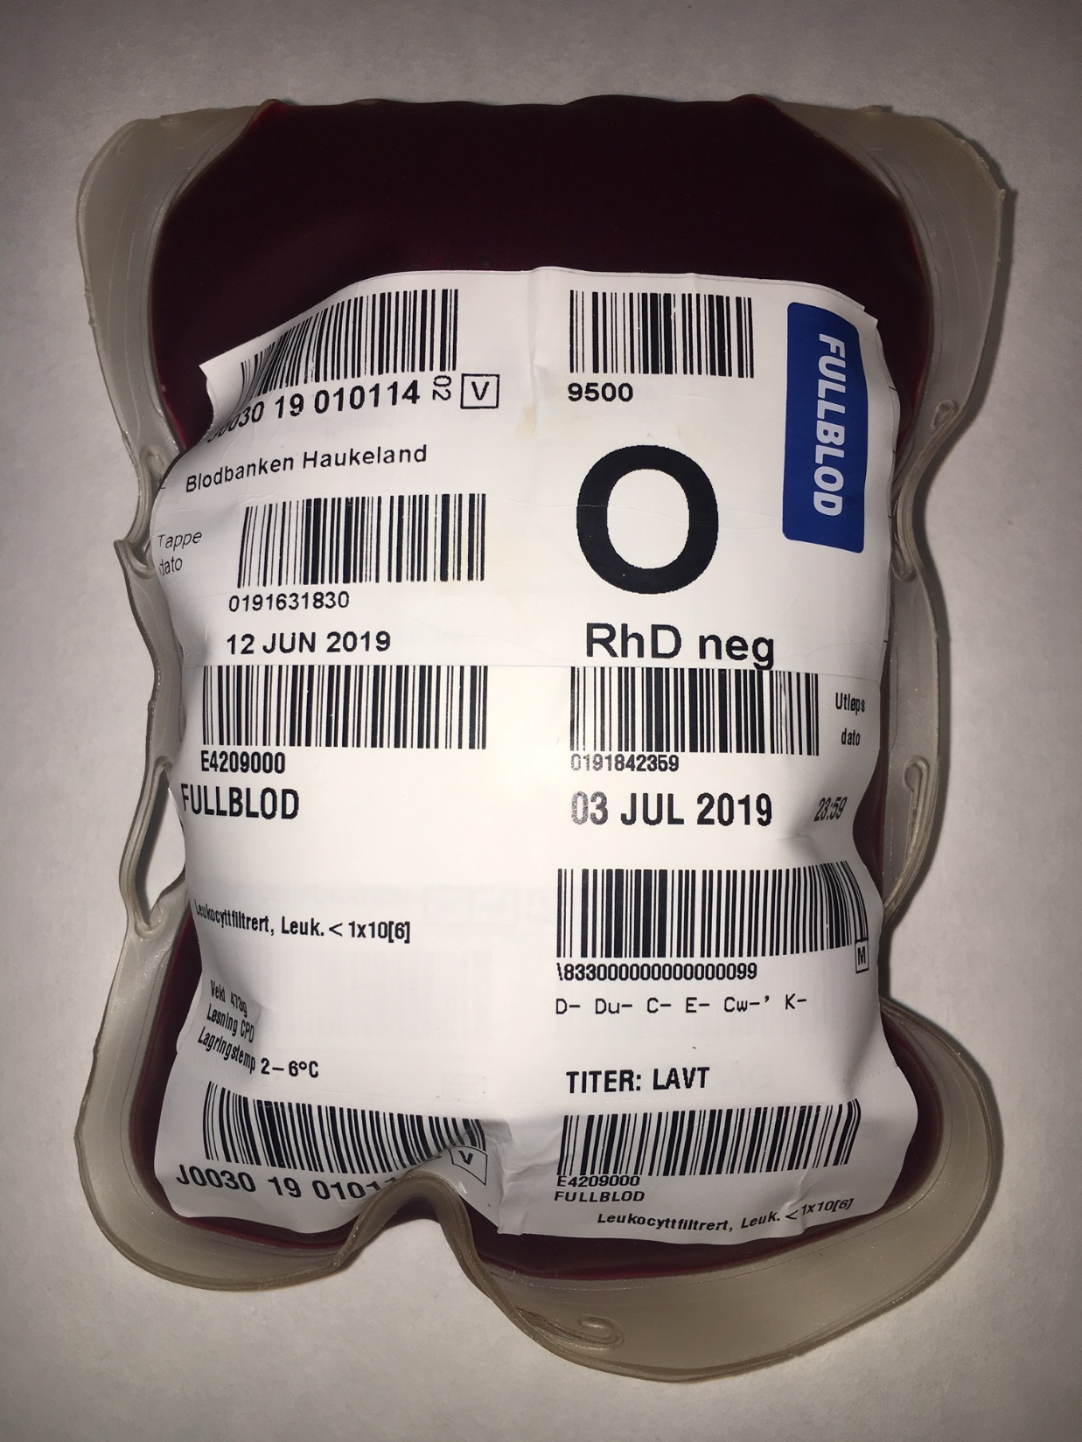
In vitro hemostatic function of cold-stored leukoreduced CPDA-1 whole blood
Factor VIII is better preserved in leukoreduced group.
Notes:
When investigating platelet function by use of ADP-induced light transmission aggregometry, we find response by day 21 in both groups. No difference were observed between groups. The factor VIII levels is better preserved in leukoreduced group.

Slide 15
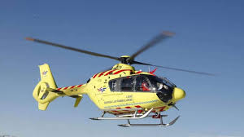
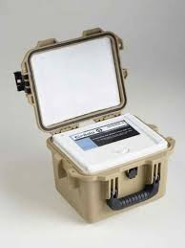
Forward storage of whole blood : Leukoreduced cold stored whole blood in a Norwegian emergency helicopter service. An observational study on storage conditions and product quality (HEMS)
AIMS
To assess in vitro quality of whole blood during storage for up to 21 days in an airtight storage container at a forward operating base.
To establish a storage protocol for forward handling of cold stored whole blood.
To evaluate if storage conditions meet EU standards.

Slide 16
Materials & Methods
Two-armed prospective observational single center study on far forward storage of whole blood.
No patient interventions
The in vitro quality of the whole blood was assessed up to 21 days of storage
Control group; 20 units stored in blood bank
Intervention group; 20 units stored at HEMS base
In vitro quality parameters:
Standard hematology, electrolytes and blood gas analysis
Thromboelastography (ROTEM and TEG)
Platelet function tests (optical aggregometry, flowcytometry and multiplate).
Storage conditions:
Ambient temperature, light, humidity, accelerometry and barometric pressures.

Slide 17
Preliminary results

Slide 18
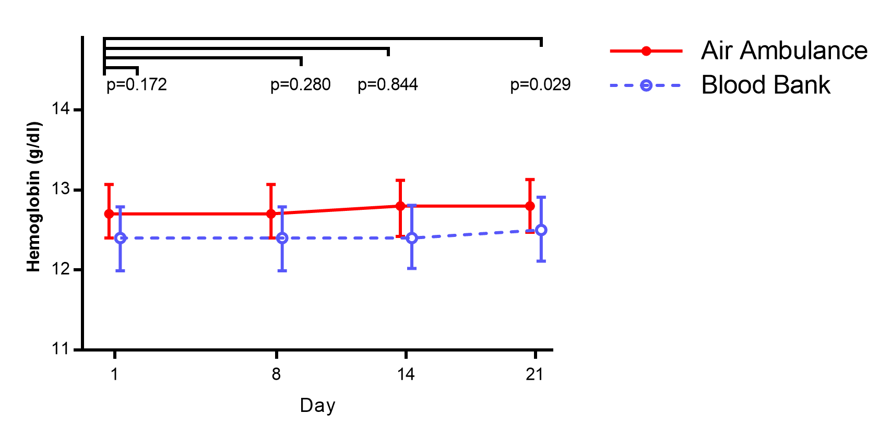
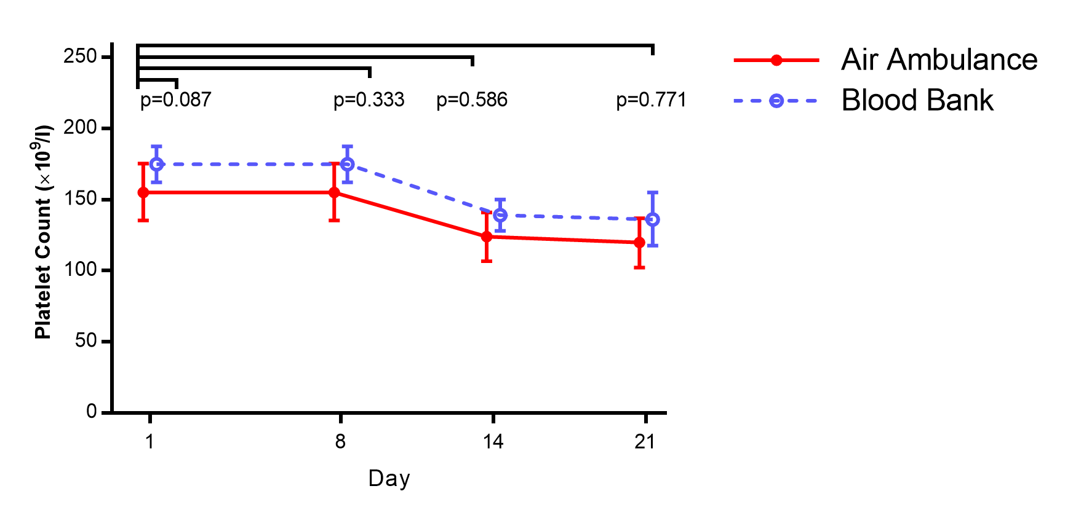
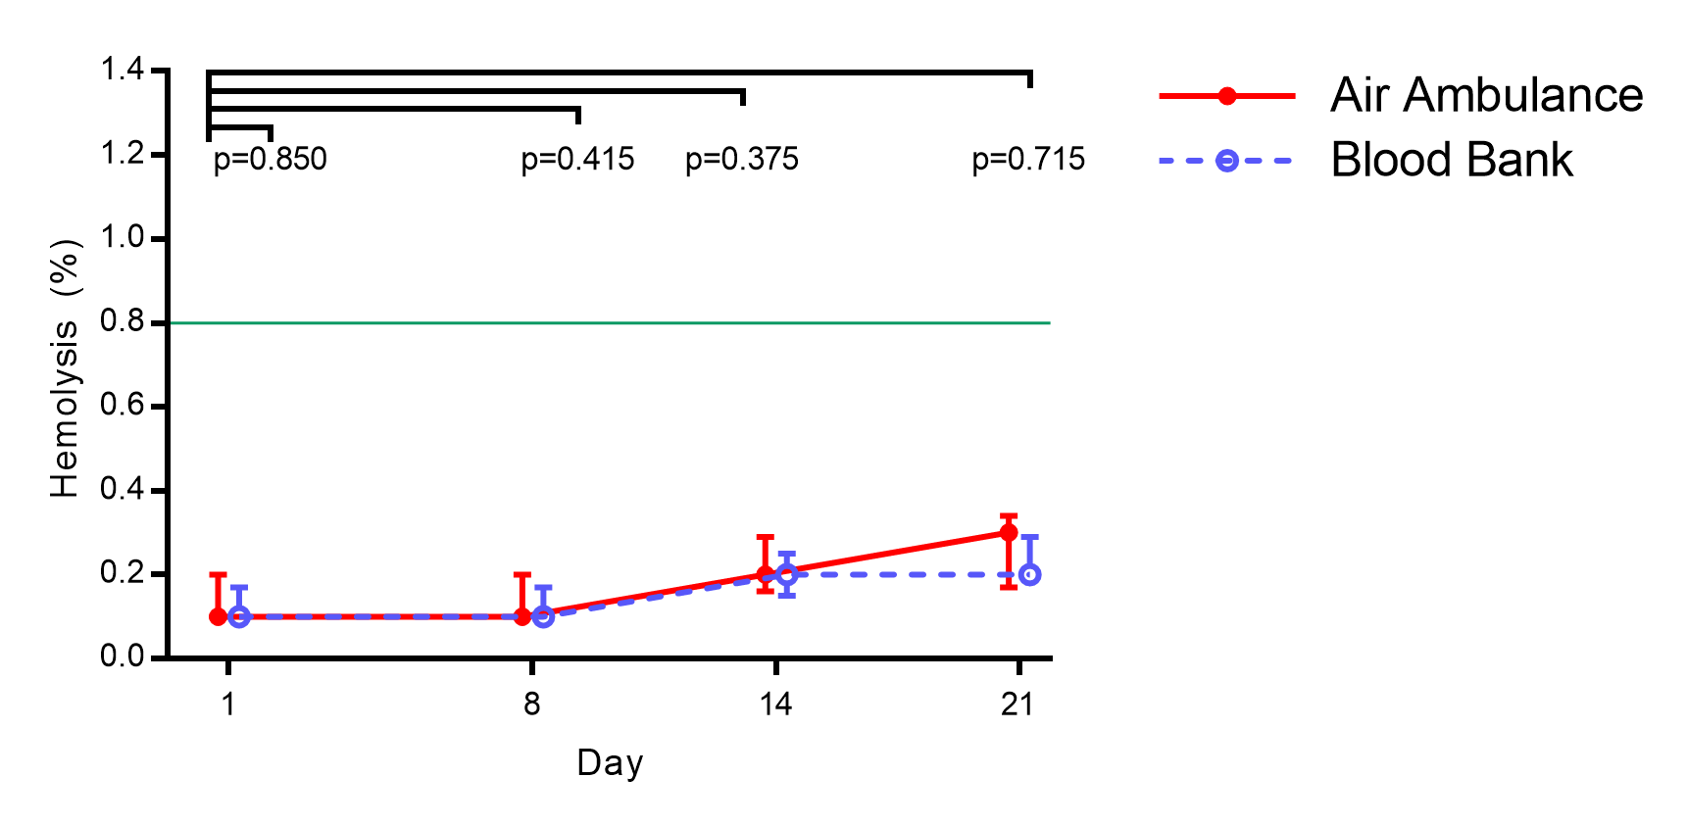
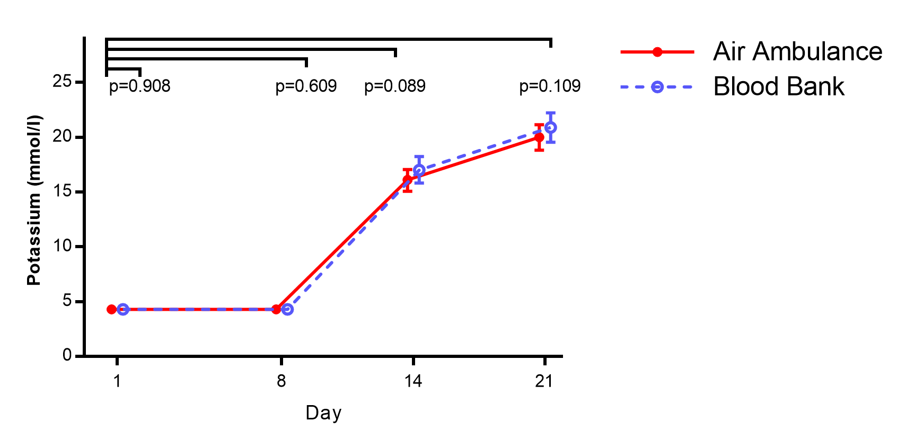
HEMATOLOGY
HEMOLYSIS

Slide 19
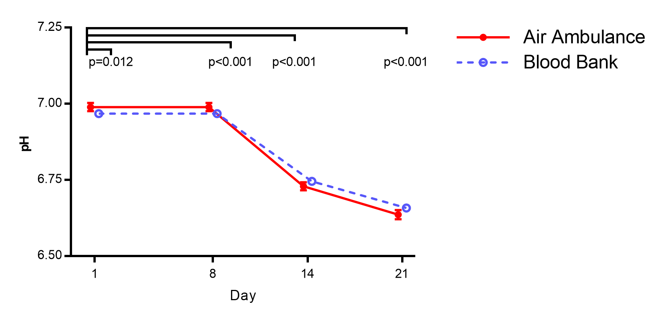
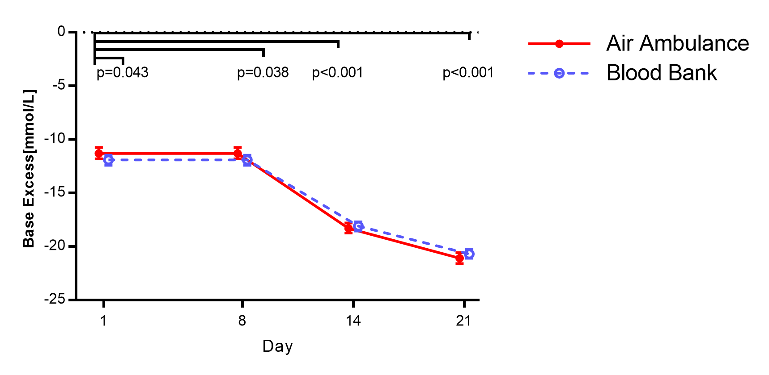
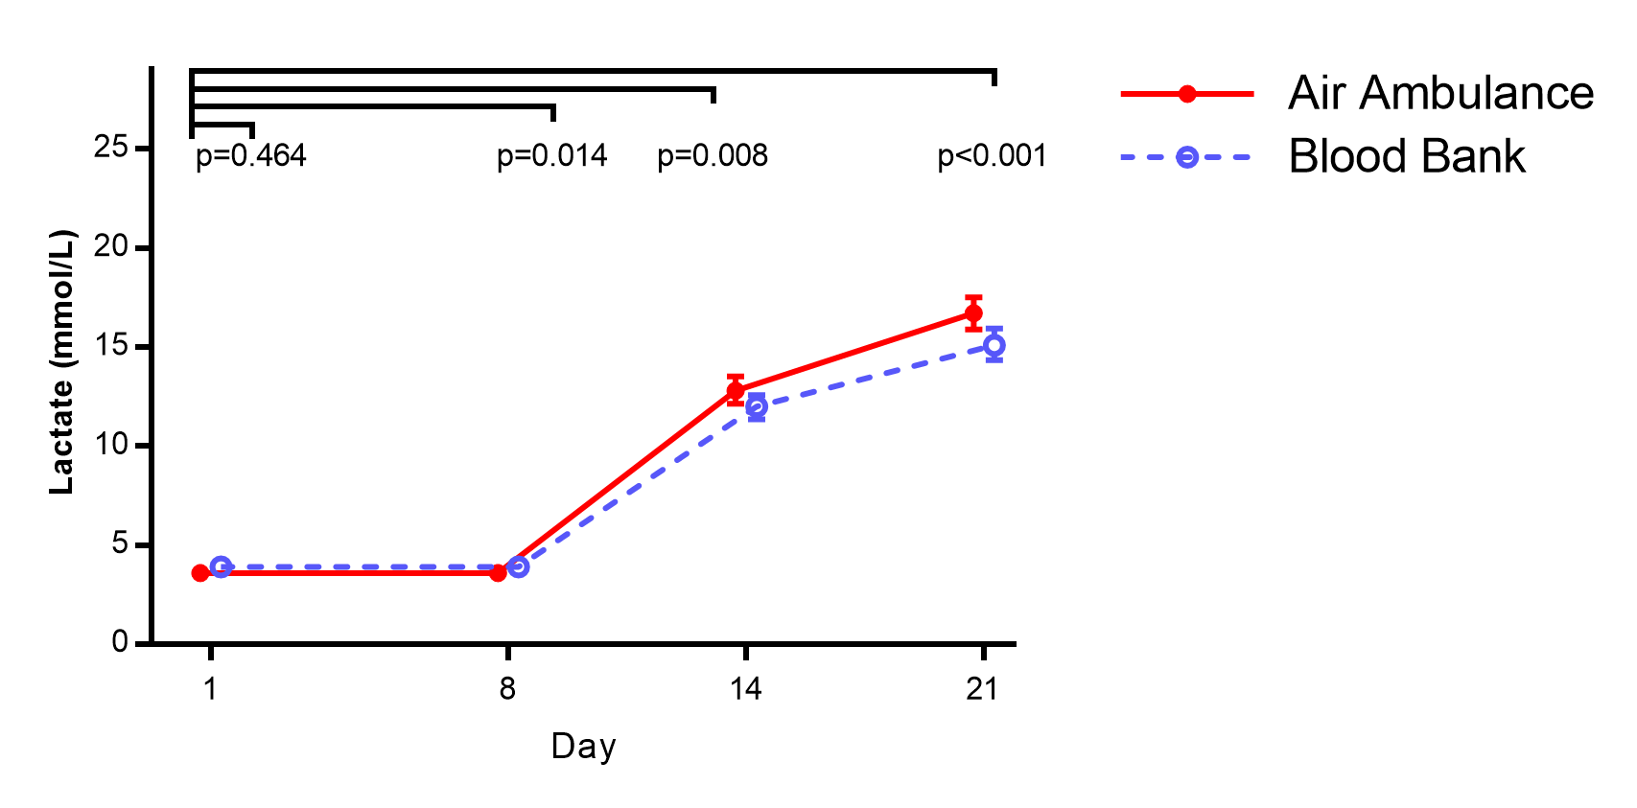
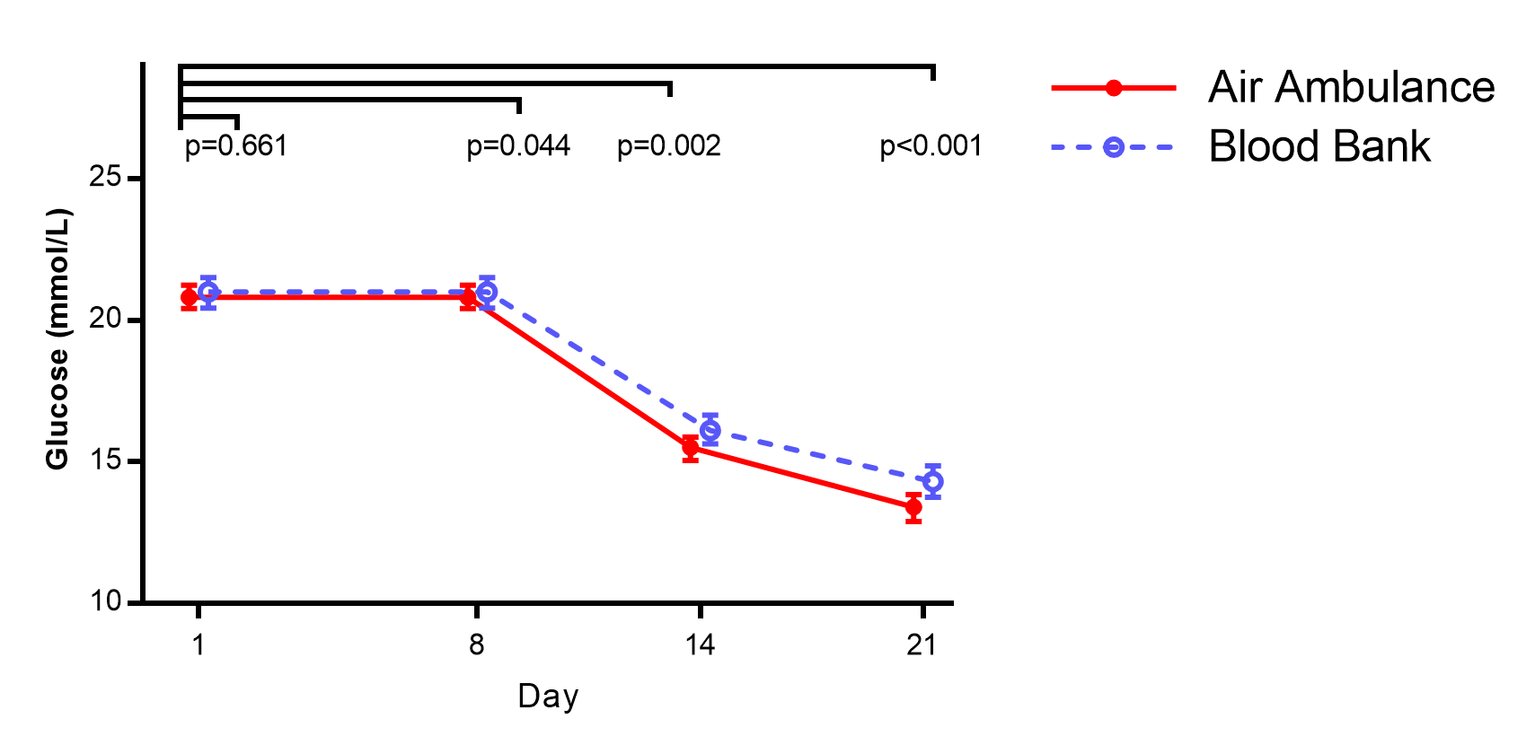
METABOLISM/RESPIRATION

Slide 20
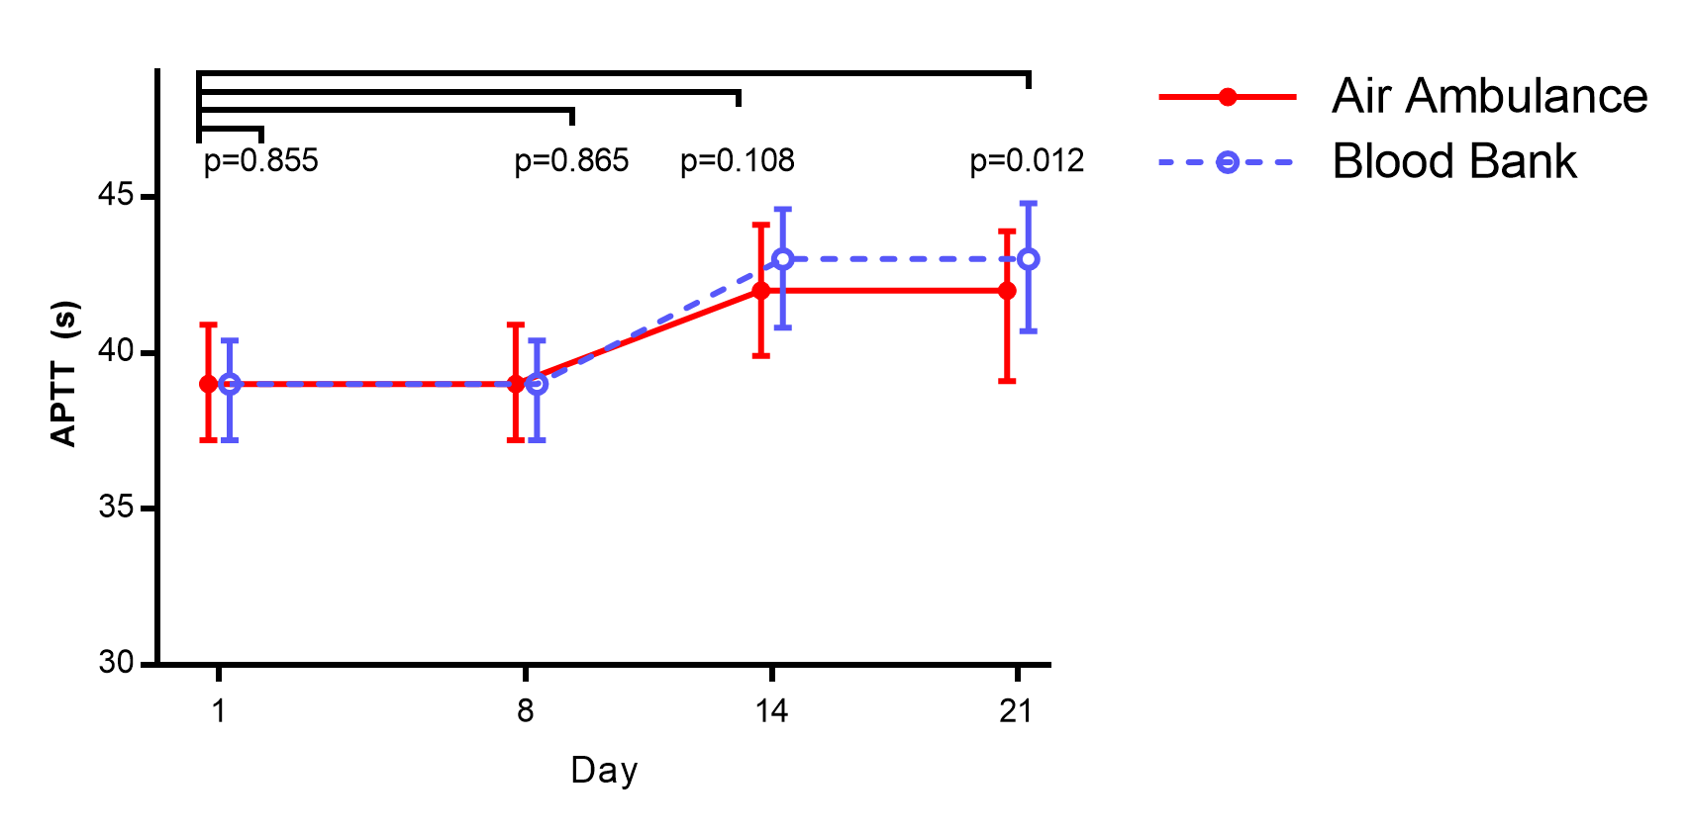
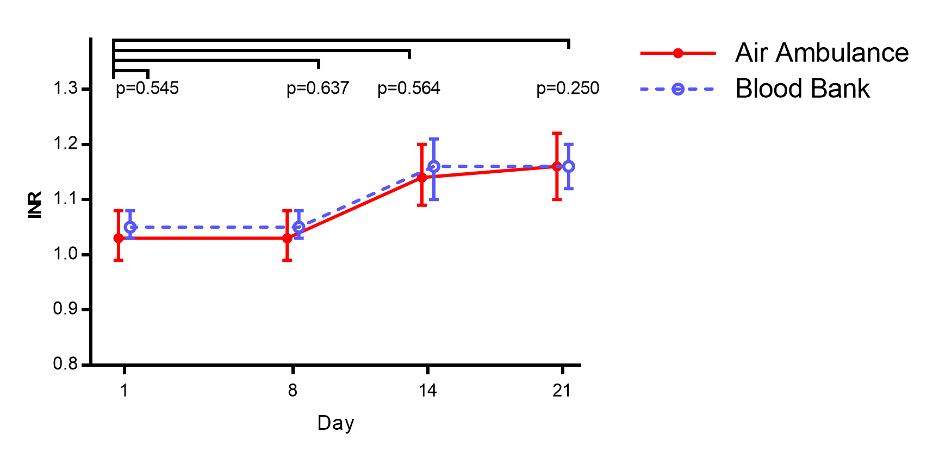
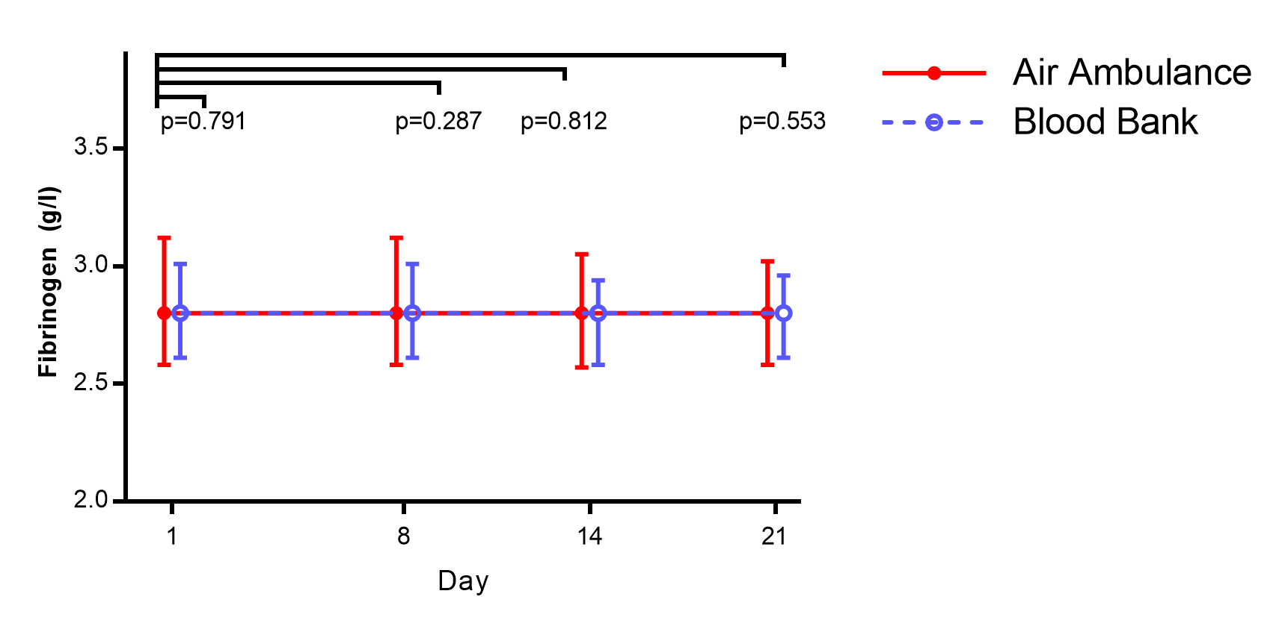
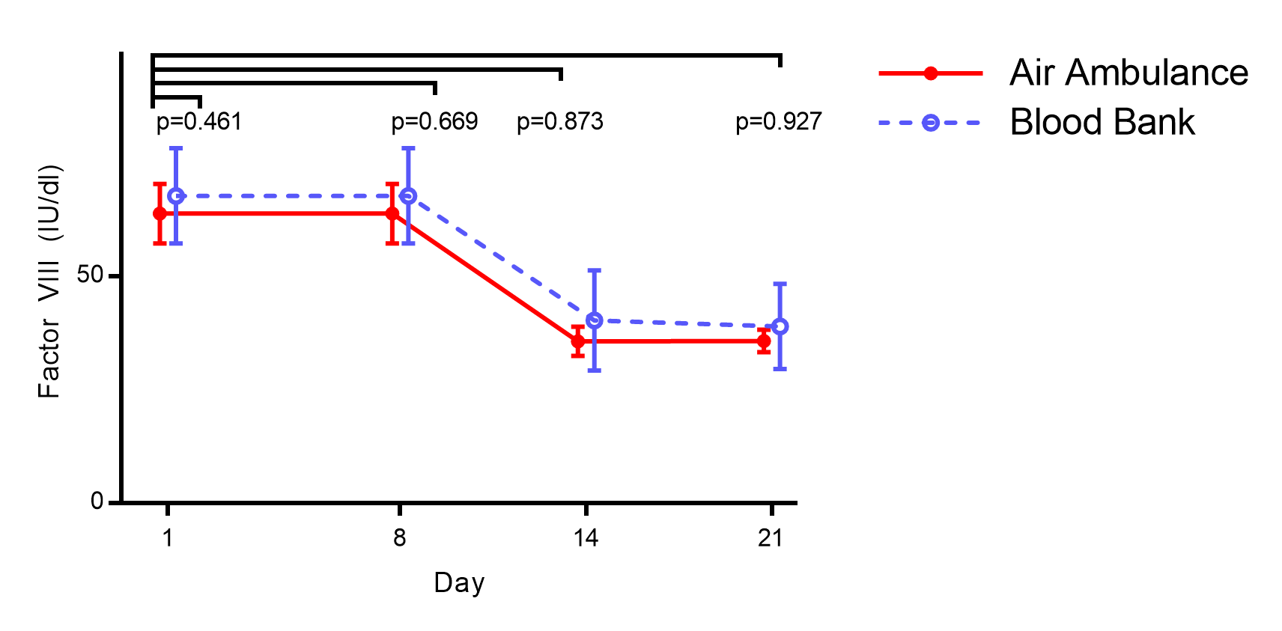
COAGULATION/FIBRINOGEN/FVIII

Slide 21
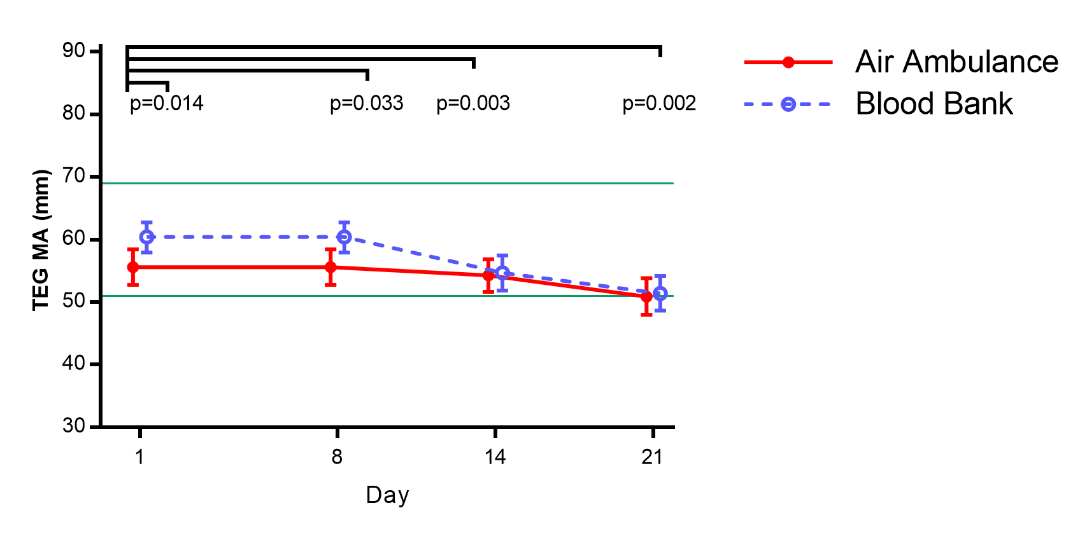
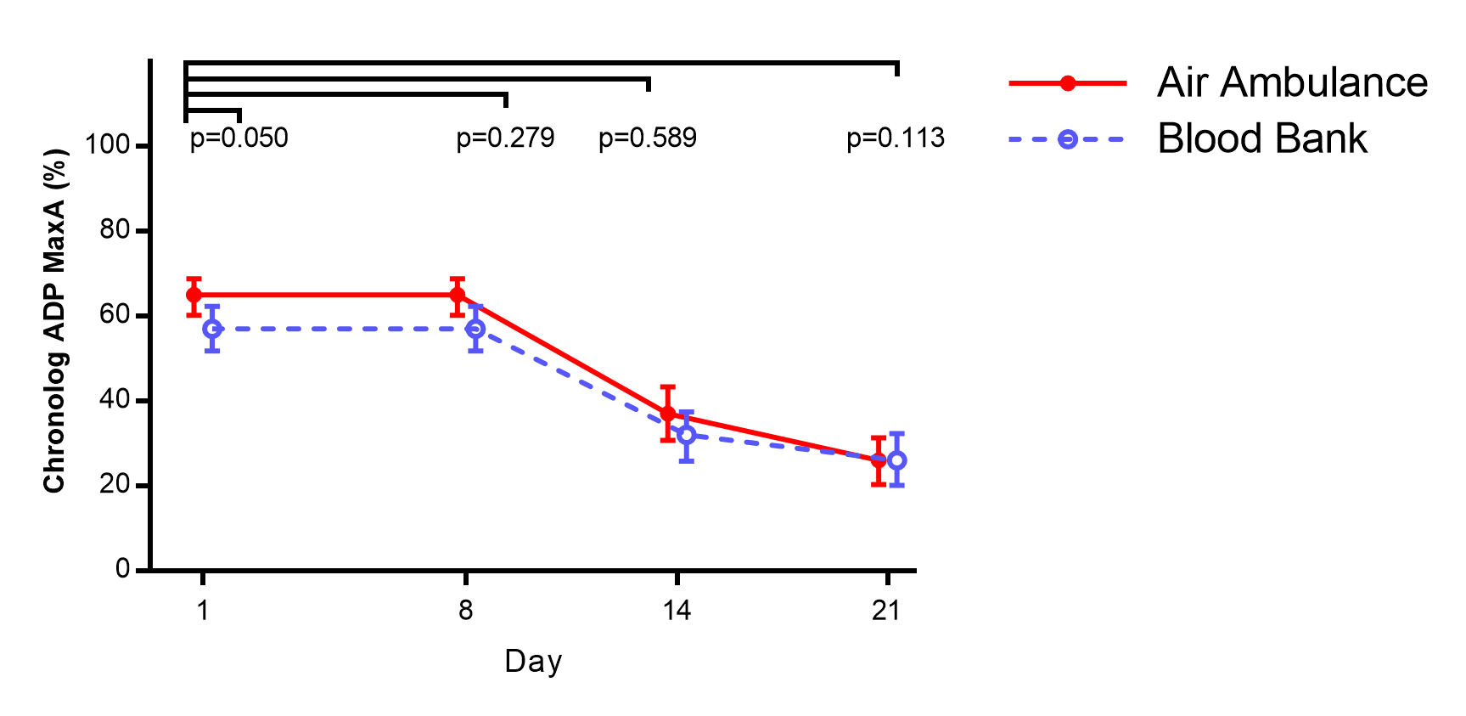
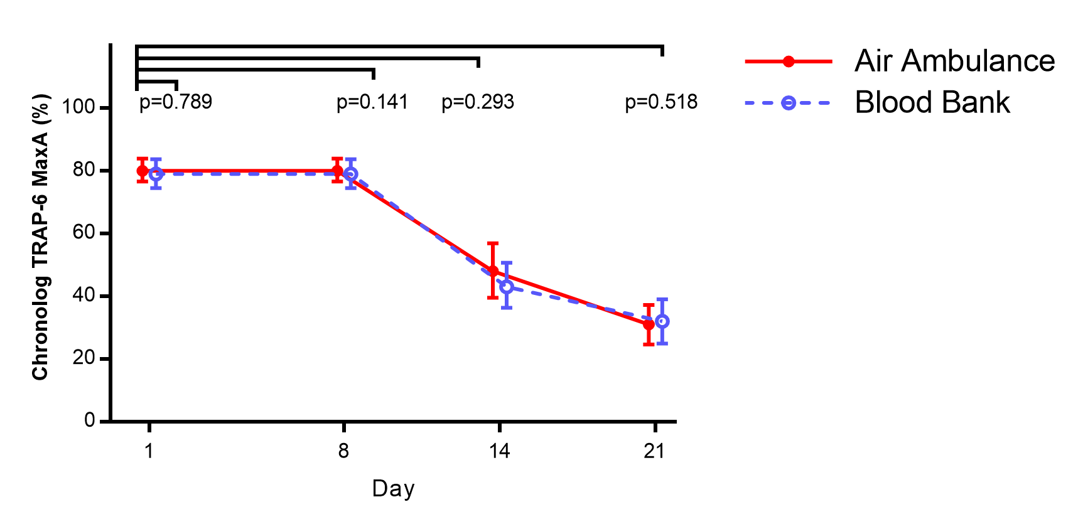
PLATELET FUNCTION

Slide 22
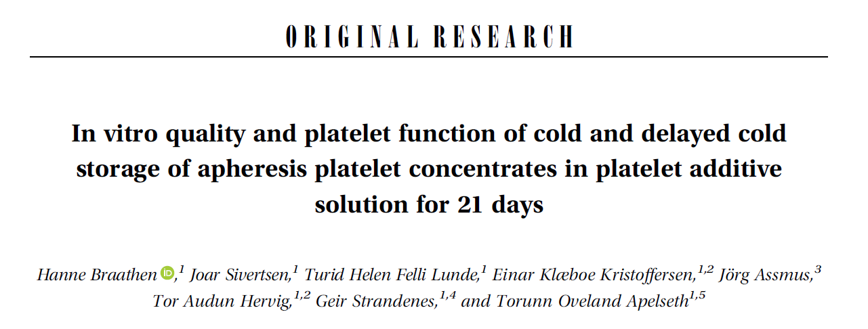
In vitro quality of cold stored platelets

Slide 23
In vitro quality and platelet function of continuous and delayed cold stored apheresis platelet concentrates in PAS
Cold-stored platelet concentrates meet the EU quality requirements on pH and platelet content

Slide 24
Platelet function

Slide 25
Platelet function cont.

Slide 26
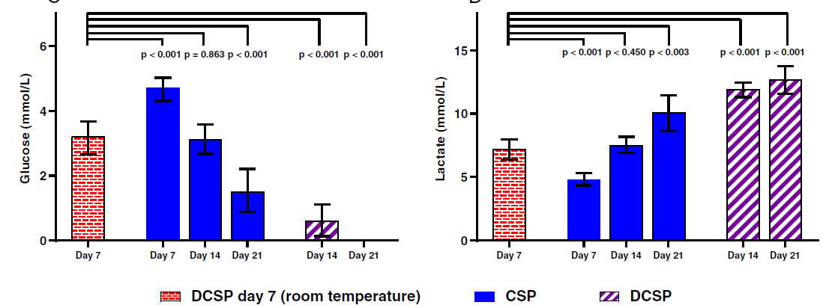
Metabolism

Slide 27
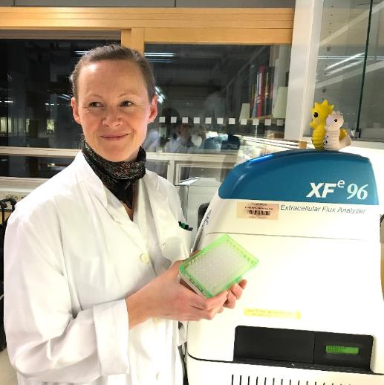
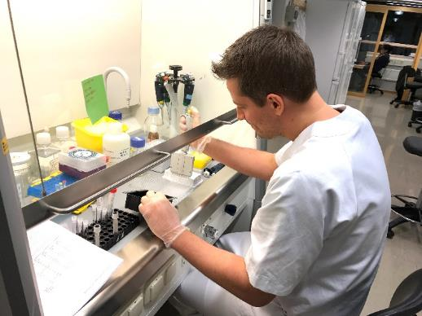
SEAHORSE study
Functional mitochondrial measurements are key to understanding cellular activation, proliferation, differentiation and dysfunction. The Seahorse XF Cell Mito Stress Test provides a complete mitochondrial profile in intact cells.

Slide 28
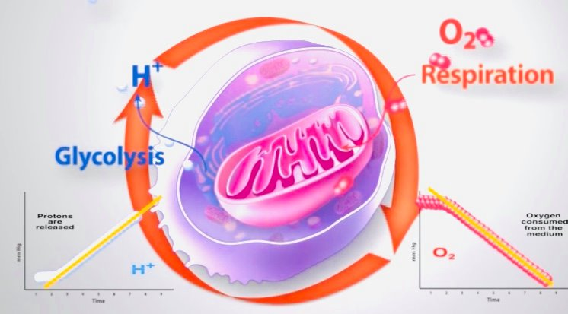
Metabolism analysis with Seahorse technology
The bioenergetic state of the cell is determined by
Mitochondrial respiration (O2 consumed/reduced concentration in the medium):
Oxygen Consumption Rate OCR
Glycolytic activity (proton release after making lactate from pyruvate and glucose):
Extracellular Acidification Rate ECAR
These two major energy pathways are measured simultaniously in this analysis system.
Figure and screenshot from www.agilent.com

Slide 30
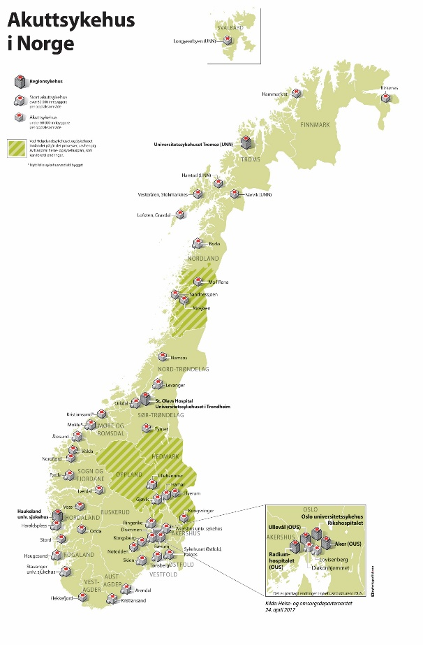
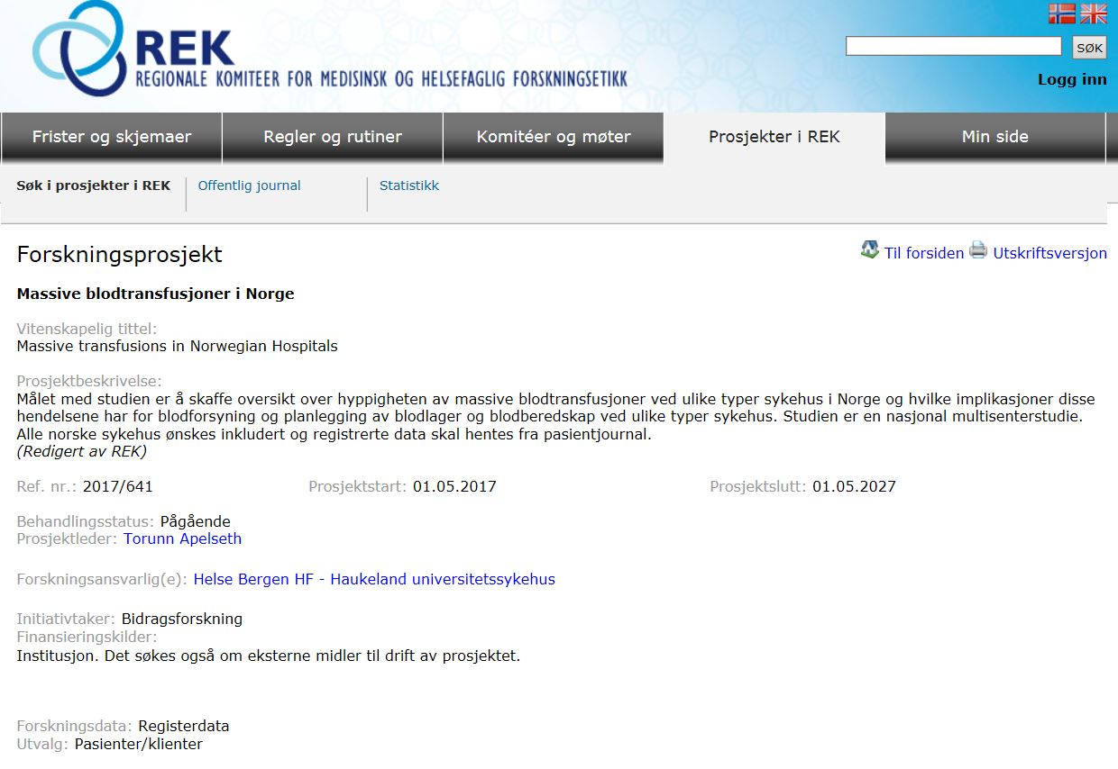
National study on massive transfusions in Norway
AIMS:
- To describe strategies for management of massive transfusions and the incidence of massive transfusions at all levels of hospitals in Norway
Notes:
Hovedhensikten med studien er å skaffe veie informasjon om frekvens av massive transfusjoner og så deretter å vurdere implikasjonene av disse for planlegging av blodbeholdning og beredskap.

Slide 31
Inventory of blood in different level hospitals in Norway
<1000 1000-5000 >5000
 | <1000 (N=20) | 1000-5000 (N=22) | >5000 (N=8)
Red cells and plasma | 19 | 4 | 0
Red cells, plasma and platelets | 1 | 18 | 6
Red cells, plasma, platelets and whole blood | 0 | 0 | 2

Slide 32
Blood collection performed
<1000 1000-5000 >5000
 | <1000 (N=20) | 1000-5000 (N=22) | >5000 (N=8)
YES | 18 | 1 | 8
NO | 2 | 1 | 0
Number of blood donors : mean (min-max) | 672 (233-2131) N=9 | 1658 (751-3645) N=13 | 7836 (2611-16012) N=5
Number of red cell units produced: mean (min-max) | 835 (267-1258) N=10 | 2814 (1017-4626) N=11 | 14957 (667-31888) N=6

Slide 33
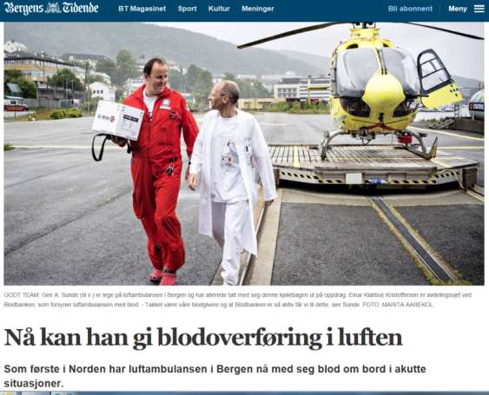
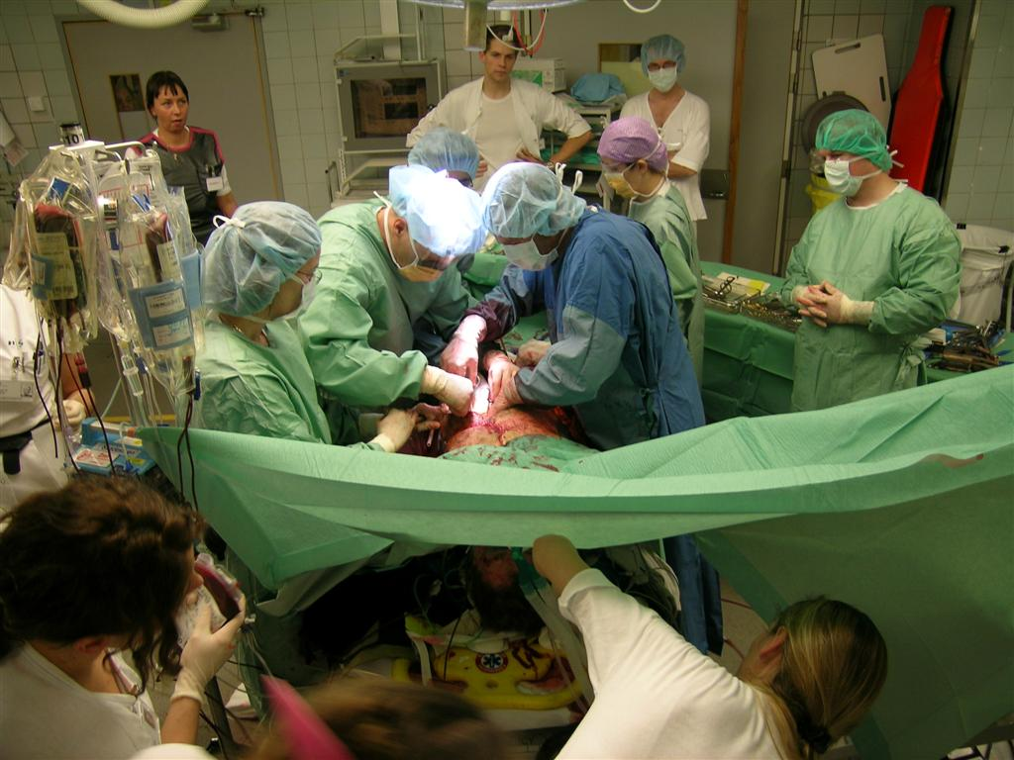
Timeline for whole blood in bergen
Whole blood in Haukeland University Hospital,
Dec 2017
Red cells in Air Ambulance,
July 2014
Whole blood in Air Ambulance,
Dec 2015
Freeze dried plasma in Air Ambulance
2013
Notes:
In Bergen we have decided to pilot this approach and supplement our component based massive transfusion packages with cold stored whole blood. This is the timeline for implementation of whole blood in Bergen. Whole blood was started at the air ambulance in december 2015 and in hospital in december 2017.

Slide 34
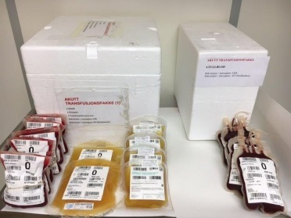
Massiv Transfusjons Pakke (MTP) Haukeland universitetssjukehus
Alternative 1:
Whole blood based MTP
4 units LTOWB
O neg, K neg: women < 50 y
O pos, K neg: men , women > 50 y
Alternative 2:
Component based MTP
6 red cell units (0)
6 SD-plasma (AB/A)
2 platelet units (0)
Children:
Both alternatives available
Notes:
Our whole blood is low titer group O leukoreduced with a platelet-sparing filter. We aim to start treatment as early as possible with whole blood and continue with components based on monitoring.

Slide 35
Praktisk informasjon om massiv transfusjonspakker finner dere her: Helse bergen HF: Overordnet prosedyre “Praktisk transfusjon” (D32611)

Slide 36
Follow up of whole blood transfusion
Blood sampling
Hemoglobin, platelet count
Hemolysis: haptoglobin, LD, bilirubin, DAT
Free anti-A and/or anti-B antibodies
(TEG)
Quality registry
Notes:
Samlet flere analyser for å monitorere pasienten med tanke på hemolyseparametre, Hb + tpk for å avgjøre evt. behov for ytterligere transfusjon med komponenter

Slide 37
Preliminary results local whole blood registry
Total number of patients: 186
Total number of units: 643
Mean number of units
per patient: 3.5

Slide 38
Indications
Maximum lactate: 26.0
Minimum platelet count: 27
Minimum Hb: 4.4

Slide 39
Age of whole blood units

Slide 40
Blood usage

Slide 41
Outcomes
No clinical hemolysis reported
Poor follow up on blood sampling:
9/67 (13%) free anti-A in group A pts
1/17 (5%) free anti-B in group B pts
No patological hemolysis markers in blood samples

Slide 42
Things to do….
2019 In vitro studies
Bacterial contamination
Temperature cycling
2019 Clinical studies:
Whole blood study on cardiac surgery patients
21 days cold stored platelets
2020 Spray dried plasma

Slide 43
Acknowledgements
The Blood Far Forward group in Bergen:
Geir Strandenes, MD
Torunn O Apelseth, MD, PhD
Einar K Kristoffersen, MD, PhD
Christopher Bjerkvig, MD
Theodor K Fosse, MD
Tor Hervig, MD, PhD
Turid Helen F Lunde, MSc
Hanne Braathen, BSc
Joar Sivertsen, BSc
Venny Kvalheim, MD, PhD
Rune Haaverstad, MD, PhD
Håkon Eliassen, Stud Med
Andrew P Cap, MD, PhD, FACP
James K Aden, PhD
U.S. Army Institute of Surgical Research, FT Sam Houston, TX, USA
Philip C Spinella, MD, FCCM
Division of Critical Care Medicine, Clinical Care Translational Research Program, Washington University, St. Louis, US
Advisors, debaters and critics in the THOR Network
Our institutions:
Department of immunology and transfusion medicine, Department of Anaesthesia and Intensive Care, Section of Cardiothoracic Surgery, Department of Heath Disease, and Laboratory of Clinical Biochemistry, Haukeland University Hospital, Bergen, Norway
Institute of Clinical Science, School of Medicine and Dentistry, University of Bergen, Norway
Norwegian Naval Special Operations Commando
Norwegian Armed Forces Medical Services
Notes:
I thank all the highly skilled members of the Blood Far Forward research Group in Bergen. Our group is a joint effort by the civilian and military health care services and include specialists in transfusion medicine, anesthesiologists and cardiac surgeons.
I also thank our eminent collaborators at the US Army Institute of Surgical Research Doctor Andre Cap and James Aden, I also thank Doctor Phil Spinella, and all our advisors, debaters and critics at the THOR Network.

