Slide 1
Updates in Topical Hemostatic Agent Research
Bijan S. Kheirabadi, PhD
2019 RDCR Symposium
June 23-26 2019, Bergen, Norway

Slide 2
Disclaimer
The opinions or assertions contained herein are the private views of the author and are not to be construed as official or as reflecting the views of the Department of the Army or the Department of Defense.
Research was conducted in compliance with the Animal Welfare Act, the implementing Animal Welfare regulations, and the principles of the Guide for the Care and Use of Laboratory Animals, National Research Council. The facility's Institutional Animal Care and Use Committee approved all research conducted in this study. The facility where this research was conducted is fully accredited by AAALAC.

Slide 3
Classification of Topical Hemostatic Agents
1. Surgical Hemostats (In hospital use):
- Treat mild to moderate bleeding
- Applied before blood flow restored (not actively bleeding)
- Biological or synthetic chemical composition
- Biodegradable and fully absorbable
- Minimal/no side effects
- Used primarily in cardiovascular and neurosurgery

Slide 4

Classification of Topical Hemostatic Agents
2. Trauma Hemostats (pre-hospital use):
- Treat severe (life-threatening) bleeding
- Applied in active bleeding wound
- Require 2-3 min manual compression
- Ready for use
- Biological/mineral composition
- Generally non-absorbable
- Indicated for temporary control of external
hemorrhage

Slide 5
Classification of Topical Hemostatic Agents
A. Trauma Hemostats (dependent on patient’s clotting function)
1. Factor Concentrators (water absorbent):
Example: Surgical gauze, TraumaDex (starch), XStat (compressed cellulose sponge)
2. Procoagulants (activate intrinsic clotting cascade):
Example: Combat Gauze (mineral-based, kaolin)
3. Mucoadesives (N-acetyl glucosamine/chitosan based): purified from microalgae and diatoms(e.g.,mRDH) or shell fish exoskeleton (chitin)
Example: mRDH, Celox Gauze, Celox Rapid, Chitogauze, HEMObandage

Slide 6
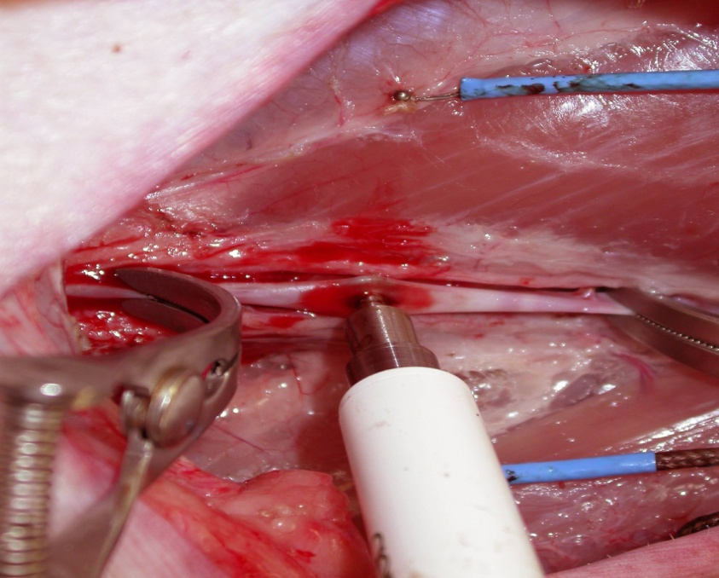
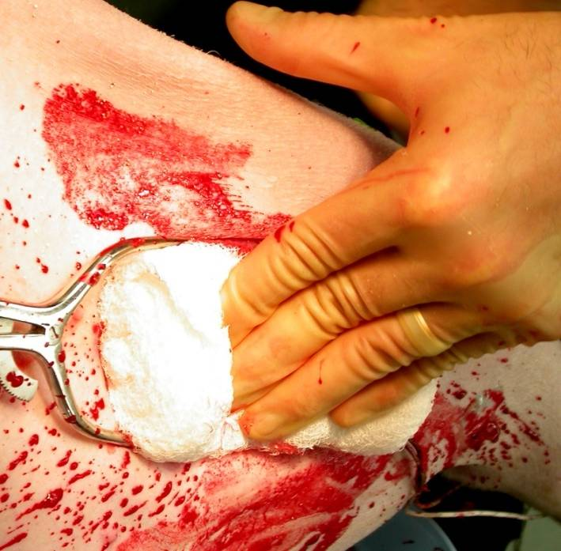
Early Preclinical Results
Combat Gauze* (80%)
P<0.01
Celox (60%)
QuikClot(16%)
HemCon (10%)
Standard Femoral Artery Injury Model
( 6 mm hole)
Kheirabadi BS, et al. J Trauma. 2009;67:450-460

Slide 7
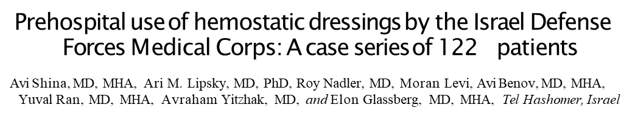
Clinical Reports
J Trauma Acute Care Surg. 2015;79: S204YS209.
A multi-institutional study of hemostatic gauze and tourniquets in rural civilian trauma
Jennifer Leonard, MD, PhD, John Zietlow, David Morris, MD, Kathleen Berns, RN, Steven Eyer, MD, Kurt Martinson, MD, Donald Jenkins, MD, and Scott Zietlow, MD, Rochester, Minnesota
J Trauma Acute Care Surg. 2016;81: 441-444.
QuikClot® Combat Gauze® Use by Ground Forces in Afghanistan
The Prehospital Trauma Registry Experience
Steven G. Schauer, DO; Michael D. April, MD, DPhil; Jason F. Naylor, PA-C; Andrew D. Fisher, PA-C, MS2; Cord W. Cunningham, MD, MPH;
Kathy L. Ryan, PhD; Krista C. Thomas, BSN; Daniel B. Brillhart, MD; Jessie Renee D. Fernandez, BS; Mark A. Antonacci, MD
J Special Op Med. 2017;17(2): 101-106.
Conclusion: Combat Gauze was successfully controlled hemorrhage in 88 t0 92 % of junctional and extremity wounds.

Slide 8
Classification of Topical Hemostatic Agents
1. Biological Sealants (Fibrin sealant)
Liquid form: have two separate components: Fibrinogen+FXIII and Thrombin+CaCl₂
Tisseel®: powder, ↓FXIII, bovine aprotinin, (85mg Fib+500 U T/ml)
Evicel™: frozen, ↑FXIII, no fibrinolytic inhibitor (70mg Fib+1000UT/ml)
CryoSeal®: produced from single unites of human FFP (40-50mg Fib/ml +T),
↑ plasminogen
Dry Dressing: TachoSil: Two-layer patch, collagen one side, Human Fib (~5.5 mg/cm²) + human T (2 U/cm²) on the other side+ FXIII, FDA approved
Evarrest: Human Fib (8 mg/cm²) + human T (31 U/cm²) + FXIII on absorbable backing (ORC and PG910 fibers), FDA approved
FAST: Human Fib (~14 mg/ cm²)+ human T (1.5 U/cm²) + FXIII
on absorbable backing (Dexon), (Discontinued)

Slide 9
Evaluation of a Novel Fibrin Sealant Patch (EVARREST) in Hemorrhage
Control After Vascular or Hepatic Injury
Jennifer E. Baker, MD*; Michael D. Goodman, MD, et al. Mil Med. 2018; July 11.doi:10. Epub.
EVARREST vs. Combat Gauze
TABLE II. Hemostatic Outcomes in Vascular and Hepatic Injury Models
Variable | Vascular Combat Gauze (n = 5) | Injury | Evarrest (n = 6) | Hepatic Injury
 |  |  |  | Combat Gauze (n = 5) | Evarrest (n = 5)
Pre-treatment blood loss (mL) | 207 ± 25 | 226 ± 71 |  | 189 ± 89 | 364 ± 164
Initial hemostasis (%) | 100 | 100 |  | 100 | 100
Post-treatment blood loss (mL) | 110 ± 164 | 737 ± 1074 |  | 219 ± 30 | 143 ± 25
Total ﬂuid (mL) | 1332 ± 1030 | 4518 ± 3625 |  | 900 ± 0 | 900 ± 0
Survival rate (%) | 100 | 80 |  | 100 | 100
Vessel patency (%) | 80 | 80 |  | — | —
Data expressed as mean ± SD or mean percentage.
No signiﬁcant (p > 0.05) difference was found between the groups (Combat Gauze vs. Evarrest) in both vascular and hepatic injury models.
Conclusion: The use of FP when compared to CG in established junctional hemorrhage and grade 5 liver injury models had equivalent outcomes regarding blood loss, mortality, and resuscitation requirements.

Slide 10
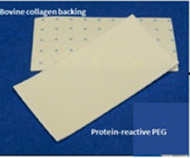
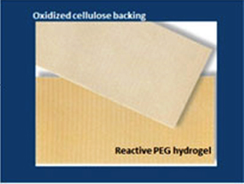
Classification of Topical Hemostatic Agents
2. Synthetic Tissue Sealant (absorbable):
-consisted of PEG polymers
- Liquid form: CoSeal (two PEGs, form hydrogel sealant cross links with protein bonding with tissue, control bleeding in vascular/aortic surgeries)
DuraSeal (PEG ester+ antrilysine amine, forms hydrogel sealing tissue, used in neurosurgery)
- Dry Dressing: HemoPatch ( NHS-PEG on collagen flee )
Veriset Patch (NHS-PEG on oxidized cellulose)
CoSeal
DuroSeal
Hemopatch
Veriset patch

Slide 11
Synthetic Sealant Chemical Reaction
NHS
NHS
PEG
NHS= N-hydroxylsuccinimide protein reactive PEG
NHS
NHS
Covalent bonding
Hemopatch
Lewis KM, Kuntze CE, Gulle H. Medical devices: Evidence and Research 2019;9: 1-9

Slide 12
A multicentre, randomized clinical trial comparing the Veriset™ haemostatic patch with fibrin sealant for the management of bleeding during hepatic surgery
Robert Öllinger¹, Andre L. Mihaljevic², Christoph Schuhmacher², Hüseyin Bektas³, Florian Vondran³, et al.
Veriset vs. TachoSil
Post hoc analysis of time to haemostasis based on bleeding severity and wound area
Stratification variableª Median time to haemostasis, min
Veriset™ group
(n = 32)
Control group (n = 18)
P-value
Non-inferiority
P-value Superiority
Bleeding severity
Minor | 1.00 | 3.00 | <0.001 | <0.001
Moderate | 1.00 | 3.00 | <0.001 | <0.001
Approximate area
<100 cm² | 1.00 | 3.00 | <0.001 | <0.001
>100 cm² | 1.00 | 4.00 | 0.014 | 0.033
ªBleeding severity assessed at the time of randomization.
Note: Three patients were excluded from the analysis because of potential data entry errors (i.e. values outside the normal range).
CONCLUSIONS: Regardless of bleeding severity or surface area, the Veriset™ hemostatic patch achieved hemostasis in this setting significantly faster than the control device (TachoSil) in patients undergoing hepatic resection.
HPB (Oxford). 2013; 15(7):548-58.

Slide 13
Current Research Goals
Determine safety and efficacy of TCCC-recommended hemostatic agents when used under PFC condition.
Identify alternative novel hemostats suitable for use in PFC.

Slide 14
Ideal Hemostatic Agent for Treating Compressible Wounds in PFC
FDA approved/cleared
Stop severe bleeding with 2 min compression
Maintain hemostasis for 2hrs at hypotensive pressure
Cause no harmful tissue effect
Ready to use and easy to apply
Require minimal/no training
Be lightweight and durable
Have long shelf life (≥ 2 yrs)
Stable in extreme temperatures (-10 to +40°C) for weeks
Cost effective
Maintain hemostasis for at least 24hrs
Secure hemostasis against normal or high blood pressure
Remain intact in rough transportation
Cause no thromboembolic complication
Preferred to be biodegradable and absorbable

Slide 15
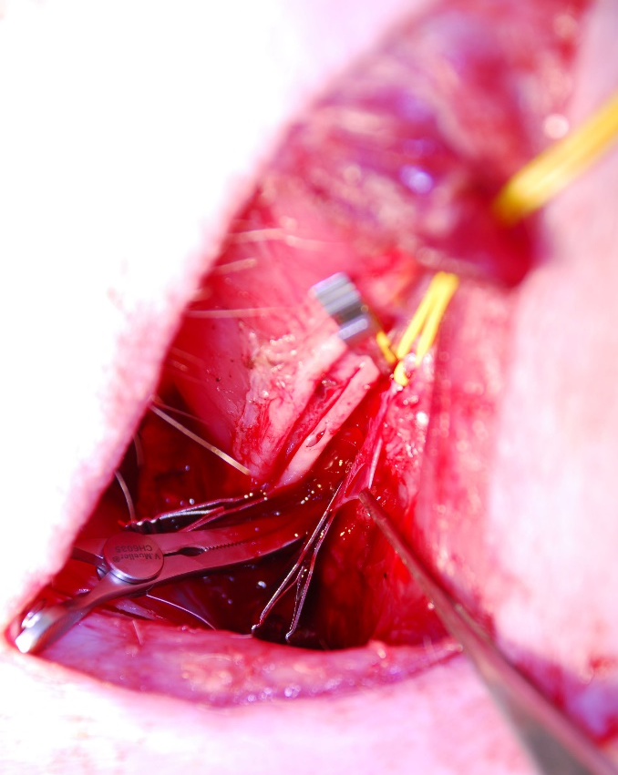
New Vascular Injury Model in Swine
  Swine were initially anesthetized with isoflurane and mechanically ventilated for instrumentation and splenectomy
  Anesthesia was then switched to IV agents (CRI, propofol+ midazolam)
  Spontaneous respiration was established for the rest of the experiment.
  Femoral arteries and veins on both legs were isolated
  Injuries were made on femoral artery (4 mm hole) and vein (1 cm longitudinal cut) of the left leg.
  10 second free bleeding was allowed and the wound was then packed with a hemostatic or control dressing (Combat Gauze).
  Repeat these procedures on the femoral vessels of the right leg.

Slide 16
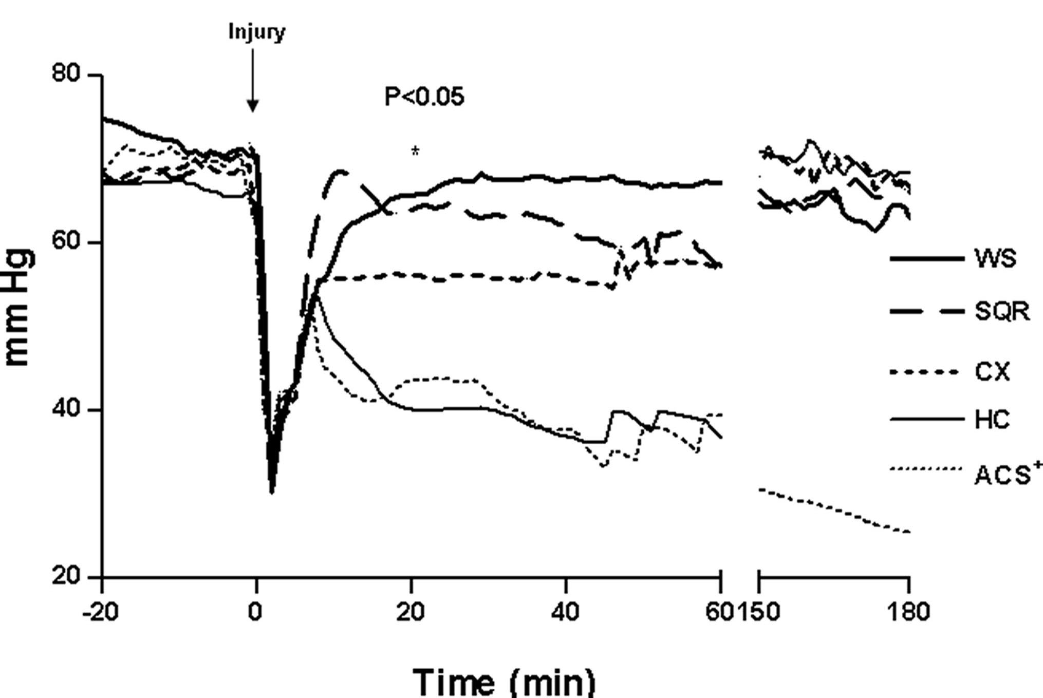
Results
Mean Arterial Pressure
TIVA –Spontaneous Res.
Injury
Femoral Isolation
Lap - Splenectomy
Standard Model
New Model

Slide 17
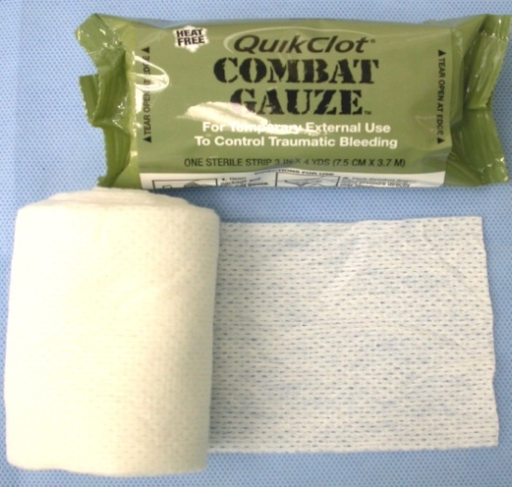
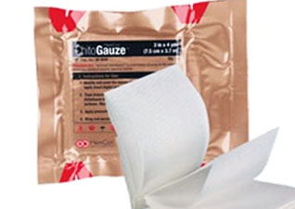
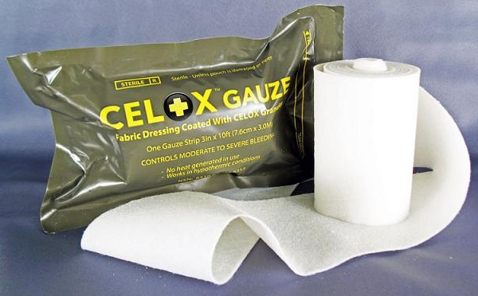
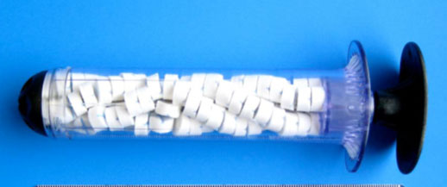
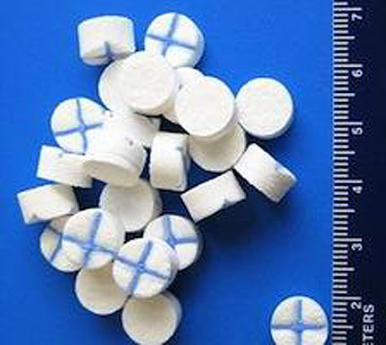
CoTCCC Recommended Hemostatic Devices
ChitoGauze
XSTAT
Celox Gauze

Slide 18
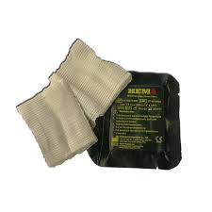
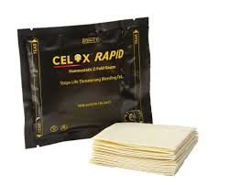
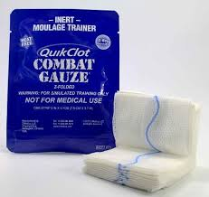
Other Hemostatic agents
Celox Rapid
Hemobandage
Placebo gauze
Hemopatch
Veriset patch

Slide 19
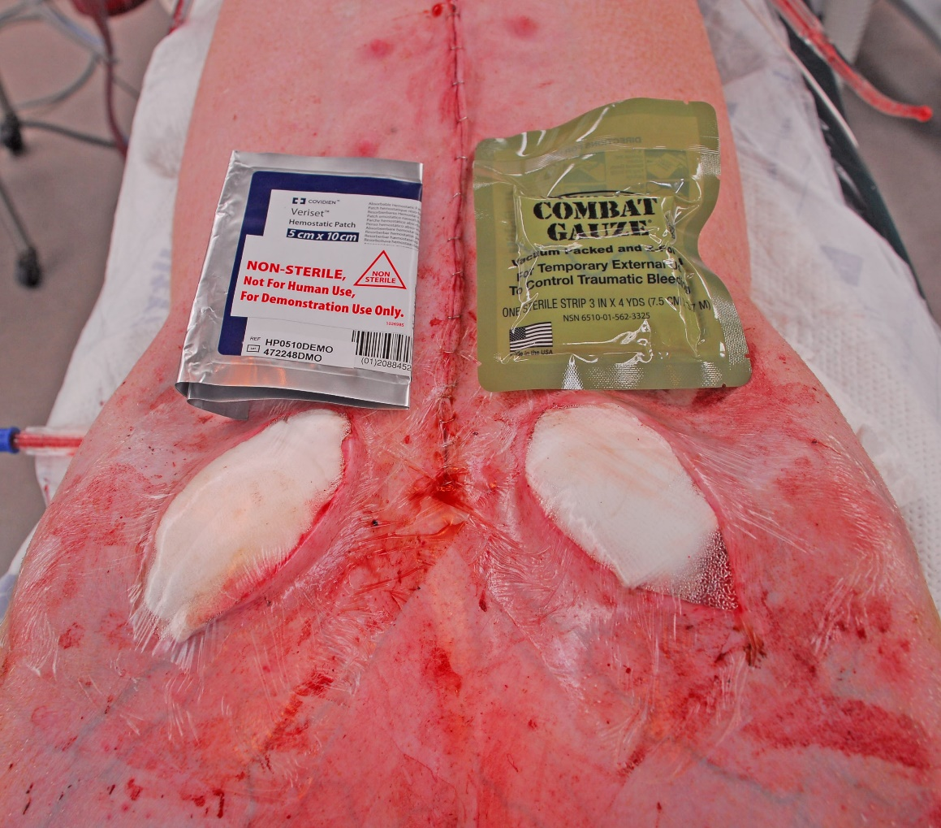
Experimental Design of Pilot Study
Each hemostat was tested 4 times against Combat Gauze
Successful hemostasis with each device was monitored for 2-3 hrs.
Limited fluid resuscitation (500 mL Hextend) was provided to maintain MAP ≥ 70 mmHg.
Stability of hemostasis was checked by vigorous legs movement at the end of experiment.
Immediate hemostasis achievement and rebleeding incidence were recoded.

Slide 20
Results
Product name | Hemostasis Achieved | Average Dressings used to achieve hemostasis | Successful Hemostasis time (min) | Bleeding occurred when legs moved
Veriset n=4 | 4/4 100% | 1 | >120 | 0/4
Combat Gauze n=20 | 15/20 75% | 1.8 | >120 | 2/15
XSTAT n=4 | 2/4 50% | 2 | >120 | 0/2
Celox Gauze n=4 | 2/4 50% | 1.5 | 120 | 2/2
Chitogauze n=4 | 2/4, 50% | 1 | >120 | 1/2
HEMObandage n=4 | 2/4 50% | 1.5 | 120 | 1/2
Celox Rapid n=4 | 2/4 50% | 2 | 108 | 2/2
Hemopatch n=4 | 1/4 25% | 1 | >120 | 0/1
Surgical Gauze placebo | 1/4 25% | 2 | 120 | 1/1

Slide 21
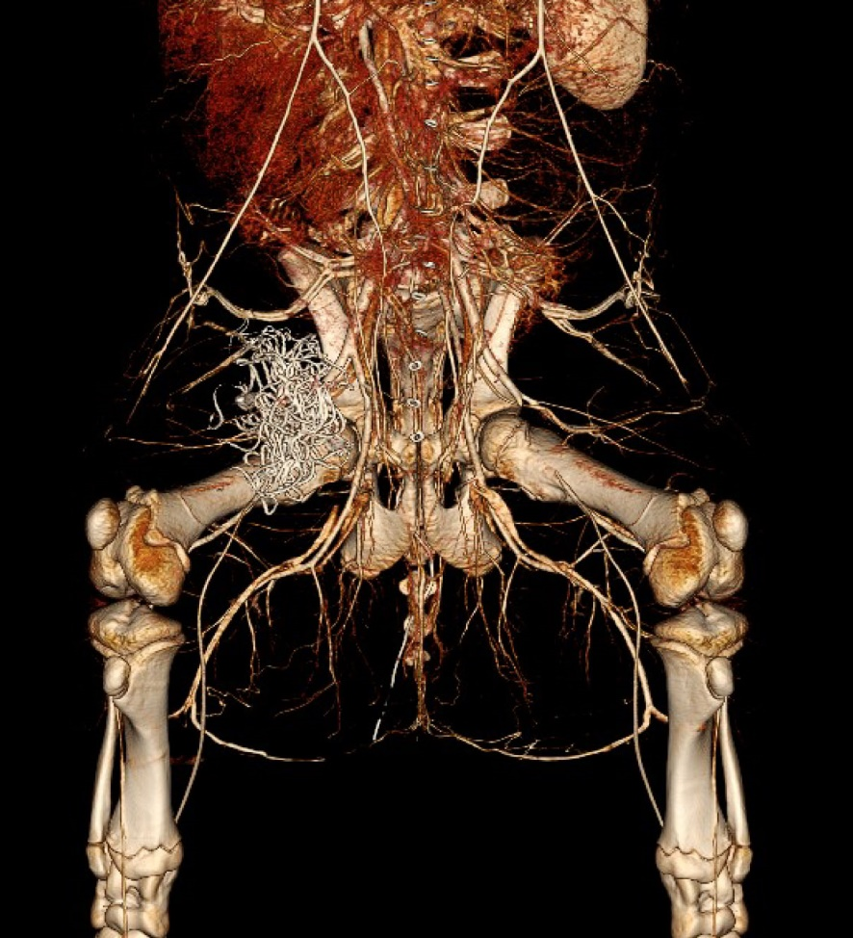
Conclusions
Procoagulant agents (CG and XStat) and synthetic tissue sealants (Veriset) are more effective in stopping high-pressure arterial and venous bleedings than chitosan mucoadhesive dressings.
Hemostasis achieved with above agents are stable and resistant against patient limb movement. These hemostats have been selected for long-term (24 hrs) safety and efficacy study in the new model.
Veriset
CG

Slide 22
Acknowledgements
John Holcomb, MD
Anthony Pusateri, PhD
Michael Dubick, PhD
Lorne Blackburne, MD
Jill Sondeen, PhD
J Scot Estep, DVM
Eric Acheson, MD
Irasema Terrazas, MS
Nahir Miranda, MA
Rodolfo Deguzman, MLT
Nathan Trevino, BS
Kristal Delgado, RN
James Williams, MS
Ashley Cox, MS
Jacqueline Crissey, PhD
Michael Scherer, MS
Veriset
CG

Slide 23
Results
Topical Hemostatic Agents vs. Combat Gauze (CON)
XX: Successful
XX: Unsuccessful

Slide 24
Evaluation of safety and effectiveness of EVARREST as an adjunct to hemostasis in subjects compared with TachoSil during thoracic aortic surgery
Moainie S. Chen E, Al-Attar, et al. Presented at The Houston Aortic Symposium, March 3-5, 2016
EVARREST Vs. TachoSil
Table 1. Subjects Achieving Hemostasis at 3 Minutes Following Treatment Application, With No Re-Bleeding Up Until Chest Wall Closure
EVARREST | TachoSil | p-value | Treatment Difference
57/76 (75.0%) | 36/80 (45.0%) | 0.0001 | 30.0%
Conclusion: EVARREST was superior to TachoSil in controlling bleeding at target bleeding sites.

Slide 25
Classification of Topical Hemostatic Agents
B. Surgical Hemostats
Adhesives (independent of patient clotting function):
1. Cyanoacrylate: a biodegrade tissue adhesive, used for skin closure, orthopedic and varicose vein surgeries, inflammatory reaction
  2. Bioglue (Alb+ glutaraldehyde): seal anastomosis, forms rigid seal causing stricture
b. Procoagulants (activate intrinsic clotting cascade):
1. w/o Thrombin: Gelfoam/Surgifoam (porcine gelatin-based), Surgicel (oxidized- cellulose), Avetine (bovine collagen based)
2. w/ Thrombin: FloSeal (gelatin+ CaCl₂+ human thrombin), HEMOBLAST powder (gelatin+ chondroitin sulfate+ human thrombin)
c. Tissue Sealants (independent of patient clotting function):
1. Biological Sealants (Fibrin Sealants)
2. Synthetic Sealants

Slide 26
Treatment of Severe Aortic Bleeding (3-mm aortotomy) Using Hemopatch in Swine on Dual Antiplatelet Therapy
Bernhard Baumgartner, DVM, PhD, Wolfgang Draxler, MSc, Kevin M. Lewis, DVM
Hemopatch (PCC) vs. TachoSil (FTC)
TABLE 1 Hemostasis properties of PCC versus FTC
 |  | Groups
Parameters | PCC w/o antiplatelet therapy n/N | PCC with antiplatelet therapy n/N | FTC with antiplatelet therapy n/N
Hemostasis 2 min after application | 27/28 (96%) | 32/34 (94%) | NA
Hemostasis 3 min after application | 28/28 (100%) | 34/34ª (97%) | 6/34ª (18%)
Hemostasis 10 min after application | 28/28 (100%) | 34/34^{b} (100%) | 25/34^{b} (74%)
Hematoma formation | 1/28 (4%) | 0/34ª (0%) | 26/34ª (76%)
ªp < .0001 and ^{b}p < .01 for PCC vs. FTC with antiplatelet therapy.
PCC = Hemopatch; FTC = TachoSil; n = number of lesions with hemostatic success and number of lesions with hematoma formation
respectively; N = total number of lesions; NA = Not applicable.
J Invest Surg. 2018; 8:1-9.
Conclusion: Treatment with Hemopatch provided superior time to hemostasis
Compared to TachoSil.

