Slide 1
Tranexamic acid - a vaccine to prevent bad bleeding
THOR 2022
Dr Ian Roberts
Professor of Epidemiology and Public Health
London School of Hygiene & Tropical Medicine
Honorary Consultant, The Royal London Hospital

Slide 2
TXA reduces surgical bleeding
TXA cuts surgical bleeding by one quarter to one third
Whatever the site of bleeding
No increase in thrombotic events (RR=1.00)
(Randomised trial data on > 100,000 patients)
Taeuber I et al. Association of intravenous tranexamic acid with thromboembolic events and mortality: a systematic review, meta-analysis, and meta-regression. JAMA Surg 2021.
Murao S et al. Effect of tranexamic acid on thrombotic events and seizures in bleeding patients: a systematic review and meta-analysis. Crit Care 2021.

Slide 3
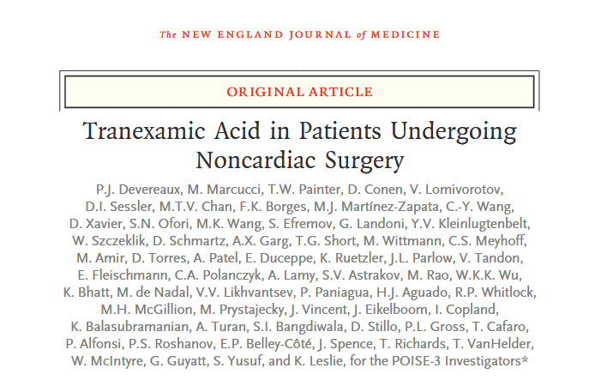
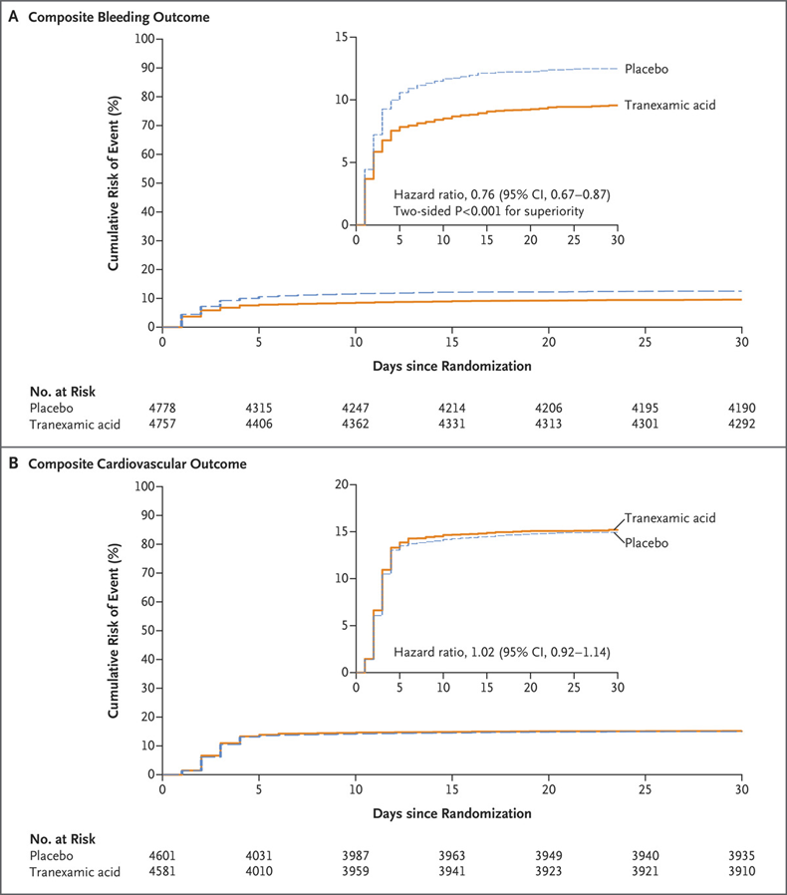
Major bleeding in 9% TXA group vs. 12% placebo group (HR=0.76; 95% CI 0.67 to 0.87) P<0.001 superiority.
Safety event 14% TXA group vs. 14% placebo group
(HR=1.02; 95% CI, 0.92 to 1.14).
Article published April 2, 2022, at NEJM.org.

Slide 4
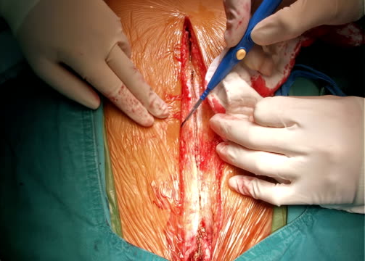
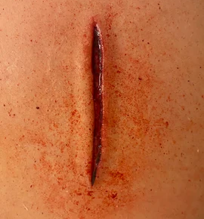


Traumatic and surgical bleeding are similar

Slide 5


Slide 6

TXA reduces bleeding deaths and all-cause mortality
Bleeding deaths | TXA | Placebo | RR (95%CI) | P value
<1 hour 1-3 hours | 198 (5.3%) 147 (4.8%) | 286 (7.7%) 184 (6.1%) | 0.68 (0.57–0.82) 0.79 (0.64-0.97) | <0.001 0.03
With no increase in thrombotic adverse events

Slide 7
Not what we did but where we did it
CRASH-2 Trial Criticism

Slide 8
The US DoD Hemorrhage and Resuscitation Research and Development Steering Committee - 2013
The CRASH-2 trial was conducted “almost exclusively in the developing world…just 1.4% of patients were from institutions in countries (none from the United States) where it was likely that trauma resuscitation and care with all therapies, including blood components, were consistently practiced.”
Lena M. Napolitano, MD, Mitchell J. Cohen, MD, Bryan A. Cotton, MD, MPH, Martin A. Schreiber, MD, et al. J Trauma Acute Care Surgery 2013: “Most of the study sites were in low- and middle-income countries where MT protocols and hemostatic resuscitation are not routinely available.”
Gruen, Jacobs, Reade writing in the Medical Journal of Australia 2013
We need to know “the efficacy of TXA in patients treated to modern trauma care standards….Even though only half received a blood transfusion, the baseline mortality rate in CRASH-2 was 16%, which is higher than that among patients treated in advanced trauma centres in Australia….”
Binz et al. Journal of Blood Transfusion 2015
“However, this paper was not without controversy. Its patient recruitment, methodology, and conductance in moderate-to-low income countries cast doubt on its ability to be applied to trauma protocols in countries with mature trauma networks.”

Slide 9
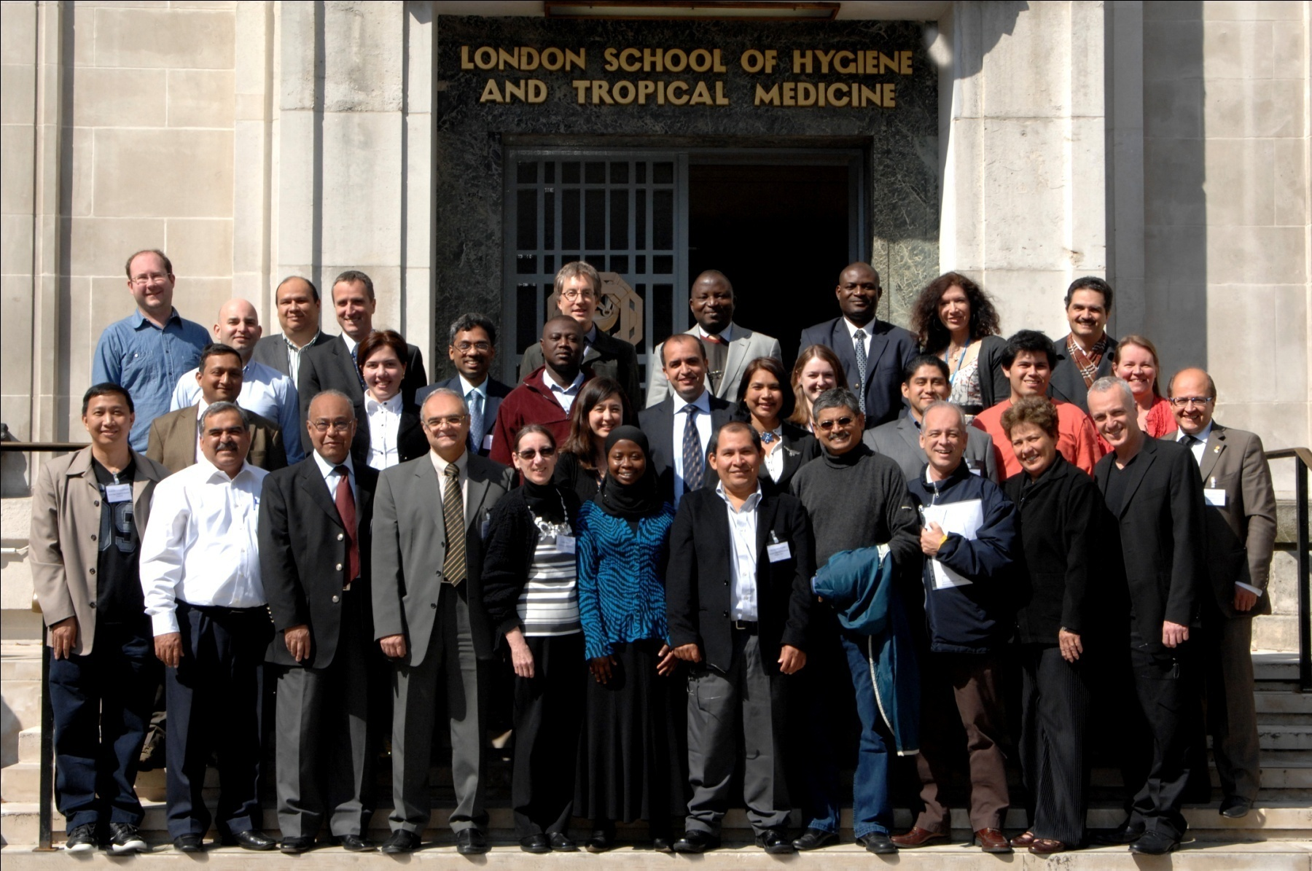

Slide 10
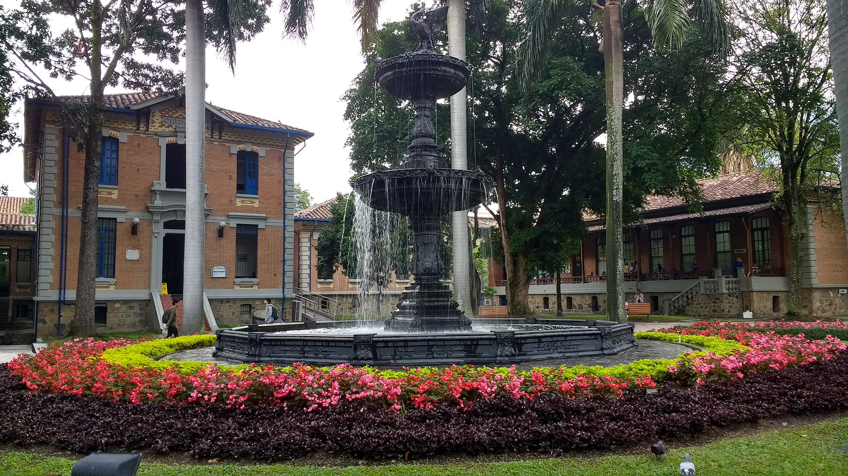
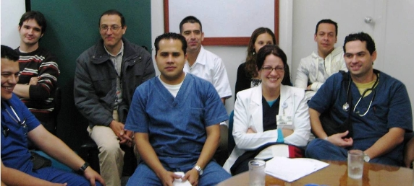
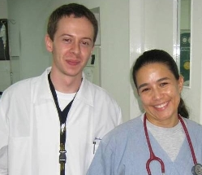
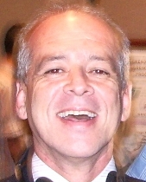
Hospital Universitario de San Vicente, Medellín, Colombia
WHO Health Service Ranking – Overall efficiency. WHO 2000
France 1st, UK=18th Colombia 22nd Australia 32nd USA 37th

Slide 11
Effect of early TXA on death due to bleedingby geographical region)
RR (95% CI) P=0.70
Hospitals
Asia 114
Latin America 56
Africa 52
EU, Australia, Canada 48
World
0.72 (0.63–0.83)
.5
.6
.7
.8
.9
1
1.1
TXA better
TXA worse

Slide 12
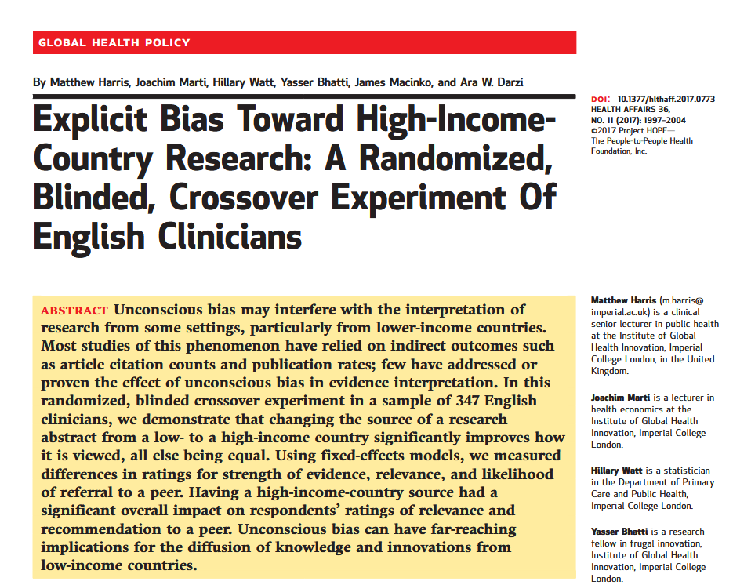

Slide 13
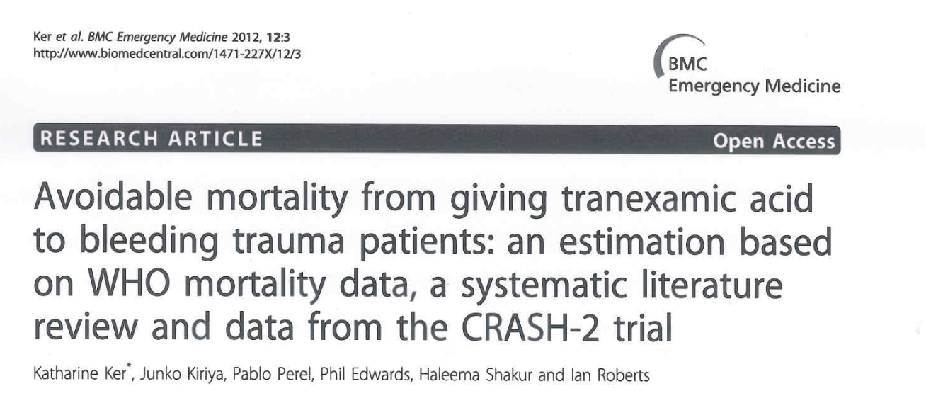
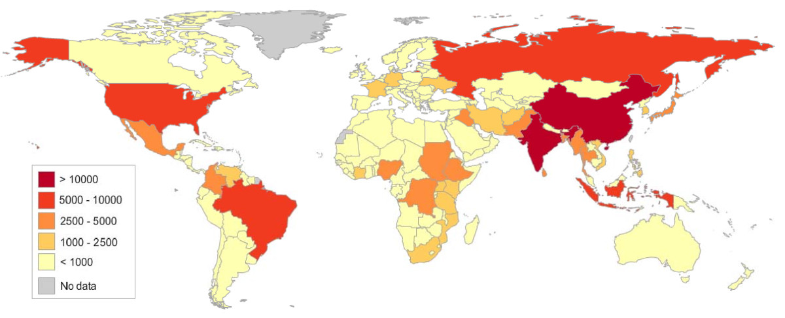
Lives saved with TXA
(every year)
TXA < 1 hour = 128,000 lives
TXA < 3hours =112,000 lives

Slide 14
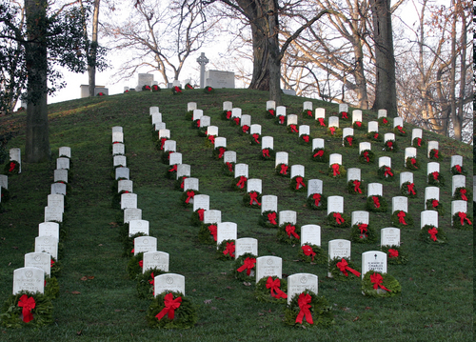

Slide 15
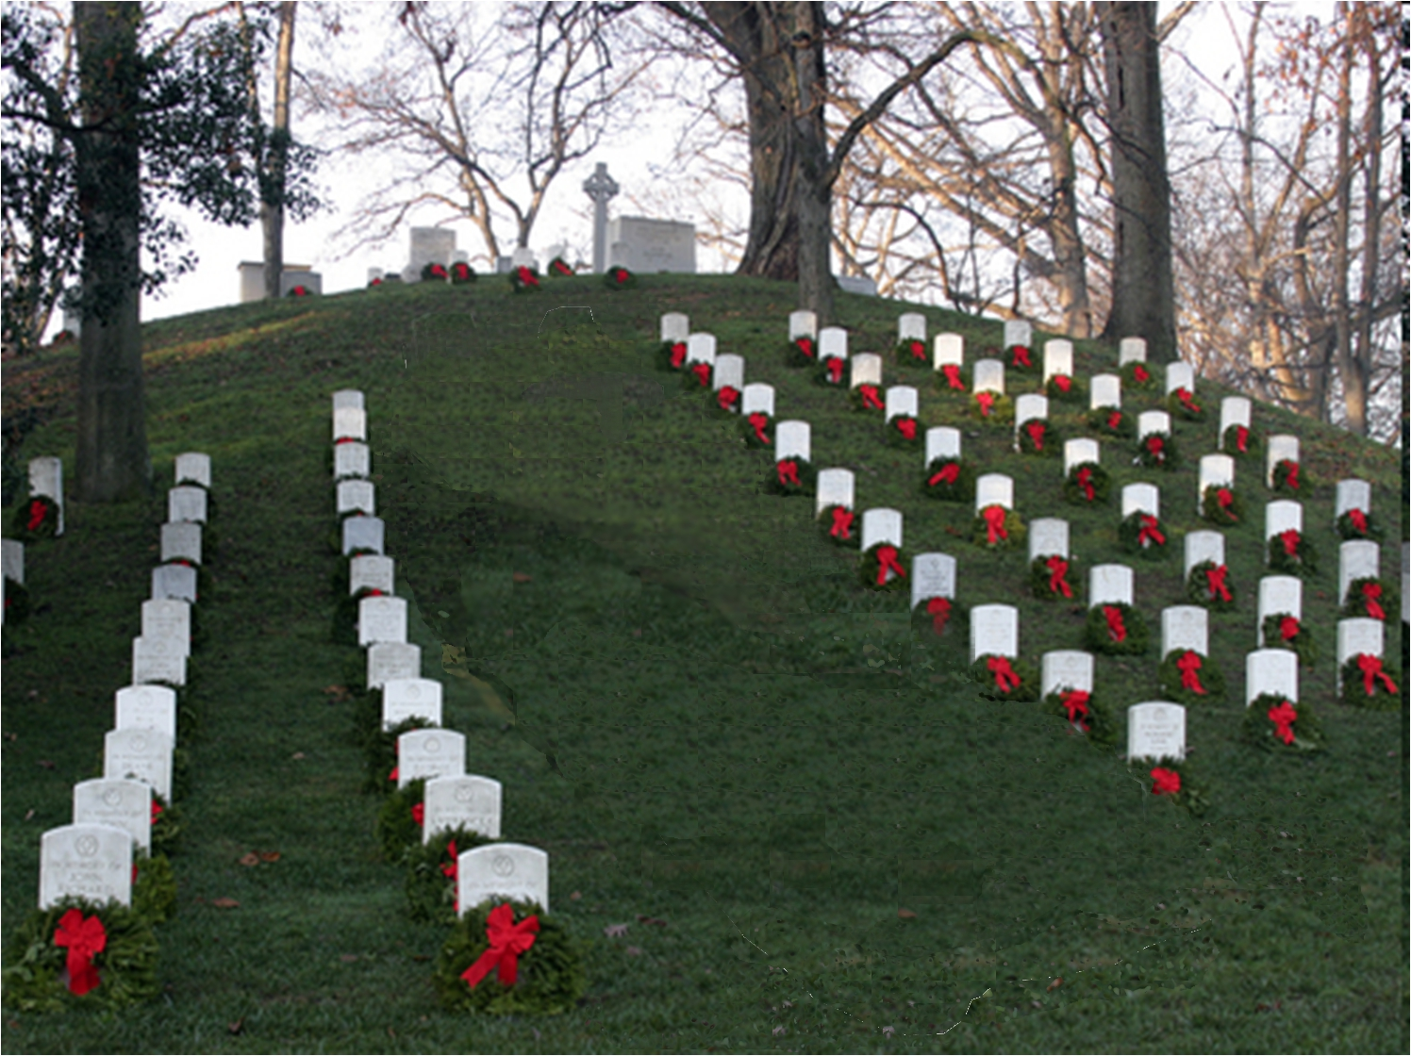

Slide 16
Early treatment is essential
Effect of treatment delay on the survival benefit from tranexamic acid

Slide 17
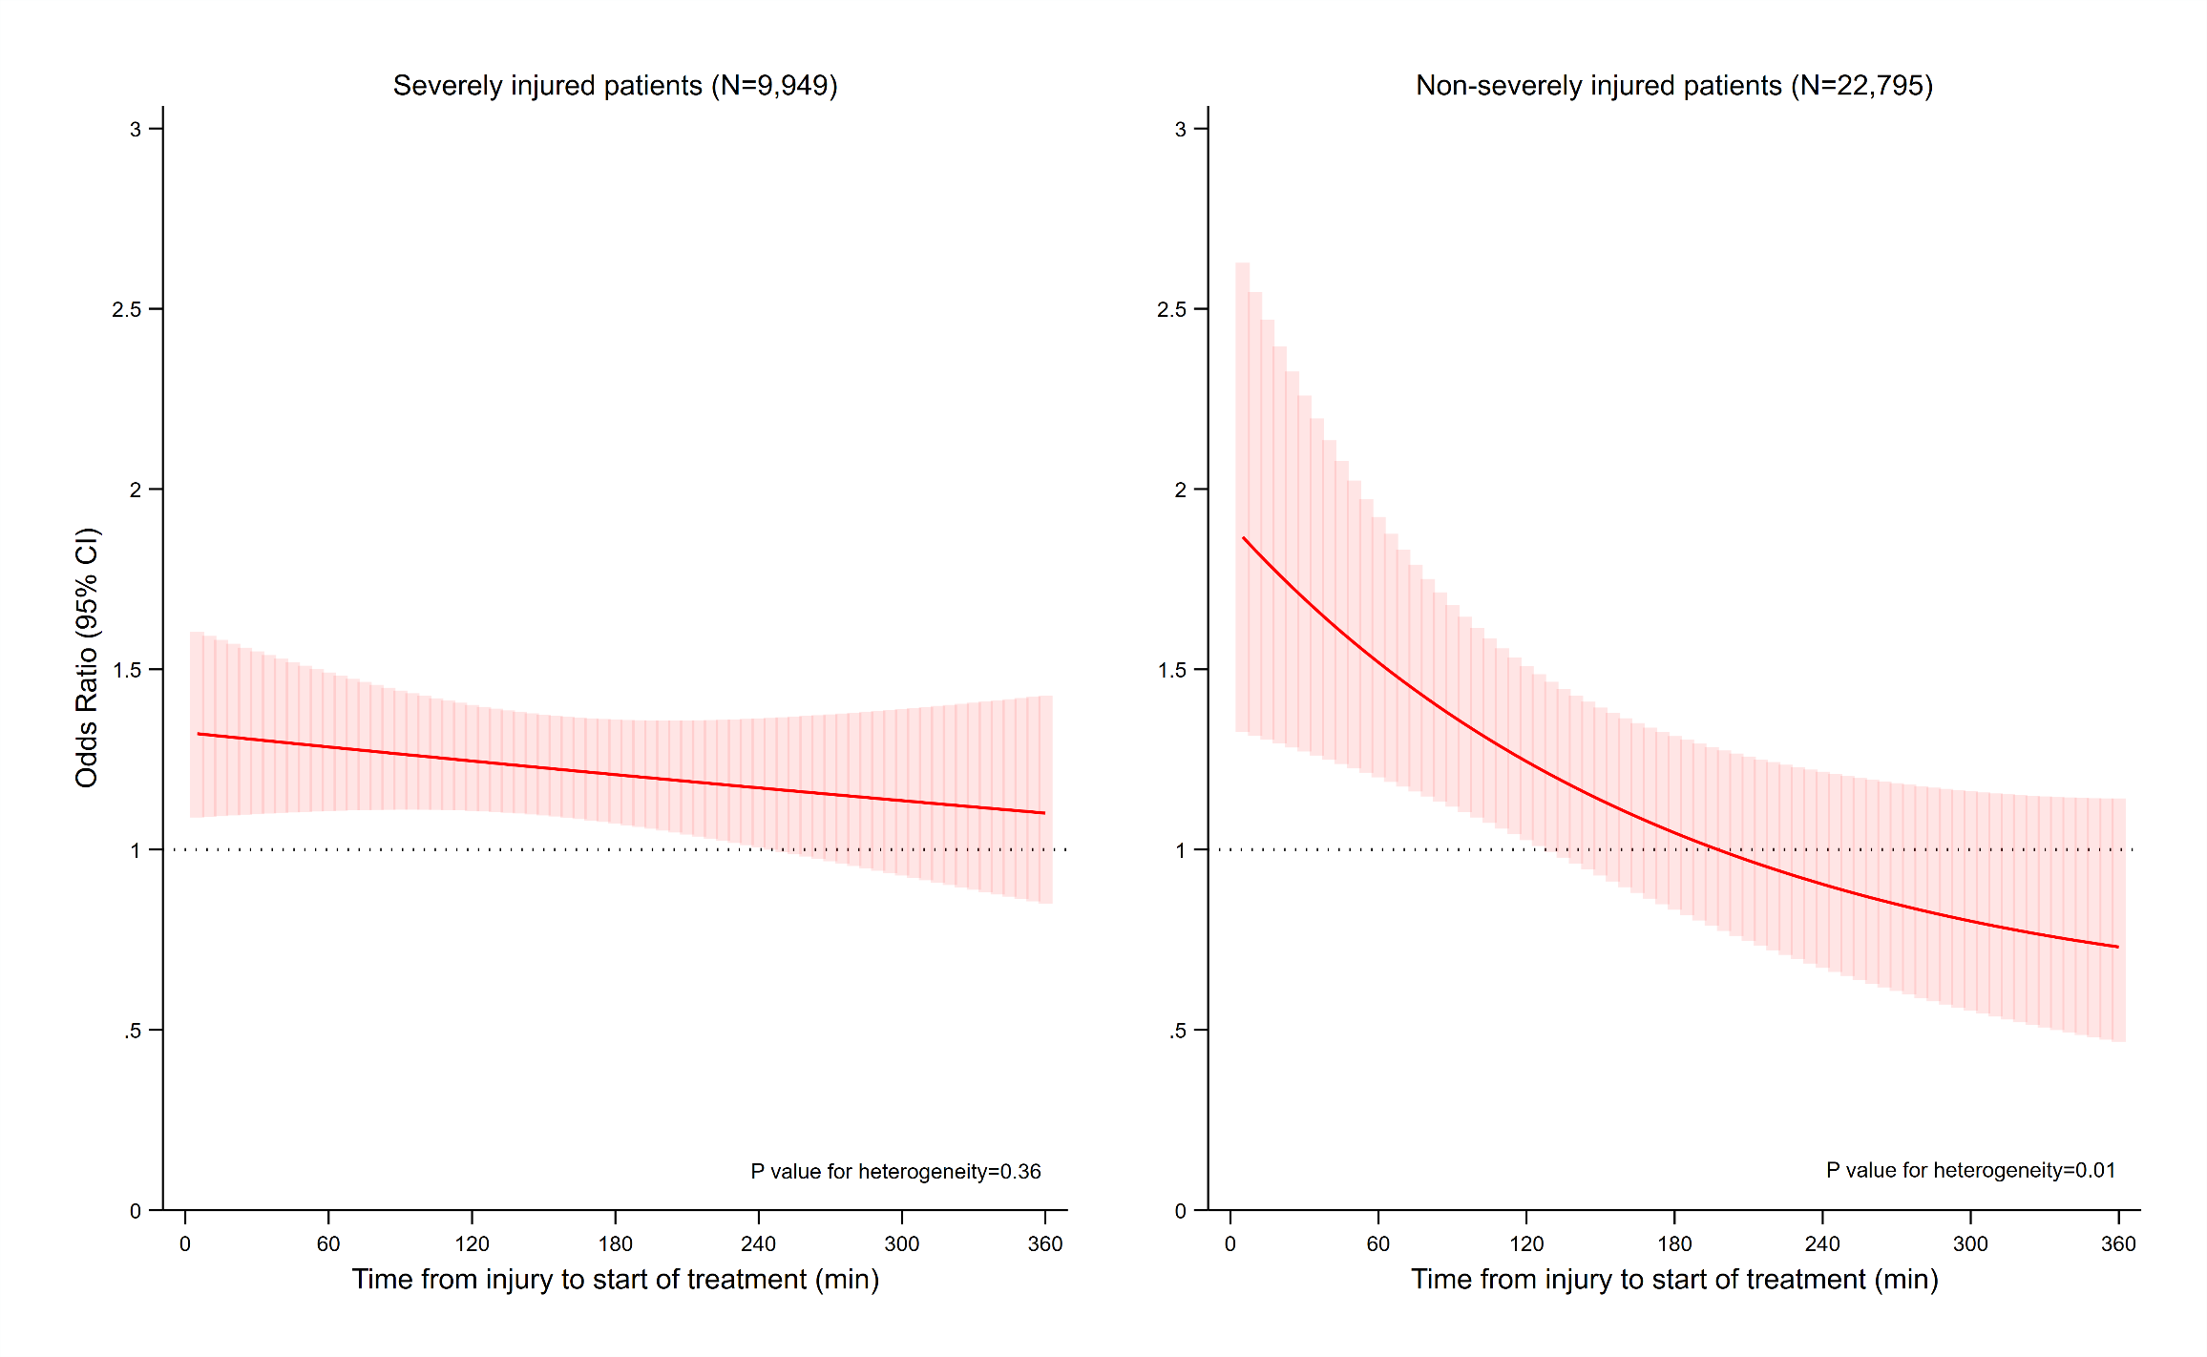
TXA saves lives in severe and non-severe injury
Severe injury N=9,949
Not severe injury N=22,795

Slide 18
Most trauma patients have a low baseline risk
We need to treat all trauma patients

Slide 19
TXA included in trauma guidelines but isolated head injury excluded
Why not isolated TBI?

Slide 20
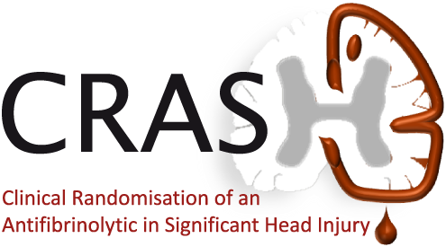
The effects of tranexamic acid in isolated TBI

Slide 21
Effect of TXA on all-cause mortality within 24 hours and within 28 days
(excluding patients with GCS 3 or bilateral unreactive pupils at baseline)
 | Deaths in TXA group (%) | Deaths in placebo group (%) | Risk ratio (95% CI)
Death within 24 hours
CRASH-2 | 6.3 | 8.0 | 0.79 (0.70-0.90)
CRASH-3 | 2.9 | 3.9 | 0.74 (0.58-0.94)
Combined | 5.0 | 6.5 | 0.78 (0.70-0.87)
Death within 28 days
CRASH-2 | 12.1 | 14.3 | 0.84 (0.77-0.92)
CRASH-3 | 14.0 | 15.1 | 0.93 (0.83-1.03)
Combined | 12.8 | 14.6 | 0.88 (0.82-0.94)
Risk ratios less than one mean there are fewer deaths in the TXA group

Slide 22
Effect of TXA on all-cause mortality at 24 hours and 28 days (all trials >500 patients)

Slide 23
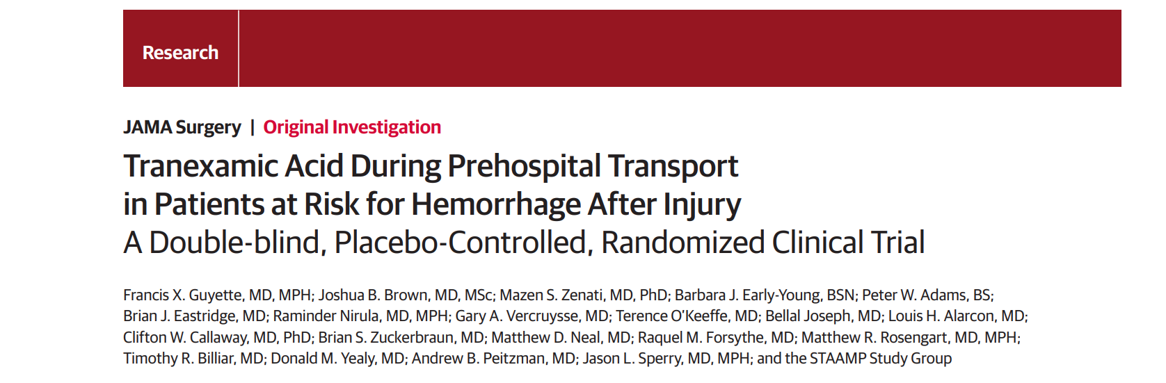
Death at 28 days | TXA | Placebo | Risk Ratio | P value
CRASH-2 | 12.1% | 14.3% | 0.84 (0.77-0.92) | <0.01
STAAMP | 8.1% | 9.9% | 0.82 (0.59-1.11) | 0.18
STAAMP trial conclusion: “Pre-hospital administration of tranexamic acid compared with placebo did not result in a lower rate of 30-day mortality in this population.”
STAAMP Trial 34% transfused vs. 50% CRASH-2 trial

Slide 24
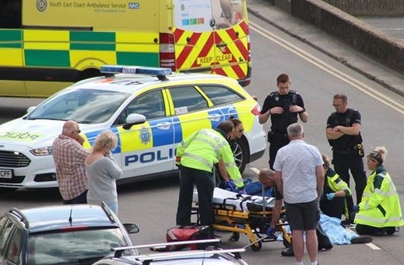
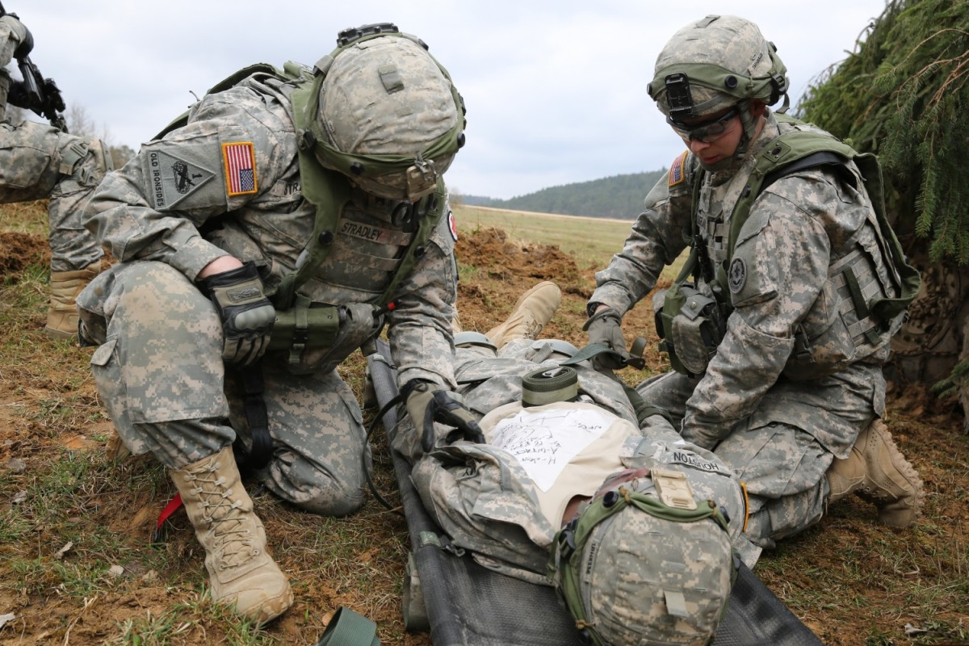
This is where patients should be treated

Slide 26
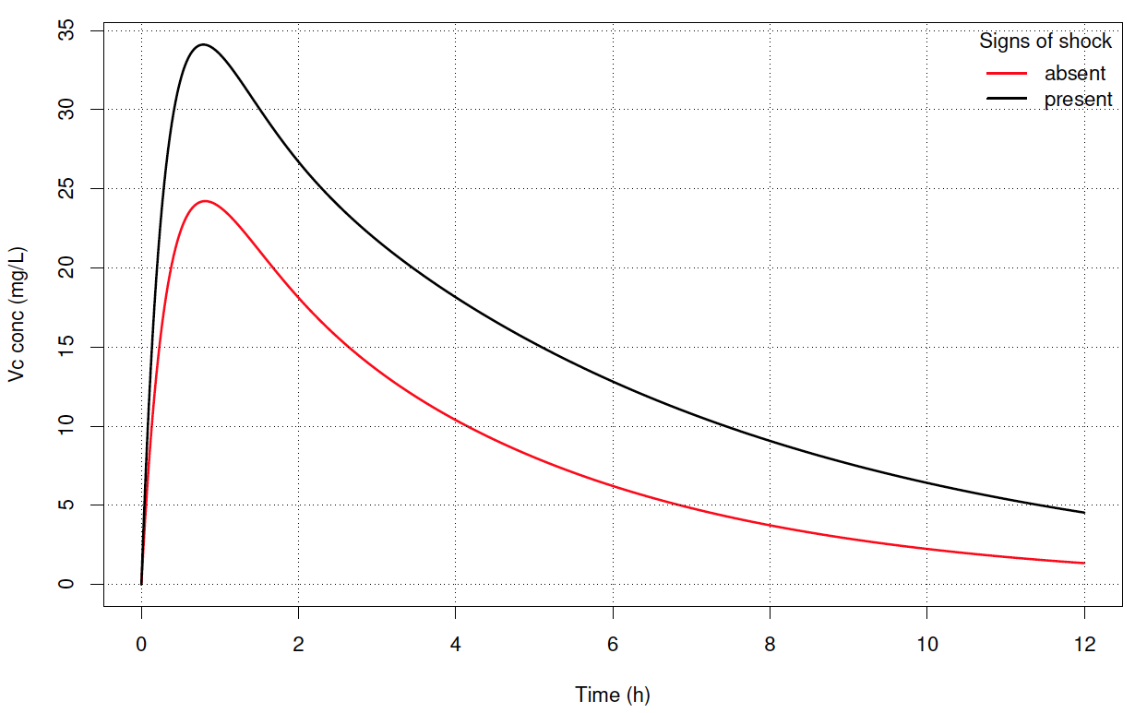
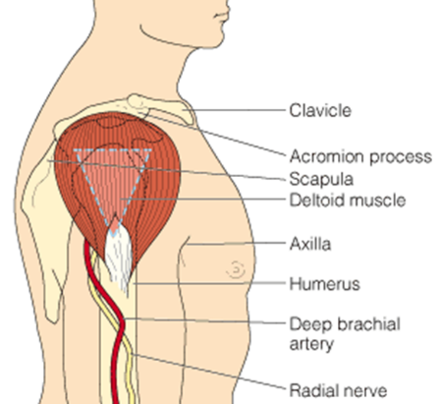
Intramuscular TXA – The impact of shock

Slide 27
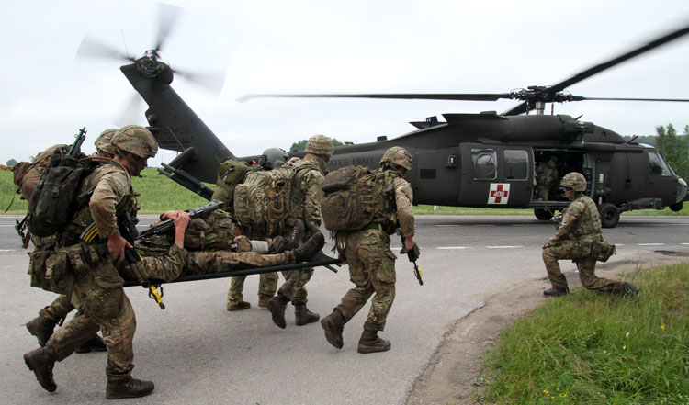
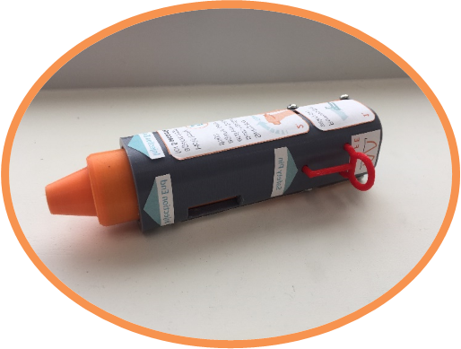
Faster Delivery = Less Bleeding = More Lives Saved

