Slide 1
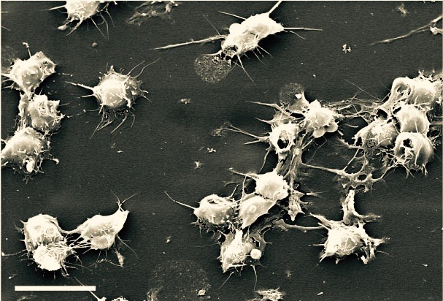


Correction of Thrombocytopathy with Stored Platelets is Influenced by Storage Temperature
Dr Tom Scorer MBBS, BSc, MRCP, FRCPath
Surgeon Lieutenant Commander, Royal Navy

Slide 2
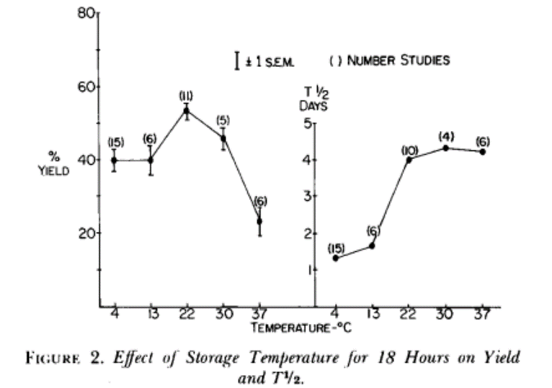
Stored Platelets – The Standard of care
Room Temperature PLT (RTP) transfusion - 22°C ± 2°C + agitation
*
5 – 7 days max storage
Highest risk of TTI
Yield and t/2 Maximal at 22°C
Use of RTP only meets the needs of a subset of patients -
Prophylaxis for thrombocytopenia
* Murphy and Gardener. Effect of storage temperature on maintenance of platelet viability--deleterious effect of refrigerated storage. NEJM 1969;15;280(20)1094-8

Slide 3
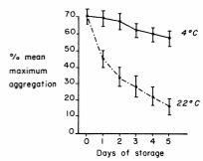
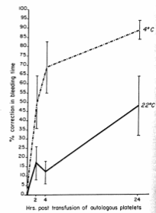
Storage temperature - Survival versus Function
In vitro function of RTP declines with storage (reversible in vivo)
1970s CSP - Reduce BT & Bleeding (aspirin & thrombocytopenia)
RTP
"storage lesion”
Reduced BT at 2, 4 and 24 hrs post-transfusion
* Becker, G.A et al.(1973) Studies of platelet concentrates stored at 22 C and 4 C. Transfusion, 13, 61-68.
Valeri, C.R. (1974a) Hemostatic effectiveness of liquid-preserved and previously frozen human platelets. The New England journal of medicine, 290, 353-358
Seghatchian J et al. (1997) The Platelet storage lesion Transfusion Medicine 11 (2) 130-144
Bikker, A (2016) Functional recovery of stored platelets after transfusion. Transfusion, 56, 1030-1037
Notes:
Reduced half life and survival no the whole story
Becker, G.A., Tuccelli, M., Kunicki, T., Chalos, M.K. & Aster, R.H. (1973) Studies of platelet concentrates stored at 22 C and 4 C. Transfusion, 13, 61-68.
Valeri, C.R. (1974a) Hemostatic effectiveness of liquid-preserved and previously frozen human platelets. The New England journal of medicine, 290, 353-358.
Nair, P.M., , P., ya, S.G., Dallo, S.F., Reddoch, K.M., Montgomery, R.K., Pidcoke, H.F., Cap, A.P. & Ramasubramanian, A.K. (2017a) Plasma factor XIII binding to cold-stored platelets results in increased fibrin crosslinking and clot strength. Arteriosclerosis, Thrombosis, and Vascular Biology, 37.
Reddoch, K.M., Montgomery, R.K., Rodriguez, A.C., Meledeo, M.A., Pidcoke, H.F., Ramasubramanian, A.K. & Cap, A.P. (2016b) Endothelium-derived inhibitors efficiently attenuate the aggregation and adhesion responses of refrigerated platelets. Shock, 45, 220-227.
Reddoch, K.M., Pidcoke, H.F., Montgomery, R.K., Fedyk, C.G., Aden, J.K., Ramasubramanian, A.K. & Cap, A.P. (2014) Hemostatic function of apheresis platelets stored at 4degreeC and 22degreeC. Shock, 41, 54-61.
Getz, T.M., Montgomery, R.K., Bynum, J.A., Aden, J.K., Pidcoke, H.F. & Cap, A.P. (2016) Storage of platelets at 4°C in platelet additive solutions prevents aggregate formation and preserves platelet functional responses. Transfusion, 56, 1320-1328.

Slide 4
Cold Stored Platelets – Better for bleeding?
Survival versus Function
Upregulated platelet activation
Improved aggregation responses
Stronger clot formation
Respond to inhibition
Reduced bacterial proliferation
No Safety concerns identified
Logistical benefits
Reddoch, K.M (2014) Shock, 41, 54-61.
Baimukanova, G (2015) Vox Sanguinis, 109, 5
Reddoch, K.M (2016) Shock, 45, 220-227.
Wood, B. (2016) Transfusion, 56, 2548-2559.
Getz, T.M (2016) Transfusion, 56, 1320-1328.
Nair, P.M (2017) Arteriosclerosis, Thrombosis, and Vascular Biology, 37
Nair, P.M (2017) British Journal of Haematology, 178, 119-129.
Cap, A.P. (2017) Blood, 130
Babic, A.M (2007) Transfusion, 47, 442-451.
NasrEldin, E. (2017) Pediatric Hematology Oncology Journal, 2, 29-34.
Ketter, P. (2017) Blood 2017 130:2407
Stubbs, J.R (2017) Transfusion, 57, 2836-2844.
Notes:
Reduced half life and survival no the whole story
Becker, G.A., Tuccelli, M., Kunicki, T., Chalos, M.K. & Aster, R.H. (1973) Studies of platelet concentrates stored at 22 C and 4 C. Transfusion, 13, 61-68.
Valeri, C.R. (1974a) Hemostatic effectiveness of liquid-preserved and previously frozen human platelets. The New England journal of medicine, 290, 353-358.
Nair, P.M., , P., ya, S.G., Dallo, S.F., Reddoch, K.M., Montgomery, R.K., Pidcoke, H.F., Cap, A.P. & Ramasubramanian, A.K. (2017a) Plasma factor XIII binding to cold-stored platelets results in increased fibrin crosslinking and clot strength. Arteriosclerosis, Thrombosis, and Vascular Biology, 37.
Reddoch, K.M., Montgomery, R.K., Rodriguez, A.C., Meledeo, M.A., Pidcoke, H.F., Ramasubramanian, A.K. & Cap, A.P. (2016b) Endothelium-derived inhibitors efficiently attenuate the aggregation and adhesion responses of refrigerated platelets. Shock, 45, 220-227.
Reddoch, K.M., Pidcoke, H.F., Montgomery, R.K., Fedyk, C.G., Aden, J.K., Ramasubramanian, A.K. & Cap, A.P. (2014) Hemostatic function of apheresis platelets stored at 4degreeC and 22degreeC. Shock, 41, 54-61.
Getz, T.M., Montgomery, R.K., Bynum, J.A., Aden, J.K., Pidcoke, H.F. & Cap, A.P. (2016) Storage of platelets at 4°C in platelet additive solutions prevents aggregate formation and preserves platelet functional responses. Transfusion, 56, 1320-1328.

Slide 5
CSP – logistical advantages
Can store alongside PRBC or WB
No agitator
No incubator
longer storage duration
(> 2.5 X assuming in theatre at day 3 and 14 day CSP product)
Enables PLT transfusion in more remote and constrained settings

Slide 6
Aim
To demonstrate thrombocytopathy due to ECBP and anti-PLT medications in whole blood assays
To establish if the storage temperature of PLTs affects their ability to correct these thrombocytopathies
Which patient populations could benefit from CSP?

Slide 7
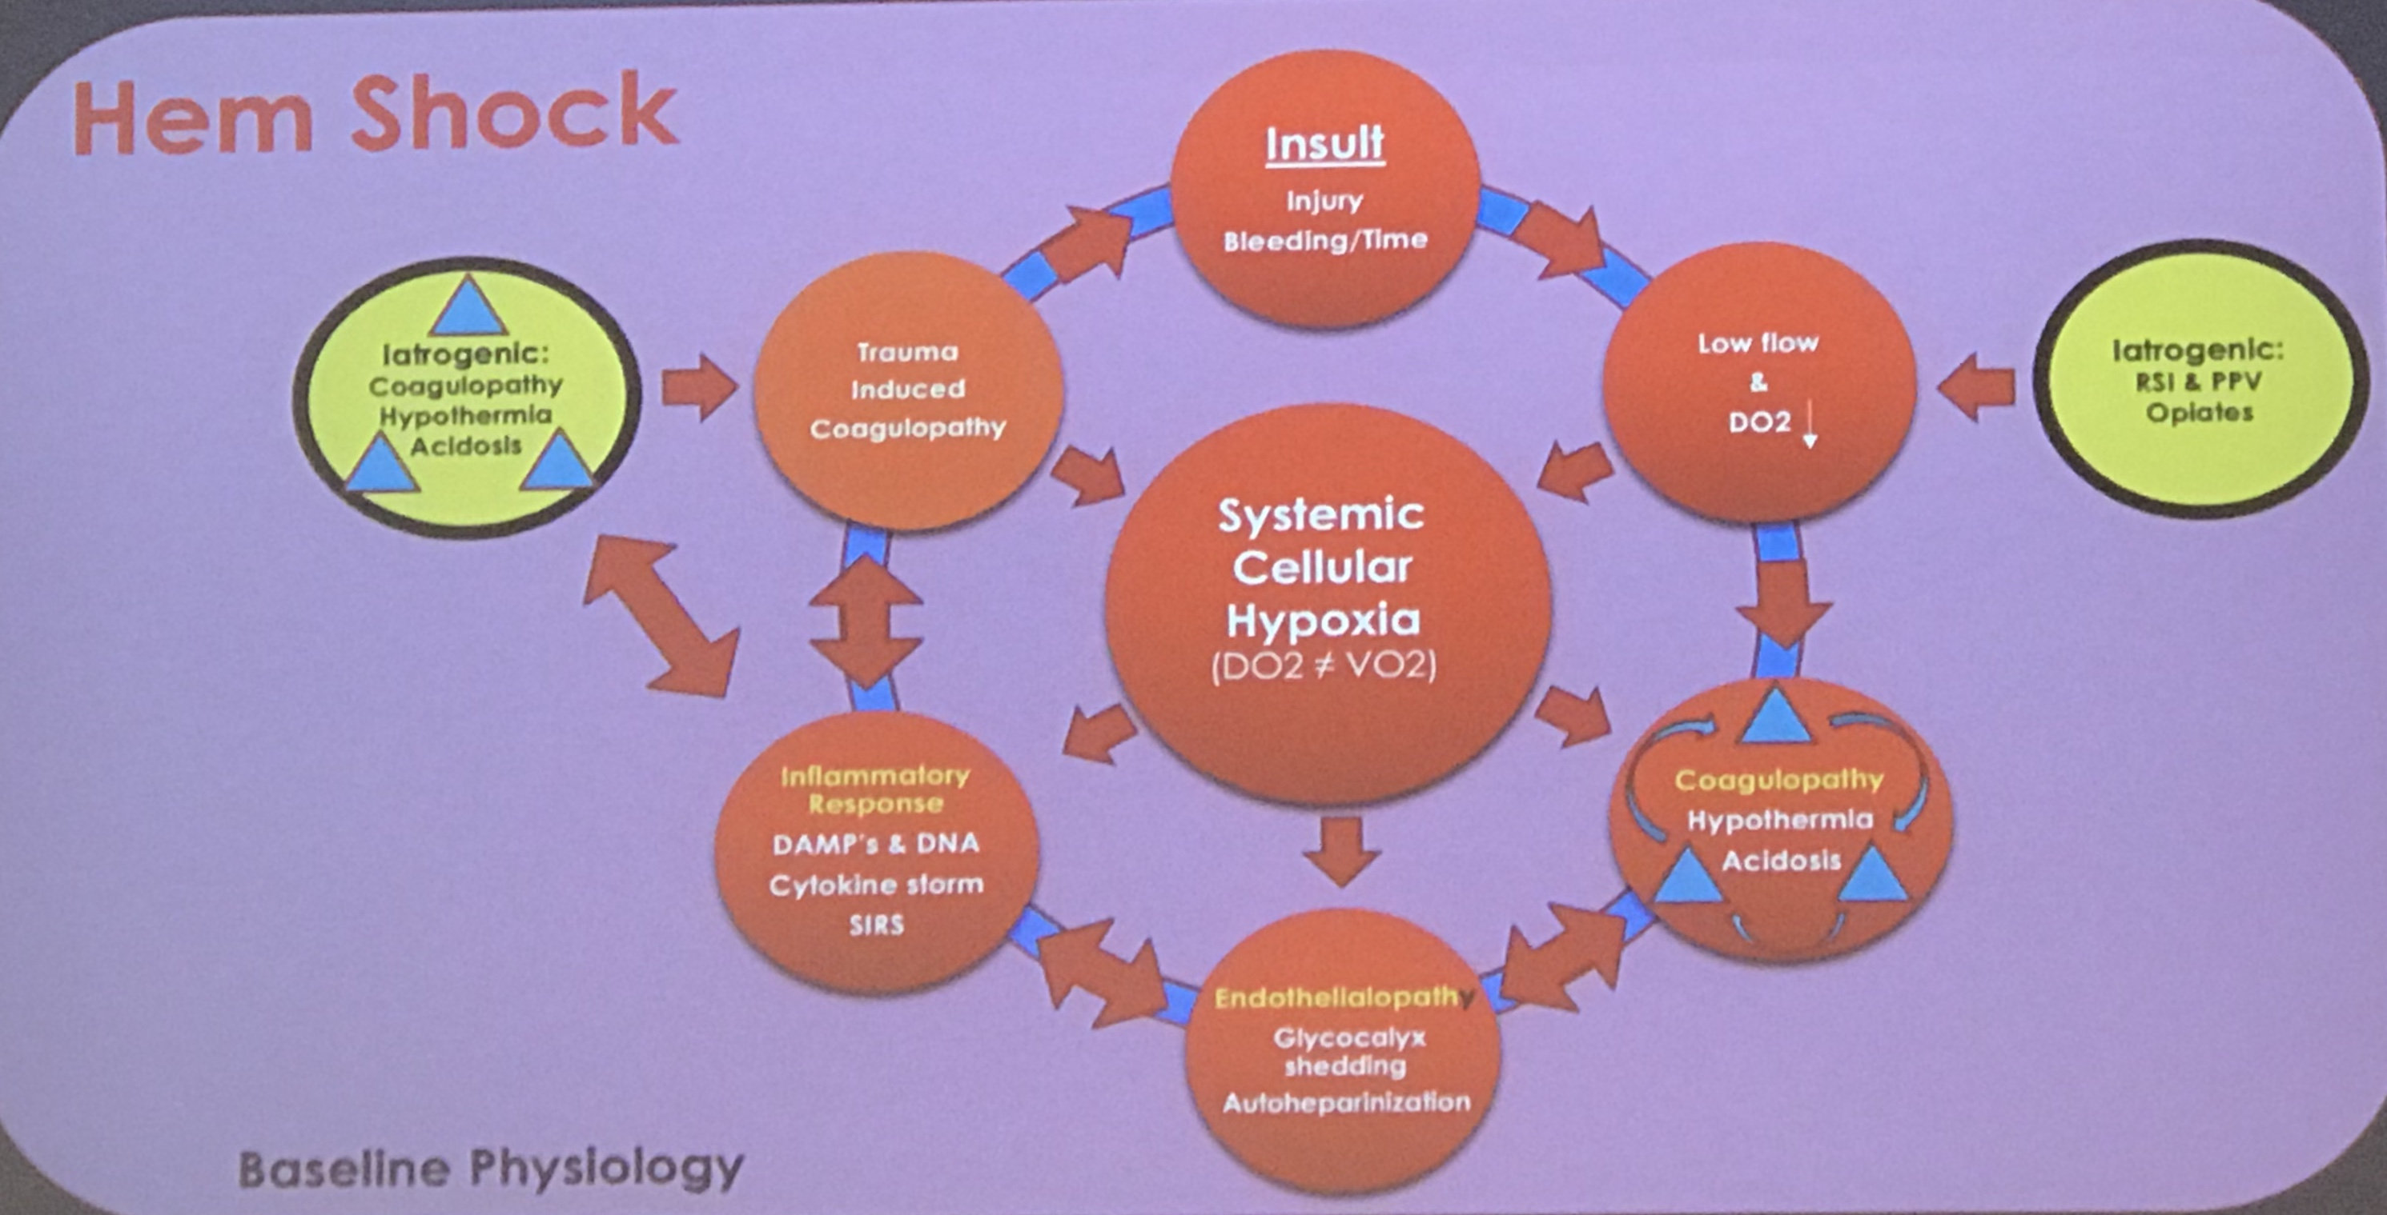
Trauma patients don’t only bleed because of the trauma…
Underlying disturbance in coagulation
  Clotting
  Endothelium
  Platelets – Anti-PLT medication
Therapy
  Dilution, Surgery…
  Mechanical – ECMO / bypass
http://maryland.ccproject.com/2014/11/25/ecls-gone-wrong-e-ecmo-attacks/
https://doi.org/10.1055/s-0037-1606179

Slide 8
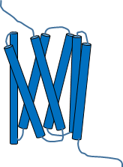

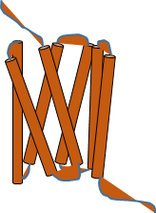


Anti-PLT Medication
Ticagrelor, clopidogrel prasugrel Ticlopidine Cangrelor
Multiple targets for anti-PLT medication
Rising complexity and combinations
ADP/ATP
Vorapaxar
Thrombin
P2Y₁₂
TPα
PAR-1
TxA₂
COX-1
GPIb-IX-V
vWF
Aspirin
cAMP AMP
vWF-fibrin
GPVI
PDE
αIIbß3
Dipyridimole
Collagen
Fibrin
Fibrinogen
vWF
Abciximab
Eptifibatide
Tirofiban
Udell JA et al. Long-term dual antiplatelet therapy for secondary prevention of cardiovascular events in the subgroup of patients with previous myocardial infarction: a collaborative meta-analysis of randomized trials. European Heart Journal 2016 37 (4) 390–399
Image courtesy of R Aungraheeta
7

Slide 9
Study design
PLT Storage
CSP
“Donor” PLT
AP
PAS
RTP
Day 0, 3, 7 & 10 (TIC alone) + 14 & 21 (DAPT)
iSTAT – CG4+
Light transmission aggregometry (ADP/AA)
Visual inspection (Aggregates/swirl)
Platelet count
1 ATD = Equivalent of 1U PLT
Transfused to 70 Kg person c. 5000ml
Notes:
Design a flow diagram
Illustrate the splitting of AP
Dosing of AP
Testing of AP
Treatment with AP
Ham up the clinical similarities

Slide 10
DAPT – CSP/RTP Treatment Study
PLT Storage
CSP
“Donor” PLT
AP
PAS
RTP
Notes:
Design a flow diagram
Illustrate the splitting of AP
Dosing of AP
Testing of AP
Treatment with AP
Ham up the clinical similarities

Slide 11
DAPT – CSP/RTP Treatment Study
PLT Storage
CSP
“Donor” PLT
DMSO
CONTROL
TIC or DAPT
AP
PAS
incubation for 15 minutes
RTP
“Recipient”
Fresh whole blood
On storage Days 0, 3, 7, 10, 14 & 21
Notes:
Design a flow diagram
Illustrate the splitting of AP
Dosing of AP
Testing of AP
Treatment with AP
Ham up the clinical similarities

Slide 12
Study design
1 & 2 (3 TIC) ATD
PLT Storage
CSP
“Donor” PLT
DMSO
CONTROL
TIC or DAPT
BioFlux
TEG PM (DAPT)
AP
PAS
incubation for 15 minutes
RTP
“Recipient”
Fresh whole blood
On storage Days 0, 3, 7, 10, 14 & 21
1 & 2 ATD
Notes:
Design a flow diagram
Illustrate the splitting of AP
Dosing of AP
Testing of AP
Treatment with AP
Ham up the clinical similarities

Slide 13
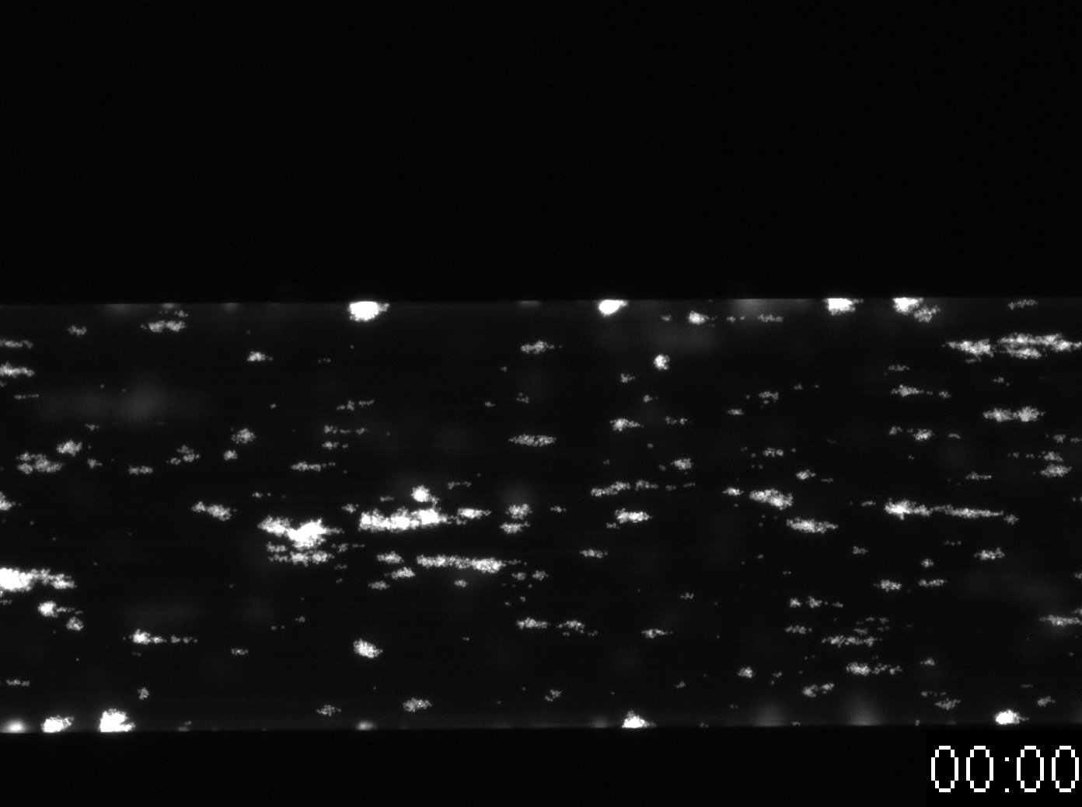
BioFlux Collagen coated (arterial shear)

Slide 14
TEG PlateletMapping®
TEG 5000
TEG 6s
1 – Kaolin (no heparin)
2 – ADP plus Activator F (aFXIIIa and Reptilase)
3 - Activator F (A) = aFXIIIa and Reptilase (+ Abciximab in TEG 6s ONLY)

Slide 15
Ticagrelor anti-platelet effect under shear
Reversal with fresh AP
Notes:
Studies have investigated 1 or 2 units

Slide 16
Correction of ticagrelor by platelets is dependent on storage temperature

Slide 17
Correction of DAPT by platelets is dependent on storage temperature

Slide 18
DAPT treated WB
Rate of SA coverage
Fold change relative to DAPT alone
n= 3 for all timepoints (exc. Day 7, n=4)
Dosing of DAPT sample with 2 ATD CSP faster rate of PLT adhesion @ day 7 & 10

Slide 19
Trauma patients don’t only bleed because of the trauma…
Underlying disturbance in coagulation
  Clotting
  Endothelium
  Platelets – Anti-PLT medication
Therapy
  Dilution, Surgery…
  Mechanical – ECMO / bypass
http://maryland.ccproject.com/2014/11/25/ecls-gone-wrong-e-ecmo-attacks/
https://doi.org/10.1055/s-0037-1606179

Slide 20
Bleeding in ECMO
derived from Extracorporeal Life Support Organization [ELSO] registry -January 2017

Slide 21
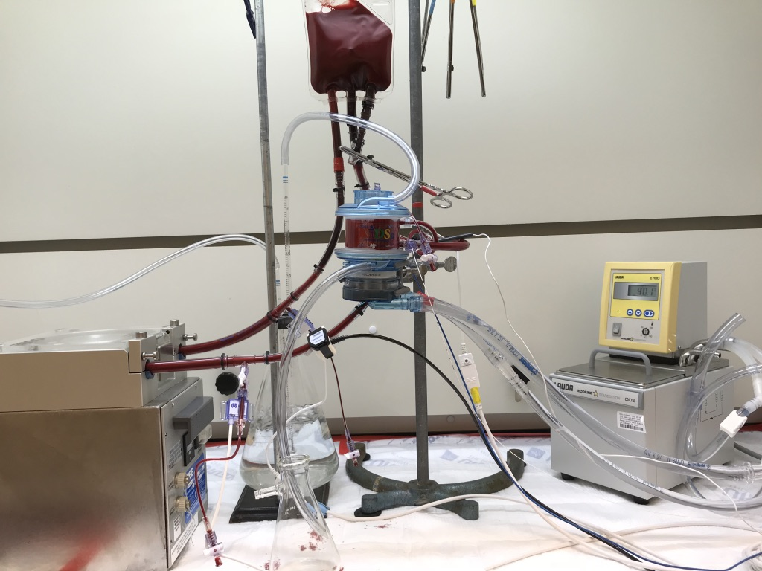
Ex-vivo simulated ECBP
400 ± 50ml - Whole blood collected into heparin (1U/ml)
Baseline samples – direct
Dry primed circuit
37ºC – via waterbath
Humidified O₂ entrained CO₂ – physiological levels
ACT 180-220s - heparin
Dextrose supplementation
Static control - 37ºC
Hourly sampling to 6 hours
WB reservoir
O₂ and CO₂ supply via humidifier
Pressure, temperature and flow monitoring
Oxygenator
Water Bath
Roller Pump
In collaboration with Dr Andrew Meyer

Slide 22
Stored Platelets
CSP
RTP
CSP
RTP
Hourly
Chemistry, Haematology, coagulation, FACS, TEG PM, TGT
< 7 days old
> 7 days old
2 ATD
TEG PLT Mapping
CKH
A
A + ADP
A + AA
2 & 6 hrs
BioFlux Arterial shear
+ 2 ATD CSP/RTP
T
C

Slide 23
Simulated Transfusion of Cold Stored Platelets
Faster adhesion to collagen under arterial shear in simulated ECBP blood
2 hours
6 hours

Slide 24
Following 2 hours simulated ECBP – T2

Slide 25
Following 6 hours simulated ECBP – T6

Slide 26
TEG PlateletMapping
Following 6 hours simulated ECBP – T6

Slide 27
A high “Fibrin” (A) TEG results in no differences
TEG PM % Aggregation value

Slide 28
High Fibrin (A) value is GP IIbIIIa dependent
CSP spiked with Tirofiban
Activator F assay
TEG 5000
TEG 6s lower MA A 66.8mm vs 50.5mm

Slide 29
Summary
Simulated transfusion with CSP corrects the thrombocytopathy of simulated ECBP and anti-PLT therapy better than RTP
Increases the evidence - Potential of CSP
Future / ongoing plans
Evaluation of patient samples, ex vivo
Evaluation in other conditions (Renal / GI)
Cold stored platelets: Better for bleeding?
Notes:
Cold Stored Platelets – May be effective in antiplatelet reversal
Opportunities for CSP outside trauma
Our troops take drugs too!

Slide 30
Acknowledgements
Study Supervisors
USAISR – LTC(P) Andrew p. Cap Medical Corps, US Army
University of Bristol - Prof Andrew Mumford
US Army Institute of Surgical Research, Coagulation and blood research team (USA)
Umang Sharma, Grantham Peltier, Colby McIntosh, Kristin Reddoch-Cardenas, Dr Andrew Meyer
Centre of Defence Pathology & Defence Professors (UK)
Prof. Mil. Med – Col David Woods RAMC
Prof. Mil. Anaesthesia – Col Tom Wooley RAMC
Col Emma Hutley RAMC – DCA Pathology

Slide 31
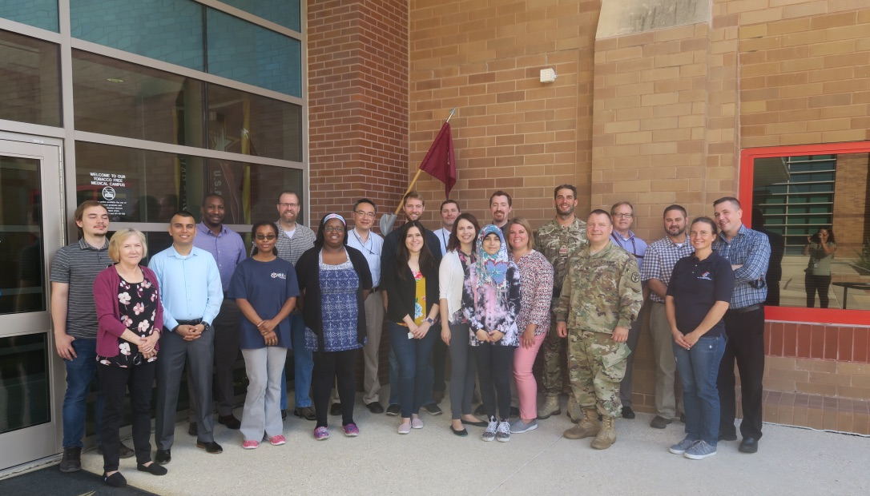
Thank-You
Notes:
Introduction:
Good morning, my name is Surg Lt Cdr Tom Scorer Royal Navy, I am Military Haematology trainee from Bristol in the SW of England.
Firstly I would like ASH for the opportunity to present these preliminary results from a study conducted earlier this year through collaboration with my colleagues at the US Army Institute of Surgical Research, Texas.
The aims of this part of the project were:

