Slide 1
Hemostatic Technologies for Abdominal Hemorrhage
.
Christian Kastrup
Associate Professor
Michael Smith Laboratories
Department of Biochemistry & Molecular Biology
University of British Columbia
Vancouver, Canada

Slide 2
Major challenge:
Non-Compressible Intra-Abdominal Hemorrhage (NCIAH)
Why Does the Kastrup Lab Care about Blood Clotting?
Often multiple bleeding sites (ex. spleen and liver)^{1,2}
Difficult to access and visualize³
Immediate surgery needed but not always feasible³
(ex. Remote, austere settings or without air superiority)
Most deaths occur pre-hospital ⁴
1 Hildebrand et al. Shock (2012) 2 Morrison, JJ. Critical Care Clinics (2017)
3 Duggan et al. J Trauma Acute Care Surg. (2013) 4 Eastridge et al. J Trauma Acute Care Surg. (2012).
Notes:
The BIG problem that I am trying to solve is bleeding from the abdomen, Bleeding from the abdomen is deadly. Together with bleeding from the torso and pelvis, intra-abdominal hemorrhage accounts for 67% of hemorrhage related deaths that result from trauma. While many bleeds such as those from the extremities such as the arms and legs can be controlled by applying pressure, abdominal hemorrhage cannot be controlled this way. This is because there are often multiple bleeding sites, such as both the spleen and the liver, and the abdominal cavity is difficult to access. You can’t see where the bleeding is coming from and often if the injury is not penetrating, blood may be pooling in the abdominal cavity undetected at first. The ONLY way to definitively treat NCIAH is surgery, where the abdominal cavity is opened up. However, this isn’t always feasible, such as those cases when civilians sustain the injury in remote areas or soldiers on the battlefield. The overwhelming majority of deaths from NCIAH occur before the soldier ever makes it to the surgeon. This suggests that part of the solution for reducing the mortality from NCIAH is to develop treatments that keep the patient alive until they reach a hospital.

Slide 3
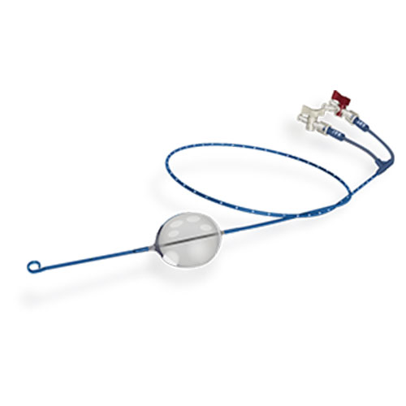
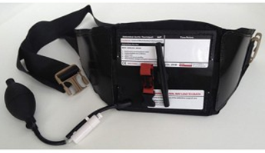
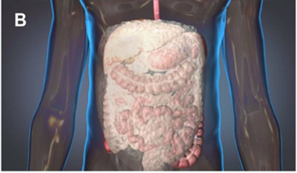
An overview of Current Mechanical Approaches:
Non-surgical interventions stabilize patient until surgery is possible
Why Does the Kastrup Lab Care about Blood Clotting?
• Resuscitative Endovascular Balloon of Aorta (REBOA)
• Abdominal and Aortic Junctional Tourniquet (AAJT)
• Abdominal “Foams” (ResQFoam, F.O.A.M., ClotFoam)
.
Rappold JF and Bochicchio GV. Transfusion (2016), Morrison, JJ. Critical Care Clinics (2017)
Notes:
Here I talk about the different interventions and their strengths and weaknesses. I identify abdominal foams as an area I want to explore.
There are primarily three non surgical interventions that are used to stabilize patients until they reach a surgeon.. Resuscitative endovascular balloon of the aorta (better known as REBOA) is an intervention in which a balloon catheter is inserted in the leg and delivered to the descending or abdominal aorta, the main artery of the anatomical trunk. The balloon catheter is then inflated when it is at a height higher than the site of the bleeding, to reduce blood flow to the area.
Abdominal and aortic junctional tourniquet is a device used to constrict the abdomen and stop blood loss by applying as much pressure as possible to the area in a non-specific manner. The device is wrapped around a patients abdomen and inflated as tightly as possible.
More recently, intra-abdominal foams have been proposed which could be injected into the abdomen to stop bleeding. There are three foams that are currently being developed which have not yet been tested in humans, ResQFoam, FOAM, and ClotFoam. This is an area that we are very interested in.

Slide 4
Why Does the Kastrup Lab Care about Blood Clotting?
What are the indications and who can benefit?
• Resuscitative Endovascular Balloon of Aorta (REBOA)
If injury below diaphragm and no barriers to femoral access
• Abdominal and Aortic Junctional Tourniquet (AAJT)
If injury located below aortic bifurcation
• Abdominal “Foams” (ResQFoam)
If injury located inside abdominal cavity or retroperitoneum, the abdominal cavity and diaphragm is intact, and no previous abdominal surgery
Cantle et al. J Spec. Oper. Med (2018)
Notes:
Specific problem that I address.
The Cantle paper explains it. The corresponding/senior author is JB Holcomb who is a leading expert on this. He started fibrin foams in the 90s. These are their findings. Might be cool to point out that foams could have saved 87% of patients, even though this was theoretical because foams are not in people yet.

Slide 5
Why Does the Kastrup Lab Care about Blood Clotting?
What are the indications and who can benefit?
• Resuscitative Endovascular Balloon of Aorta (REBOA)
Use by emergency physicians reported,
but mostly performed by surgeons in civilian setting
Only suitable for <1 hour : Can cause distal ischemia and compartment syndrome¹⁻³
In civilian hospitals, higher mortality rate, kidney injury and lower leg amputation with REBOA use³
1 Wasicek et al. The American Surgeon (2018), 2 Zhang et al. Ann Vasc Surg (2019) 3 Joseph et al. JAMA Surgery (2019)
Notes:
Specific problem that I address.
The Cantle paper explains it. The corresponding/senior author is JB Holcomb who is a leading expert on this. He started fibrin foams in the 90s. These are their findings. Might be cool to point out that foams could have saved 87% of patients, even though this was theoretical because foams are not in people yet.

Slide 6
Why Does the Kastrup Lab Care about Blood Clotting?
What are the indications and who can benefit?
• Abdominal and Aortic Junctional Tourniquet (AAJT)
Used by first responder: All levels of expertise¹
Only suitable for <4 hours : Can cause distal ischemia and compartment syndrome²⁻⁴
1 Kotwal RS and Butler Jr., FK. Wilderness Environ Med (2017) 2 Brännström et al. J Trauma Acute Surg (2018)
3 Kheirabadi et al. J Surg Res (2018) 4 Chang R, Wilderness Environ Med (2017)
Notes:
Specific problem that I address.
The Cantle paper explains it. The corresponding/senior author is JB Holcomb who is a leading expert on this. He started fibrin foams in the 90s. These are their findings. Might be cool to point out that foams could have saved 87% of patients, even though this was theoretical because foams are not in people yet.

Slide 7
Why Does the Kastrup Lab Care about Blood Clotting?
What are the indications and who can benefit?
• Abdominal “Foams” (ResQFoam)
Potentially useful for patients not expected to survive to definitive care
Expected use by physicians and advanced medics
Only suitable for <3 hours: Complications such as bowel damage, occluding distal
blood flow, compartment syndrome, and multi-organ failure
Notes:
Specific problem that I address.
The Cantle paper explains it. The corresponding/senior author is JB Holcomb who is a leading expert on this. He started fibrin foams in the 90s. These are their findings. Might be cool to point out that foams could have saved 87% of patients, even though this was theoretical because foams are not in people yet.

Slide 8
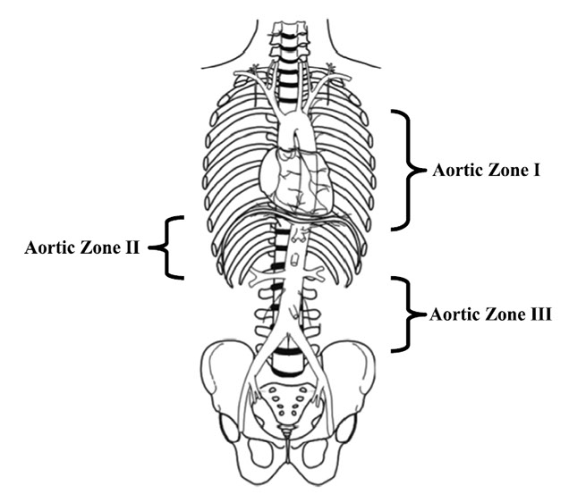
Why Does the Kastrup Lab Care about Blood Clotting?
Controlling Abdominal Hemorrhage: REBOA
Stannard et al. J Trauma Acute Care Surg (2011)
Prytime Medical
Balloon catheter inserted into aorta
Inflation results in tamponade
Use by physicians reported, but most commonly performed by surgeons
Cantle et al. J Spec Med Oper. (2018), Greene, J. Annals Emergency Med. (2018)
Notes:
Even surgeons require a particular skill set to do it.
Resuscitative Endovascular Balloon Occlusion of the Aorta (REBOA) as an Adjunct for Hemorrhagic Shock
Stannard, Adam MRCS; Eliason, Jonathan L. MD; Rasmussen, Todd E. MD

Slide 9
Why Does the Kastrup Lab Care about Blood Clotting?
Controlling Abdominal Hemorrhage: REBOA
Only suitable for <1 hour : Can cause distal ischemia and compartment syndrome ¹⁻³
Does REBOA lead to increased mortality?
Norii et al. J Trauma Acute Care Surg. (2015)
Joseph et al. JAMA Surgery (2019)
1 Wasicek et al. The American Surgeon (2018), 2 Zhang et al. Ann Vasc Surg (2019) 3 Joseph et al. JAMA Surgery (2019)
Notes:
Specific problem that I address.
Life over Limb: Lower Extremity Ischemia in the Setting of Resuscitative Endovascular Balloon Occlusion of the Aorta (REBOA)
Resuscitative Endovascular Balloon Occlusion of the Aorta (REBOA) Not Yet Applicable for Widespread Out-of-Hospital Use: A Case of Nonsurvivable Complication from Prolonged REBOA Inflation.

Slide 10
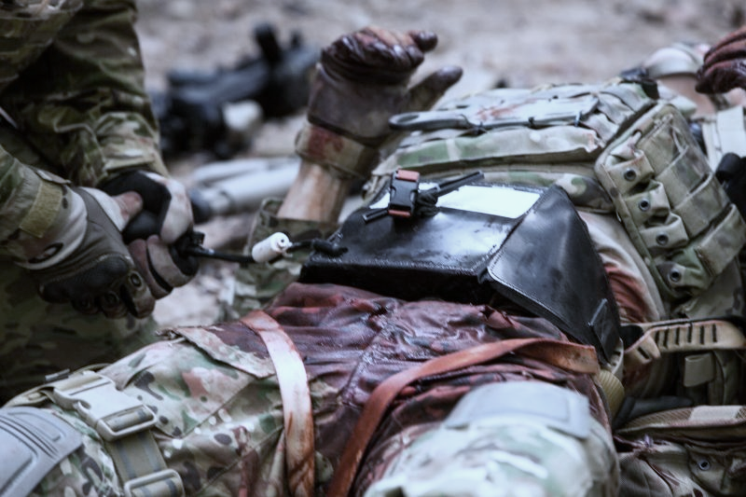
Controlling Abdominal Hemorrhage: Tourniquets (AAJT)
Compression Works
Trauma System News
Compression device that increases intra-abdominal pressure
Used by first responder: All levels of expertise¹
Only suitable for <4 hours : Can cause distal ischemia and compartment syndrome²⁻⁴
1 Kotwal RS and Butler Jr., FK. Wilderness Environ Med (2017) 2 Brännström et al. J Trauma Acute Surg (2018)
3 Kheirabadi et al. J Surg Res (2018) 4 Chang R, Wilderness Environ Med (2017)
Notes:
Physiological Consequences of Abdominal Aortic and Junctional Tourniquet (AAJT) Application to Control Hemorrhage in a Swine Model.
Also hard to use “”
no evidence of improved outcomes from comparative studies of junctional tourniquets or the AAJT in the literature. (ref 4)
Junctional Hemorrhage Control for Tactical Combat Casualty Care

Slide 11
Why Does the Kastrup Lab Care about Blood Clotting?
Controlling Abdominal Hemorrhage: Intra-abdominal “Foams”
Expand and fill abdomen to achieve hemostasis by either:
Increasing pressure (ResQFoam, F.O.A.M.)
or
Binding to damaged tissue (ClotFoam)
Potentially useful for multiple injuries and difficulty locating source of bleed
Notes:
Specific problem that I address.

Slide 12
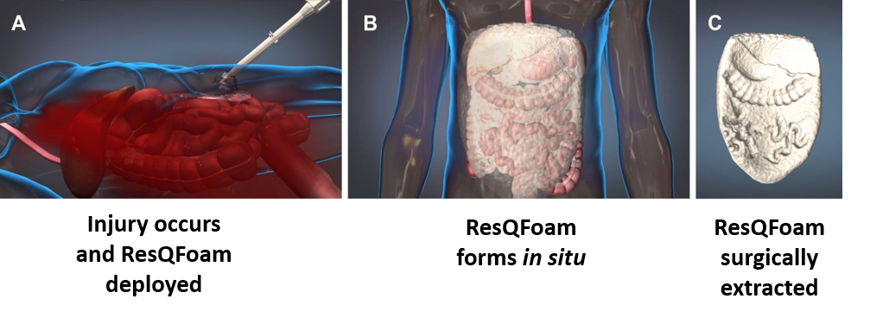
Why Does the Kastrup Lab Care about Blood Clotting?
ResQFoam (Arsenal Medical) = non-resorbable self-expanding
polyurethane polymer
Non-resorbable (Commits soldier to surgery)
Delivered with pneumatic mixing system and custom trocar
Not likely for point of care in austere settings – need incision for trocar
Potentially useful for patients not expected to survive to definitive care
Demonstrated hemostatic efficacy and safety in multiple pre-clinical models.
Next: REVIVE trial (Late 2019)
Duggan et al. J Trauma Acute Care Surg. (2013), Arsenal Trauma Foam System FDA Workshop,
Arsenal Medical Official Website, Rago with King, Trauma (2016)
Notes:
https://arsenalmedical.com/trials

Slide 13
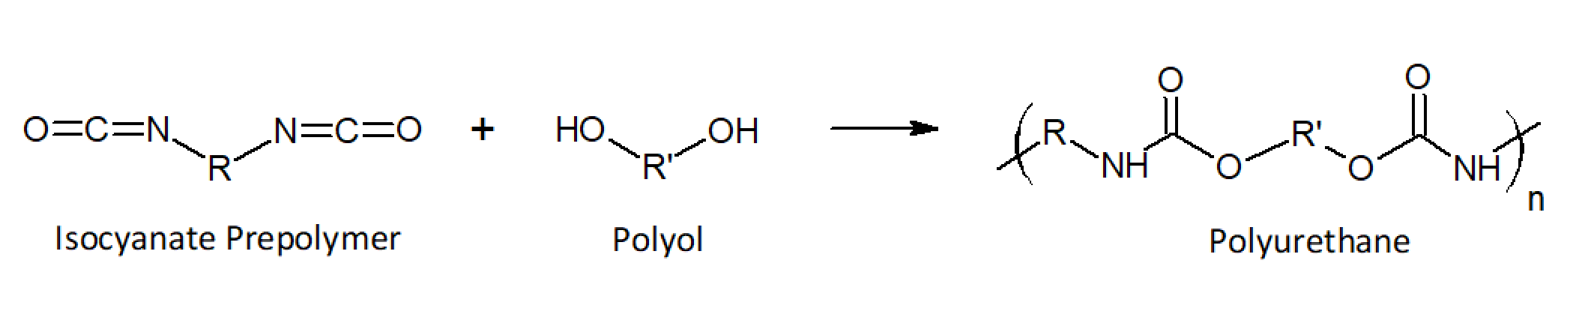
A polyol phase and isocyanate phase react in the abdomen
to produce polyurethane foam
Why Does the Kastrup Lab Care about Blood Clotting?
Also contains:
Polysiloxane surfactant
Triethylenediamine catalyst
Water (blowing agent)
Step 1: “Blowing” reaction → expansion of the material by 30 fold and CO₂ produced
Step 2: “Gelling” reaction → Hardening of the polyurethane
Duggan et al. J Trauma Acute Care Surg. (2013), Polymer Properties Database
Notes:
Self-expanding polyurethane polymer improves survival in a model of noncompressible massive abdominal hemorrhage. J Trauma Acute Care Surgery 2013 (everything else)
https://polymerdatabase.com/polymer%20classes/Polyurethane%20type.html (chemical structure and reaction)

Slide 14
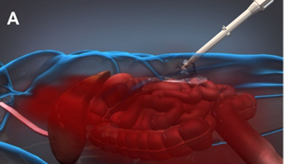
ResQFoam works by filling the abdominal cavity to
apply pressure to the bleed
Why Does the Kastrup Lab Care about Blood Clotting?
Rago et al. J Trauma Acute Care Surg. (2015)
Duggan et al. J Trauma Acute Care Surg. (2013)
Modified from: Arsenal Trauma Foam System FDA Workshop
Notes:
Most of the current foams fill the abdominal cavity, apply pressure to the walls and trap the bleed as well as provide non-localized compression to the bleeding site, wherever that may be. However, they have key limitations. The abdomen needs to be intact. There are also reported potential complications, which include completely occluding blood flow below the abdominal region, abdominal compartment syndrome, and multi-organ failure. Also, the most promising of these foams, which is scheduled for a clinical trial in late 2019, is non resorbable. Therefore, when the patient reaches a surgeon, the surgeon has to first take out the foam before repairing the injury. Also, the injury usually begins bleeding again as soon as the foam is taken out. Lastly, none of the foams activate blood coagulation to stop bleeding.
ARSENAL

Slide 15
The REVIVE trial: Reducing Exsanguination Via in vivo Expandable Foam
Why Does the Kastrup Lab Care about Blood Clotting?
Up to 40 patients ( > 15 years old) with Class III or IV hemorrhagic shock or ABC score ≥2
Single arm, multicenter (Level 1 Trauma centers)
Abdominal hemorrhage confirmed by: Direct visual assessment, FAST, or DPA
Primary Outcome: Improved systolic blood pressure over baseline following intervention
Secondary Outcomes: Verify safety by measuring adverse events attributed to device use
Arsenal Medical REVIVE trial (https://arsenalmedical.com/trials)
Notes:
Https://arsenalmedical.com/trials
ALSO:
Decision to administer foam is made within 30 minutes of admission to the emergency department
Decision made to proceed to emergent laparotomy made within 30 minutes of admission to the emergency department.
Definitive surgical care is expected to occur within three hours of foam deployment
DPA: Diagnostic peritoneal aspiration
FAST: focused assessment with sonography in trauma

Slide 16
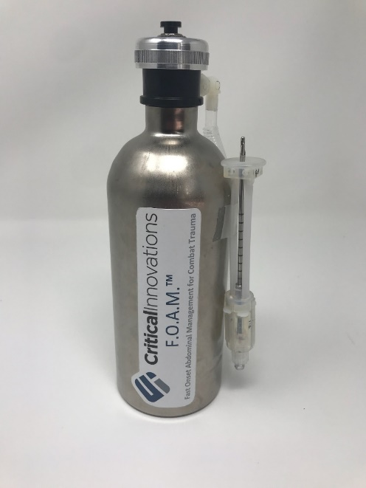
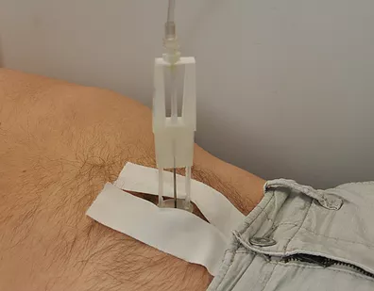
Why Does the Kastrup Lab Care about Blood Clotting?
F.O.A.M. (CriticalInnovations) also exerts pressure
MTEC
CriticalInnovations
Exerts intra-abdominal pressure, similar to ResQFoam but resorbable
Self-blunting pneumothorax needle
Can be used by non-surgeon providers
In development
Notes:
MTEC website
https://www.criticalinnovations.com/technologies
https://mtec-sc.org/mtec-current-projects/multi-topic/

Slide 17
Why Does the Kastrup Lab Care about Blood Clotting?
ClotFoam (Biomedica) =
Fibrin sealant without thrombin embedded in gelatin scaffold
Component 1: Gelatin in basic solution
+
Component 2: Acid
=
Hydrogel formation + CO₂ release
(“Foam”)
“Foam”
+
Component 3: Fibrin monomer in acid
=
Component 4: Factor XIII and Ca²⁺
In development
RESULT: Polymerized fibrin embedded in gelatin
with Factor XIII to stabilize
Notes:
Maybe delete. No literature only 1 report and patents. Important to know that it exists though. There is also another fibrin sealant made with fibrinogen and thrombin but it was scratched because it could not deliver the agent in pooled blood (Duggan et al. J Trauma 2013 in the discussion)
https://patents.google.com/patent/US20110066182
https://patents.google.com/patent/US20100197893
https://www.sbir.gov/sbirsearch/detail/389309,
Rappold JF and Bochicchio GV. Transfusion (2016),
ClotFoam is delivered into the cavity by an hydraulic applicator through a mixing needle. (FIG. 1) The mixing needle can be adapted for use in different laparoscopic procedures as for other minimally invasive procedures.

Slide 18
Challenges of Intra-abdominal “Foams”: Summary
Why Does the Kastrup Lab Care about Blood Clotting?
• Does not activate coagulation (ResQFoam, FOAM, ClotFoam)
• Abdomen needs to be intact (ResQFoam, FOAM)
• Complications such as bowel damage, occluding distal blood flow
and ischemia, compartment syndrome, and multi-organ failure
(ResQFoam, FOAM)
• Non-resorbable (ResQFoam only)
• Anesthetist required (?) (ResQFoam, FOAM)
Notes:
ALL SOURCES TAKEN FROM earlier slides.

Slide 19
Why Does the Kastrup Lab Care about Blood Clotting?
Challenges of Intra-abdominal “Foams”
Question:
Why not use hemostatic agents (ex. thrombin, TXA) in foams?
Answer (?):
Hemostatic agents are ineffective in NCIAH because
the agent cannot be transported to the bleeding
site within the abdomen ¹⁻⁴
1 Kheirabadi B and Klemcke HS “Combat Casualty Care in Ground Based Tactical Situations: Trauma Technology and Emergency Medical Procedures” (2004), 2 DARPA Wound Stasis Research Program (2010),
3 Mueller et al. J Trauma Acute Care Surg (2012) 4 Gordy SD and Rhee P, Expert Review of Medical Devices (2011)
Notes:
I discuss the specific problems I want to address.
Kheirabadi B and Klemcke HS “Combat Casualty Care in Ground Based Tactical Situations: Trauma Technology and Emergency Medical Procedures” (2004).
DARPA’s wound stasis program
JTAC 2013 (resqfoam first paper)
Mueller et al. (sponge Xstat paper)
Pusateri Quikclot paper Application of a granular mineral-based hemostatic agent (QuikClot) to reduce blood loss after grade V liver injury in swine.
Military applications of novel hemostatic devices (Gordy and Rhee)
Comparison of 10 Different Hemostatic Dressings in an Aortic Injury
https://www.naemt.org/docs/default-source/education-documents/phtls/trauma-resources/phtls-literature-reviews/Prehospital_Topical_Hemostatic_Agents.pdf?sfvrsn=bfb9cbfe_2

Slide 20
Transport (dispersion) of Hemostatics Fail
During Severe Hemorrhage
Can this be addressed?

Slide 21
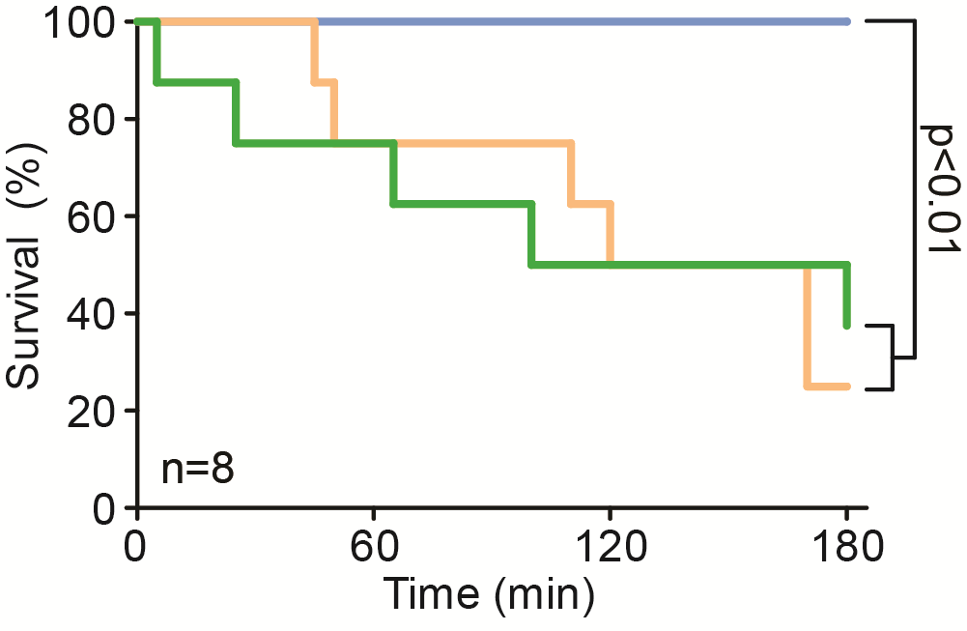
Hemorrhage Without Compression = Hemorrhage
Propelled TXA & Thrombin Keeps Pigs Alive 2/3
Without manual compression, current topical hemostatics can fail.
Clay on Gauze
Combat Gauze
Thrombin on Gauze
(surgical standard)
J.R. Baylis, A.E. St. John, … R.T. Liggins, N.J. White, C.J. Kastrup; Shock (2016)

Slide 22
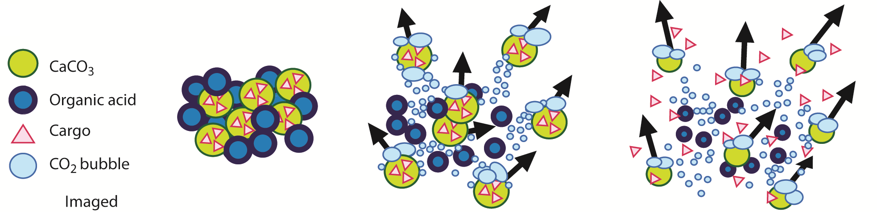
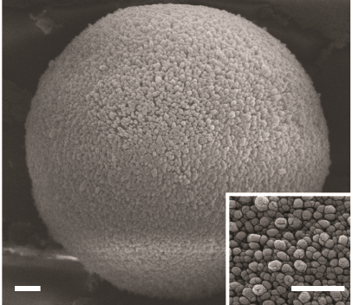
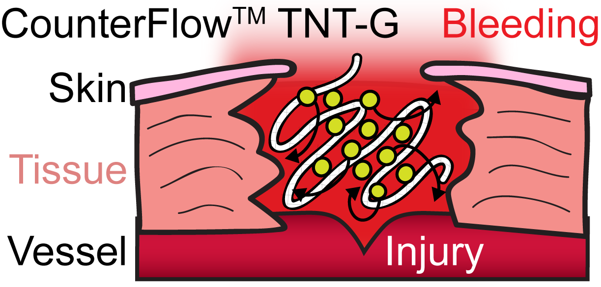
A Wound-Penetrating Technology:
Self-Propelling Particles (CounterFlow)
Why Does the Kastrup Lab Care about Blood Clotting?
30 μm
500 nm
500 nm
J.R. Baylis, A.E. St. John, … N.J. White, C.J. Kastrup; Science Advances (2015)

Slide 23
A Wound-Penetrating Technology:
Self-Propelling Particles (CounterFlow)
Why Does the Kastrup Lab Care about Blood Clotting?
CaCO_{3(s)} + 2H⁺_{(aq)} Ca²⁺_{(aq)} + CO_{2(g)} + H₂O_{(l)}
Tranexamic acid (TXA)
TXA is an antifibrinolytic drug, a “clot stabilizer”
J.R. Baylis, A.E. St. John, … N.J. White, C.J. Kastrup; Science Advances (2015)

Slide 24
A Wound-Penetrating Technology:
Self-Propelling Particles (CounterFlow)
Why Does the Kastrup Lab Care about Blood Clotting?
CaCO₃ and CO₂:
Safe, bioabsorbable and soluble in blood, wounds and vessels.
J.R. Baylis, A.E. St. John, … N.J. White, C.J. Kastrup; Science Advances (2015)

Slide 25
Self-Propelled Thrombin = Pigs Survive
Propelled TXA & Thrombin Keeps Pigs Alive 2/3
n = 8
Self-Propelled Thrombin
(CounterFlow)
on Gauze
Clay on Gauze
(military standard)
Thrombin on Gauze
(surgical standard)
J.R. Baylis, A.E. St. John, … R.T. Liggins, N.J. White, C.J. Kastrup;
Science Advances (2015), Shock (2016)

Slide 26
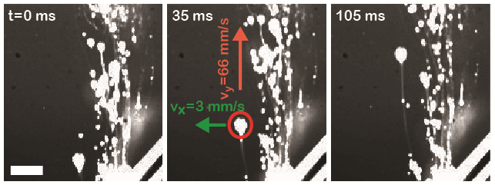
CaCO₃ particles propel at high velocities
2 mm
Self-Propelled Thrombin on Gauze
2 mm
1 cm
Bubbles escaping wound
Notes:
The buoyant force (F_{buoy}) is given by F_{buoy} = ρgV, where ρ is the density of the aqueous solution, g is the acceleration due to gravity, and V is the bubble volume. The CO₂ bubbles were modeled as oblate spheroids. The drag force (F_{drag}) is given by F_{drag} = ½ρAv²C_{D}, where A is the frontal area of the bubble, v is the upward velocity, and C_{D} is the coefficient of drag. Equating F_{buoy} to F_{drag} gives v = (4gr/3C_{D})^{1/2},where r is the bubble radius.

Slide 27
Self-Propelled Thrombin = Pigs Survive
Propelled TXA & Thrombin Keeps Pigs Alive 2/3
Self-Propelled Thrombin on Gauze
Gauze Delivers:
Systemic TXA
Ca²⁺
Pressure from CO₂
Thrombin (optional)
1 cm
Bubbles escaping wound
Baylis, Cau, others, White, Kastrup.
Science Advances (2015), Shock (2016), J Thrombosis Haemostasis (2019)

Slide 28
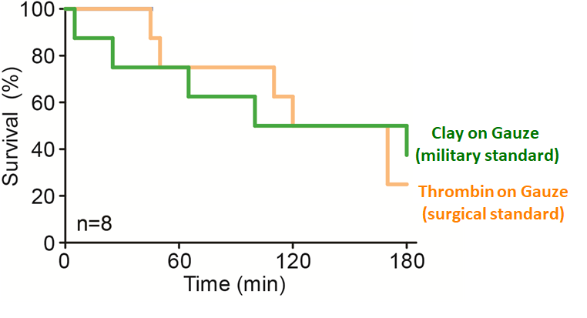
Self-Propelled Thrombin = Pigs Survive
Propelled TXA & Thrombin Keeps Pigs Alive 2/3
Self-Propelled Thrombin on Gauze
Self-Propelled TXA
on Gauze
No
treatment
Plain Gauze
(no agent)
500 nm
500 nm
500 nm
500 nm
Baylis, Cau, others, White, Kastrup.
Science Advances (2015), Shock (2016), J Thrombosis Haemostasis (2019)
Notes:
Hypothesis rationale

Slide 29
Propelled Thrombin Gauze (PTG)
Reduces Bleeding from Turbinate and Carotid Artery
Baylis, others, Kastrup, Laryngoscope (2017)

Slide 30
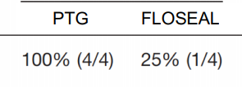
Propelled Thrombin Gauze (PTG)
Reduces Bleeding from Turbinate and Carotid Artery
Proportion of carotid artery injuries
that achieved hemostasis
Baylis, others, Kastrup, Laryngoscope (2017)

Slide 31
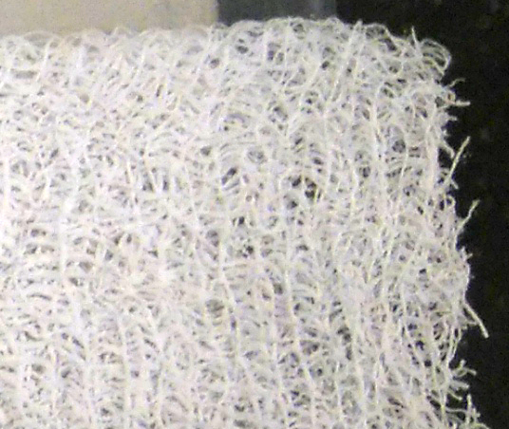
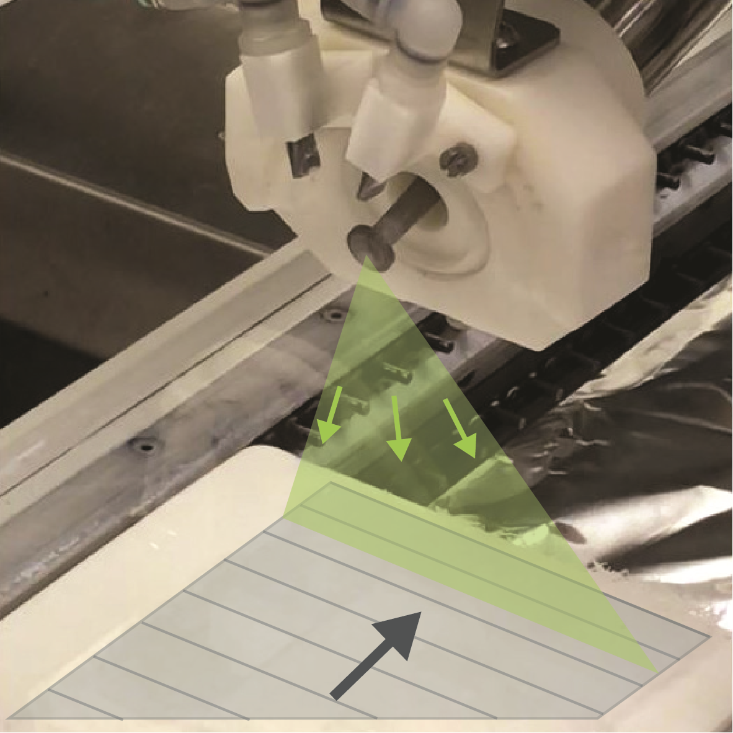
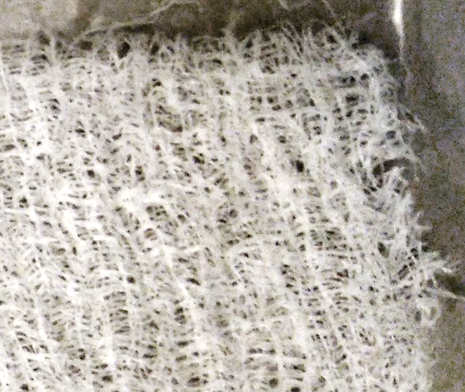
Loading CounterFlow onto Substrates is
Scalable and Automatable
Why Does the Kastrup Lab Care about Blood Clotting?
Spray nozzle depositing CounterFlow solution/suspension
TXA-loaded
Conveyor-fed substrate
CaCO₃-loaded
Notes:
James present

Slide 32
Hypothesis we are currently testing:
Delivery of hemostatic agents using
self-propelling particles
will enable hemostatics to treat NCIAH

Slide 33
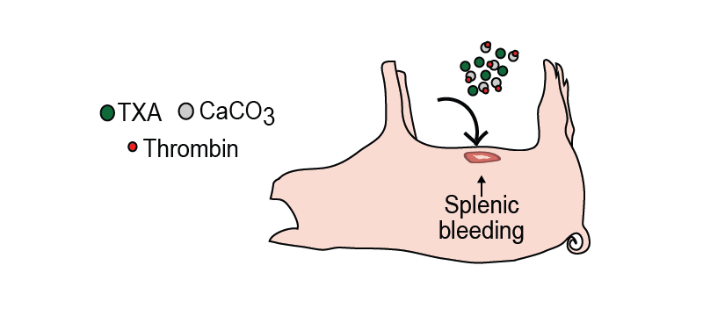
Self Propelled Thrombin can Disperse Throughout the Abdomen
To Control Abdominal Hemorrhage
Clot at site of injury
Baylis, Cau and others, H. Semple, Kastrup, Unpublished
Notes:
In a pilot study, using a model of non-compressible intra abdominal hemorrhage, one pig was treated by making a small surgical incision and non –specifically injected the propelled particles loaded with thrombin into the intra-peritoneal space. The particles were found distributed throughout the abdomen after, there was a robust clot found at the site of injury which was the spleen, and the pig’s blood pressure did not reach critical levels.

Slide 34
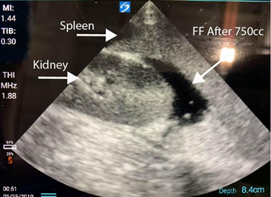
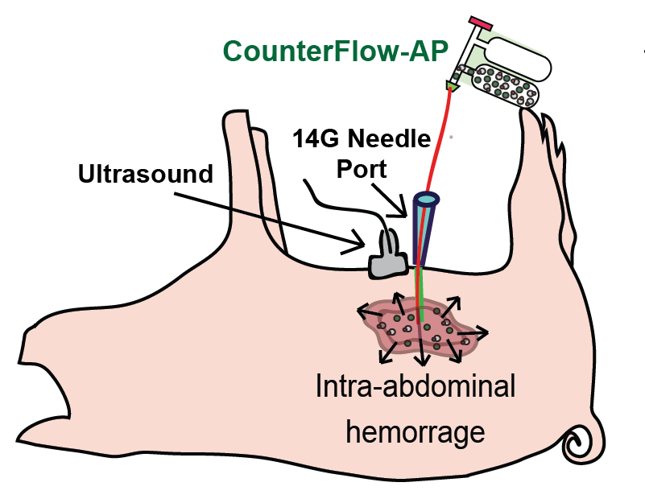
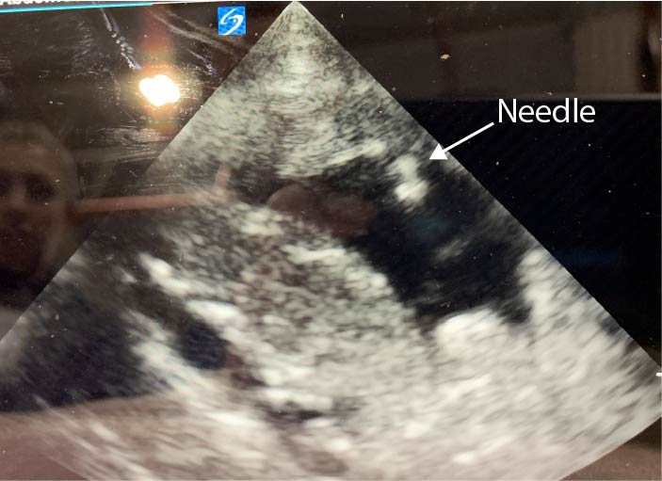
Toward a Hemostatic Spray for Abdominal Hemorrhage
Positive FAST
Treatment delivered through angiocatheter
Spray device fabricated
Source: Lt. Col Andrew Beckett

Slide 35
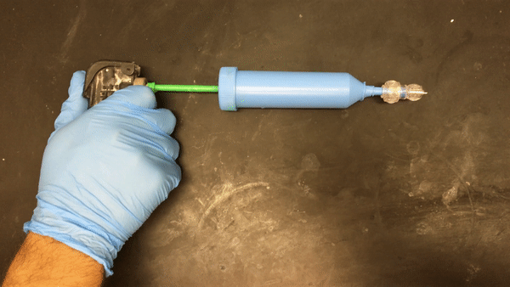
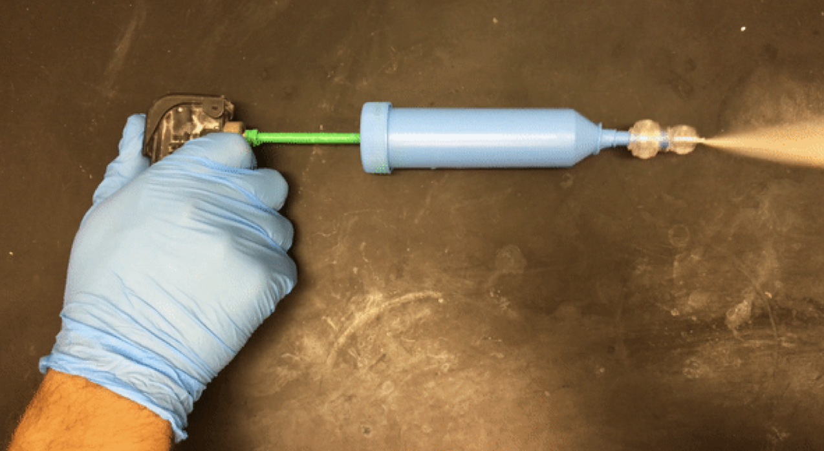
CounterFlow can be Sprayed with an
Endoscope-Compatible Device
Why Does the Kastrup Lab Care about Blood Clotting?
Notes:
CounterFlow can be sprayed from an endoscopy compatible device to treat UGI bleeds.
- Each cartridge holds 15g of Counterflow (contents completely expelled after 5 sprays)
Will be testing the created device using the protocol outlined in Giday et al. publication testing TC-325 powder (Cook) in a swine model in mid July (date unknown).

Slide 36
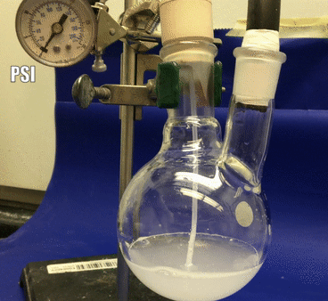
Toward a Hemostatic Spray for Abdominal Hemorrhage

Slide 37
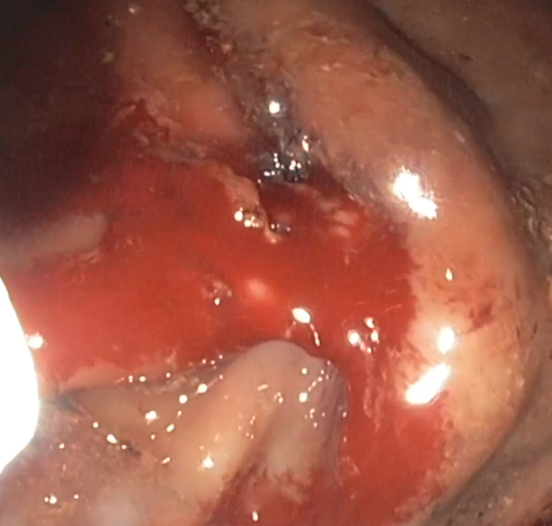
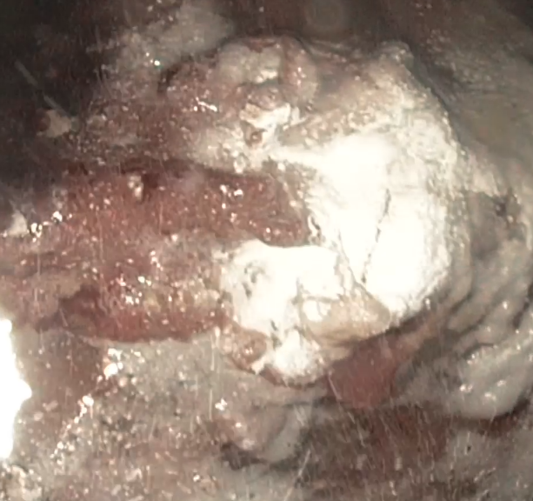
Self-Propelled Thrombin Stopped Bleeding when Sprayed into Stomach through Endoscope
8 different vessels injured in total of 3 pigs
Time to hemostasis | Mass Particles delivered
4.3 +/- 1.4 min | 2.4 +/- 0.6 g
Ali-Mohamad, Cau, Baylis, others, Donnellan, Kastrup, Unpublished
Notes:
Another form of non-compressible hemorrhage that we are exploring for SPP is upper gastrointestinal bleeding, which affects xxxxxx with 5-30% mortality. Recently, hemostatic powders such as FDA approved Hemospray, that are sprayed at the bleeding site in an endoscopic procedure have become popular for treating these bleeds. However current powders have rebleeding rates as high as 49%. We developed a spray device to spray SPP through an endoscope in the same type of pig model that Hemospray was tested in. The time to hemostasis was 2.4 +/-1.4 min and mass particles delivered awas 2.4 +/- 0.6. This is 6x faster and 40x less material with respect to Hemospray, indicating the SPP is a promising strategy for treating UGIB. Our next step is to test the safety of this approach by performing recovery experiments on the pigs that are treated with UGIB and also to evaluate SPP efficacy in direct comparison to other methods to stop bleeding.
In conclusion, SPP is atechnology that disperses hemostatic agents throughout wounds. In pre clinical models, It has proven to manage extremely challenging bleeds that have high flow rates, are located in difficult to reach areas and cannot be compressed.

Slide 38
A Wound-Penetrating Technology:
Self-Propelling Particles (CounterFlow)
Why Does the Kastrup Lab Care about Blood Clotting?
Expected Advantages:
• Can be administered by non-surgeon physician or assistant,
without an anesthetist,
using standard techniques to assess NCIAH (FAST sonography exam)
and then enter abdomen (paracentesis, DPL, etc)
• Does not exert sustained pressure
(reduced risk of ischemia and compartment syndrome)
• Resorbable, does not commit soldier to laparotomy

Slide 39
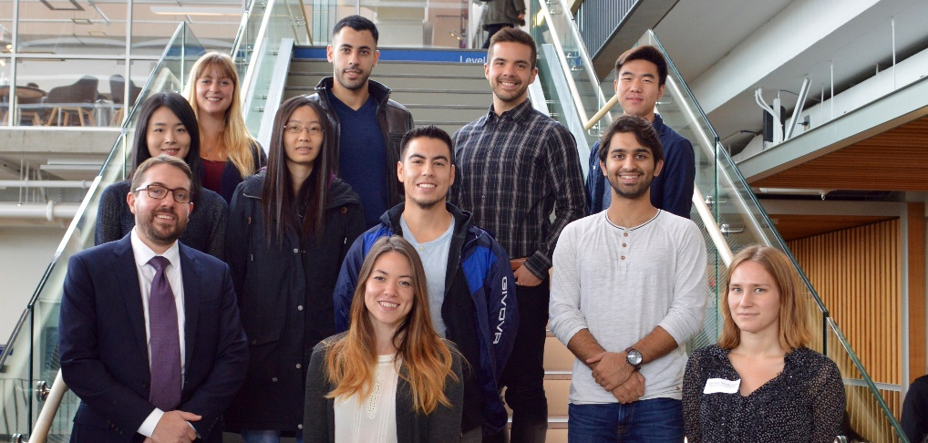



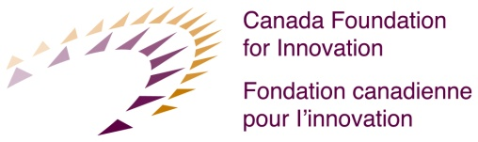
Collaborators (this work):
• Nathan White (U. Washington)
• Andrew Beckett (McGill)
• Hugh Semple (Canadian Armed Forces)
• Fergal Donnellan (Vancouver. Gen. Hosp.)
• Richard Liggins (Centre Drug Research and Development)
• Lindsay Machan (Vancouver Gen. Hosp.)
• Andrew Cap, James Bynum, Adam Meledeo (USAISR)
Canada’s Department of National Defence
American Society of Gastrointestinal Endoscopy
Notes:
I would like to acknowledge of our collaborators for these works (right side) as well as all of the funding agencies that made these discoveries possible.

Slide 40
CONCLUSION: Self-propelled particles are promising for intra-abdominal foams because they improve the delivery of hemostatic agents
Future Directions
Formulation and spray device refinement for performance and safety
Quantify dispersal of particles throughout abdomen
Test in a swine model of NCIAH
Notes:
Conclusions one line at top, remove rest, just future directions.

Slide 41
Why Does the Kastrup Lab Care about Blood Clotting?
Non-surgical interventions stabilize patients
until surgery is possible
• Resuscitative Endovascular Balloon of Aorta (REBOA)
• Abdominal and Aortic Junctional Tourniquet (AAJT)
• Abdominal “Foams” (ResQFoam, F.O.A.M., ClotFoam)
.
Rappold JF and Bochicchio GV. Transfusion (2016).
Notes:
Here I talk about the different interventions and their strengths and weaknesses. I identify abdominal foams as an area I want to explore.
There are primarily three non surgical interventions that are used to stabilize patients until they reach a surgeon.. Resuscitative endovascular balloon of the aorta (better known as REBOA) is an intervention in which a balloon catheter is inserted in the leg and delivered to the descending or abdominal aorta, the main artery of the anatomical trunk. The balloon catheter is then inflated when it is at a height higher than the site of the bleeding, to reduce blood flow to the area.
Abdominal and aortic junctional tourniquet is a device used to constrict the abdomen and stop blood loss by applying as much pressure as possible to the area in a non-specific manner. The device is wrapped around a patients abdomen and inflated as tightly as possible.
More recently, intra-abdominal foams have been proposed which could be injected into the abdomen to stop bleeding. There are three foams that are currently being developed which have not yet been tested in humans, ResQFoam, FOAM, and ClotFoam. This is an area that we are very interested in.

Slide 42
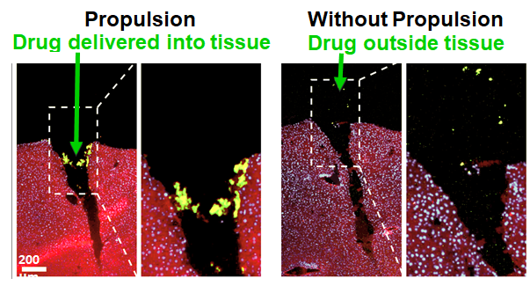
A Wound-Dispersing Technology:
Self Propelling Particles (CounterFlow)
Why Does the Kastrup Lab Care about Blood Clotting?
Cargo Loaded
Cargo Propelled
500 nm
500 nm
Baylis, others, Kastrup. Science Advances (2015)
2
Notes:
In our lab we have developed self-propelling particles, which can be loaded with therapeutic cargo to more effectively deliver this cargo to wounds. SPP consist of CaCO3 microparticles, which are loaded with cargo, and an organic acid. When this dry mixture comes into contact with blood, it reacts to form CO2 and the cargo is propelled deep into wounds. In one experiment, a mouse’s liver was injured and a drug was applied with or without propulsion to the bleeding site. With propulsion, the drug was effectively delivered into the tissue. Without propulsion, the drug was found outside of the tissue. This suggests that SPP improves the transport of drugs into wounds.

Slide 43
A Wound-Penetrating Technology:
Self-Propelling Particles (CounterFlow)
Why Does the Kastrup Lab Care about Blood Clotting?
Hypothesis:
Delivery of hemostatic agents using
self-propelling particles enables them
to treat NCIAH
Cargo Loaded
Cargo Propelled
500 nm
500 nm
Baylis, others, Kastrup. Science Advances (2015)
2
Notes:
Hypothesis

Slide 44
ResQFoam works by filling the abdominal cavity to
apply pressure to bleed
Why Does the Kastrup Lab Care about Blood Clotting?
• Does not activate coagulation
• Abdomen needs to be intact
• Potential complications: occluding distal blood flow, compartment syndrome, and multi-organ failure
• Non-resorbable (ResQFoam only)
Key Limitations:
Cantle et al. J Spec Oper Med (2018).
Rappold JF and Bochicchio GV. Transfusion (2016).
Notes:
Most of the current foams fill the abdominal cavity, apply pressure to the walls and trap the bleed as well as provide non-localized compression to the bleeding site, wherever that may be. However, they have key limitations. The abdomen needs to be intact. There are also reported potential complications, which include completely occluding blood flow below the abdominal region, abdominal compartment syndrome, and multi-organ failure. Also, the most promising of these foams, which is scheduled for a clinical trial in late 2019, is non resorbable. Therefore, when the patient reaches a surgeon, the surgeon has to first take out the foam before repairing the injury. Also, the injury usually begins bleeding again as soon as the foam is taken out. Lastly, none of the foams activate blood coagulation to stop bleeding.
ARSENAL

