Slide 1
Tactical Combat Casualty Care Update June 2023
Brendon Drew, DO, FAWM, FACEP
Harold Montgomery, SO-ATP

Slide 2
Disclosures
My views and opinions may not reflect those of the Defense Health Agency, the Joint Trauma System, the U.S. Navy, the U.S. Marine Corps or the Department of Defense
My opinions may not reflect those of other medical directors
No financial conflicts
My friends and I share slides

Slide 3
Perspective
An end-user for 20 years
My son is an end-user
Marine Expeditionary Force
Privileging Authority
Medical director
No command authority

Slide 4
Nothing gets a pass because “That’s the way we’ve always done it.”

Slide 5
Focus
Evidence
Logistics
Recommendations
Guidelines (not protocols)
TXA example

Slide 6
TCCC Employment
Medical Direction
Curriculum
Change Paper
Guidelines
Detail

Slide 7
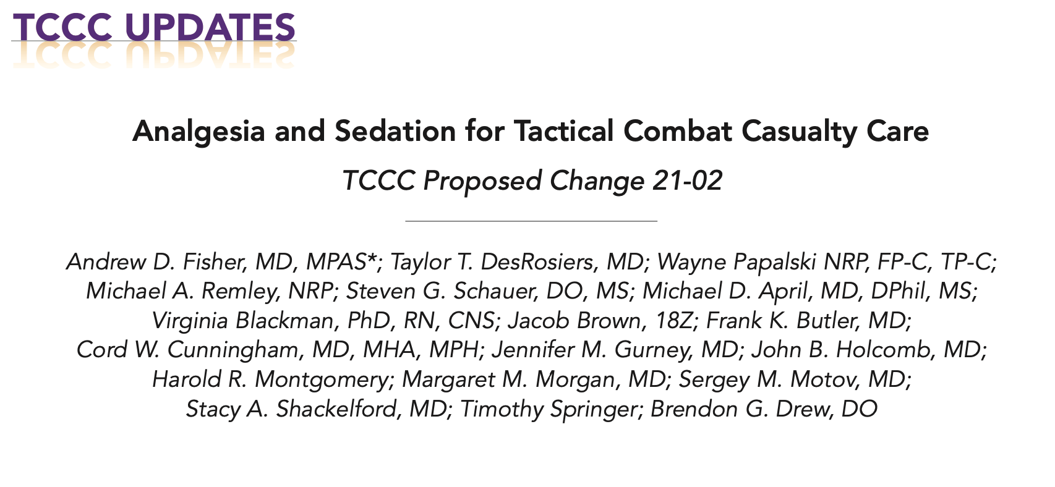

Slide 8
Analgesia and Sedation
Added IV/IO/IN fentanyl for Tier 4
Avoidance of polypharmacy
Avoidance of protocolled benzodiazepines
Address incomplete dissociation
Directly address full dissociation
Did not add sufentanil

Slide 9
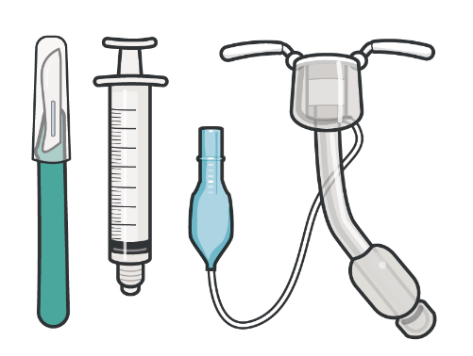
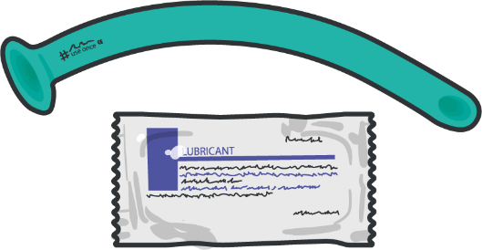
Pending TCCC Changes
Airway Management (Travis Shaw)
Interim: removed of Cric-Key and iGel
NPA/BVM as intermediate step
?
?

Slide 10
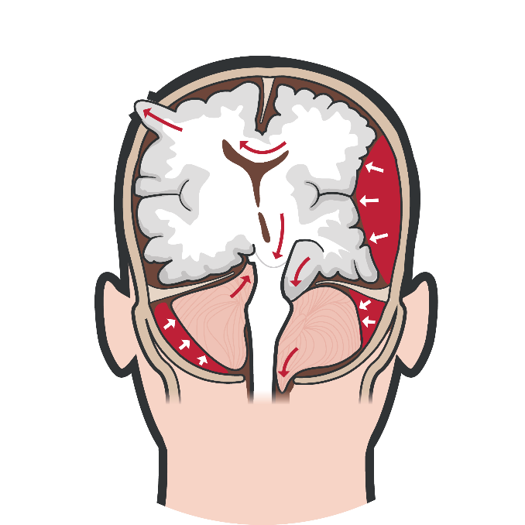
Pending TCCC Changes
TBI (Steve Rush)
Monitoring while sedated (+/- airway)
Prevent hypotension - Ideal blood pressure target?
Herniation targets - Ideal fluid choices?
Skill level expectations

Slide 11
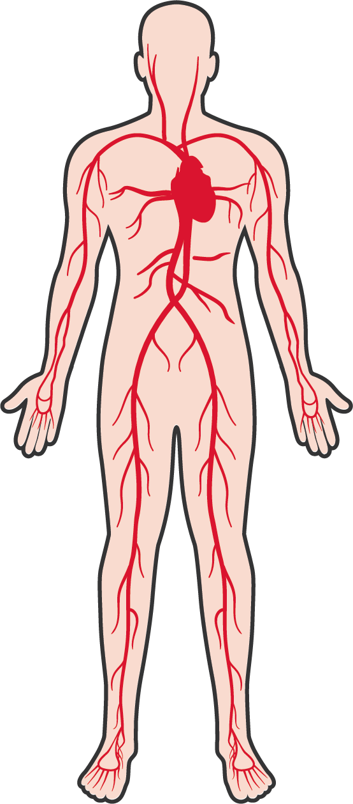
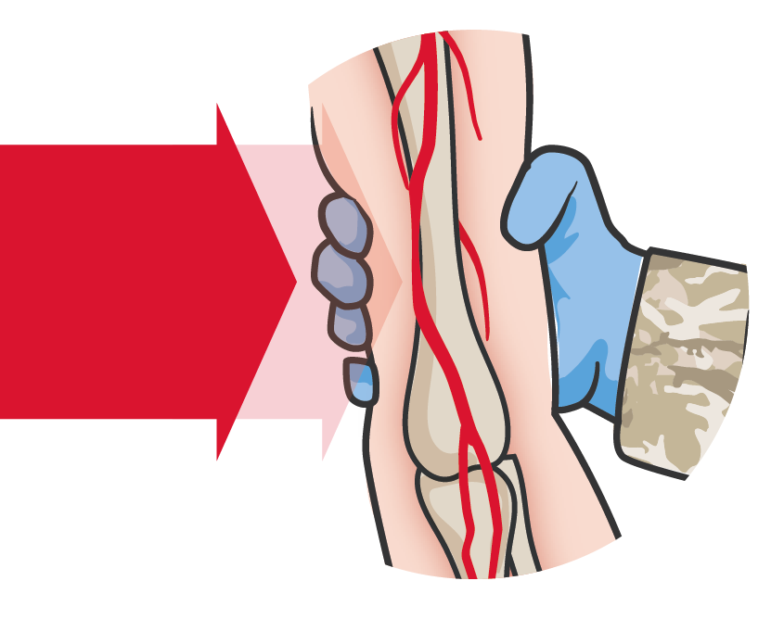
Hemorrhage Control
Lead: Win Kerr
Academic Action Officer: Ann Long
Re-evaluation of methods and devices
Minus TQs
Minus hemostatic agents

Slide 12
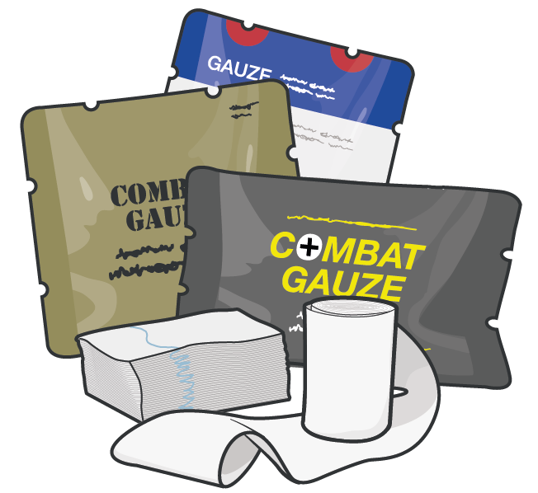
Hemostatic Agents
Lead: Lorenzo Paladino
Academic Action Officer: Montane Silverman
Review of objective comparisons

Slide 13
TXA
Lead: Chris Gonzalez
Academic Action Officer: Brit Long
Relook at 2020 change
Best dose
Speed of administration
Redosing
IM administration

Slide 14
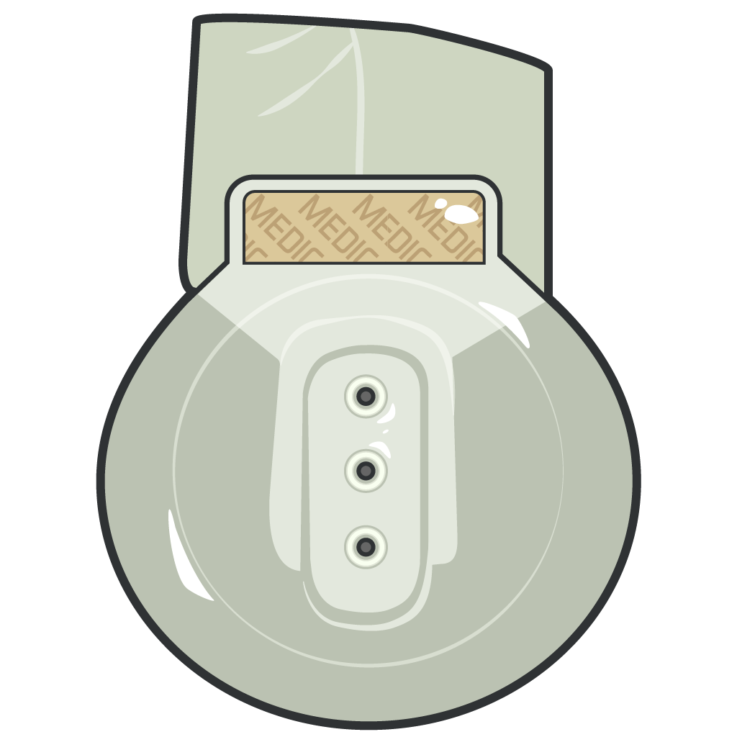
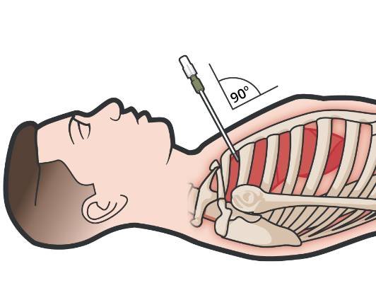
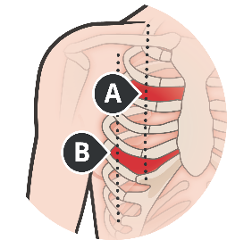
Pneumothorax
Lead: John Maitha
Academic Action Officer: Chris Androski
Needle vs finger priority
Registry review for needle complications
Prehospital thoracostomy

Slide 15
Antibiotics
Lead: Piotr Wisniewski
Selection
Timing
Review of prior neutral results

Slide 16
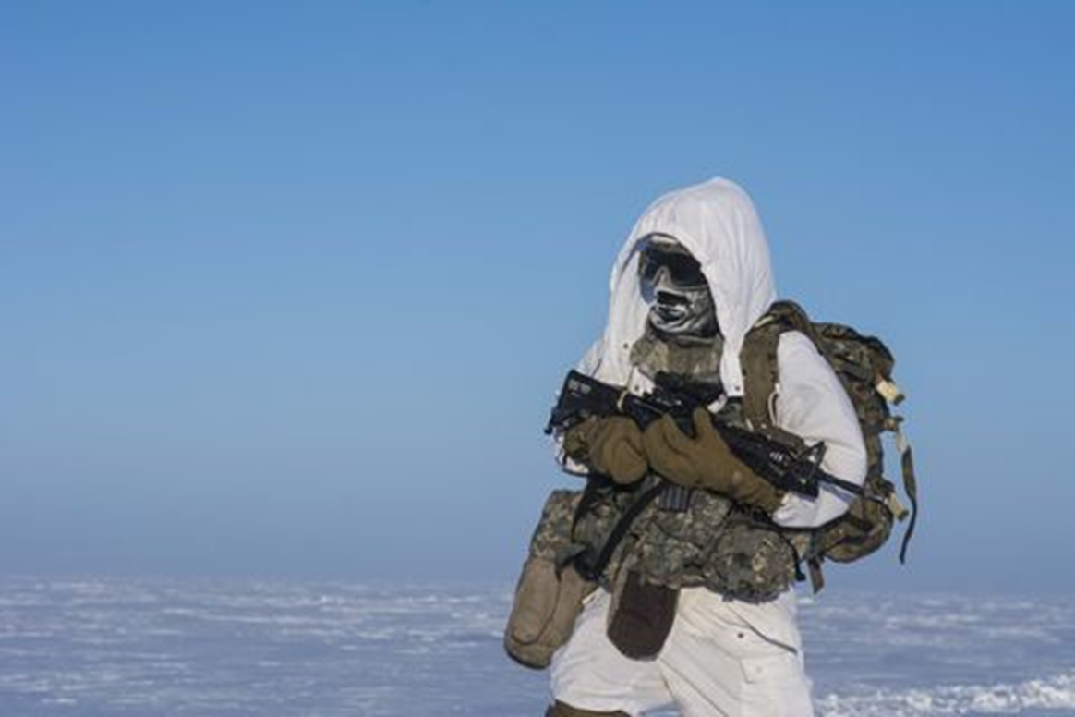
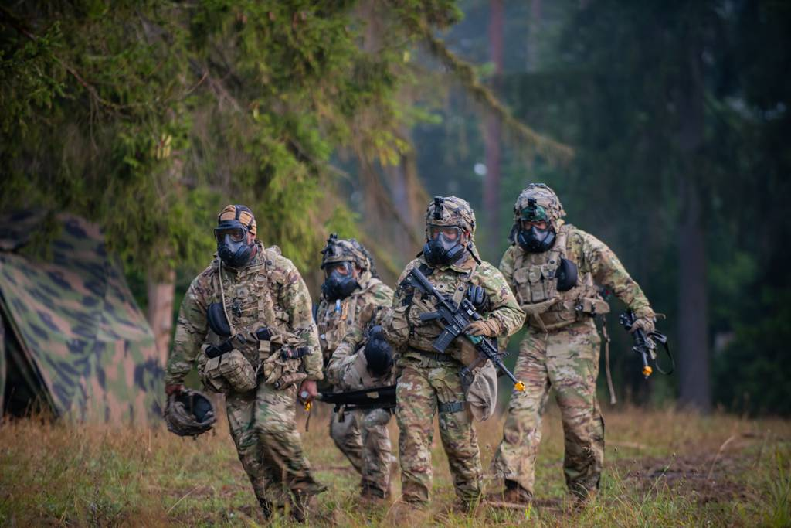
Working Efforts
TCCC in Extreme Cold Weather
TCCC in CBRN

Slide 17
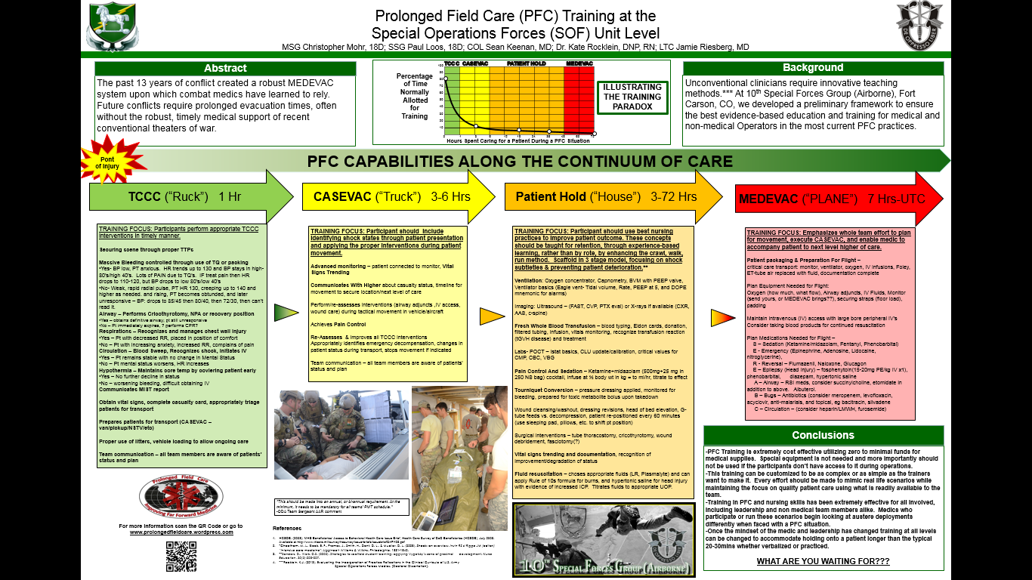
Prolonged Casualty Care
TCCC (“Ruck”)
1 Hr
CASEVAC (“Truck”)
3-6 Hrs
Patient Hold (“House”)
3-72 Hrs
MEDEVAC ("PLANE")
7 Hrs-UTC

Slide 18
PFC vs PCC
Prolonged Field Care Continues
SOCOM effort
Broader focus
Prolonged Casualty Care
Conventional Forces
Narrower focus
Continuation of TCCC
JTS Guidelines
JTET Curriculum

Slide 19
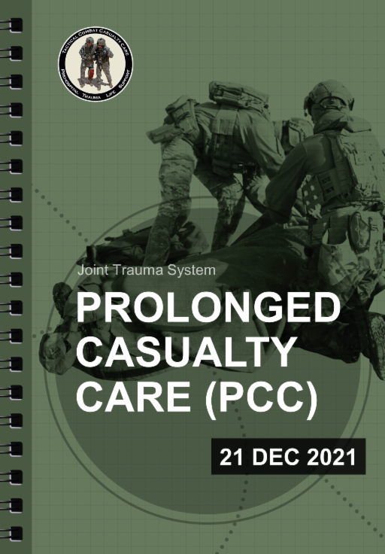
Prolonged Casualty Care (PCC)
PCC Guidelines published Dec 2021
PCC Curriculum Working Group developing learning objectives and curricula core requirements.
PCC Working Group transitioning to standing subcommittee under CoTCCC.

Slide 20
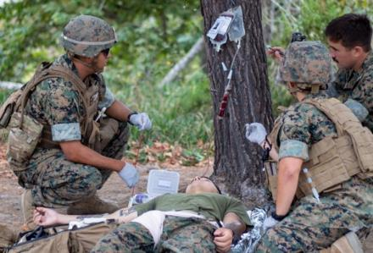
Spectrum of Role I Care
DNBI:
Tropical Medicine
Mental Health
Ortho Injuries
Women’s Health
30 min
90 min
70 hours +
Sick Call Screener
Prev Med Techs
Embedded Mental Health
EMT-Basic
TCCC
Valkyrie
Whole Blood
Prolonged Casualty Care

Slide 21
International Involvement
JTS Liaisons
Nominated by leadership
Co-authors
CPGs
Change papers
Selected by expertise, experience and publications

Slide 22
Deployed Medicine
www.deployedmedicine.com
“Deployed Medicine” mobile app on iOS or Android
A Training, Education, Pre-Deployment and Down-Range Tool for individuals and organizations.
All Course and Content can be downloaded to personal and gov EUD Smart Devices and Desktop
Assessments are taken within Deployed Medicine and maIntained in student record
Now:
All TCCC Training & Reference
JTS Clinical Practice Guidelines
Canine Casualty Care
Prolonged Casualty Care
Coming:
EWSC, ASSET+, KSA-related, Equipment Ref & Tng
Emerging:
Equipment Behavior Health SOF Medicine Global Health

Slide 23
QUESTIONS/COMMENTS
Brendon Drew
Chair, Committee on TCCC
Joint Trauma System
prehospital1996@outlook.com
Harold Montgomery
Joint Program Manager, TCCC
Vice Chair, Committee on TCCC
Joint Trauma System
Harold.r.montgomery2.CIV@health.mil
HRMontgomery75@gmail.com
@CommitteeonTCCC
tc3committee
CoTCCC Committee-on-TCCC
@CoTCCC
http://jts.amedd.army.mil/

