Slide 1

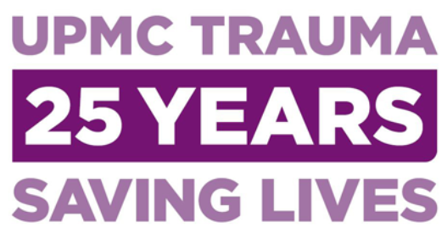

Tourniquets: State of the Art and the Stop The Bleed Implementation Experience
30 YEARS
Matthew D. Neal, MD FACS
Roberta G. Simmons Assistant Professor of Surgery
Attending Surgeon, Division of Trauma and Acute Care Surgery
Department of Surgery, University of Pittsburgh
Co-Director, Pittsburgh Trauma Research Center
Staff Surgeon, University of Pittsburgh Police Special Emergency Response Team (SERT)

Slide 2
Disclosures
Laboratory funding: NIH, DoD
External Scientific Advisory Board and Research Funding, Janssen Pharmaceuticals
Research funding: Haemonetics, Instrument Labs, Accriva
External Scientific Advisory Board CSL Behring
US Patent 9,072,760 TLR4 inhibitors for the treatment of human infectious and inflammatory disorders

Slide 3
Overview
Civilian effectiveness
Tourniquet options
Controversial areas and special populations
Stop The Bleed Implementation
Tree of Life Synagogue Shooting

Slide 4
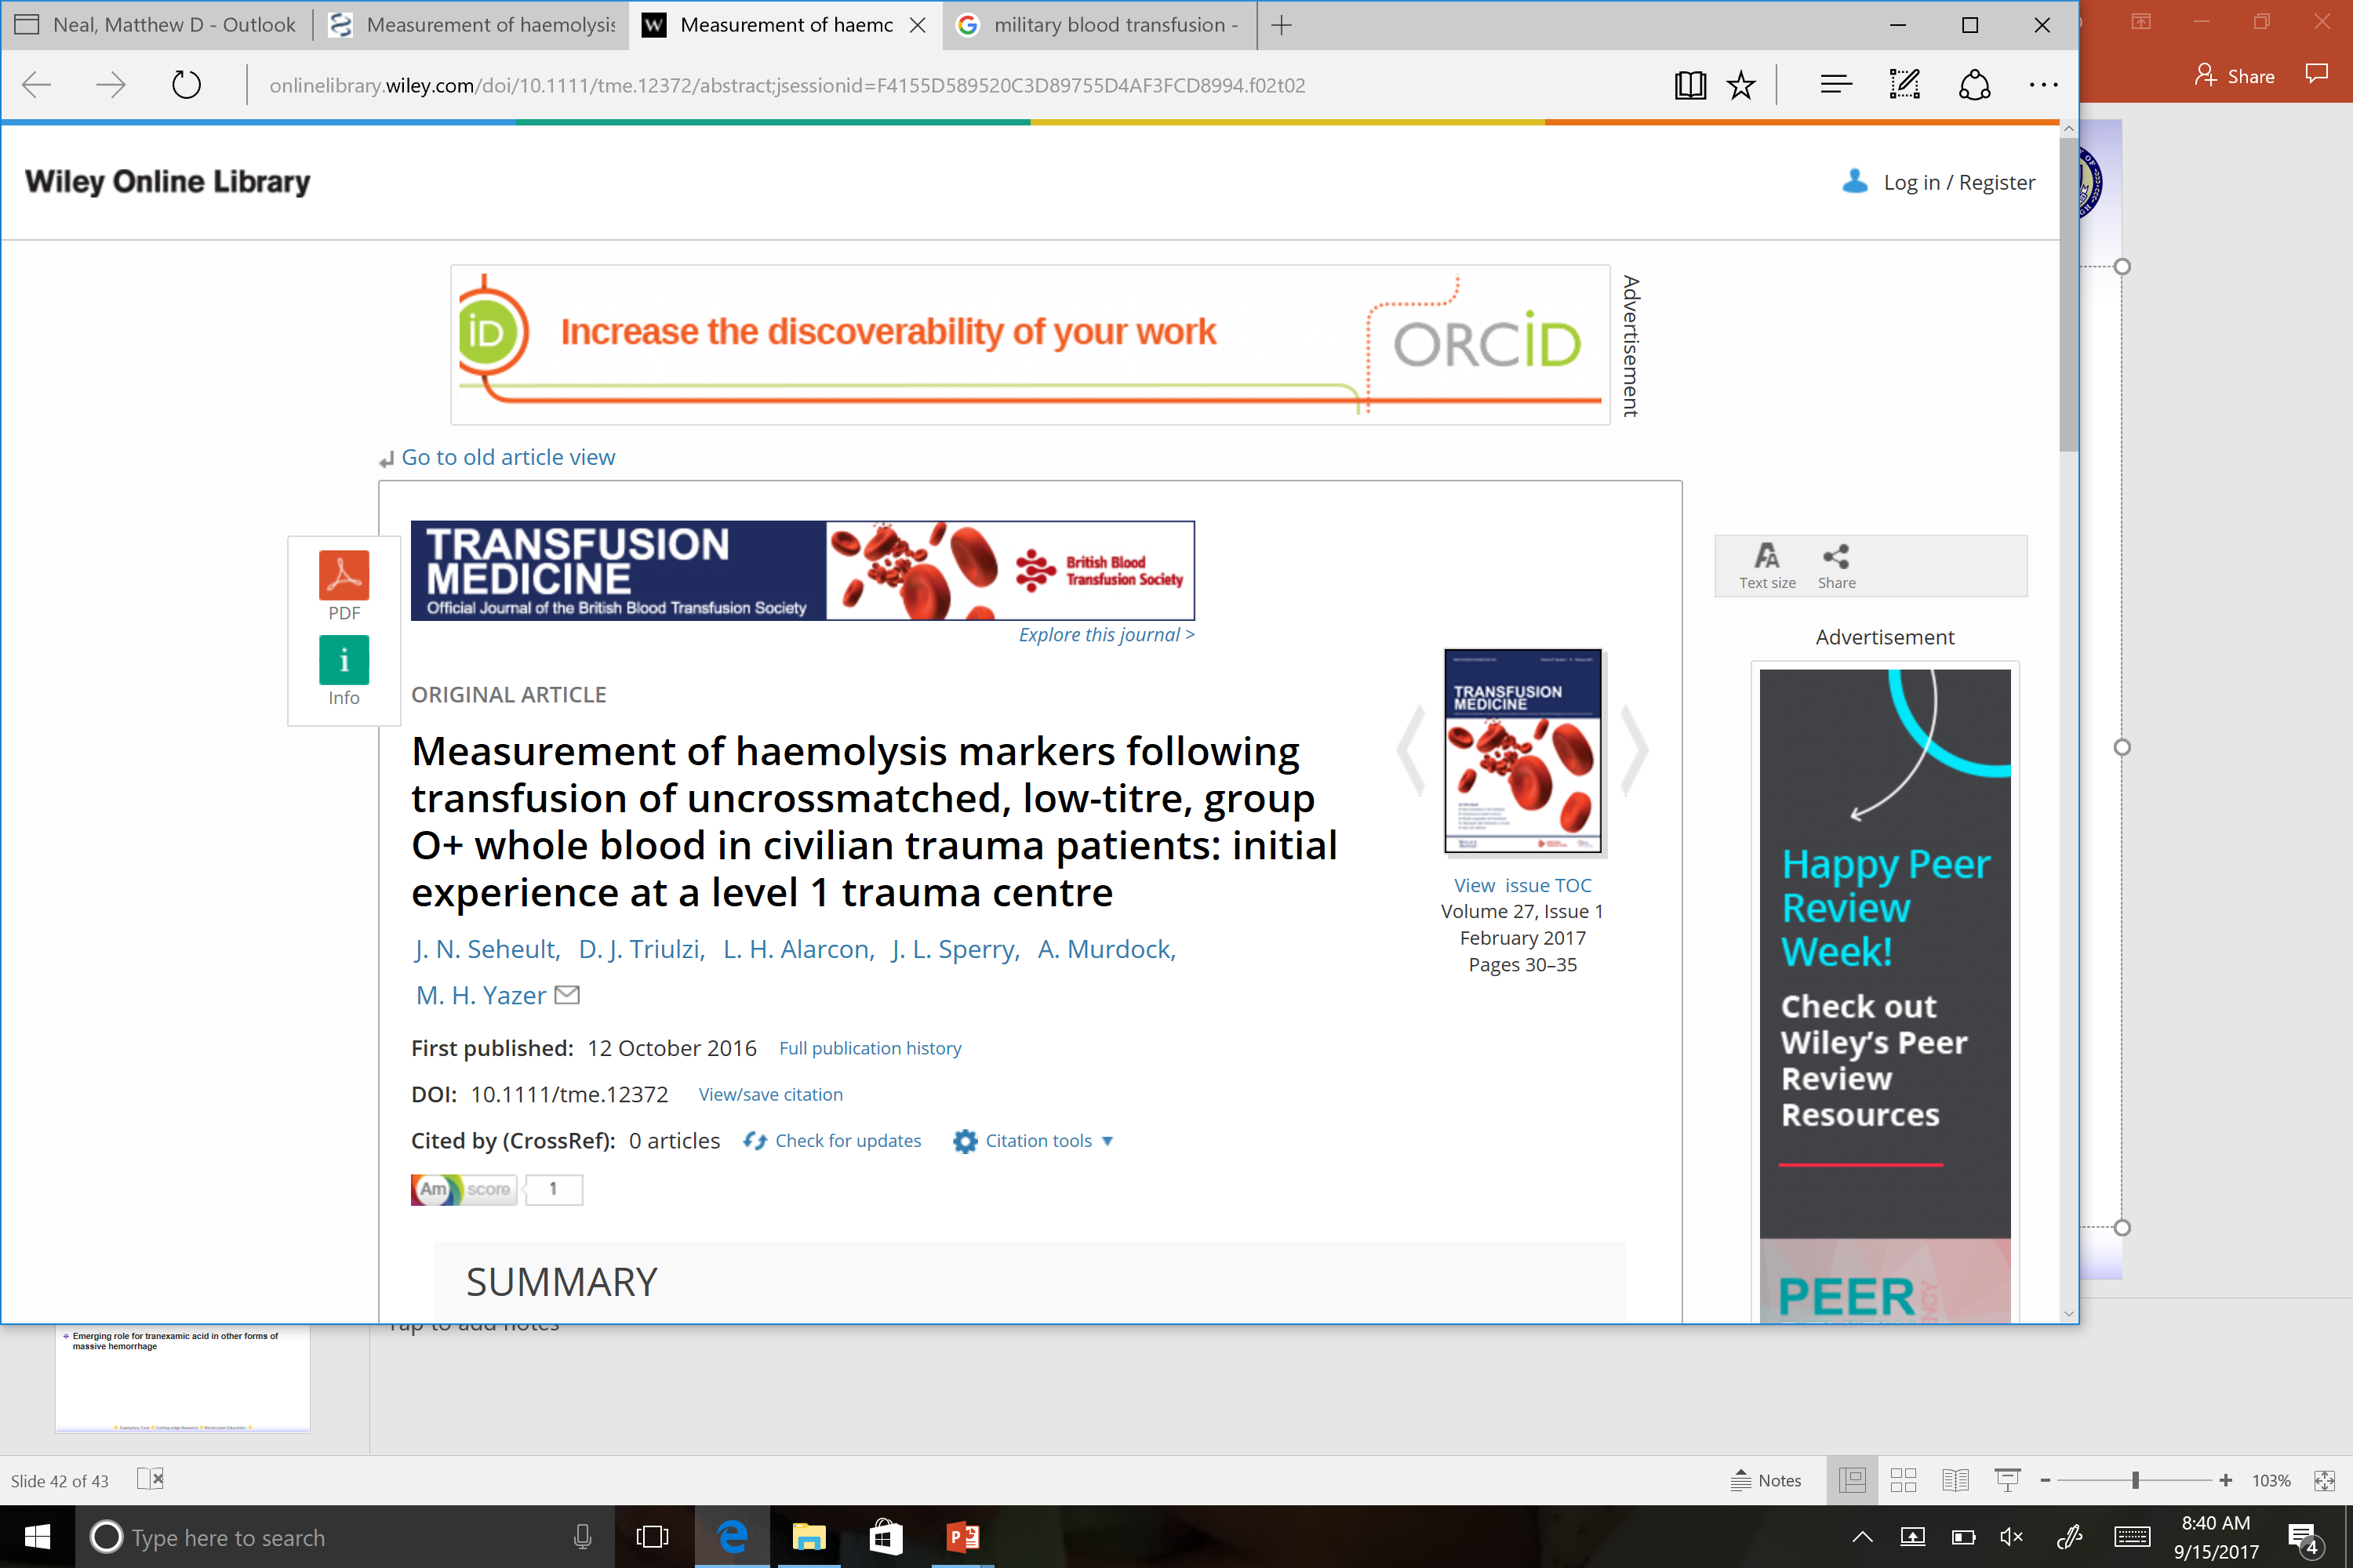
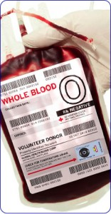
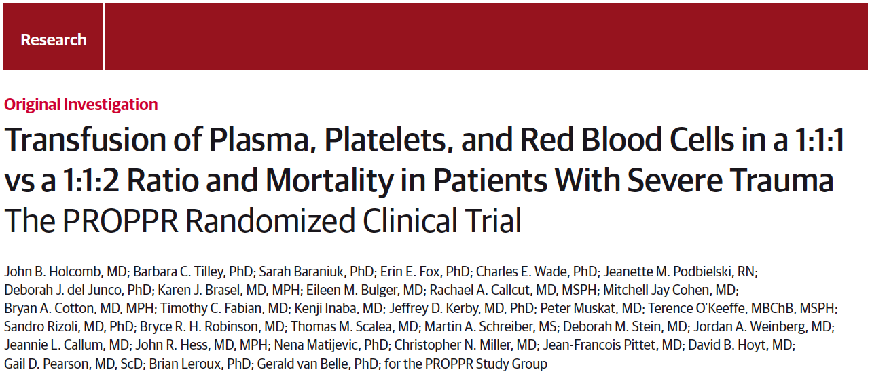
Civilian application of military medicine

Slide 5
Civilian tourniquet use: outpacing the data
Rapid growth
American College of Surgeons COT: prehospital guidelines
AHA and American Red Cross Guideline Update for First Aid
European Resuscitation Council Guidelines for Resuscitation: First Aid
Nearly all based on military data

Slide 6
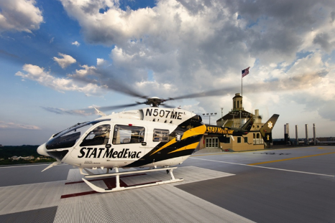
What do we know about civilian tourniquet use?
Systematic review and meta-analysis
Nine studies, 8 USA
Report from National Emergency Medical Systems Information System (NEMSIS) Database
>2700 cases
90% “effective” -- NO a priori definition of “effective”
Average duration of application 21-90 minutes
Kauvar DS, JTACS, 2018

Slide 7
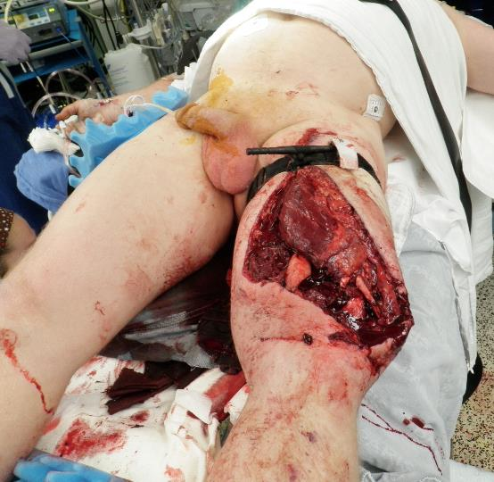
Civilian Tourniquets: Outcomes and Safety
Mortality averaged 6% (5 reports)
Amputation rate: 5.4% (4 reports)
ZERO attribution to TQ use
Myonecrosis N=1
All complications: 24% (3 studies)
--Extremity compartment syndrome 4%
--Peripheral nerve dysfunction 3.7%

Slide 8
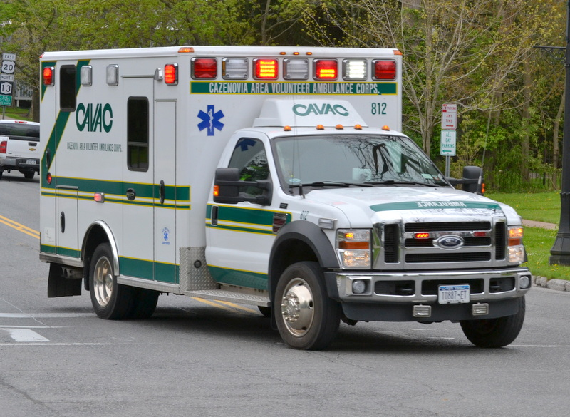
Major knowledge gaps in civilian tourniquets
Limited to a few trauma centers
68% from NEMSIS = blunt trauma
Limited information (injury pattern, MESS)
No prospective data
Difficult, (? Impossible), to have a control group
Lacking definition of indication
42 states in USA have EMS extremity exsanguination protocols, 15 provide indications

Slide 9
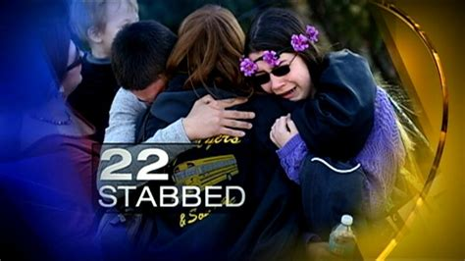
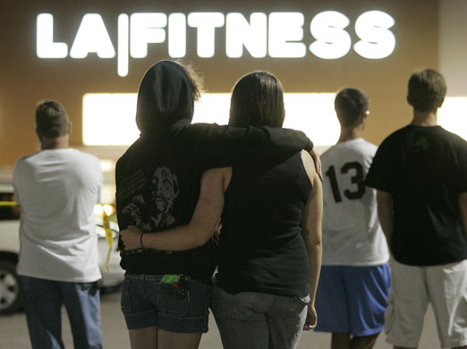
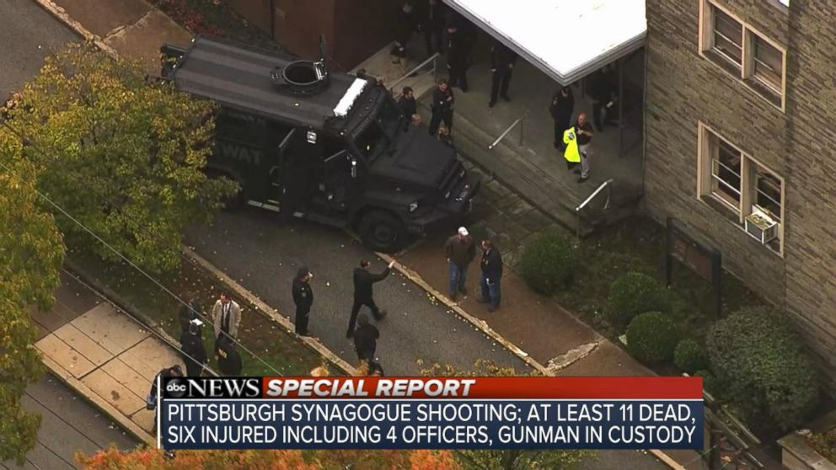
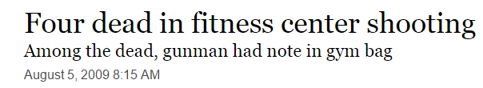
Civilian tourniquet implementation
Do we really need data?
Indications: Justice Potter Stewart….
How many?
--Goolsby C, et al. Equipping Public Spaces to Facilitate Rapid Point-of-Injury Hemorrhage Control After Mass Casualty, Am J Public Health, 2019. Answer = 20
What kind?

Slide 10
CoTCCC Recommended Tourniquets
Non-Pneumatic
Pneumatic
Combat Application Tourniquet Gen 6 (CAT-6)
CAT-7
Ratcheting Medical Tourniquet (RMT) Tactical
SAM Extremity Tourniquet (SAM-XT)
SOF Tactical Tourniquet-Wide (SOFTT-Wide)
Tactical Mechanical Tourniquet (TMT)
TX2 Tourniquet (TX2)
TX3 Tourniquet (TX3)
Delphi EMT (EMT)
Tactical Pneumatic Tourniquet 2” (TPT2)

Slide 11

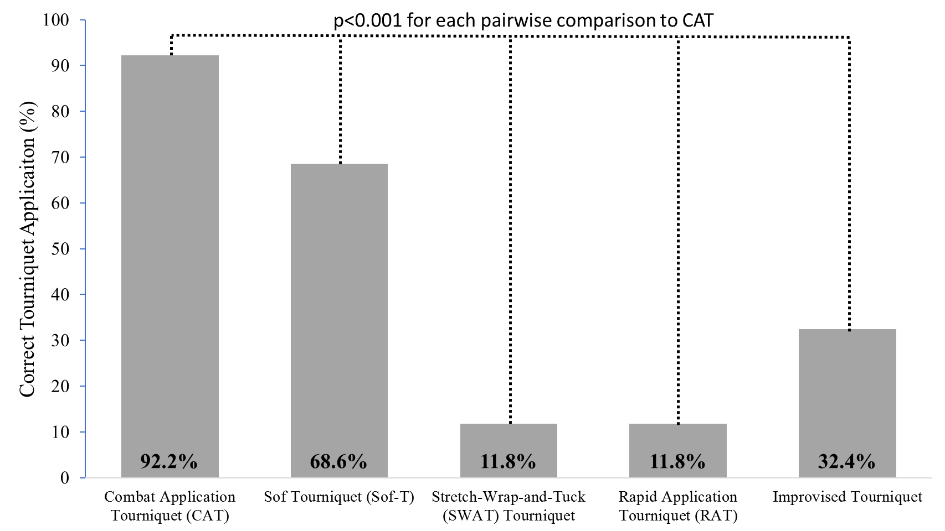


102 Laypeople Evaluated
Sof-T
CAT
CAT
SWAT
RATS
Improvised
RATS
Improvised
Sof-T
SWAT
Notes:
We performed a cross-over randomized trial evaluating laypeople immediately after completing the "Stop the bleed" B-Con course on their ability to apply 4 different types of commercial tourniquets and to improvise a tourniquet. Participants applied the tourniquets to a hapmed trainer, which is high-fidelty and provides feedback to the participant regarding whether the bleeding has stopped as well as telling the investigator how much pressure was applied and the estimated blood loss. Multiple pairwise comparisons were made between each tourniquet and the CAT tourniquet as this is the type most commonly taught in the course.
We found that there was a significant difference between the CAT and other commercial tourniquets which were applied at a significantly lower rate and that improvised tourniquets were correctly applied only a 1/3 of the time even when the optimum materials were provided.

Slide 12
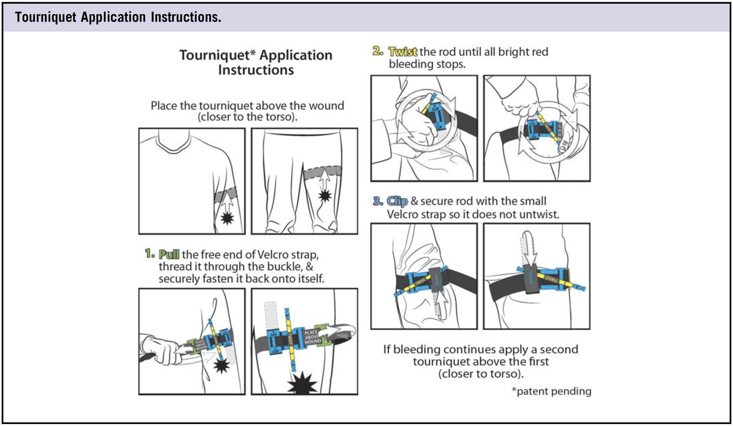
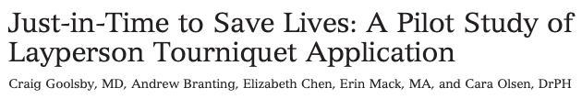
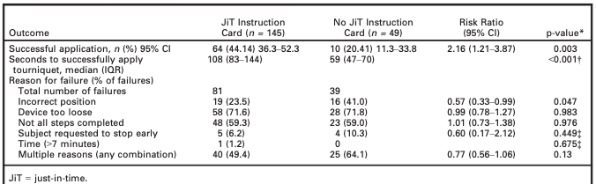
Notes:
Goolsby demonstrated that Just-in-time cards can enable laypeople without formal training to correctly apply a tourniquet 44% of the time compared to 20% for the control group when participants are handed the tourniquet along with instruction flashcard.
This is what the instructions look like describing the steps for tourniquet application.

Slide 13
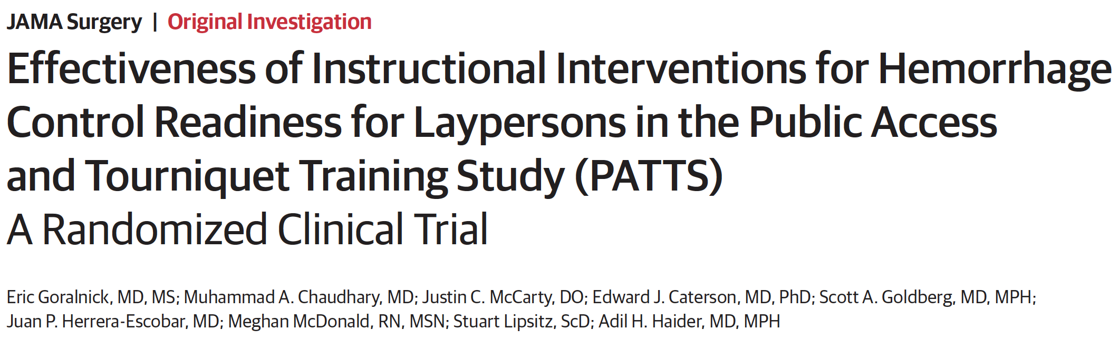
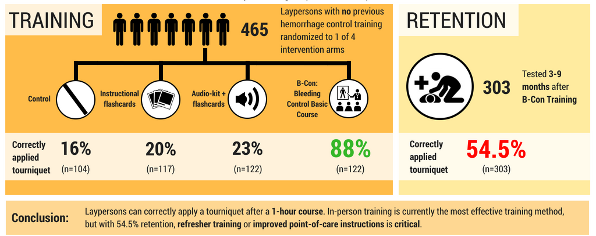
Notes:
In the PATTS trial, which we approached and powered with the expectation that flashcards and audiokits would have similar efficiacy to what was seen in Dr. Goolsby's study, we found that participants don't actually always interact with the kits as we expect and , in the case of the POC instructions, instead take the tourniquet out of the kit without interacting with the instructions. This illustrates an important difference between AEDs and tourniquets in that you can not separate an AED from its instruction but with a tourniquet you can. We do however, believe that, point-of-care instructions with further innovation and adaptation, similar to the process that AEDS when through, will play an important component in creating an efficacious population capable of responding in an emergency..
A component of this study was also to evaluate the longer-term retention of the B-Con training where we found that just over half of participants retain the skill 3-9 months later, but importantly younger adults retain the skill much more at a rate of nearly 70%.

Slide 14
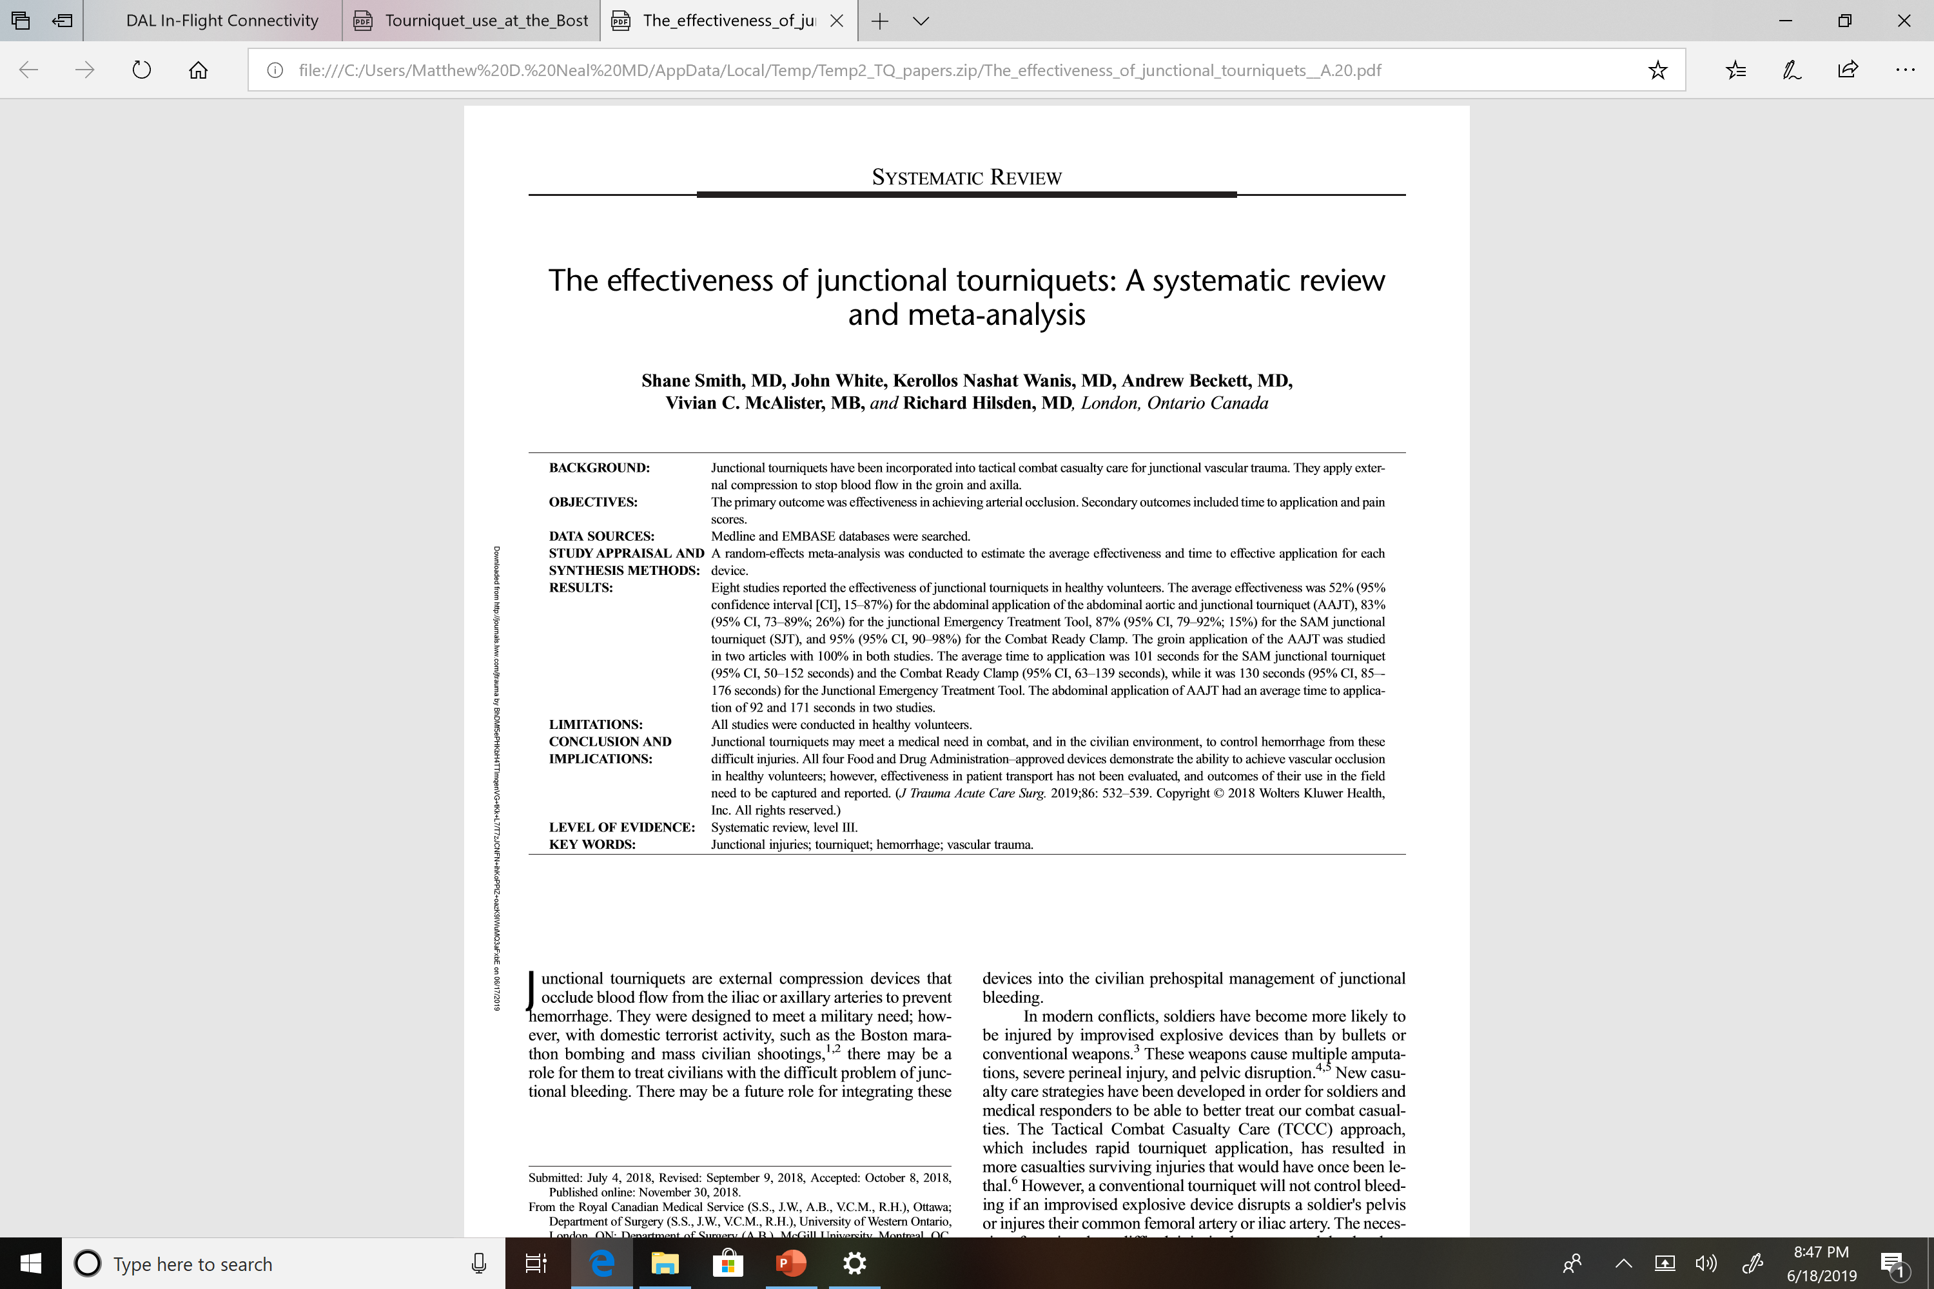
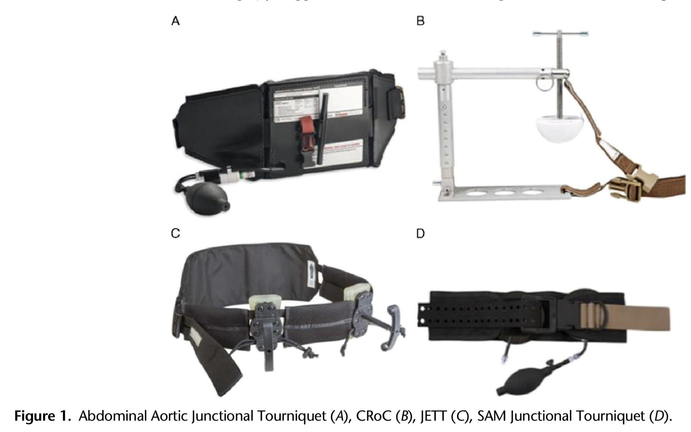
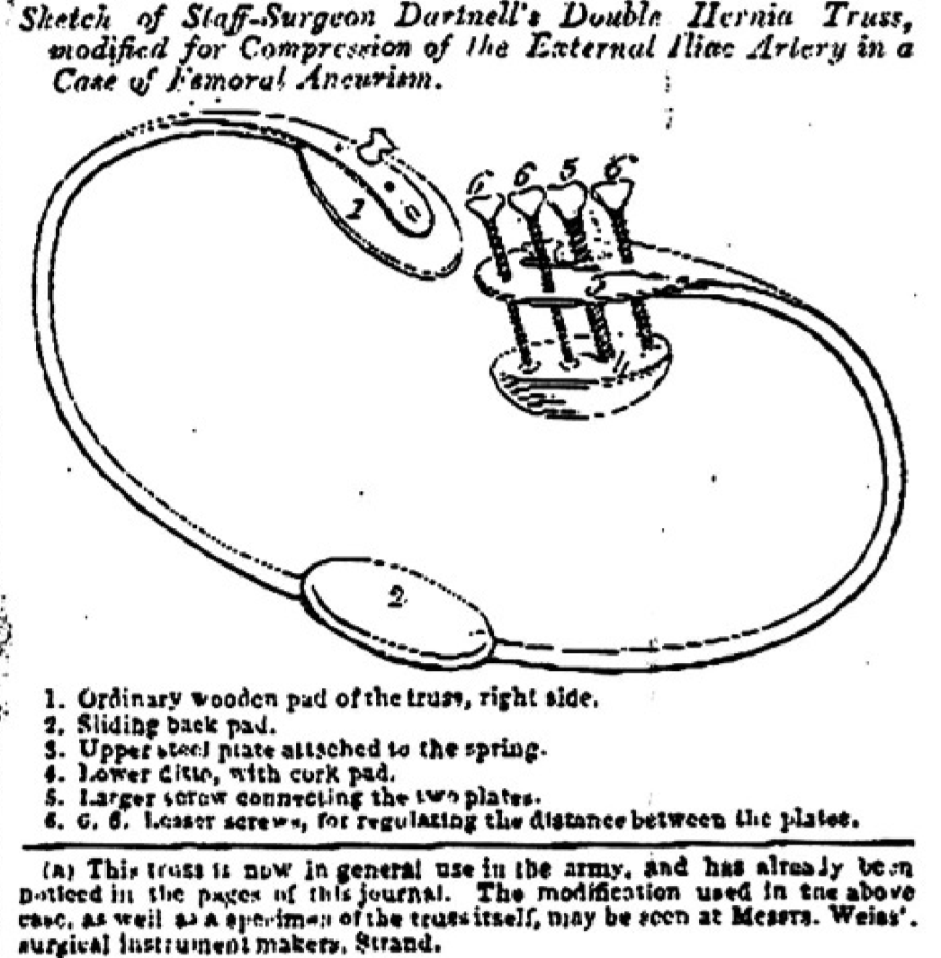
Tourniquet controversies: Junctional TQs

Slide 15
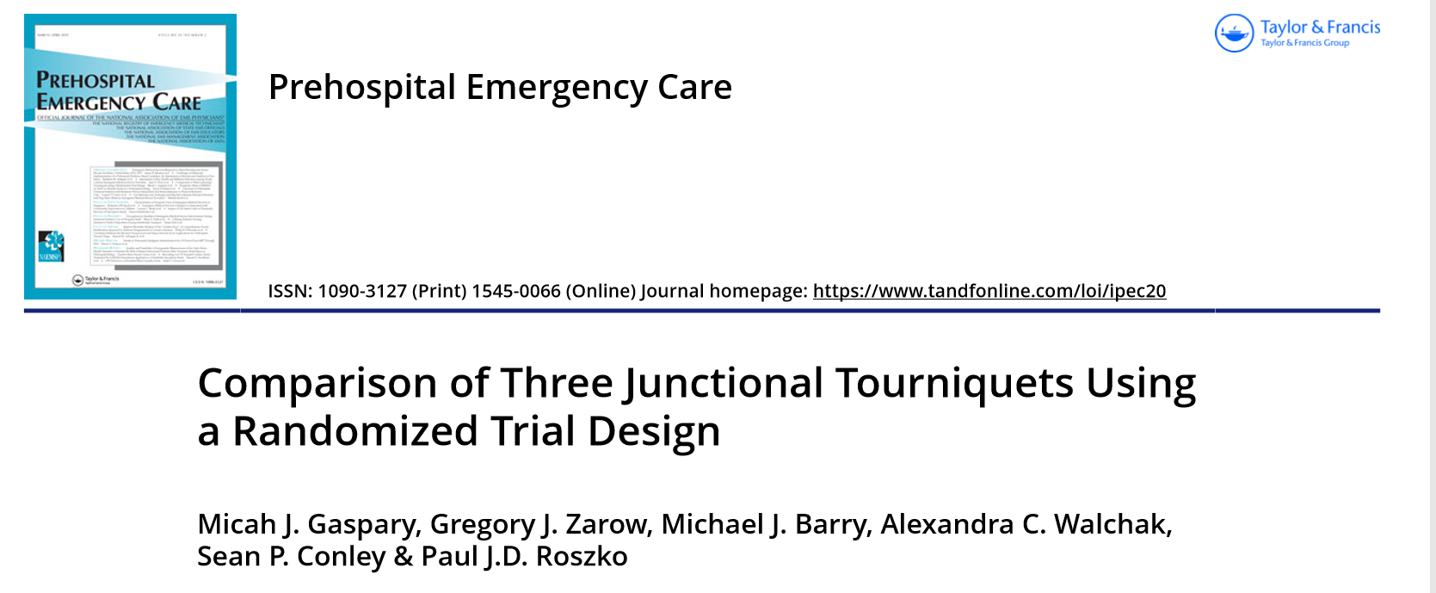
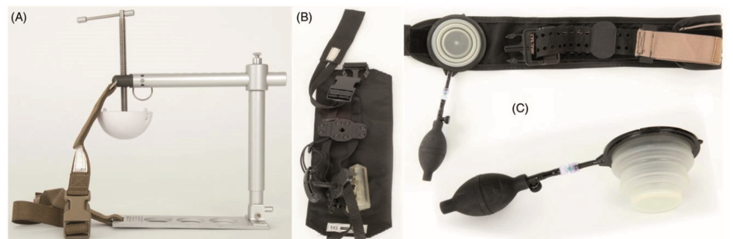
SJT, JETT, CRoC
Active duty corpsmen
JETT & SJT shorter application time
All effective in stationary
Abysmal (24-48%) efficacy
in transport

Slide 16
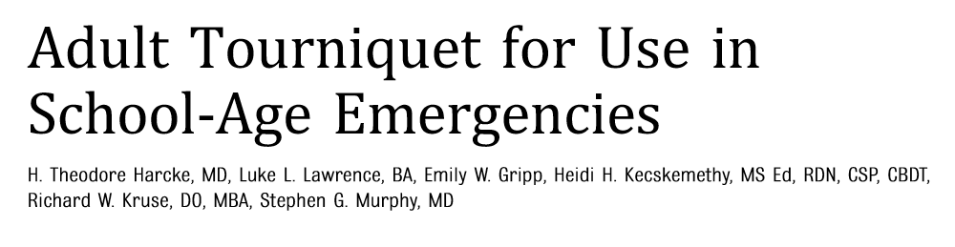
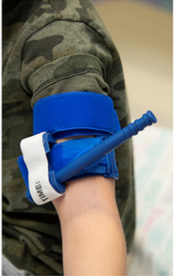
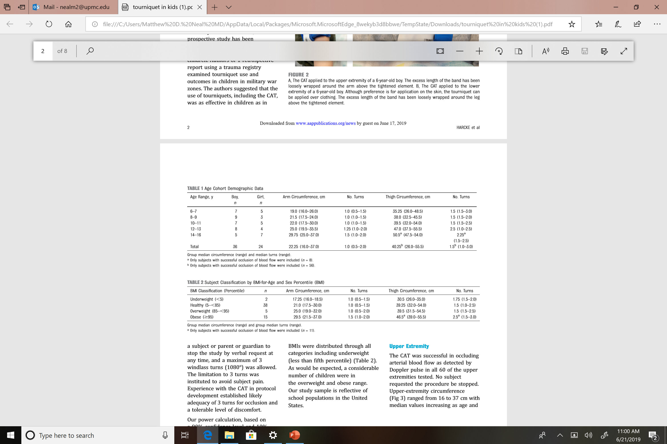
Special populations: Pediatrics
FEMA funded, American Red Cross partnered bleeding control program for school aged children

Slide 17
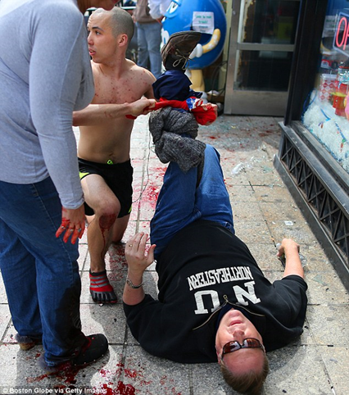
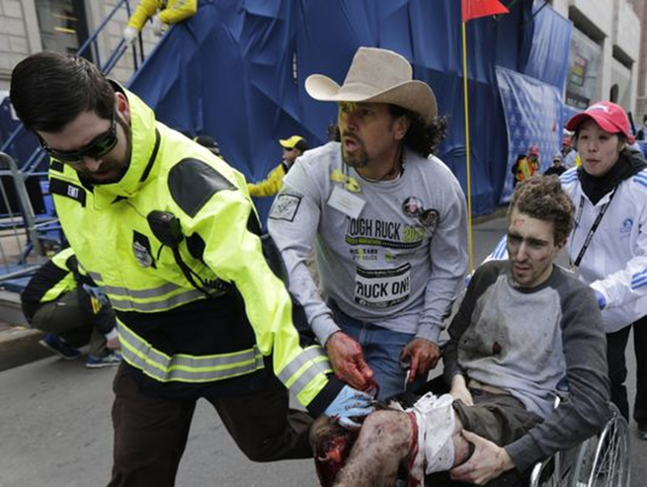
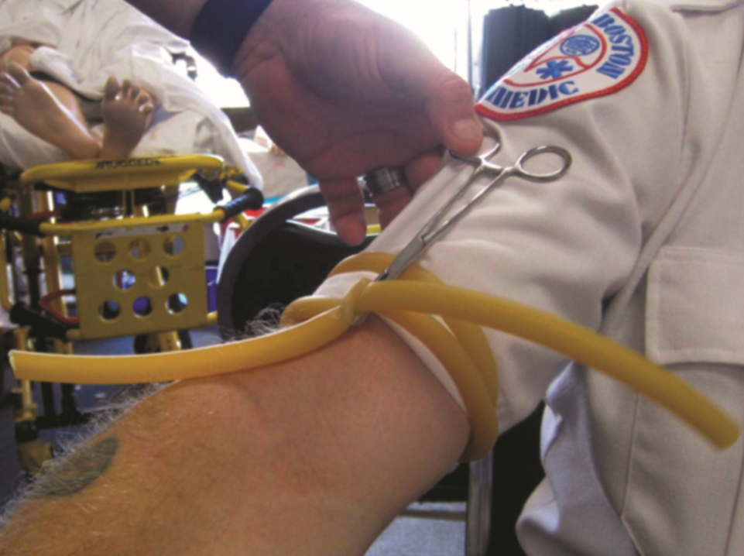
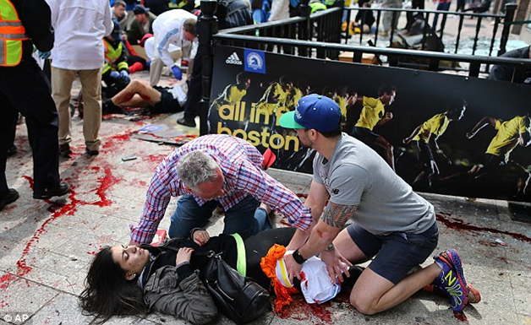
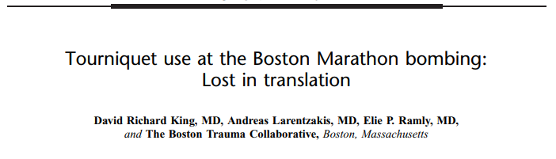
Improvised TQs: Boston Marathon Bombing
4/15/2013
66 Extremity injuries, 44% life threatening
Immediate responders placed 27 improvised tourniquets
Multiple venous, all ineffective
8 injuries without TQs

Slide 18
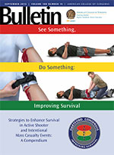

Hartford Consensus I - 2013
Joint Committee to Create a National Policy to Enhance Survivability from Active Shooter and Intentional Mass Casualty Events
Brought together experts from Trauma, EM, Law Enforcement, Fire/Rescue, EMS and Military
Goal to develop a coordinated response and strategy
  Initial focus on EMS and Law enforcement tactics
Notes:
Dr. Jacobs is the senior trauma surgeon and Vice President, Academic Affairs, Hartford Hospital; Director, Hartford Hospital Trauma Institute at Hartford Hospital – the closest trauma center to the Sandy Hook incident.
He personally embarked on a comprehensive review of the injuries and, through this examination process, determined that providing first responders with more ready access to the sites of active shooter and mass casualty
events could have a positive impact on survival.
Dr. Jacobs, with the backing of the American College of Surgeons and the ACS Committee on Trauma, then assembled a team of government and health care leaders, including representatives from the White House; the National Security Council; the Department of Homeland Security; the Federal Emergency Management Agency; law enforcement, including the Federal Bureau of Investigation; the Department of Defense; and prehospital and physician provider organizations.
The primary tenet of the Hartford Consensus is that no one should die of uncontrolled bleeding.

Slide 19
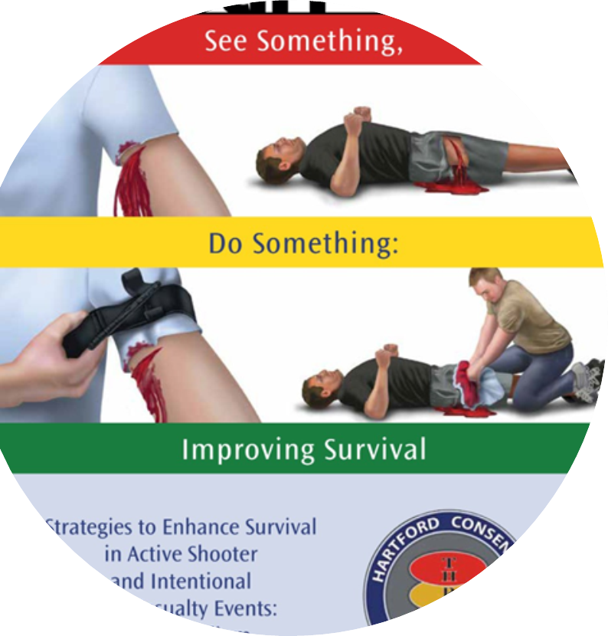
Hartford Consensus II: Public: Everyone Can Save a Life
The initial response to an intentional mass casualty event will almost always be from uninjured bystanders and minimally injured victims
Design educational programs and implement training
Train “IMMEDIATE RESPONDERS”
Preposition equipment in appropriate locations
Education message should include – “Run, Hide, Fight”

Slide 20
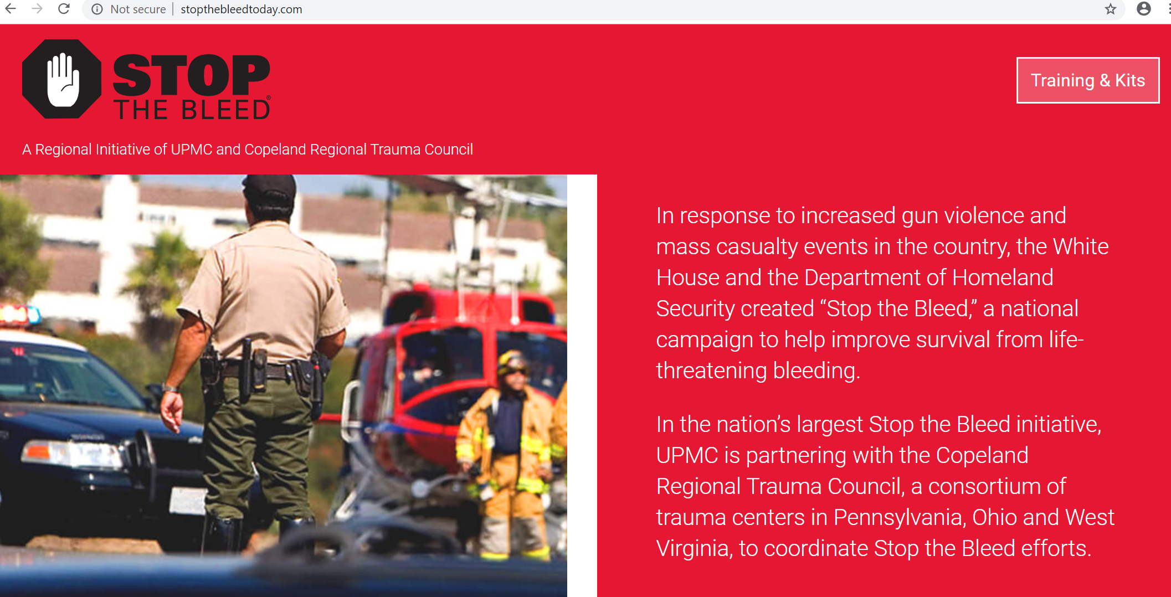
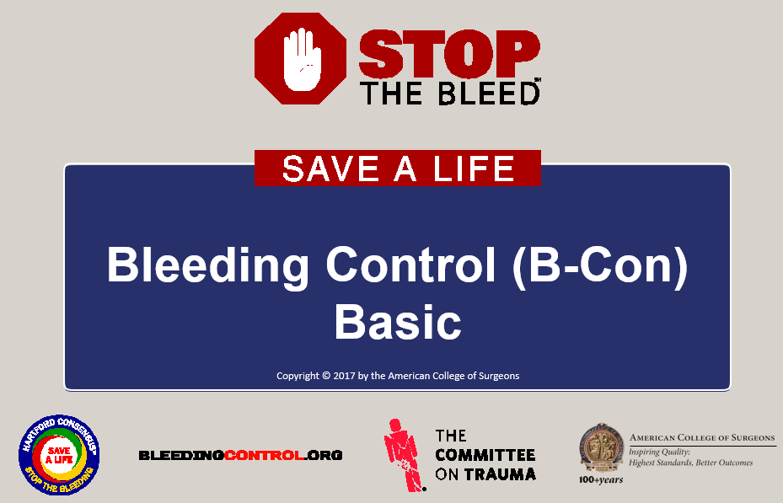
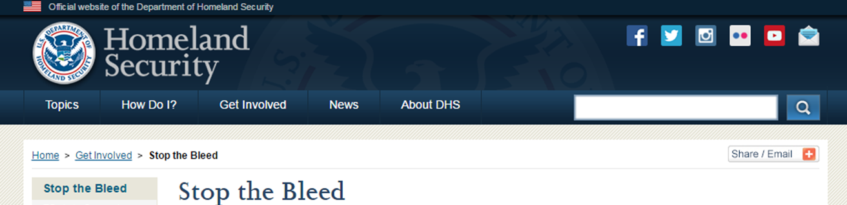
Stop the Bleed Campaign

Slide 21

Primary Principles of Immediate Response
Ensure your own safety
The ABCs of Bleeding
A – Alert – call 9-1-1
B – Bleeding – find the bleeding injury
C – Compress – apply pressure to stop the bleeding by:
  Covering the wound with a clean cloth and applying pressure by pushing directly on it with both hands, OR
  Using a tourniquet, OR
  Packing (filling) the wound with gauze or a clean cloth and then applying pressure with both hands
Notes:
These are the basic principles that should govern your response if you find yourself in one of these situations:
- First, make sure the scene is safe. You must ensure your own safety before trying to help someone else.
- Next, get help. Call or have someone call 9-1-1 for assistance. Make every effort to assure help is on the way as you proceed to the next step.
- Look for the site of bleeding. The site of the bleeding will frequently dictate how you will need to control it.
- Once you have located the source, control of the bleeding will involve the application of direct pressure, the placement of a tourniquet, the packing of an open wound or a combination of all of these techniques.
We will discuss each of these points in more detail in coming slides.

Slide 22
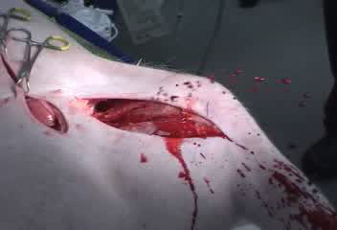
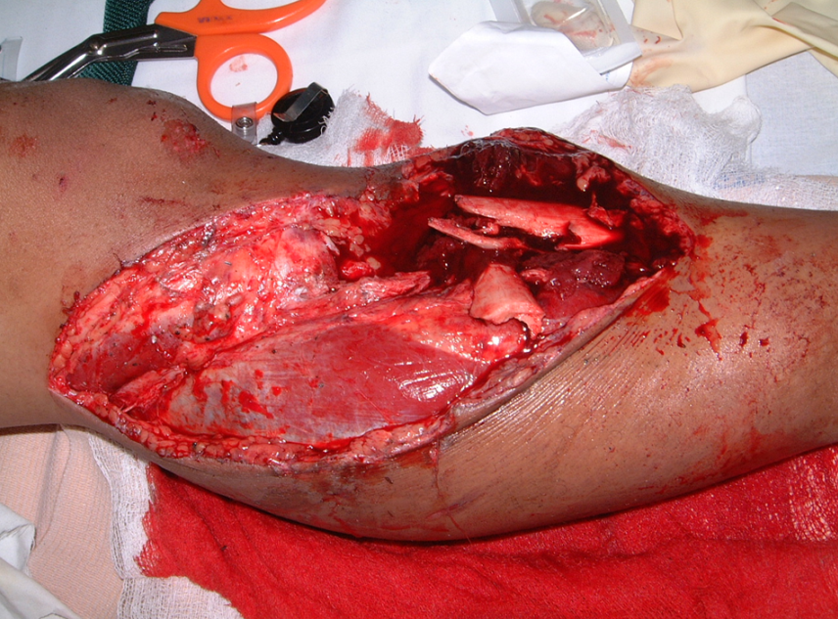
ABCs of Bleeding
Primary Principles:
B • Bleeding (continued)
What is “life-threatening” bleeding?
Blood spurting out of a wound
Blood soaking the sheet or clothing
Photo courtesy of Norman McSwain, MD, FACS, NREMT-P.
Notes:
Here are two illustrations of potentially life-threatening bleeding.
- On the left, you see blood that is spurting or pumping out of the wound.
- On the right, you see a large injury to an extremity with blood soaking the sheet underneath.

Slide 23
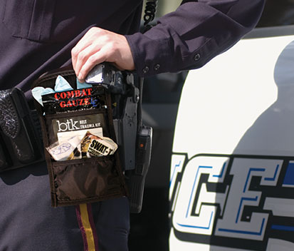
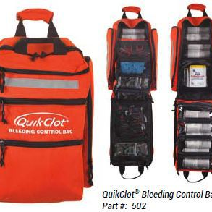
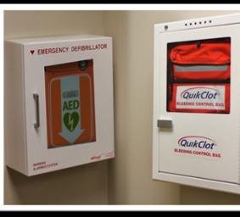
Building Equipment Capabilities
All police should carry a hemostatic dressing, gloves and a tourniquet
Bleeding control bags should be accessible in public places

Slide 24
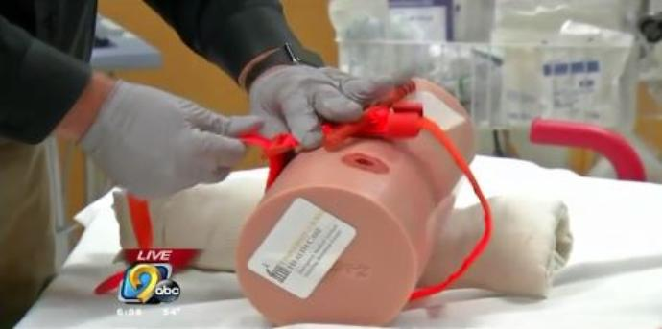
Western PA STB Initiative
Launched July 2016
Initial financial support from UPMC ($1.3 million), Jewish Healthcare Foundation, LHAS
Goal:
  Train as many immediate responders as possible
  Bleeding control kit in every school in Western PA
  Tourniquet on the belt of every LEO

Slide 25
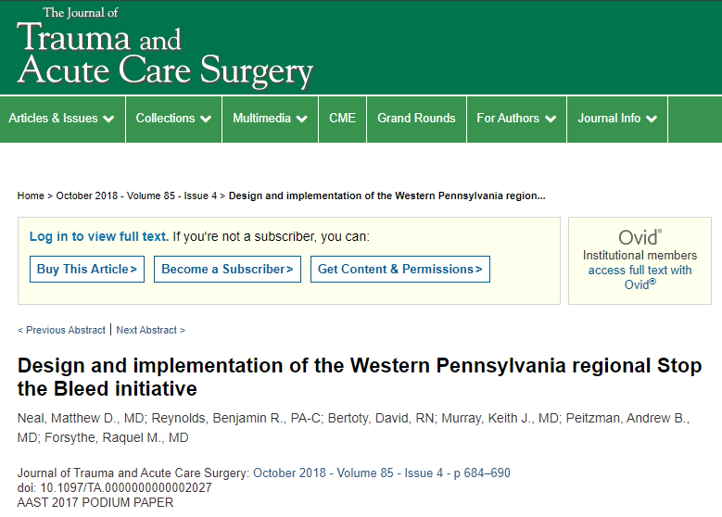
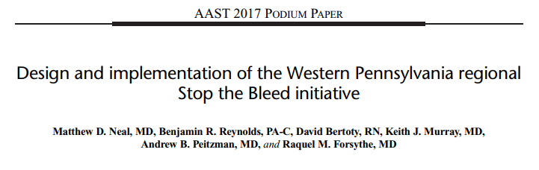
Western PA STB Initiative
- Model for Implementation of STB
As of June 22, 2019:
  Total trained: 46,232
  Trainers: 3,616
  Law Enforcement Officers: 6,850
  Immediate Responders: 33,766

Slide 26
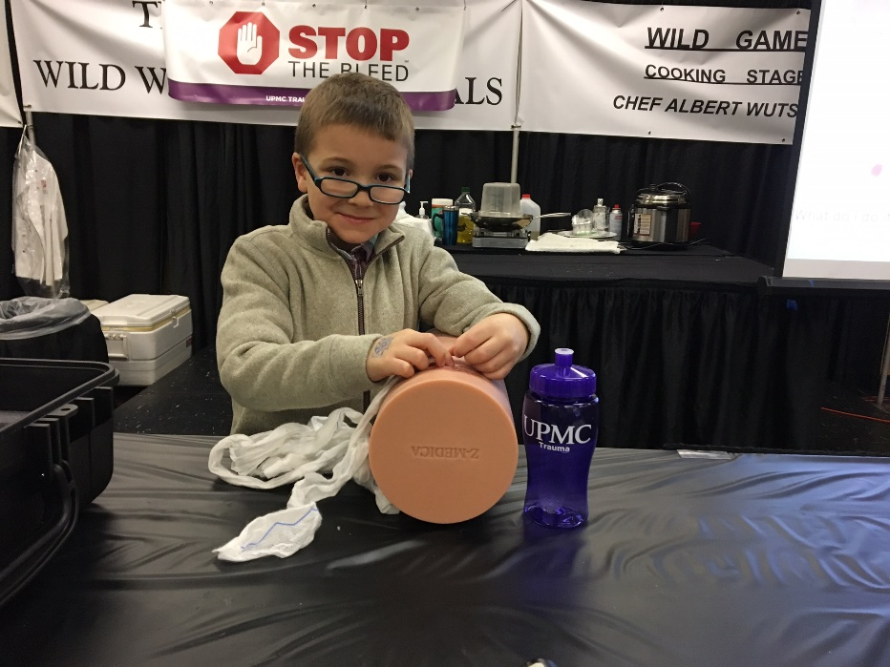
Western PA STB Initiative
Western PA STB Initiative
September 2017
Jewish HealthCare Foundation
$100,000 grant to purchase bleeding kits for EVERY synagogue in Pittsburgh
Active shooter training
Dedicated training in Squirrel Hill Synagogues -- with my 9 year old son
Notes:
Finding that some members of the public were at times overwhelmed by the training, I would frequently take my 9-year-old son along with me. Volunteering his time to teach and understand the issues was a valuable lesson for him, but it also provided strong evidence that “everyone” can indeed save a life by having a young child expertly demonstrate the basic skills of bleeding control. My son taught with me in Squirrel Hill synagogues, and while he taught community members how to apply tourniquets, they taught him about their place of worship, their community and their faith.

Slide 27
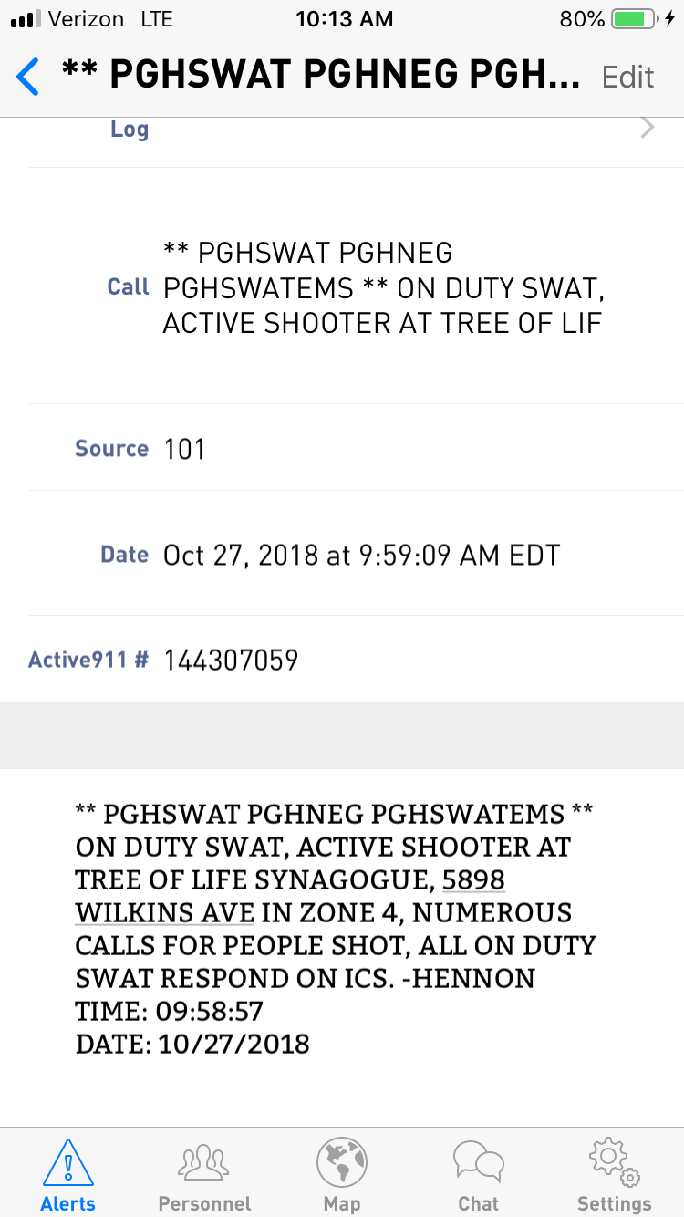
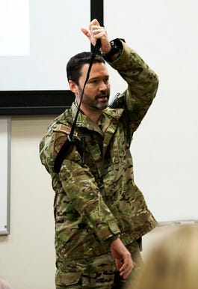
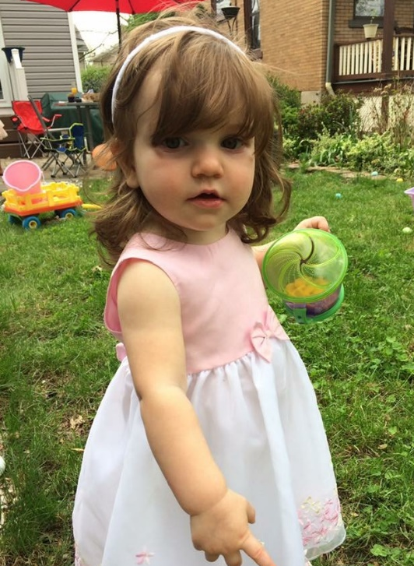
Saturday, October 27, 2018 – Ellie’s 3rd birthday
Costume party with 13 toddlers
11am start
PGH SWAT notification

Slide 28
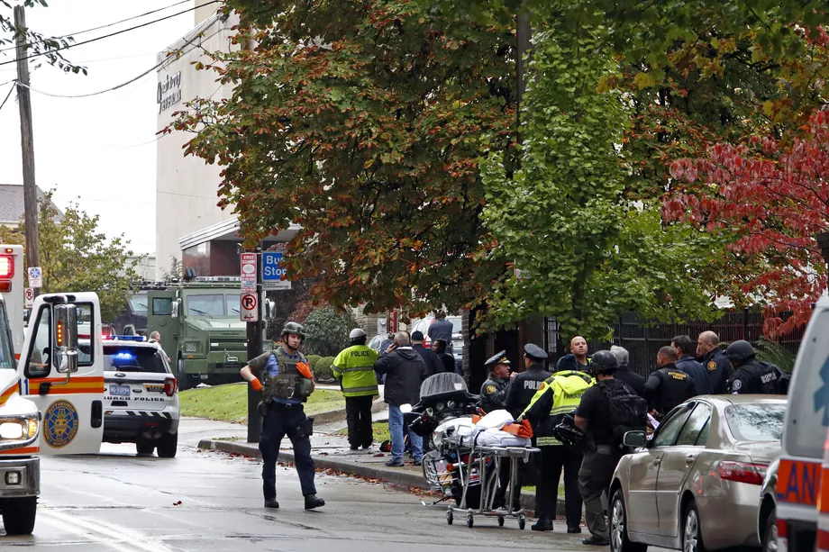
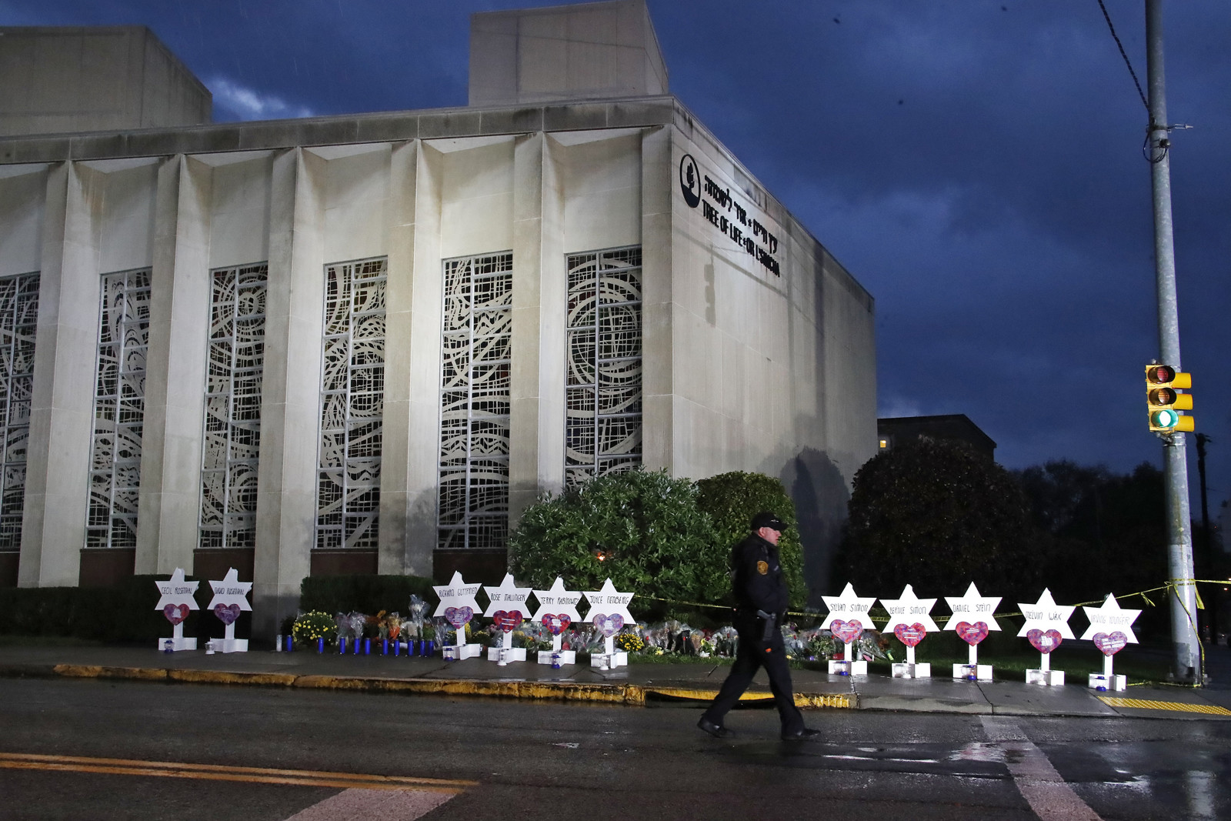
Saturday, October 27, 2018 – Tree of Life Synagogue Shooting
Pittsburgh’s Darkest Day
Notes:
A gunman, armed with an AR-15 assault rifle and three Glock 357 handguns, opened fire at a synagogue in Pittsburgh, Pennsylvania, on Saturday morning. Authorities said 11 people were killed and six others were injured, with two in critical condition. No children were among the dead, authorities said.
Police said that the suspect was in custody, and authorities later identified him as Robert Bowers, 46.
Wendell Hissrich, Pittsburgh Public Safety director, said at a press briefing that the scene inside was “very bad.” Bob Jones, the director of the FBI’s Pittsburgh office, said in an afternoon press conference that the attack led to “the most horrific crime scene” he had seen in two decades with the bureau.
Police responded to the incident, and the gunman fired at them as they approached. The four police officers’ injuries are not life-threatening.

Slide 29
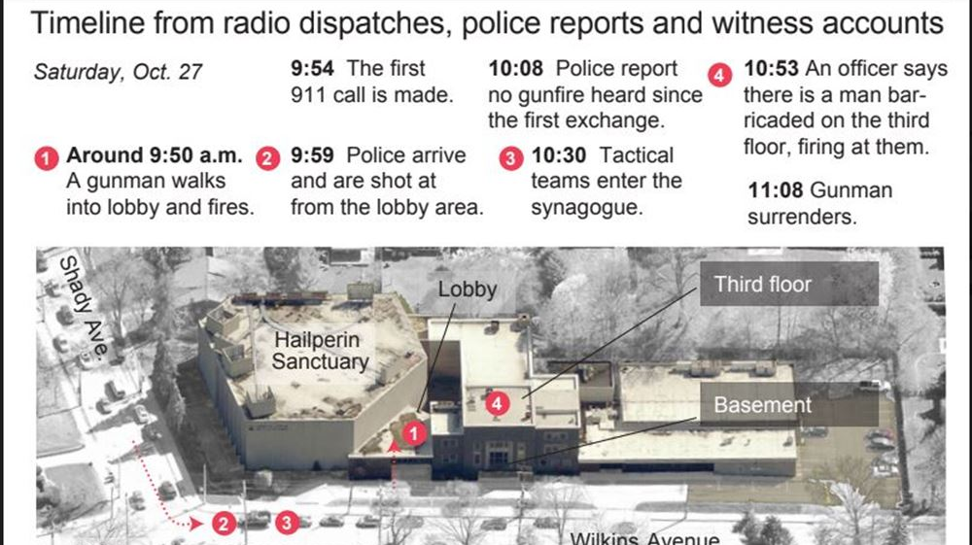

Slide 30

With a blunted sense of pride…
What went RIGHT
Everyone who left the synagogue alive on 10/27/18 is alive today
Three reasons
--Tactical Medical Care
--Stop The Bleed
--Modern Trauma Care
30 YEARS

Slide 31

Impact of Stop The Bleed at Tree of Life
Stop the Bleed training had been provided at TOL
There was a large Bleeding Control Kit at the scene
As a result of training, the Rabbi had his cell phone with him and was able to call 911 immediately
TEMS made entry alongside Pittsburgh SWAT
Multiple tourniquets applied at the scene to multiple victims by TEMS and Law Enforcement (TQs provided as part of STB training)

Slide 32


Operative Report
PATIENT NAME: LEGER, DANIEL R
MRN: 970045931
ACCOUNT #: 0248913728300
ROOM #: 6GF/G623
DATE OF BIRTH: 04/13/1948
SURGEON NAME: MATTHEW NEAL
ATTENDING PHYSICIAN: MATTHEW NEAL
SURGERY DATE: 10/27/2018
ADMISSION DATE: 10/27/2018
DISCHARGE DATE:
This is the first of three operative reports to be dictated to which will
be on the same day.
PREOPERATIVE DIAGNOSIS: Gunshot wound to the pelvis.
POSTOPERATIVE DIAGNOSIS: Gunshot wound to the pelvis.
PROCEDURES:
1. Exploratory laparotomy for control of hemorrhage.
2. Low anterior resection.
3. Small bowel resection.
4. Repair of bladder injury.
5. Exploration of left retroperitoneal hematoma.
6. Left groin exploration.
7. Application of negative pressure wound VAC.
SURGEON: Matthew Neal, M.D.
ASSISTANT: Gregory Watson, M.D.
SECOND ASSISTANTS: Crisanto Torres, M.D. and Maryam Mohammed, M.D.
ANESTHESIA: General.
ESTIMATED BLOOD LOSS: 5 liters.
FINDINGS: Destructive transpelvic gunshot wound with injury to left colon,
rectum; significant bladder injury; and small bowel and mesentery injury.
Large volume hemoperitoneum.
Six wounded to UPMC
Tourniquets saved at least 3 lives
--2 major arterial injuries
--one major venous and soft tissue injury
Tactical EMS and timely evacuation saved a 4th
WHOLE BLOOD

Slide 33


Tree of Life Survivors
Notes:
Daniel Leger, left, and Andrea Wedner, both survivors of the Tree of Life synagogue shooting, embrace after Pittsburgh Mayor Bill Peduto signed three gun-control bills into law, Tuesday, April 9, 2019, at the City-County Building in downtown Pittsburgh. (Steph Chambers/Pittsburgh Post-Gazette via AP)

Slide 34





Dr. Oz Show, Nov. 2018
Dr. Oz, Nov 2018

Slide 35
Conclusions
Civilian data on tourniquet use is limited
Junctional TQ and special populations lack even more data
Implementation and education should be the major focus
But…..
Preventable deaths still happen, maybe more common
Stop The Bleed saved lives

Slide 36

Questions?
  @macky_neal
  nealm2@upmc.edu
  www.bleedingcontrol.org
Acknowledgements:
Craig Goolsby, MD
Scientific Director
National Center for Disaster Medicine and Public Health

