Slide 1

Plasma for the Frontlines
Michael Adam Meledeo
Research Scientist, Coagulation and Blood Research
U.S. Army Institute of Surgical Research
25 June 2019

Slide 2
Disclaimer
The opinions or assertions contained herein are the private views of the author and not to be construed as official or as reflecting the views of the Department of the Army or the Department of Defense.

Slide 3
Whole blood is the goal…
Until whole blood logistics can be perfected, we will continue to optimize plasma usage
Can we normalize Role 1 usage of plasma?
  FFP untenable
  Two options: liquid (never frozen) plasma or dried plasma

Slide 4
Liquid plasma: 40-day storage
Never-frozen product (D5-40, n=20) versus fresh PPP (D0, n=6) and FFP/PF24 (lines, n=40).

Slide 5
Liquid plasma: 40-day storage
Platelet effect
Never-frozen product (D5-40, n=20) versus fresh PPP (D0, n=6) and FFP/PF24 (lines, n=40).

Slide 6
Freeze-dried plasma: end-of-feasibility
Terumo FDP at 2 year expiration date versus donor-matched frozen product. n=10 each

Slide 7
Freeze-dried plasma: end-of-feasibility
Terumo FDP at 2 year expiration date versus donor-matched frozen product. n = 10 each

Slide 8
Other plasma efforts: French LyoPlas
Extension of expiration
  Fibrinogen levels near threshold of 200 mg/dl,
  no significant decline over 21 months
  PT, aPTT elevated but steady
  FVIII declines but remains above 20% threshold
  Several FDPs have no clot function after expiration
Usability after temperature excursion
  >40 °C for 14 hours, peak 57.5 °C
  Immediate functional decline (~3 month loss)
  Relative stability

Slide 9
Impact of Intercept Pathogen Reduction Treatment on Cold-Stored Apheresis Platelets
James A. Bynum, PhD
Chief, Coagulation and Blood Research
U.S. Army Institute of Surgical Research
25 June 2019

Slide 10
Background
Platelet units pose the greatest risk of TTI amongst blood products.
  ~1:2000 platelet units deemed contaminated via active surveillance each year.
The reemergence of Zika and Chikungunya suggests the need for pathogen reduction technologies (PRTs).
  INTERCEPT system – FDA-approved for platelets and plasma.

Slide 11
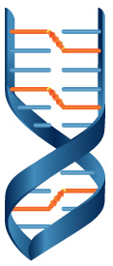
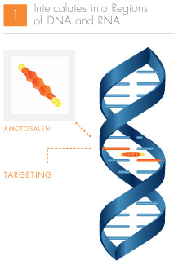
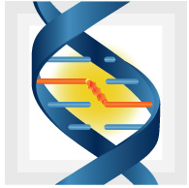
INTERCEPT Blood System
1) Amotosalen—added to platelets or plasma—intercalates into regions of DNA and RNA.
2) UVA light activates amotosalen and causes crosslinking in DNA strands.
3) Replication, transcription, and translation are blocked.
Amotosalen
UVA Illumination
Targeting
*Images adapted from Cerus

Slide 12
Platelet Count, pH, and Metabolism
CTRL
INT
* p<0.05 vs CTL (same day)
  Platelet counts are comparable.
  Lactate levels are significantly reduced in INT samples.

Slide 13
ROTEM
CTRL
INT
  INT-treated plasma samples show prolonged CFT.
  Clot strength is reduced starting at Day 7 in INT samples.
  Lysis does not occur in INT samples

Slide 14
Platelet Constitutive and Activation Markers
CTRL
INT
  INT platelets in plasma show increased activation at Day 14 of storage.

Slide 15
Thrombin Generation
CTRL
INT
  ETP is comparable between INT and CTL platelets.

Slide 16
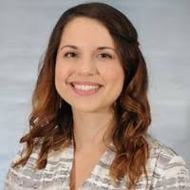
Conclusions
INT samples showed similar hemostatic function to untreated cold-stored bags.
Lactate levels were significantly decreased in INT-treated samples.
INT samples are more activated and have comparable thrombin profiles.
Amicus/Intersol-Treated samples demonstrated improved fxn—Increased use of PAS in CSPs should be explored/optimized!
Kristin Reddoch-Cardenas, PhD Staff Scientist
Kristin.m.cardenas2.ctr@mail.mil

