Slide 1
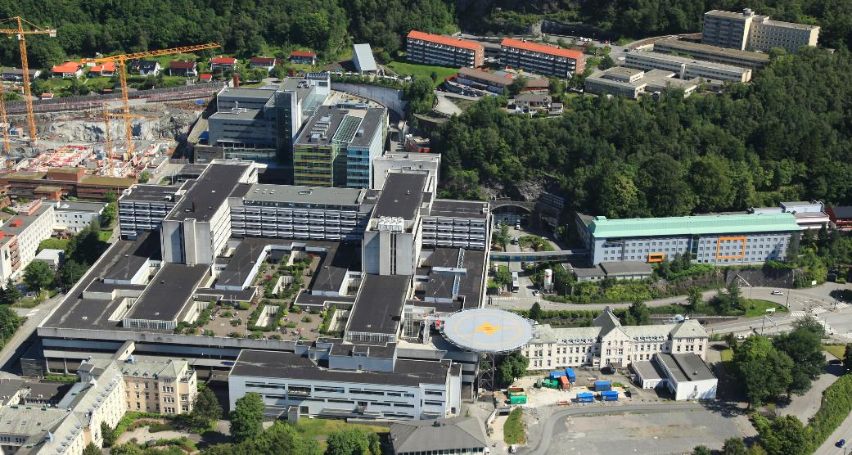
Haukeland University Hospital
Notes:
13200 employees several sites
Om lag 984 000 pasientmøte. Dette omfattar innleggingar og polikliniske konsultasjonar i somatikk, psykisk helsevern og rus. Radiologiske undersøkingar er ikkje inkludert.
Totalt kostnadsbudsjett for 2021 på kr 13,463 mrd.
Investeringsbudsjett på kr 1,775 mrd. til nytt medisinsk utstyr og nye bygg
229 ulike yrkesgrupper
4709 fødslar
40 000 operasjonar utført
11,4 millionar laboratorieanalysar

Slide 2
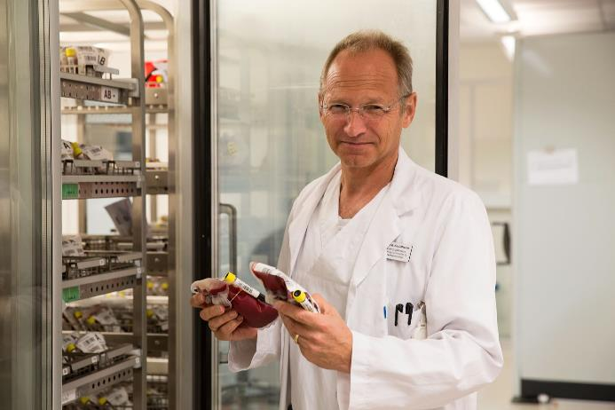
Bergen Bloodbank perspective
Increasing use of LTOWB
Cold platelets
Dried plasma
Sender et al. PloS 2016

Slide 3
Bergen
Notes:
1640 units dispensed to 493 pts
>1000 units to Norwegian Armed Forces Joint Medical Services
LTOWB increase in non-trauma use?

Slide 4
Bergen
LTOWB user survey - Logistics: easier to dispense, store, transport and transfuse
Logistics handling and forward storage of LTOWB a.o.
To leukoreduce or not leukoreduce….?

Slide 5
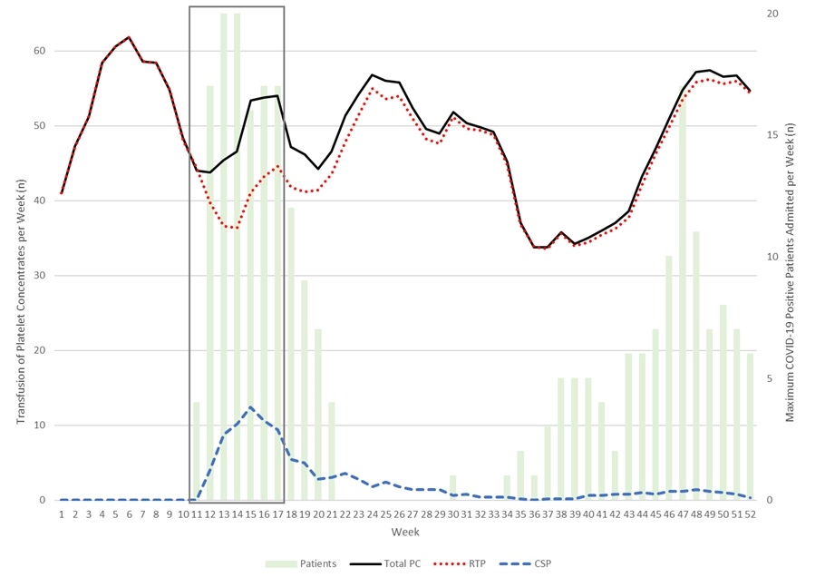
Cold platelets
Underconsumption?
  Bloodbank logistics
  Awareness & knowledge
Delayed cold-stored platelets?
Cold buffycoat platelets?
Braathen et al. 2022

Slide 6

Dried plasma and other
Availability and supply
In-house production
  Available technology?
  Regulatory obstacles
Anaerob redcell concentrates?
Notes:
Machu Picchu med huayna picchu i bakgrunnen

Slide 7
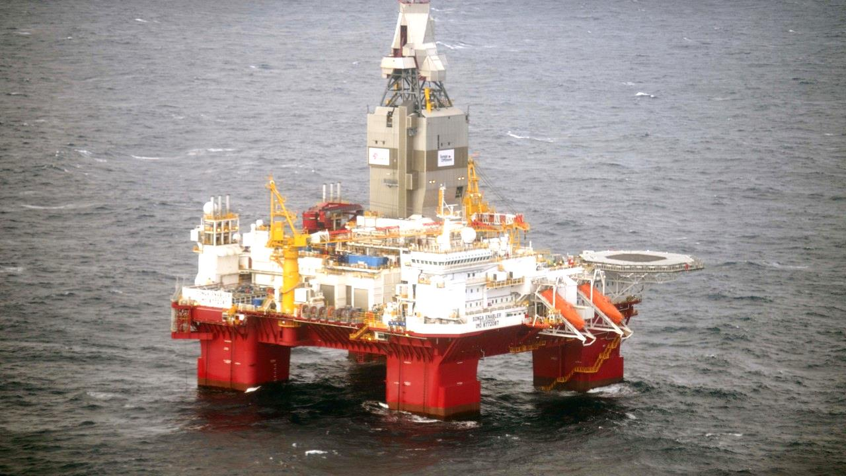
National bloodproduct preparedness
Lack of coordination
  Civilian-civilian and civilian-military
Lack of oversight
Bloodproduct preparedness not incorporated into laws and regulations
And much more….

