Slide 1

Some advice on implementing an LTOWB program at your hospital
Mark Yazer, MD
Professor of Pathology, University of Pittsburgh
Adjunct Professor of Clinical Immunology, University of Southern Denmark
Visiting Professor of Pathology, University of Tel Aviv

Slide 2
The Pittsburgh approach to use of WB in adult trauma
Started in December 2014
Male trauma patients with hypotension of any age
  Female trauma patients ≥50
2, 4, 6, 8 WB units kept in the emergency room refrigerator for immediate use
After these 8 units administered, conventional products administered as per TEG results
  Also possible to use 2 more LTOWB units in MTP
X
X
X
X

Slide 3
2630 recipients, 5940 units since 2014
5
6
>6
4
# LTOWB units/patient
3
1
2

Slide 4
7 years of LTOWB at 2 level 1 centers

Slide 5
7 years of LTOWB at 2 level 1 centers

Slide 6


The calculus of titering WB
No titer
100%
<50
80%
<100
<200
98%
98%

Slide 7
25 months of Vitalant’s experience collecting & supplying whole blood titer <100 to 5 hospitals
355 whole blood units collected/month
262 units used as LTOWB or RBC (74%)
93 units wasted (26%)
117 used as LTOWB
145 used as RBC
Deferral rates
Titer <50: 16%
Titer <100: 7%

Slide 8
How to reduce waste from unused LTOWB

Slide 9
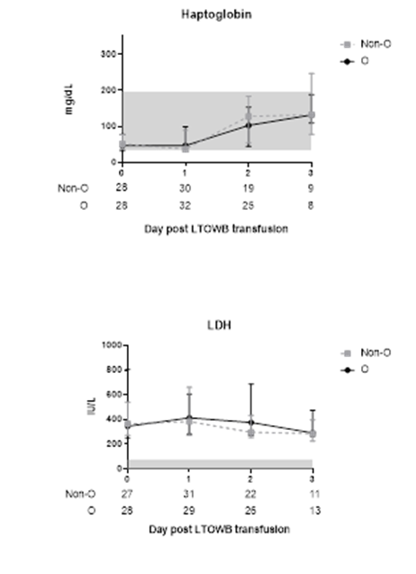
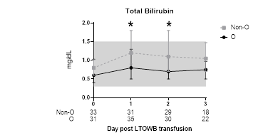
No hemolysis amongst adult recipients of ≥4 LTOWB units
Non group O (n=39, 9 received ≥6 units)
Titer <100
Group O (n=38, 9 received ≥6 units)
Yazer et al. Transfusion in press

Slide 10
The Pittsburgh approach to WB in peds trauma
Started in June 2016
For both male and female trauma patients
O neg WB, titer <50, <100
Signs of shock due to hemorrhage with hypotension
≥ 15, 10 kg and ≥ 2, 1 years of age
Maximum of 20, 30, 40 ml/kg
1 WB unit kept in the emergency department refrigerator for immediate use
After maximum amount of WB administered, conventional products administered as per TEG results
X
X
X
X
X
X

Slide 11
No hemolysis amongst pediatric recipients of 20-40 ml/kg LTOWB units
Titer <50
N=26
N=21
Morgan KM et al. Transfusion 2021;61:S8-S14

Slide 12
If I was starting an LTOWB program now…
Start with 8 units for adults, 40 ml/kg for kids
Give D+ LTOWB to all injured adults
Would include LTOWB in MTP for everyone else
Use LTOWB for children
Any reasonable titer is safe in adults
  <50 is too low to sustain the inventory
Can keep some LTOWB in emergency fridge and have more available from the blood bank
Try and recycle or move older units to reduce waste
Measuring biochemical markers only needed for recipients of >6 units

Slide 13
LTOWB is commonly used at American Level 1 trauma centers
43/103 = 42% use LTOWB (additional 14 implementing “soon”)
22/43 = 51% use LTO+WB for FCP
AABB changed LTOWB standard
Yazer MH et al. Transfusion 2021;61:1757-1763

