Slide 1
Tranexamic acid: The Story Continues…
Joseph F. Rappold, MD FACS
CAPT MC USN (Ret)
Maine Medical Center/Tufts University

Slide 2
Disclosures/Funding
No disclosures
DoD (CDMRP MBRP Award#W81XWH-20-1-0474)
Pilot Grants
  Maine Medical Cardiovascular Research Institute
  Tufts University School of Medicine

Slide 3
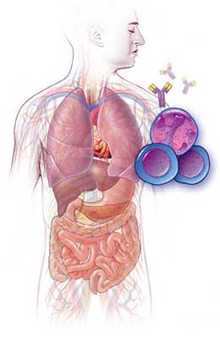
PRO-INFLAMMATORY RESPONSE
P.I.C.S.
Failed Resuscitation
IL-1
IL-6
TNF-α
Genomic effect
Insult/Injury
DAMPs
Homeostasis
TGF-β
IL-10
FGF
Melanocortin
Genomic effect
ANTI-INFLAMMATORY RESPONSE

Slide 4
Events following trauma
Release of Damage Associated Molecular Patterns (DAMPs)
Enhanced production and secretion of pro-inflammatory cytokines
Loss of glycocalyx from endothelial cells (Kozar/Pati)
Increased permeability of endothelial monolayer
  Edema
MSOF/ARDS/AKI

Slide 5
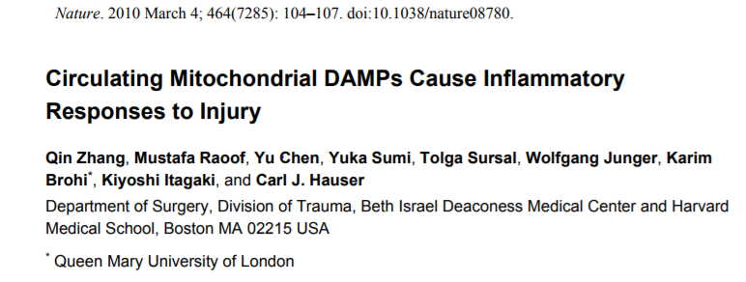
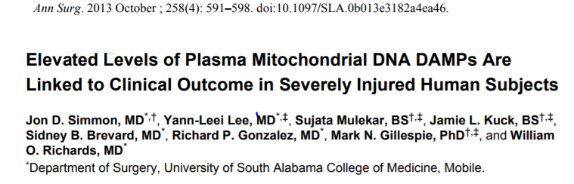
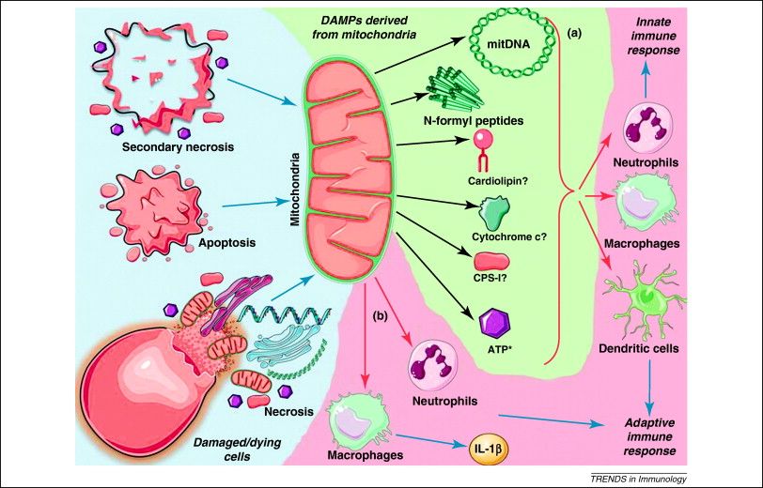
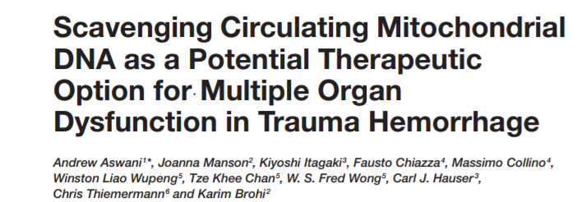
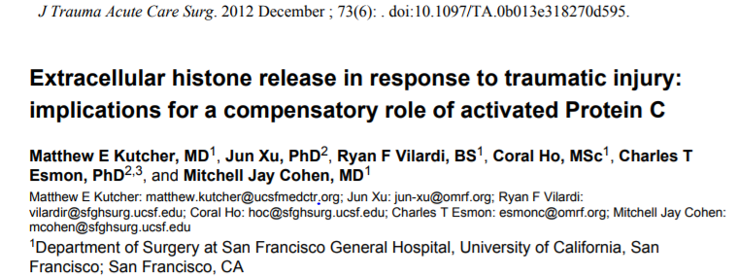
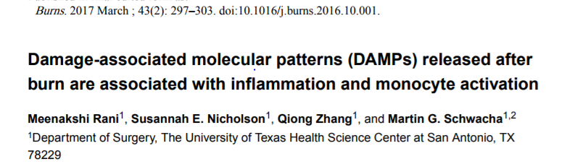
DAMPs
DAMPs= Damage associated molecular patterns

Slide 6
Examples of DAMPs
HMGB1
S100 family proteins
Histones
mtDNA*
Formylated peptides

Slide 7
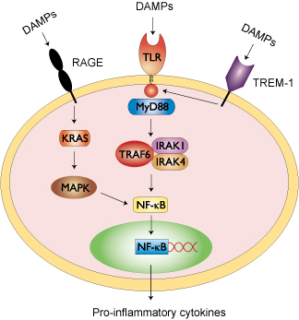
IL1α, Il1β, IL6, IL8, TNFα

Slide 8
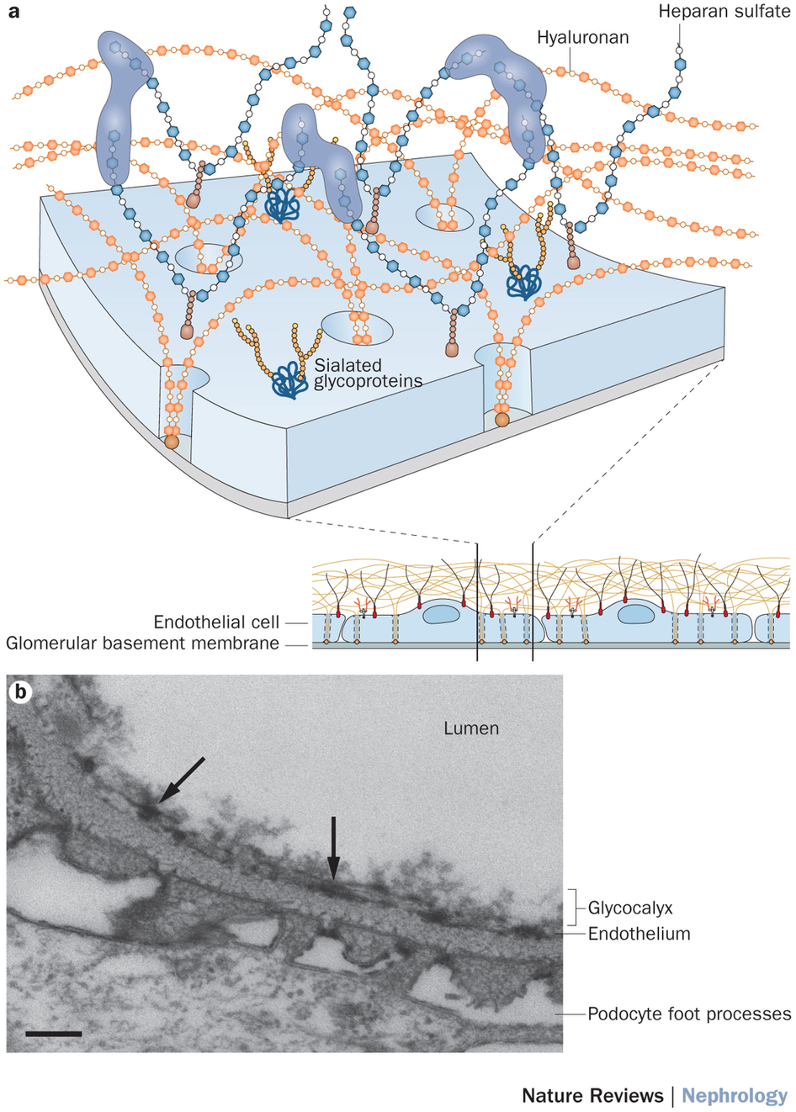
Endothelial
glycocalyx

Slide 9
Damage to the glycocalyx
Affects luminal surface of the endothelial cell (EC)
Compromises the status of adherence junctions (AJ) between the lateral membranes of the capillary EC.

Slide 10
The release of DAMPs and shedding of glycocalyx are provoked not only by acute hemorrhagic trauma but also by other physiological stressors such as cardiovascular surgery, burns and sepsis

Slide 11
The shedding of gycocalyx follows the trauma-induced release of DAMPs
(Example: cardiac bypass)

Slide 12
The shedding of glycocalyx takes place simultaneously with the increase of leukocyte count in circulation
Syndecan-1
WBC

Slide 13
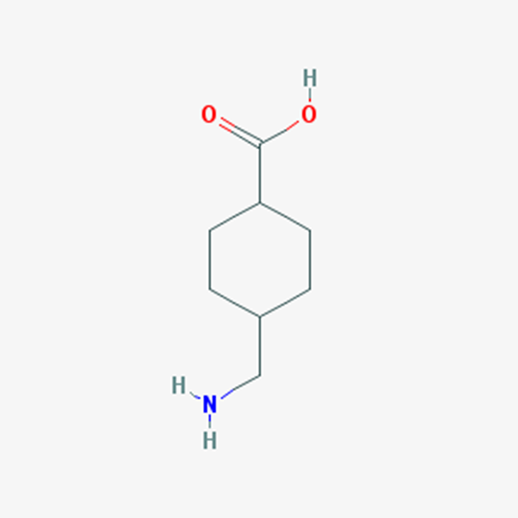
Tranexamic acid (TXA) is a potent anti-fibrinolyic agent that potentially improves outcome in severe hemorrhagic trauma (CRASH 2/3, MATTERs)
Bulk of recent data indicates that mechanisms underlying protective effect of TXA transcend its anti-fibrinolytic activity

Slide 14
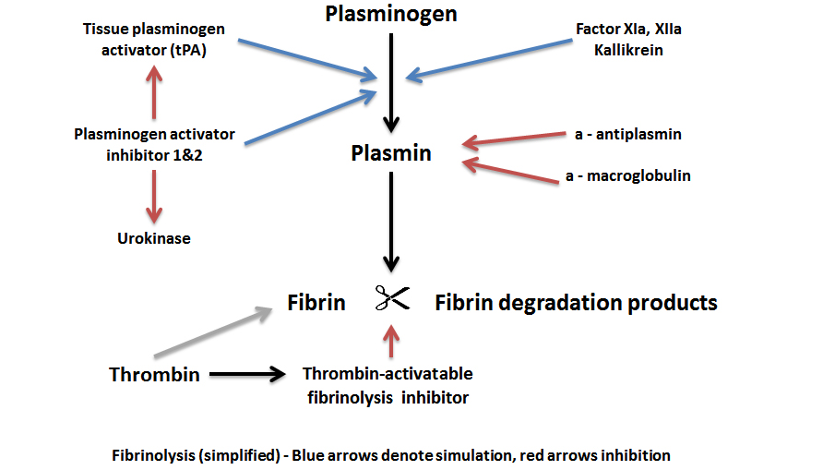
TXA

Slide 15





Trauma
DAMP molecules release
Endothelium
permeabilization
Loss of glycocalyx
Release of cytokines
Fibrinolysis
?
?
?
TXA
What are the cell and molecular mechanisms underlying the extensive protective effects of TXA in traumatic hemorrhage?

Slide 16
TXA inhibits lung injury and inflammation in hemorrhagic rats and suppresses the
activity of enzymes shedding glycocalyx in the gut (Peng et al. , J of Trauma
and Acute Care Surgery, 2016)
TXA decreases the blood levels of proinflammatory cytokines in hemorrhagic rats
(Teng et al, Experimental Animals, 2018)
In the endothelial cell culture, TXA decreases the shedding of glycocalyx induced by
hydrogen peroxide and protects the integrity of the monolayer (Diebel et al, J of Trauma
and Acute Care Surgery, 2017,2018)

Slide 17
TXA suppresses the spontaneous release of mtDNA from granulocytes and endothelial cells

Slide 18
TXA suppresses the release of endogenous mtDNA induced by exogenous mtDNA

Slide 19
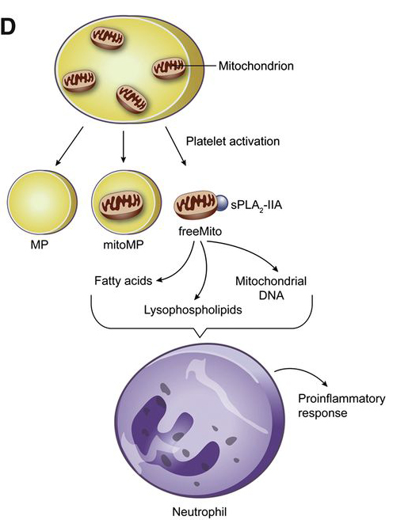
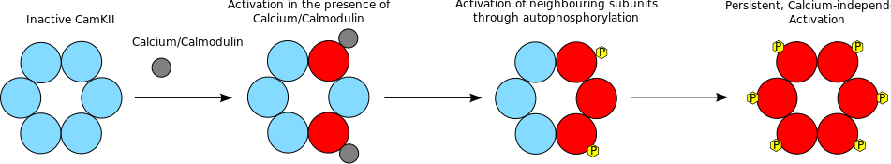
TXA suppresses the release of mtDNA from isolated platelets in vitro
In platelets, TXA suppresses the phosphorylation of the stress response enzyme CamKII

Slide 20
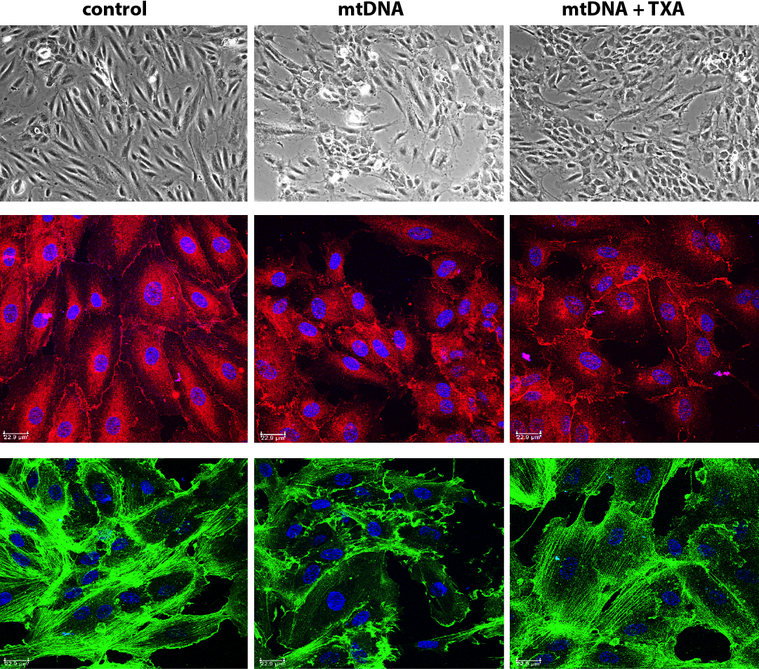
TXA protects endothelial monolayer from the damage induced by exogenous mtDNA
Phase contrast
Beta-catenin
F-actin

Slide 21
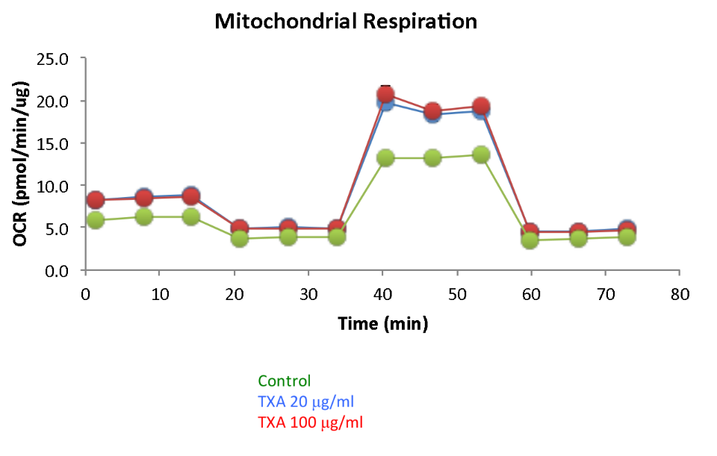
Seahorse study of metabolic activity in HUVEC cells revealed that TXA strongly increases mitochondrial respiration in endothelial cells
https://www.ncbi.nlm.nih.gov/pmc/articles/PMC6660401/bin/nihms-1020115-f0003.jpg
Notes:
Ocr oxygen consumption rate is lower in control
Seahorse measures oxygen consumption rate

Slide 22
TXA enhances the mitochondrial spare respiratory capacity and ATP production
in the endothelial cells
TXA 20
TXA 100
Control

Slide 23
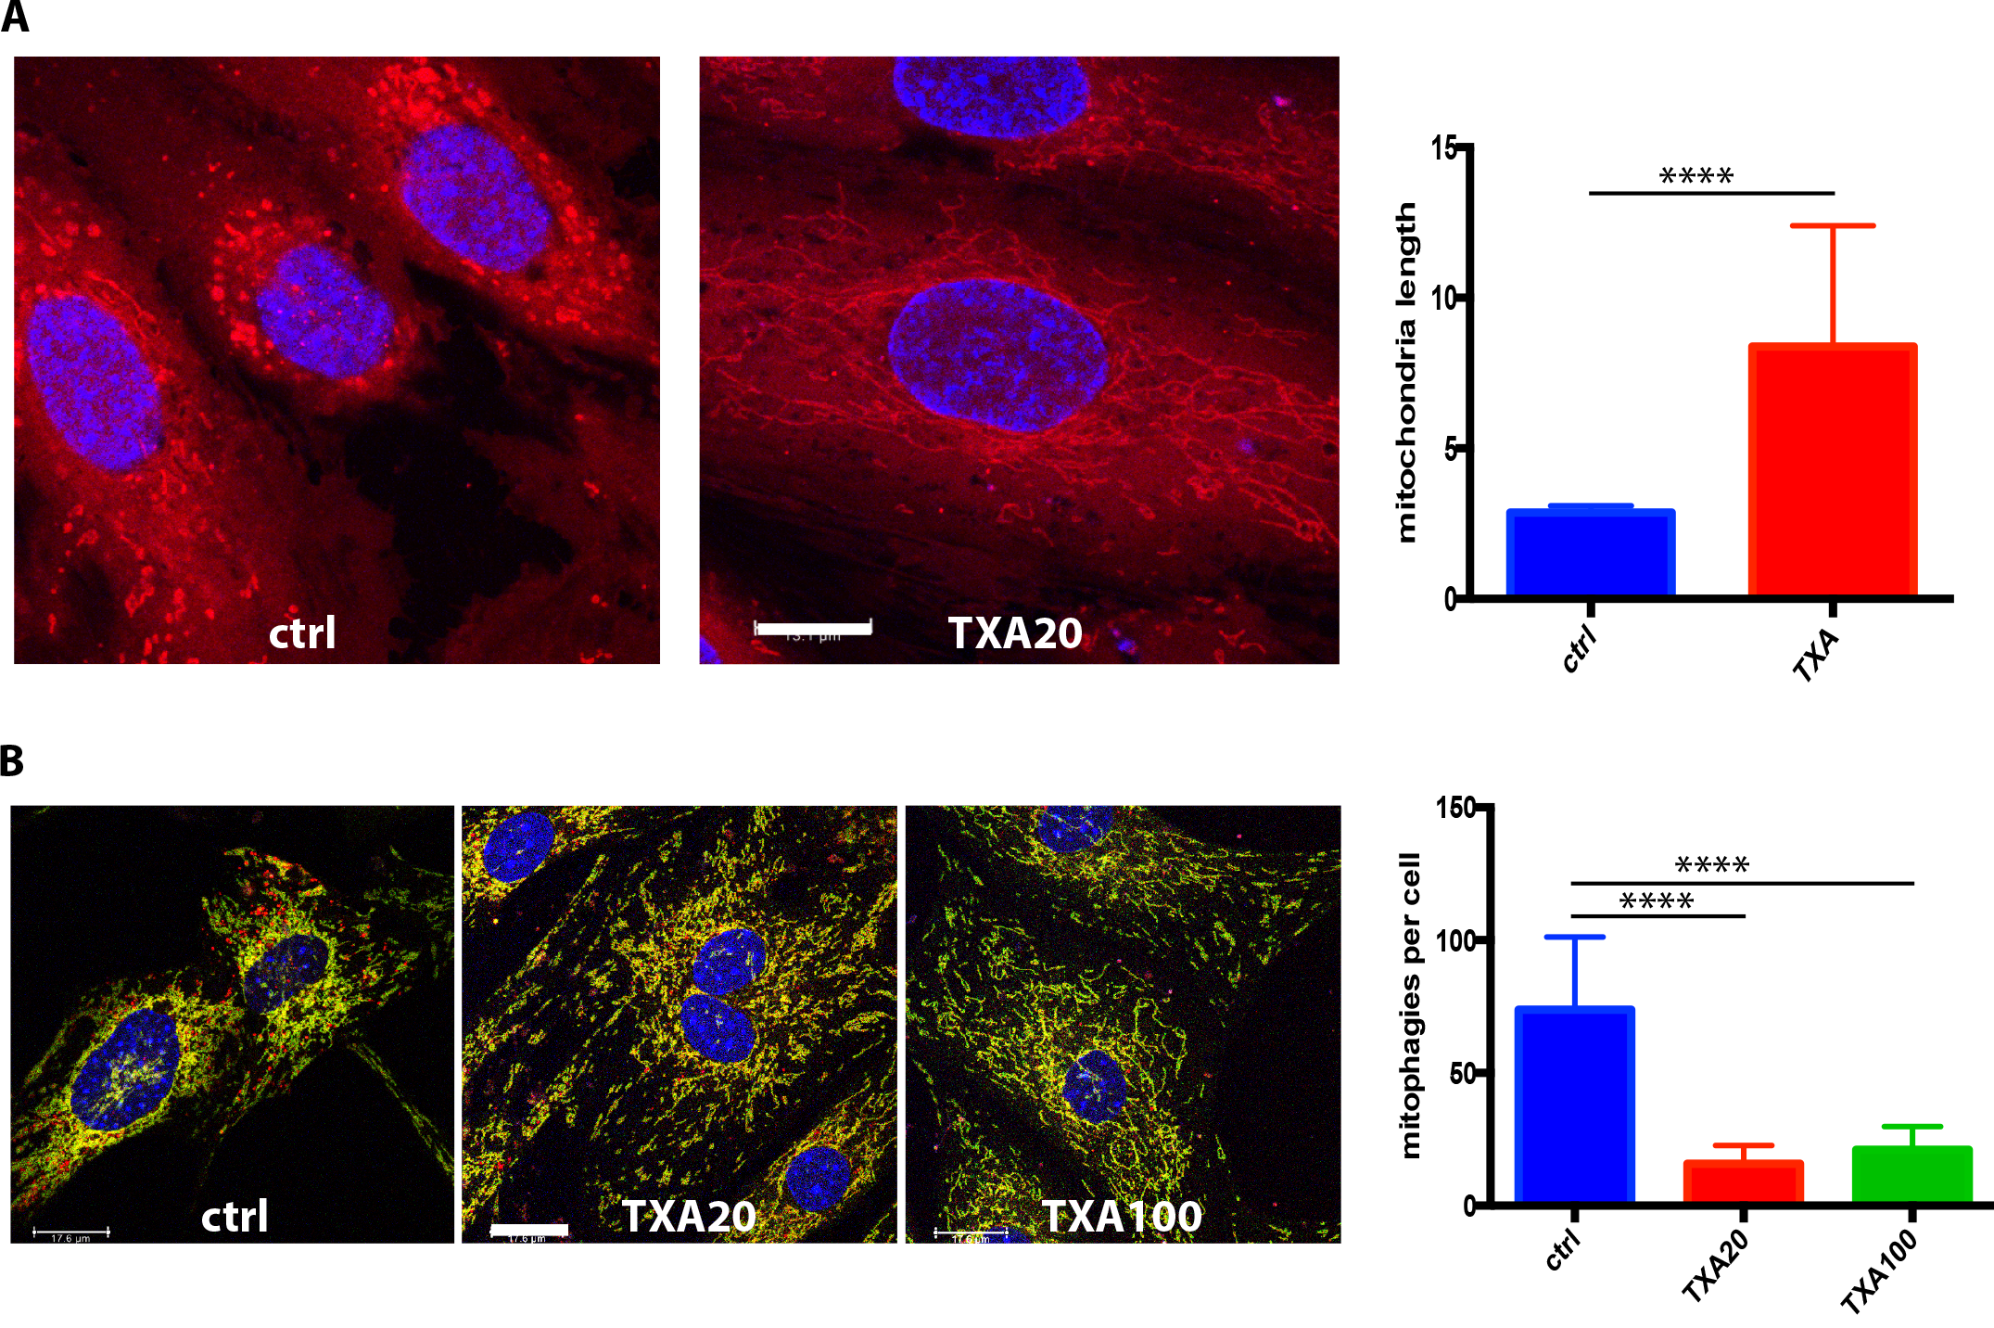
TXA increases the length of mitochondria (A) and suppresses mitophagy (B) in the
endothelial cells
Mitophagies: red structures in Figure B

Slide 24
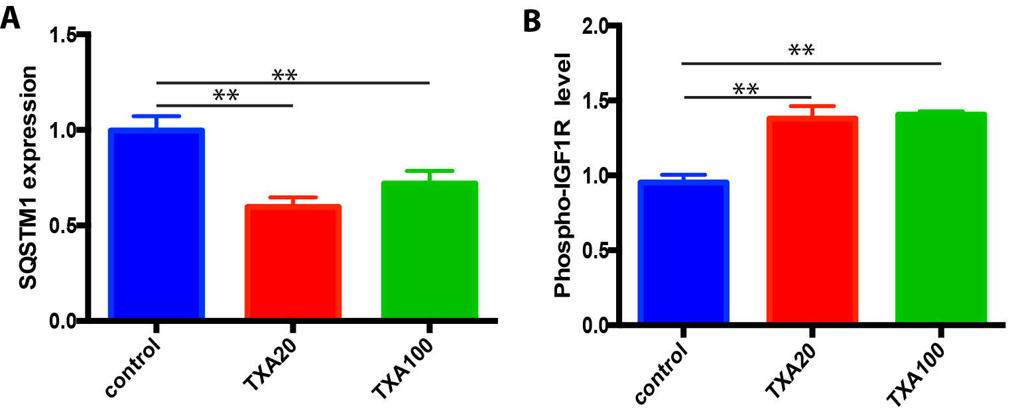
A study using the ActivSignal array demonstrates that in endothelial cells
TXA suppresses the level of the mitophagy pathway component SQSTM1 and
enhances the IGFR1 activity known to stimulate the mitochondrial biogenesis

Slide 25
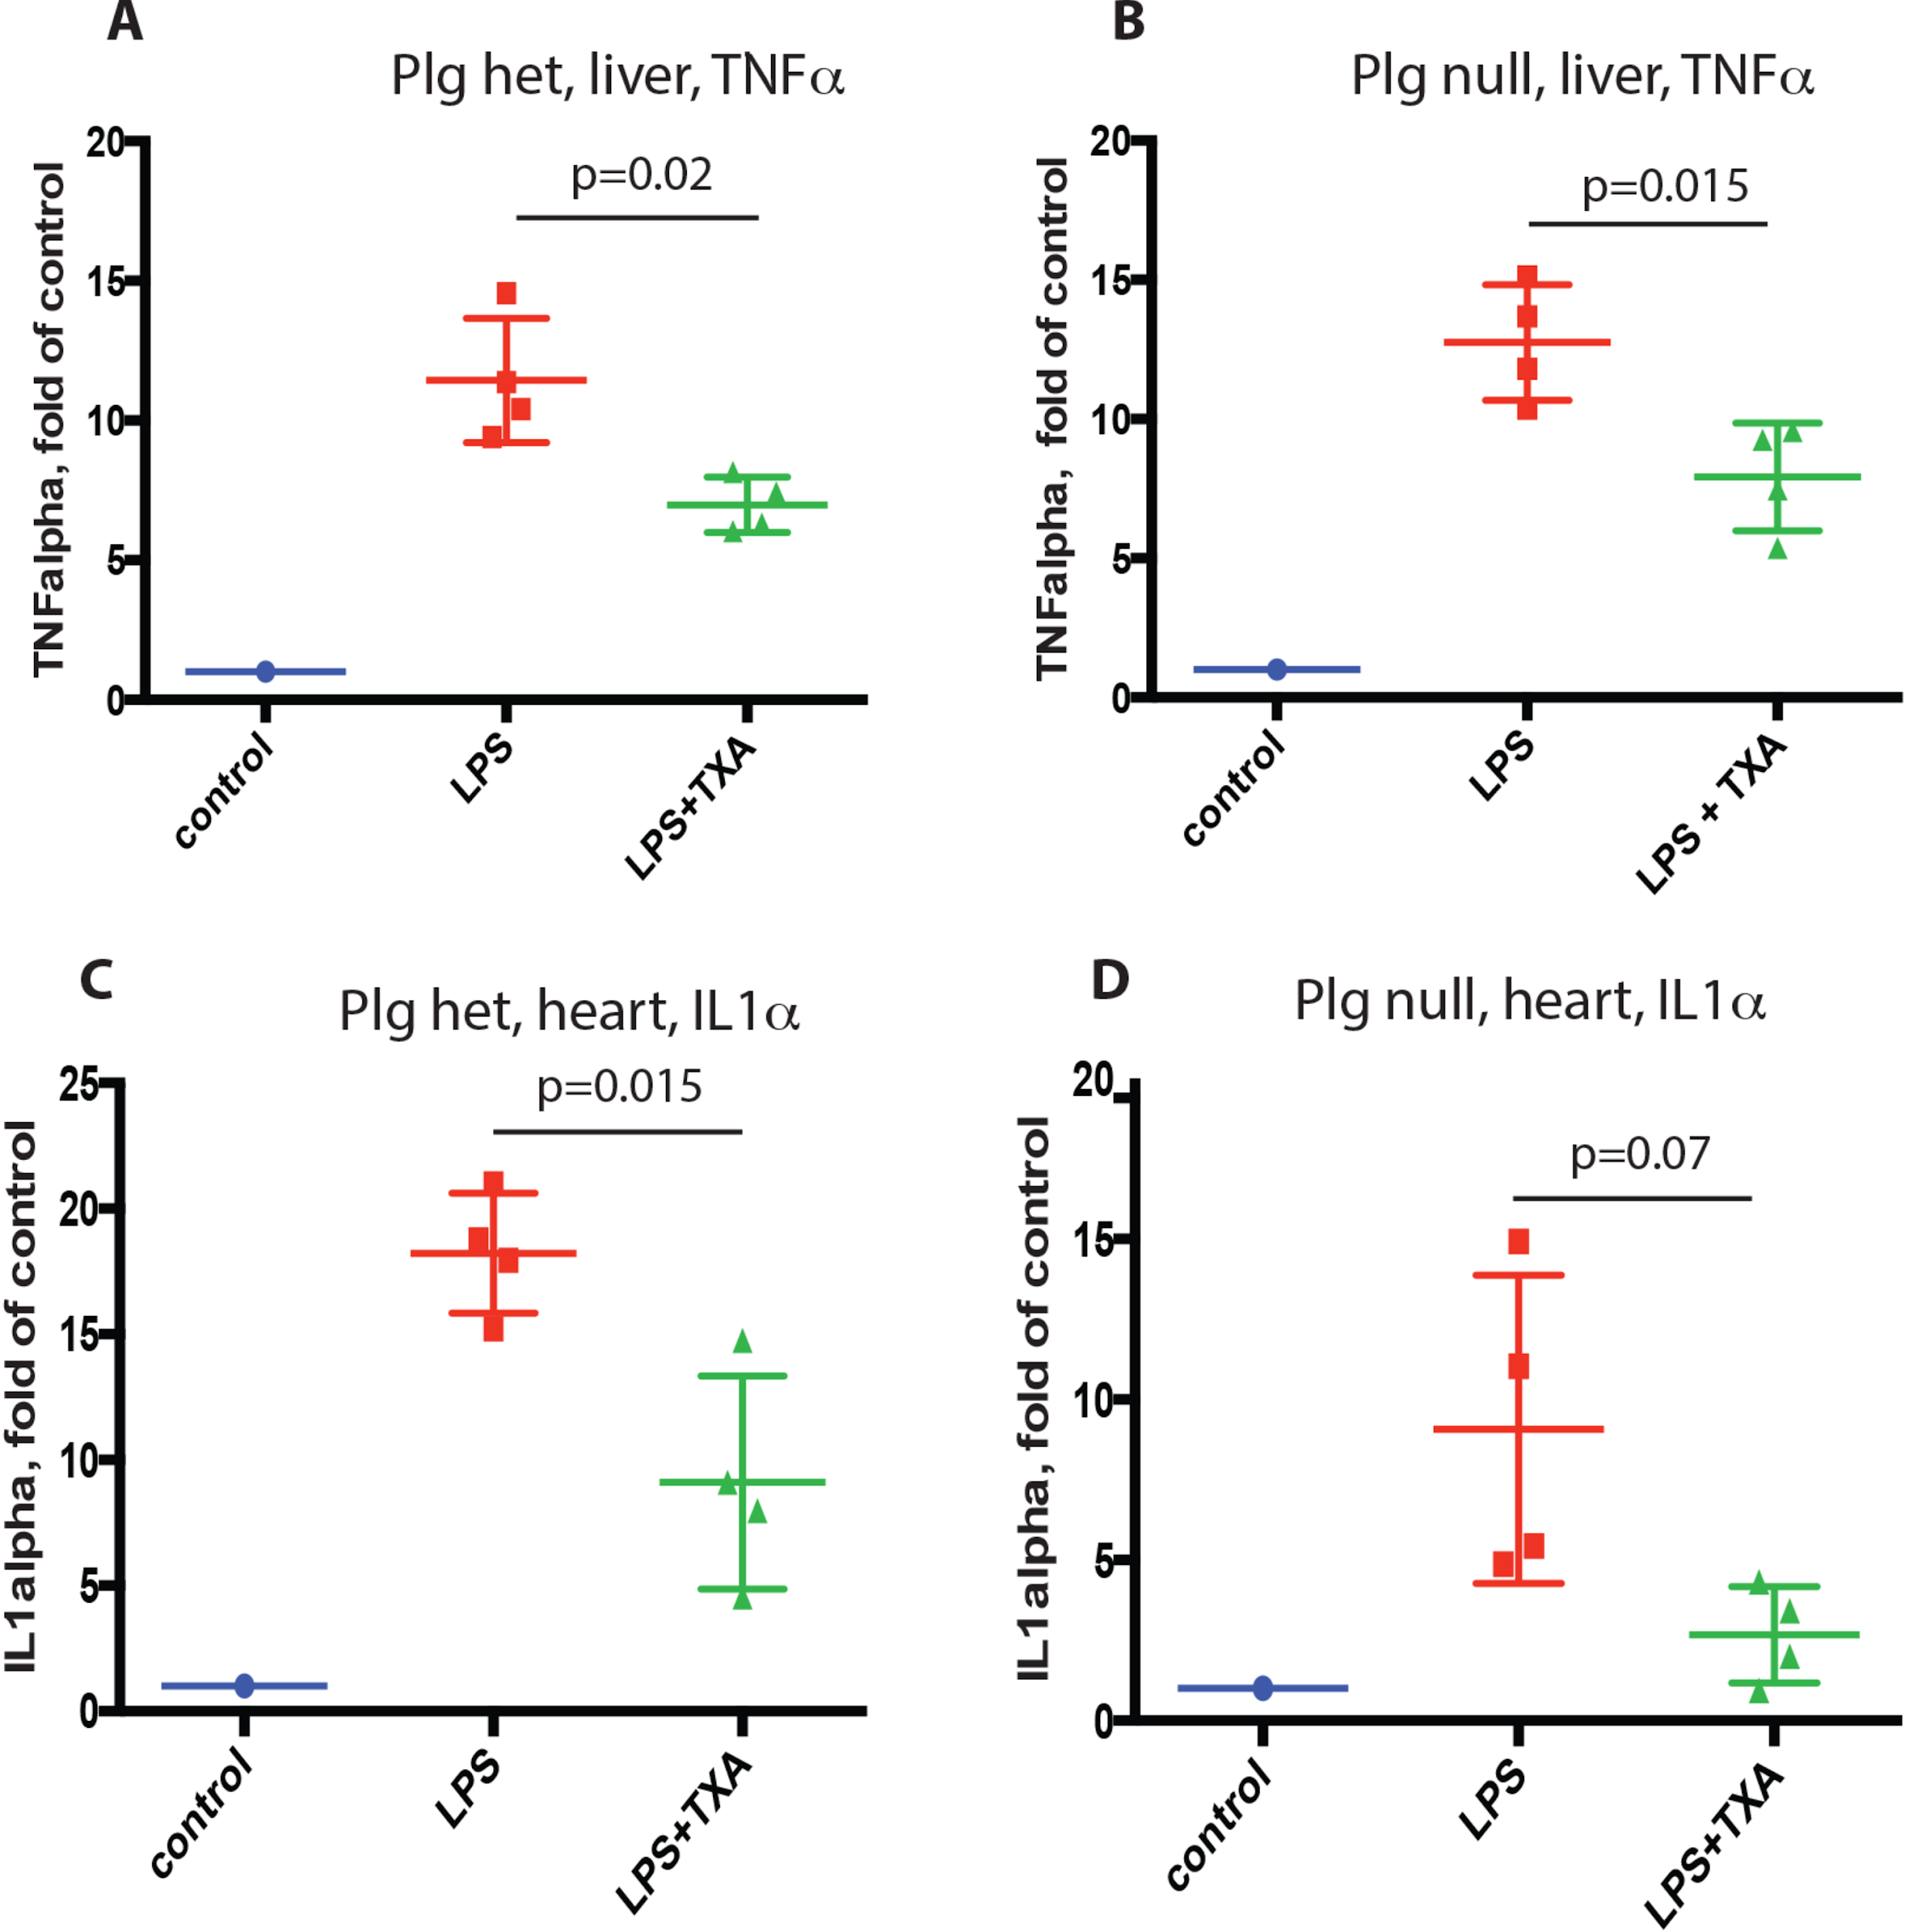
In mice, TXA suppressed the LPS-induced upregulation of inflammatory cytokine expression.
TXA suppresses the LPS-induced upregulation of the expression of TNF-alpha in liver and IL1-alpha in heart
This effect is observed both in plasminogen null and heterozygous mice
Apparently, TXA effect is not dependent on plasminogen/plasmin inhibition

Slide 26
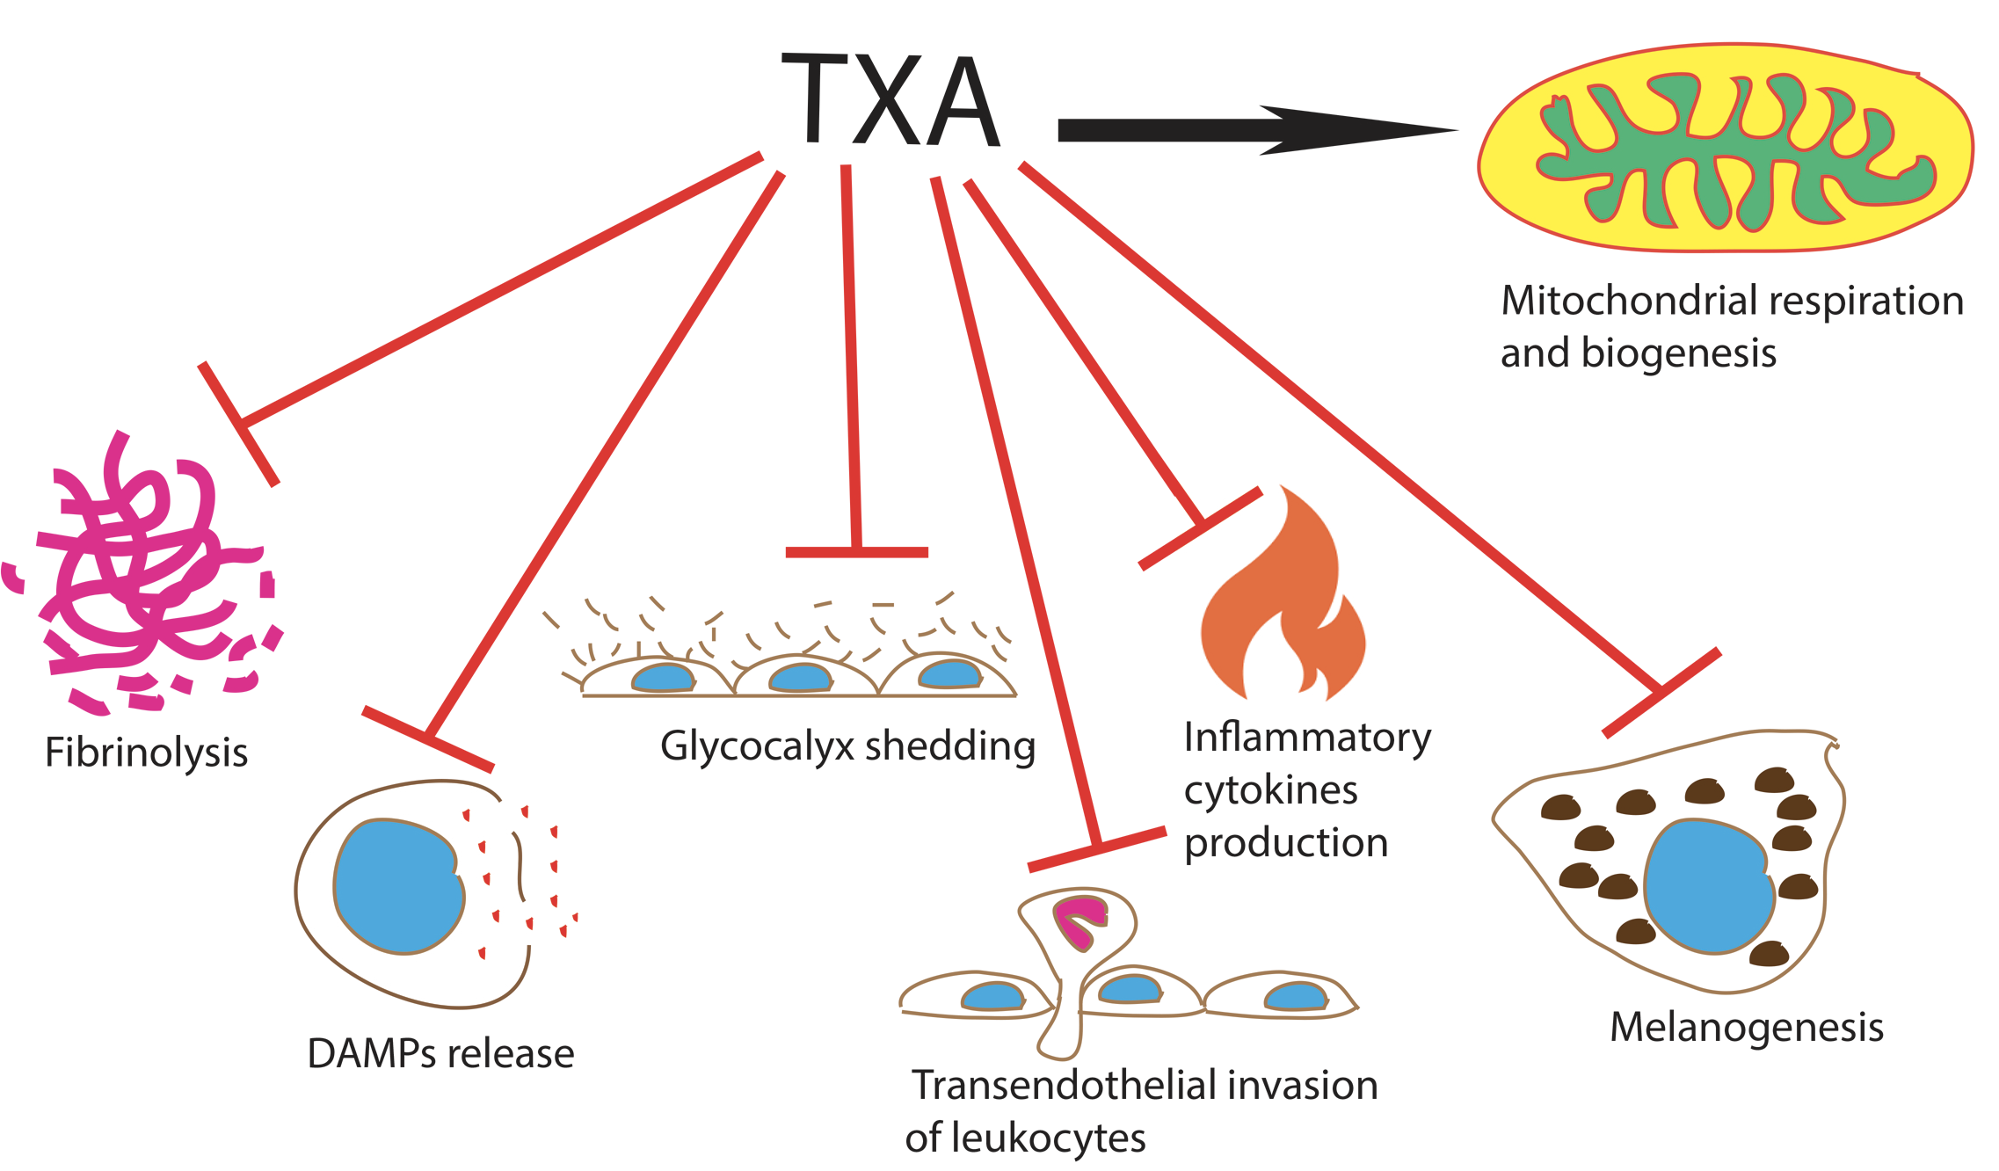
Biological effects of TXA

Slide 27
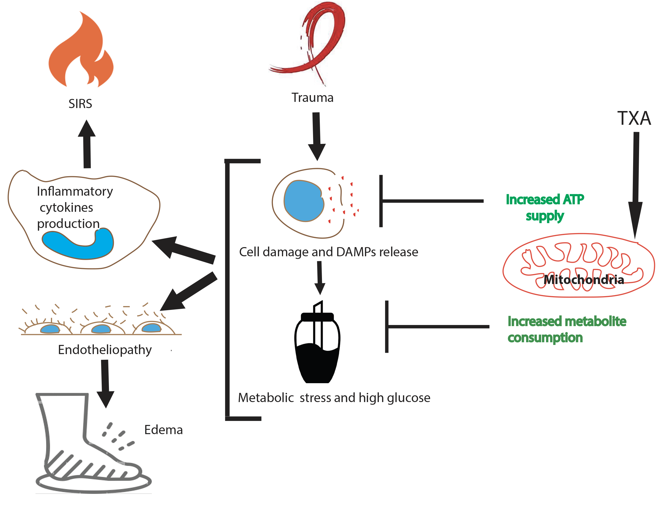
Working hypothesis: by enhancing mitochondrial respiration, TXA suppresses the
trauma-induced DAMP release and metabolic stress, which results in the protection
of the endothelial monolayer and decrease of inflammation

Slide 28
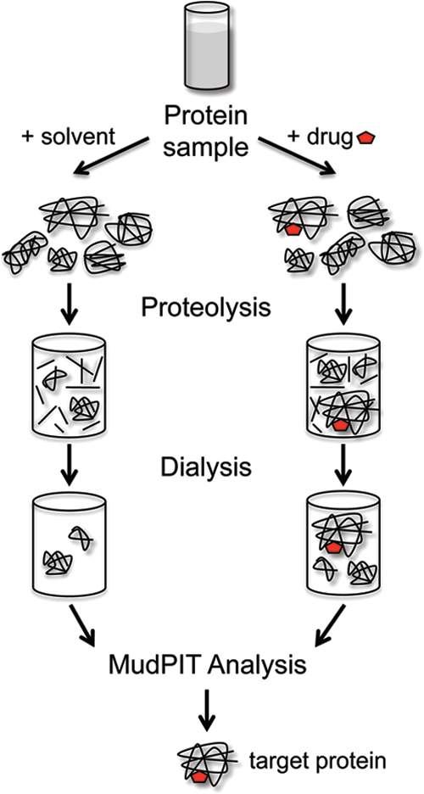
What are protein targets of TXA, besides plasmin?
Results of DARTS analysis of TXA protein targets in endothelial cells
Pyruvate kinase M (PKM2)
RAB GDP dissociation inhibitor beta
Nucleoside diphosphatase kinase B
S-adenosylmethionine synthase isoforms type-2
Leucine-rich repeat containing protein 59
Nucleoside diphosphatase kinase B

Slide 29
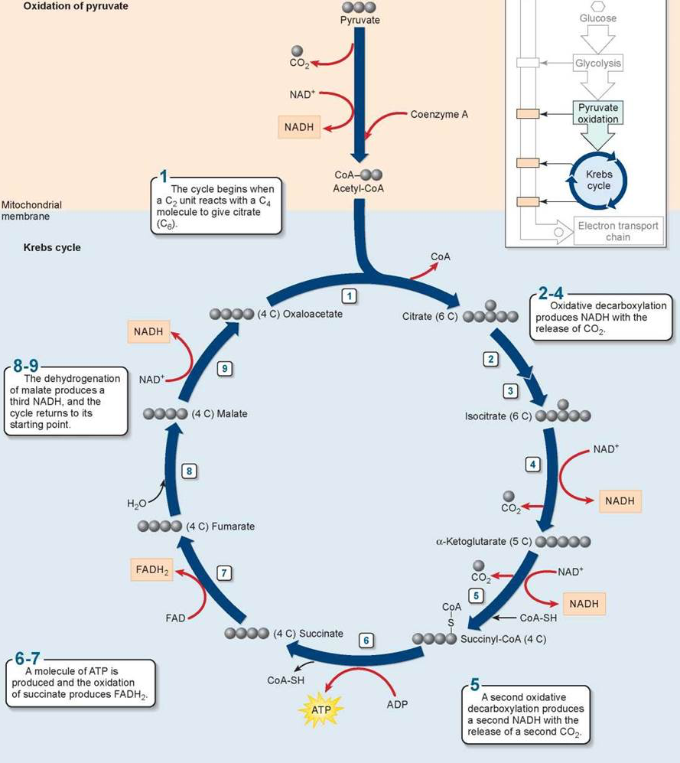
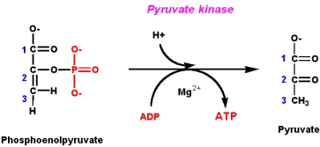
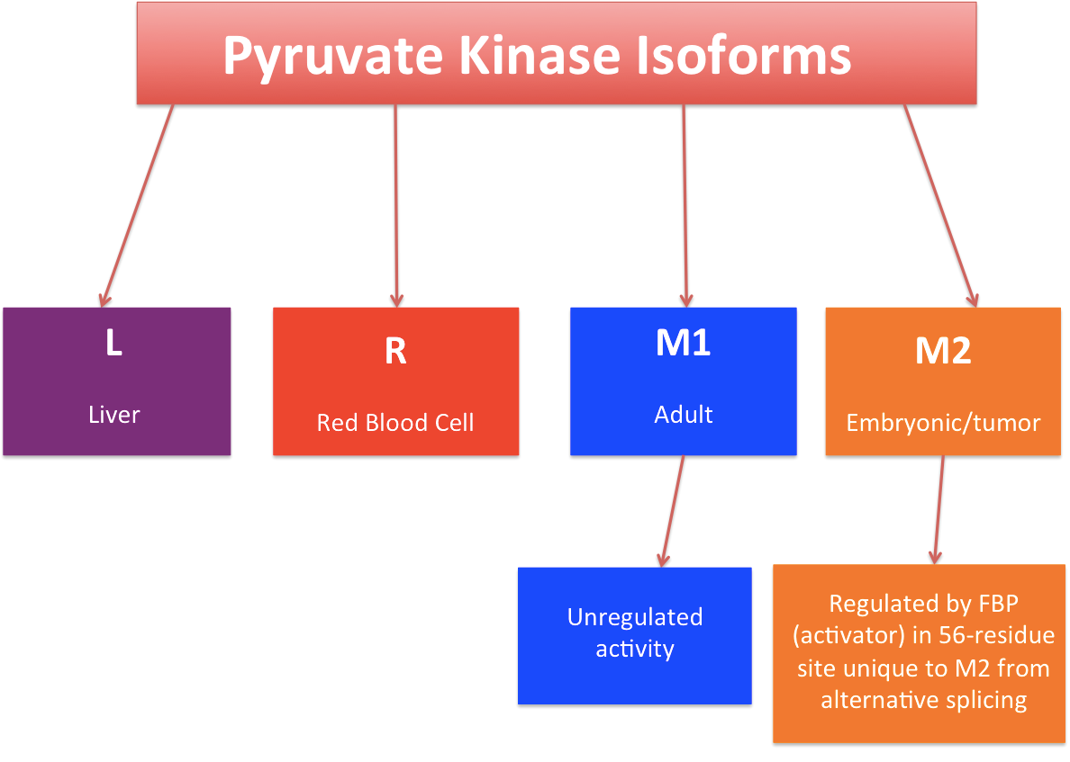

Slide 30
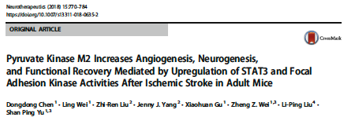
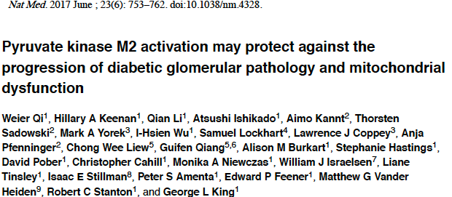
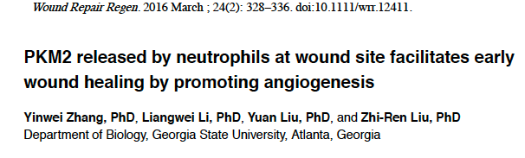

Slide 31
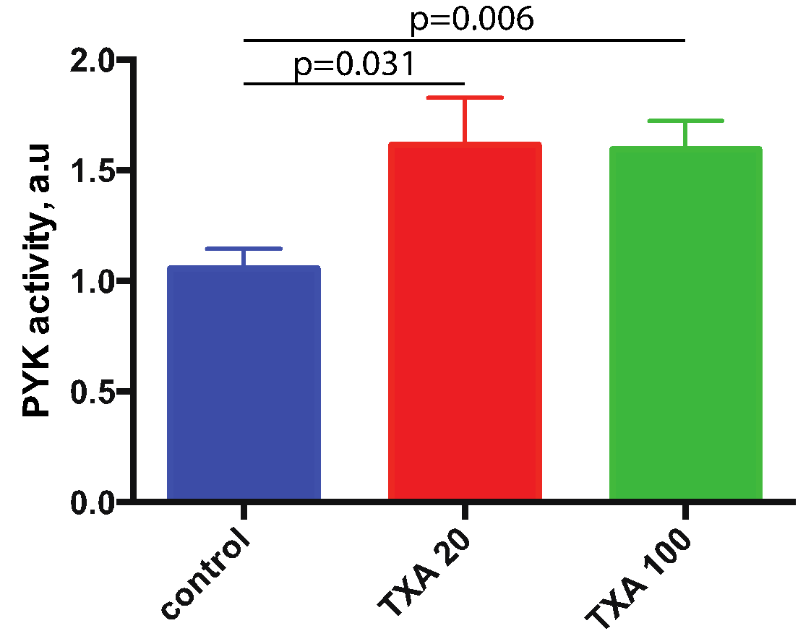
TXA enhances Pyruvate Kinase activity in endothelial cells

Slide 32
TXA decreases the presence of PKM2 in nuclear and
cytoskeletal fractions of endothelial cells

Slide 33
TXA stimulates the tetramerization of PKM2

Slide 34
TXA regulates mitochondrial respiration and inflammation through differential PKM2 oligomerization (hypothetical scheme)

Slide 35
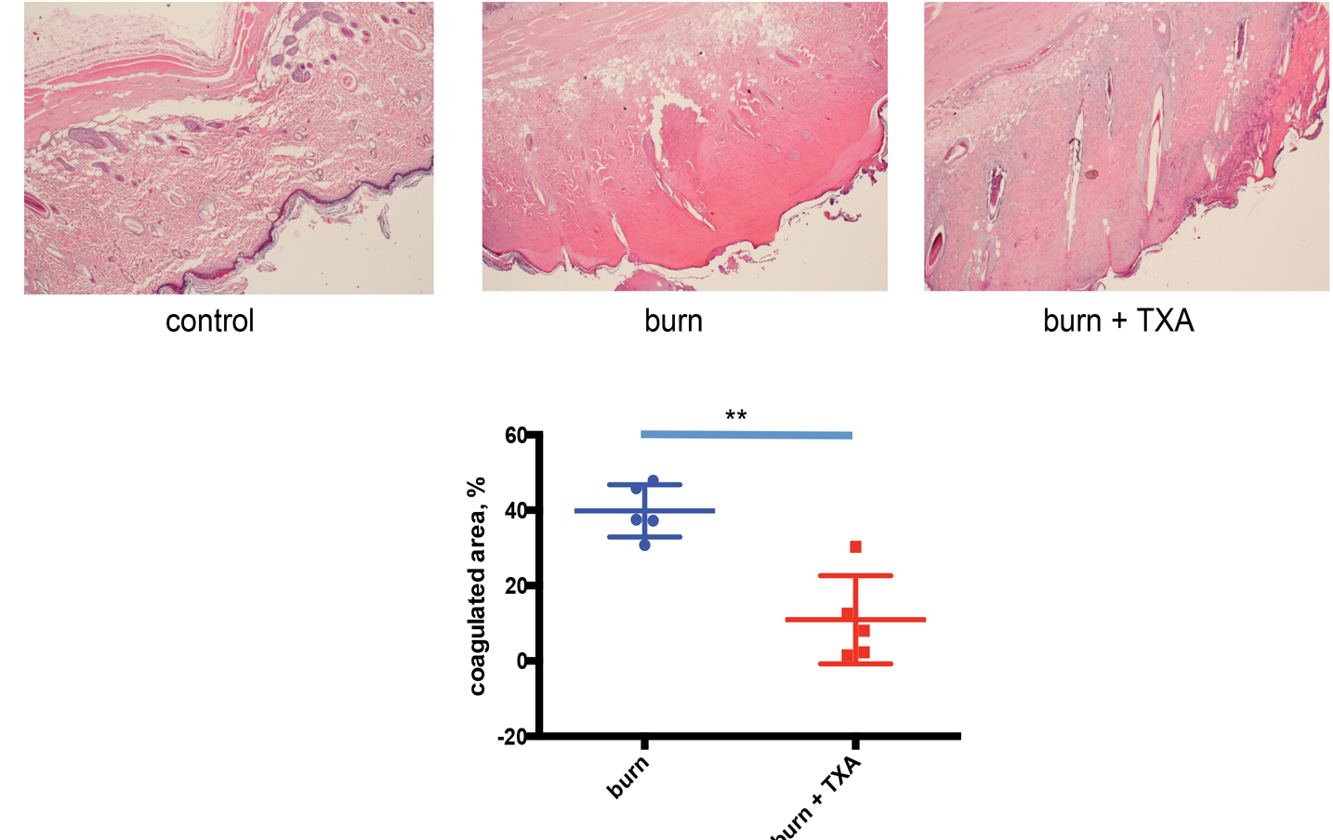
Rat burn experiment. HE staining of skin sections demonstrates that TXA decreases necrotic areas 7 days after 10% body surface burn

Slide 36
TXA inhibits the burn-induced release of mtDNA to the bloodstream of mice

Slide 37
TXA suppresses the burn-induced infiltration of macrophages to the lungs of mice

Slide 38
Rat burn experiment. HE staining of skin sections demonstrates that TXA decreases necrotic areas 7 days after 10% body surface burn

Slide 39
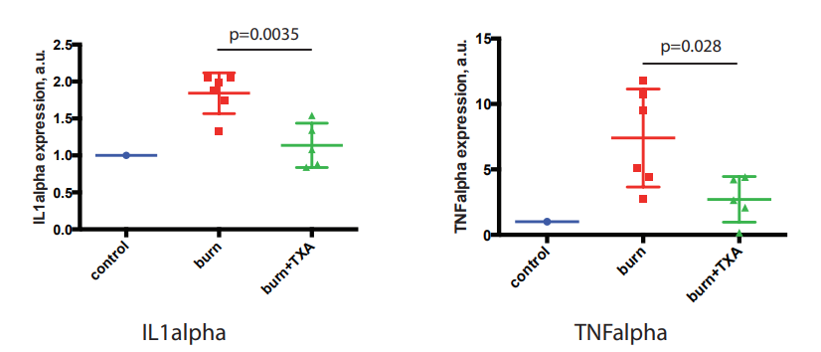
TXA decreases the levels of proinflammatory cytokines TNFα and IL1α in rat hearts. 6h after 30% burn.

Slide 40
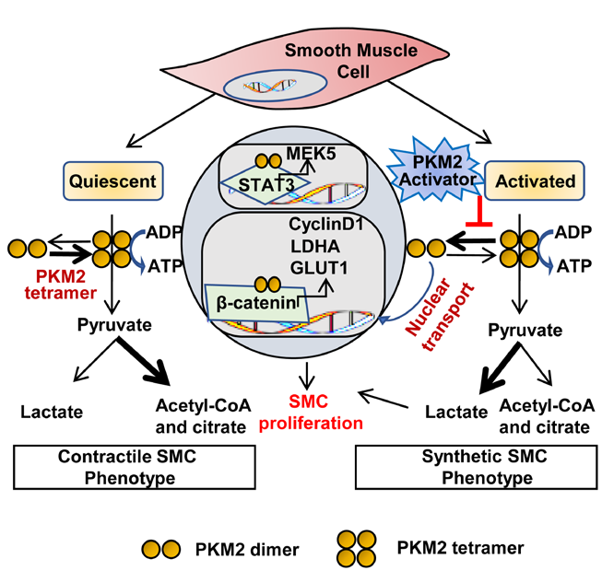
TXA
+ Oxidative phosphorylation
+ Mitochondrial energetics
-From Jain et al, ATVB, 2021

Slide 41
Conclusions:
1. TXA suppresses the release of a major DAMP, mtDNA from a variety of cells in vitro and
in vivo
2. TXA protects the endothelial monolayer from damage
3. TXA suppresses the Burn-induced invasion of inflammatory cells to lungs
4. TXA enhances mitochondrial respiration
5. TXA suppresses mitophagy and enhances mitochondrial biogenesis
6. TXA enhances the repair of burned rat skin
7. TXA suppresses the expression of inflammatory cytokines induced by burn injury
and endotoxin application.
8. TXA binds PKM2 and increases its activity
9. TXA decreases the presence of PKM2 in the nuclear fraction, which may suppress
the pro-inflammatory effects of PKM2.

Slide 42
Questions to be addressed/future plans:
1. Do protective effects of TXA in vitro and in vivo depend on the stimulation of
mitochondrial metabolism
2. Do protective effects of TXA in vitro depend on plasmin inhibition? More experiments
with plasminogen null mice are needed.
3. What are the roles of individual TXA-binding proteins (PKM2 primarily) in its protective
effects?
4. Can other chemical stimulators of the mitochondrial function be used in
trauma patients to improve their recovery?
5. Does TXA regulate the levels of metabolic stress markers (lactate, glucose,
succinate, ATP) in trauma?
6. Is there a role for TXA in sepsis?

Slide 43
Research team and acknowledgments
Igor Prudovsky, PhD, DSc
Robert Kramer, MD
Damien Carter, MD
Sergey Ryzhov, MD, PhD
Douglas Sawyer, MD, PhD
Michael Robich, MD
Monica Palmeri, MHS
Doreen Kacer, BS
Jack Vernamonti, MD
Tee Soul, BS
Kathleen Pyburn, BS
Chloe Kumpel, BS
Victoria Vieira-Zucco, BS
Autumn Green, BS
We are grateful to Ilya Alexandrov for ActivSignal array analysis and to Keyran Wynne for mass-spec studies

