Slide 1


Blood Availability
For Mass Casualties
Data From THOR-AABB Working Group
WORK IN PROGRESS
NO PHOTOS, PLEASE
Jeremy W. Cannon, MD, SM, FACS
Trauma, Surgical Critical Care & Emergency Surgery
Perelman School of Medicine at the University of Pennsylvania

Slide 2
Acknowledgments
THOR: Phil Spinella, Mark Yazer
AABB: Srijana Rajbhandary, Dana Devine, Christine Bales
Red Cross: Dayand Borge
Working Group: Jim Stubbs, Don Jenkins, Paul Ness, Andre Cap
Penn Med Student: Jessica Guzman

Slide 3
J Trauma ACS. 2016;81: 50–57
Resuscitation
Gap
Resuscitation
Gap
Standard TC [PRBC] stock hold is inadequate in meeting complete casualty treatment for even the smallest event size.

Slide 4
What about MCI’s?
Are the Blood Banks Ready?

Slide 5
Background
US cities run on a tight blood inventory margin
  Enough to sustain daily needs (“Just In Time”)
  ? enough to meet major surge in demand
Mass casualty incidents = drain inventory fast
  Boston 2013
  Re-supply plans rely on regional response
Major blind spots exist in our current plans
  Blood product inventory monitoring
    Not centralized
    Contingency planning reactive rather than proactive
  MCI plans have not focused on blood product needs

Slide 6
Background
Assess number of injuries after MCI
Project blood product needs
Compare supply:demand

Slide 7
Hypothesis
Current blood product inventory in major US urban centers would not meet the blood product demand following a large open-air blast multi-casualty incident.
demand
units
inventory
time (hours)

Slide 8
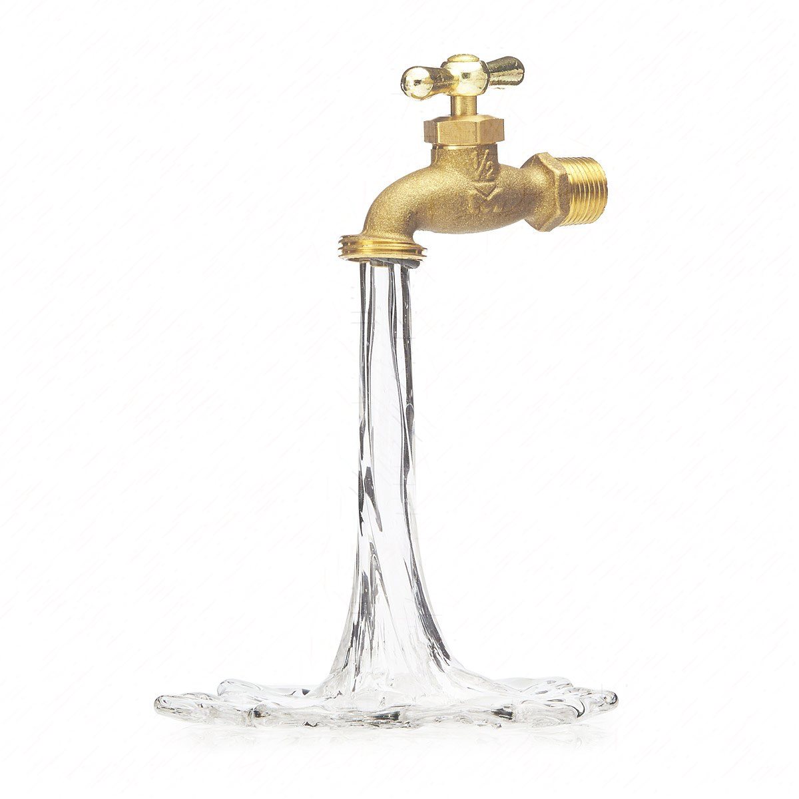

Leaky Bucket Analogy
Re-Supply
Blood Bank Inventory
Transfusion Demand

Slide 9
Assumptions
“Perfect” patient distribution
Local distribution center re-supply
  Immediately
  After 4 hours
All blood products within the inventory available
Apheresis plasma = equivalent of 2 units
Apheresis plts = equivalent of 5 units
Readiness Level
  Minimum Readiness = 50th Percentile, 1:1:2
  Optimal Readiness = 95th Percentile, 1:1:1

Slide 10
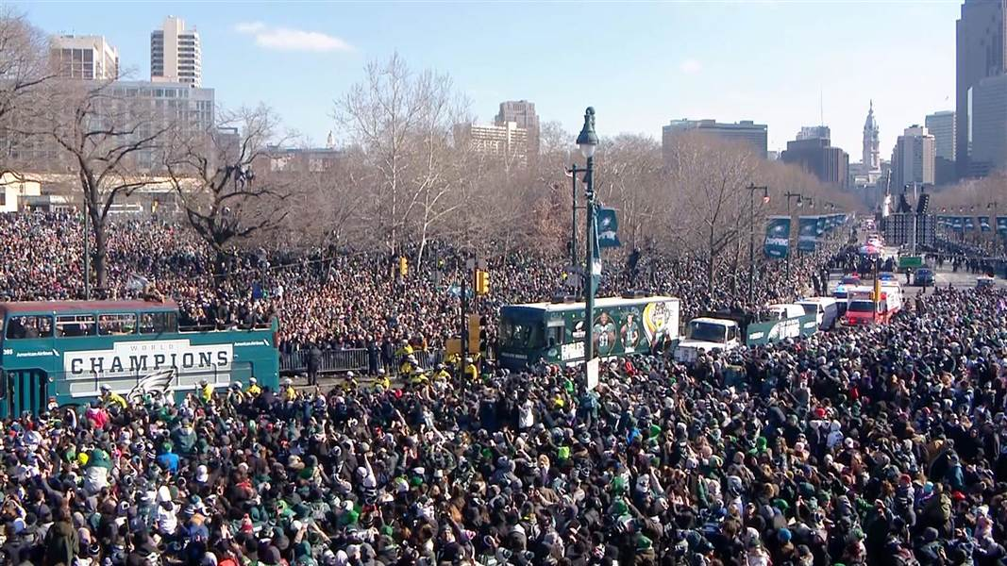

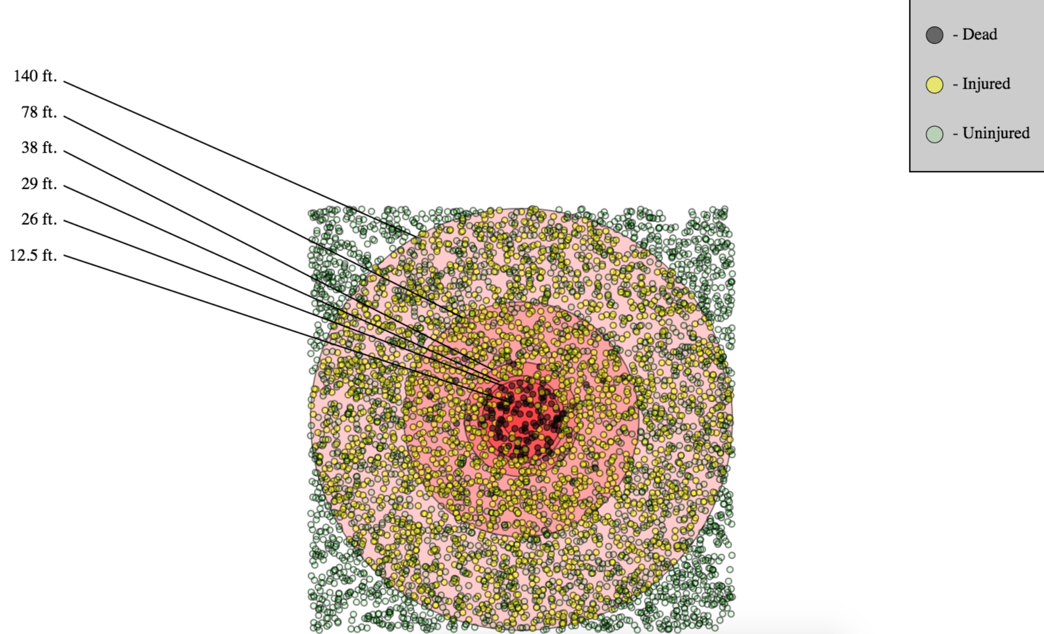
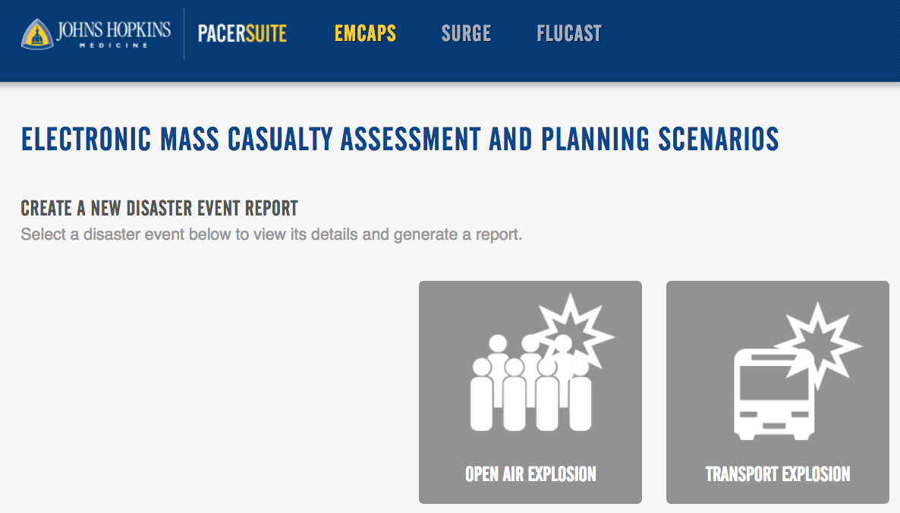
Assess # of Injuries:
EMCAPS Disaster Modeling
1000#
https://www.pacerapps.org/Emcaps/Disaster

Slide 11
Assess # of Injuries:
EMCAPS Disaster Modeling
Single 1000 pound explosive
Spacing between people 1.2 feet
Outcome
  154 ± 12 dead
  2218 ± 46 injured survivors
  “Severely Injured” Subset
    Torso, Vascular/Amputation
    95 ± 9
Multiple bombs scale linearly (per BARDA)

Slide 12
Model Blood Product Needs
PRBC per Patient Index (PPI)¹
What is the denominator?
  Injured Patients?
  ED Patients?
  Admitted Patients?
  “Severely Injured” Patients
¹Arch Surg. 2008;143(10):983-989

Slide 13
J Trauma ACS. 2013;75: 468–74
NO CORRELATION
r²=0.75

Slide 14
Model Blood Product Needs: Challenges = Variability, Limited Data
n=16 Bomb Events

Slide 15
Model Blood Product Needs
PPI: All Injured Patients
  Minimal Readiness = 50th Percentile, 1:1:2
    0.3 PRBC per Injured Patient
    0.15 FFP, Plt x5, (Cryo) per injured patient
  Optimal Readiness = 95th Percentile, 1:1:1
    2.5 ALL products per Injured Patient
PPI: Severely Injured Patients
  Minimal Readiness = 6 (PRBC), 3 (FFP, Plt, Cryo)
  Optimal Readiness = 12 per Severely Injured (ALL)

Slide 16
Model Blood Product Needs
All Injured (n=2218 ± 46 ) | Minimal | Optimal
PRBC (0.3, 2.5) | 727 | 5428
Plasma (0.15, 2.5) | 366 | 5428
Platelets (1/5 = 0.03, 0.5) | 73 | 1109
Cryo (0.15, 2.5) | 366 | 5428
Severely Injured (n=95 ± 9 ) | Minimal | Optimal
PRBC (6, 12) | 570 | 1140
Plasma (3, 12) | 285 | 1140
Platelets (1/5 = 0.6, 2.4) | 57 | 228
Cryo (3, 12) | 285 | 1140

Slide 17
Model Blood Product Needs

Slide 18
Model Blood Product Needs
*
*
*
*

Slide 19
Model Blood Product Needs
# Per Severely Injured | PRBC | FFP | PLT | CRYO
1:1:1 (:1) | 12 | 12 | 2.4 | 12
Transfusion. 2016;56: S208–16

Slide 20
How much blood available?
  Boston Area in 2007
  1000 units of Type O
  1000 units of Type A, B, AB
Survey 6 US metropolitan areas x 3 Dates
  Boston, Pittsburgh, Baltimore, Miami, San Antonio, LA
    Hospitals (Trauma Centers + Other)
    Distribution Centers
  Blood product inventory
  Seasonal variation
  AM/PM, Weekday/weekend variation

Slide 21
Response Rate
15 Jan 2019 (Tue), 12 APR 2019 (Fri)
  Blood Distributors: 6/9 (67%)
  Hospitals: 45/97 (47%)
  Boston*, Pittsburgh = 100%

Slide 22
Regional Analysis
BOSTON HOSPITALS ONLY
PITTSBURGH HOSPITALS ONLY
30 Untreated Patients
60 Untreated Patients
1,000 lb truck bomb = 2,218 injured alive, 95 critical
Blood Demand = 1.1k PRBC, 1.1k FFP, 224 PLT, 1.1k Cryo
Adequate PRBC, FFP
Inadequate PLT (Bos + Pitt), Cryo (Pitt)
WB inventory = 0 units in Boston

Slide 23
Regional Analysis: Geospatial
Boston, 15 JAN 2019
TC
TC
pTC
TC
TC
TC
10 Hospitals, 1 Blood Supply Center
100% Response
AM and PM inventories similar

Slide 24
Center-Level Analysis
Trauma Center (n=11) Readiness
  Severely Injured Patients 1:1:1 capacity
  Avg = 8, Range 2-21
Non-Trauma Center (n=11) Response
  Severely Injured Patients, 1:1:1 capacity
  Avg = 1, Range 0-5

Slide 25
THOR/AABB Working Group Action Plan
Finalize results
  3rd survey in July
  Detailed analysis of survey results
    Regional Analysis, Re-supply, Geospatial
    Center-level Analysis
      Seasonal/weekday variation
      Hospital designation (Trauma vs Other)
  Further Modeling: Event/Injury, “Leaky Bucket”
Based on results, develop action plan
  Civilian walking blood bank
  Cold stored platelet approval
  Stock/train on fibrinogen concentrate
  Monitor WB results and dissemination
  Lobby for central monitoring (regional, national)

Slide 26
Blood Availability
For Mass Casualties
Data From THOR-AABB Working Group
Jeremy W. Cannon, MD, SM, FACS
Trauma, Surgical Critical Care & Emergency Surgery
Perelman School of Medicine at the University of Pennsylvania

Slide 27
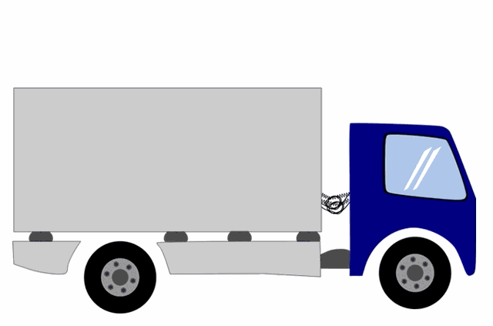
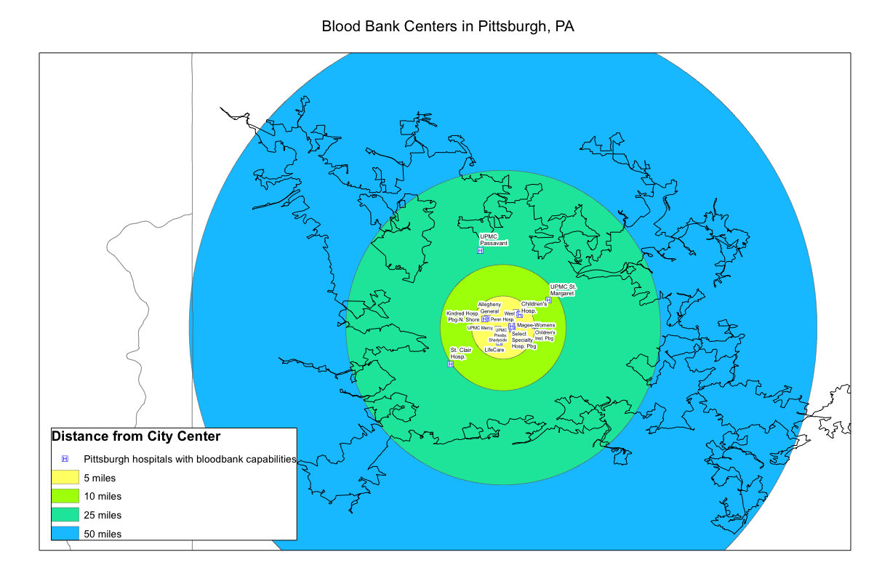
Pittsburgh Metro Area
1000 lb

