Slide 1
So you don’t like titers, eh? Let’s see if you prefer functional assays
Mark Yazer, MD
Professor of Pathology, University of Pittsburgh
Adjunct Professor of Clinical Immunology, University of Southern Denmark
Visiting Professor of Pathology, Tel Aviv University

Slide 2
Disclosures
Grífols: Honoraria & SAB
Macopharma: Scientific advisory board
Octapharma: Scientific advisory board
Terumo: Honoraria
Haemonetics: Honoraria
Cook Biotech: Scientific advisory board
Verax Biomedical: Scientific advisory board
New Health Sciences: Scientific advisory board

Slide 3
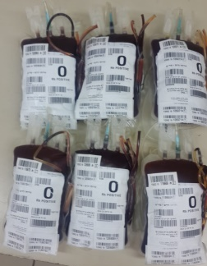
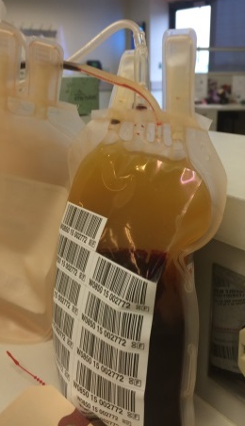
Do titers suck in predicting hemolysis?
Increasingly popular/necessary to transfuse potentially ABO-incompatible products in massive bleeding
For whole blood, the hemolysis-reduction step is to ensure that it is of “low titer”
For plasma/platelets there is no specific AABB requirement for hemolysis risk mitigation
Transfusing center has to have a policy vis-à-vis these incompatible products
How well do product titers predict hemolysis?

Slide 4
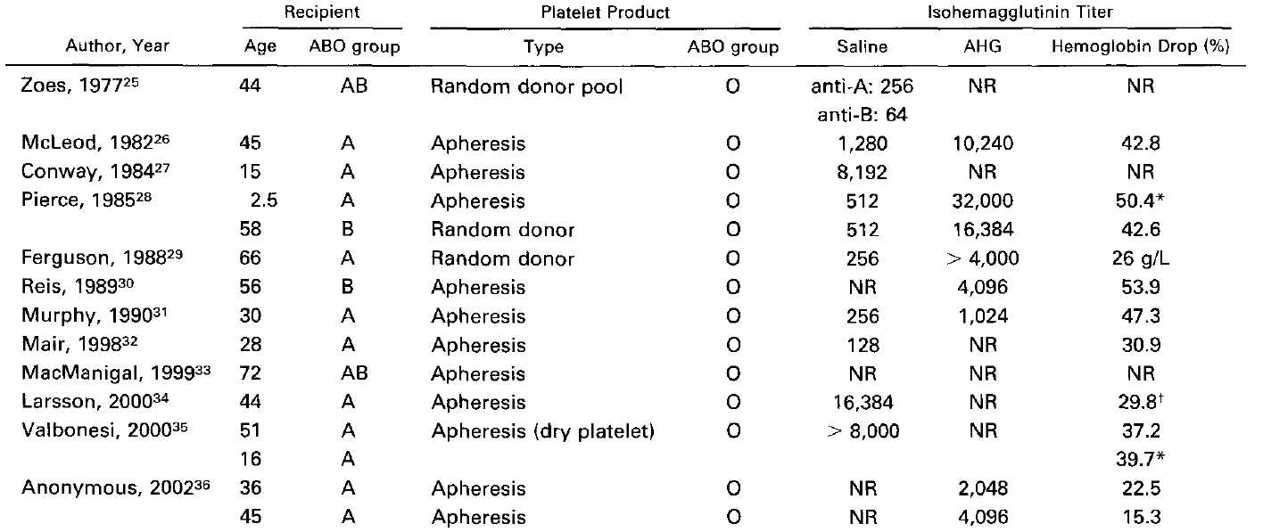
Safe threshold? Hemolysis happens primarily at high titer
Lozano and Cid Transf Med Rev 2003;17:57-68

Slide 5
Can also happen at low titer
Josephson et al. Transfusion and Apheresis Science 2010;42:83-88

Slide 6
So what is a safe titer threshold?
I don’t know
Probably doesn’t exist
Question really is – below what titer threshold is hemolysis unlikely
Risk is always there, but can we minimize it by performing something other than a titer?

Slide 7
Hemolysis isn’t good but it’s not all the same
Intravascular hemolysis
Mediated by IgM antibodies that activate complement
RBCs destroyed in the vessel
Causes shock, death, badness
Chaos
This is the type we try to prevent by titering at immediate spin
Extravascular hemolysis
Mediated by IgG antibodies that do not usually activate complement
RBCs destroyed in an orderly manner in the liver and spleen
A dignified and solemn death
Causes a reduced hemoglobin peak after transfusion, or a more rapid return to the recipient’s baseline Hb
Nobody really cares about this kind of hemolysis when it comes to emergency blood products

Slide 8
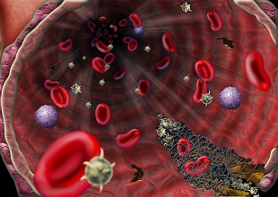
C
B
Crª
D
Vel

Slide 9
C
B
Crª
D
Vel

Slide 10
Y
IgM anti-B antibody
C
B
Crª
D
Vel

Slide 11
Y

Slide 12
Y
C
B
Crª
D
Vel

Slide 13
Complement activated
Complex stuff
Membrane Attack Complex
Y
C
B
Crª
D
Vel

Slide 14
Y
C
B
Crª
D
Vel

Slide 15
RBC stroma
RBC stroma
Free Hb
Free Hb
Free Hb
Free Hb

Slide 16
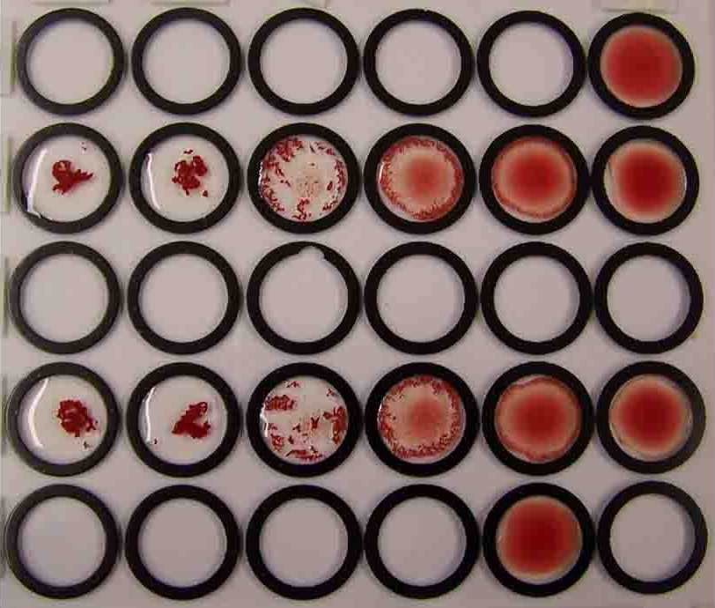
How to use complement for predicting hemolysis
“Hemolysin test”
Mix RBCs with donor plasma
Add complement source, warm to 37°C, manually observe supernatant plasma for hemolysis
Graded:
3+ complete hemolysis
2+ for 50% hemolysis
1+ for trace hemolysis
Negative = no hemolysis
Not at all subjective, very repeatable between operators
negative
3+
Sarcastic font

Slide 17
More ways to use complement for predicting hemolysis
In transfusion nothing can be just left alone, we tinker
Is there a more precise way of quantifying the extent of RBC hemolysis?
Complement Hemolysis Using Human Erythrocytes (CHUHE)
Cunnion et al. Transfusion 2017;57:517

Slide 18
CHUHE assay
Some absorbance at 412 nm
No absorbance at 412 nm
Basically the same thing as the manual hemolysin test
Main difference is that the plasma free Hb is read by a spectrophotometer
Probably more precise than manual interpretation
Also background hemolysis is subtracted

Slide 19
Baseline CHUHE values
Absorbance values >1.3 suggest total hemolysis
CHUHE value from group B SCD patient with “AHTR” from 1 group O RBC transfusion
Cunnion et al. Transfusion 2017;57:517
Cinnion et al. Transfusion 2016;56:1845

Slide 20
CHUHE vs titers
Similar titers produce different CHUHE hemolysis (412 nm absorbance) values
B, AB RBCs
Cunnion et al. Transfusion 2017;57:517

Slide 21
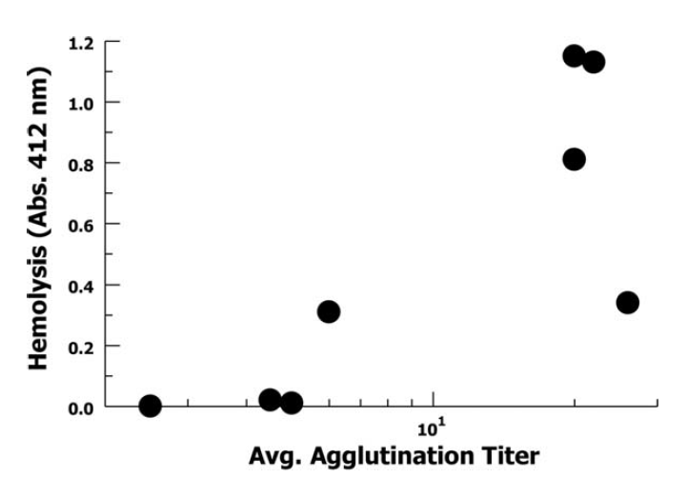
Some correlation between saline titer and CHUHE value
20
Group A plasma
Cunnion et al. Transfusion 2017;57:517

Slide 22
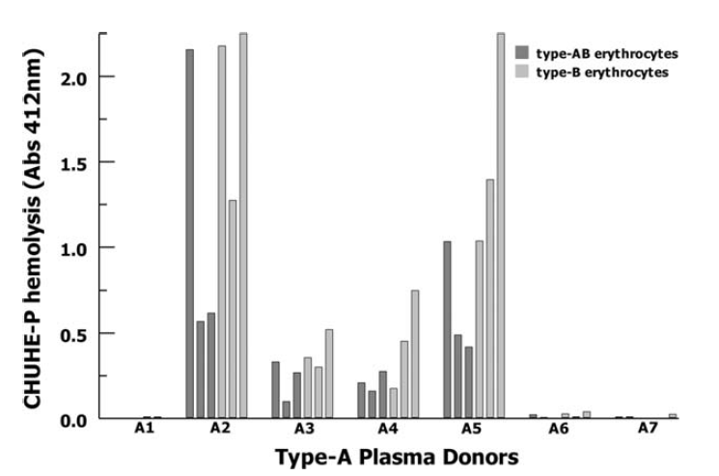
Donor plasma reacts differently with different RBCs
1.3 = total hemolysis
0.45 = “AHTR” case
Cunnion et al. Transfusion 2017;57:517

Slide 23
Thoughts on this method
Pros
Actual measure of complement-mediated hemolysis
Relatively quick to perform
Free Hb can be measured by Hemocue
Cons
No idea what constitutes a clinically significant CHUHE value
Just because the titer and CHUHE values are discordant does not mean that the CHUHE value is correct or more clinically accurate
“AHR” case not well evaluated – no mention of crossmatch compatibility, RBC antibodies in recipient, pretty hard to imagine that 30 ml of plasma could cause hemolysis

Slide 24
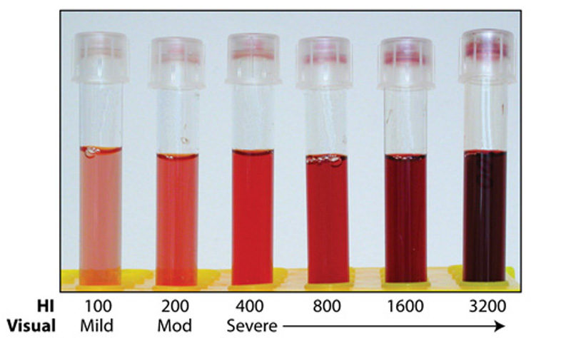
Normal RBCs have built in defense against MAC attack
Primarily 2 molecules, CD55 and CD59
Formerly known as complement decay accelerating factor and membrane inhibitor of reactive lysis, respectively
Attached to RBC membrane via GPI-linked anchor
Some people genetically lack the GPI anchor
Paroxysmal nocturnal hemoglobinuria (PNH)
Several other proteins/antigens also missing from their RBCs
These cells have increased susceptibility to complement

Slide 25
Complement activated
Complex stuff
CD59
CD55
Membrane Attack Complex

Slide 26
Complement activated
Complex stuff
CD59
CD55
Membrane Attack Complex

Slide 27
Complement activated
Complex stuff
CD59
CD55
Membrane Attack Complex

Slide 28
CD59
CD55

Slide 29
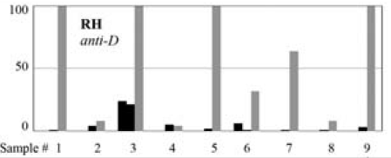
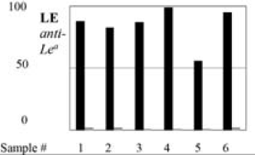
Take advantage of complement sensitive RBCs
Using cells that are sensitive to complement we can predict hemolytic potential of antibodies
Incubate complement sensitive cells with antibodies, add complement, watch the sparks fly by flow!
Titer
% loss of RBCs
Anliker et al. Transfusion 2018;58:2992

Slide 30
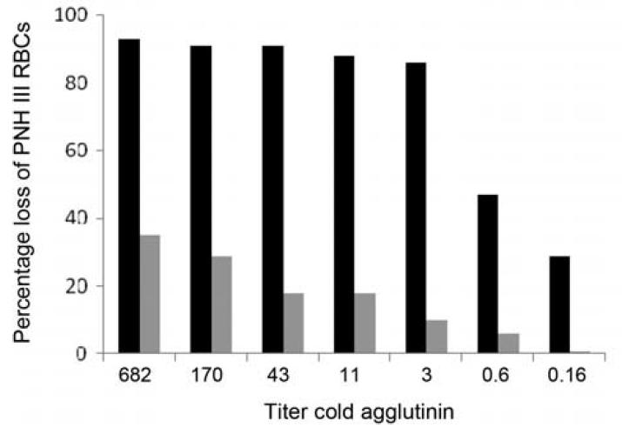
Take advantage of complement sensitive RBCs
Titer
% loss of RBCs
Anliker et al. Transfusion 2018;58:2992

Slide 31
Thoughts on this method
Pros
Actual measure of complement-mediated hemolysis
Relatively quick to perform (hours)
Looks pretty easy to interpret
Probably amenable to high-ish throughput
Cons
No idea what constitutes a clinically significant % loss of cells
Are complement sensitive RBCs representative of normal RBCs?
Only people with PNH should fear anti-Leª
Need PNH type III RBCs
Need a flow cytometer
Authors did not test anti-A or –B; maybe saving for follow up paper?

Slide 32
Let’s get ready to rumble! Monocyte monolayer assay (MMA)
Extravascular hemolysis also happens
Mediated by IgG
Not usually as acute a clinical problem as intravascular hemolysis
Largely ignored when titering plasma or whole blood
MMA can help predict hemolytic potential of IgG

Slide 33
Plasma with IgG antibodies
Y
Y
Y
U
U
U

Slide 34
Y
Y
Y
U
U
U

Slide 35
Y
Y
Y
U
U
U

Slide 36
Monocyte Monolayer Assay
Count the RBCs that are internalized or attached to monocytes
Express results as a % of monocytes with attached or internalized RBCs compared to total number of monocytes counted
Positive results are usually >3-5%, sometimes as high as >20%
Y
Y
U
U
U
Y

Slide 37
MMA can be made a bit more accurate
Do all the steps of the MMA then…
1. ADCC: ⁵¹Cr labeled sensitized RBCs are exposed to monocytes and the liberated radioactivity is measured in the supernatant
2. CLA: Oxygen radicals produced by activated monocytes interact with luminol to emit light which can be quantifed
3. Flow Cytometry: A fluorochrome is attached to the RBC membrane facilitating the counting of adherent or phagocytosed RBCS

Slide 38
MMA results depends on many factors
4 patients plasma samples tested before and after IVIG treatment
Autologous monocytes
Donor monocytes
Tong et al. Transfusion 2016;56:2680-2690

Slide 39
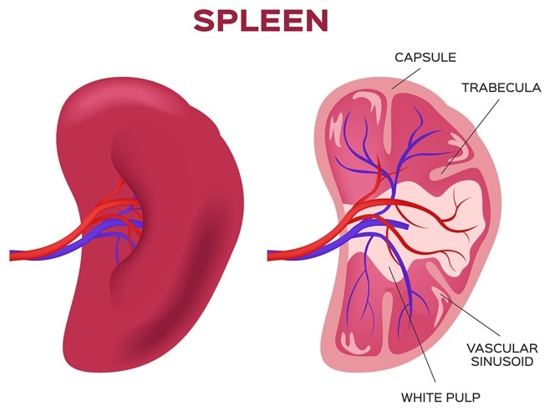
Thoughts on this method
Pros
Only assay that tries to replicate a “spleen in a dish”
Can sort of be high throughput
Cons
Takes all day to perform
Results affected by so many factors
No standardized way of reporting results
All manual
Not always easy to interpret
Best suited for determining the potency of IgG antibodies
Nobody really cares about IgG antibodies in emergency use settings

Slide 40
Conclusions
Titers tell use how much antibody there is in a sample
Good information, but makes no functional prediction
Functional assays try to replicate the effect of complement or IgG on hemolysis
Still are in vitro tests trying to replicate in vivo outcomes
Need to “crack the code” of their clinical utility
Bletchley Park

Slide 41
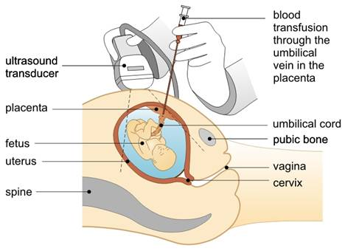
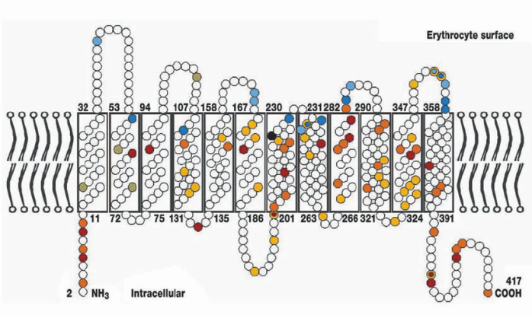
Risk of D alloimmunization
D antigen positive fetus
Anti-D
1%
Fetal demise
X
X
22%
85%
4%

Slide 42
