Slide 1



Pain Control in Prehospital Setting
Highlights on the intranasal route
Pasquier P, Dubecq C, Montagnon R
“Pépé”
Pierre PASQUIER. MD, OF-5
French SOF Medical Command / Medical referent
Percy Military Teaching Hospital / ICU
Val-de-Grâce Military Medical Academy
pierre.pasquier@intradef.gouv.fr

Slide 2

Disclaimers
No conflicts of interest.
The opinions or assertions expressed herein are the private views of the authors and are not to be considered as reflecting the official views of the French Military Medical Service.
Very French accent!
Notes:
A French man, so with a very French accent!

Slide 3
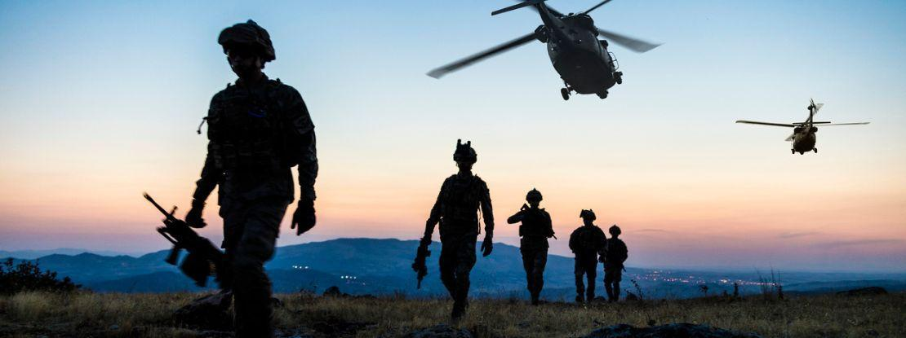
Objectives
Recognize challenges in prehospital pain control.
Describe the intranasal route solution.
Understand benefits/limits.

Slide 4
Objectives
Recognize challenges in prehospital pain control.
Describe the intranasal route solution.
Understand benefits/limits.
CONVINCE YOU THAT IS (ALSO) IMPORTANT!

Slide 5
IN pain control in prehospital setting
Why?
When?
How?

Slide 6
Why?

Slide 7
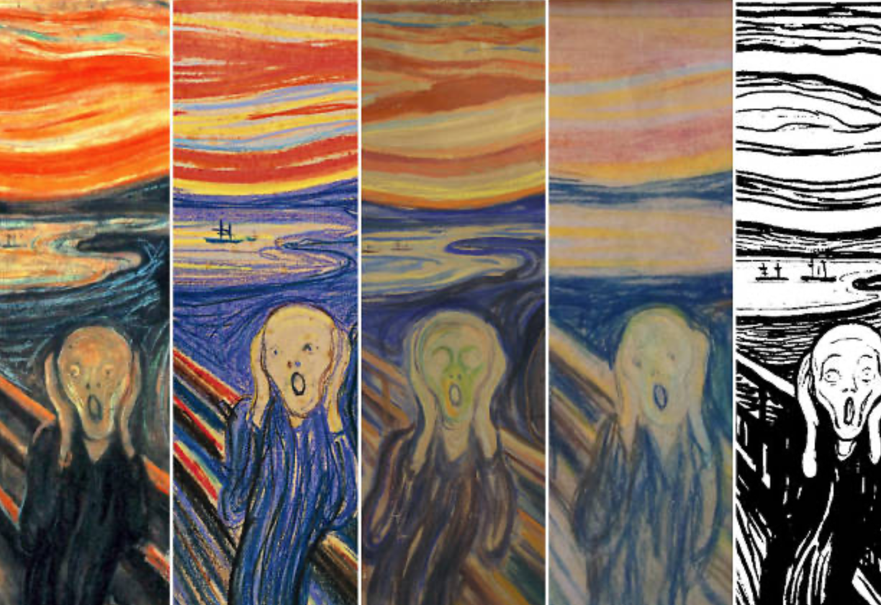
Edvard MUNCH. Skrik 1893-1917
Notes:
Awful situation of a trauma patient suffering in hard conditions without pain control

Slide 8
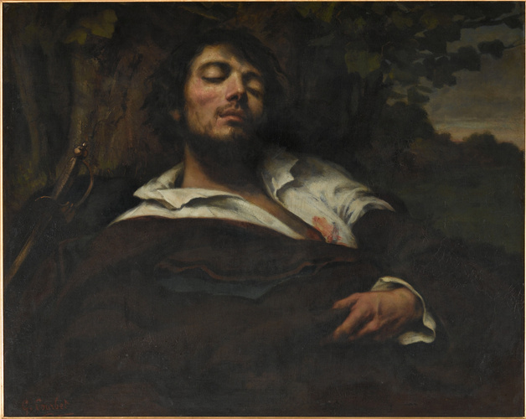
Gustave COURBET. L’homme blessé 1844-1854
Notes:
Peaceful situation of a trauma patient relieved of suffering in good conditions by appropriate pain control

Slide 9
The goal of initial pain management isn’t to extinguish pain,
but to reduce the pain perceived by the patient
to a tolerable level without causing serious side effects.
Phrampus PE, et al. JEMS 2016

Slide 10
Qualities of the ideal analgesic in military prehospital setting?
Strategical
allow the injured soldier to remain as functional as possible…
and continue to fight if needed;
Medical
rapid onset of action, proven efficacy and safety, minimal side effects, and few contraindication;
Logistical
durable packaged, multiple routes of administration.
Buckenmaier C 3rd. J R Nav Med Serv. 2006

Slide 11
↑ morbidity and ↑ mortality
Poor pain control
Adverse effects of pain medication
especially in shock patients!
Buckenmaier C 3rd, et al. Pain Med 2009
Notes:
Some have stated that poorly controlled acute pain could be associated with increased morbidity and mortality.
Nevertheless, there is more evidence for adverse effects of pain medication in patients with shock

Slide 12
Intranasal route
No need for needles
↓ danger
No IV lines
↓ time ↓ material
Easy to use by everybody.
Simple!

Slide 13
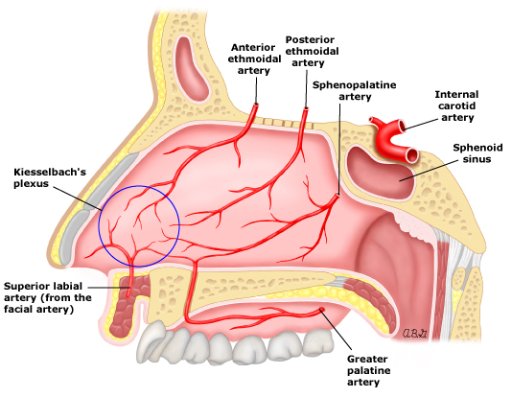
Intranasal route
Rich vascular plexus of the nasal cavity
rapid systemic drug absorption
quick onset of action
→ rates of absorption and plasma concentrations
comparable to IV administration,
better than SC or IM routes.
Efficacy!
Pires A, et al. J Pharm Pharm Sci 2009

Slide 14

Seizure : midazolam, lorazepam
Pain control : fentanyl, ketamine, ketorolac, butorphanol
Sedation : midazolam, fentanyl, ketamine
Agitation : haloperidol, midazolam
Opiate overdose : naloxone
Hypoglycemia : glucagon
Data available
Freestone DS, et al. Br J Clin Pharmacol 1976
Dubecq C, et al. J Spec Oper Med 2023

Slide 15
Why to control the pain?
To reduce the pain of suffering patients.
To improve further outcomes for the patient.
To improve your own conditions to treat the patient.

Slide 16

Why to use the intranasal route?
Easy.
Effective.
Experienced.

Slide 17
When?

Slide 18
→ as soon as possible!

Slide 19
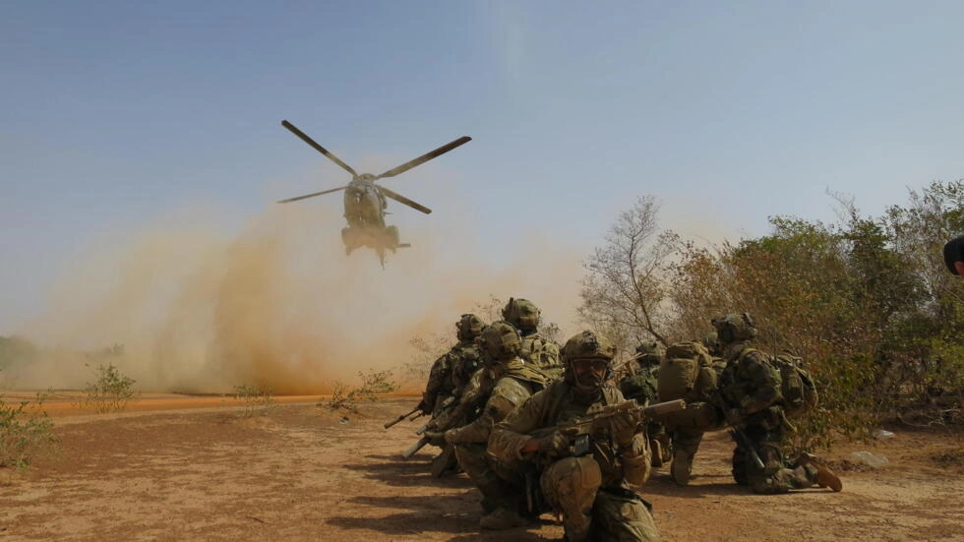
CUF > TFC > TEC: when there’s no time for IV
© RFI/Olivier Fourt

Slide 20
In irregular warfare
# to economize IV lines?
Farr WD. JSOU 2019

Slide 21

In mass casualties-incidents
# to rapidly relieve many patients
Swiech A, et al. Anaesth Crit Care Pain Med 2020

Slide 22
How?

Slide 23
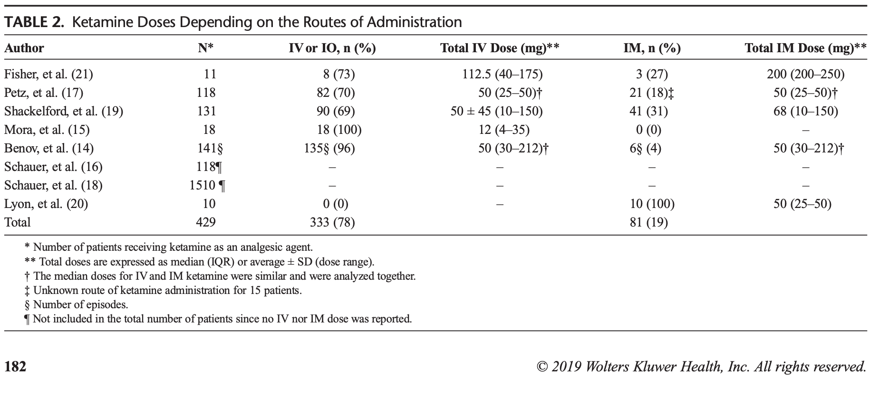
Use ketamine
Efficacy
Safety
Especially in the specific combat prehospital setting
de Rocquigny G, et al. J Trauma Acute Care Surg 2019
Fisher AD, et al. J Spec Oper Med 2020

Slide 24

IN ketamine
Onset of action < 5’
Peak of effect 10’
Duration of action > 60’
Dubecq C, et col. MEA 2017

Slide 25
Or fentanyl
Efficacy
… but ± more side-effects, specific of opioids
Frey TM, et al. JAMA Pediatrics 2019
Montagnon R, et al. J Spec Oper Med 2023

Slide 26
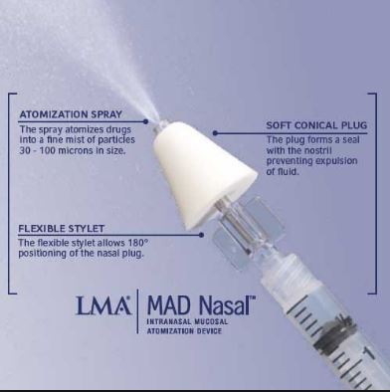
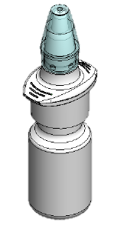
Which device?
Metered Aerosol Device (MAD®)
French military medical service device
r
Palmer GM. J Paediatr Child Health 2016
Montagnon R, et al. J Trauma Acute Care Surg 2023

Slide 27
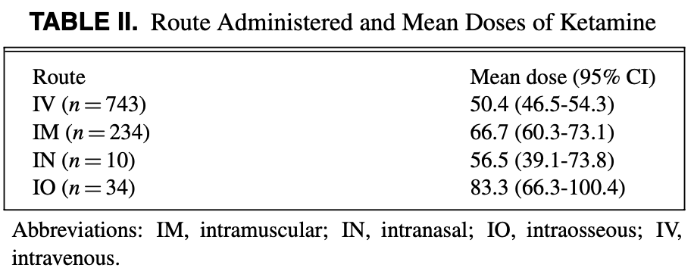
Which dose?
50 mg per dose
0.5mL per nostril max
ketamine 100mg/mL
0.1 mL per spray
→ 2 sprays/ nostril = 40 mg
± repeat 10’ later : 1 spray/ nostril = 20 mg
Bebarta GE, et al. Mil Med 2021

Slide 28
Take home messages

Slide 29
Respect the laws
… and the laws will respect you!

Slide 30
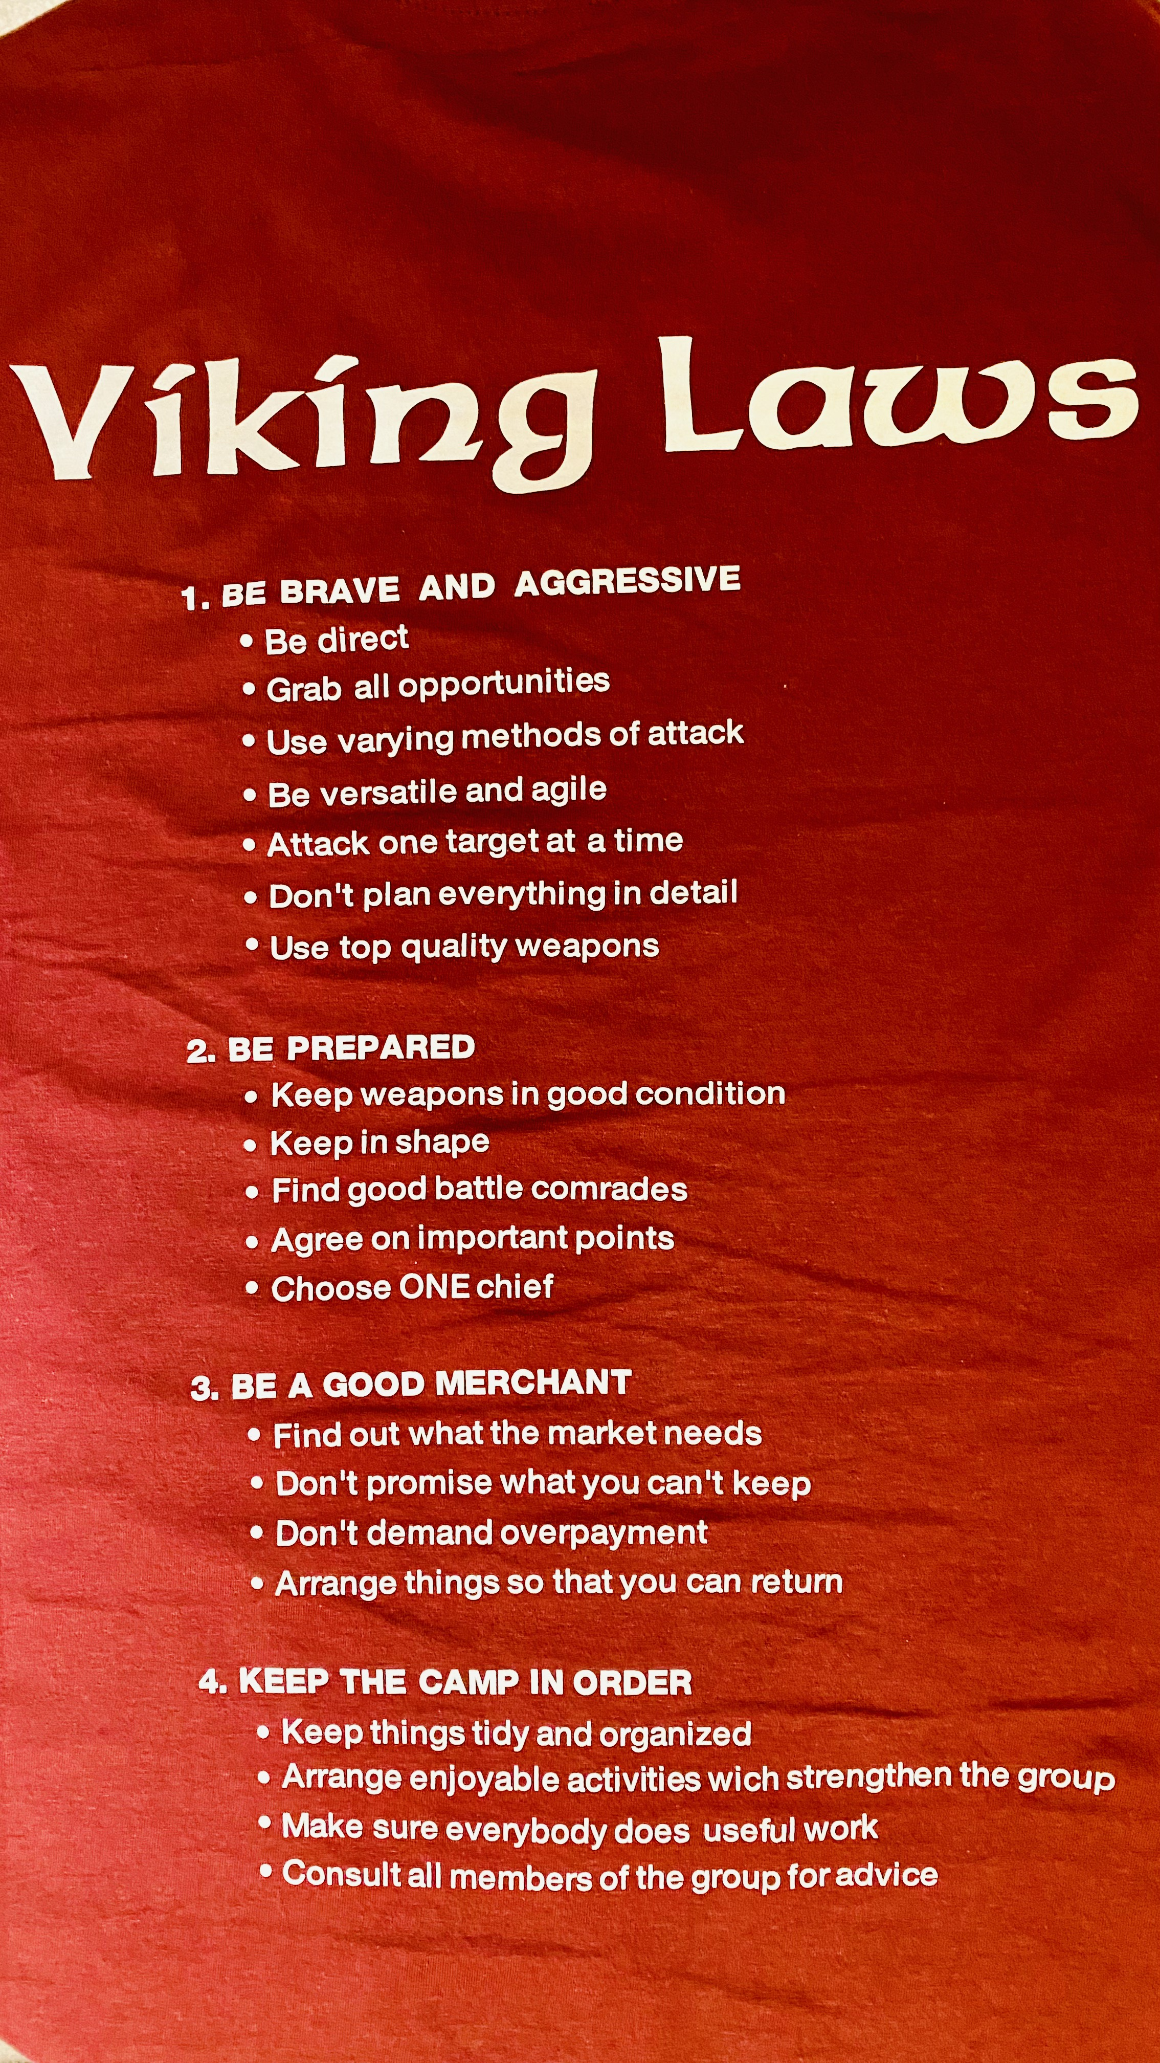
BE BRAVE AND AGRESSIVE
Be direct.
#control the pain!
Grab all opportunities.
#including intranasal route.
Use varying methods of attack.
#multimodal analgesia.

Slide 31
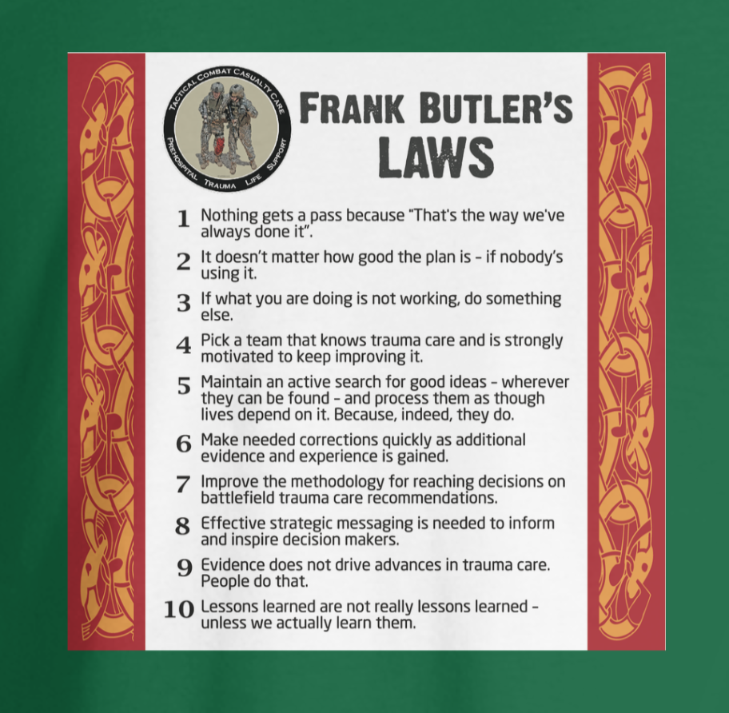
Nothing gets a pass because “that’s the way we’ve always done it”.
#French syrette of morphine?
Maintain an active search for good ideas.
# French military medical service development of personal devices delivering individual doses of IN

Slide 32
To go further into the details
Fisher AD, et al. Analgesia and Sedation for Tactical Combat Casualty Care: TCCC Proposed Change 21-02. J Spec Oper Med 2022.
Dubecq C, et al. Combat Casualties Treated With Intranasal Ketamine for Prehospital Analgesia: A Case Series. J Spec Oper Med 2023.
Andolfatto G, et al. Prehospital Analgesia With Intranasal Ketamine (PAIN-K): A Randomized Double-Blind Trial in Adults. Ann Emerg Med 2019.

Slide 33

Questions & Comments?
Merci beaucoup!
Photo credit Brice

Slide 34
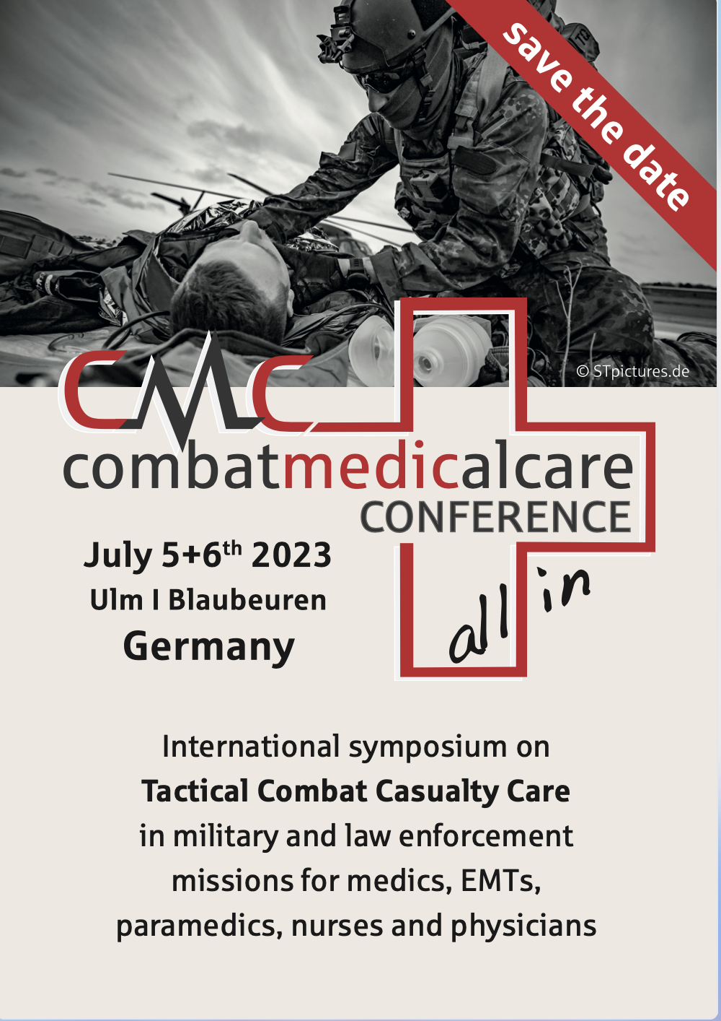
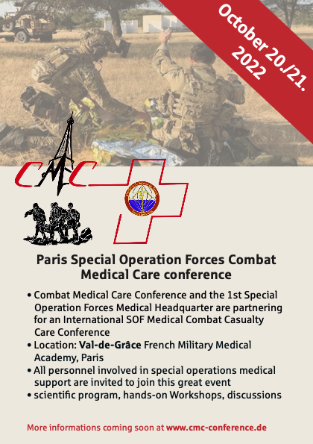
Next rendez-vous!
July 05-06, 2023
Ulm GERMANY
October 15-16, 2024
Paris FRANCE
October 15-16
2024

Slide 35
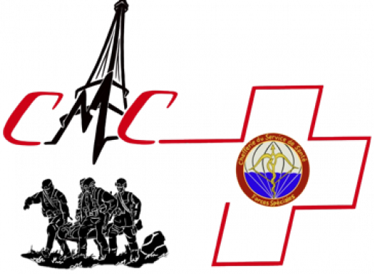
Paris SOF-CMC conference
October 15-16, 2024

