Slide 1

Radiation-induced blood failure and hemostatic resuscitation as a countermeasure
June 23-26, 2019
Bergen, Norway
Isabel Lauren Jackson, PhD
Associate Professor, Dept. of Radiation Oncology
Deputy Director, Division of Translational Radiation Sciences
Director, Medical Countermeasure Program
@RadNucPhD

Slide 2
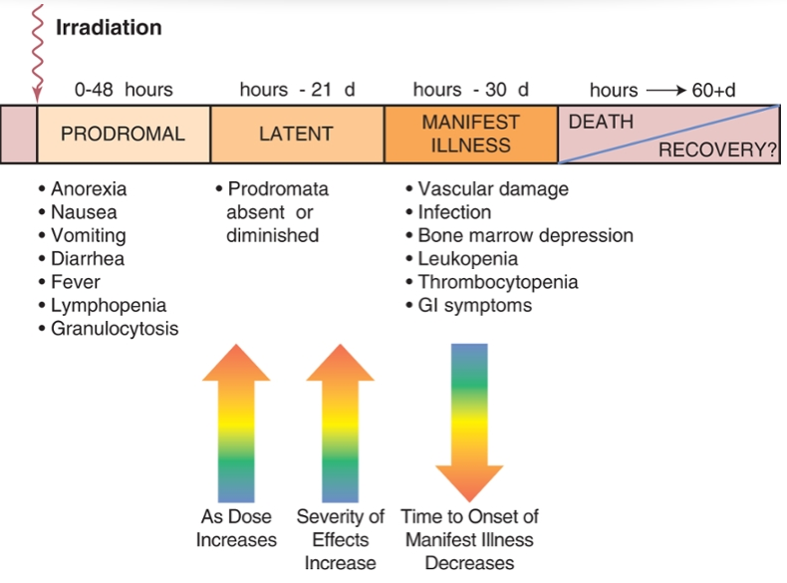
Clinical Picture of Acute Radiation Sickness (ARS) in humans
ARS is a combination of clinical syndromes occurring in stages between hours to weeks after exposure as injury to various tissues and organs is expressed.
Bushberg et al. Essential physics of medical imaging. 3rd Ed. 2011

Slide 3
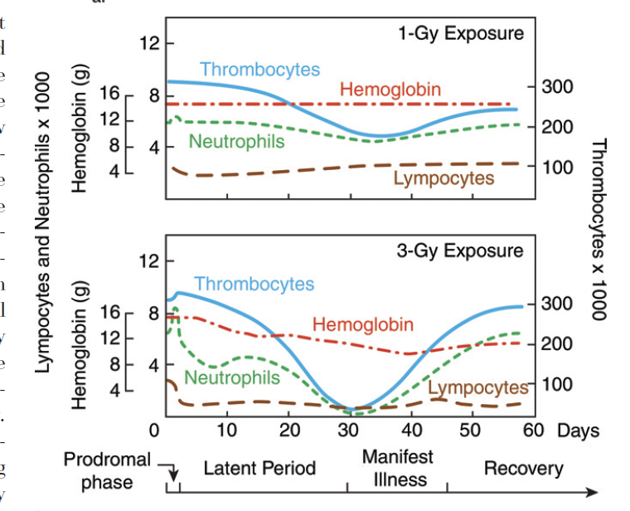
Acute radiation exposure leads to bone marrow failure at doses >2 Gy
AB Wolbarst et al. Radiology. 254(3):660
Notes:
IS THIS HUMAN DATA? Would clarify on slide

Slide 4
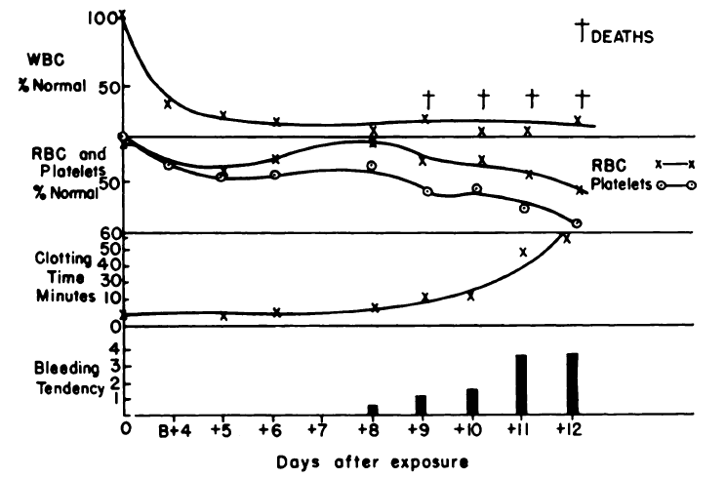
Thrombocytopenia, hemorrhage, and anemia are major causes of mortality
Hemostatic dysfunction
  Petechiae, ecchymosis, and other hemorrhagic lesions observed in the second to third weeks post-exposure.
  Appearance of heparin like substance in the blood followed by thrombocytopenia has been reported in animal models in the 1950s.
  Thrombocytopenia found in preclinical studies to be secondary to prolonged bleeding and clotting time, impaired clot retraction and extensive hemorrhage
Relationship between the cellular elements and clotting time to the development of the hemorrhagic syndrome in swine at Bikini Atoll
Notes:
Before this slide describe what blood failure is. I can send a figure that summarizes blood failure
Add a second slide with same title that summarizes
Shock/anemia and immune dysfunction. Sequence the 4 areas in the order in which you think they occur temporally
After Buddemeier, could refer to psychological effects of Fukushima among Japanese after Fukushima

Slide 5
Mortality associated with radiation-induced blood failure
Shock (oxygen debt): Inadequate oxygen delivery to meet demand
Hemostatic dysfunction
  Impaired thrombin formation
  Reduced fibrinogen function
  Reduced platelet function
  Increased fibrinolysis
Consequences of oxygen dept
  Lactic acidosis
  Cellular injury
  Platelet dysfunction
  Endothelial injury
  Coagulopathy
  Capillary leak
  Bacterial translocation and sepsis
Spinella PC, Cap AP. Curr Opin Hematol. 2017.

Slide 6
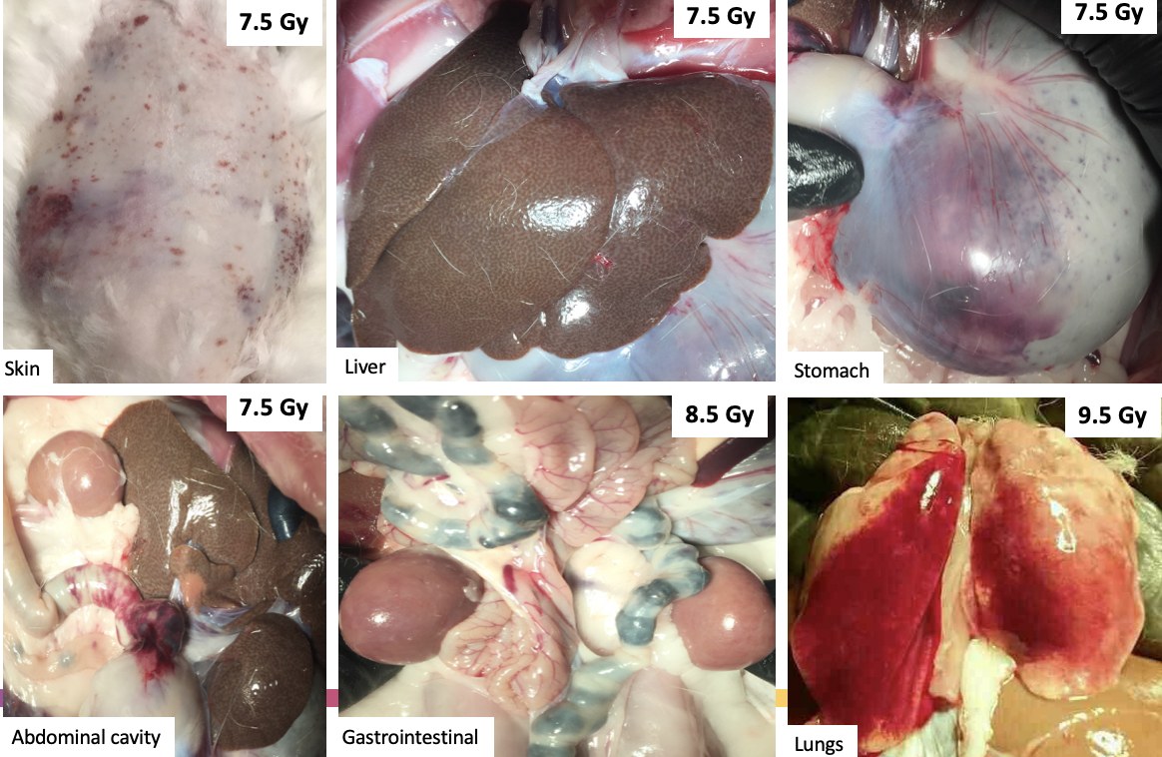
Thrombocytopenia and hemorrhage after total body irradiation in a rabbit model
Sponsored by BARDA
Notes:
For this crowd TBI means traumatic brain injury. Either spell it out or call it ARS. TBI will confuse the shit out of this group

Slide 7
Severe hypocoagulability at the time of euthanasia due to criteria
*Baseline: Pre-irradiation
*Survivors: 45-day endpoint
*Decedents: Euthanized prior to the study endpoint
*Samples did not clot during the 60 min. run; therefore a clotting time of 3600 sec (60 min. without clotting) was used to visually represent group comparisons
Sponsored by BARDA
Notes:
Incoagulable is a word we don’t use. How about ”severe hypocoagulability at the time of euthanasia“
Is this at study day 45 when the platelet count had already increased back above 100?

Slide 8
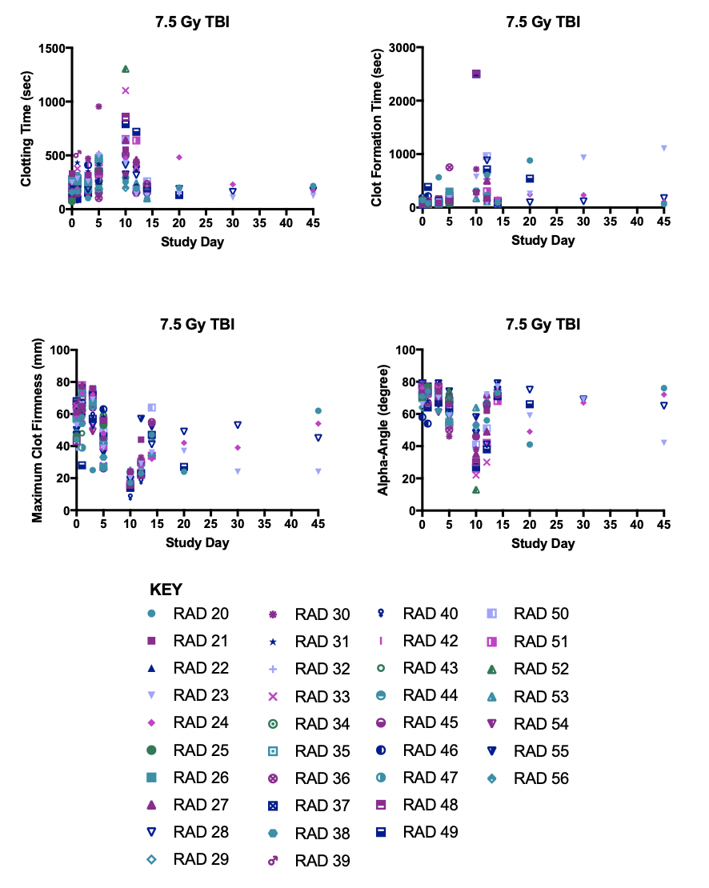
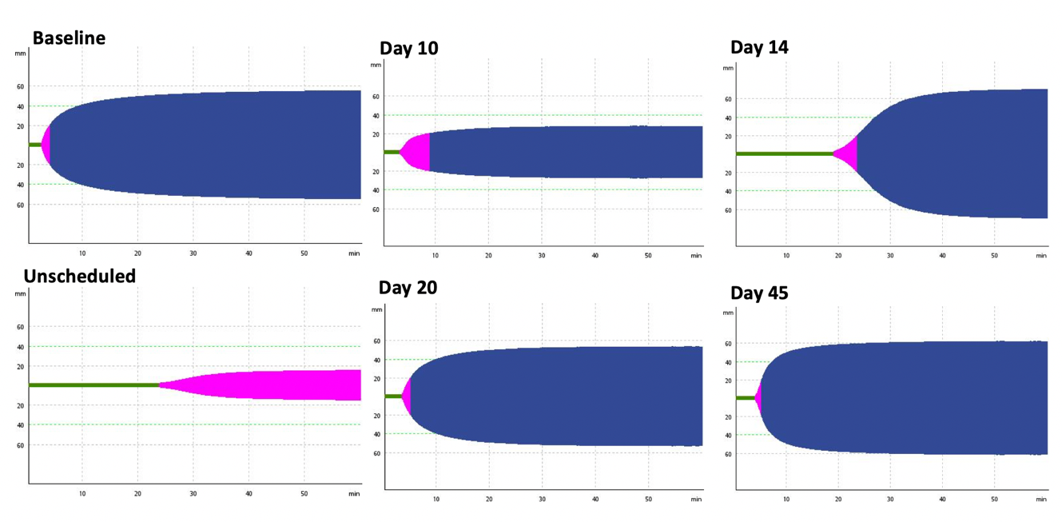
Time-dependent changes in hemostatic function after irradiation
Sponsored by BARDA

Slide 9
Radiation-induced changes in routine coagulation markers
Sponsored by BARDA

Slide 10
Radiation-induced changes in coagulation factor activity
Sponsored by BARDA

Slide 11
Changes in thrombin generation after total body irradiation in rabbits

Slide 12
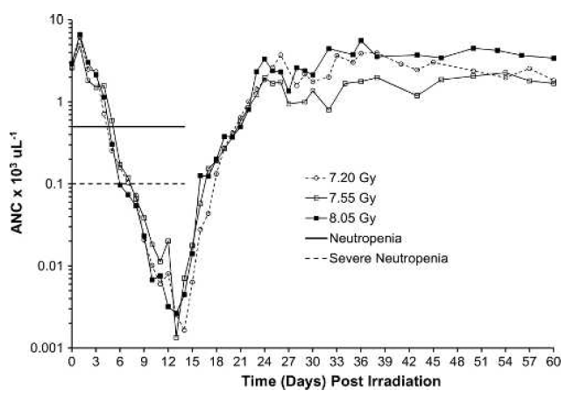
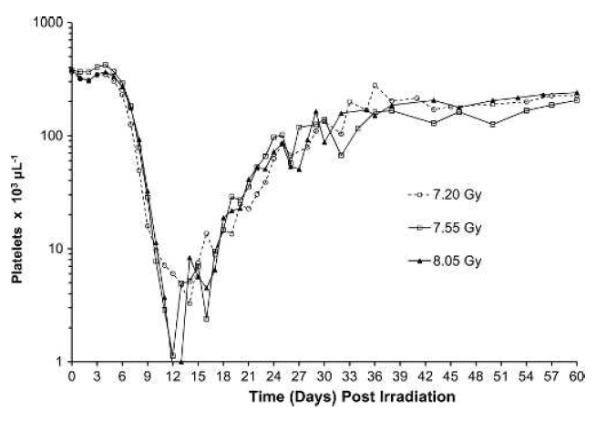
Clinical Manifestations of ARS in the Non-Human Primate
Sponsored by NIAID/NIH
Farese et al. Health Physics. 103(4): 367, 2012

Slide 13
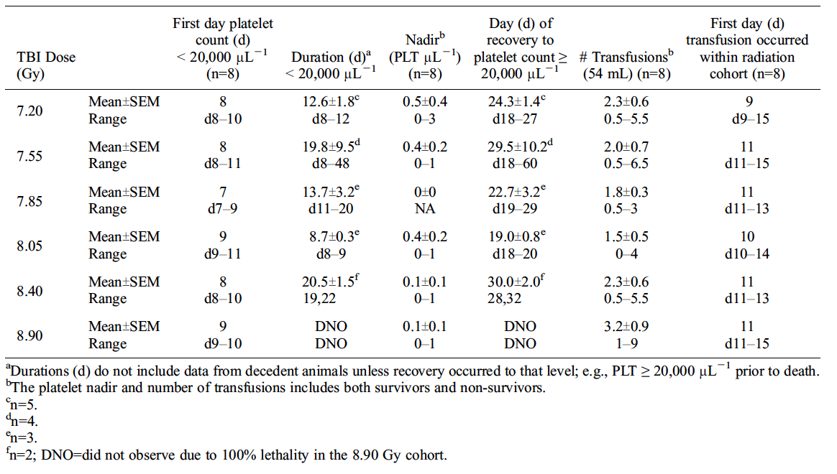
Thrombocytopenia associated with ARS in the Non-Human Primate
Sponsored by NIAID/NIH
Farese et al. Health Physics. 103(4): 367, 2012

Slide 14
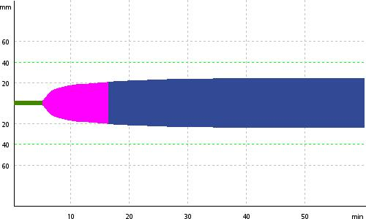
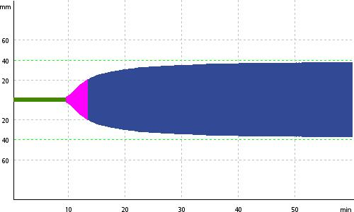
Impact of blood transfusion from healthy donors on viscoelasticity in the NHP
PLT 24,000/μL
CT 300 seconds
CFT 675 seconds
Alpha angle 62 degrees
MCF 24 mm
PLT 23,000/μL
CT 558 seconds
CFT 235 seconds
Alpha angle 52 degrees
MCF 37 mm
Euthanized on day 22 post-total body irradiation
Sponsored by NIAID/NIH

Slide 15
Conclusions
Blood failure is a major component of the acute radiation syndrome associated with life-threatening total body doses of irradiation
Rabbits, swine, and non-human primates offer opportunities to understand the mechanisms and pathogenesis of blood failure after total body irradiation, and relationship to mortality
The NHP model of radiation-induced ARS provides a platform for establishing safety, efficacy, and guidelines for transfusions in radiological or nuclear incident victims with ARS
  RBC transfusion
  Plasma transfusion
  Platelet transfusion
  Other blood products

Slide 16

Acknowledgements
Zeljko Vujaskovic, MD, PhD – Director, DTRS
Amit Sawant, PhD, Imaging Physics
Yannick Poirier, PhD, Preclinical Radiation Physics
Diana Newman, BS, Program Director
Allison Gibbs, BS, Research Manager
Elisabeth Vicente, MS, Biomarkers Manager
Andrew Zodda, MS, Research/QC Supervisor
Anthony Russo, BS, QC Specialist
Chris Johnstone, PhD, Research Physicist
Elena Rose-Fown, AA, Project Coordinator
Megan Lesniewski, BS, Lead Specialist
Greg McNew, BS, Lead Specialist
Eduardo de Faria, DVM, Research Specialist
Emma Youngman, BS, Research Assistant
Alyssa Truss, BS, Lead Research Specialist
Kristi Manuel, MS, Research Specialist
Sarah Triesler, BS, Research Specialist
Lindzey Calfee, BS, Research Assistant
Christine Steinhart, MS, Lead Specialist
Joe Piegols, BS, Research Specialist
Don Winans, BS, Research Specialist
Buddha Mali, BS, Research Specialist
Alycia Smith, BS, Research Assistant
Sandrine Soman, MS, Research Assistant
Jaslin Bennett, BS, Research Assistant
Demi Fortson, MS, Research Assistant
Dalara Fiorini, BS, Lab Animal Tech Assistant
Mathangi Gopalakrishnan, PhD, Biostats/Pharmacometrics
BARDA Non-Clinical RadNuc Network

Slide 17
Natural history of disease progression
Lymphopenia
Neutropenia
Thrombocytopenia
Anemia/Hemorrhage
Death or Recovery
Day 1
Day 3
Day 7
Day 9
Day 14
Day 20
Day 30
Day 60

