Slide 1
Haemovigilance of novelties in processing, storage, transport and application of blood products Arlinke G. Bokhorst, MD M&G President of IHN Director TRIP Netherlands office for hemo- & biovigilance
Metal–Organic Framework Nanoparticle-Assisted Cryopreservation of Red Blood Cells; Wei Zhu e.a. Am. Chem. Soc. 2019, 141, 19, 7789–7796

Slide 2
DISCLAIMER: no conflicts of interest
Innovation in the transfusion chain
Authorisation of blood products compared to other medical substances
Assessment of risk involved with novelties
Use of cinical data and haemovigilance systems

Slide 3
Constant impuls to innovate the blood transfusion chain
Donors
Blood establishments
Hospitals
Patients
Oversight
Manufacturers
Research & education
Society
New product – therapy
more effective version of existing treatment
more efficient, convenient
New indication – new disease
Less costs
Re-inventions
Better availability

Slide 4
Innovation blood products for trauma resuscitation
Optimal Blood use | Components : Ratio’s + effect massive transfusions |  |  |  | Whole Blood : indications
 | Plasma | PLT | Thrombo’s | RBC
Standards of care | Testing for TTI AB0/Rh compatibility Pathogen inactivation Leucoreduction Donor screening Plasma replacement Plasticers!?! |  |  |  | Effect of: LR of WB LT (0) WB Rh incompatible? Pathogen inactivation? Infection risk due to WBB Health of Walking Donors
Prehospital settings
Storage conditions & time | Liquid plasma Freeze dried plasma |  | Frozen plt Cold vs. warm | Frozen/new protectants | Warm fresh Frozen?
Availability Far forward transport | Logistics of frozen blood bank Prolonging shelf life Parachute dropping /transport containers /temperature monitoring
AIM of research: establish efficacy, quality, safety of novelties in blood transfusion

Slide 5
Authorisation of blood products for human application
”fresh” blood products :
EU Directive 2002/98 :
Licencing of blood establishment: GMP – process validation – change control
US: 21 CFR 607 registration of BE and product list.
New blood products?
CoE :4.4.3.1…..A scientific and risk-based validation approach could be justified for new blood components
Plasma derived products :
Pharmaceutical legislation :Market Authorisation via EMA, FDA
21 CRF 601.12 :approval required for :
any change in the product, …. That has a substantial potential to have an adverse effect on the product in relation to it’s safety and efficacy.

Slide 6
Difference between ”MA” of blood products versus Medical Devices and pharmaceuticals
Processing on a small scale, non industrialized, base product variable
Batch controls not always feasible (scarcity of the product)
prove of clinical efficacy (absence of harm)
No prove of superiority of non-inferiority
No regulated requirement for trials, (Post) marketing surveillance
Report of change ( validation of the processes)
SARE reporting (haemovigilance)

Slide 7
Haemovigilance : beyond our roots
+ donor safety + optimal blood use
Analysis of adverse reaction + event reporting (errors , near misses, human fault leading to potential harm)
+ users safety
+ incident reporting
Patient safety
Preventive measures based on Adverse reaction analysis
Haemovigilance
Medical device vigilance
Pharmacovigilance

Slide 8
Necessity for clinical evaluation of novel Blood products
Blood (SoHO) specific guidelines for Preparation Process Authorization: Principles from EuroGTP II and GAPP
Is it a novelty ?
Three step approach :
Risk assessment
Risk mitigation in vitro/ pre-clinical studies
Clinical risk monitoring in patients

Slide 9
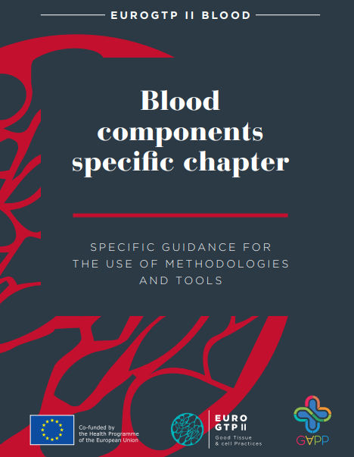
Interactive tool
Guide you through the process of identifying the risks
Calculate the risk profile : Negligible, Low, moderate, High
Recalculate after mitigation through in vitro/ non-clinical studies
Establishes remaining risk and gives directions for clinical
data needed.
Documents the assessment process and data
http://goodtissuepractices.eu/images/docs/EuroGTPII_Blood_INT.pdf
Interactive Assessment Tool
Guide

Slide 10
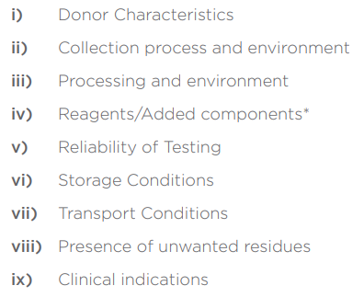
Systematic Risk assessment methodology Risk factors

Slide 11
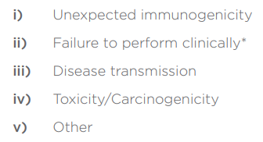
Systematic Risk assessment methodology Risk types

Slide 12
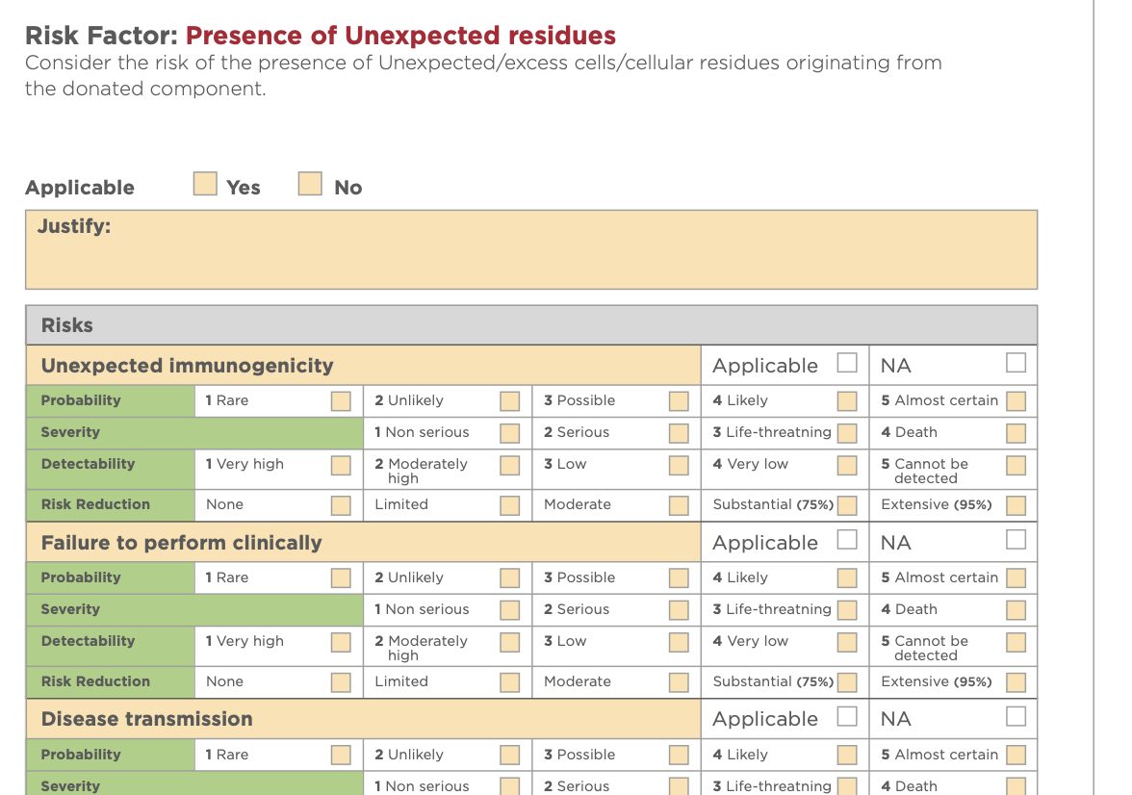
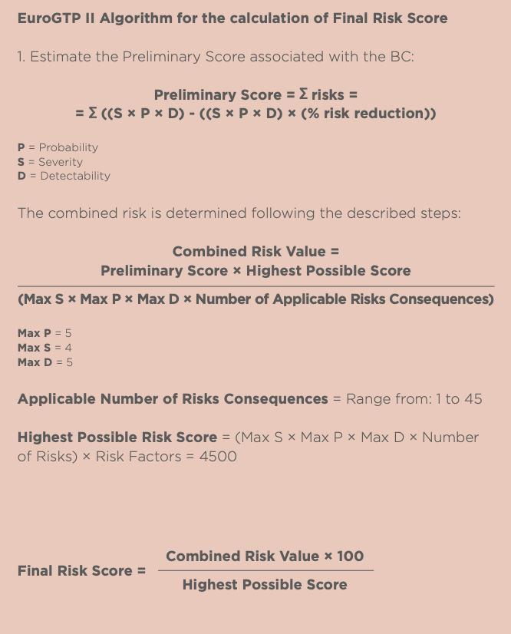

Slide 13
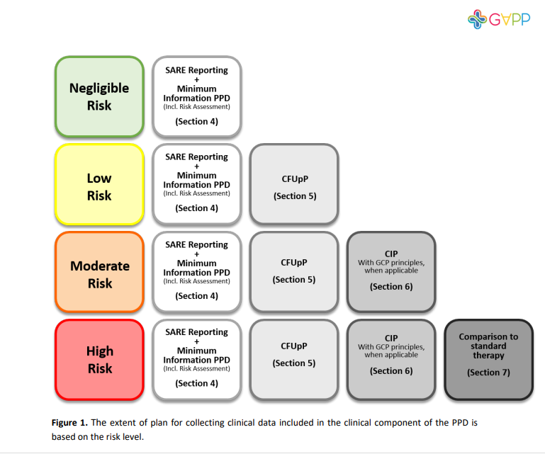
Requirements for clinical application in humans
Iterative
Haemovigilance data are the bases
Clinical follow up Plan
Clinical Investigation Plan : clinical trial setting
Superiority study
Cave : ethical aspects and insurance

Slide 14
Sources of clinical data
Assessment of clinical data may be based on :
Scientific literature incl. Search protocol
Unpublished data of the BE in collaboration with the clinic
Real Word Data : Patient health status from different sources
Electronic hospital records
Insurance, pharmacists laboratory
Registry data of for instance disease specific or patient groups
“Smart watches”
PROMS
Biological materials /samples

Slide 15
Innovation of blood products for trauma resuscitation
Haemovigilance is the basis for any product innovation
Patient follow up needed to monitor clinical outcome
Clinical trials with novelties focuses first at efficacy and non -inferiority
Literature :
Data on unwanted adverse reactions of these products are limited

Slide 16
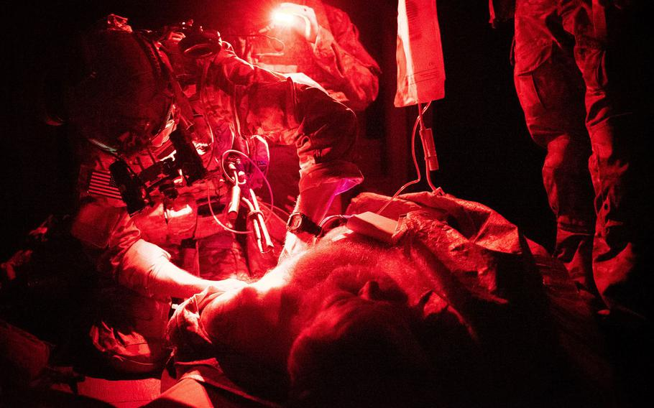
Treatment takes place under difficult circumstances
Patients are often young and healthy, no comorbidity
Universal blood group/novelties aiming at contamination risk
Patients are often lost to follow-up, due to far forward treatment and/or foreigners
Informed consent for trial settings is hard to obtain
Numbers to treat are low

Slide 17
Recommendations to obtain clinical insight on novel blood products in case of Massive blood loss
Combine the collection of adverse reactions reporting with other mandatory feed back, like on traceability
Make use of the positive risk/benefit ratio of trauma patients and settings where follow-up is adequately organized (military setting?) for “ first in patient” applications
Need to collaborate with non-emergency setting to perform clinical trials and systematic follow up
Organize a network of trauma centres (THOR?) to collect reports/built a database on SARE with novel blood products for blood loss
Civil/military
International

