Slide 1
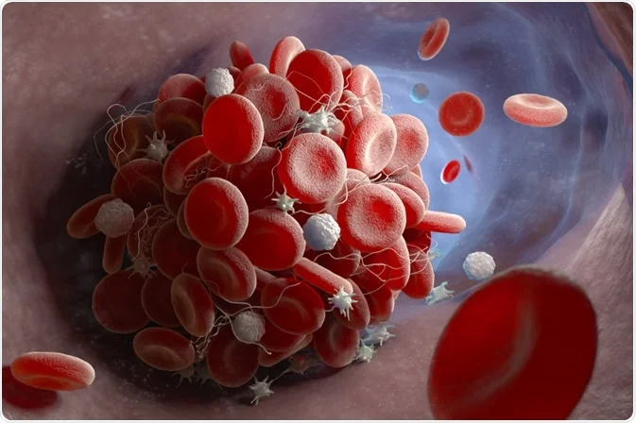
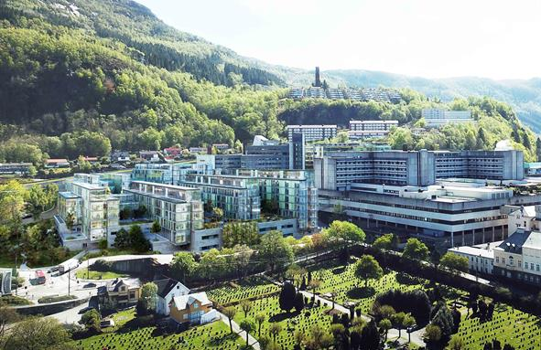
LTOWB HOSPITAL EXPERIENCE
Christopher Bjerkvig, MD
Bergen HEMS
Haukeland Uni. Hospital
NORNAVSOC
RDCR 26.07.22

Slide 2
Disclaimer
The opinions or assertions contained herein are the private views of the author and are not to be construed as official or as reflecting the views of the Norwegian armed forces medical services or Helse-Bergen
Notes:
Just quick – these are my own opinions. I don have any conflict of interests.

Slide 3
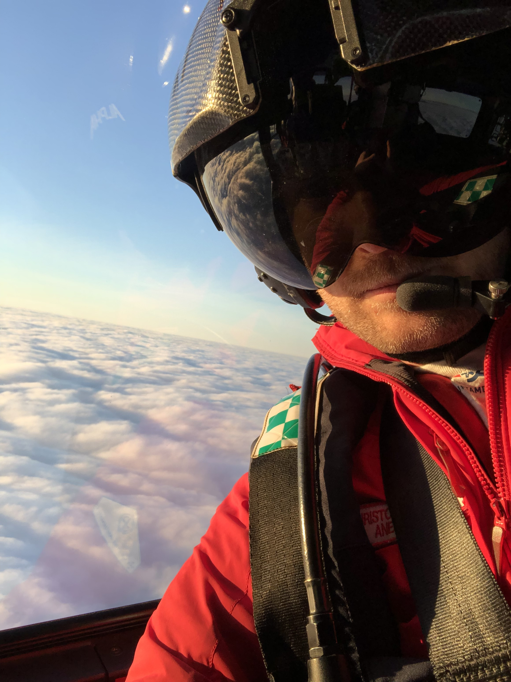
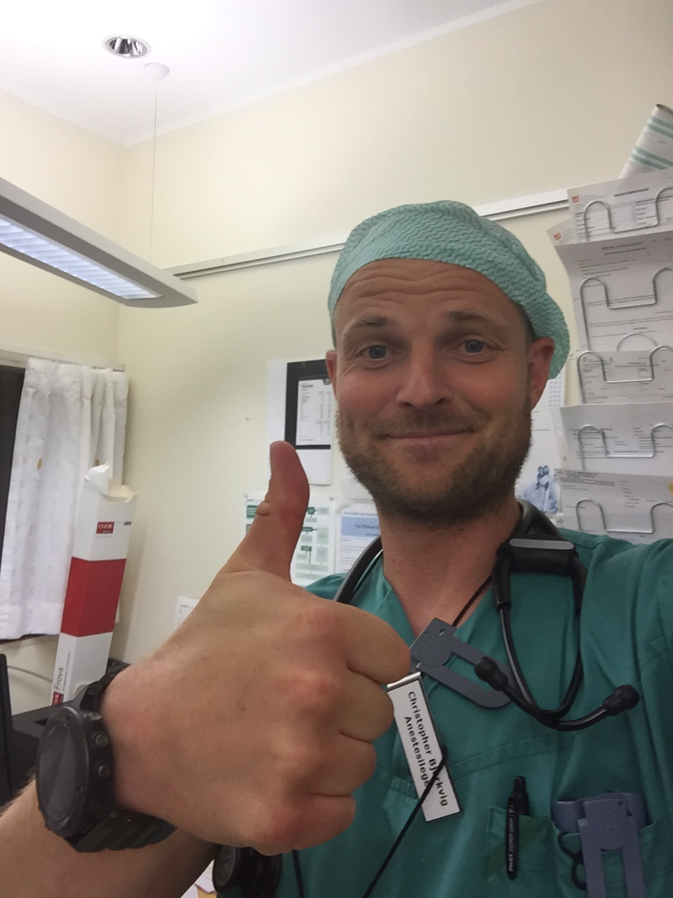
Notes:
So my main job is on the air ambulance. at Bergen HEMS. As a part of my job we do rotations inhospital at Haukland University hospital.

Slide 4
Haukeland University Hospital
Level 1 trauma center
Population 1.1 million
National Burn Unit
Local hospital
Population 285.000
~ 800 beds

Slide 5
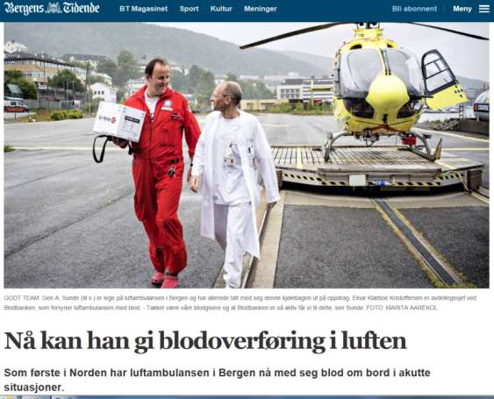
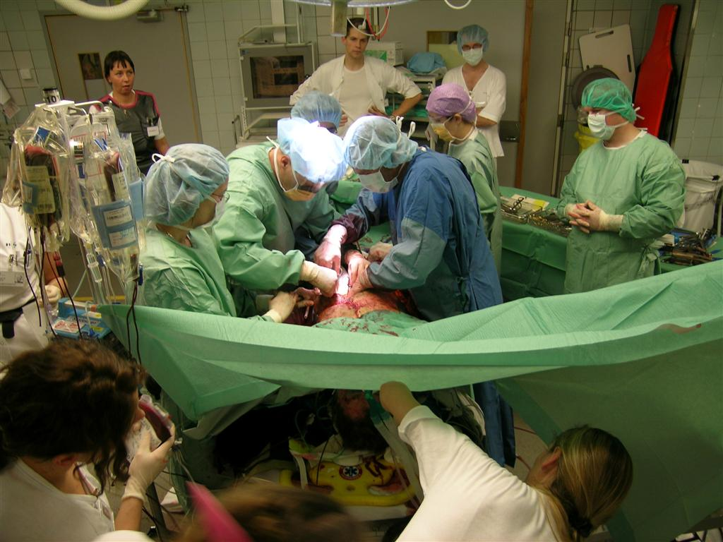
Timeline LTOWB Haukeland University Hospital
Red cells in Air Ambulance,
July 2014
Whole blood in Haukeland University Hospital,
Dec 2017
Whole blood in Air Ambulance,
Dec 2015
Whole blood in
Voss Hospital
April 2019
Freeze dried plasma in Air Ambulance
2013

Slide 6
Rationale – “Hemostatic resuscitation”
Enhance the body’s ability to form clots at sites of active bleeding
Minimize adverse effects (edema and dilution of clotting factors) resulting from iatrogenic resuscitation injury
3) Restore adequate intravascular volume and organ perfusion prior to definitive surgical control of hemorrhage
4) Optimize oxygen carrying capacity
Notes:
As you all know – the goal is to support hemostasis, and to minimize the adverse effects of dilution. In addition we want to restore intravascular volume and optimize oxygen carrying capacity.

Slide 7
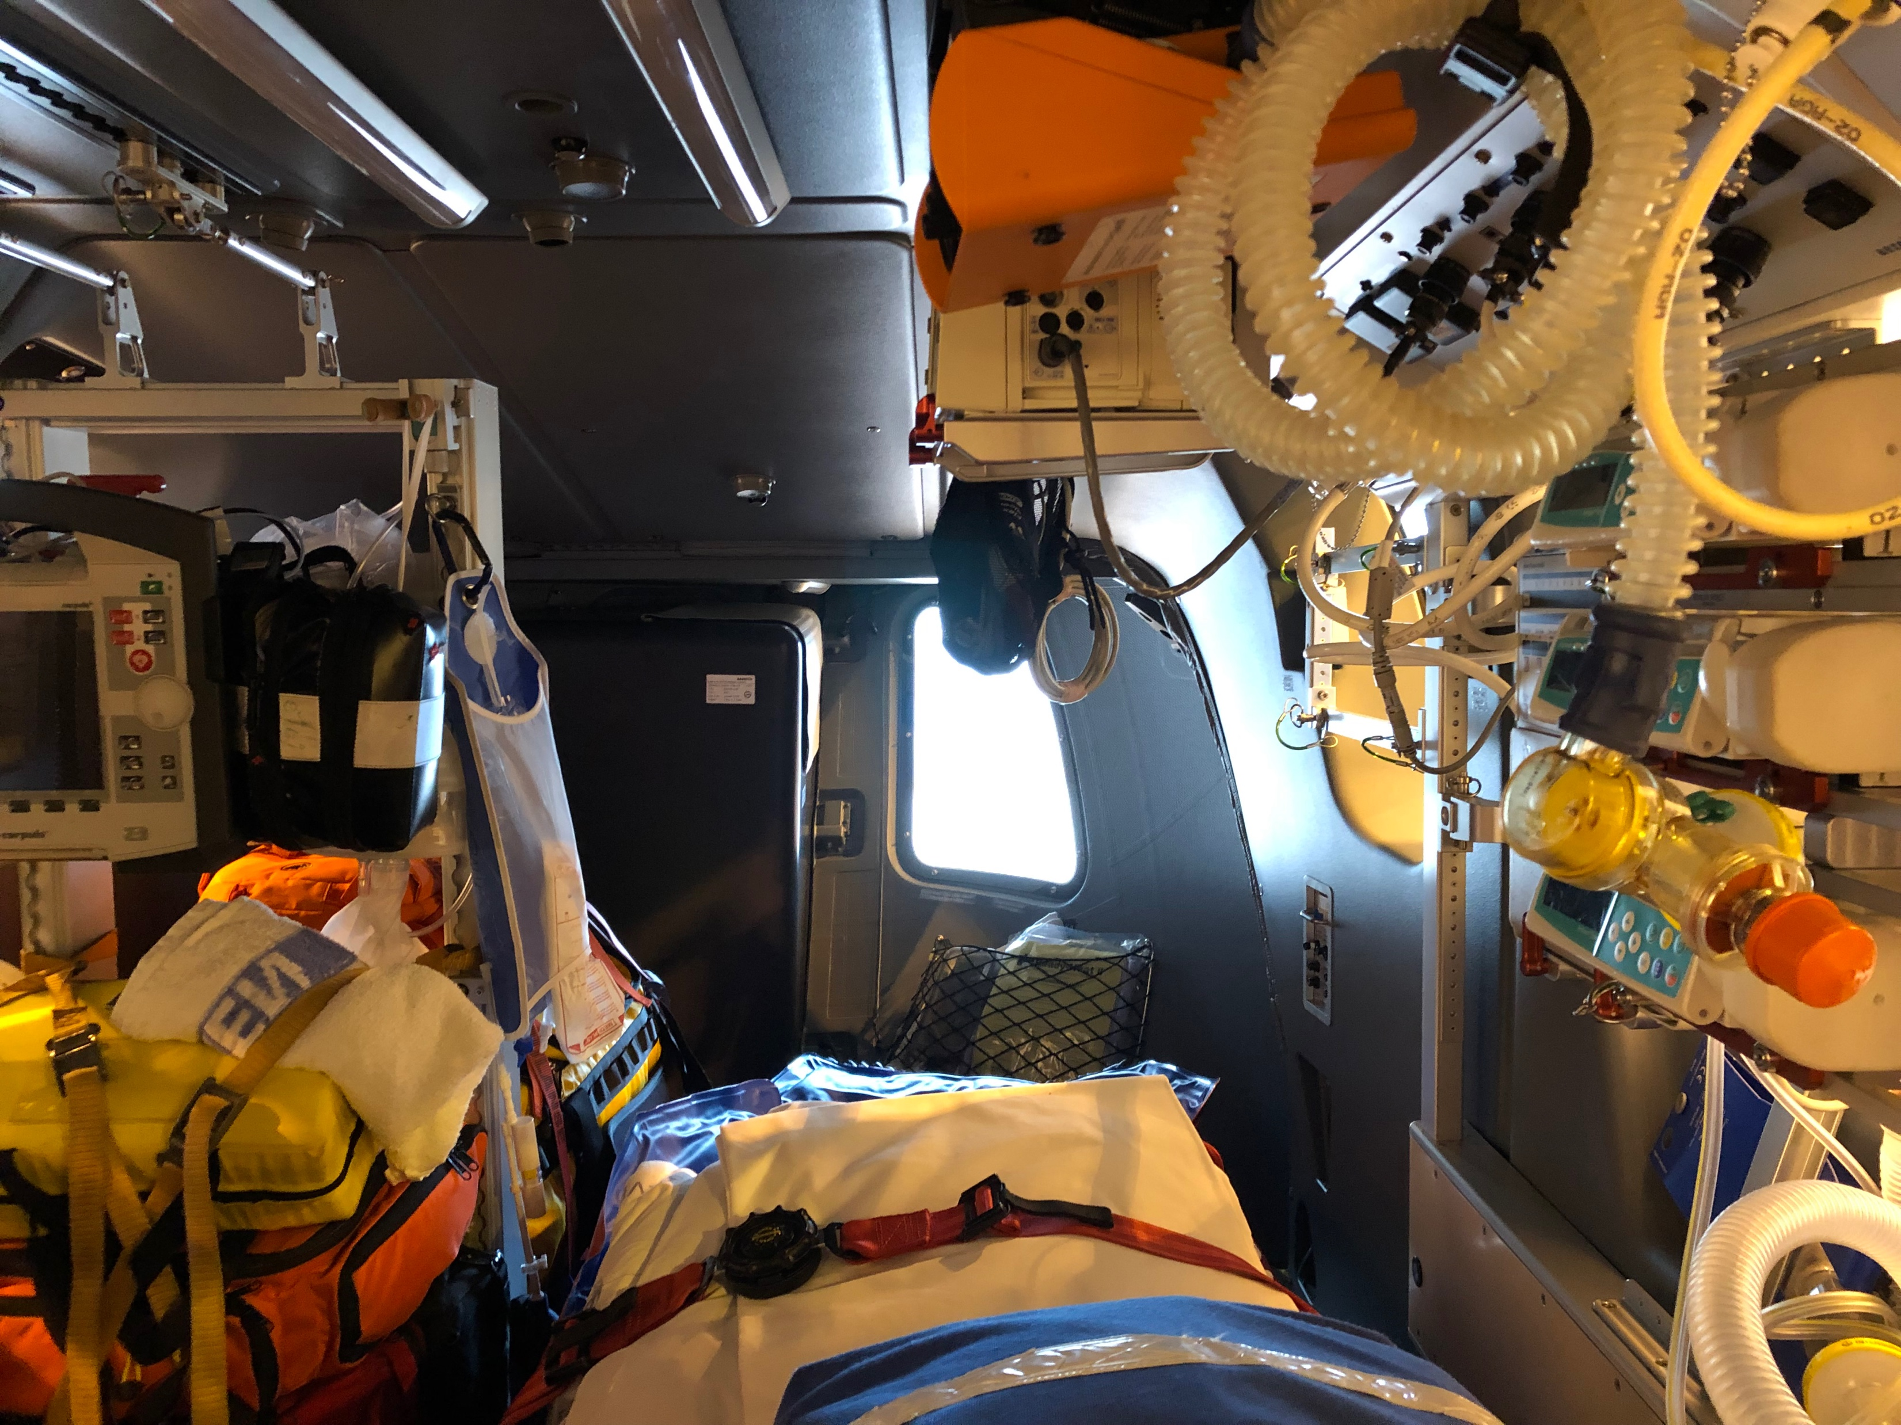
Rationale – Prehospital implementation
Non-compressible bleeding
Balanced transfusion:
Only realistic option LTOWB
Logistical challenge
Vascular access
Confined workspace
Hard to communicate
«Not enough hands»
Single bag is easier than 3
«Get the initiative
Stay on top of things»
Notes:
So we are talking about time critical non compressible bleeding. If we are aiming for a balanced transfusion – the only realistic option is WB. In addition, resuscitation in this kind of environment may be challenging.

Slide 8
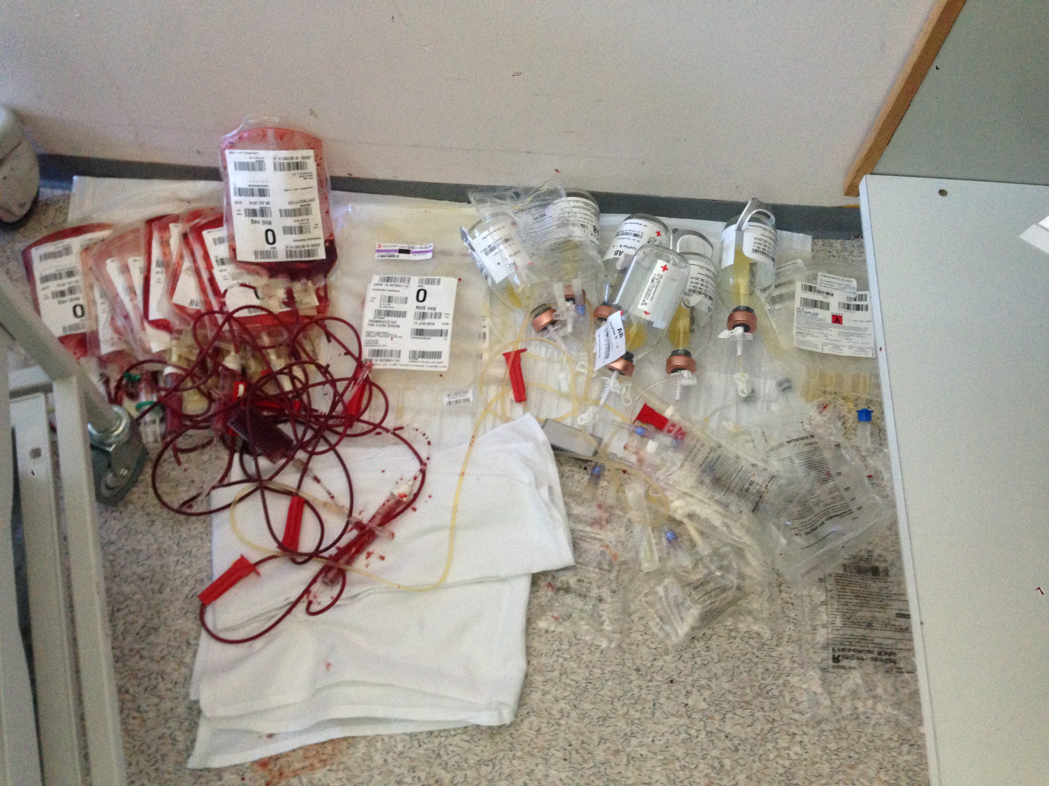
Rationale – While awaiting hemorrhage control:
Logistics - massive transfusion protocol:
Vascular access
Acitvation of MTP – Blood bank logistics
Crew resource management
Workload/mental capacity
Balanced transfusion
«It always ends up 1:1:1 but during???
Intrahospital transfer
Diagnostics
Easier with one bag instead of three
Notes:
When we are talking about the rationale for implementing WB inhospital – the arguments are exacly the same. The logistics of massive transfusion is Easier to transfuse 1 bag instead of three

Slide 9
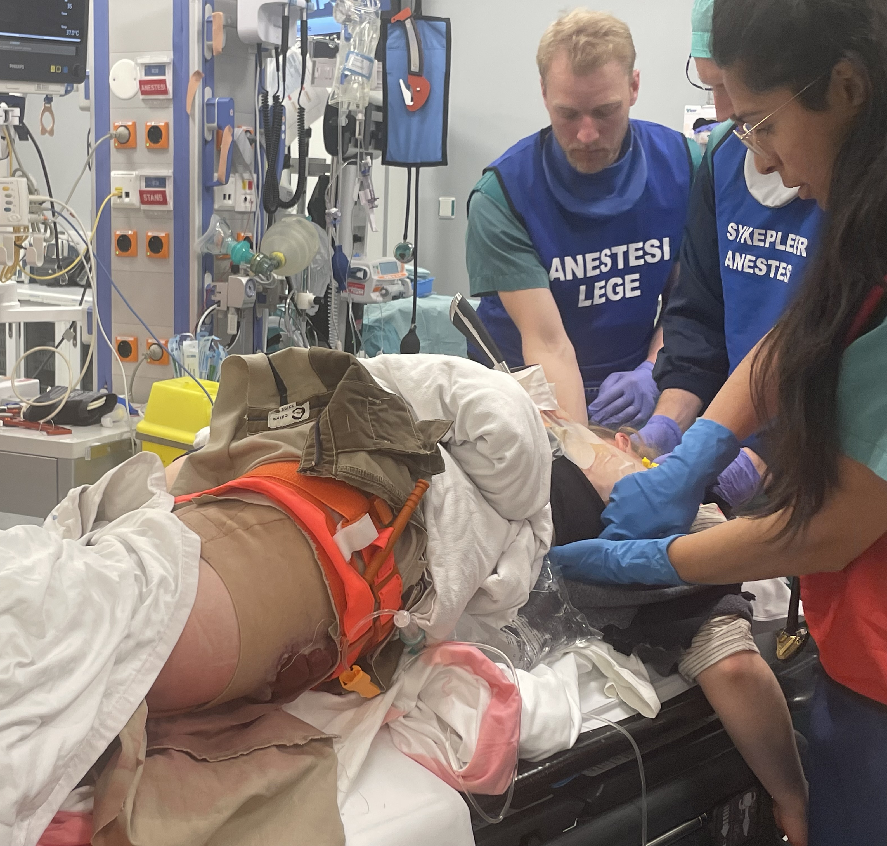
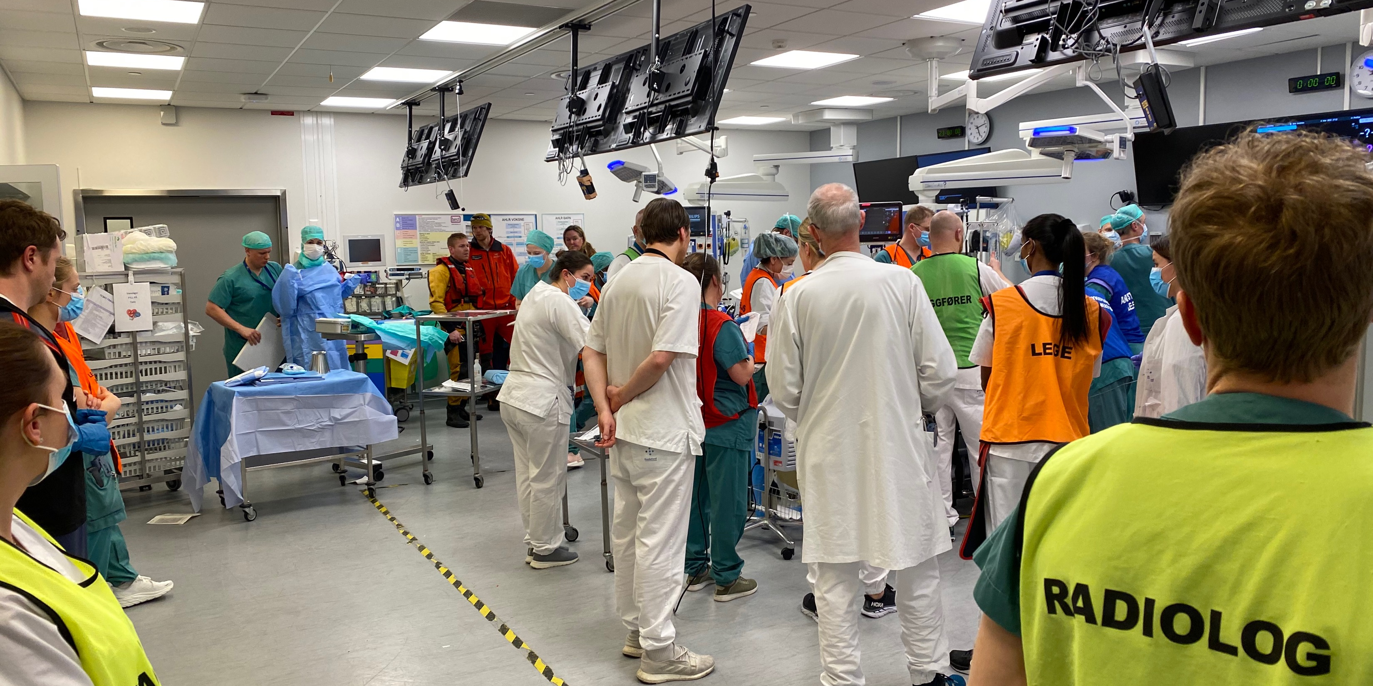
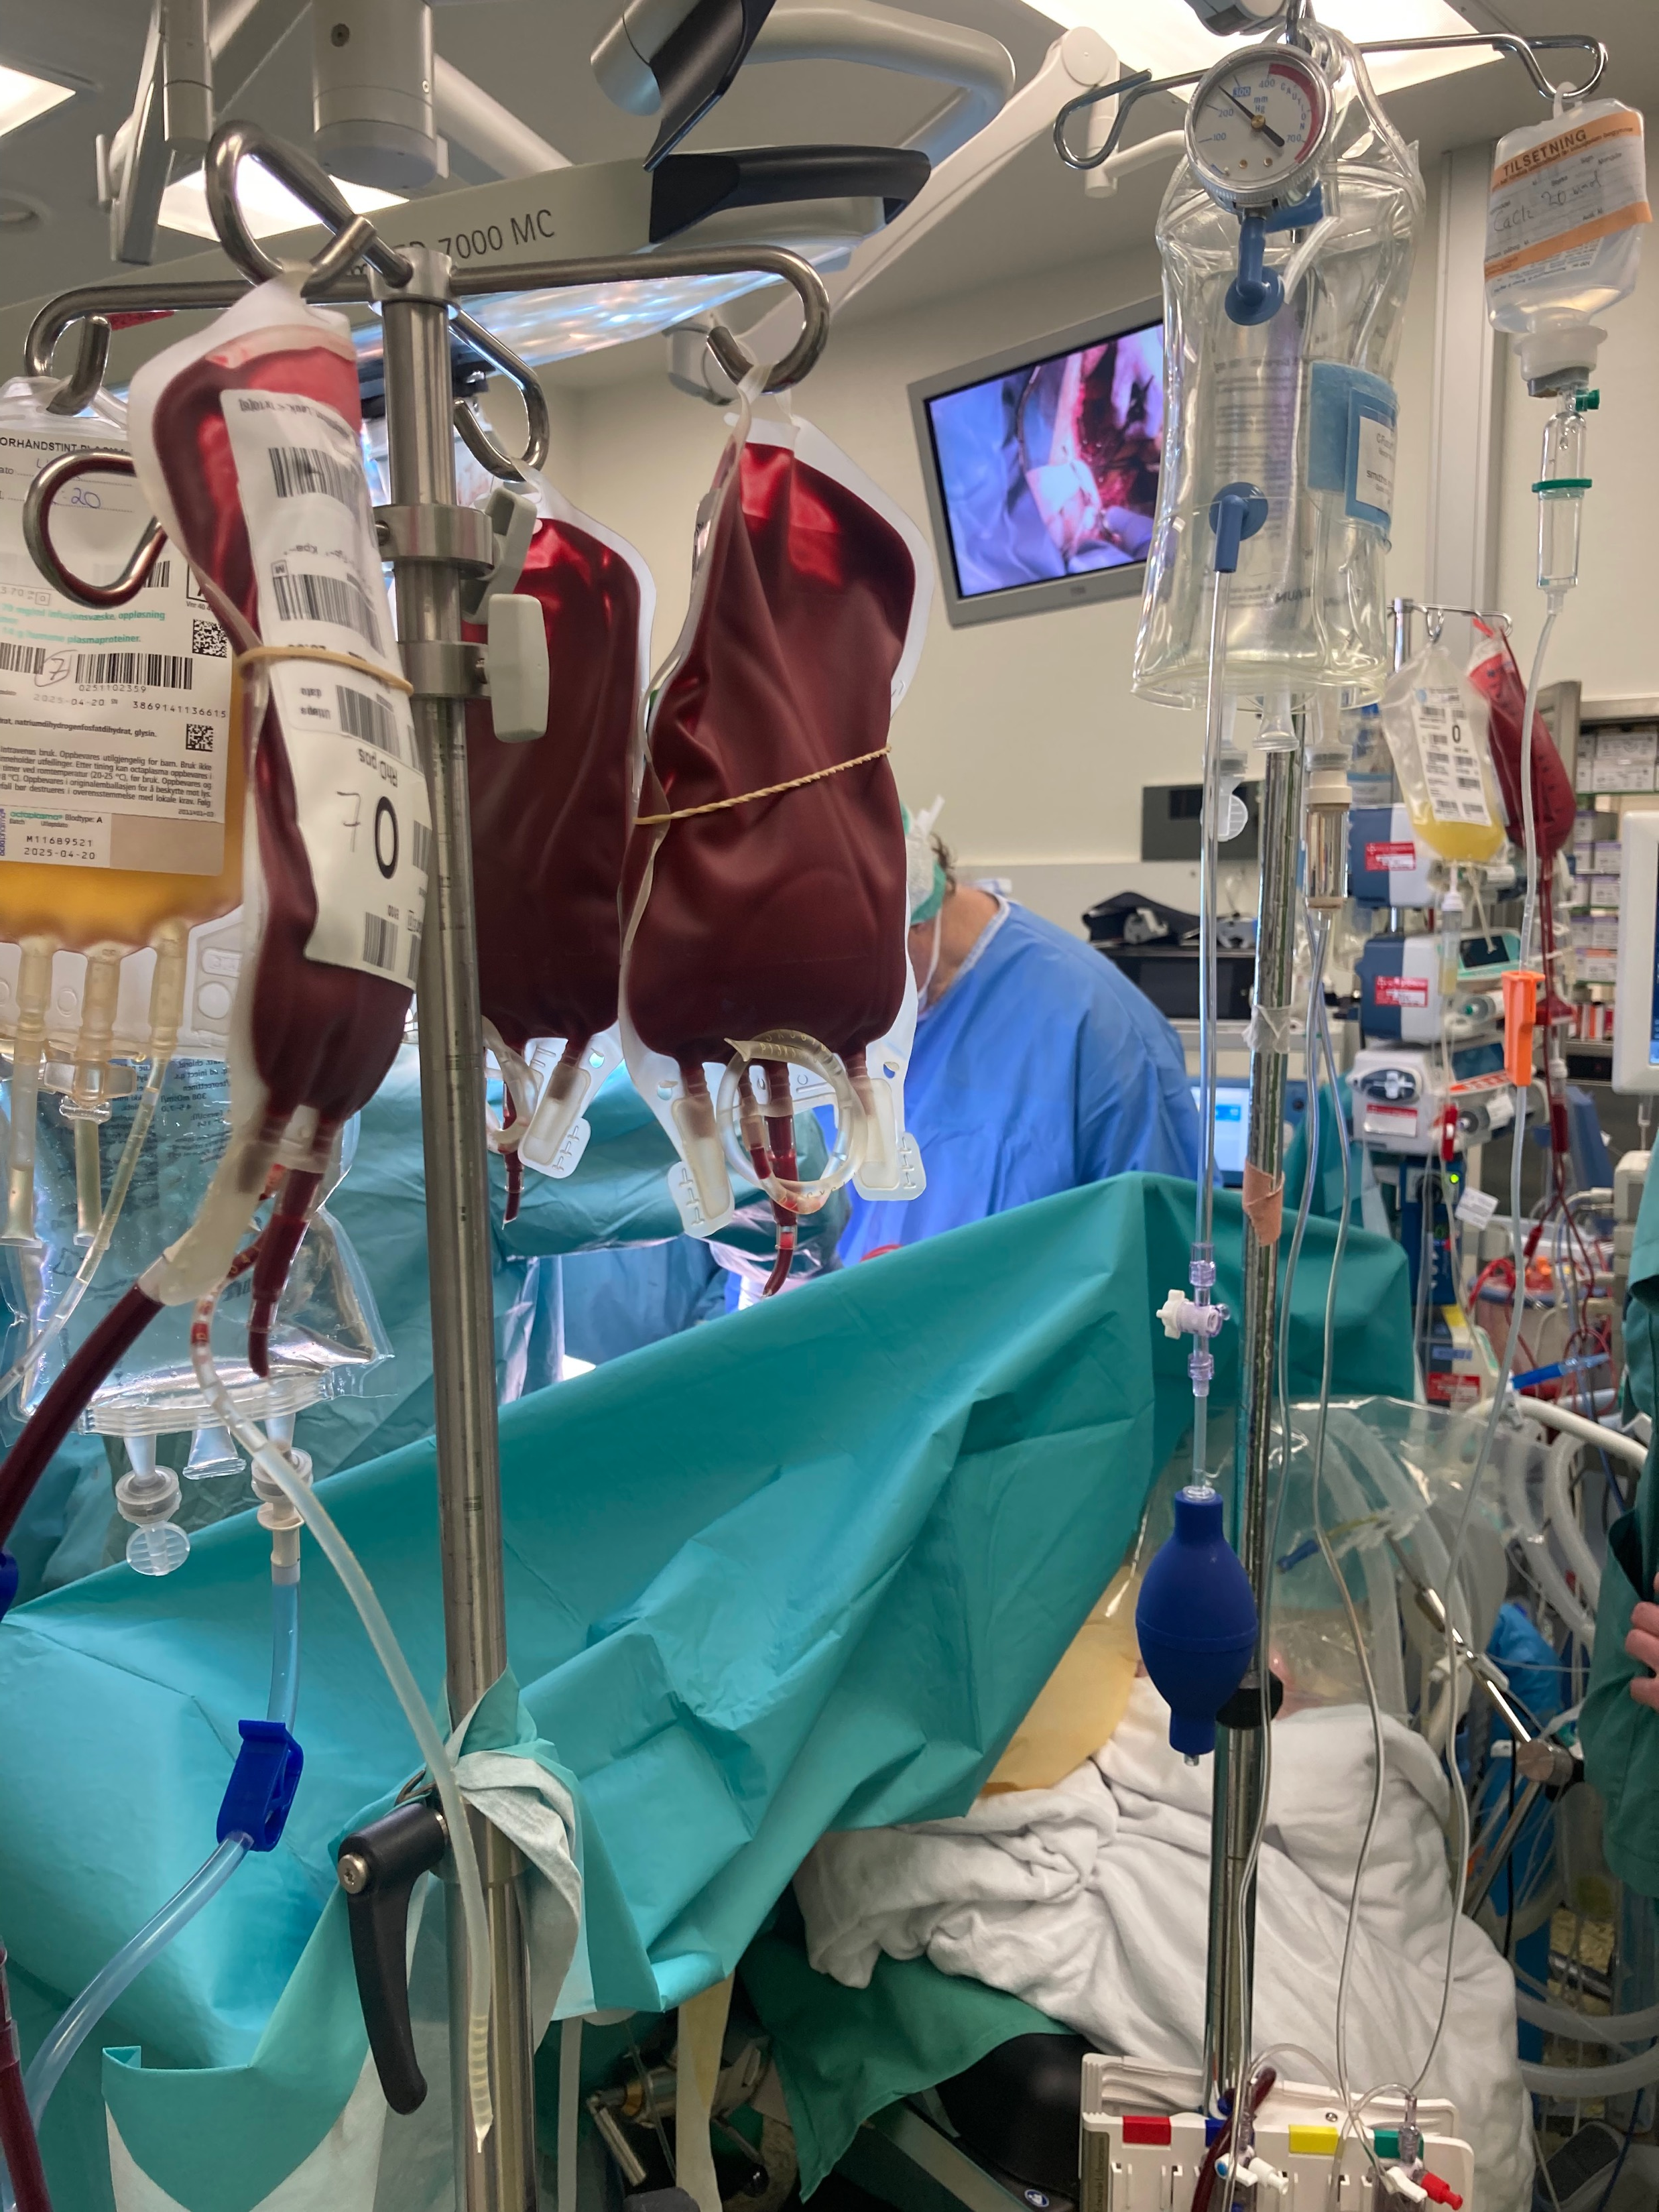
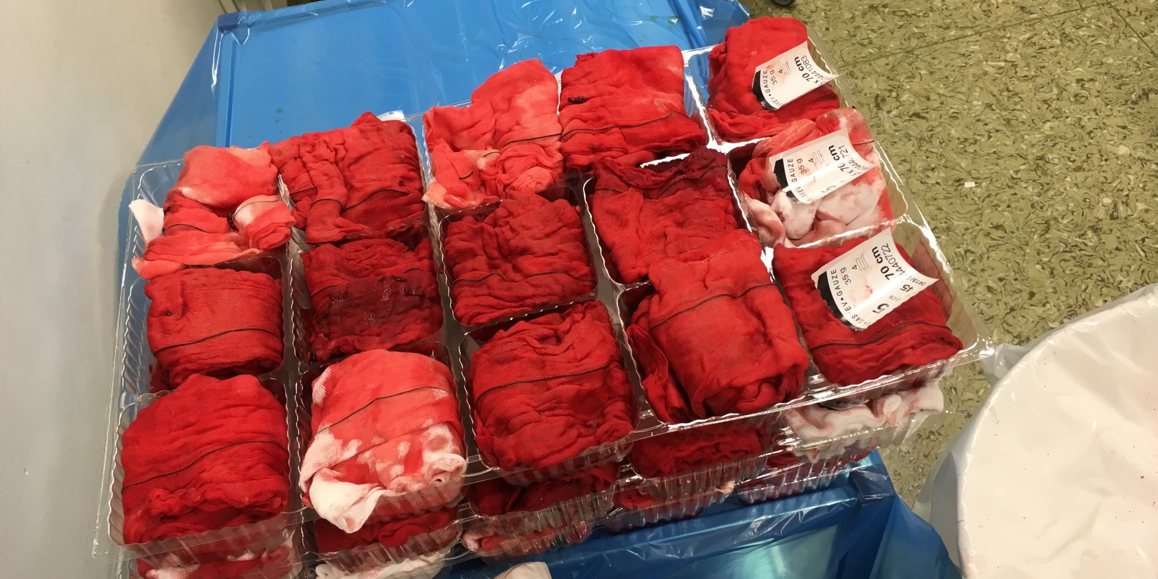
Rationale – Inhospital LTOWB
While waiting for hemorrhage control:
No time to waste
«Stay on top of things – do not lag behind!»
«Minimize the shock dose»
Notes:
So when we are talking about LTOWB inhospital, I believe the arguments are the same. When considering an uncontrolled hemorrhage in critical patients, whether it is due to trauma, multiple patients, obgyn – bleeding or critical bleeding due to unforseen events during elective surgery, or medical bleeding there are several challenges.

Slide 10
Potential benefit?
Oxygen carrying capacity in LTOWB compared to components?
Fibrinogen?
Less impact of hypocalcemia due to large amounts of additives in component alternative?
Less need for the use advanced of TEG/ROTEM in the early phase of care etc?

Slide 11
Smaller hospitals?
Platelet inventory?
Personell on standby?

Slide 12
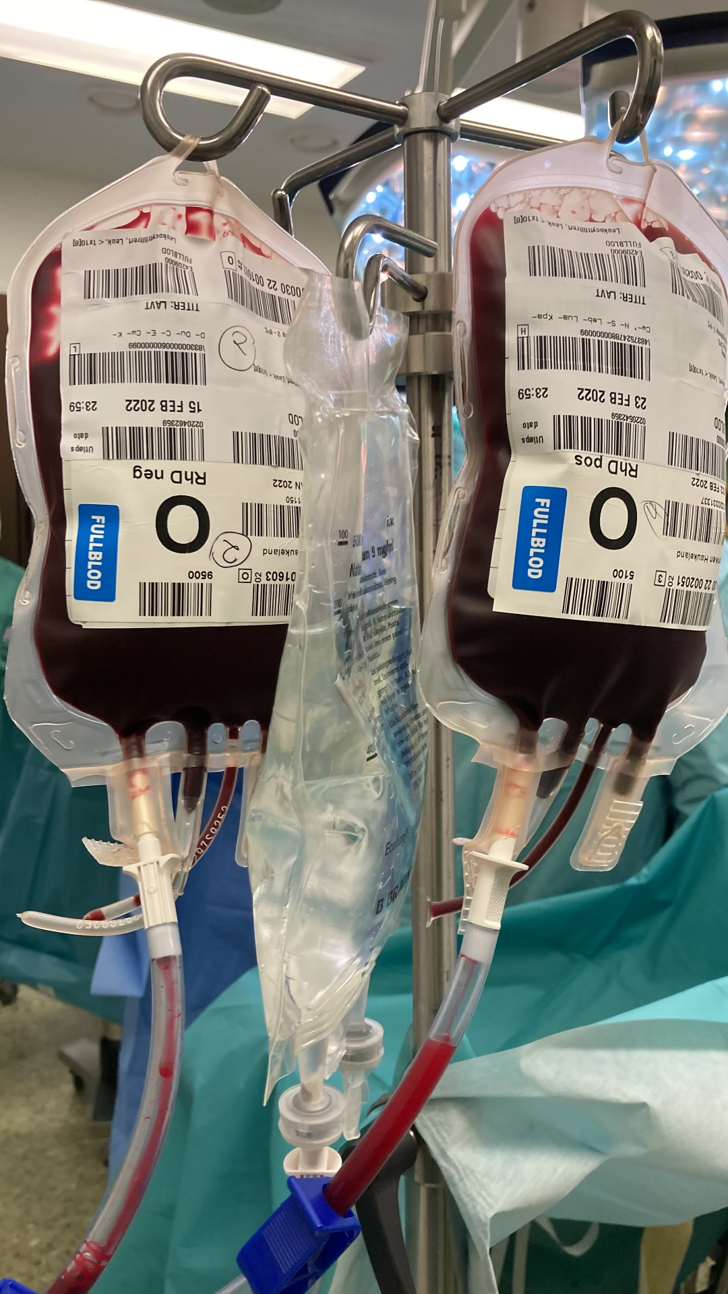

Slide 13
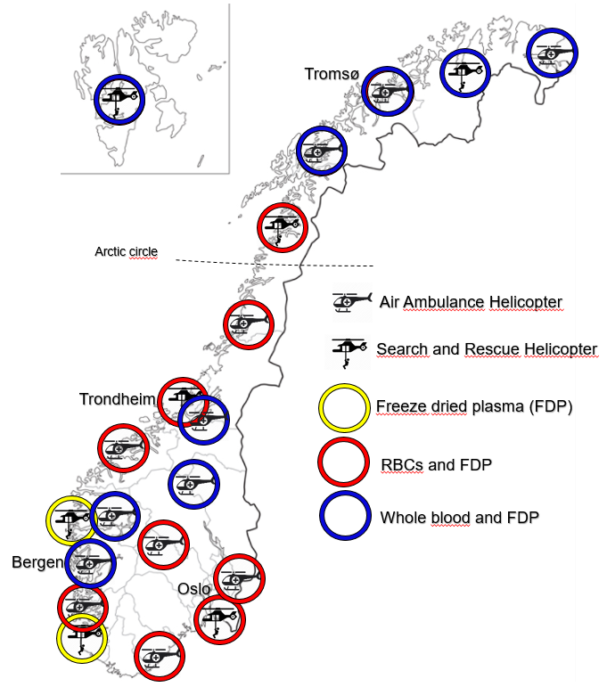
Prehospital inventory
HEMS and SAR Bases

Slide 14
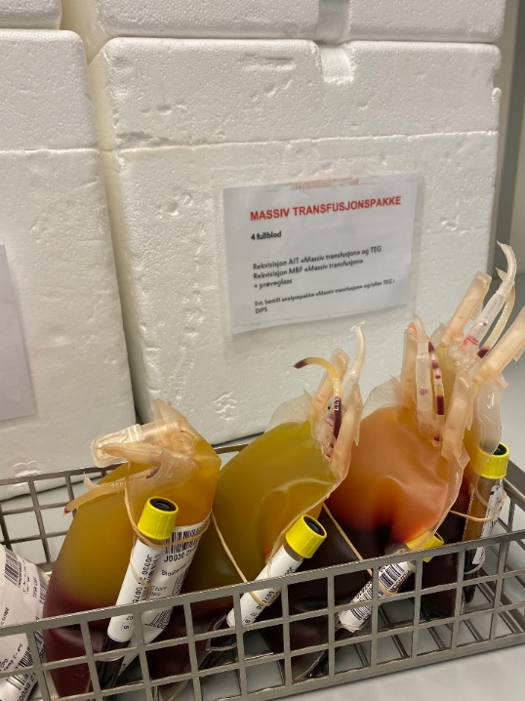
Whole Blood in Helse Bergen
CPD Leukoreduced whole blood
Storage: 7-21 days
Donors:
Group O
RhD positive and RhD negative
Both male and female donors
Low titer definition: (gel-method):
IgM anti-A/B < 256
IgG anti-A/B < 512
Massive transfusion package
Notes:
For routine use we have CPD …

Slide 15
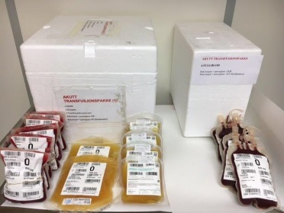
Massive transfusion package:
Alt 1:
WB - MTP
4 units low titer group O
O neg, K neg: female < 50 years
O pos, K neg: male , female > 50 years
Alt 2:
Component - MTP
6 Erythrocyte concentrates (0)
6 SD-plasma (AB/A)
2 platelet concentrates (0)
Children:
Both options available
Notes:
Our whole blood is low titer group O leukoreduced with a platelet-sparing filter. We aim to start treatment as early as possible with whole blood and continue with components based on monitoring.

Slide 16
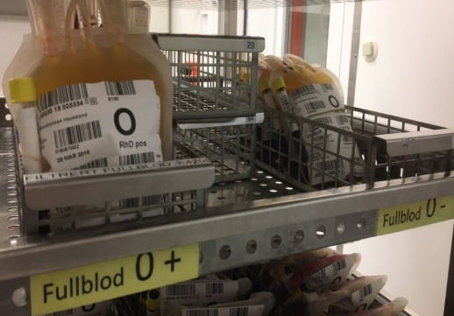
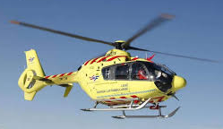
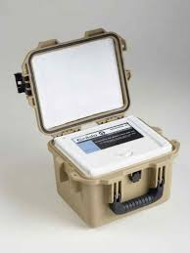
Inventory
Haukeland Hospital: 8 units 4 O RhD pos (lav titer, K neg) 4 O RhD neg (lav titer, K neg)
OBGYN dept: 2 units O RhD neg (lav titer, K neg)
Voss Hospital: 2 units O RhD neg (lav titer, K neg)
HEMS: 2 units O RhD neg (lav titer, K neg)

Slide 17
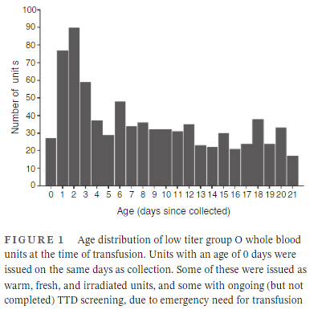
LTOWB Transfusions (Des 2017-Today)
493 patients
Avg age: 55 years (IQR 52-58, min-max 1-92)
~64% male
~36% female
Total 1640 units
Avg. 3.7 units (IQR 3.2-4.2, min-max 1-35) pr episode
No upper limit in the amount of units pr episode.
Storage duration 0-21 days (fig. 1)
Ref. Hagen KG et al. A Whole Blood based resuscitation strategy in civilian medical services; experience from a Norwegian hospital in the period 2017 – 2020. Transfusion. 2021. DOI: 10.1111/trf.16490. In press

Slide 18
Indications

Slide 19
Hva synes helsepersonell om fullblod?
Ref. Hagen KG et al. A Whole Blood based resuscitation strategy in civilian medical services; experience from a Norwegian hospital in the period 2017 – 2020. Transfusion. 2021. DOI: 10.1111/trf.16490. In press

Slide 20
Conclusion
LTOWB has its greatest potential in the early phases of care. (Before surgical/medical/radiological hemostasis)
Logistics of the early, aggressive resuscitation of hemorrhagic shock.
Minimize the shock dose burden
At least one - two extra pair of hands in resuscitation team
Clinical evidence of potential superiority is secondary (irrelevant?) in the early stages of care.

