Slide 1
The Evidence for Whole Blood
Col Tom Woolley
Defence Professor Anaesthetics and Critical Care

Slide 2
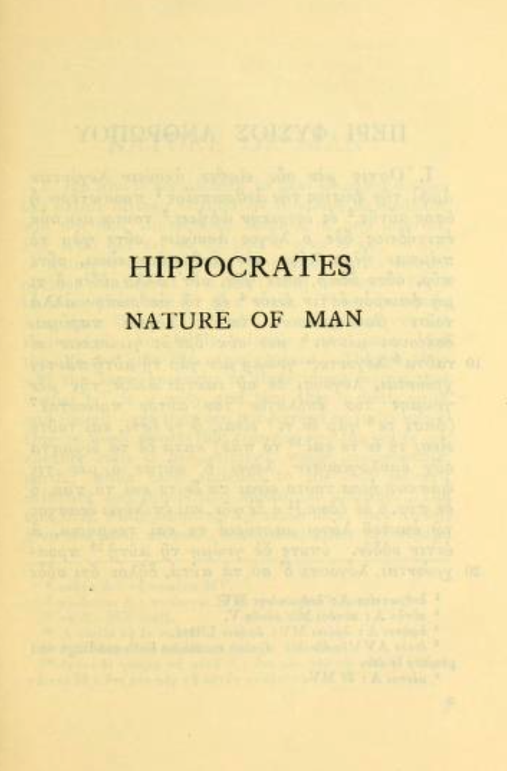

Slide 3
1818
Human to human
1666
Dog to dog
1666
2022
1667
Sheep to human

Slide 5
1818
Human to human
1990’s
ACoTS
Early plasma
1666
Dog to dog
1915 anticoagulant
1917 Robertson Blood bank
1943
Churchill
1666
2022
2000’s
1667
Sheep to human
1901
ABO blood groups
1940
Rhesus
Plasma for Britain
Dried plasma
Army Blood transfusion Service
1960’s to 1990’s
Da’nang Lung
Shift to crystalloid and components
ATLS
Goal directed therapy
Infected blood
Iraq
Afghanistan
RATIO’s
PROMMT
PROPPR
PAMPER
COMBAT
RePHIL
SWIFT
CRYOSTAT
ACIT
RCP
CSP
CSWB
CRASH
1864
FWB American Civil war

Slide 6
Why blood and not water?

Slide 7
No Difference?
COMBAT
RePHILL

Slide 8
PAMPER

Slide 9
Shackelford et al
Notes:
Figure 3: Kaplen Meyer survival curves from Shackelford et al JAMA 2017 vol. 318 (16) pp.1581-1591. 1st Graph (fig 3 from original paper) shows improved survival in the transfused cohort in matched casualties with haemorrhagic shock. The second graph (fig 4 in original paper) shows the 24 hour survival with matched casualties who received transfusion in less than or greater than 15 mins from time of MEDVAC. Median time to transfusion was 36 minutes (IQR 27 – 46 Mins)

Slide 10
WW1

Slide 11
WWII

Slide 12
PAMPER

Slide 13
Evidence for WB
3 systematic reviews
Malkin et al 2020
Avery 2020
Kronstedt 2022

Slide 14
WB vs components (1:1 + plt)
142 papers whittled down to 5 studies
No survival or transfusion benefit (?FWB in military)
Safe no serious adverse events (?ARDS is FWB)

Slide 15
WB vs components
1551 papers whittled down to 6
No improvement (or reduction ) in survival
Safe no serious AE (?ARDS in FWB and /AKI in non leucodepleted WB)

Slide 16
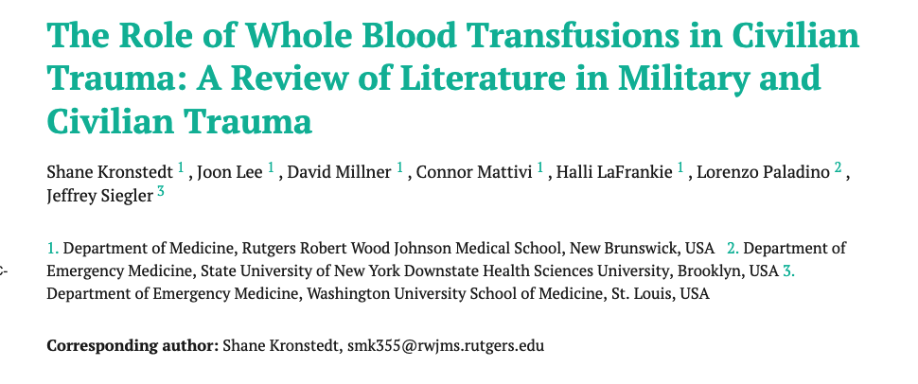
WB to components
1918 articles whittled down to 19
No inferiority or superiority
Safe

Slide 17
What about Time end points?

Slide 18
Shackelford et al
Notes:
Figure 3: Kaplen Meyer survival curves from Shackelford et al JAMA 2017 vol. 318 (16) pp.1581-1591. 1st Graph (fig 3 from original paper) shows improved survival in the transfused cohort in matched casualties with haemorrhagic shock. The second graph (fig 4 in original paper) shows the 24 hour survival with matched casualties who received transfusion in less than or greater than 15 mins from time of MEDVAC. Median time to transfusion was 36 minutes (IQR 27 – 46 Mins)

Slide 19
RePhill
In patients with trauma-related haemorrhagic shock does prehospital administration of packed red cells and lyophilised plasma (Lyo-Plas) compared with normal saline reduce the composite outcome of mortality and failure to reach lactate clearance?
Median time to arrival to hospital 83 mins
Median ISS 36

Slide 21
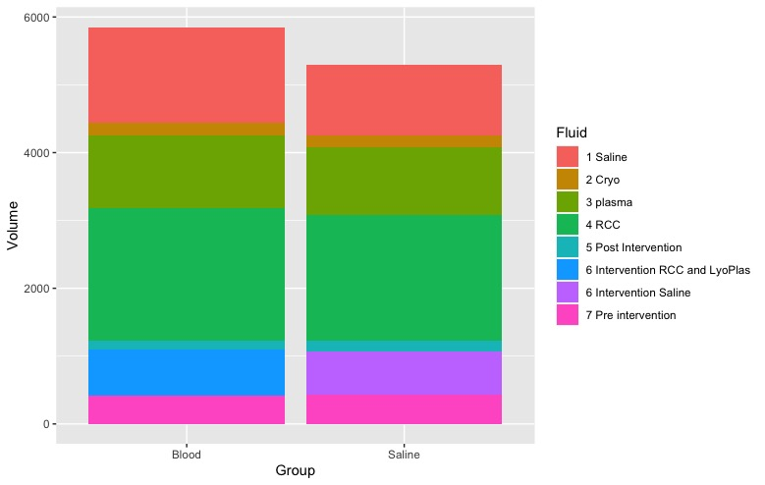
1417
1037
175
175
1075
1000
1960
1855
123
160
680
630
422
437

Slide 22
1417
1037
175
175
1075
1000
1960
1855
123
160
680
630
422
437

Slide 23
1417
1037
175
175
1075
1000
1960
1855
123
160
680
630
422
437

Slide 24
RePhill

Slide 25
PROMMTT
After 24 hours, plasma and platelet ratios were unassociated with mortality, when competing risks from non-hemorrhagic causes prevailed
Increased ratios of plasma:RBC and platelets:RBC) were independently associated with decreased 6-hour mortality, when hemorrhagic death predominated.
In the first 6 hours, patients with ratios < 1:2 were 3–4 times more likely to die than patients with ratios ≥1:1.

Slide 26
PROPPR
No difference in 24 hour or 30 day mortality
Exsanguination, which was the predominant cause of death within the first 24 hours, was significantly decreased in the 1:1:1 group (9.2% vs 14.6% in 1:1:2 group; difference, −5.4% [95% CI, −10.4% to −0.5%]; P = .03).
More patients in the 1:1:1 group achieved hemostasis than in the 1:1:2 group (86% vs 78%, respectively; P = .006).

Slide 27
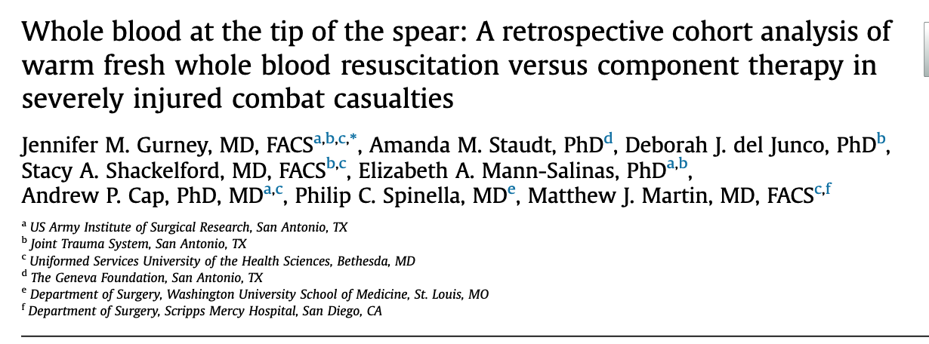
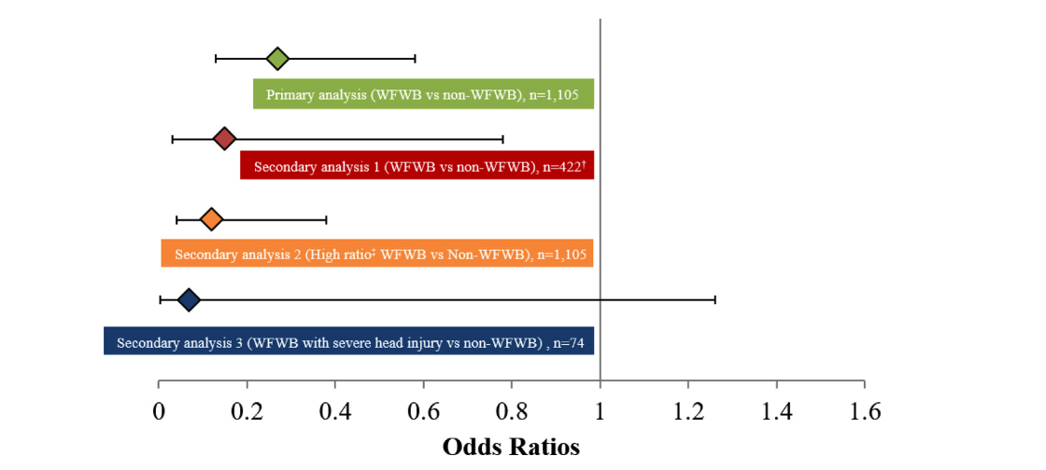
6 Hour mortality
1015 patients received
FWB (221) matched to 884 Component red cells
6 hour mortality
Adjusted 6 hour mortality
High ratio (>33% FWBB) vs low ratio (<33% FWB)

Slide 28
So what?
We get them alive to hospital AND we stop the bleeding
Its what happens next that isn’t good enough
Are we looking for a “magic bullet” or do we just want to give the patient a chance of life?

Slide 29
So if its no better why should we do it?

Slide 30
It is better, we just haven’t proven it
Yet

Slide 31
Its not just about mortality

Slide 32
Trauma Trials at DSTL
Various large animal bleeding and trauma models
Terminally anaesthetised
35% blood volume bleed
Tissue injury
Potential to rebleed
+/- Blast injury
Resuscitation strategies

Slide 33
Novel Hybrid
1.00
1.00
Novel hybrid
0.75
0.75
Survival
Survival
0.50
0.50
0.25
0.25
Hypotensive
0.00
0.00
0
0
100
100
200
200
300
300
400
400
500
500
Time from onset of resuscitation (min)

Slide 34
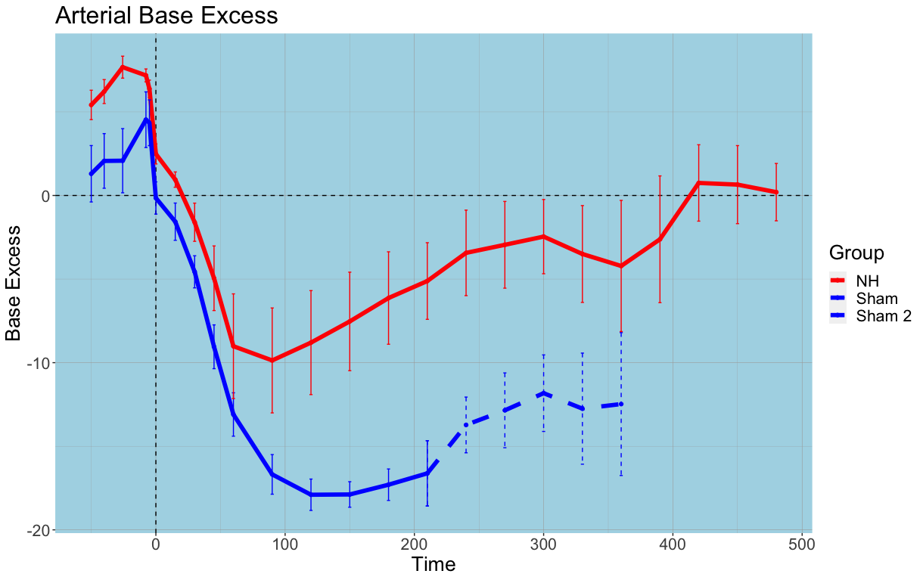
Novel Hybrid resuscitation:

Slide 35
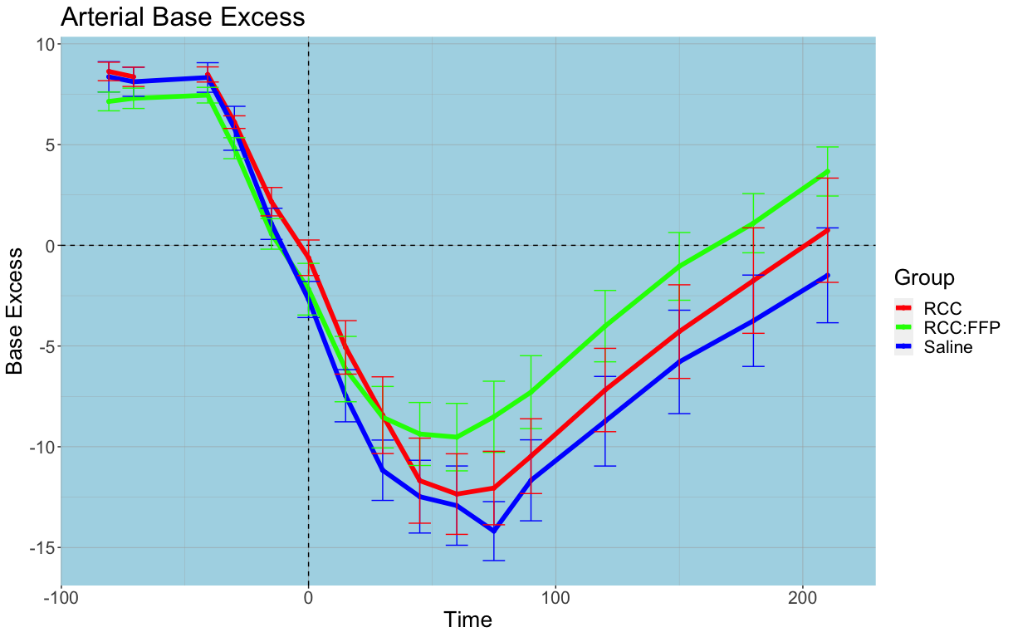
Effect of Prehospital blood

Slide 36
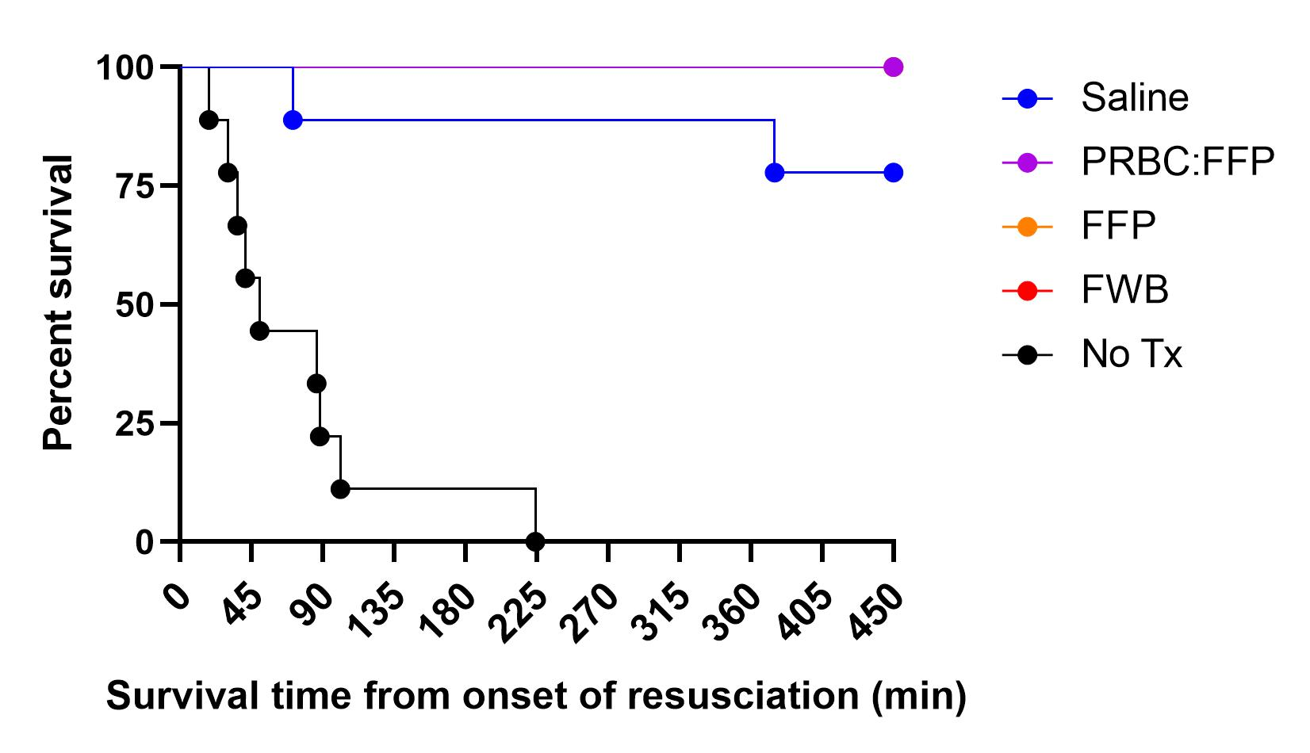
Survival

Slide 37
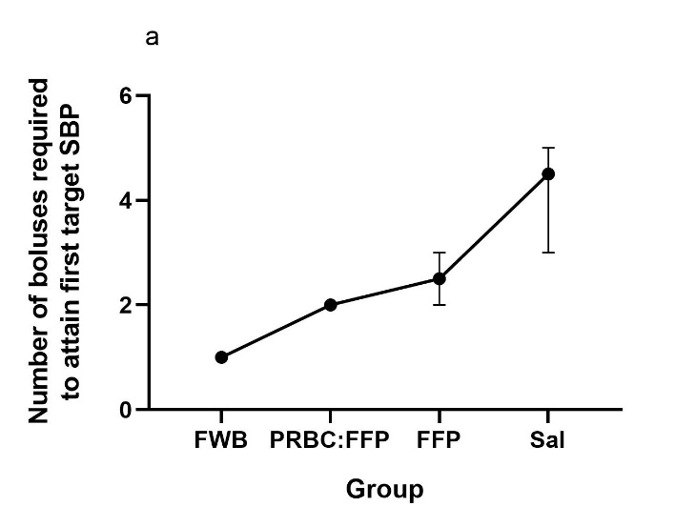
Logistical impact
Notes:
Number of boluses needed to attain SBP 80 mmHg at the start of the resusc phase (immediately after the end of the shock phase)
What happened in response to the NEXT bolus (so all starting from the same starting point with respect to them having ALREADY achieved SBP 80 with the previous bolus ….)
Time to the next bolus after the one in b
Bottom row should be self explanatory

Slide 38
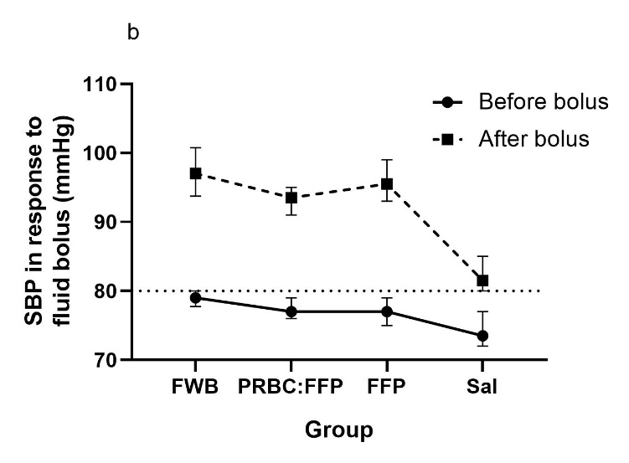
Logistical impact
Notes:
Number of boluses needed to attain SBP 80 mmHg at the start of the resusc phase (immediately after the end of the shock phase)
What happened in response to the NEXT bolus (so all starting from the same starting point with respect to them having ALREADY achieved SBP 80 with the previous bolus ….)
Time to the next bolus after the one in b
Bottom row should be self explanatory

Slide 39
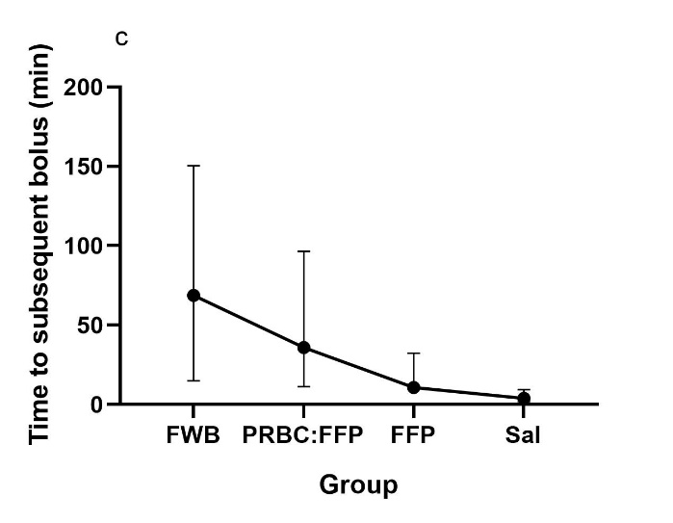
Logistical impact
Notes:
Number of boluses needed to attain SBP 80 mmHg at the start of the resusc phase (immediately after the end of the shock phase)
What happened in response to the NEXT bolus (so all starting from the same starting point with respect to them having ALREADY achieved SBP 80 with the previous bolus ….)
Time to the next bolus after the one in b
Bottom row should be self explanatory

Slide 40
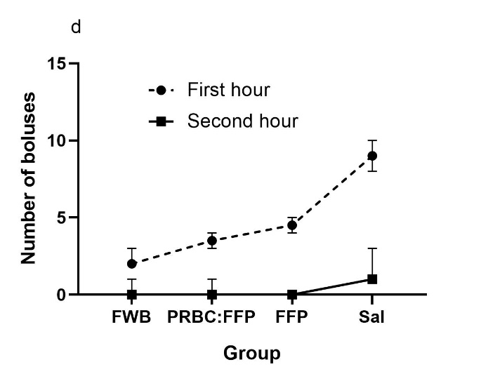
Logistical impact
Notes:
Number of boluses needed to attain SBP 80 mmHg at the start of the resusc phase (immediately after the end of the shock phase)
What happened in response to the NEXT bolus (so all starting from the same starting point with respect to them having ALREADY achieved SBP 80 with the previous bolus ….)
Time to the next bolus after the one in b
Bottom row should be self explanatory

Slide 41
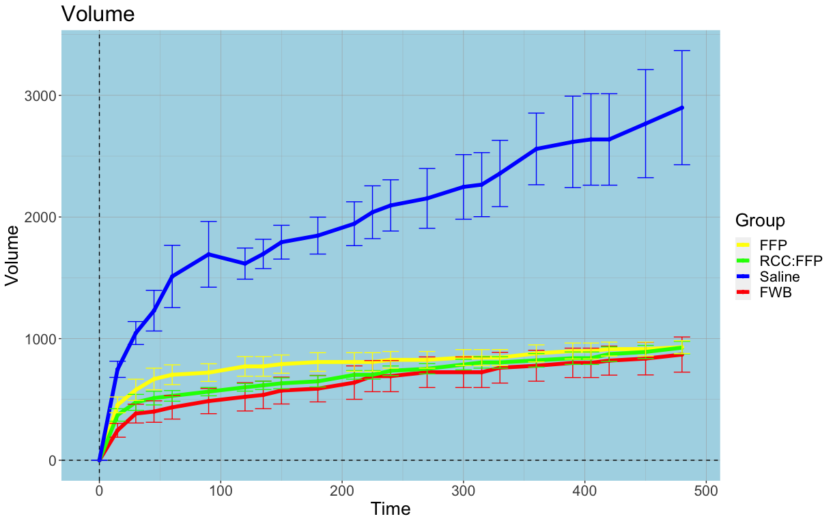
FBR

Slide 42
Blood for a bleeding patient

Slide 43
Blood for a bleeding patient

Slide 44
Blood for a bleeding patient

Slide 45
Results
Transfusion of a combined component (2 units of RCP) had a shorter flow-time and touch-time compared to both other arms (separate components) and required fewer steps, pieces of equipment and checks to complete transfusion
After one-way ANOVA, the differences between group A and groups B and C were found to be statistically different, with a p-value of .00193 (significant at p < 0.5)
Notes:
The use of a combined component had the shortest touch-time and flow time, and required fewer steps, people and equipment. The total volume of 2 RCP units (~940 mL) is only 100mL less than the total volumes of 2 RBC (500mL) and 2 TP (540mL). Therefore the above results may largely be due to the fewer number of steps required to administer RCP, such as fewer blood component safety checks. Most pre-hospital teams carry only one blood warmer, and venous or intraosseus access may be challenging and a rate limiting step in a haemodynamically unstable and shocked trauma patient; being able to transfuse two components simultaneously with a combined product may mitigate these limitations.

Slide 46
Summary
Early blood is best
WB is certainly no worse than components
WB “frees up bandwidth”
WB gives us a fighting chance!

