Slide 1
Hemovigilance and International Hemovigilance Network Overview
Mary Townsend, MD
Chair, ISBT Haemovigilance Working Party
Member, IHN Board
USA

Slide 2
Definitions : WHO
Haemovigilance is a set of surveillance procedures covering the whole transfusion chain (from the collection of blood and its components to the follow-up of recipients), intended to collect and assess information on unexpected or undesirable effects resulting from the therapeutic use of labile blood products, and to prevent their occurrence or recurrence.

Slide 3
Definitions : IHN
Haemovigilance is the systematic monitoring of adverse reactions and adverse incidents in the whole transfusion chain from donor to patient, and all activities which can contribute to safer and more effective use of blood products.

Slide 4
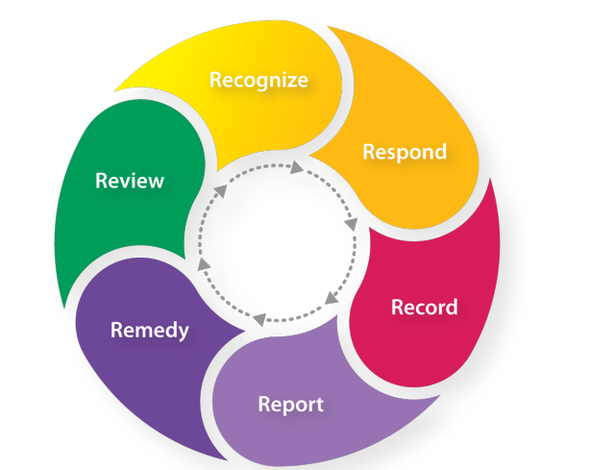
HV in Action: The 6 “R”s

Slide 5
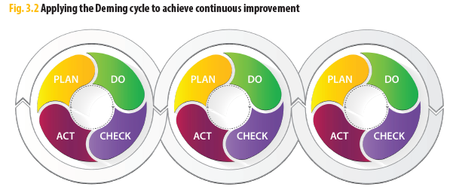
Example of Deming Quality Cycle for reactions

Slide 6
A Word about Definitions

Slide 7
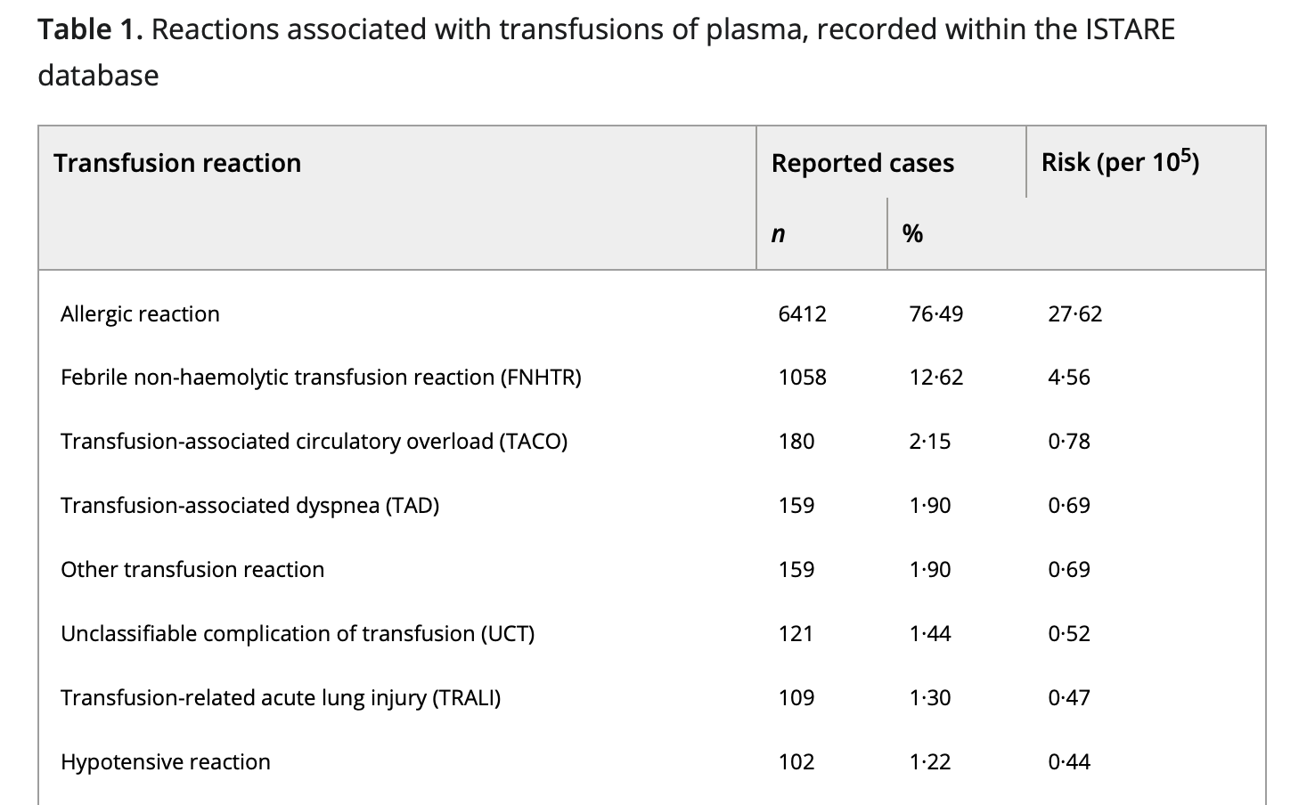
Are we all speaking the same language?
Why Definitions Matter
What is “plasma?”
FFP, FP24 are blood products
SD plasma is a pharmaceutical product in many countries
Plasma derivatives are pharmaceuticals
How do we keep oversight of donor and recipient vigilance when different vigilance systems and definitions apply?

Slide 8
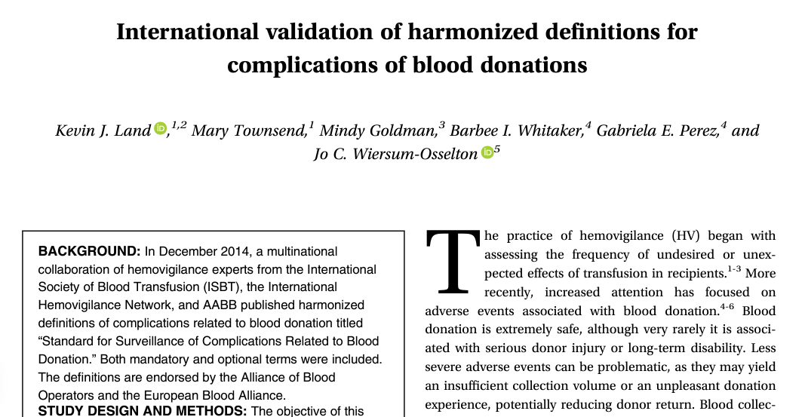
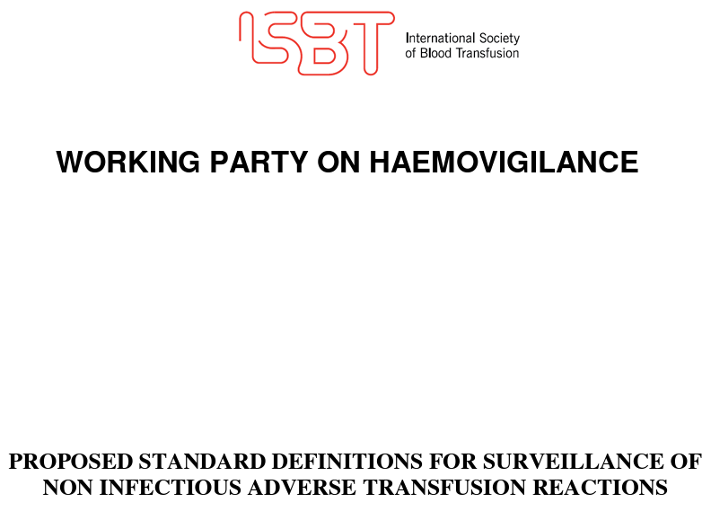
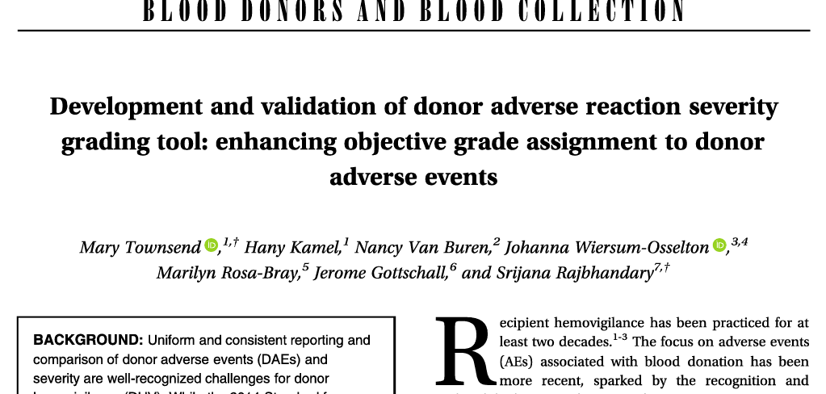
Are we all speaking the same language?
Why Definitions Matter
Why Definitions Matter!

Slide 9
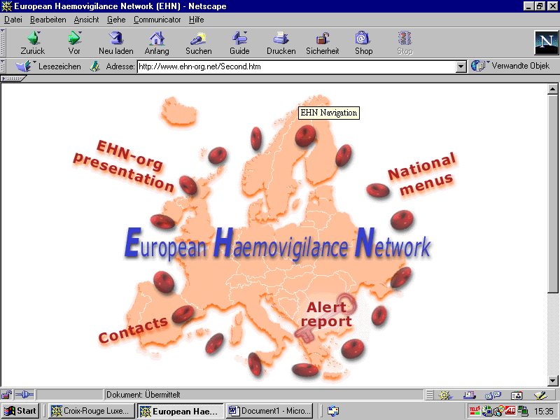
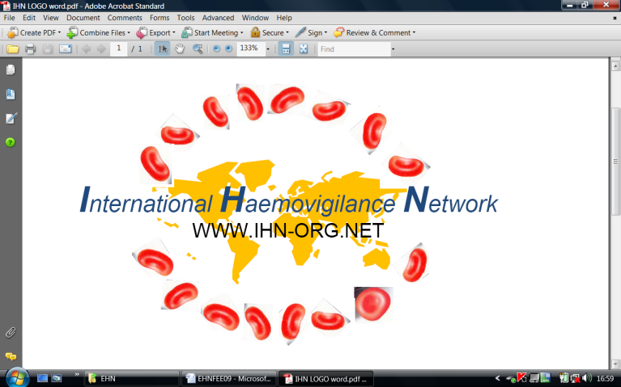
HV systems: a brief timeline
New IHN
Logo
Recognition TTI: HIV and Hepatitis
Japan establishes first HV system
European Haemovigilance Network
International Haemovigilance Network (IHN)
French
HV system
1980’s
1993
1994
1996-8
2008
2011
2012
2015
2018

Slide 10
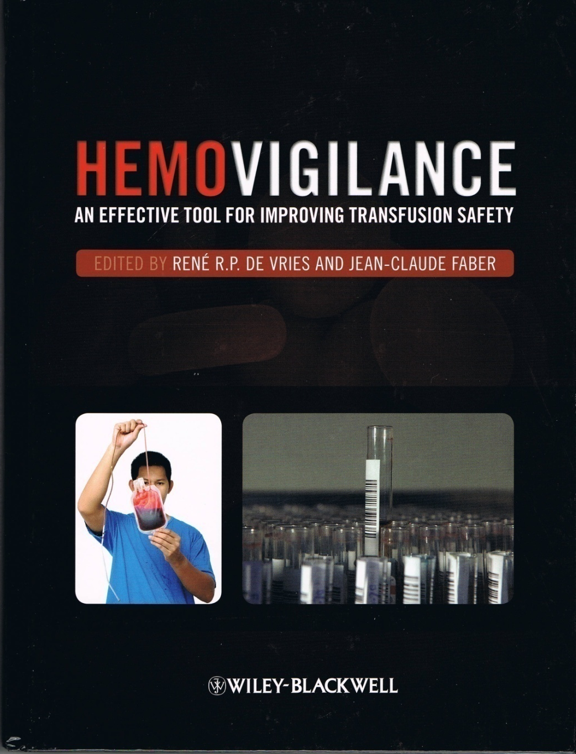
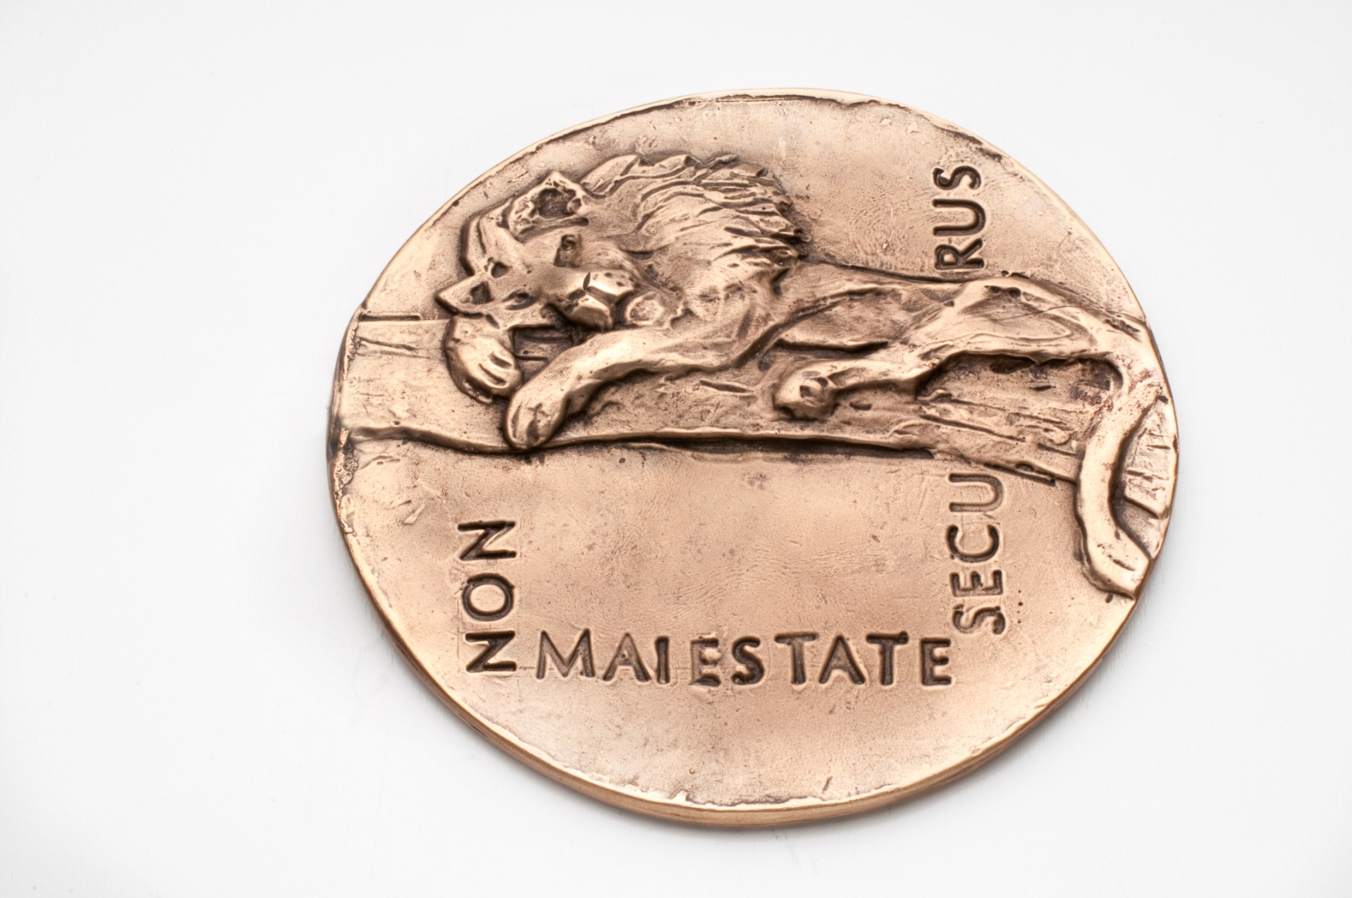
International network of HV systems
Collaboration, sharing experience, benchmarking
International database (ISTARE)
Definitions (with ISBT, AABB)
Seminars
Education/publications (textbook)
Award and medal
www.ihn-org.com

Slide 11

IHN structure and governance
IHN Board
  Administrative support: Ingrid van Veen (TRIP office)
Seminar committee: Barbee Whitaker, USA
  Seminar support: MCI
Data committee: Kevin Land, USA & Jo Wiersum, NL
Communications committee: Kevin Land, USA
Membership committee: Akanksha Bisht, India
Finance and external relations committee
Research committee: Pierre Tiberghien, France
The committees:
Undertake activities in line with overall IHN strategic plan
Provide opportunities for members to participate
Volunteers for IHN/collaborative projects always welcome

Slide 12

IHN Board
Current members:
President: Arlinke Bokhorst, NL
Past-president: Martin Schipperus, NL
Treasurer: Ai Leen Ang, Singapore
Secretary: Akanksha Bisht, India
Member: Pierre Tiberghien, France
Member: Barbee Whitaker, USA
Member: Shruthi Narayan, UK
Member: Øystein Flesland, Norway
Member: Betina Sørensen, Denmark
ISBT representative: Mary Townsend, USA (Chair ISBT Working Party on HV)
  Supported by Ingrid van Veen (administrator, NL)

Slide 13
VISION
Health services around the world
will have effective HV systems in place
MISSION
1. To promote HV internationally
to improve outcomes for donors and patients
2. To support HV systems worldwide
3. To be the leading international HV resource
IHN shall be a financially sustainable organisation
The governance structure shall be aligned
to pursue IHN’s mission and meet its strategic goals
Promote consistent data collection and validation, appropriate analyses and effective recommendations.
Develop innovative
long and short term
HV outcome measures.
Develop objective indicators
for demonstrating the effectiveness of HV.
Be a forum for networking/exchange for HV professionals.
Have an effective
engagement strategy for
the various HV stakeholder communities.
Be the global source and advocate of best definitions and analytic systems for donation and transfusion-related adverse events.
Fulfill educational needs of members and other stakeholder groups.

Slide 14
Collaborations/co-operations
WHO: Technical consultations, Aide-Mémoire and guidance document on HV, NOTIFY library
ISBT: Through Working Party on HV – definitions and validation studies, share experiences
AABB: Definitions, validation studies
EU: Stakeholder consultations
Support to national HV programs

Slide 15
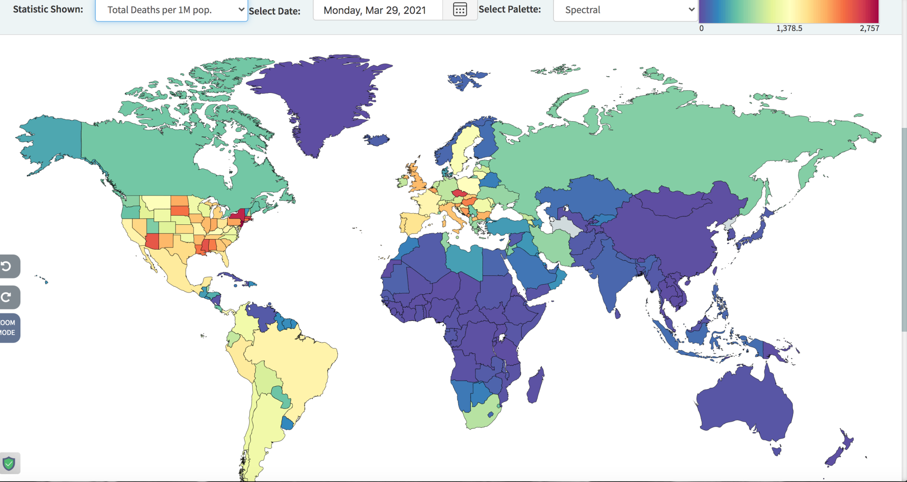

Slide 16
IHN support to national HV systems and WHO and other meetings
Bordeaux
1997
Lyon
1998
Montpellier
2000
Athens
2001
Amsterdam
2003
Zurich
2004
London
2005
Porto
2006
Dublin
2007
Frankfort
2008
Rome
2009
Dubrovnik
2010
Amsterdam
2011
Montreal
2012
Brussels
2013
Paris
2016
Manchester
2018
Barcelona
2014
Virtual
March 2021
Virtual
September 2021

Slide 17

International Surveillance database for
Transfusion Adverse Reactions and Events in donors and recipients of blood components (ISTARE)
Aggregate data from national HV systems
Denominators
Donor adverse reactions
Transfusion reactions and adverse events
  By blood component, severity (all levels included), imputability
Online data entry since 2010
Managed by IHN Database working group
Over 30 countries participate
Most provide donor complication data
Notes:
Denominators: numbers of WBD and apheresis donations. Donor adverse reactions collected separately (WBD-apheresis) if the country can provide this.
Units issued and transfused.

Slide 18
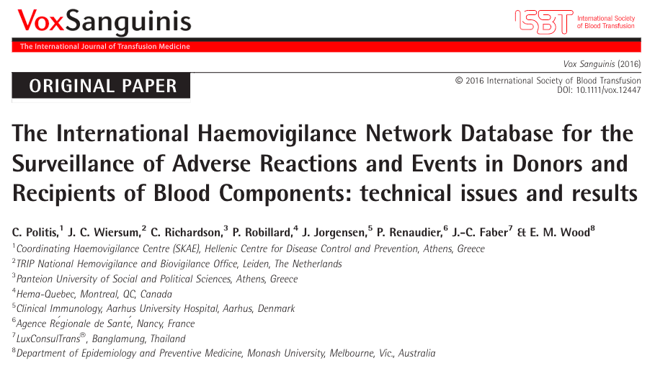

Slide 19
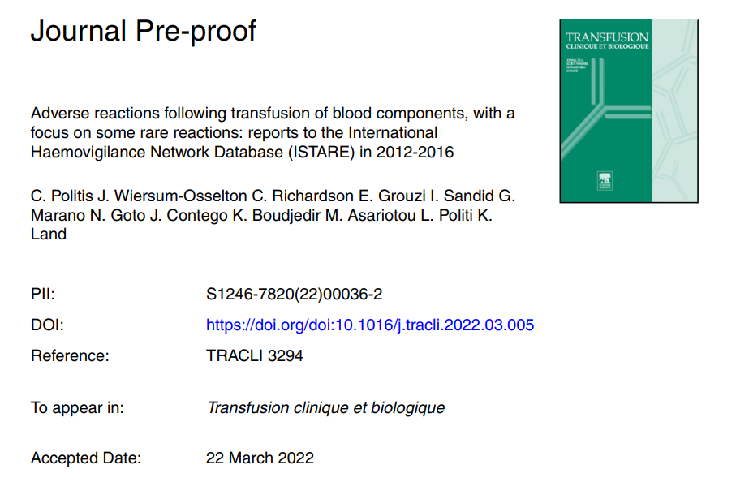
Notes:
Denominators: numbers of WBD and apheresis donations. Donor adverse reactions collected separately (WBD-apheresis) if the country can provide this.
Units issued and transfused.

Slide 20
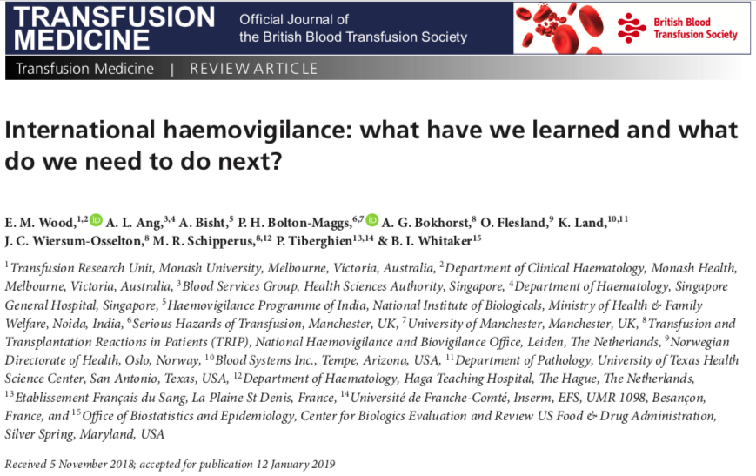

Slide 21
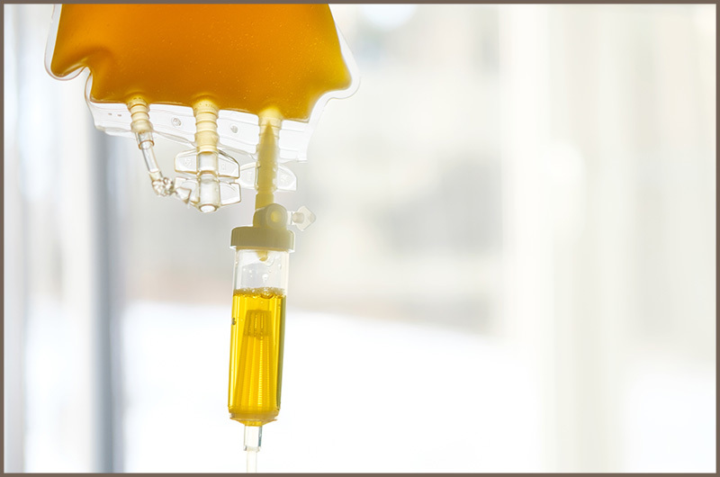
Focus on plasmavigilance
Convalescent plasma COVID-19
Still unresolved issues related to TACO and TRALI
“new” blood products

Slide 22


