Slide 1
Delayed cold stored platelets - The effect of temperature on platelet function
Torunn Oveland Apelseth
The Norwegian Blood Preparedness Center
Haukeland University Hospital, Bergen, Norway
Norwegian Armed Forces Medical Services
University of Bergen , Bergen, Norway

Slide 2
DISCLOSURES
I have no conflicts of interest to disclose for this presentation.
The opinions expressed are my private views and are not to be construed as official or as reflecting the views of the Norwegian Armed Forces Medical Services.

Slide 3
Acknowledgements
The Blood Far Forward research group in Bergen:
Geir Strandenes, MD
Torunn O Apelseth, MD, PhD
Christopher Bjerkvig, MD
Theodor K Fosse, MD
Håkon Eliassen, MD
Tor Hervig, MD, PhD
Einar K Kristoffersen, MD, PhD
Turid Helen F Lunde, MSc
Hanne Braathen, BSc
Joar Sivertsen, BSc
Venny Kvalheim, MD, PhD
Rune Haaverstad, MD, PhD
Col Andrew P Cap, MD, PhD, FACP
U.S. Army Institute of Surgical Research, FT Sam Houston, TX, USA
Philip C Spinella, MD, FCCM
Division of Critical Care Medicine, Clinical Care Translational Research Program, Washington University, St. Louis, US
Our institutions:
Department of immunology and transfusion medicine, Department of Anaesthesia and Intensive Care, Section of Cardiothoracic Surgery, Department of Heath Disease, and Laboratory of Clinical Biochemistry, Haukeland University Hospital, Bergen, Norway
Institute of Clinical Science, School of Medicine and Dentistry, University of Bergen, Norway
Norwegian Naval Special Operations Commando
Norwegian Armed Forces Medical Services
Notes:
I will like to give my thanks to all the highly skilled members of the Blood Far Forward research Group in Bergen. To Our collaborators at the US Army Institute of Surgical Research Doctor Andre Cap, To Doctor Phil Spinella, and the THOR Network.

Slide 4
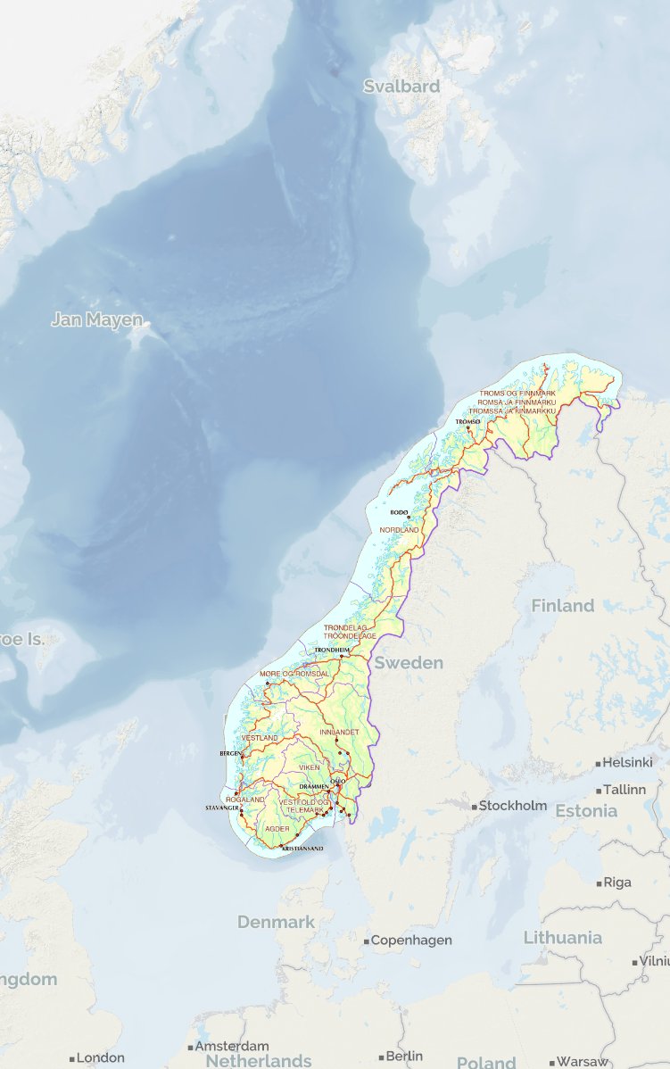
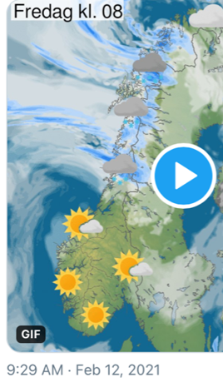
Why a cold stored platelets program in norway?
Population: 5.4 million
Size: 385, 000 km²
Fjords, mountains and scattered populations.
Larger cities mainly in the costal areas and southern part of the country.
Long distance between Level 1 trauma centers.
(Weather forecast
Feb 12. 2021)
Notes:
I will start by introducing you to the setting that we work in. Norway is a large country, with few people. The cities are mainly in the coastal areas and in the south. We have long distances between the level 1 trauma centers, so this means that we rely heavily on transport of our patients by either ground or air ambulances.
With a population of only 5.4 million across an area of 385,000 km², Norway has a demanding topography consisting of mountains and fjords, which may make ground ambulance transport of critical trauma patients challenging. Furthermore, the long distances between Norwegian Level 1 trauma centers (approx. 600 km) support the use of air transport and demands that the HEMS uses a RDCR approach to critical patients

Slide 5
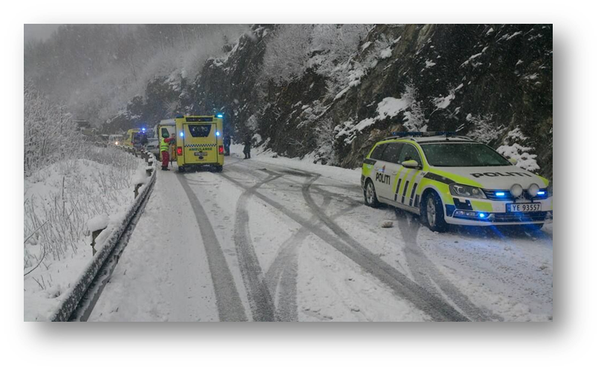
Long transport times to hospital
Ground ambulance transport is challenging in some areas
Decentralized health system.
Government funded. Regional health authorities administer the hospitals.
https://norskluftambulanse.no/trosser-naturkreftene-pa-basen-i-bronnoysund/
Notes:
That said, we have challenges with both geography and weather that can make the transport rather difficult.
So we have a desentralised government funded health system. Trying to reduce the time of transport.

Slide 6
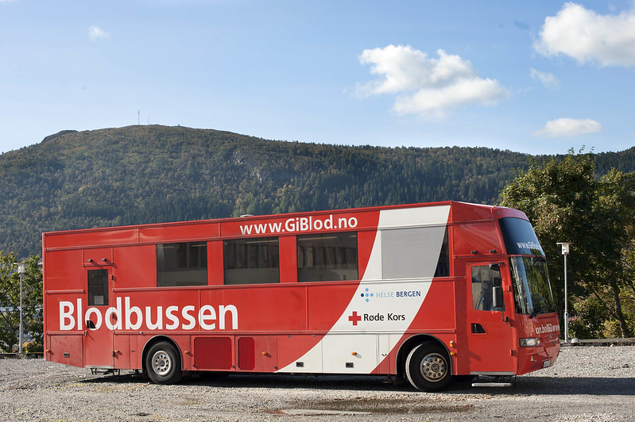
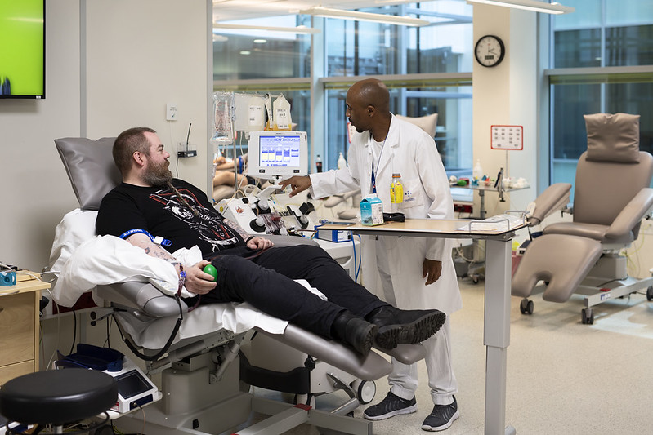
Norwegian blood bank structure
All hospitals in Norway have their own blood bank.
Activities include blood collection, component production and storage, in-hospital immunohematology and transfusion services
Inventory of blood components differ based on local policies. Smaller rural hospitals often no platelet inventory.
Notes:
The Norwegian Blood System is based on individual Blood Bankds located at the hospitals. In these Blood Banks we collect, produce and issue blood. The inventory of blood compoentns is decided on local policies, which also means that some of our smaller rural hospitals do not have all types of blood components in stock. Ths means, they ofthen lack a platelet containing blood product.

Slide 7
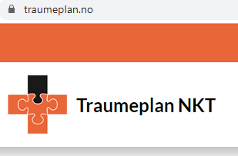
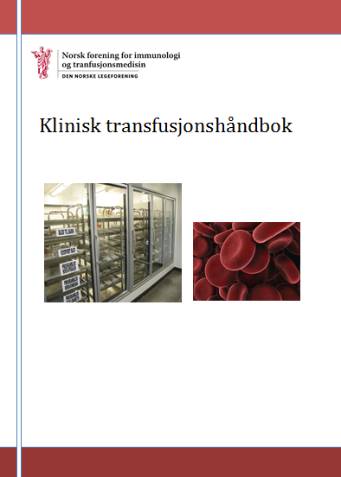
national guidelines for bleeding patients
Norwegian civilian and military trauma and transfusion guidelines recommend an early balanced transfusion therapy for patients with severe bleeding.
Notes:
Our national civilan and military guidelines recommend early balanced transfusion for patients with severe bleeding.

Slide 8
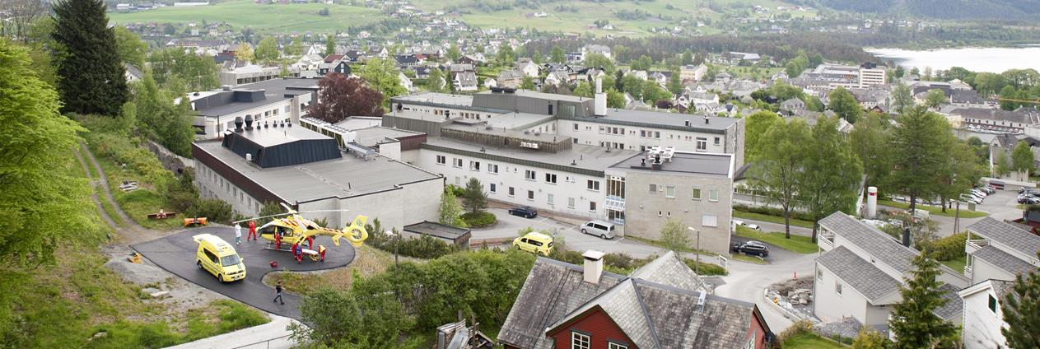
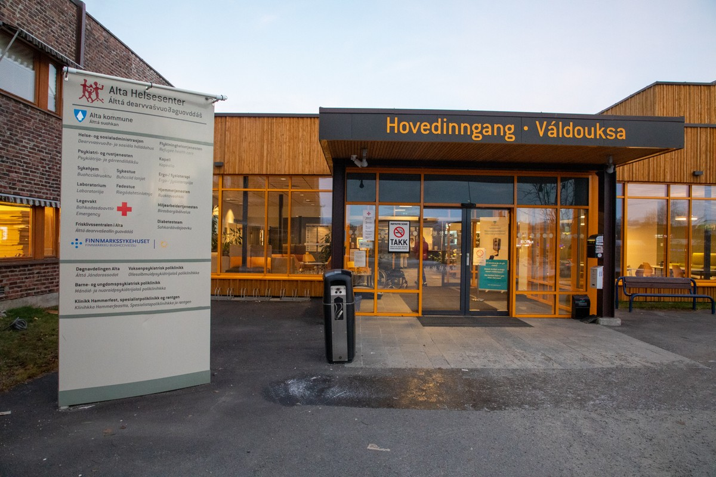
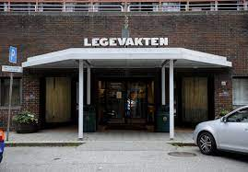
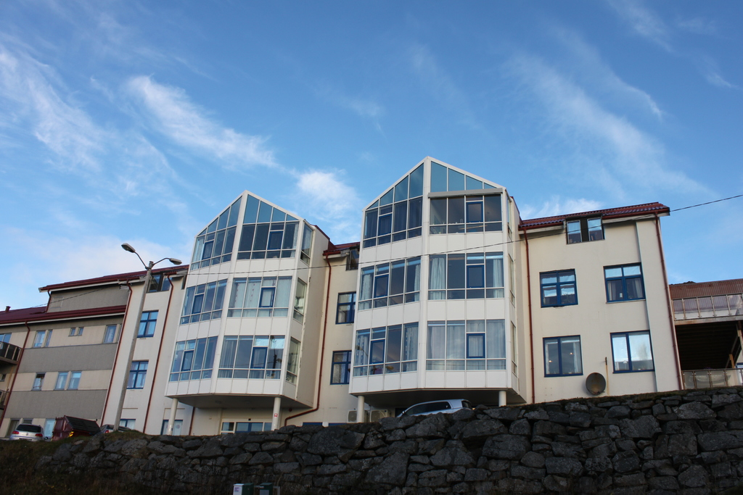
To enable an early balanced transfusion in Norway, a platelet containing blood product is needed on all treatment levels.
Level 1 Trauma Hospitals
Ambulance Service
Small rural hospitals
Municipal Health
Services
Notes:
But since we have these challenges with distances, we have o face considerrably logistial challenges.
And to be able to follow this recommendation we have to consider systems for blood preparedness on all treatment levels from the level 1 trauma centers and to the municipal health servides. .

Slide 9
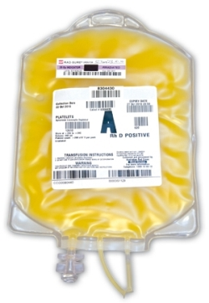
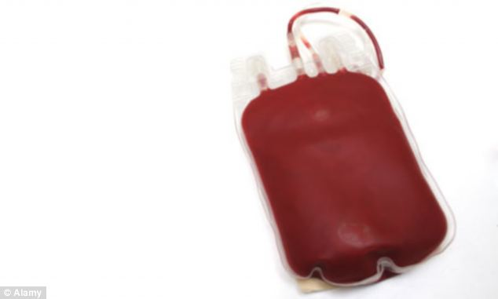
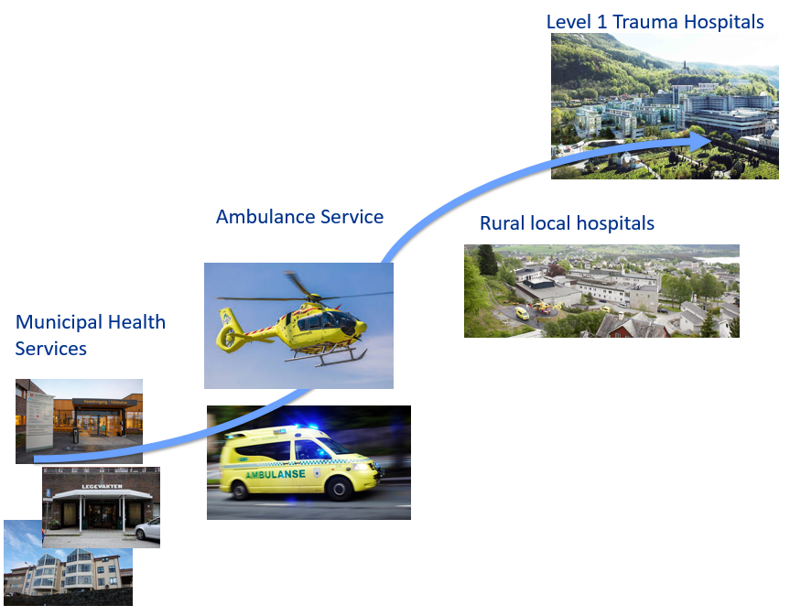
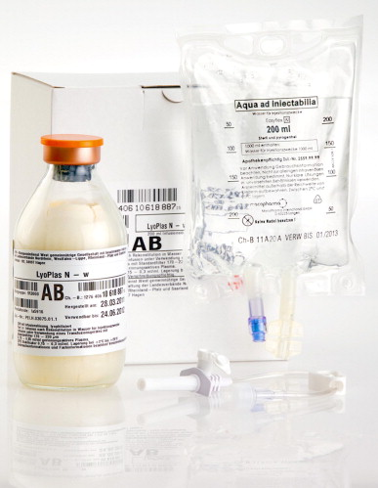
The blood products that we work with in the Norwegian Blood Preparedness Model
Cold stored /frozen platelets
Whole Blood
Fullblod
RBC
Whole Blood
Dried plasma
Whole Blood
Whole Blood
Whole Blood
Dried plasma
Cold stored /frozen platelets
Dried plasma
Dried plasma
Notes:
To do so, we have been working in a military-civilian collaboration to investigate and explore the use of new, or old, blood products.
In this presentation, I will talk about our experience with the use of cold stored platelets and discuss the effect of cold storage on the function of the platelets.

Slide 10
Potential benefits of storing platelets cold
Findings from laboratory studies with importance for clinical use:
Preserved metabolism
Reduced risk of bacterial contamination
Preactivation
Shape change
Preserved platelet function
Improved clot formation
Reduced circulation time
Extended storage time
Ref. Getz TM. Physiology of cold-stored platelets. Transfusion and apheresis science : official journal of the World Apheresis Association : official journal of the European Society for
Haemapheresis. 2019;58(1):12-5.
Ketter PM et al. Platelet enhancement of bacterial growth during room temperature storage: mitigation through refrigeration.
Transfusion. 2019;59(S2):1479-89.
Braathen H et al. In vitro quality and platelet function of cold and delayed cold storage of apheresis platelet concentrates
in platelet additive solution for 21 days. Transfusion. 2019;59(8):2652-61.
Johnson L et al. Refrigeration and cryopreservation of platelets differentially affect platelet metabolism and function: a comparison with conventional platelet storage conditions. Transfusion. 2016;56(7):1807-18.
Reddoch KM et al. Hemostatic function of apheresis platelets stored at 4 degrees C and 22 degrees C. Shock (Augusta, Ga). 2014;41 Suppl 1:54-61.
Bynum JA et al. Bioenergetic profiling of platelet mitochondria during storage: 4 degrees C storage extends platelet mitochondrial function and viability. Transfusion. 2016;56 Suppl 1:S76-84.
Getz TM et al. Storage of platelets at 4 degrees C in platelet additive solutions prevents aggregate formation and preserves platelet
functional responses. Transfusion. 2016;56(6):1320-8.
Reddoch-Cardenas KM et al. Cold storage of platelets in platelet additive solution: an in vitro comparison of two Food and Drug Administration-approved collection and storage systems. Transfusion. 2018.
Notes:
What can we learn form in vitro studies of cold stored platelets?
The morphological and molecular changes that occur due to cold exposure enhance the ability of the platelets to participate in the hemostatic process at the cost of rapid clearance from circulation.
In vitro studies have demonstrated that cold storage reduces both glucose utilization and lactate production compared to room temperature controls (RT). Cold storage better preserve platelet function and reduce risk of bacterial contamination. All this gives us a potential for extended storage time.

Slide 11
Bergen Blood Far Forward Research and implementation program
Whole blood
Cold stored platelet concentrates
In vitro comparison of fresh whole blood
and reconstituted whole blood
2012
Effects of platelet sparing filtration of whole blood.
Blood Far Forward 1-3 (ClinicalTrials Id: NCT01892670).
2013
Platelet Recovery And Survival After Whole Blood Treated with Mirasol Pathogen Reduction. Medic 1-2.
(ClinicalTrials Id: NCT02330081)
2014
In vitro platelet function in apheresis platelets stored cold
stored cold with agitation for up to 21 days.
In vitro Platelet function in Whole Blood collected from a «Walking Blood Bank» (the Royal Norwegian Navy).
2015
Whole Blood in Civilian Air Ambulance, Bergen
Cold stored apheresis platelets in PAS in treatment of
post-operative bleeding in patients undergoring complex
cardiothoracic surgery. (ClinicalTrials Id: NCT02495506)
Part 1: Storage for up to 7 days.
Leukoreduced whole blood for austere environments
Leukoreduced cold stored whole blood in a Norwegian
emergency helicopter service. An observational study
on storage conditions and product quality (HEMS).
2016
In vitro platelet function in apheresis platelets stored cold
stored cold without agitation for up to 21 days.
Effect of delayed cold storage of platelet concentrates in PAS.
Whole blood in hospital Massive Transfusion Protocol.
Local quality registry on massive transfusions/whole blood.
2017
National study on massive transfusions in Norway
Cold stored apheresis platelets in PAS in treatment of
post-operative bleeding in patients undergoring complex
cardiothoracic surgery. (ClinicalTrials Id: NCT02495506)
Part II: Storage for 7-14 days.
2018
In vitro hemostatic function of cold-stored leukoreduced CPDA-1 whole blood
Effect of leukoreduction on risk of bacterial growth
Temperature cycling of CPDA-1 Whole blood
2019
Delayed CSP (7 days) function and metabolism
2020
Cold stored (14 days) apheresis platelets introduced in routine
Blood Preparedness pilot Northern Norway – Civilian WBB
2021
In vitro platelet function in delayed cold
stored IPU platelet concentrates
Notes:
This is the overview of our research and implementation program. And I will walk you through what we have learnt so far.

Slide 12
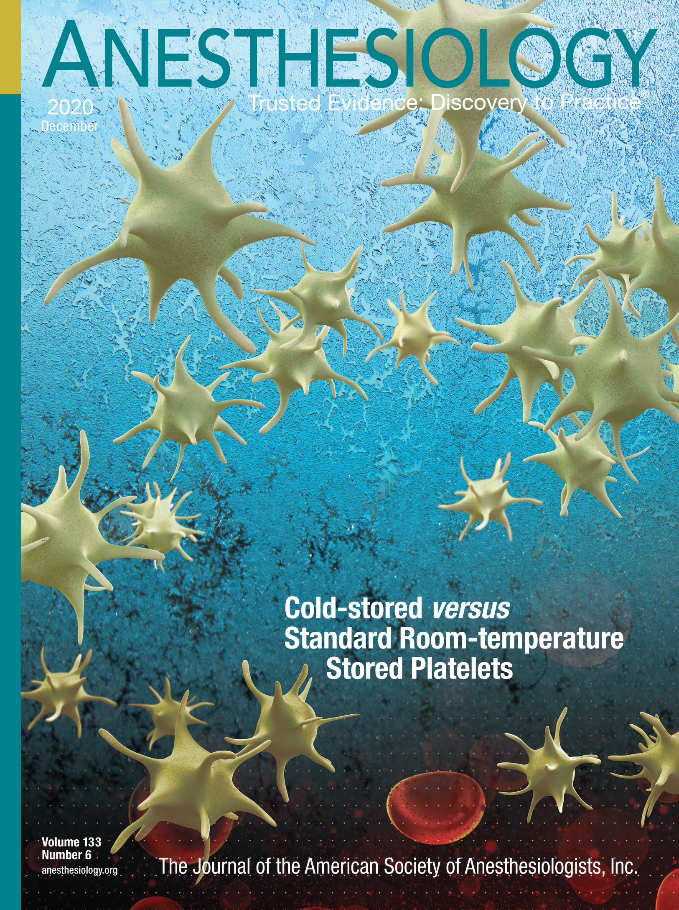
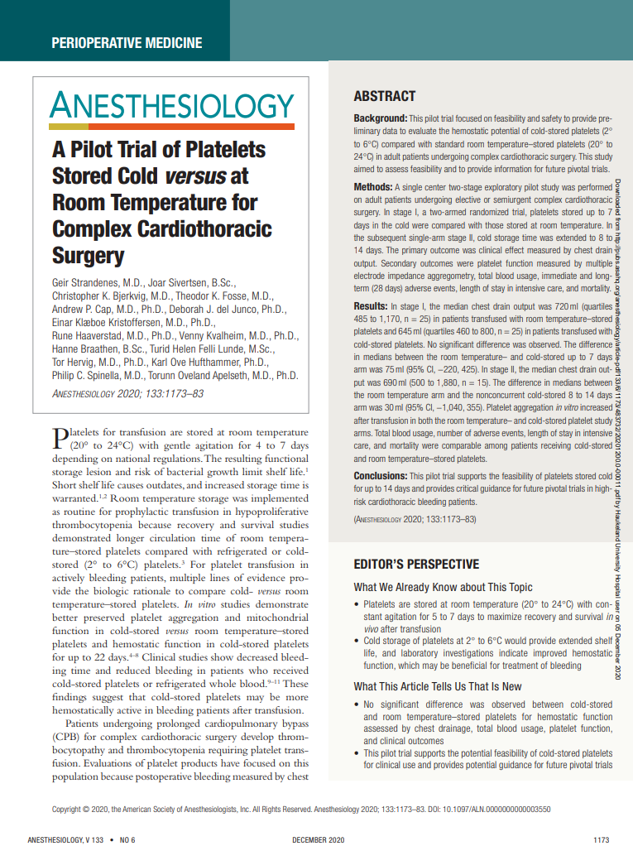
Pilot study of cold stored platelets in patients undergoing complex Cardiothoracic Surgery
Strandenes et al 2020
Single center two stage exploratory pilot study performed at Haukeland University Hospital, Bergen, Norway.
Adult patients undergoing complex cardiothoracic surgery.
Stage 1: Two-armed randomized trial
7 days cold stored platelets
7 days room temperature platelets
Stage 2: Singel arm
8-14 days cold stored platelets
Ref. Strandenes G, Sivertsen J, Bjerkvig CK, Fosse TK, Cap AP, Del Junco DJ, et al. A Pilot Trial of Platelets Stored
Cold versus at Room Temperature for Complex Cardiothoracic Surgery. Anesthesiology. 2020;133(6):1173-83.
Notes:
Early 2020 we published the results from our pilot study of cold stored platelets in patients undergoing complex cardothoracic surgery. Before starting our study we had done laboratory studies describing the quality of cold stored platelets.
Our clinical study was performed in two stages. First a two-armed randomized trial investigating the effect of platelets stored cold or in room temperature for up to 7 days. In the second stage a singel arm of platelets stored cold for 8 to14 days.

Slide 13
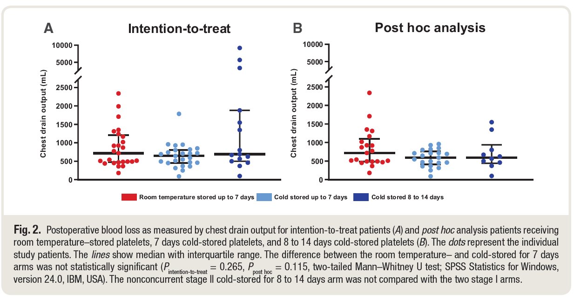
Post operative blood loss (CHEST drain output)
Notes:
The primary outcome of the study was post operative blood loss as measured by chest drain output. The results are presented as individual data, and the median and interquartile range are marked. No significant difference were observed between the groups.

Slide 14
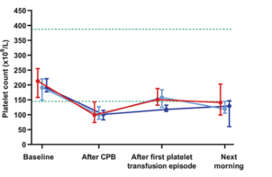
Blood usage and platelet count
Blood usage
Platelet count
Median with interquartile range. Green dotted lines indicate reference values.
Notes:
There were noe difference in blood use, and the platelet counts were similar up to the morning after surgery.

Slide 15
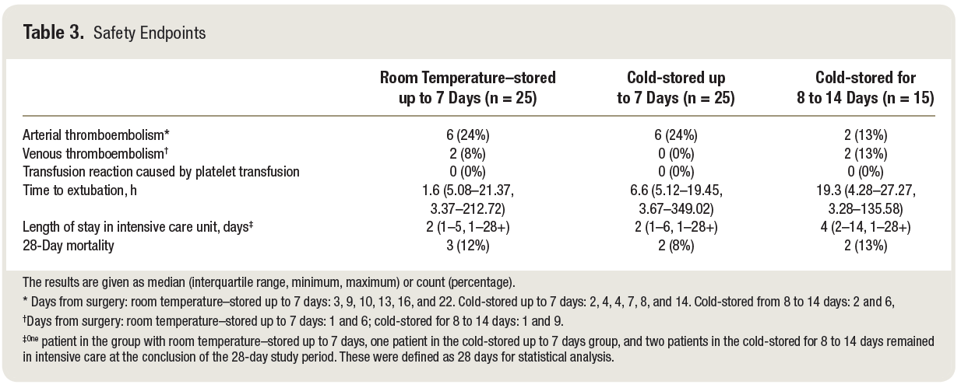
Safety endpoints
Notes:
When ic came to the safety. The patients were very sick and as you see some of them had long stays in the intensive care unit. The 28 days mortality and risk of thromboembolic events, were however, similar between the groups.

Slide 16
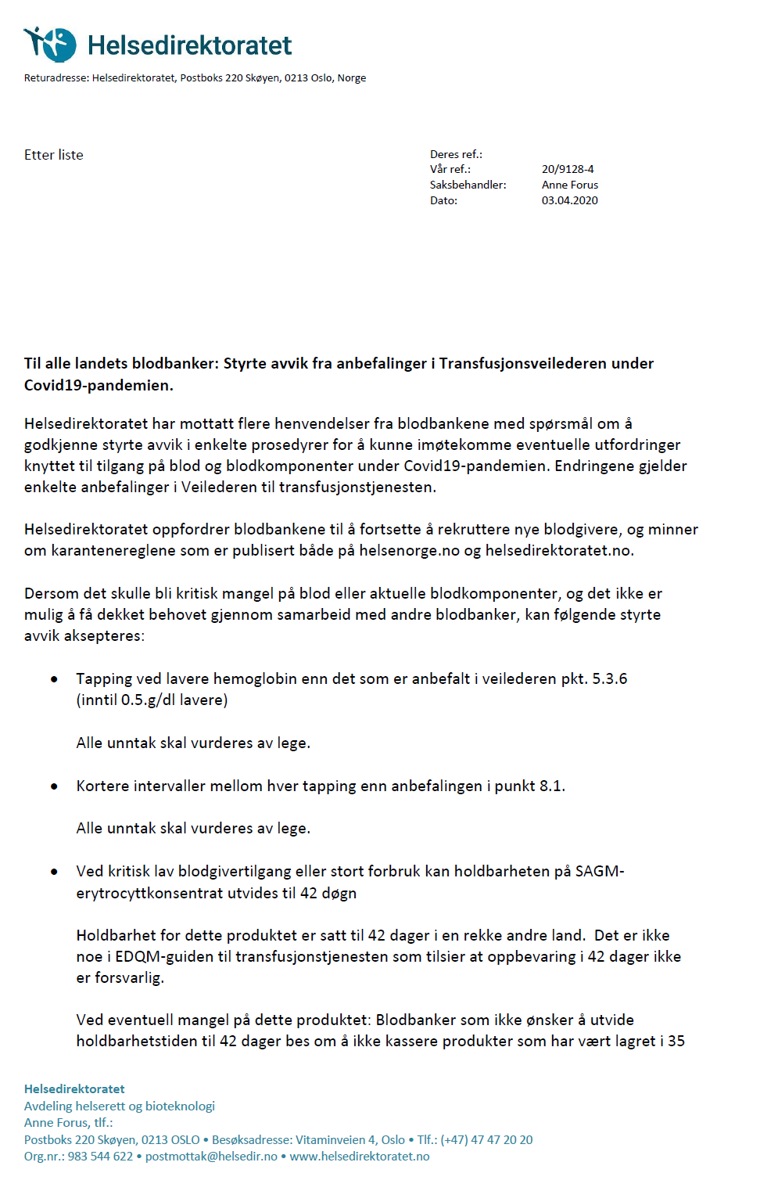
Reducing risk of blood shortages during the pandemic
Approval from to the Norwegian Health Authority to implement cold stored platelets to reduce risk of platelet shortages (03.04.2020):
Platelets stored cold for up to 14 days may be used for patients with bleeding.
«Blodbanker som ønsker å implementere dette må bruke validerte metoder og sikre forsvarlige prosedyrer og kvalitetskrav. Per nå er det Blodbanken i Helse Bergen som har dette implementert som bruk i kliniske studier.»
Notes:
Then came the pandemic. And early in the first phase of the pandemic, the Norwegian Health Autohority approved the use of 14 days cold stored platelets for reatment of bleeding patients. To reduce risk of platelet shortages.

Slide 17
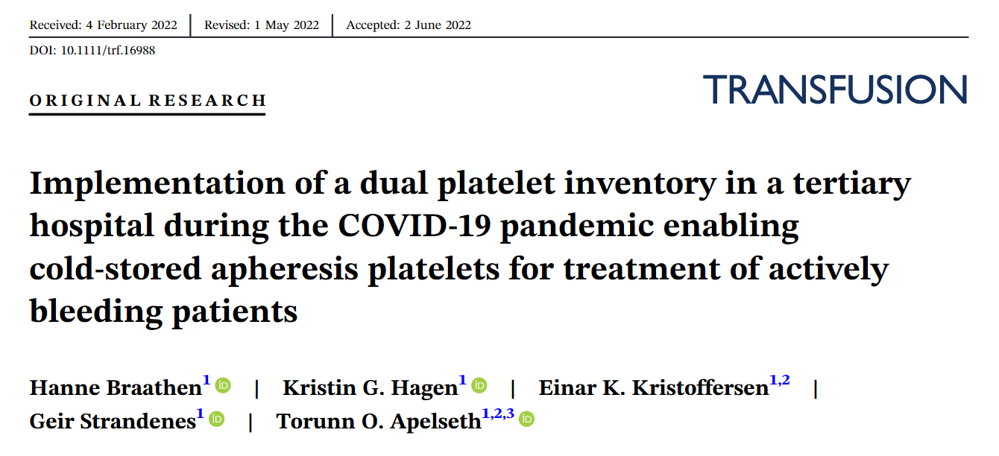
March 2020- December 2021:
276 CSP apheresis units produced
186 CSP units transfused to 92 patients.
Main indication: Surgery (88%)
No transfusion reactions reported.
Main challenge: outdating
Notes:
From 17 March, 2020, to 31 December, 2021, we produced 276 CSP units and transfused 186 units to 92 patients. Main indication for transfusion was surgical bleeding (88%). No transfusion reactions were reported. 24-hour survival was 86%. During early lockdown 19% of platelet concentrates issued were CSP, with outdate of 15%. Overall outdate in the study period was 33%. The majority (75%) of survey respondents answered that they had received sufficient information and training before CSP were implemented

Slide 18
Delayed cold stored platelets
Platelets stored in room temperature and transferred to cold storage
Main patient population needing platelet transfusion in hospitals are non-bleeding patients
Easier management of platelet inventory

Slide 19
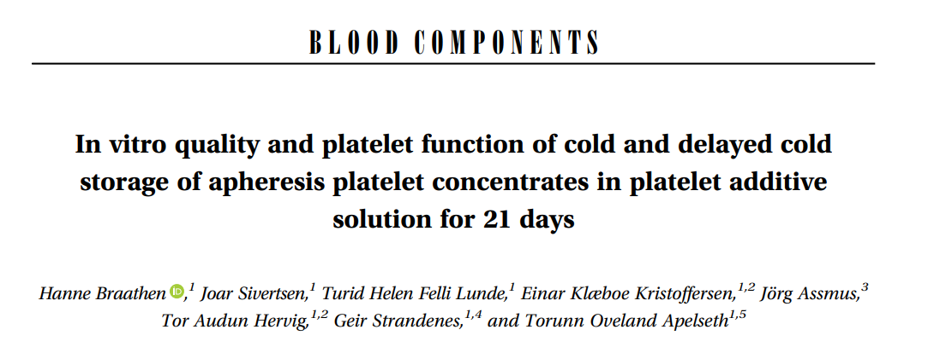
N=10 double apheresis platelet concentrates in 37% plasma/63% PAS-IIIM
2 groups:
Non-agitated continuos cold storage (CSPs)
Delayed cold storage (DCSPs) 7 days agitated storage at room temperature followed by non-agitated cold storage for 14 additional days (total 21 days)
Ref. Braathen H, Sivertsen J, Lunde THF, Kristoffersen EK, Assmus J, Hervig TA, Strandenes G, Apelseth TO. In vitro quality and platelet function of cold and delayed cold storage of apheresis platelet concentrates in platelet additive solution for 21 days 2019;59: 2652-61.

Slide 20
results
All platelet units, both CSPs and DCSPs, complied with the EU guidelines throughout storage for 21 days, except for swirling (not detectable after cold storage).
Notes:
CONCLUSION: Cold storage of platelets improved platelet function in in vitro assays, even though delayed cold storage on Day 7 showed poorer results compared to continuous cold storage. This difference could be explained by accelerated metabolism and higher glucose consumption during the period of room temperature storage. Cold storage and delayed cold storage could ease inventory management. Further studies investigating the in vitro and clinical effects of cold-stored and delayed-cold-stored platelets are encouraged.

Slide 21
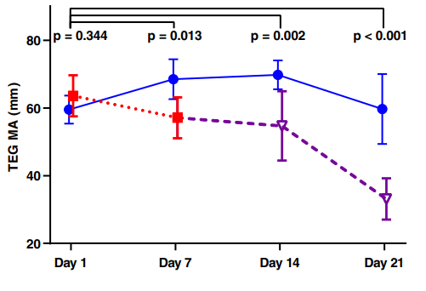
Platelet function
Cold storage improved platelet function; however, DCSP on Day 7 showed poorer results compared to CSP.

Slide 23
Cold storage slowed down metabolism, with lower lactate and higher glucose concentrations in the CSP compared to the DCSP throughout storage for 21 days.

Slide 24
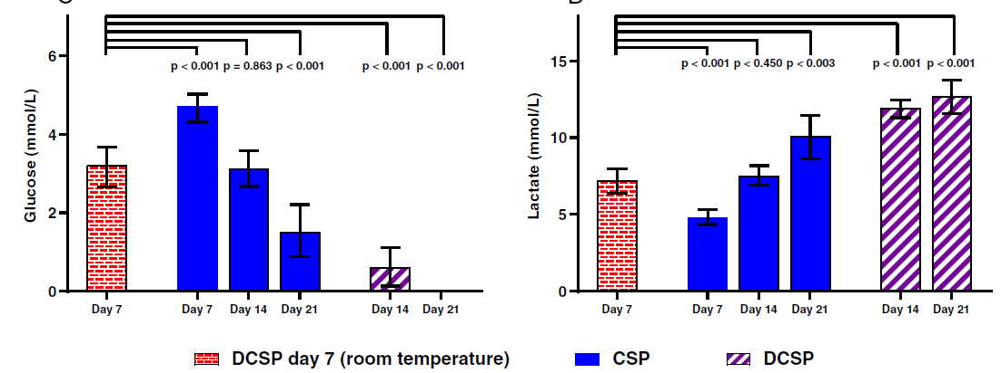
Measurements of Glucose and lactate

Slide 25
Ongoing Follow up studies of delayed cold stored platelets

Slide 26
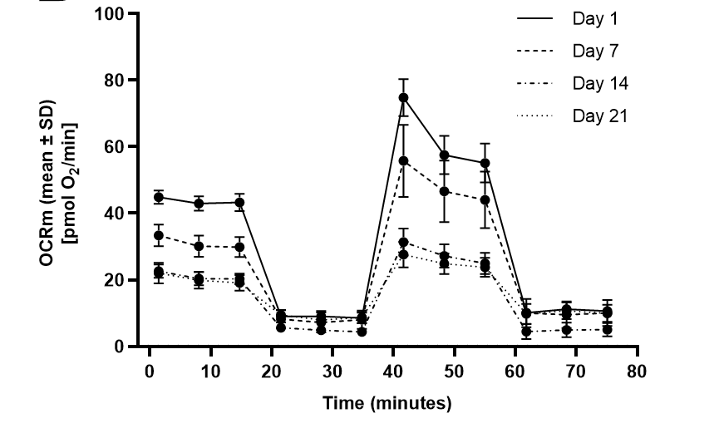
Delayed cold storage (day 7) - bioenergetic profile and platelet function
In this study we evaluate the bioenergetic profile in delayed cold-stored (from day 7) platelets when compared to platelets stored continuously cold for up to 21 days.
Mitochondrial respiration analysis was performed using the Seahorse XF Cell Mito Stress Test kit on the Seahorse XFe96 Extracellular Flux Analyzer.
The overall rates of mitochondrial respiration in the platelets decreased depending on storage duration. Figure shows results for one bag during continuous cold storage
Notes:
oxygen consumption rate (OCR)

Slide 27
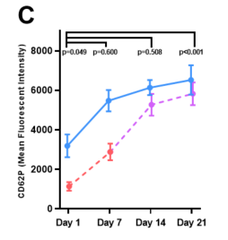
Platelet function and activation
Platelet aggregation response was measures by light transfmission aggregometry and flow cytometry.

Slide 28
Glucose and lactate

Slide 29
delayed cold storage of whole blood derived platelet concentrates (IPU-method)
Pool-and-split design to prepare 18 identical IPU PC pairs
Two groups:
Continuously cold storage (CSP)
Delayed cold storage (DCSP) day 5
stored agitated at room temperature until day 5 and then transferred to cold storage

Slide 30
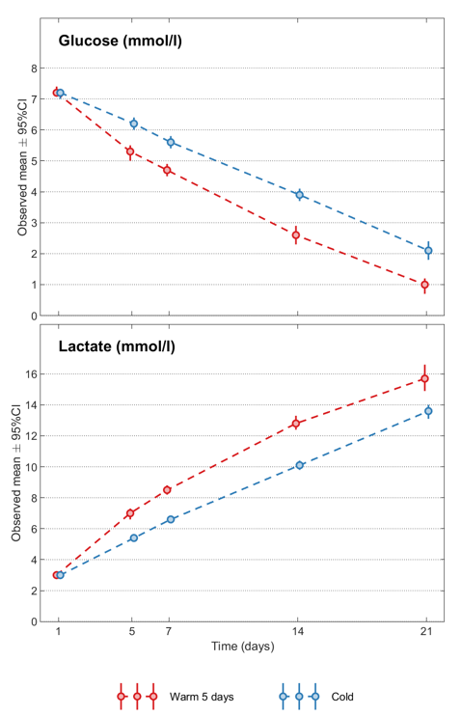
results
All IPU PCs complied with EU guidelines (EDQM)
Both groups had mean platelets >200x10⁹/unit on day 21.
pH remained above 6.4 for all sample points.
The continuous cold-stored group was more pre-activated measured by flow cytometry; however, the delayed cold-stored group showed a higher ability to be activated by agonists.
IPU PCs are suitable for cold storage from day 1 until day 21 and delayed cold from day 5 until day 14.
Our results support delayed cold storage of IPU PCs. Due to challenges with the planning of donation and production of apheresis PCs, we find that IPU PCs are better suited for cold and delayed cold storage.

Slide 31
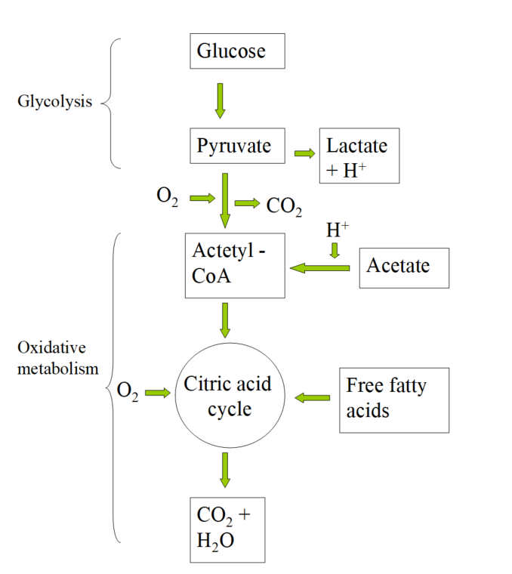
DISCUSSION: Major metabolic pathways in platelets stored in platelet additive solutions
Figure adapted from:
Kaushansky K, Roth G. Megakaryocytes and Platelets. In: Greer J, Foerster J, Lukens J, et al., eds. Wintrobe's Clinical Hematology, 2004:605-50.
Lehninger A, Nelson D, Cox M. Glycolysis and the Catabolism of Hexoses. In: Principles of Biochemistry, 1993:403.

Slide 32
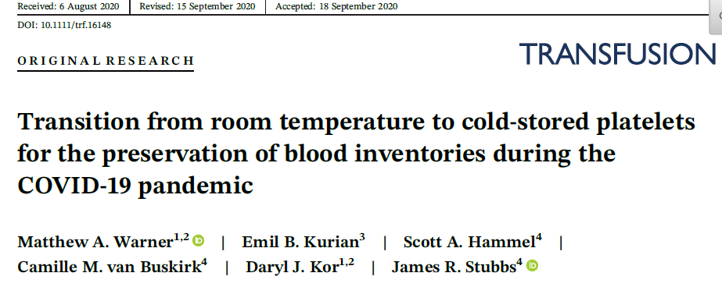
Discussion: How does our Findings relate to other studies
Two laboratory studies indicate that platelets may be stored at room temperature for up to four to five days, and then transferred to cold storage with adequate in vitro function for 21 days. (1,2)
A single-center case study has also been performed to explore the use of delayed cold-stored platelets (day 5) as a measure to prolong platelet storage during the COVID-19 pandemic. Reported transfusion of 61 cold stored platelet units to 40 patients. 95% transfused in operation room. Hemostasis deemed adequate in all cases. No transfusion reaction. (3)
References:
1. Wood B JL, Hyland RA, Marks DC. . Maximising platelet availability by delaying cold storage. Vox Sang. 2018;Online ahead of print.
2. P. Schubert ZC, B. Culibrk, W. Zhao, K. McTaggart, D Devine. Impact of timing for switching platelet concentrates from 22C til 4C and subsequent storage on platelet quality. Vox Sang. 2020;Vox Sanguinis(2020)115 35.
3. Warner MA, Kurian EB, Hammel SA, van Buskirk CM, Kor DJ, Stubbs JR. Transition from room temperature to cold-stored platelets for the preservation of blood inventories during the COVID-19 pandemic 2021;61: 72-7.

Slide 33
summary
Clinical and laboratory studies indicate that cold storage of platelets can preserve platelet function and metabolic reserve
Delayed cold stored platelets could be the blood bankers dream product for inventory management
- Is it time to test this in clinical studies?

Slide 34
Thanks!
Email: torunn.oveland.apelseth@helse-bergen.no

