Slide 1
Hemostasis Monitoring Comparisons And Future Directions
Nathan J. White, MD
Associate Professor of Emergency Medicine
University of Washington Seattle, Washington, USA

Slide 2
Disclosures
Cofounder, stockholder, and consultant to Stasys Medical Corp. (Platelet Diagnostic)
Consultant to Tournitek, Inc.
Member, Trauma Hemostasis & Oxygenation Research (THOR) Network.
Visiting Clinician Scientist, Lee Kong Chian School of Medicine, Nanyang Technological University, Singapore
Grant Funding from U.S. NIH, DoD, iTrauma Care
One time travel Support from Vidacare Corp, TEM Int., CSL Behring
Inventor: platelet diagnostic and hemostatic biopolymer

Slide 3
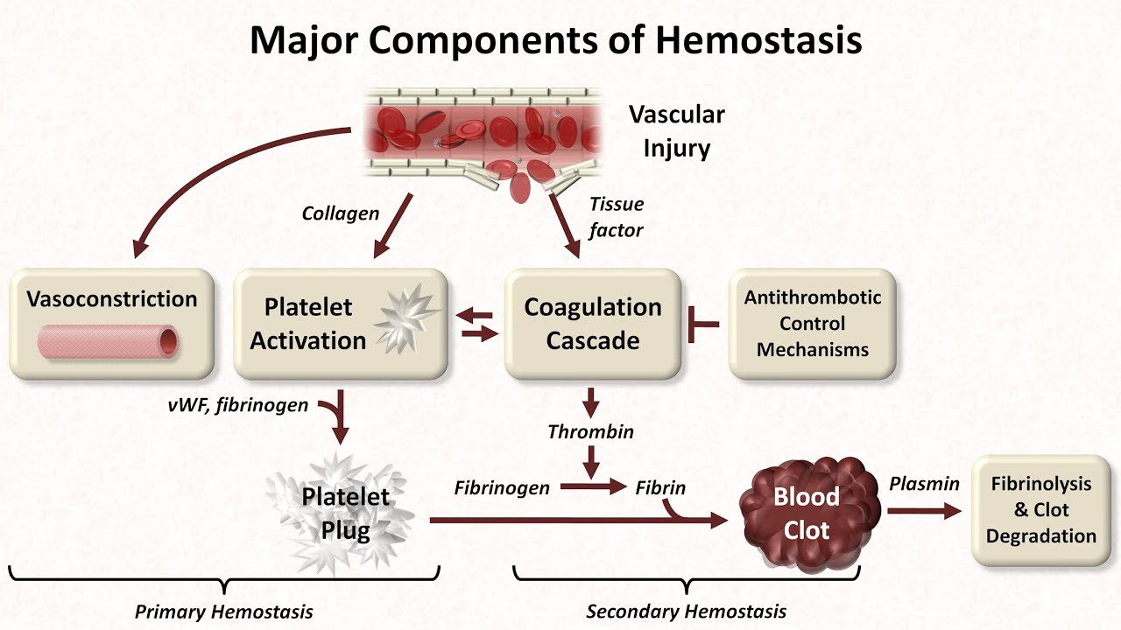
Outline
What is the assay?
How is it performed?
What is the relevance to trauma?
Pitfalls?
Strong Medicine: https://www.youtube.com/watch?v=5GPPt0kftfE

Slide 4
Trauma-Induced Coagulopathy
Chang, et al. Blood. 2016 Aug 25;128(8):1043-9.
Notes:
To monitor and treat TIC we must be comfortable with all parts of the hemostatic system, because all parts are affected.

Slide 5
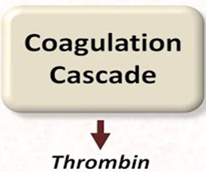
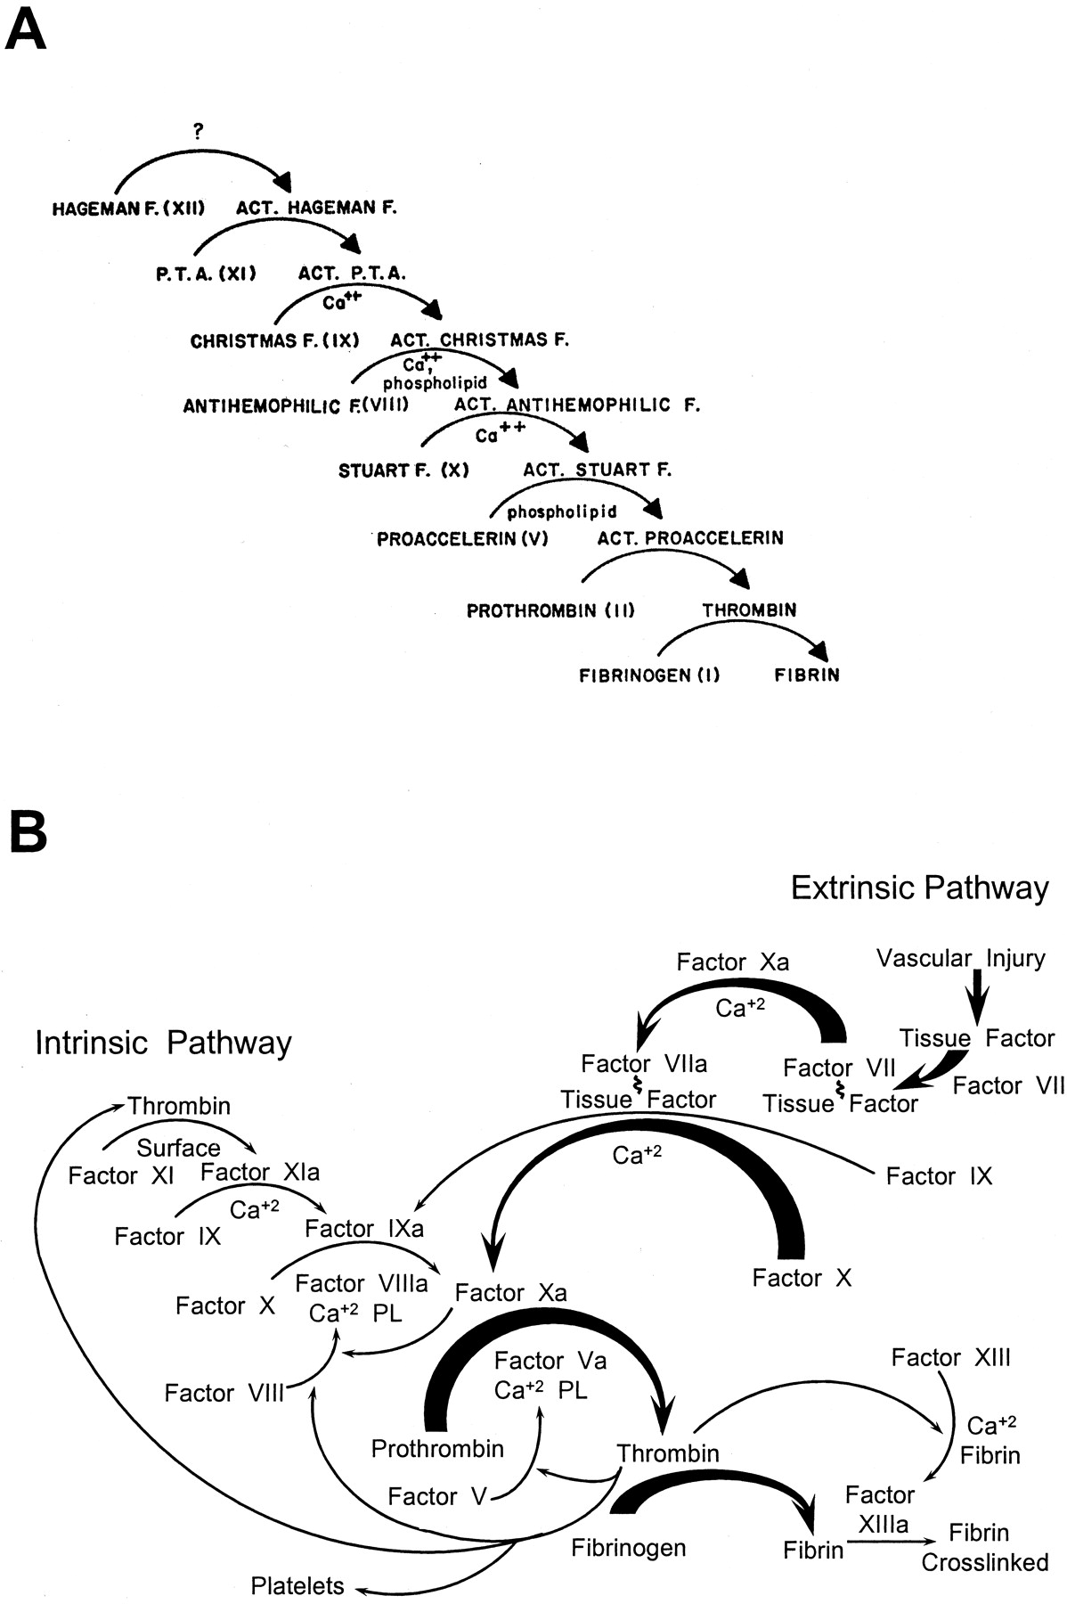


Coagulation Cascade
©2003 by American Society for Biochemistry and Molecular Biology
Davie E W J. Biol. Chem. 2003;278:50819-50832
Notes:
A, “waterfall sequence for intrinsic blood clotting” from Ref. 68. B, “coagulation cascade and fibrin formation by the intrinsic and extrinsic pathways” modified from Ref. 4.

Slide 6
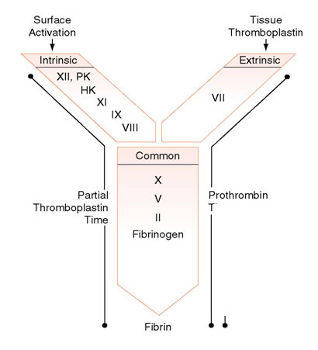
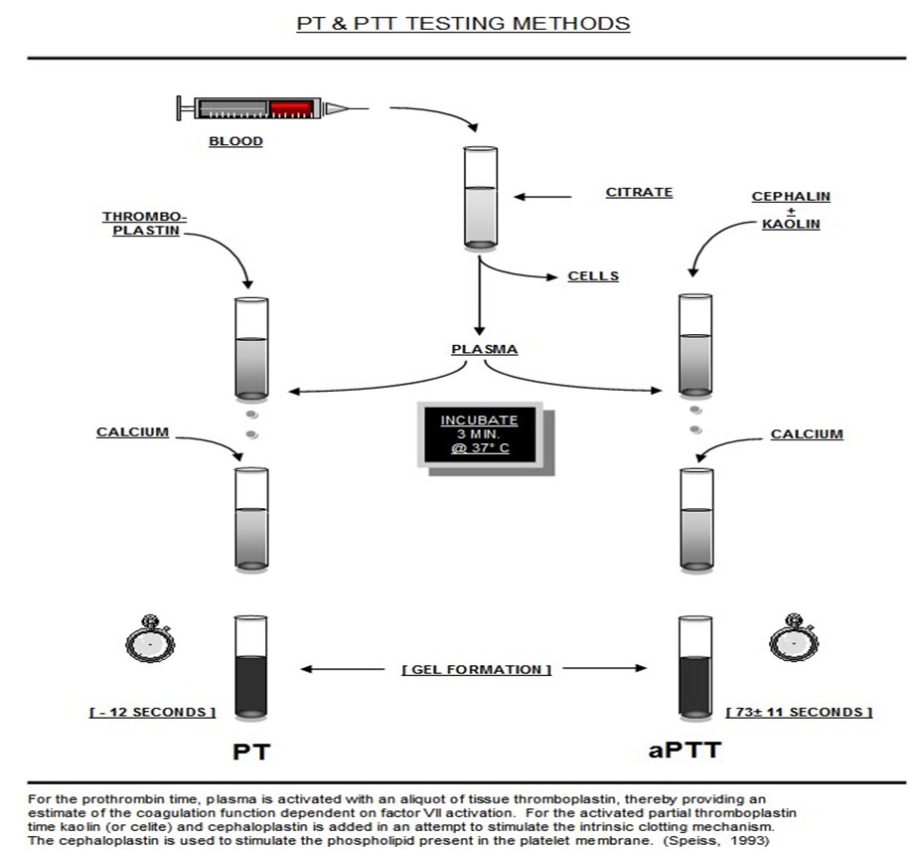
Coagulation Cascade Monitoring
Normal PT
reference range 13-15 seconds.
Normal aPTT reference range 27-35 seconds.
http://teachingcases.hematology.org/green/teaching_points.cfm
http://circuitsurfersdotcom.files.wordpress.com/2011/02/ptt.jpg

Slide 7
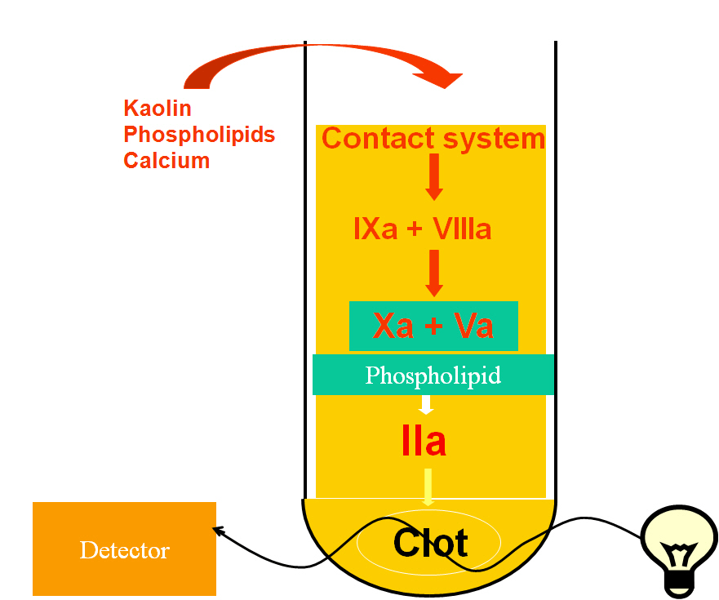
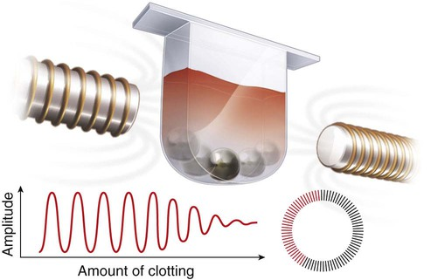
Method of Measurement
Absorbance
Mechanical
More susceptible to changes in fibrin polymerization-- Starches

Slide 8
Relevance to Trauma
Trauma Coagulopathy
PT/INR
  PTr/INR > 1.2
    Mortality doubled (7-15%), increased transfusion requirement
  INR >1.5
    More specific, increased mortality, organ failure, and VTE.
aPTT
  aPTT > 60 sec
Frith et al. JTH 2010, 8: 1919–1925
Peltan et al. Crit Care Med 2015; 43:1429–1438
Brohi et al. J Trauma. 2003;54:1127–1130
Rizoli et al. J Trauma. 2011; 71(5 Suppl 1): S427–S434.

Slide 9
Pitfalls
Blind to primary hemostasis (Platelet, vWF)
Sensitive to changes in fibrinogen concentration, fibrin polymerization, fibrin degradation products, and FXIIIa activity
Insensitive to hypothermia
http://www.practical-haemostasis.com/Screening%20Tests/pt.html

Slide 10
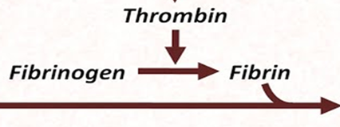
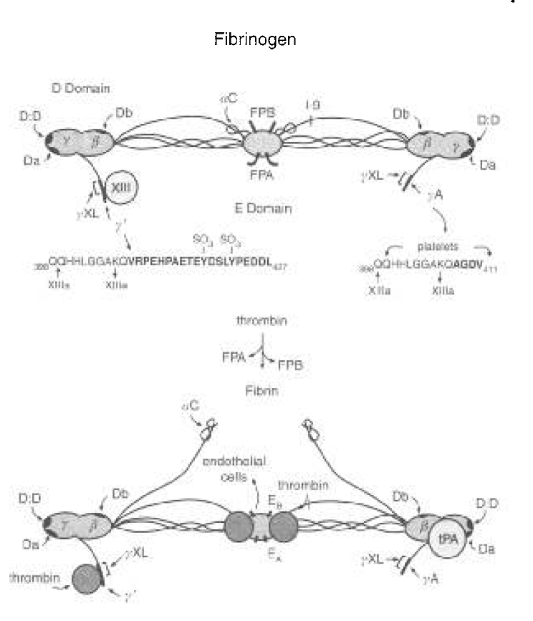
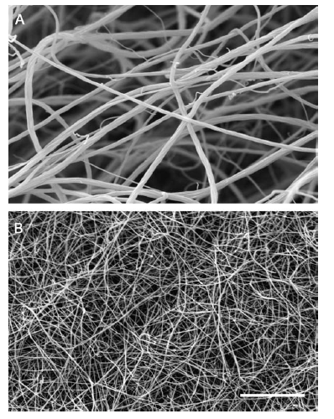
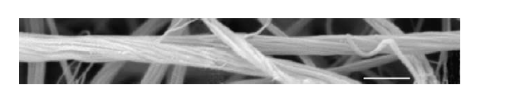
Fibrinogen
Weisel. Biophysical Chemistry 112 (2004) 267– 276

Slide 11
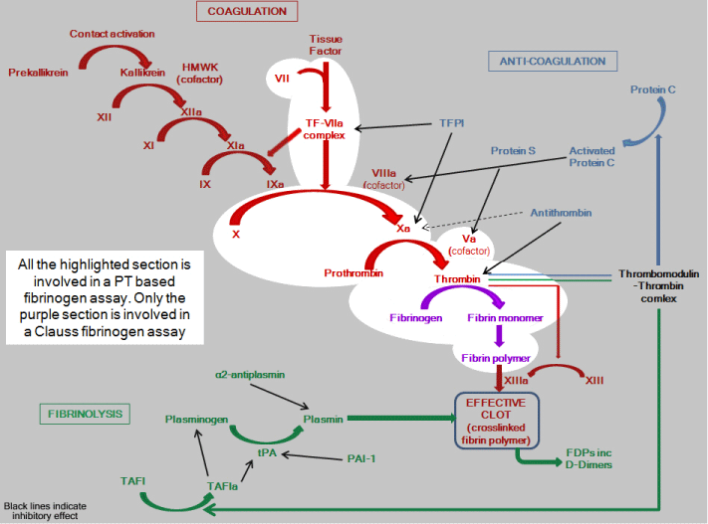
Fibrinogen Monitoring
Assays
  Clauss (based upon thrombin-induced clotting time)
  PT-derived (based upon the PT)
  Immunological (fibrinogen antigen)
  Gravimetric (clot weight)
  Viscoelastic Assays with platelet inhibition
Normal range = 2-4 g/L (200-400mg/dl)
http://practical-haemostasis.com/Screening%20Tests/fibrinogen.html
Notes:
Clauss is strongly favored over the PT method

Slide 12
Relevance to Trauma
Trauma Coagulopathy
Hypofibrinogenemia is strongly associated with increased mortality
≤1.5g/L in 8.2%, and <2 g/L in 19.2% of trauma patients
Nonlinear relationship between fibrinogen and mortality
Clauss Fibrinogen
  < 2.29 g/L, (or 229 mg/dl) associated with increased mortality
Rourke et al. J Thromb Haemost 2012; 10: 1342–51.
Hagemo et al. Critical Care 2014, 18:R52

Slide 13
Pitfalls
Blind to primary hemostasis (Platelet, vWF)
Sensitive to changes in fibrin polymerization (Calcium, ionic strength, temperature), fibrin degradation products, and FXIIIa activity
Sensitive to Direct Thrombin Inhibitors
http://www.practical-haemostasis.com/Screening%20Tests/pt.html

Slide 14
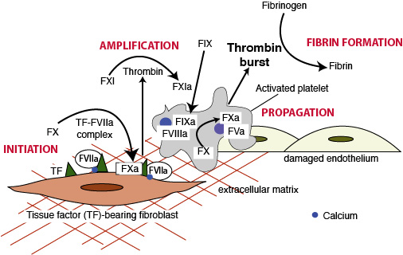
Whole-Blood Coagulation
http://eclinpath.com/hemostasis/physiology/secondary-hemostasis/secondary-haemostasis/

Slide 15
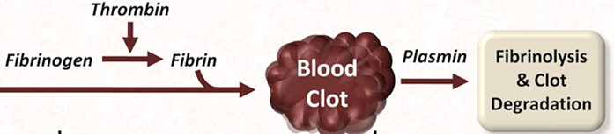
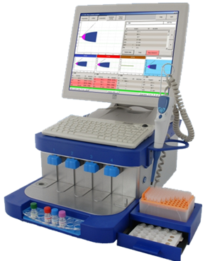
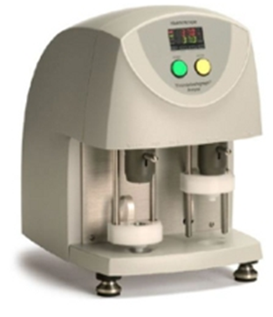
Viscoelastic Hemostatic Assays
Hochleitner et al. Clinical and Applied Thrombosis/Hemostasis, 2015:1-10
Tynngård et al. Thrombosis Journal (2015) 13:8

Slide 16
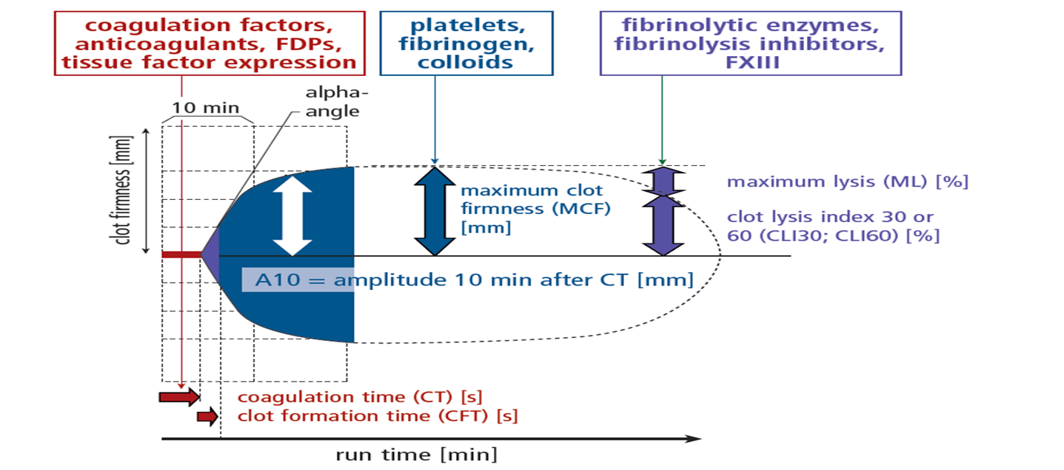
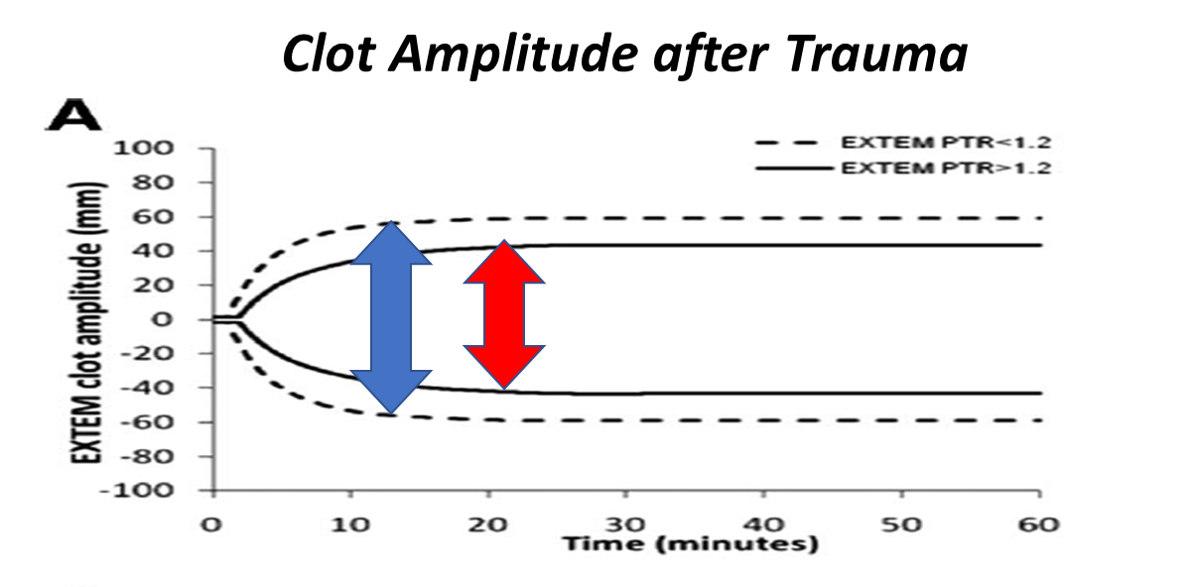
Relevance to Trauma
Davenport ,et al. Crit Care Med 2011 Vol. 39, No. 12
Lier et al. Hämostaseologie 2013; 33:

Slide 17
Pitfalls
High PAP
+
High ML
Insensitive to primary hemostasis and platelet function
    Collagen, ADP, AA
Insensitive to fibrinolytic activation.
Single parameters are difficult to interpret and require context.
High PAP
+
Low ML
Low PAP
+
Low ML
Raza et al. JTH 2013; 11: 307–314
Noorman and Hess. TRANSFUSION 2018;58;2430–2436
Notes:
Effect of platelets on MA is dependent upon fibrinogen concentration. So in order to decide treatment one of these must be known.

Slide 18
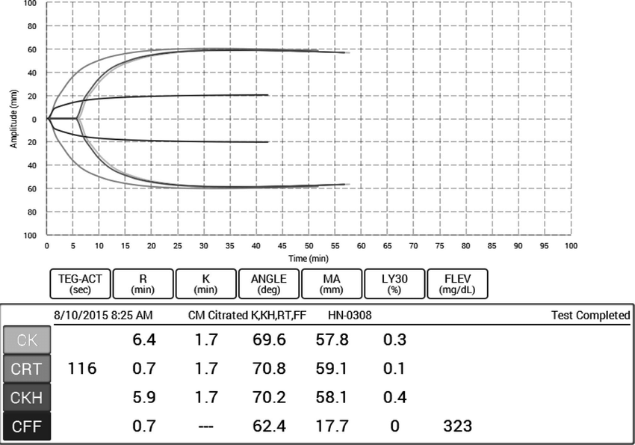
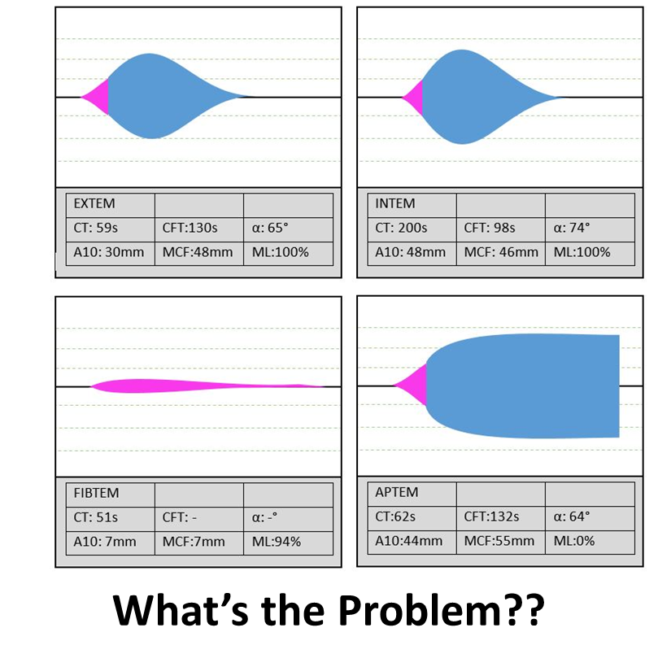
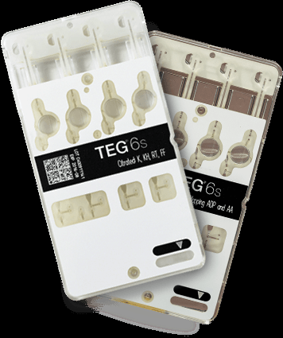
Multiplexed VHA’s

Slide 19
Relevance to Trauma Care
ROTEM Systematic Review
  13 Studies
  Moderate Quality (no RCT’s)
  EXTEM and FIBTEM clot amplitude (CA5, CA10) or maximal clot firmness (MCF) diagnose coagulopathy, predict blood transfusion, and mortality.
  The presence of fibrinolysis associated with mortality.
Single center randomized controlled trial showed survival benefit for TEG vs. plasmatic factors.
Veigas et al. Scandinavian Journal of Trauma, Resuscitation and Emergency Medicine (2016) 24:114
Gonzalez et al. Ann Surg 2016;263:1051–1059

Slide 20
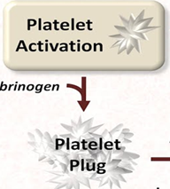
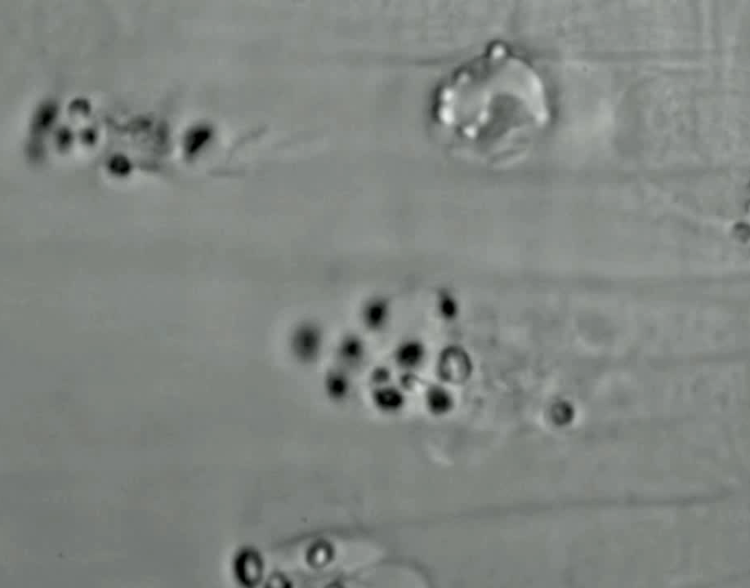

Platelets
Adhesion and Aggregation
Contraction
Credit: David Motto MD, PhD. Bloodworks Northwest, Seattle, WA
Credit: Diagouraga B et al. J Cell Biol 2014;204:177-185

Slide 21
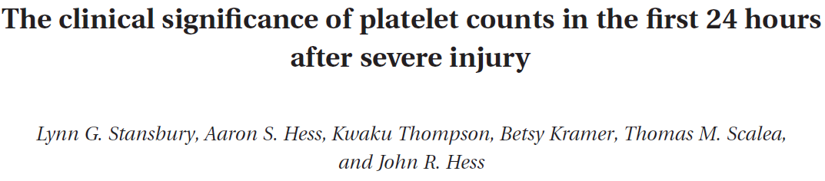
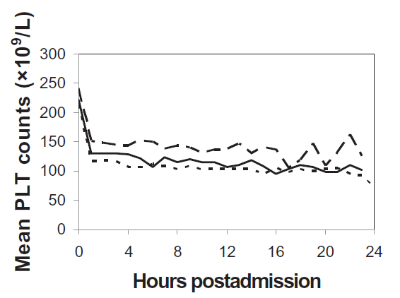
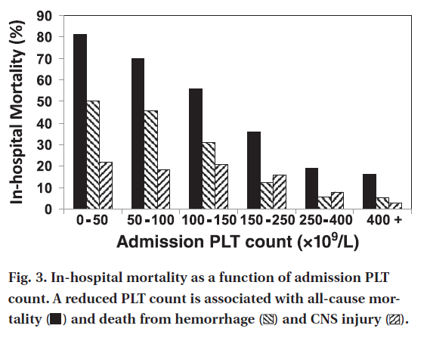
Platelets
Count
Transfusion, June 2012
Notes:
Most platelet counts are normal upon arrival.
Admission platelet count is directly related to mortality
However, this may be only half the story.

Slide 22
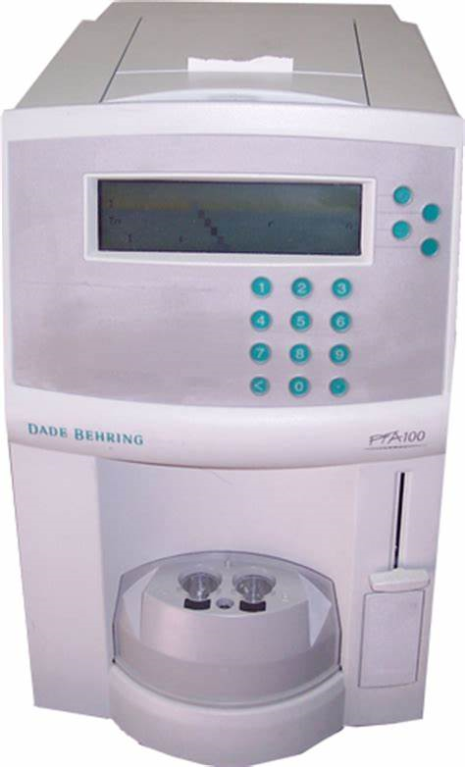
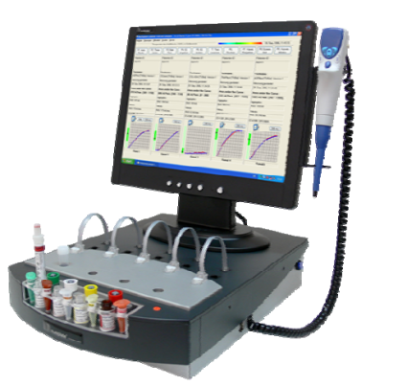
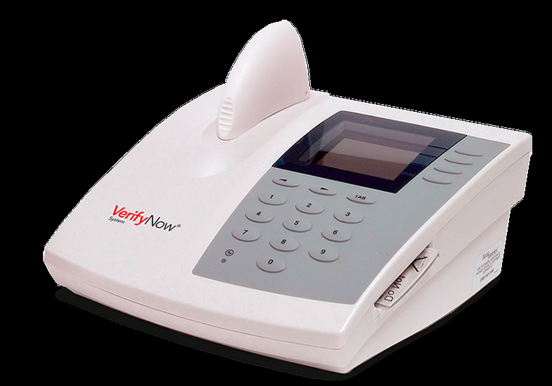
Platelet Function Monitoring
Adhesion and Aggregation
Light Transmittance Aggregometry
(ex. Chronolog, Verify Now)
Aperture Occlusion Time
(ex. PFA-100)
Impedance Aggregometry
(ex. Multiple Electrode Aggregometry)
Grove. Dan Med J 2012;59(9):B4506

Slide 23
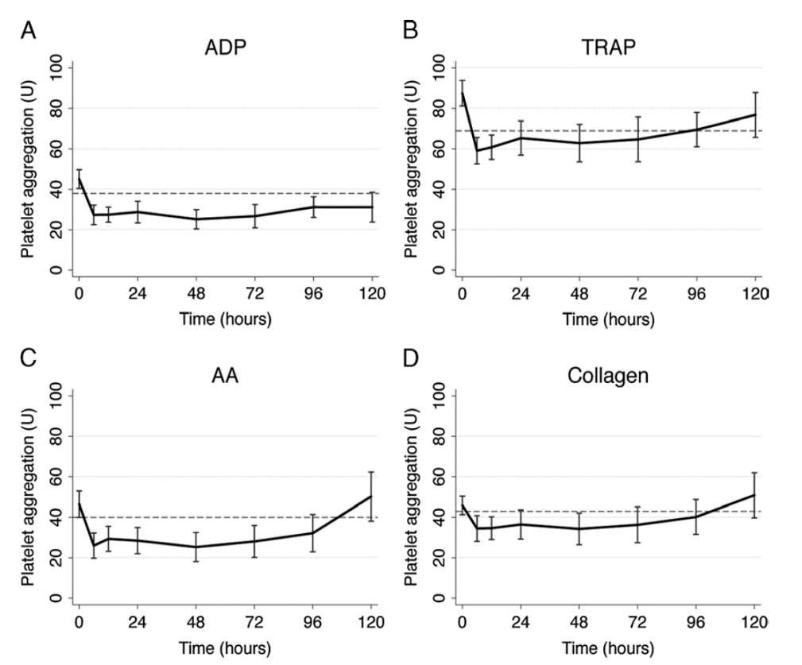
Relevance to Trauma
Platelet Aggregation
10X Mortality
Grove. Dan Med J 2012;59(9):B4506
Kutcher et al. J Trauma Acute Care Surg. 2012.
Notes:
Low grade aggregation deficits….
Important to survival
Mechanism is unknown…

Slide 24
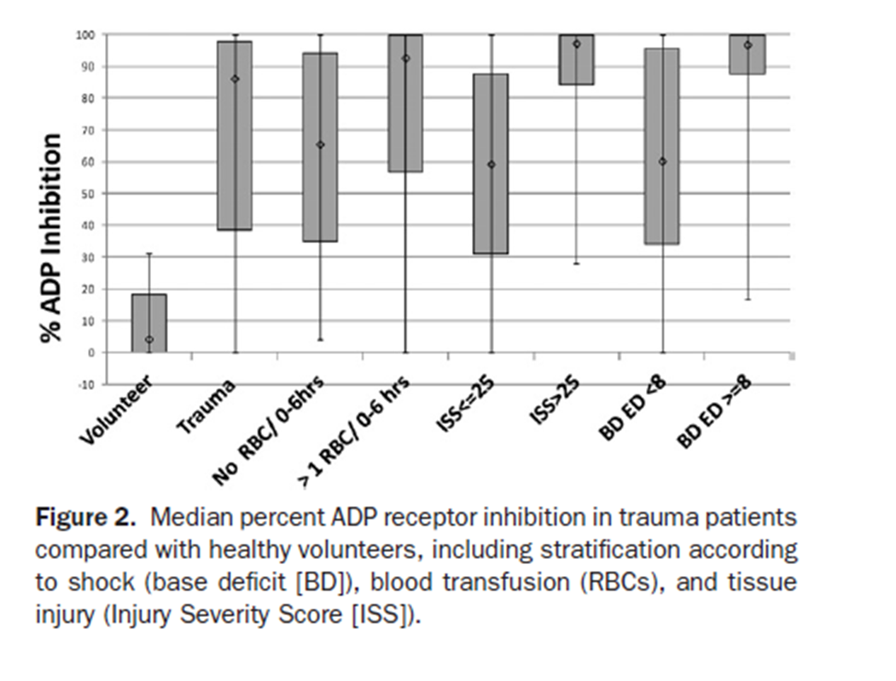
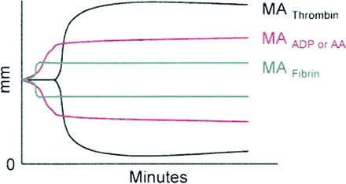
Platelet Function Monitoring
Clot Contraction
% Inhibition
Anesth & Analg May 2009 vol. 108 no. 5 1425-1429
Wohlauer et al. J am Coll Surg 2012;214:739-746
Notes:
The two primary determinants of clot strength is platelet contraction (70-80%) and fibrin.

Slide 25
Aggregation or Contraction?
N=52 ED trauma patients, ISS=21.5, Mortality = 17%
  Only MP aggregation was significantly decreased in patients who died during hospitalization
  Only the TEG PM values were significantly lower in patients receiving any blood products within the first 4 h after arrival to the hospital
George et al. Transfusion Medicine, 2017

Slide 26
Pitfalls
Sensitive to Hct and platelet count
  LTA
  Multiplate
  PFA-100
    Plt <80 · 10⁹/L,
    Hct <30%
Sensitive to vWF
Sensitive to handling
LTA
MEA
Femia et al. J Thromb Haemost 2013; 11: 2193–6.
Notes:
Effect of platelets on MA is dependent upon fibrinogen concentration. So in order to decide treatment one of these must be known.

Slide 27
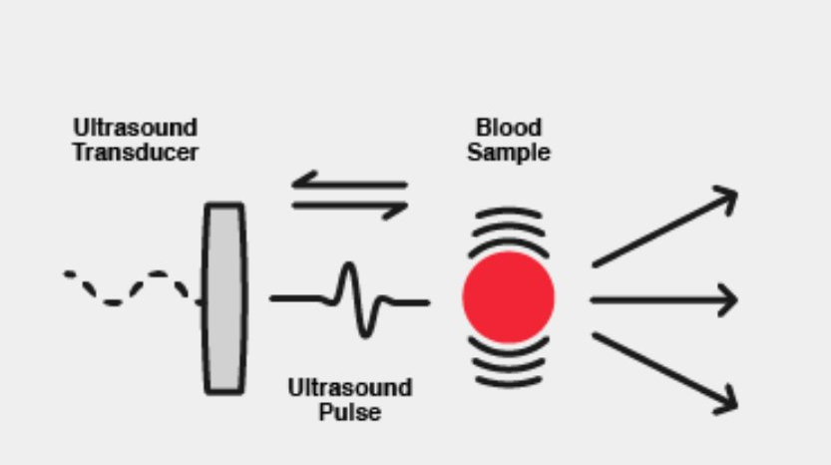
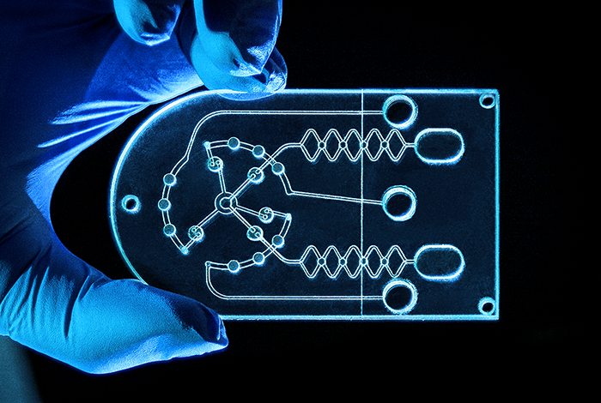
Future Directions
https://hemosonics.com/technology/
Santos-Martinez et al. Analyst, 2011, 136, 5120
Notes:
Quartz Crystal Microbalance with Dissipation monitoring (QCM-D)

Slide 28
Ultrasound-Actuated VHA
Sonic Estimation of Elasticity via Resonance (SEER)
Correlation with VHA’s in cardiac surgery
Baryshnikova et al. Journal of Cardiothoracic and Vascular Anesthesia 33 (2019) 15901598
Corey et al. Ann Biomed Eng. 2016 May ; 44(5): 1405–1424.

Slide 29
Microfluidics
Schoeman et al. Cell Mol Bioeng. 2017 February ; 10(1): 3–15
Notes:
Advantage of reproducing in vivo conditions of blood flow.

Slide 30
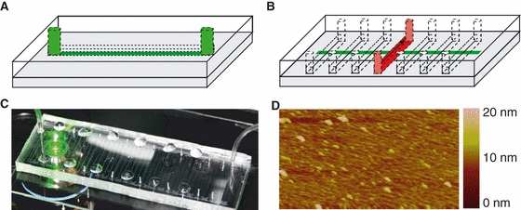
Mulitmodal Monitoring
Li et al. J Trauma Acute Care Surg. 2016;80: 440–449
Neeves et al. JTH, 6: 2193–2201

Slide 31
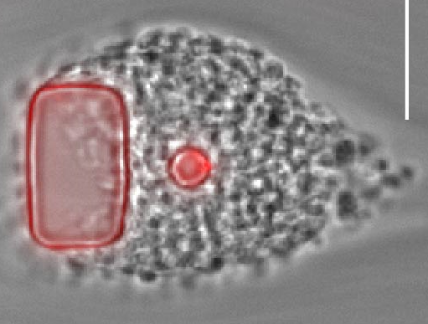
Microfluidic Platelet Function
Stalker et al. Blood. 2013;121(10):1875-1885)
Notes:
Shell and core model of hemostasis

Slide 32
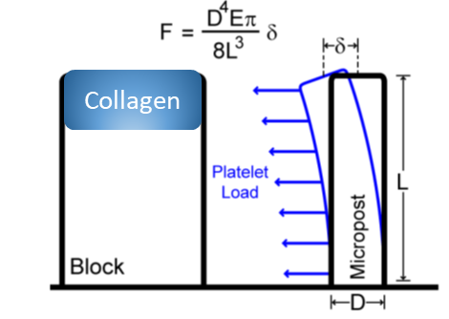
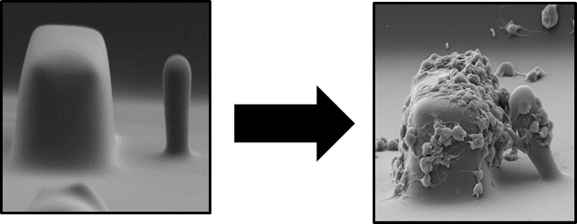
Shear-Induced Platelet Activation
Ting et al. Nat Commun. 2019 Mar 13;10(1):1204

Slide 33
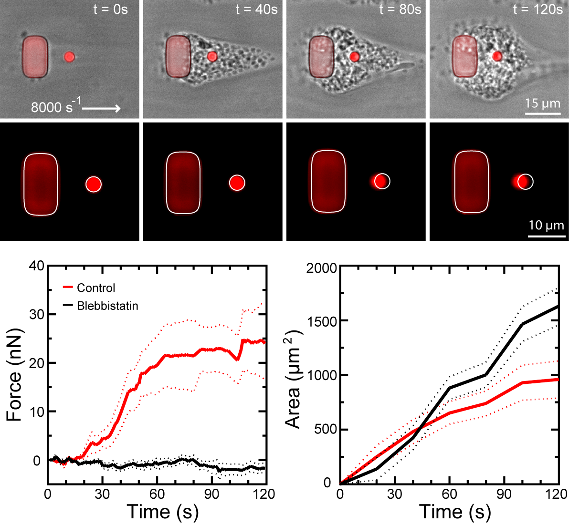
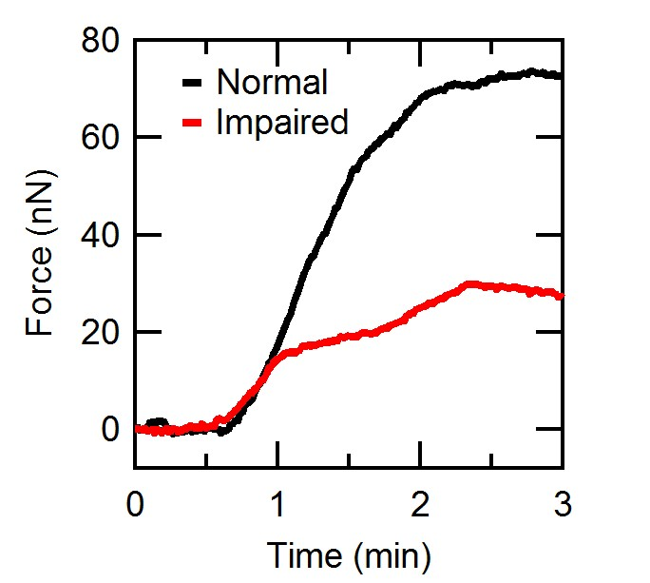
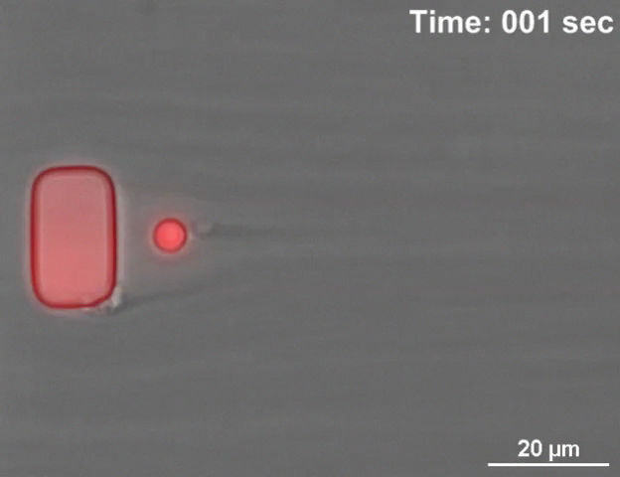
Microfluidic Platelet Forces
Optical Reading
Force Data

Slide 34
Microfluidic Platelet Forces after Trauma
Ting et al. Nat Commun. 2019 Mar 13;10(1):1204

Slide 35
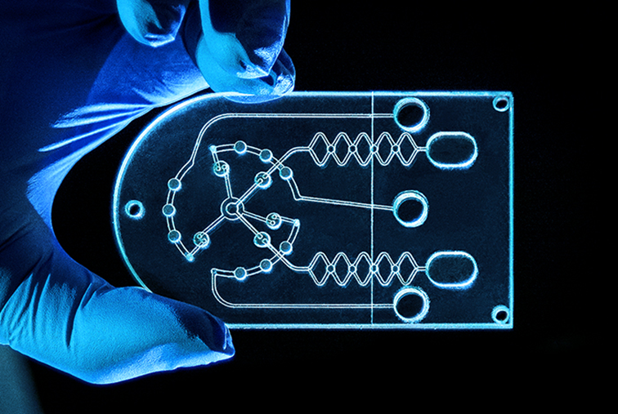
Microfluidics
Advantages
Disadvantages
Scale
Time
Flexibility
Multiplex
In Vivo
Reliability
Reproducibility
Manufacturing
Trauma relevance

Slide 36
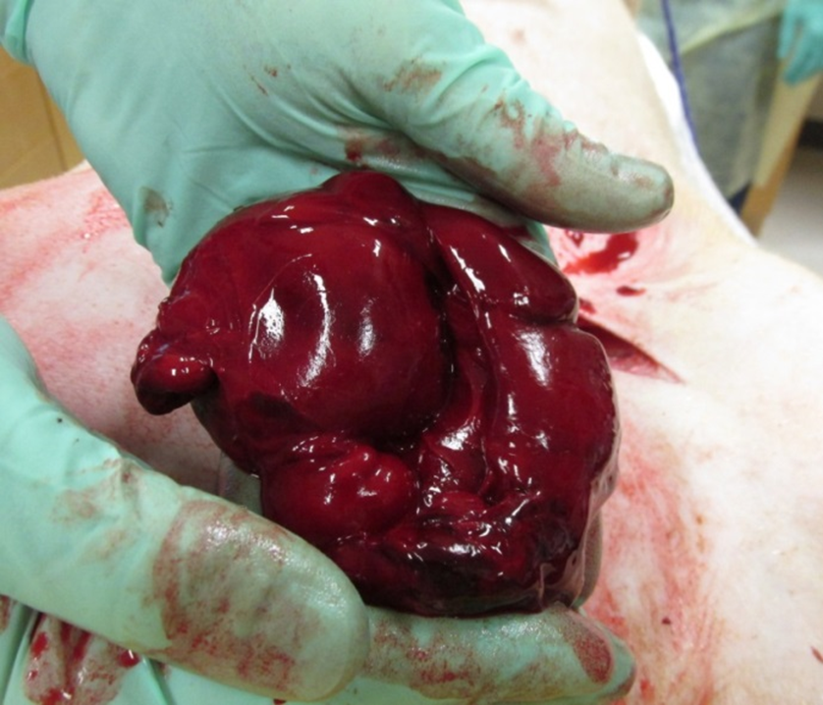
THANK YOU!

