Slide 1

THOR Case Presentation
From STRAC-istan

Slide 2
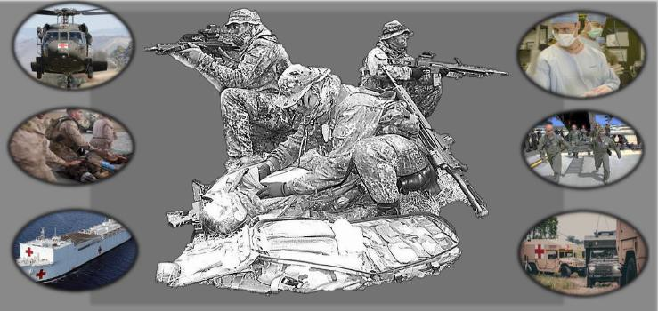
Patient Presentation
Medically Ready Force… Ready Medical Force

Slide 3
Del Rio, Texas (150mi from San Antonio)
Injury Summary
~0730
26 yo restrained female involved in collision with tree @ 55mph
Required extrication. Airbags deployed
GCS 8-10
Weak radial pulse
No advanced airway
Medically Ready Force… Ready Medical Force

Slide 4
Initial Hospital—Level 4 Trauma Center
Arrived @ 0758 (~30m post-injury)
Presents unresponsive, GCS 3
Pupils dilated 3-4mm, equal, sluggish. Bleeding from nares.
Decreased breath sounds bilaterally, ventilated with Ambu-bag
Distal pulses present. Distended abdomen. 3 large bore IVs in place.
Externally rotated R hip with shortened leg
Intubated with Rocuronium, 7.5mm ETT
Medically Ready Force… Ready Medical Force

Slide 5
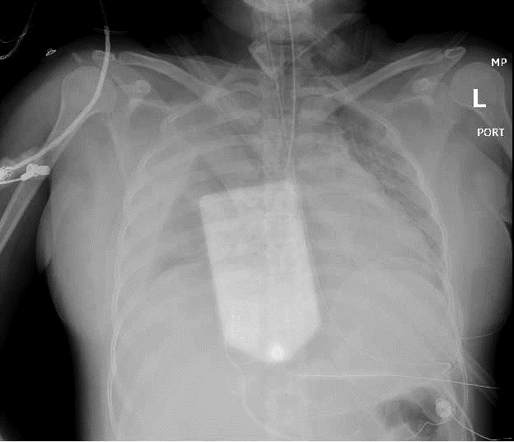


Initial Hospital—Level 4 Trauma Center
Initial CXR showing Right Hemothorax
(yellow arrow)
Chest tube placed with 1500cc immediate return
Medically Ready Force… Ready Medical Force
1

Slide 6
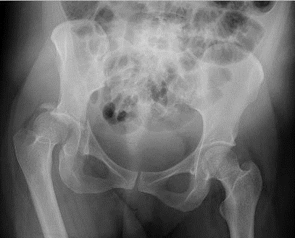
Initial Hospital—Level 4 Trauma Center
Initial AP Pelvis showing
right acetabulum fracture
(yellow arrow)
Right hip quickly reduced
Medically Ready Force… Ready Medical Force
1

Slide 7
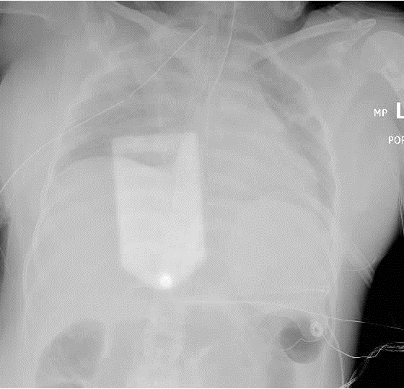
Initial Hospital—Level 4 Trauma Center
CXR s/p Right Chest tube
(yellow arrow)
with improved hemothorax
VS after placement:
SBP 131, HR 130, sat 96%
Proceeded to CT scan
Med
ically Ready Force… Ready Medical Force
1

Slide 8
Initial Hospital—Level 4 Trauma Center
CT Findings:
Brain normal, C-spine normal, T/L spine normal
Chest – proximal descending aorta dissection/pseudoaneurysm
Abd/pelvis –extravasation from left iliac vein, comminuted fx R acetabulum with sciatic nerve disruption
Face – nondisplaced orbital wall fx with intra- and peri-orbital emphysema
Medically Ready Force… Ready Medical Force

Slide 9
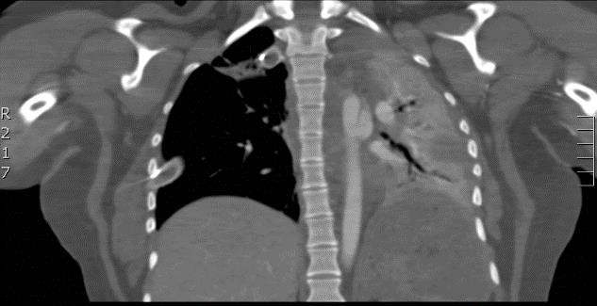
Initial Hospital—Level 4 Trauma Center
Aortic injury with Pseudoaneurysm
Hemothorax and left lung collapse with mediastinal shift to left
Medically Ready Force… Ready Medical Force
1

Slide 10
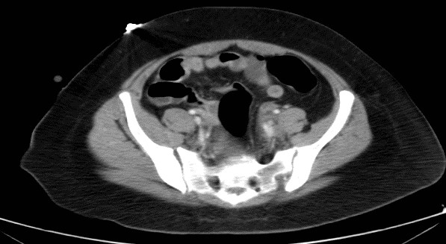
Initial Hospital—Level 4 Trauma Center
Left external iliac vein injury with adjacent hematoma
Medically Ready Force… Ready Medical Force
1

Slide 11
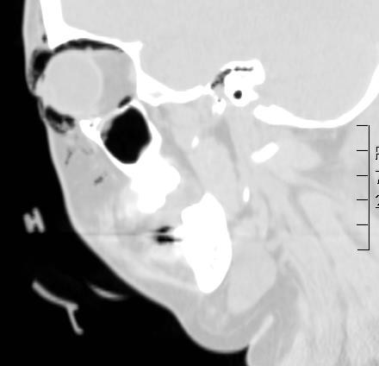
Initial Hospital—Level 4 Trauma Center
Orbital and periorbital emphysema
Medically Ready Force… Ready Medical Force
1

Slide 12
Initial Hospital—Level 4 Trauma Center
This level 4 trauma center cannot do thoracotomy.
Any advice for the level 4 docs?

Slide 13
Initial Hospital—Level 4 Trauma Center
Left chest tube placed w 250cc. Right chest tube output now at 4L
Call placed to Level 1 trauma center for transfer @ 0839
V tach leading to PEA during R IJ catheter placement
ROSC obtained after 1 cycle of CPR
Air Life team on scene @ 0905
PEA arrest again with AE crew present
Departure delayed to stabilize patient for flight (leaving at @1125)
Medically Ready Force… Ready Medical Force

Slide 14
Initial Hospital
Regional Medical Center ER:
Exhausted County O pos blood supply. Total 14u PRBC, 8u FFP
Hypotension improves with blood and vasopressors
Patient opened eyes and followed commands
MEDS: TXA, 4gm calcium, 2 amp epi, 4 amp bicarb, Levophed@ 15, Ancef, 70mg ketamine
This event highlighted need for a chest tube collection system that allows autotransfusion of hemothorax. This has been acquired
Medically Ready Force… Ready Medical Force

Slide 15
Initial Hospital
What do you think about autotransfusion from the chest tube collection chamber in this setting?

Slide 16
Interfacility Transfer
Air Life team departure @ 1125:
Place tibial I/O access for meds during flight
Last vital signs in ED: BP 132/81, HR 141, T94.1, O2 sat 96%
Erratic BP readings in flight but maintained strong carotid pulse
Given 5u WB during flight
Meds given: 450mg Ketamine, 500mcg fentanyl
Levofed 15 mcg/kg/min
67 minute flight time
Medically Ready Force… Ready Medical Force

Slide 17
Level 1 Trauma Center
ER, arrives @ 1253 (5 hrs post-injury):
BP 98/62, HR 125, RR 26, SpO2 95%. Levophed gtt at 15
Best GCS 7T, moves both arms, reaches for ET tube
FAST + for hemoperitoneum in 3 windows
CXR: large residual hemothorax on right
Total output from right chest tube ~ 4L
Moved to OR
Medically Ready Force… Ready Medical Force

Slide 18
Level 1 Trauma Center
OR:
Thoracotomy: Right azygous vein injury ligated
Laparotomy: Pelvic hematoma explored, left iliac vein ligated
  Left zone II hematoma undisturbed
  Temporary abdominal closure
Balanced resuscitation: 14 PRBC, 14 FFP, 2 platelets, 10 cryo
pH improved 6.9 to 7.25.
Medically Ready Force… Ready Medical Force

Slide 19
ICU
pH 7.25
Levofed 5 mcg/kg/min
Lactate 5.0
Next steps in resuscitation?

Slide 20
ICU
Over the next 2 hours, urine output is 40 cc
How do you respond?

Slide 21
Level 1 Trauma Center
VASCULAR OR (4 hours later):
Successful endograft landing distal to subclavian artery
Pulmonary compliance worsening with peak airway pressures >35
Oxygen saturations consistently <80%
Temporary loss of airway with tube exchange→cricothyroidotomy
Placed on venovenous ECMO at end of case. Moved to ECMO Unit
Medically Ready Force… Ready Medical Force

Slide 22
Level 1 Trauma Center
What can be done now for resuscitation to facilitate weaning from ECMO?

Slide 23
Level 1 Trauma Center
ECMO Unit (post-injury day 1):
Weaned to VC/AC 30% within 6 hours. Following commands, 11T
Returned to OR same day for fascial closure and oral intubation
Decannulated on post-injury day 2
Acetabulum repair post-injury day 8
Transferred to ward post-injury day 19
Discharged to acute rehab post-injury day 22
Medically Ready Force… Ready Medical Force

Slide 24
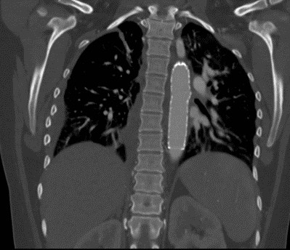
Level 1 Trauma Center
Outpatient CT Chest Angio:
1 month post-op
TEVAR in good position
No endoleak
Medically Ready Force… Ready Medical Force

Slide 25
Follow-up
Outpatient Follow-up:
Trauma Clinic, 6 weeks post-injury:
  Healed thoracotomy/laparotomy wounds→F/U w primary care
Ortho Clinic, 8 weeks post-injury:
  Toe-touch ambulation. Ankle-foot orthosis to avoid contracture
  Neuropathic pain to foot. Off all narcotic pain meds
Medically Ready Force… Ready Medical Force

Slide 26

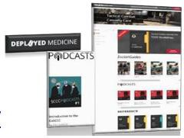
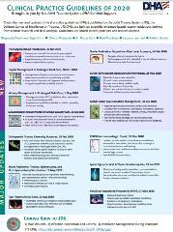
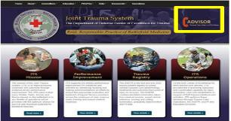
JTS Website
Deployed Medicine
http://jts.amedd.army.mil/
Policy and Official Activities
CPGs & training slides
Emergency War Surgery Course slides
Forms, documents
Trauma Resources
PI Hot Topics
COVID Resources
https://deployedmedicine.com/
Training & EducationResource
TCCC curriculum andresources
Updated videos, podcasts, and resources
Download CPGs to your smartphone
COVID Resources and conference podcasts
Medically Ready Force… Ready Medical Force

