Slide 1
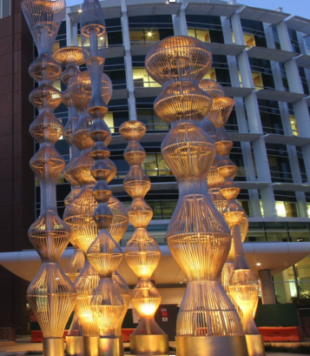

Platelet Defects with Trauma
Platelet Defects with Trauma
Lucy Zumwinkle Kornblith, MD, FACS
Assistant Professor of Surgery
Assistant Professor of Laboratory Medicine
Trauma Surgery and Surgical Critical Care
University of California, San Francisco
Zuckerberg San Francisco General Hospital
Notes:
Good afternoon, my name is Lucy Kornblith, and I am an Assistant Professor of Surgery and of Laboratory Medicine at the University of California, San Francisco. My clinical practice is as a trauma surgeon and intensivist, and my research is primarily focused on the translational study of post-injury platelet biology.
I want to express my gratitude to the THOR Steering Committee for the true honor and privilege of being here and getting to talk about the state of the field of post-injury platelet dysfunction AND →function amongst so many in this room who have pioneered what we understand today

Slide 2
Disclosures
Funding:
  NIH, NIGMS & NHLBI
  DOD
  University of California, San Francisco
Consulting:
  Cerus Corporation
  University of Maryland/BARDA
  Gamma Diagnostics
Notes:
My disclosures are funding and scientific consulting related, but I will not specifically discuss anything I advise on today

Slide 3
Platelets
Selected
Weyrich, A. S. & Zimmerman, G. A. Platelets:signaling cells in the immune continuum. Trends Immunol. 25, 489–495 (2004).
Rondina, M. T., Weyrich, A. S. & Zimmerman, G. A. Platelets as cellular effectors of inflammation in vascular diseases. Circ. Res. 112, 1506–1519 (2013).
Nachman, R. L. & Rafii, S. Platelets, petechiae, and preservation of the vascular wall. N. Engl. J. Med. 359, 1261–1270 (2008)
Hoffman, M. & Monroe, D. M. III A cell- based model of hemostasis. Thromb. Haemost. 85, 958–965 (2001).
Kutcher, M. E. et al. Characterization of platelet dysfunction after trauma. J. Trauma Acute Care Surg. 73, 13–19 (2012).
Tweardy, D. J. et al. Essential role for platelets in organ injury and inflammation in resuscitated hemorrhagic shock. Shock 26, 386–390 (2006).
Ding, N. et al. Toll- like receptor 4 regulates platelet function and contributes to coagulation abnormality and organ injury in hemorrhagic shock and resuscitation. Circ. Cardiovasc. Genet. 7, 615–624 (2014).
Subcellular, anucleate
Biologically active:
  hemostasis
  endothelial health
  immune function
Appreciation of platelet role in injury intensified with the cell-based model of hemostasis
Qualitative changes in human and animal models of injury
Notes:
First, it is important to recognize that despite being subcellular and anucleate, platelets are biologically dynamic in coordinating
hemostasis, endothelial health and immune function
Interest in the role of platelets in trauma-induced coagulopathy (TIC) or blood failure really intensified following Dr. Hofmann and her colleagues describing the cell- based model of haemostasis in 2001
And since then
→About 20 years of subsequent evidence has supported the Rare presence of quantitative abnormalities and the VERy common presence of qualitative abnormalities in
platelet function in both human and animal models of TIC.
This has been primarily centered on the hemostatic aspects of platelet function and associated hypocoagulable states, but it must be recognized that the secondary platelet functions related to endothelial and immune function are also an ever-growing focus that I am certain Dr. Neal will talk about related to thromboinflammation this afternoon

Slide 4
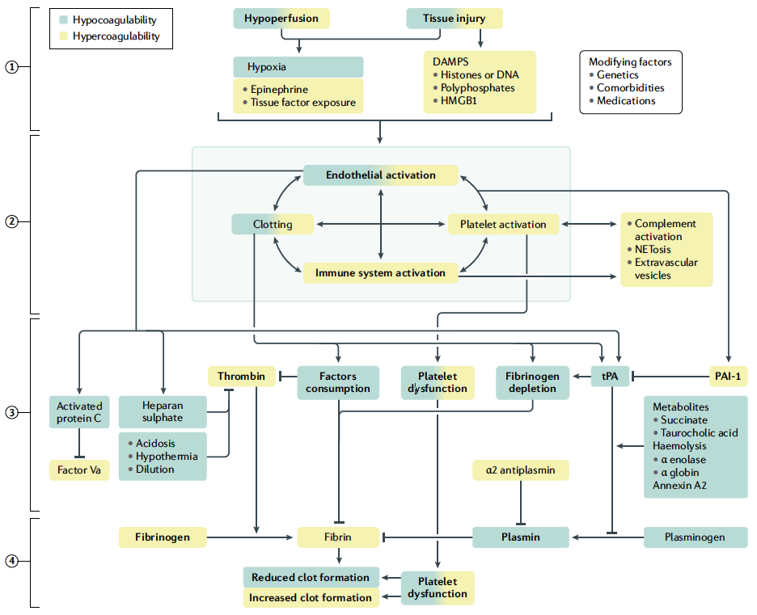
Moore EE, Moore HB, Kornblith LZ, Neal MD, Hoffman M, Mutch NJ, Schöchl H, Hunt BJ, Sauaia A. Trauma-induced coagulopathy. Nat Rev Dis Primers. 2021 Apr 29;7(1):30.(2021).
Notes:
Now, functionally, both →platelet activation and →platelet dysfunction have been well described in the injury literature, seen in up to 50% of injured patients, however the story of post-injury platelet function and biology is of course so much more complicated than just activation or dysfunction or in Pat Thompson’s words from yesterday, “of unimaginable compledity”

Slide 5
Post-injury platelet behavior
Selected
Jacoby RC, Owings JT, Holmes J, Battistella FD, Gosselin RC, Paglieroni TG. Platelet activation and function after trauma. J Trauma. 2001 Oct;51(4):639-47
Kornblith, L. Z. et al. Fibrinogen and platelet contributions to clot formation: implications for trauma resuscitation and thromboprophylaxis. J. Trauma Acute Care Surg. 76, 255–256; Discussion 262–263 (2014).
Zipperle, J. et al. Potential role of platelet- leukocyte aggregation in trauma- induced coagulopathy: ex vivo findings. J. Trauma Acute Care Surg. 82, 921–926 (2017).
Dunbar NM, Chandler WL. Thrombin generation in trauma patients. Transfusion. 2009;49:2652–60.
Starr, N. E. et al. Identification of injury and shock driven effects on ex- vivo platelet aggregometry: a cautionary tale of phenotyping. J. Trauma Acute Care Surg. 89, 20–28 (2020).
Kornblith, L. Z. et al. Perhaps it’s not the platelet:
ristocetin uncovers the potential role of von Willebrand factor in impaired platelet aggregation following traumatic brain injury. J. Trauma Acute Care Surg. 85, 873–880 (2018).
Plautz, W. E. et al. Von Willebrand factor as a thrombotic and inflammatory mediator in critical illness. Transfusion 60, S158–S166 (2020).
Moore, H. B. et al. Shock induced systemic hyperfibrinolysis is attenuated by plasma first resuscitation. J. Trauma Acute Care Surg. 79, 897–903; discussion 903–904 (2015).
Thrombocytopenia associated with bleeding
Majority with initial normal platelet counts
Increased markers of activation
Increased platelet contribution to clot strength
Increased pro-coagulant factor release
Impaired aggregation responses ex-vivo
Platelet exhaustion?
Notes:
In aggregate, the evidence supports that quantitative consumptive and dilutional thrombocytopenia are unsurprisingly independently associated with bleeding. However, the vast majority of the time, injured and hemorrhaging patients have initial normal platelet counts
And, there is evidence of →activated and functioning platelets, measured by surface and cellular markers of activation
AND downstream hemostatic effects of platelet activation, like
→increases in platelet contribution to clot strength, and
→the release of very procoagulant factors from platelets, like THROMBIN
However, despite this evidence of increased platelet activation and appropriate pro-hemostatic platelet functional phenotypes
→patients with TIC are ALSO identified to have high rates of paradoxically impaired platelet aggregation when the platelets are measured ex-vivo, often TERMED platelet dysfunction, though it remains unclear whether that term DYSFUCNTION adequately describes the platelet biologic phenotype of trauma
There is some evidence and associated hypotheses from many that this impaired aggregation response ex-vivo may be due to → a concept of ‘platelet exhaustion’. The theory that due to injury and shock driven massive endothelial release of tissue factor, platelet activating factor, vWF, etc platelets are activated beyond what is needed for primary haemostasis at local sites of injury, thereby creating a pool of circulating platelets that are ‘spent’ or exhausted following the release of their procoagulant and anticoagulant factors.
As such, the thought is that when we then sample and measure these, PERHAPS they cannot respond to stimulation
Now, although this theory may explain the biologic findings, it is important to recognize that the evidence of platelet exhaustion remains primarily associative at this time, and not conclusive.

Slide 6
Clinical associations
Selected
Jacoby RC, Owings JT, Holmes J, Battistella FD, Gosselin RC, Paglieroni TG. Platelet activation and function after trauma. J Trauma. 2001;51(4):639-647.
Kutcher ME, Redick BJ, McCreery RC, et al. Characterization of platelet dysfunction after trauma. J Trauma Acute Care Surg. 2012;73(1):13-19.
Kornblith, L. Z. et al. It’s about time: transfusion
effects on postinjury platelet aggregation over time.
J. Trauma Acute Care Surg. 87, 1042–1051 (2019).
Solomon C, Traintinger S, Ziegler B, et al. Platelet function following trauma. Thromb Haemost. 2011;106(08):322-330.
Sirajuddin S. Inhibition of platelet function is common following even minor injury. J Trauma Acute Care Surg. 2016;81(2):328-332.
Vulliamy, P. et al. Platelet transfusions reduce
fibrinolysis but do not restore platelet function during
trauma hemorrhage. J. Trauma Acute Care Surg. 83,
388–397 (2017).
Fields, A. T. et al. Good platelets gone bad: the effects
of trauma patient plasma on healthy platelet
aggregation. Shock 55, 189–197 (2021).
Holcomb JB, Tilley BC, Baraniuk S, et al. Transfusion of Plasma, Platelets, and Red Blood Cells in a 1:1:1 vs a 1:1:2 Ratio and Mortality in Patients With Severe Trauma: The PROPPR Randomized Clinical Trial. JAMA. 2015;313(5):471.
Cardenas JC, Zhang X, Fox EE, et al. Platelet transfusions improve hemostasis and survival in a substudy of the prospective, randomized PROPPR trial. Blood Adv. 2018;2(14):1696-1704.
Henriksen HH, Grand AG, Viggers S, et al. Impact of blood products on platelet function in patients with traumatic injuries: a translational study. J Surg Res. 2017;214:154 161.
Impaired platelet aggregation in:
  mild injury
  brain injury
  severe injury
  with and without TIC
Variable associations with poor outcomes
Platelet transfusion:
  improves outcomes
  does not resolve impaired ex-vivo aggregation
Notes:
Now, additionally, we have to understand the clinical findings that have been identified in association with the ex vivo impairments in platelet aggregation
First, these ex-vivo impairments in platelet aggregation are identified in up to half of injured patients REGARDLESS of severity of injury, and in patients both with and without hemorrhage, shock, and a clinical coagulopathy
Further, →there have been variable associations with poor outcomes and not all patients who present with evidence of impaired platelet aggregation responses go on to fair poorly
and
→Data suggest that despite improvements in outcomes with platelet transfusion for hemorrhaging trauma patients, the acquired ex-vivo platelet aggregation impairments that are identified may not actually be reversed by transfusion of platelets
SO PUTTING all of that together, suggests to us that NOT all identified impairments in ex vivo platelet aggregation are maladaptive.
There are many hypotheses to why this is …. it may be related to issues with how we measure function of platelets in ex-vivo environments, or it may be that there are many phenotypes of platelet function dependent on degrees of injury and shock, highlighted by Dr. Moore yesterday when he mentioned heterogenous biologic response to trauma. Although these areas are controversial, I think most CAN AGREE that
Pursuing mechanistic and molecular understandings is important as we try to untangle the biology and determine whether what is being identified is adaptive or maladaptive in nature, or perhaps both, whether it requires specific treatment, and what that treatment should be.

Slide 7
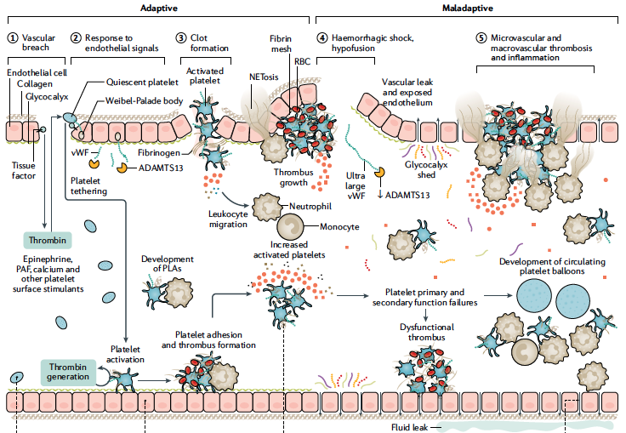
Moore EE, Moore HB, Kornblith LZ, Neal MD, Hoffman M, Mutch NJ, Schöchl H, Hunt BJ, Sauaia A. Trauma-induced coagulopathy. Nat Rev Dis Primers. 2021 Apr 29;7(1):30. doi: 10.1038/s41572-021-00264-3. Erratum in: Nat Rev Dis Primers. 2022 Apr 22;8(1):25.
Selected:
Ding, N. et al. Toll- like receptor 4 regulates platelet function and contributes to coagulation abnormality and organ injury in hemorrhagic shock and resuscitation. Circ. Cardiovasc. Genet. 7, 615–62 (2014).
Vogel, S. et al. Platelet- derived HMGB1 is a critical mediator of thrombosis. J. Clin. Invest. 125, 4638–4654 (2015).
Li, R., Elmongy, H., Sims, C. & Diamond, S. L. Ex vivo recapitulation of trauma- induced coagulopathy and preliminary assessment of trauma patient platelet function under flow using microfluidic technology. J. Trauma Acute Care Surg. 80, 440–449 (2016).
Colace, T. V., Jobson, J. & Diamond, S. L. Relipidated tissue factor linked to collagen surfaces potentiates platelet adhesion and fibrin formation in a microfluidic model of vessel injury. Bioconjug Chem. 22, 2104–2109 (2011).
Neeves, K. B. et al. Microfluidic focal thrombosis model for measuring murine platelet deposition and stability: PAR4 signaling enhances shear- resistance of platelet aggregates. J. Thromb. Haemost. 6, 2193–2201 (2008).
Vulliamy, P. et al. Histone H4 induces platelet ballooning and microparticle release during trauma hemorrhage. Proc. Natl Acad. Sci. USA 116, 17444–17449 (2019).
?
Notes:
SO, what has been identified so far on a mechanistic and molecular level?
Well, first, that platelets are responding normally to the physiologic signals of injury
→ Surface stimulation with thrombin and other stimulants leads to
→platelet activation, AND autocrine stimulated→ additional thrombin generation
Resulting in→ procoagulant calcium mobilization, structural changes,
factor degranulation, phosphatidylserine exposure and glycoprotein receptor
conformational changes
ALL of that described in TRAUMA
AND
Secondarily, →activated platelets recruit leukocytes to local environments.
And release trophogens, →to stabilize the endothelium
However, suspected maladaptive mechanisms have also been identified with →primary and secondary platelet function failures.
characterized by altered and shed glycoproteins, impaired calcium signaling, altered granule content, and loss of trophogenesis with endothelium,
LEADING to promotion of a procoagulant and pro- inflammatory milieu with increased circulating platelet–leukocyte aggregates , recruitment of monocytes, NET formation →attachment of histones to platelets and procoagulant platelet ballooning, circulating DAMPS → as well as derangements in the ADAMTS13 axis as we just heard about from Dr. Juffermans
And all of these pro- inflammatory mechanisms have been identified in association with early failures in platelet haemostasis and later Hypercoagulability, and development of →micro- thrombosis and macrothrombosis
BUT, what causes → THIS transition from ADAPTIVE to proposed MALADAPTIVE platelet behavior in injury is not clear and MAY be one of the keys to understanding ultimately WHICH trauma patients will develop a maladaptive platelet phenotype and perhaps even who needs treatment and what that personalized treatment should be-do they get the purple or green injector from yesterday?
So, I want to share just a little bit of data working to understand what may be contributing to this transition

Slide 8
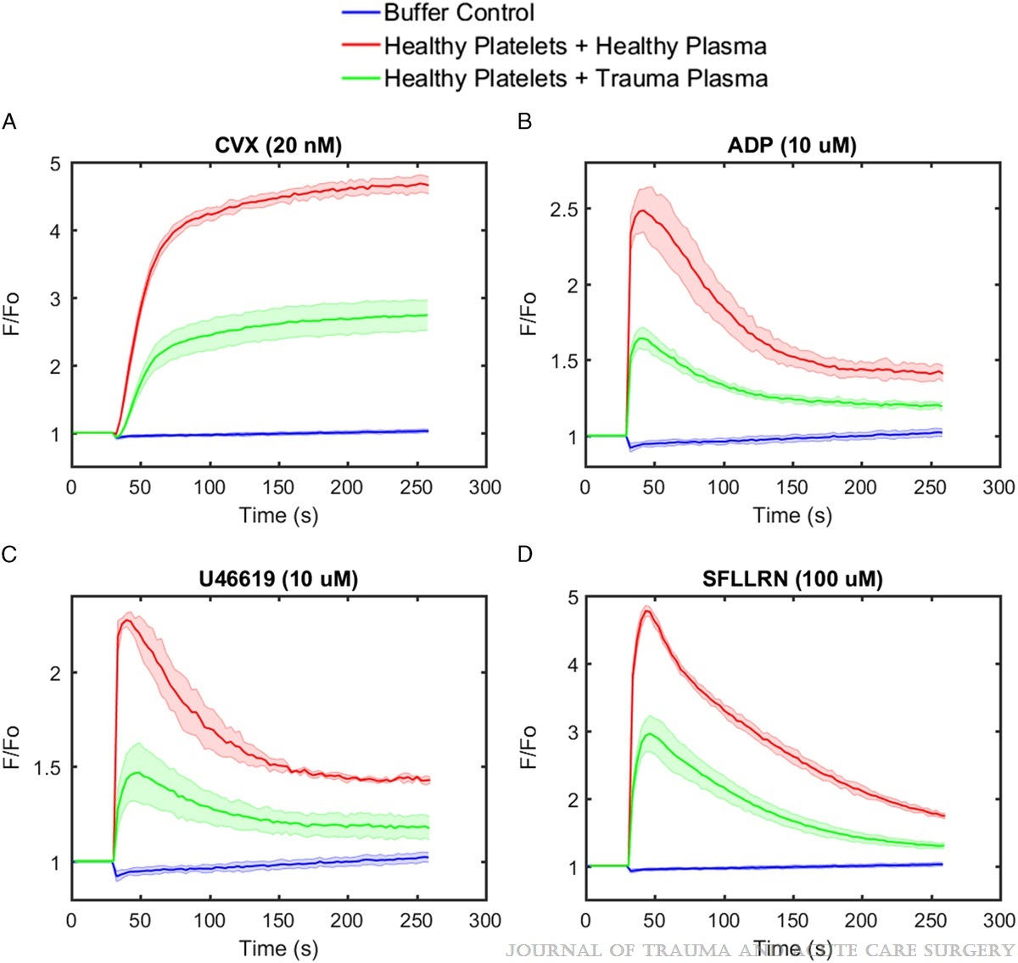
Verni CC, Davila A Jr, Balian S, Sims CA, Diamond SL. Platelet dysfunction during trauma involves diverse signaling pathways and an inhibitory activity in patient-derived plasma. J Trauma Acute Care Surg. 2019 Feb;86(2):250-259.16).
Notes:
In 2019 Dr. Scott Dimond and colleagues elegantly demonstrated that healthy donor platelets have a reduction in CALCIUM MOBILIZATION (which of course is central to platelet functional behavior, when treated with trauma patient-derived plasma. Healthy platelets were incubated in plasma systems and exposed to platelet stimulants. Compared to treatment with healthy plasma, which you see in the red line, there was a →50% reduction in calcium mobilization in response to all stimulants tested when treated with trauma patient derived plasma in the green line
Suggesting the potential presence of circulating soluble inhibitors of platelets present in the trauma patient plasma
And this is not a concept isolated to platelet cellular function. Other groups like Dr. Cohen and many in this room who have studied endothelial cell biology have demonstrated evidence of soluble plasma effects on endogenous cellular function, specific to ENDOTHELIAL cells in the microvascular environment of injury
So, we further explored the effects of the circulating soluble microvascular environment of injury on platelet FUNCTIONAL BEHAVIOR beyond calcium mobilization
----
→Collagen,
→adenosine diphosphate,
→thromboxane A2, and
→thrombin.

Slide 9
Thrombin stimulation
Healthy
Uninjured
Mild injury/no shock
Mild injury/shock
Severe injury/no shock
Sever injury/shock
Plasma
Impedance
-80⁰C Storage
AUC
Healthy
Baseline
Platelets
Multiplate
Aggregometry
Time (Min)
Starr, N. E. et al. Identification of injury and shock driven effects on ex- vivo platelet aggregometry: a cautionary tale of phenotyping. J. Trauma Acute Care Surg. 89, 20–28 (2020).
Fields AT, Matthay ZA, Nunez-Garcia B, Matthay EC, Bainton RJ, Callcut RA, Kornblith LZ. Good Platelets Gone Bad: The Effects of Trauma Patient Plasma on Healthy Platelet Aggregation. Shock. 2021 Feb 1;55(2):189-197.
Notes:
AND, based on prior investigations demonstrating that the DEGREE of injury and presence of shock are associated with different phenotypes of platelet functional impairments, we treated
->platelets isolated from healthy donors
→With plasmas that came from healthy, uninjured, and trauma patients with varying degrees of injury and shock
→And then we measured their aggregation behavior to thrombin stimulation

Slide 10
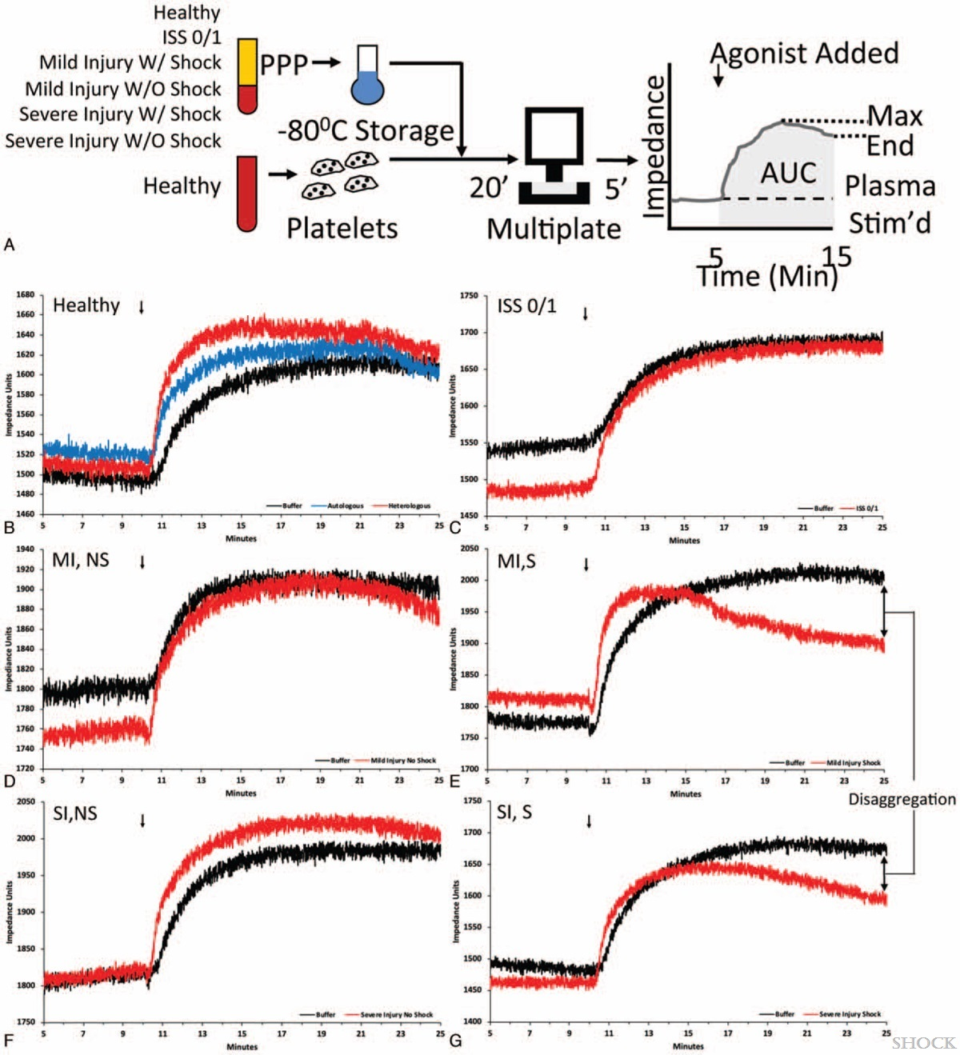
Fields AT, Matthay ZA, Nunez-Garcia B, Matthay EC, Bainton RJ, Callcut RA, Kornblith LZ. Good Platelets Gone Bad: The Effects of Trauma Patient Plasma on Healthy Platelet Aggregation. Shock. 2021 Feb 1;55(2):189-197.
Notes:
And we found was that Platelets treated with→ HT Buffer, the black line, autologous healthy plasma, the blue line, or heterologous healthy plasma the red line in this panel all behaved similarly in aggregation
As did → platelets treated with plasma from trauma patients found to be uninjured (ISS of 0 or 1) the red line in this panel AND→ those with mild and severe injury but NO SHOCK, the red lines
However, →platelets treated with plasma from trauma patients with SHOCK regardless of degree of injury
had significantly impaired thrombin-stimulated aggregation responses compared with platelets treated with plasma from patients without shock (P = 0.002).
And you can see they particularly had this interesting pattern of disaggregation
Interestingly, it also appeared that the platelets treated with plasma from patients with severe injury, but without shock in the bottom left panel, ACTUALLY had →amplified aggregation in response to thrombin stimulation (P = 0.030).
-------------

Slide 11
Fields AT, Matthay ZA, Nunez-Garcia B, Matthay EC, Bainton RJ, Callcut RA, Kornblith LZ. Good Platelets Gone Bad: The Effects of Trauma Patient Plasma on Healthy Platelet Aggregation. Shock. 2021 Feb 1;55(2):189-197.
Notes:
So the results that Dr. Diamond and colleagues saw with calcium mobilization suggesting that soluble plasma mediators may downregulate platelets during trauma were confirmed in our functional data
BUT ADDITIONALLY we found that these effects are likely → SHOCK-mediated. Shock states may lead to circulating inhibitors of platelets that prime platelets for hypoaggregatory responses
WHEREAS
tissue injury-mediated soluble factors may actually→ lead to circulating activators of platelets that prime platelets for hyperaggegatory responses
OF COURSE, These findings may have relevance in traumatic hemorrhage and shock given if there are soluble inhibitors of endogenous circulating platelets, they may also inhibit the responses of transfused platelets which COULD explain the body of clinical data demonstrating an overall lack of improvement in platelet aggregation measures following platelet transfusion in trauma patients
AND is another example of what Dr. Cap described yesterday related to how BAD shock is on the microvascular environment and cellular dysfunction

Slide 12
Post-injury platelet biology
What we know
What we don’t know
Platelet counts normal
Increased levels of activated platelets
Ex-vivo platelet aggregatory function is impaired
Identified in TBI, severe injury, AND also MILD injury
Multiple pathways potentially contribute:
  altered & shed glycoprotein VI and glycoprotein Ibα surface receptors
  histone driven platelet structural changes
  changes in the von-Willebrand factor-platelet axis
  impaired calcium signaling
  circulating soluble inhibitors and activators
  and others…
Adaptive or maladaptive?
Defined biology explained by ex-vivo assays?
Requires treatment?
What is the treatment?
Notes:
So, to recap a bit, in most hemorrhaging patients with TIC
Initial platelet counts are normal,
there is evidence of platelet activation and hemostatic platelets
BUT, despite this, impaired platelet aggregation ex vivo is common, YET ALSO SEEN in injured patients who DO NOT HAVE blood failure or TIC
And multiple pathways have been identified in association with platelet hemostatic failures including
altered & shed glycoprotein VI and glycoprotein Ibα surface receptors
histone driven platelet structural changes
changes in the von-Willebrand factor-platelet axis
impaired calcium signaling
circulating soluble inhibitors
Amongst others
But, →there remains a lot that we don’t know including →whether THE biology is truly pathologic and maladaptive or likely on a spectrum, →whether the platelet dysfunction identified throughout the literature is primarily an issue with ex-vivo measurements,
→whether this identified dysfunction needs treatment, and if it does,
→what the right therapeutic is

Slide 13
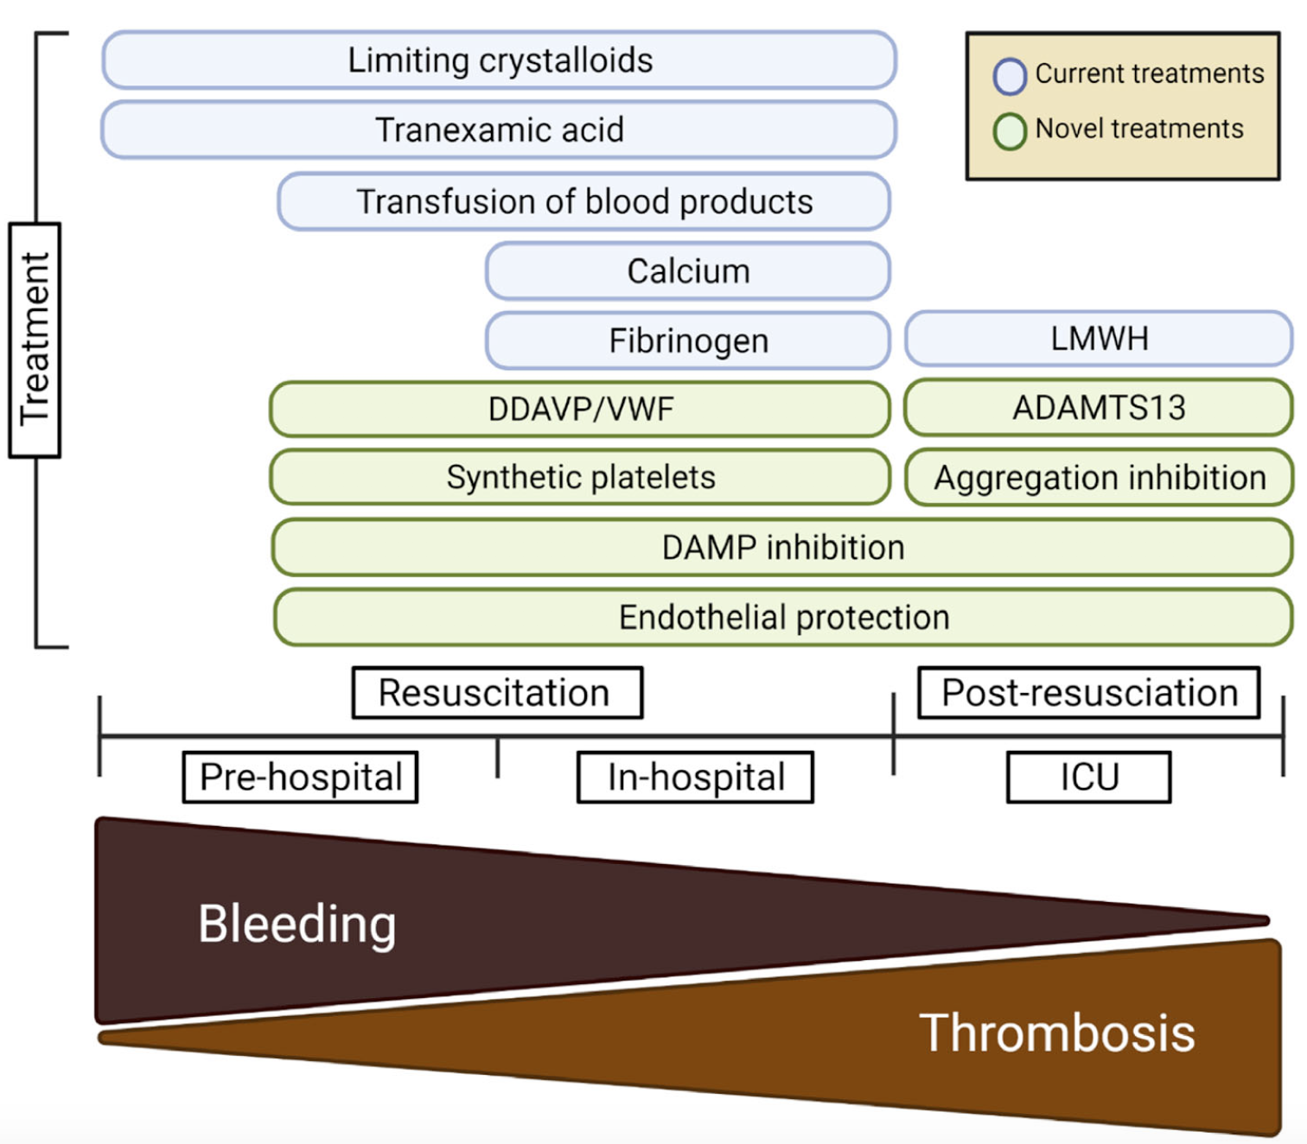
Sloos PH, Vulliamy P, van 't Veer C, Gupta AS, Neal MD, Brohi K, Juffermans NP, Kleinveld DJB. Platelet dysfunction after trauma: From mechanisms to targeted treatment. Transfusion. 2022 Jun 24. Epub ahead of print. PMID: 35748694.
Notes:
And this is important to figureout because there is a lot happening with novel therapeutics on the platelet-axis → targeting many of these areas involved in maladaptive platelet behavior.
For those interested, I would recommend this hot of the press review in Transfusion published last month by some of our colleagues here today focused on platelet dysfunction after trauma from mechanisms to targeted treatments
But, this review also highlighted for ME something else of significant importance WHICH is how WE as a community have primarily characterized platelet behavior up to now, by taking platelets from circulation and measuring their responses in functional ex-vivo assays of activation, aggregation, and adhesion, or by measuring secondary evidence of function
(like through soluble markers of platelet activation. )

Slide 14
Post-injury platelet biology
What we know
What we don’t know
Platelet counts normal
Increased levels of activated platelets
Ex-vivo platelet aggregatory function is impaired
Identified in TBI, severe injury, AND also MILD injury
Multiple pathways potentially contribute:
  altered & shed glycoprotein VI and glycoprotein Ibα surface receptors
  histone driven platelet structural changes
  changes in the von-Willebrand factor-platelet axis
  impaired calcium signaling
  circulating soluble inhibitors
  and others…
Adaptive or maladaptive?
Defined biology explained by ex-vivo assays?
Requires treatment?
What is the treatment?
Notes:
But I THINK to get at these unanswered questions about post-injury platelet biology, exploring them through alternative methods is likely IMPORTANT. For example,
going further upstream to the platelet transcriptome and how the platelet trascriptome is edited in trauma may help us answer some unanswered questions

Slide 15
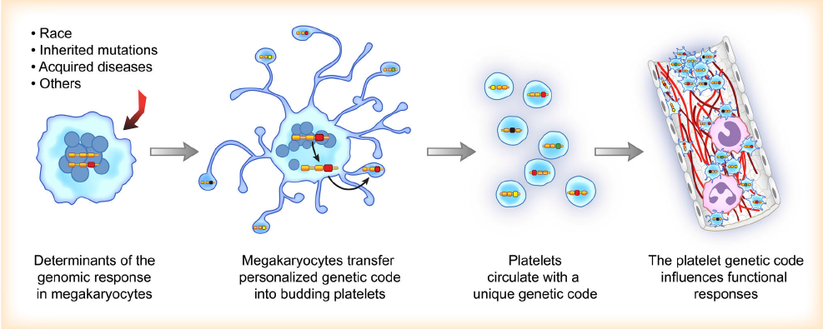
PHYSIOLOGIC SIGNAL
Schwertz et al (2006). J Exp Med
Weyrich et al. (2004) Semin Thromb Hemost
Nassa et al. (2018). Sci Re
Bray et al (2013). BMC Genomics
Rondina et al (2015). J Thromb Haemost
Notes:
Of course, platelets do not transcribe genes de novo because they are anucleate, BUT
they DO carry messenger RNA from →megakaryocytes
→to code for functional proteins for all their responsibilities: adhesion, aggregation, secretion, immune regulation, etc
AND, what is particularly remarkable is that there is evidence that-->CHANGING physiology,
Can take that genetic code in circulating platelets AND INDUCE →RNA editing specific to the physiologic signal for a TAILORED downstream response

Slide 16
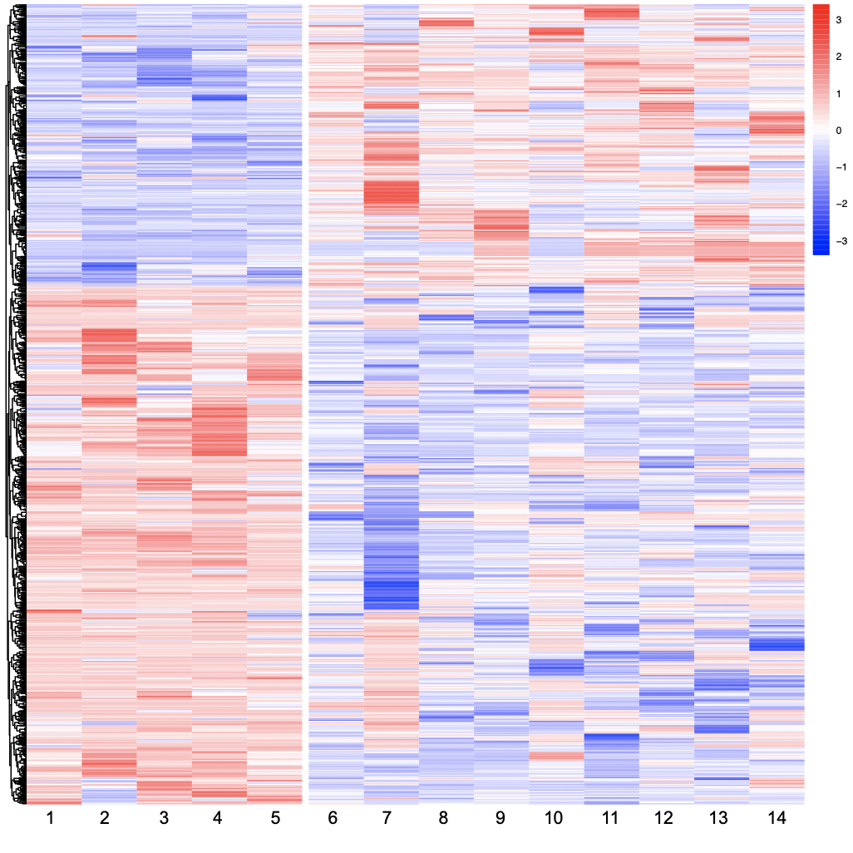
Fields AT, Lee MC, Mayer F, Santos YA, Bainton CMV, Matthay ZA, Callcut RA, Mayer N, Cuschieri J, Kober KM, Bainton RJ, Kornblith LZ. A new trauma frontier: Exploratory pilot study of platelet transcriptomics in trauma patients. J Trauma Acute Care Surg. 2022 Feb 1;92(2):313-322. PMID: 34738997
Healthy
Trauma
Notes:
And, if you look at this heat map of platelet RNA editing signatures (which is specifically showing differential alternative splicing signatures, a process of RNA editing) in →healthy donors on the left compared to → a small sampling of trauma patients on the right you can see that there is relatively →uniform PLATELET RNA editing in the healthy donors, and unsurprisingly a →higher degree of heterogeneity in platelet RNA editing across the trauma patients AGAIN clearly highlighting the importance of understanding the heterogenous biologic response to trauma
-------
A) Heat map showing discovery of differential alternative splicing of platelet RNA in healthy donors (left) versus trauma patients (right). Blue corresponds to decreased inclusion ratio and red corresponds to increased inclusion ratio for each splicing event. In total 1188 differential alternative splicing events across 691 platelets genes passed a FDR cutoff of <0.001. B) Unsupervised principal component analysis reduced the differential alternative splicing data into two components explaining 16.85% and 38.43% of the data, respectively. Despite being unsupervised, healthy donor samples clustered together in Group 1, patients suffering from blunt injuries clustered together in Group 2, and patients suffering from penetrating injuries clustered together in Group 3. PC, principal component. C) Selected pathways from Gene Ontology enrichment analysis which are overrepresented among the platelet genes found to have differential alternative splicing between healthy donors and trauma patients, along with their FDR. Discovered pathways involve many common functions of platelets, including both coagulation and immune responses.

Slide 17
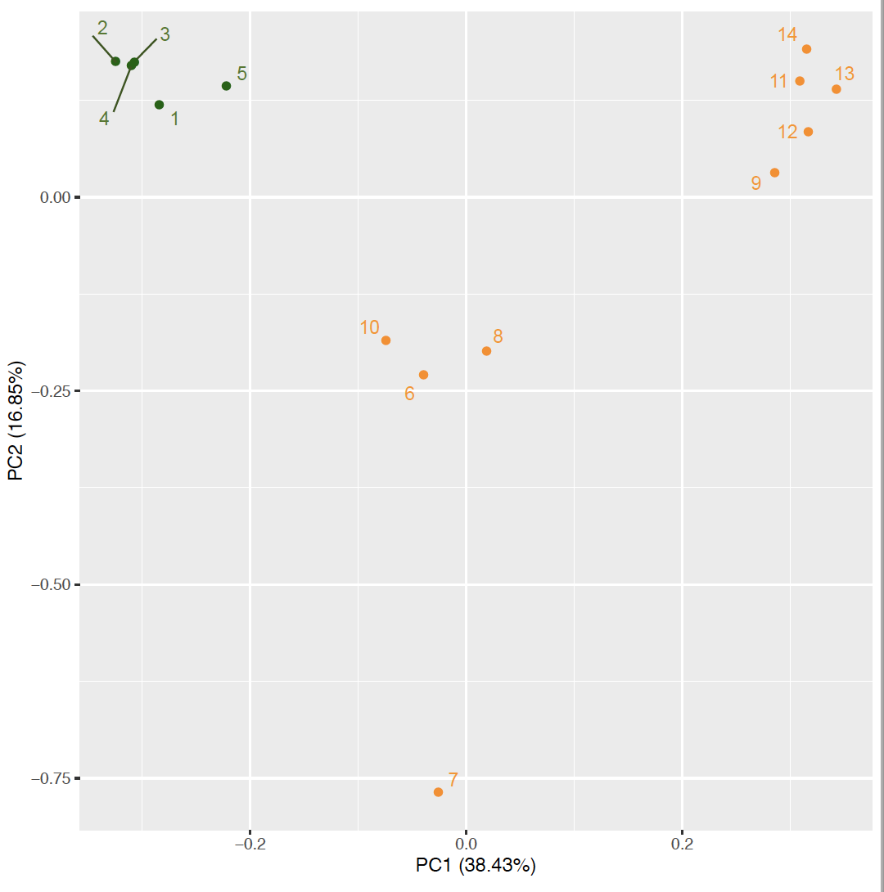
Healthy
Penetrating
Blunt
Fields AT, Lee MC, Mayer F, Santos YA, Bainton CMV, Matthay ZA, Callcut RA, Mayer N, Cuschieri J, Kober KM, Bainton RJ, Kornblith LZ. A new trauma frontier: Exploratory pilot study of platelet transcriptomics in trauma patients. J Trauma Acute Care Surg. 2022 Feb 1;92(2):313-322. PMID: 34738997
Notes:
BUT, what was interesting about these platelet RNA editing signatures is that using unsupervised principal components analysis….outside of →THIS 1 outlier trauma patient at the bottom, three very distinct tight clusters of platelet RNA editing signatures formed along the first two principal components
Which perfectly corresponded to →healthy donors, →trauma patients with blunt injury, and →trauma patients with penetrating injury
------
explaining nearly 17% and 39% of the data, respectively
-------
A) Heat map showing discovery of differential alternative splicing of platelet RNA in healthy donors (left) versus trauma patients (right). Blue corresponds to decreased inclusion ratio and red corresponds to increased inclusion ratio for each splicing event. In total 1188 differential alternative splicing events across 691 platelets genes passed a FDR cutoff of <0.001. B) Unsupervised principal component analysis reduced the differential alternative splicing data into two components explaining 16.85% and 38.43% of the data, respectively. Despite being unsupervised, healthy donor samples clustered together in Group 1, patients suffering from blunt injuries clustered together in Group 2, and patients suffering from penetrating injuries clustered together in Group 3. PC, principal component. C) Selected pathways from Gene Ontology enrichment analysis which are overrepresented among the platelet genes found to have differential alternative splicing between healthy donors and trauma patients, along with their FDR. Discovered pathways involve many common functions of platelets, including both coagulation and immune responses.

Slide 18
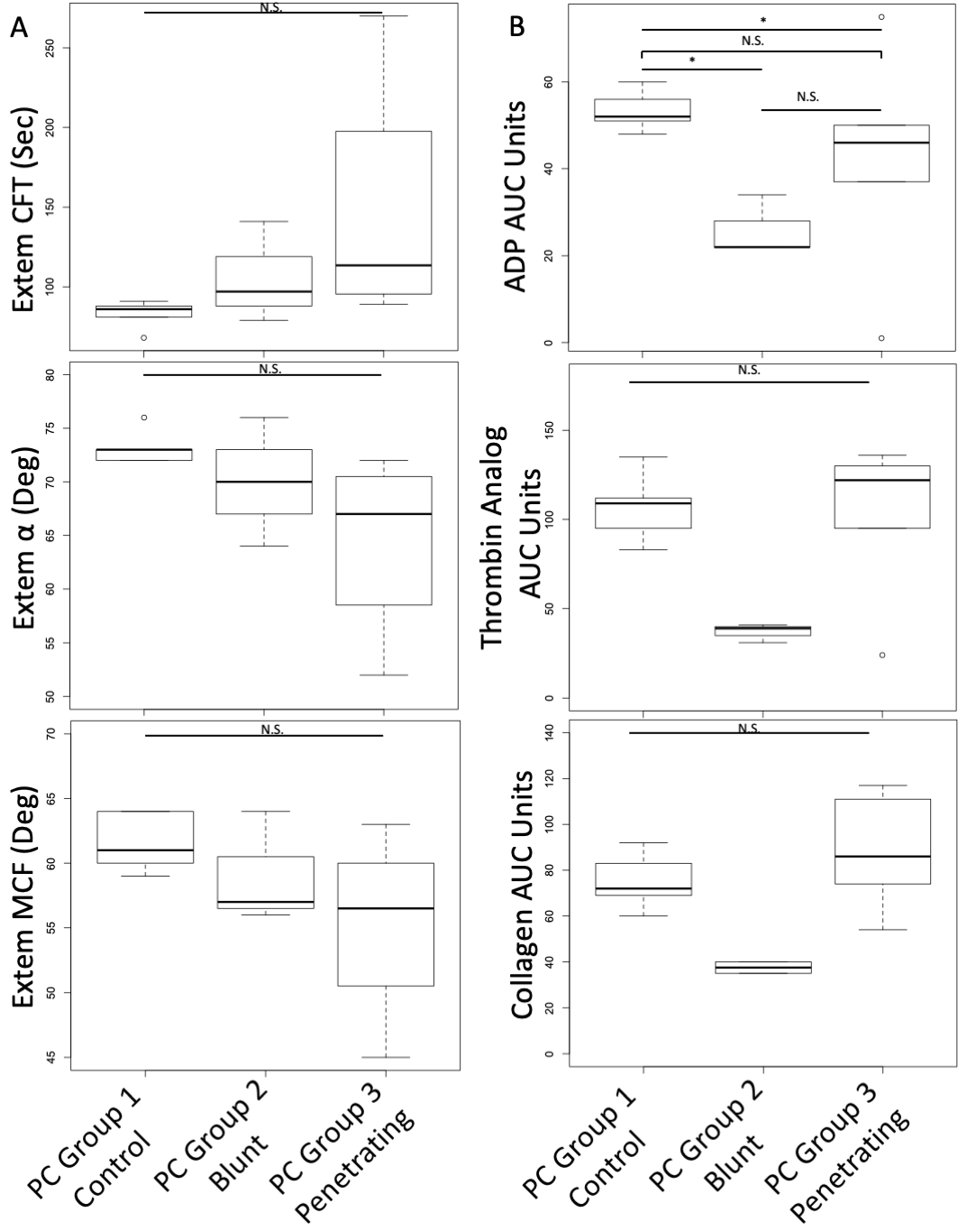
Fields AT, Lee MC, Mayer F, Santos YA, Bainton CMV, Matthay ZA, Callcut RA, Mayer N, Cuschieri J, Kober KM, Bainton RJ, Kornblith LZ. A new trauma frontier: Exploratory pilot study of platelet transcriptomics in trauma patients. J Trauma Acute Care Surg. 2022 Feb 1;92(2):313-322. PMID: 34738997
Notes:
AND, if you look EVEN closer at those clusters, these clusters based on platelet RNA editing signatures differed in clot formation and platelet aggregation as WELL..
This cluster →of penetrating injury trended toward more coagulopathic with → prolonged clot formation, →and decreased alpha angle, and → clot strength
Whereas, this cluster →of blunt injury trended toward → lower platelet aggregation responses than the healthy or penetrating clusters
SUGGESTING that the physiology driven editing of platelet RNA in circulating platelets may be able to give us insights into the molecular underpinnings of identified alterations in platelet hemostatic function that has been identified in such a large proportion of trauma patients.
------
Figure 3. Principal components groups (identified through differential alternative splicing of platelet genes) have distinct clot formation and platelet aggregation responses. A) Rotational thromboelastometry (Extem) shows PC Group 3 (trauma patients suffering from penetrating trauma), and to a lesser extent PC Group 2 (trauma patients suffering from blunt trauma), had prolonged clot formation time (CFT), decreased α angle and decreased maximum clot formation (MCF). B) Platelet Aggregometry shows PC Group 2 (trauma patients suffering from blunt trauma) had reduced platelet aggregation responses to ADP, thrombin analog, and collagen stimulation. Kruskal-Wallis tests were used to assess overall statistical significance and Wilcoxon signed rank tests were used to make pairwise comparisons; N.S., not statistically significant; *, p≤0.05

Slide 19
Future
What should a native platelet be doing?
What should a transfused platelet be doing?
What should a transfused platelet not be doing?
Extensive methods of studying post-injury platelet biology…
  In-vivo systems
  Microfluidics
  Cell culture
  Mitochondrial respiration
  Ultrastructure microscopy
  Platelet genomics
Selected
Vulliamy, P. et al. Histone H4 induces platelet ballooning and microparticle release during trauma hemorrhage. Proc. Natl Acad. Sci. USA 116, 17444 17449 (2019).
Kornblith, L. Z. et al. A journey upstream: fluctuating platelet- specific genes in cell free plasma as proofof- concept for using RNA sequencing to improve understanding of post- injury platelet biology. J. Trauma Acute Care Surg. 88, 742–751 (2020).
Diamond, S. L. Platelet dysfunction during trauma involves diverse signaling pathways and an inhibitory activity in patient- derived plasma. J. Trauma Acute Care Surg. 86, 250–259 (2019).
Lee, M. Y., Verni, C. C., Herbig, B. A. & Diamond, S. L. Soluble fibrin causes an acquired platelet glycoprotein VI signaling defect: implications for coagulopathy. J. Thromb. Haemost. 15, 2396–2407 (2017).
Notes:
SO as we continue seek answers about the mechanisms of post injury platelet dysfunction AND function, it is important to ask ourselves something that I remember Dr. Karim Brohi saying, and that is
What should a native platelet be doing and NOT be doing, and what should a transfused platelet be doing and NOT be doing
And to recognize that the complexities in studying platelet function (including their small size, reactive nature, and limitations of currently used common assays), will require us to think outside the box
→and pursue expanded methods for improving our understanding of whether post-injury platelet dysfunction is pathologic in nature,
AND to put our heads together with experts in other silos of microvascular injury like RADIATION INJURY, COVID-19, CARDIOVASCULAR DISEASE
AND our colleagues and experts in Blood banking, platelet storage lesions, and novel therapeutics to improve our understanding and ultimately our treatments

Slide 20
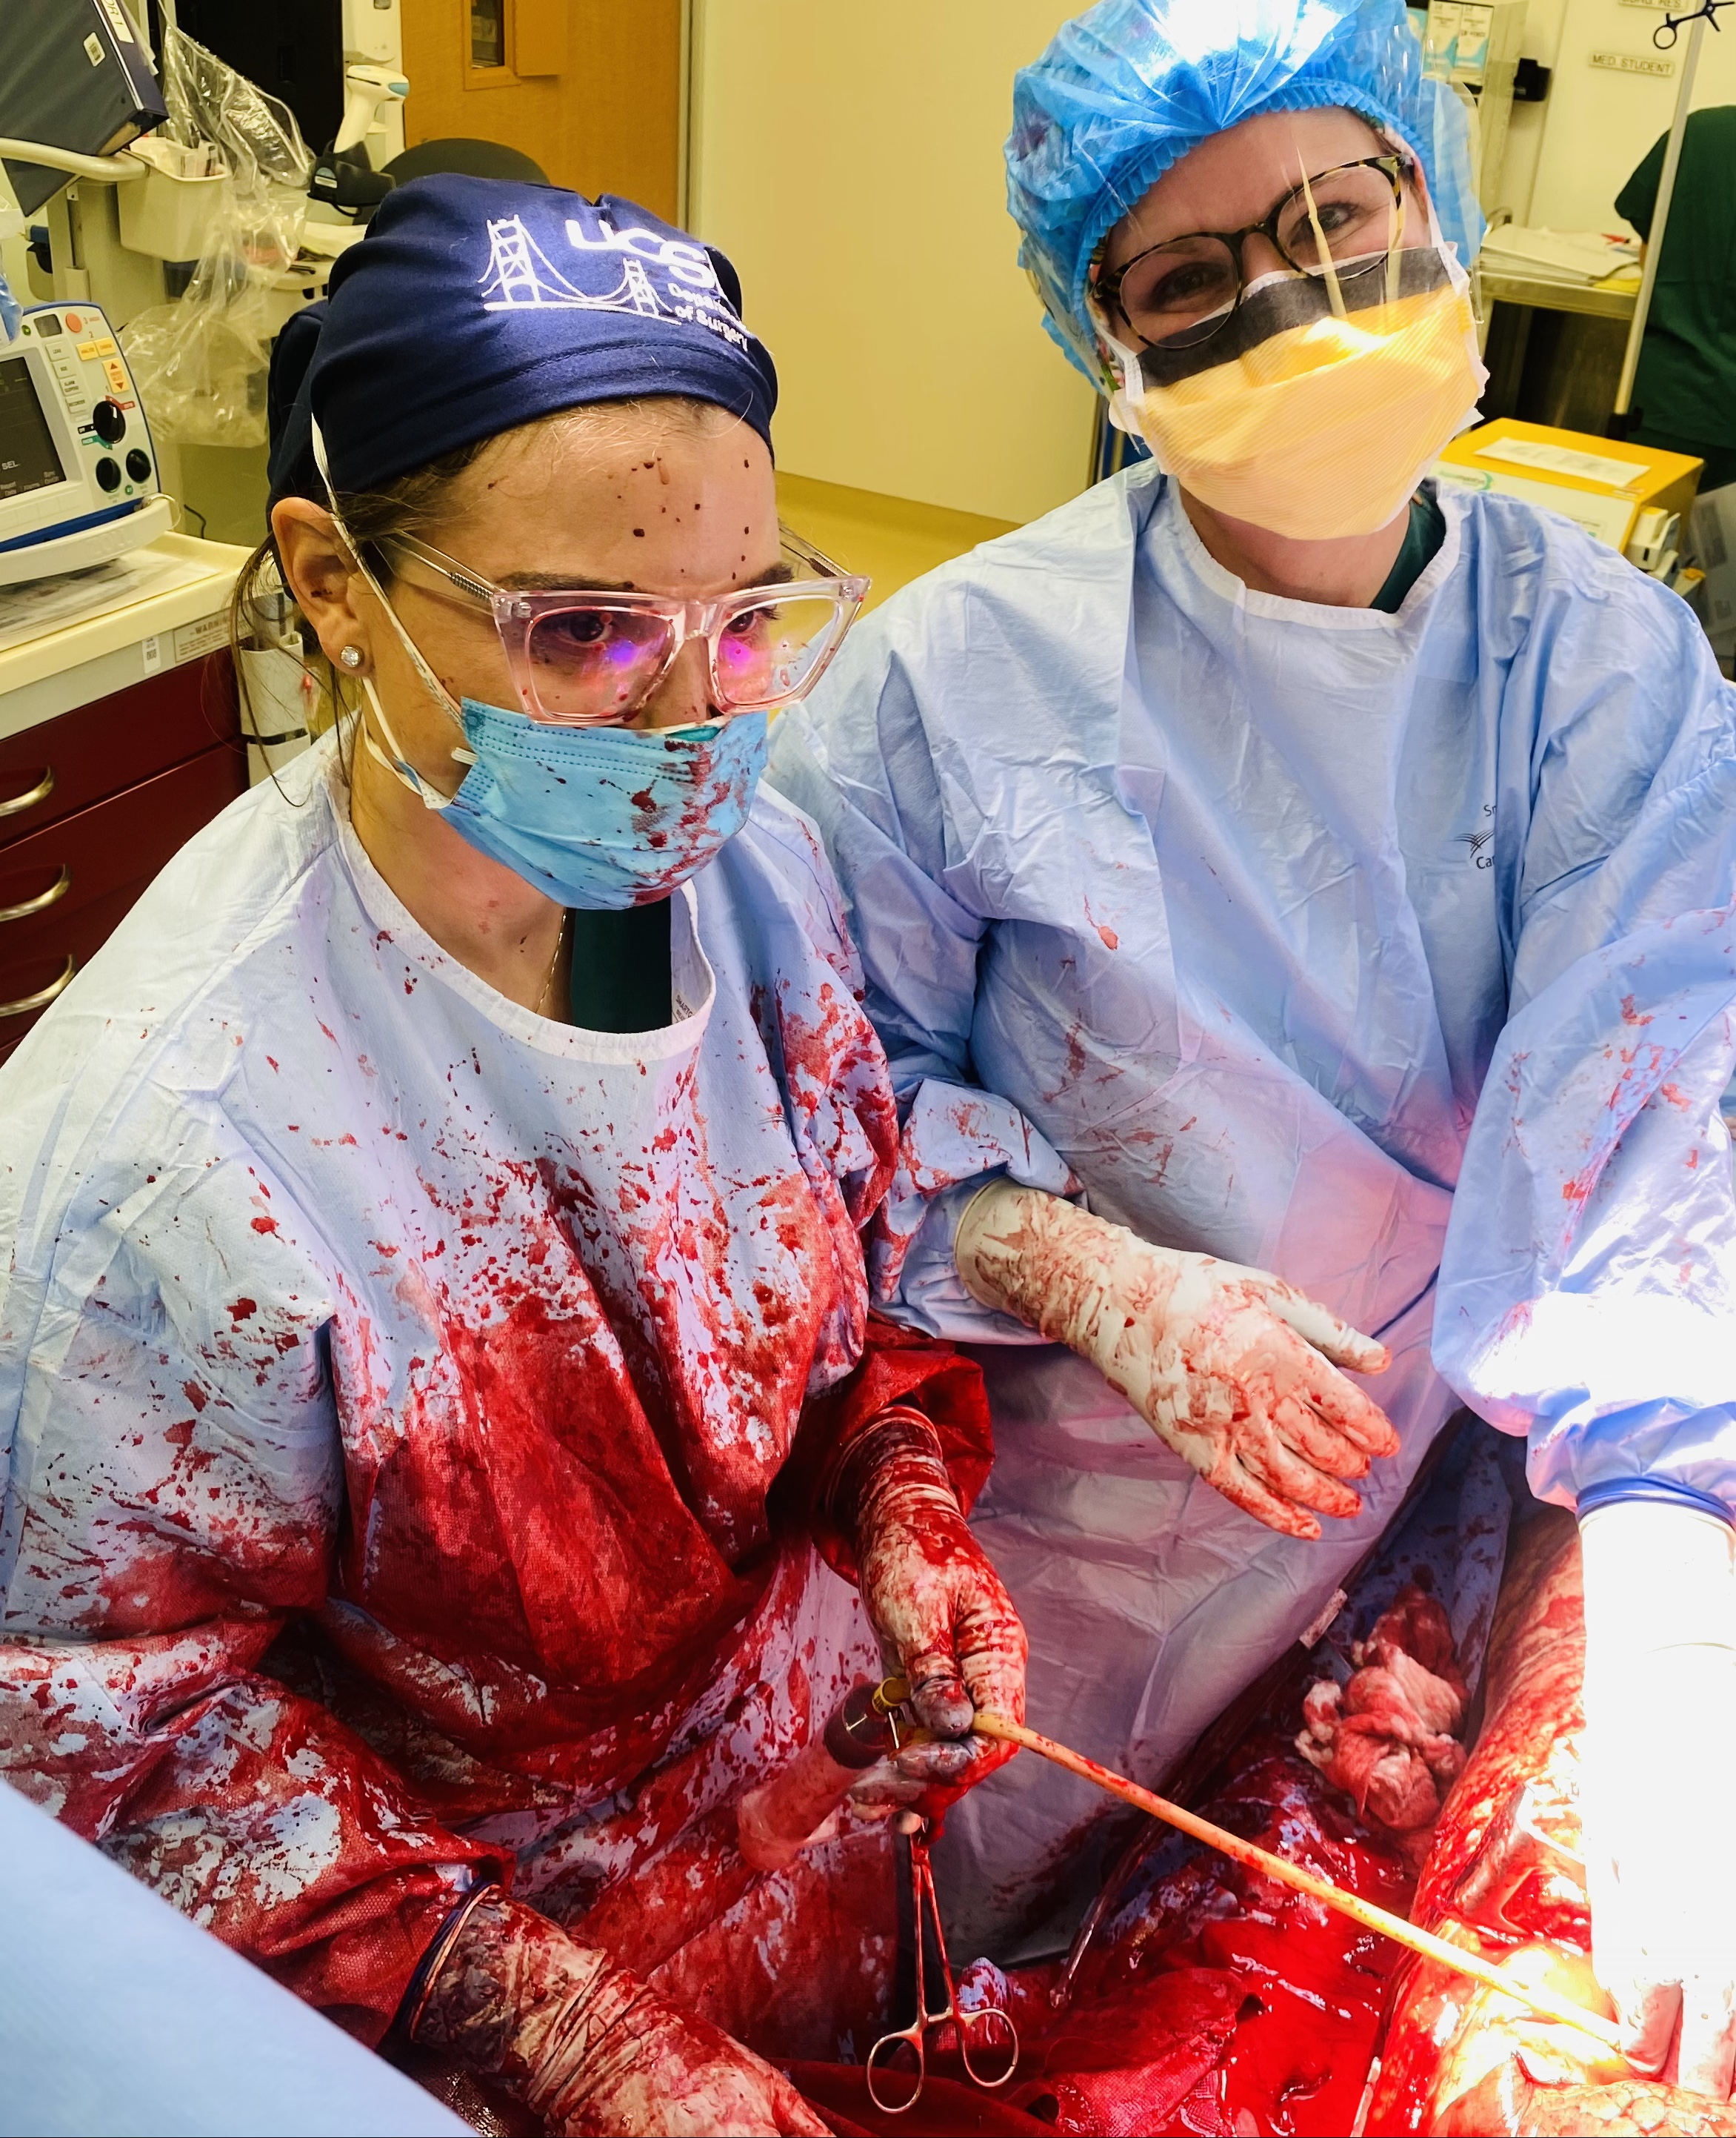
Platelets
Thanks to:
Generous Patients
Kornblith Lab
Alex Fields
Brenda Nunez-Garcia
Kim Herrera
Chris Lee
Marcela Matheus
Deanna Lee
Zachary Matthay
Collaborators & Mentors
Roland Bainton
Cevi Bainton
Yale Santos
Macky Neal
Mitch Cohen
Jeffrey Berger
Robby Campbell
Guy Zimmerman
Shibani Pati
Michael Matthay
Joe Cuschieri
Gene Moore
Notes:
I will stop there, and I look really forward to ongoing discussion and questions. Thanks to our generous patients who make the advancement of science possible, my team, and of course my ever supportive mentors and collaborators.

