Slide 1
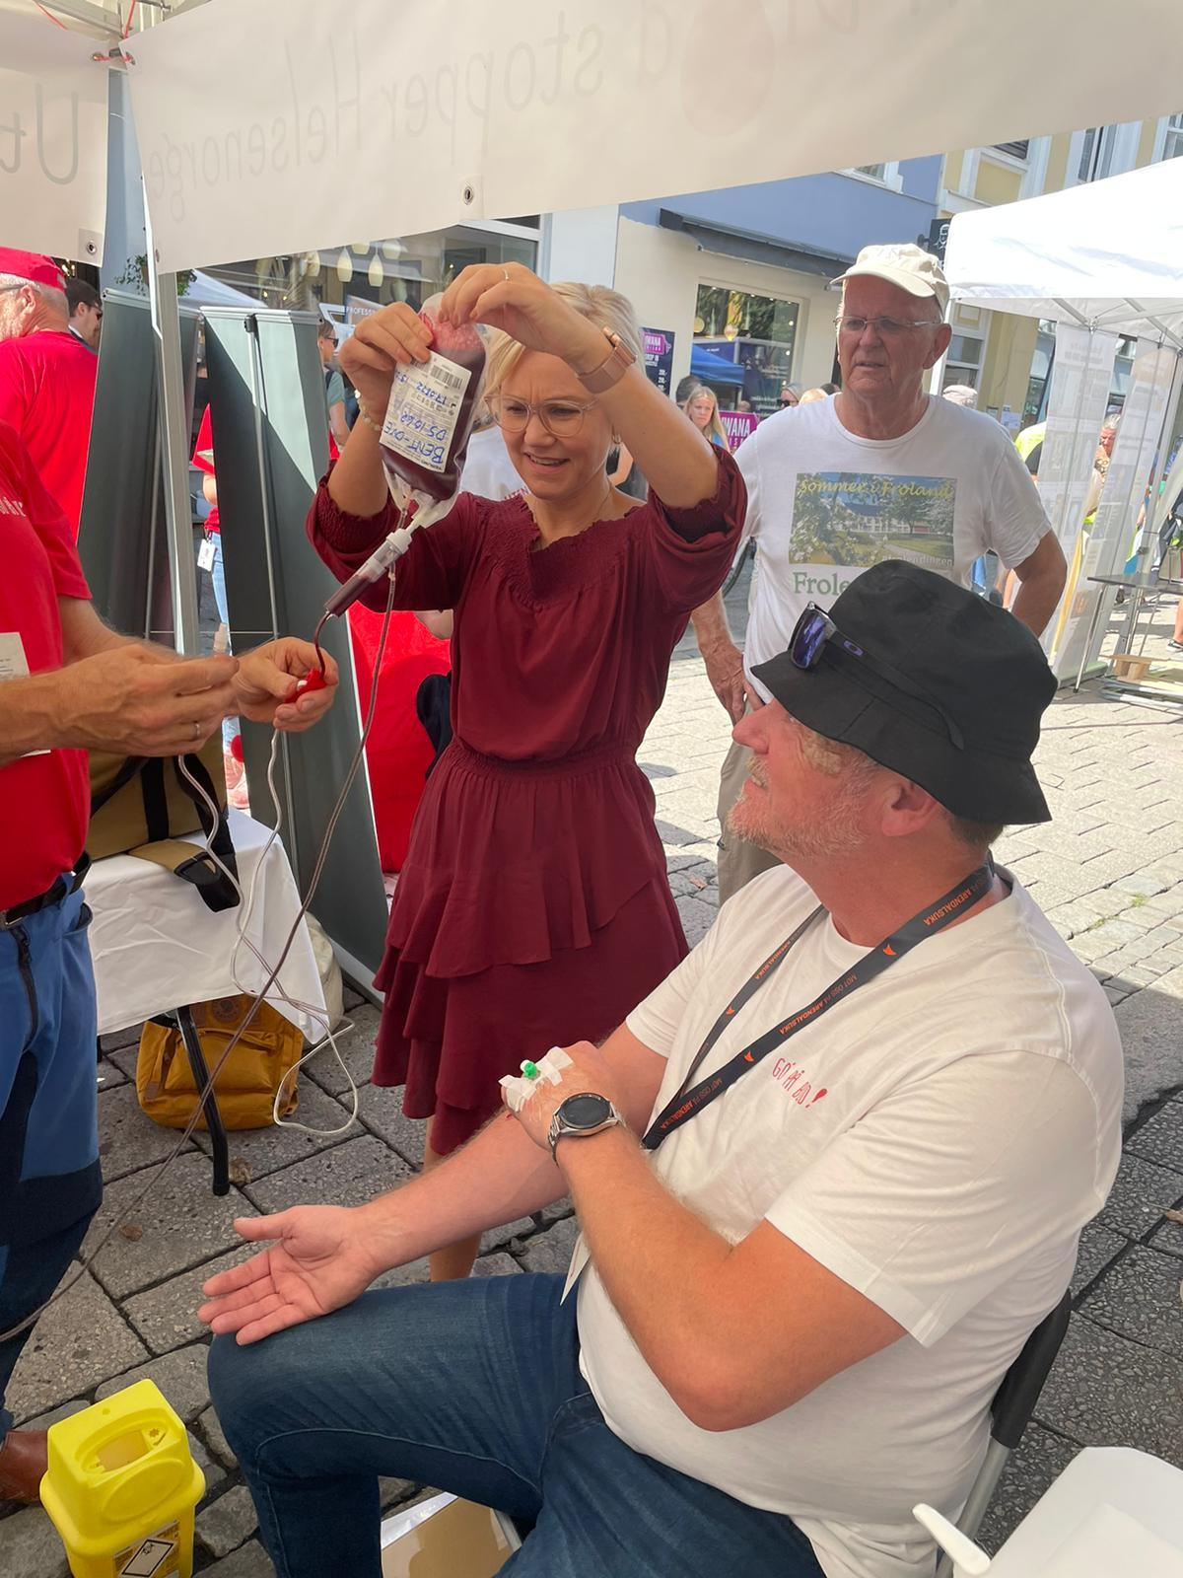
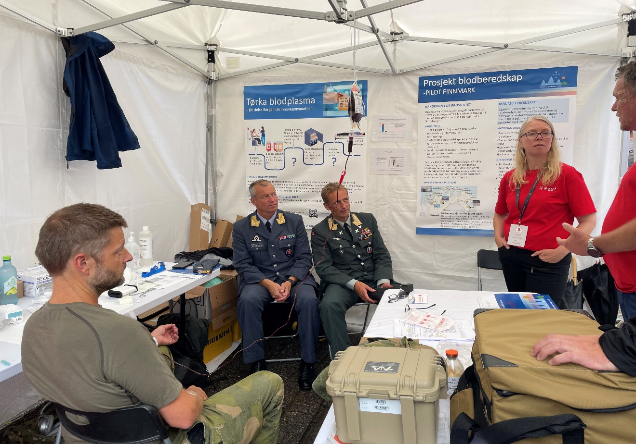
Only Group O for Whole Blood?
Geir Strandenes, MD Anesthetist and Senior Advisor Norwegian Coordination Center for Blood Preparedness Department of Immunology and Transfusion Medicine Haukeland University Hospital Norway

Slide 2
The use of blood-type tattoos during the Cold War
By December 1952, the Civil Defense Office had blood-typed more than 1,500,000 people in Michigan. Methods were greatly improved and each person had received a small plastic tag with their blood type and Rh factor, color-coded so that blood types could be identified even if the tags were burned.14 By June 1953, Illinois, Indiana, Massachusetts, and Utah had adopted programs for bloodtyping all residents, using either dog tags or tattooing for identification.

Slide 3
Blood-type tattooing occurred as a response to the increased need for blood during the Korean Conflict (June 1950 through July 1953). Most of the blood collected by the Red Cross was sent overseas, creating a shortage at home. A proposed solution was the establishment of ‘‘walking blood banks’’ in which people were pretyped so that they could give on-the-spot transfusions.

Slide 4

O Rh(D) neg
Low titer

