Slide 1

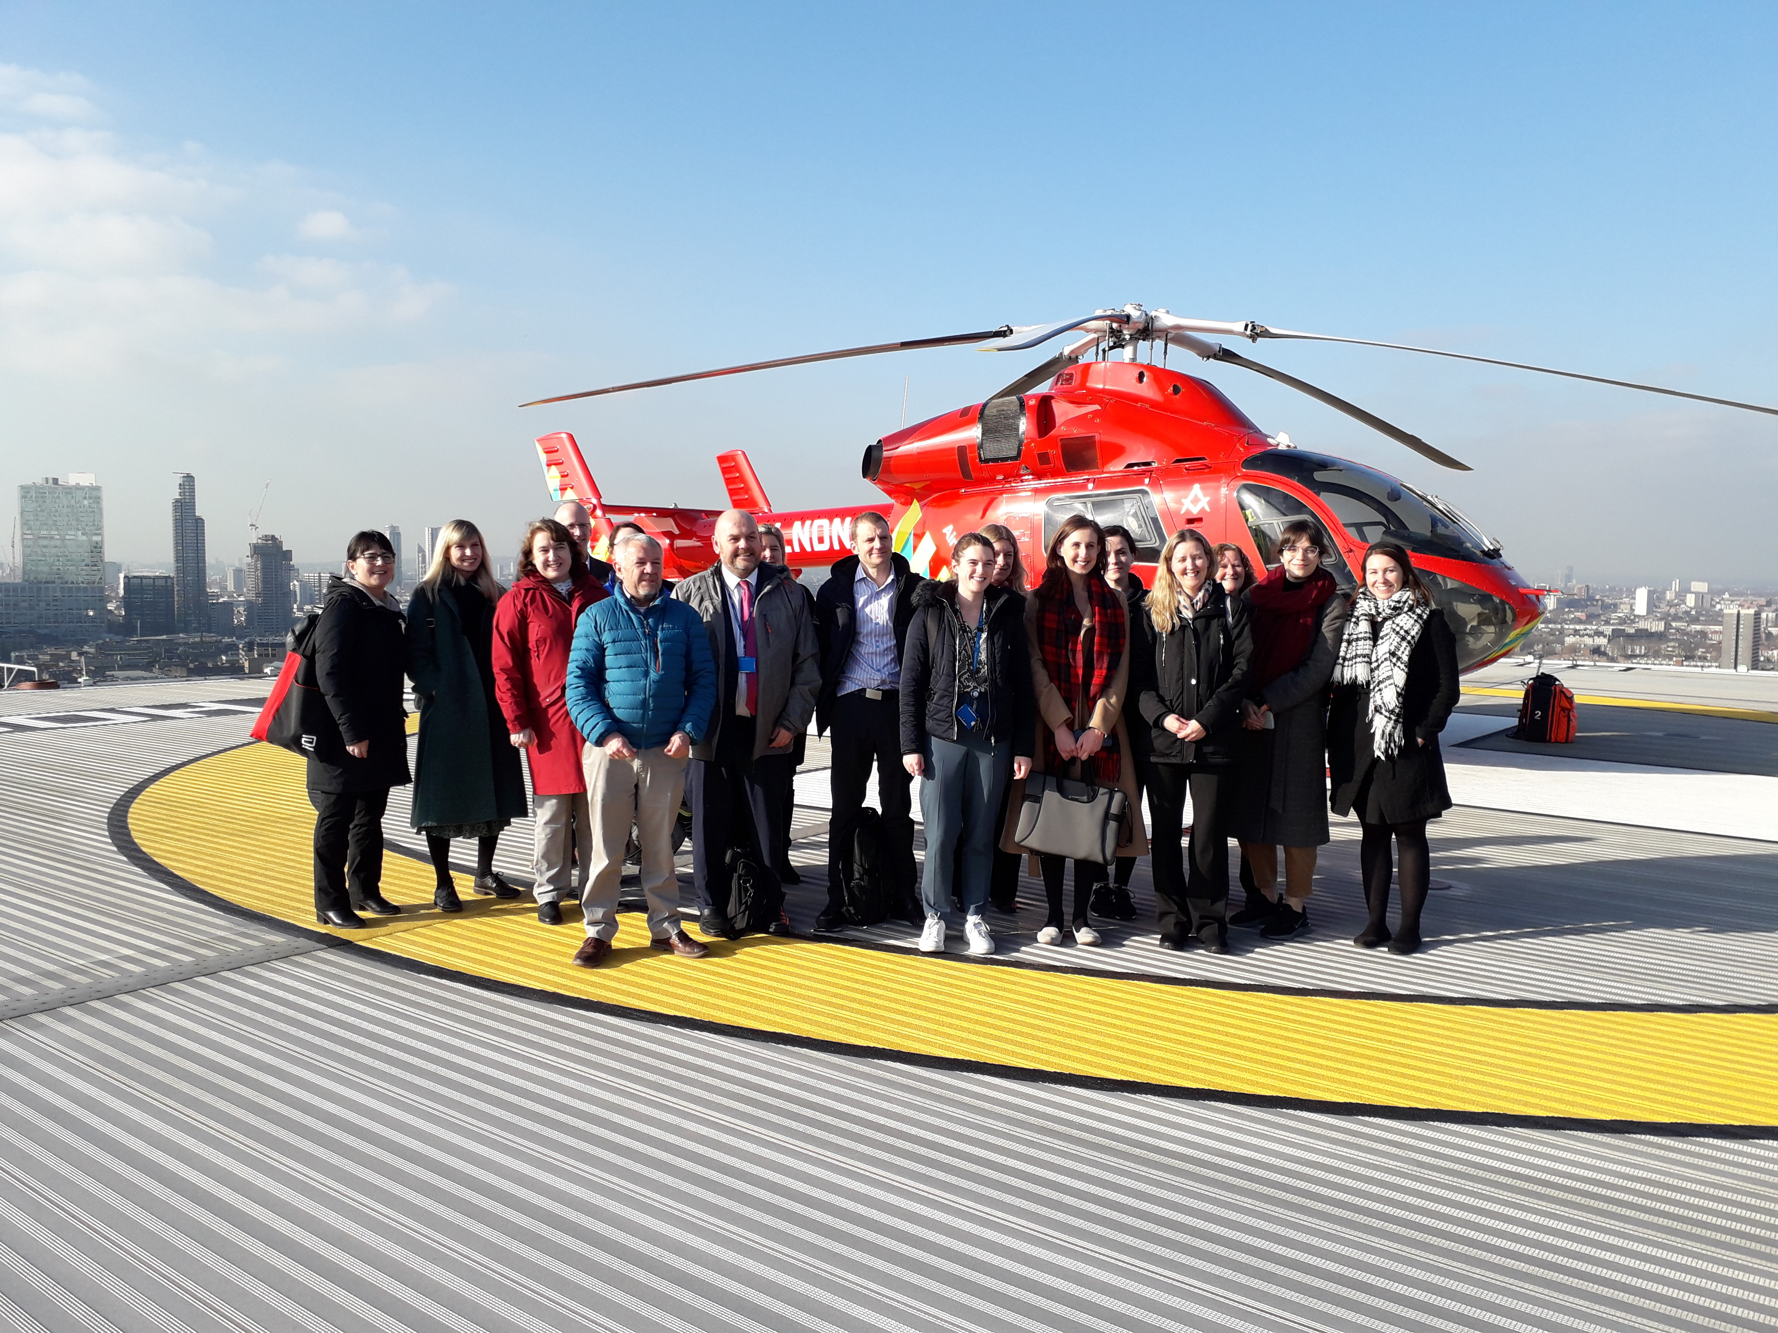
What data are needed for blood collectors to provide cold-stored whole blood?
Rebecca Cardigan PhD, FRCPath
Head of Component Development/PI, NHS Blood & Transplant, England
Affiliated Lecturer, Dept Haematology, University of Cambridge

Slide 2
Conflicts of interest
I am a member of Terumo BCT’s Advisory Board, who make filters for LD whole blood
I work for a national blood provider!

Slide 3
Content
What is the clinical need/benefit v current standard of care?
Donor selection
Manufacture and storage of the product
Cost and logistics
What are the outstanding research questions?
These considerations differ depending on current standard of care, nature of blood supplier & local societal considerations in relation to risk

Slide 4



Perceived benefits of whole blood transfusion
Improved efficacy/reduced transfusion requirements
Balanced resuscitation
1:1:1
Simpler/reduced time to administer
Can we reduce the mortality of patients from traumatic major haemorrhage?

Slide 5
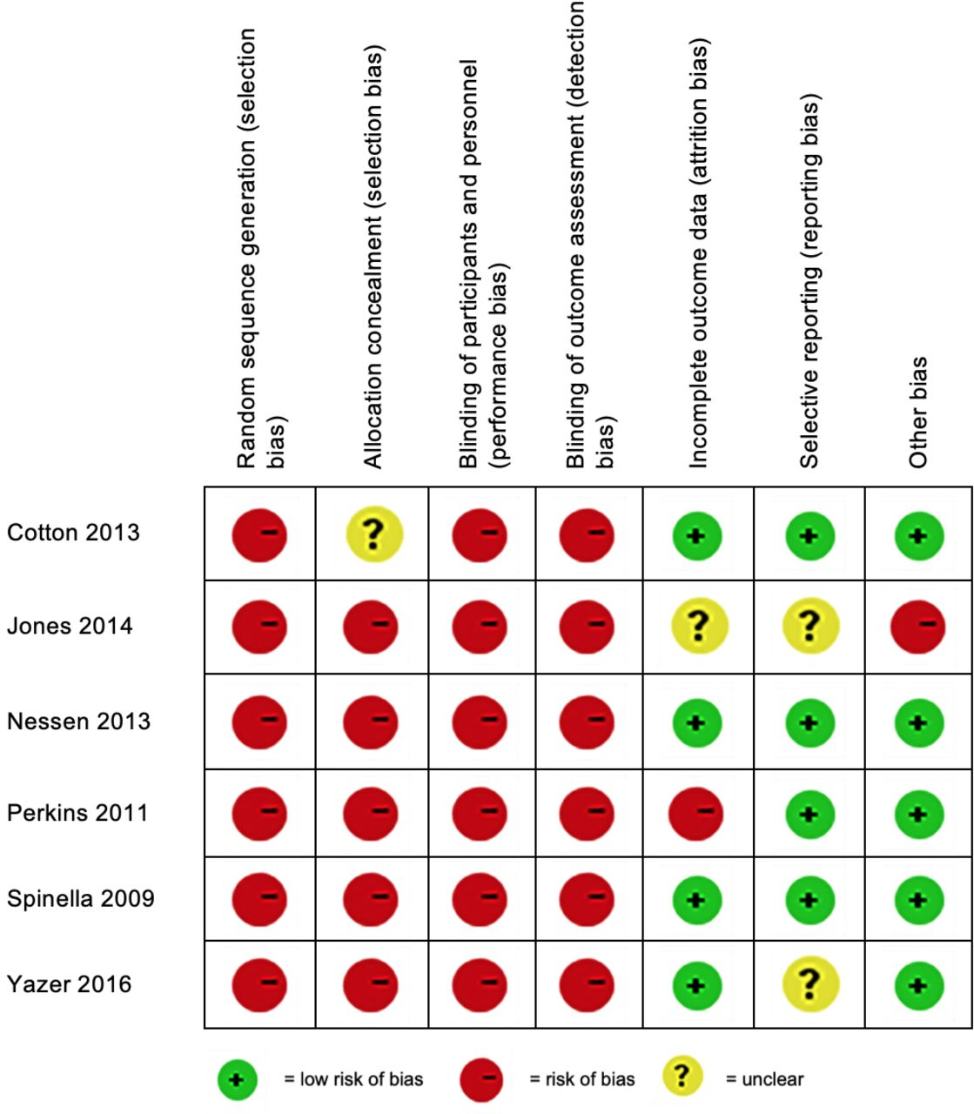
Evidence that WB is superior to component therapy is lacking
Pascale Avery et al. Emerg Med J 2020;37:370-378

Slide 6
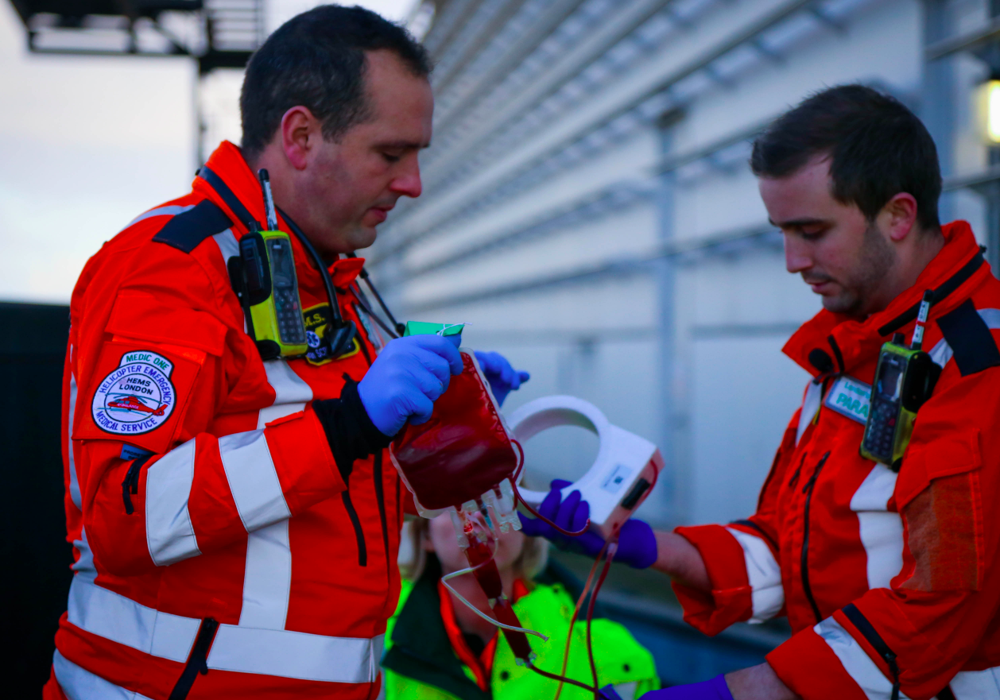
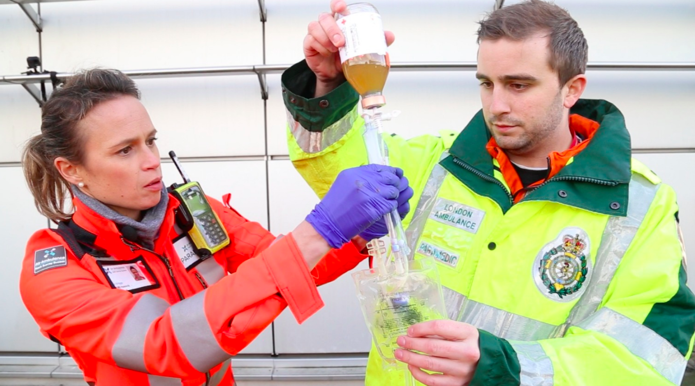
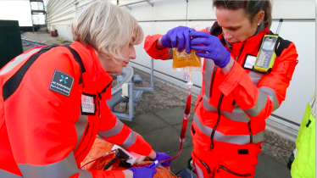
Practical advantages – simulation exercise
Cross-over study comparing 3 arms:
2 LD WB
2 RBC + 2 thawed FFP
2 RBC + 2 Lyoplas
The same scenario was tested with 6 emergency team members
Harriet Tucker (QMUL) & Anne Weaver (Barts Health)
Notes:
The scenario was developed and tested with 6 HEMS teams
Prior to starting, all crew members were familiarised with all blood components and equipment needed to ensure familiarity

Slide 7
Results – simulation exercise
Arms | Flow time | Touch Time | No. of steps | No of equip. | No of checks | No of people
2 RBC + 2 FFP | 12min 20sec | 5min 21sec | 40 | 10 | 16 | 2
2 RBC + 2 Lyoplas | 18min 29sec | 15min 3sec | 46 | 12 | 16 | 3
2 LD WB | 6min 31sec | 2min 31secs | 28 | 4 | 8 | 2
Harriet Tucker (QMUL) and Anne Weaver (Barts Health)
Notes:
The use of a combined component had the shortest touch-time and flow time, and required fewer steps, people and equipment. The total volume of 2 RCP units (~940 mL) is only 100mL less than the total volumes of 2 RBC (500mL) and 2 TP (540mL). Therefore the above results may largely be due to the fewer number of steps required to administer RCP, such as fewer blood component safety checks. Most pre-hospital teams carry only one blood warmer, and venous or intraosseus access may be challenging and a rate limiting step in a haemodynamically unstable and shocked trauma patient; being able to transfuse two components simultaneously with a combined product may mitigate these limitations.

Slide 8
Donor selection considerations
We need to mitigate the risk of group O plasma to non-O patients:
TRALI – male only donors or females tested for HLA/HNA antibodies
HTR – select donations that test as low titre for anti-A +B – not everyone is set up to do this routinely
- Choice of anticoagulants (CPDA-1 v CPD)
– D negative or positive, or both?
- For ‘non-standard’ LD filters collect in these bags or others?

Slide 9
Donor pool for WB is smaller than for red cells
Group O D neg (8%)
Male only (4%)
Low titre anti-A/B (3.5%)
No anti-platelet medication?

Slide 10
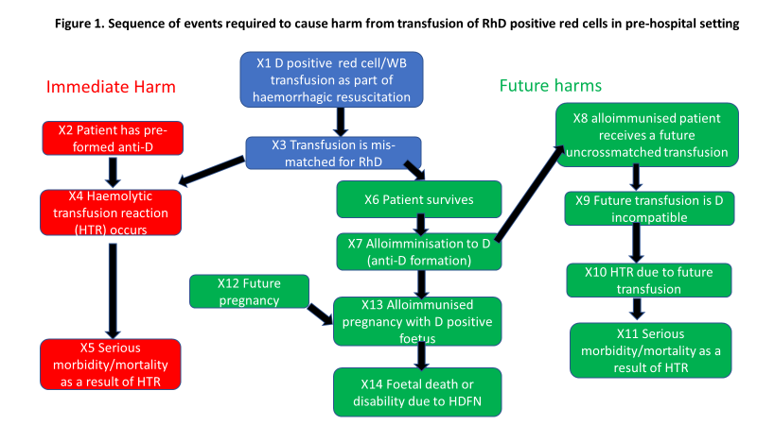
What are the risks of using D positive blood?
Cardigan et al, Vox Sang. 2022 May;117(5):701-707

Slide 11
Modelling a change in policy from D neg to D pos for England
Harm | All recipients 1 event every x transfusions (95% CI) | D-negative females of child bearing potential 1 event every x transfusions (95% CI)
Major morbidity or mortality due to HTR from index D-positive transfusion | 2.7x10⁴ (7.6x10³ -3.4x10⁵) | 6.6x10³ (1.8x10³– 9.2x10⁴)
Major morbidity or mortality due to future HTR | 8.5x10⁵ (1.8x10⁵ – 2.1 x10⁷) | 1.4x10⁵ (3.1x10⁴ – 3.7 x10⁶)
Foetal death or permanent disability due to anti-D HDFN in future pregnancy | 2.9x10⁴ (1.2x10⁴ – 1.2x10⁵) | 570 (260-2,300)
Any of above 3 harms | 1.4x10⁴ (5.6x10³ -4.2x10⁴ ) | 520 (250-1,700)
<1% improvement in mortality with WB would ‘offset’ life years lost due to HDFN risk
1:5 years
Cardigan et al, Vox Sang. 2022 May;117(5):701-707

Slide 12
Manufacturing considerations
Time from donation to processing – current IFU for Terumo does not cover 24H ambient hold
To LD or not to LD, use of different collection packs & filters
Shelf-life
The move away from DEHP in the EU

Slide 13
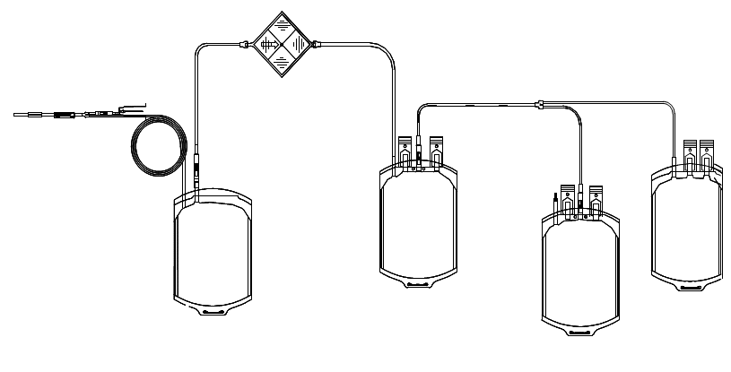
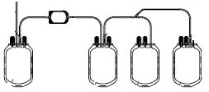
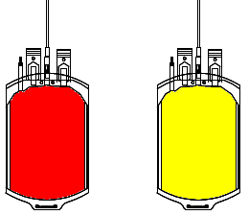
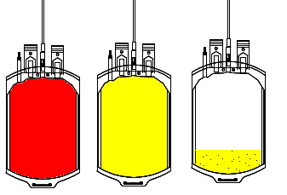
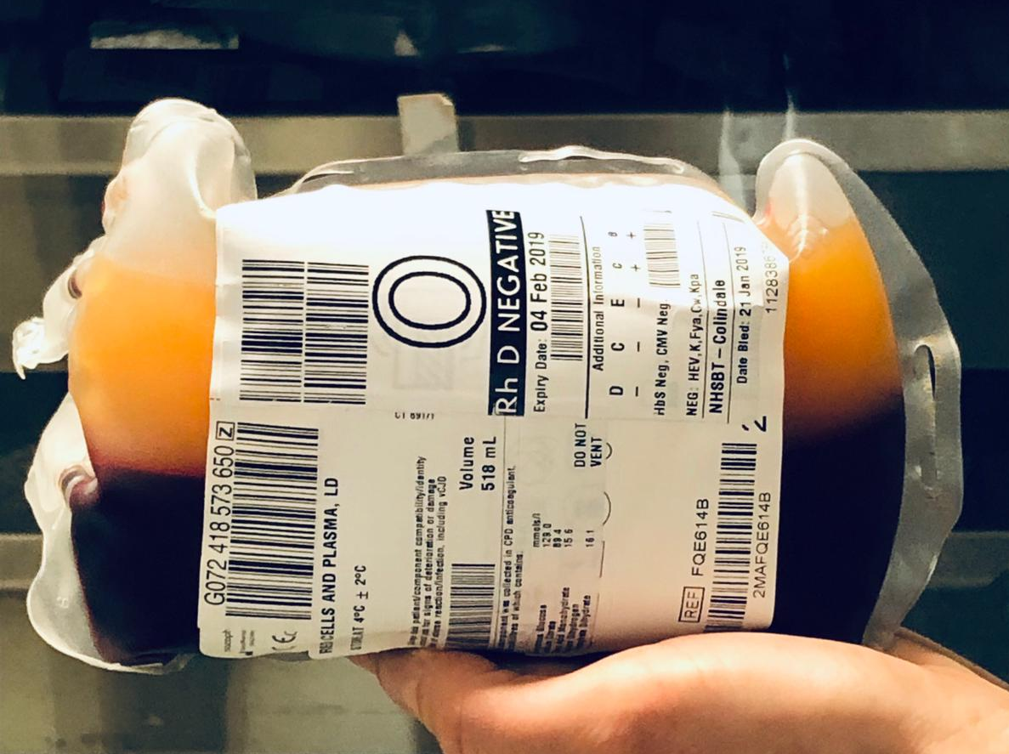
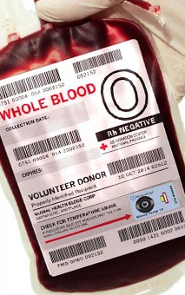
Special filters are needed to produce LD WB containing platelets
Current
Alternative
Leucodepletion filter removes platelets
Leucodepletion filter saves platelets
For NHSBT LD WB likely 30% more expensive than RBC +FFP
Red cells
Plasma
Red
cells
Plasma
¼ unit of
platelets
Filters approx. 10 x more expensive

Slide 14

Shelf-life is shorter than standard red cells
Increased wastage
Options
Recycle
Use for non-trauma
Use D pos
RBC 35-42d
CPD WB 7-21d

Slide 15
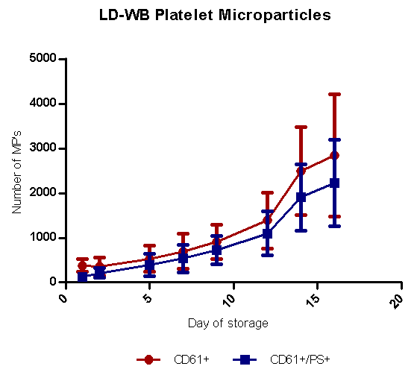
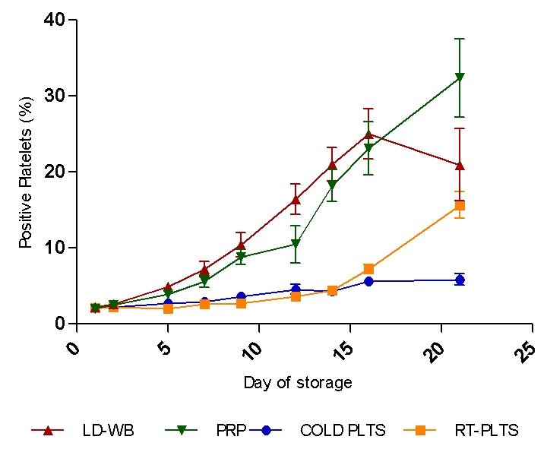
It’s difficult to know what its shelf life should be

Slide 16
WB status – large national blood providers
 | American Red Cross | Netherlands | Australia | Canada | France | UK
In routine use | YES | NO | NO | NO | NO | NO
Lab studies | - | Ongoing | ? | Completed | Completed | Completed
Clinical studies | RCT’s in USA planned | None planned? | None planned? | Ongoing | Ongoing | About to start
Plans to implement? | - | For military use only in first instance | Not currently | Applying to add to licence | Only in context of studies | Only in context of studies

Slide 17
Research Questions
Is WB superior to component therapy in the resuscitation of bleeding patients?
  Relevant clinical outcomes – mortality, transfusion requirements
  Logistical benefits, time on scene
What is it’s optimal shelf-life?
Are the risks associated with use of D positive blood acceptable if D negative blood is unavailable?
  What do patients and the public think?
Is it cost-effective?

Slide 18
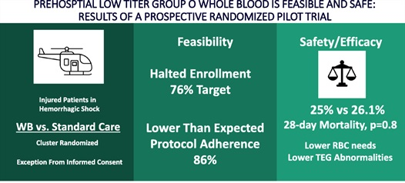
PPOWER pilot RCT USA n=86
Guyette et al. J Trauma Acute Care Surg 2022 May 1;92(5):839-847.

Slide 19
TOWAR Study USA
 | Prospective RCT
Design | Randomised parallel assignment
Study population | Pre-hospital haemorrhagic shock
Participants | 1020
Comparators | Up to 2 units WB pre-hospital versus standard of care
Primary endpoint | 30d mortality
Secondary endpoints | Numerous including age of blood (1-14d v >14d)
Recruiting : Due to complete mid 2025
Source:clinicaltrials.gov

Slide 20
TSTORHM study
- France
SWiFT study
- England
Design | Prospective RCT non-inferiority
Study population | Trauma triggering MTP
Sample size | 164 (82 per arm)
Comparators | WB (up to 6 units) v component therapy
WB used | Terumo filter, 21d shelf-life, ‘recycled at 7-14d’
Primary endpoint | MA by TEG
Secondary endpoints | Laboratory markers of haemolysis 2h & 30d mortality Units transfused
Design | Prospective multi-centre unblinded RCT
Study population | Pre-hospital major traumatic haemorrhage
Sample size | 848
Comparators | Wb (up to 2 units) v standard of care (RBC + plasma)
WB used | Terumo filter, 21d shelf-life
Primary endpoint | all-cause mortality or received ≥10 units of any blood components ≤24 hours from randomisation
Secondary endpoints | Morbidity & Mortality 30, 90 days Hospital resource to discharge Cost-effectiveness Health-related quality of life at 90 days Safety

Slide 21
Thank you!
rebecca.cardigan@nhsbt.nhs.uk
Or connect with me via LinkedIn

