Slide 1
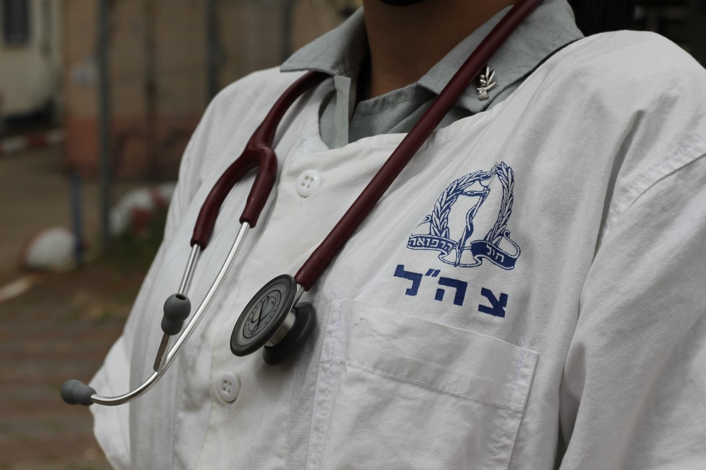
Leading Change in Your Own Backyard
BG Prof. Elon Glassberg
IDF Surgeon General
& Chief of the IDF Medical Corps
IDF-MC FOR YOU

Slide 2
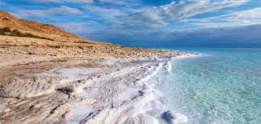
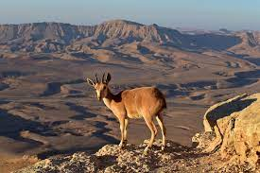
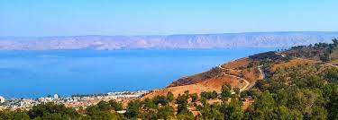

Slide 3
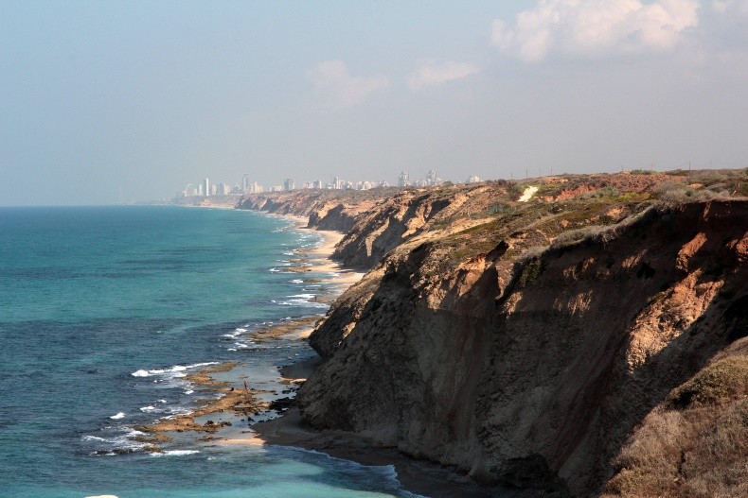
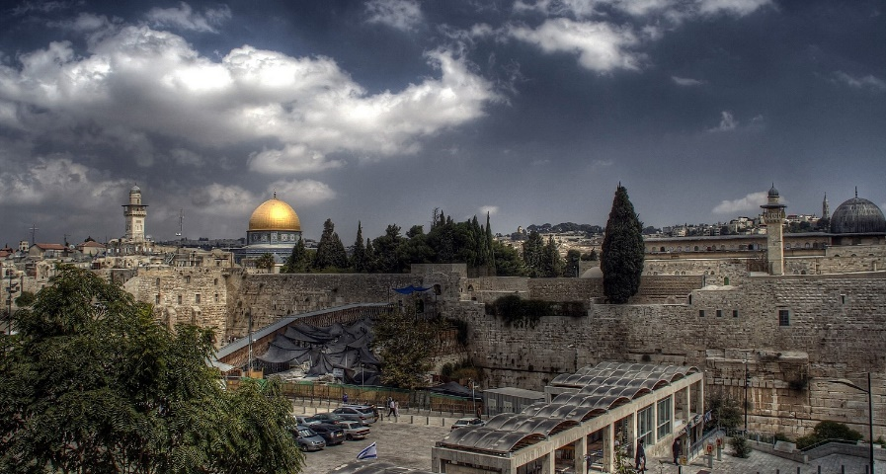
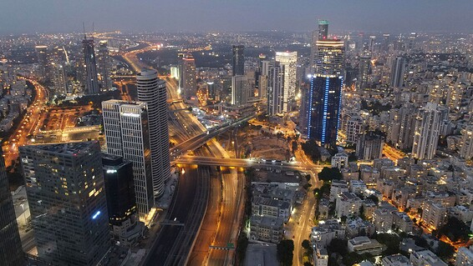
Israel
~9M residents
Renowned for technological advancement
Middle East – for the good (and the bad)
IDF-MC FOR YOU

Slide 4
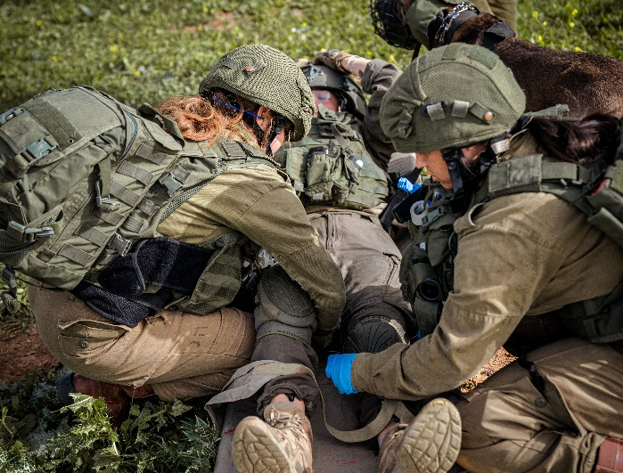
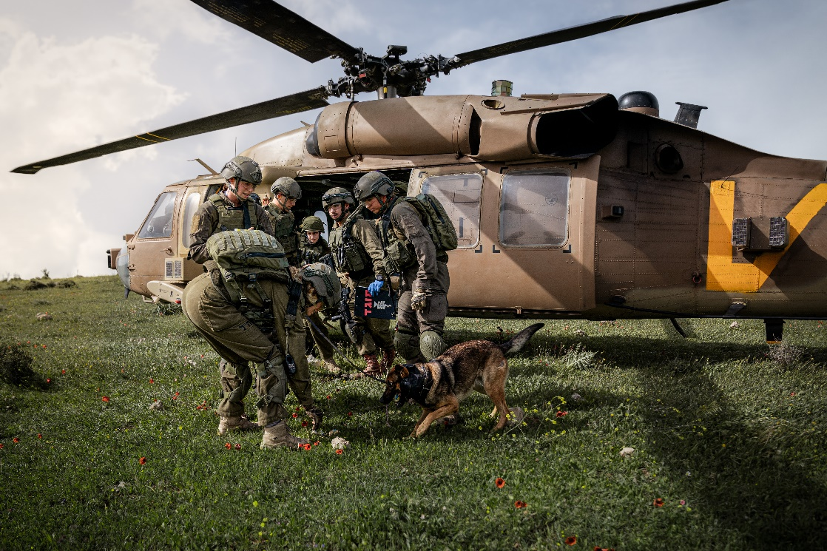
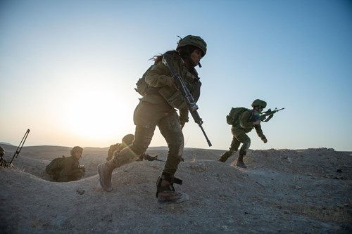
Israel Defense Forces
Male and female soldiers
Mandatory military service
One Medical Corps (and one SG)
IDF-MC FOR YOU

Slide 6
The THOR charm Put to work
IDF-MC FOR YOU

Slide 8
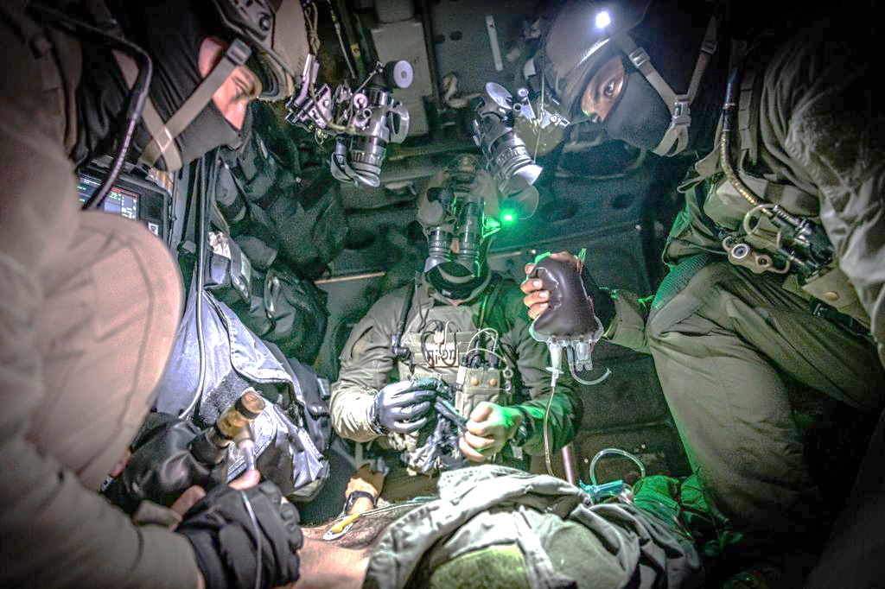
Where we are today
IDF-MC FOR YOU

Slide 9
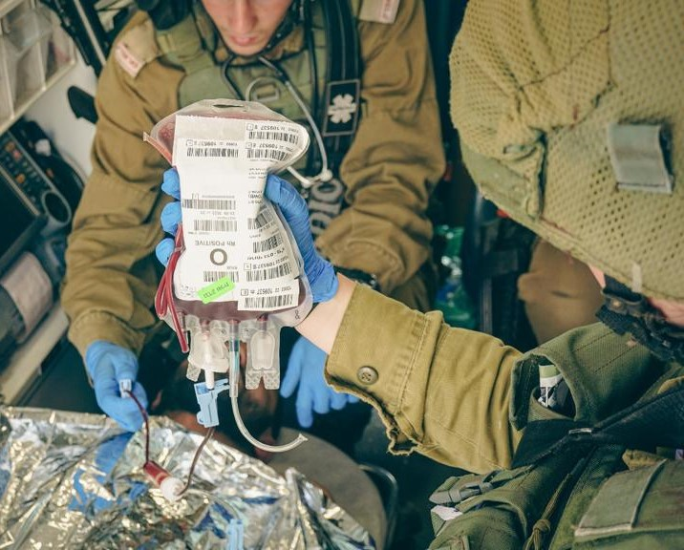
Where we are today
IDF-MC FOR YOU

Slide 10
Tomorrow:
IDF-MC FOR YOU

Slide 11
Notes:
From here – consider including or not (AW protocol)

Slide 12
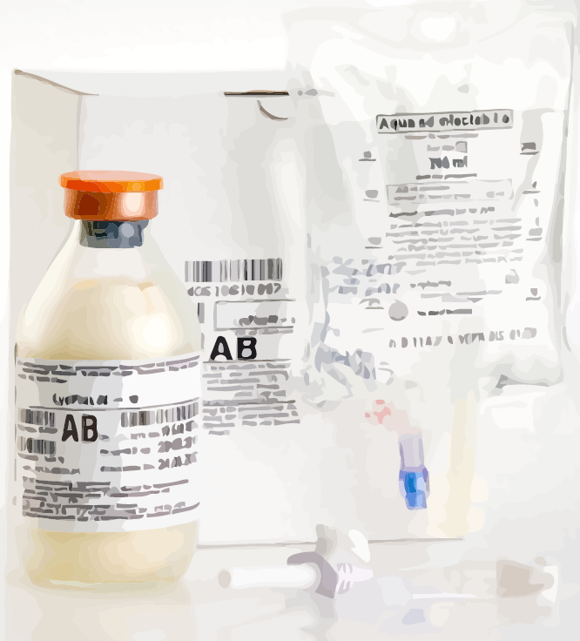
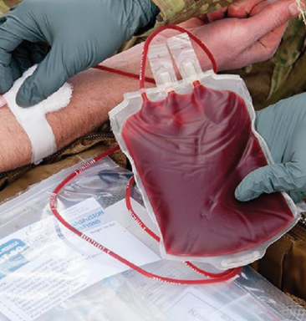
Up to 2011
PRBC only for aeromedical teams
2012
TXA
2013
FDP
2018
LTOWB for aeromedical teams
2021
LTOWB on ground ambulances
Notes:
From here – consider including or not (AW protocol)

Slide 13
Notes:
How did we get here

Slide 14
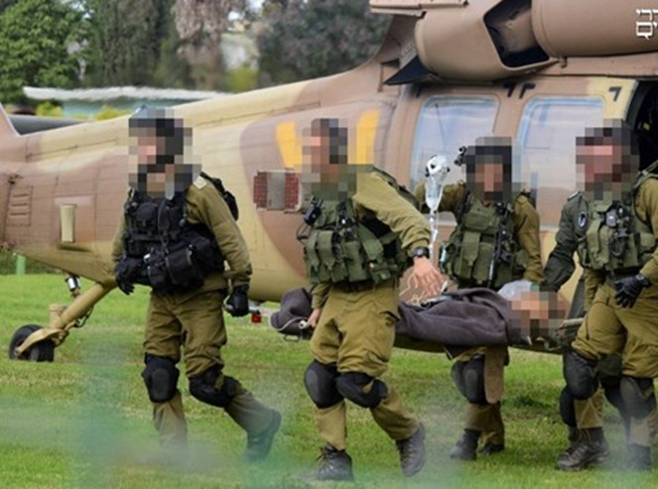
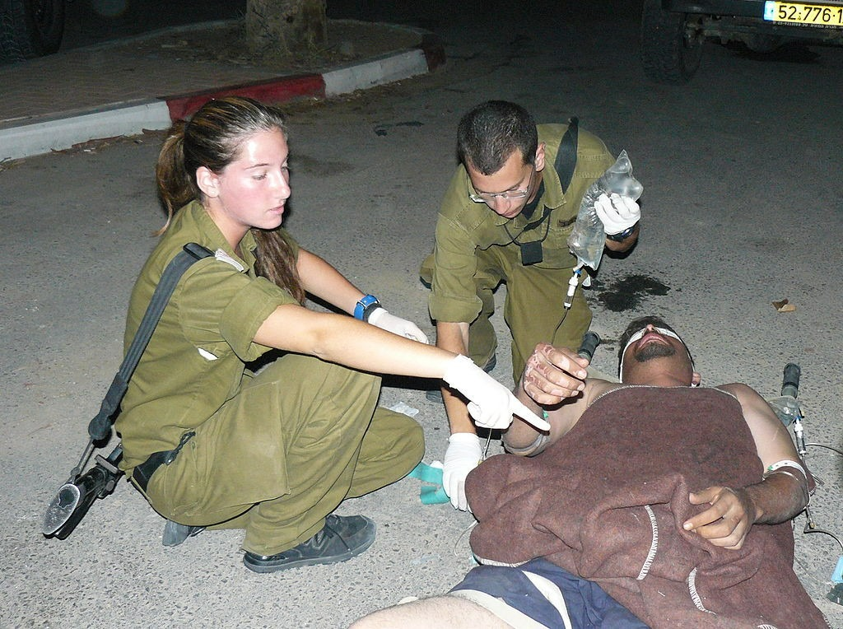

Slide 17
You must never be satisfied !

Slide 21
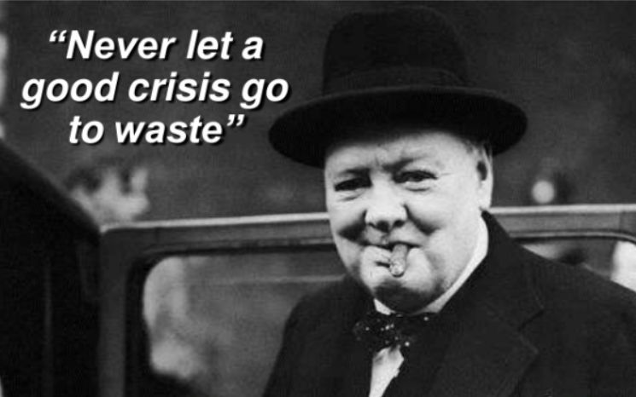

Slide 23
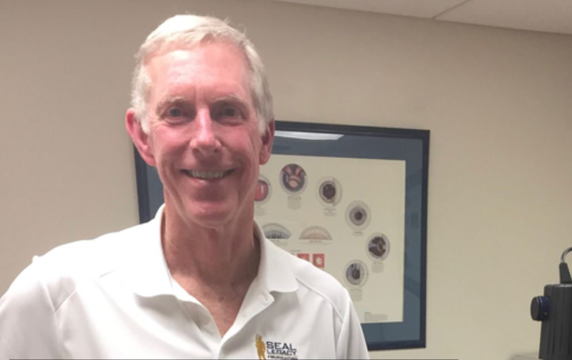

Slide 24
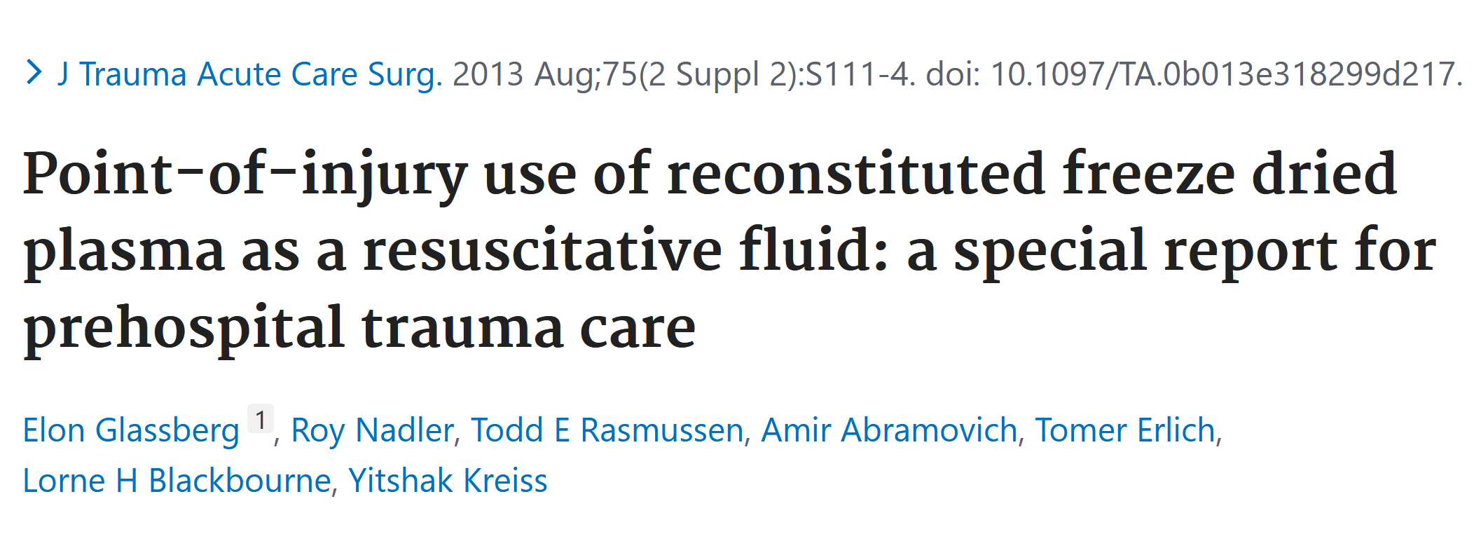

Slide 26
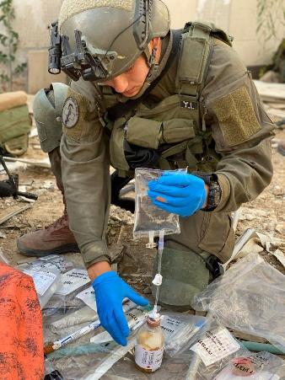
Up to 2011
PRBC only for aeromedical teams
2012
TXA
2013
FDP
Notes:
From here – consider including or not (AW protocol)

Slide 28
And then…. we heard about THOR…..

Slide 29
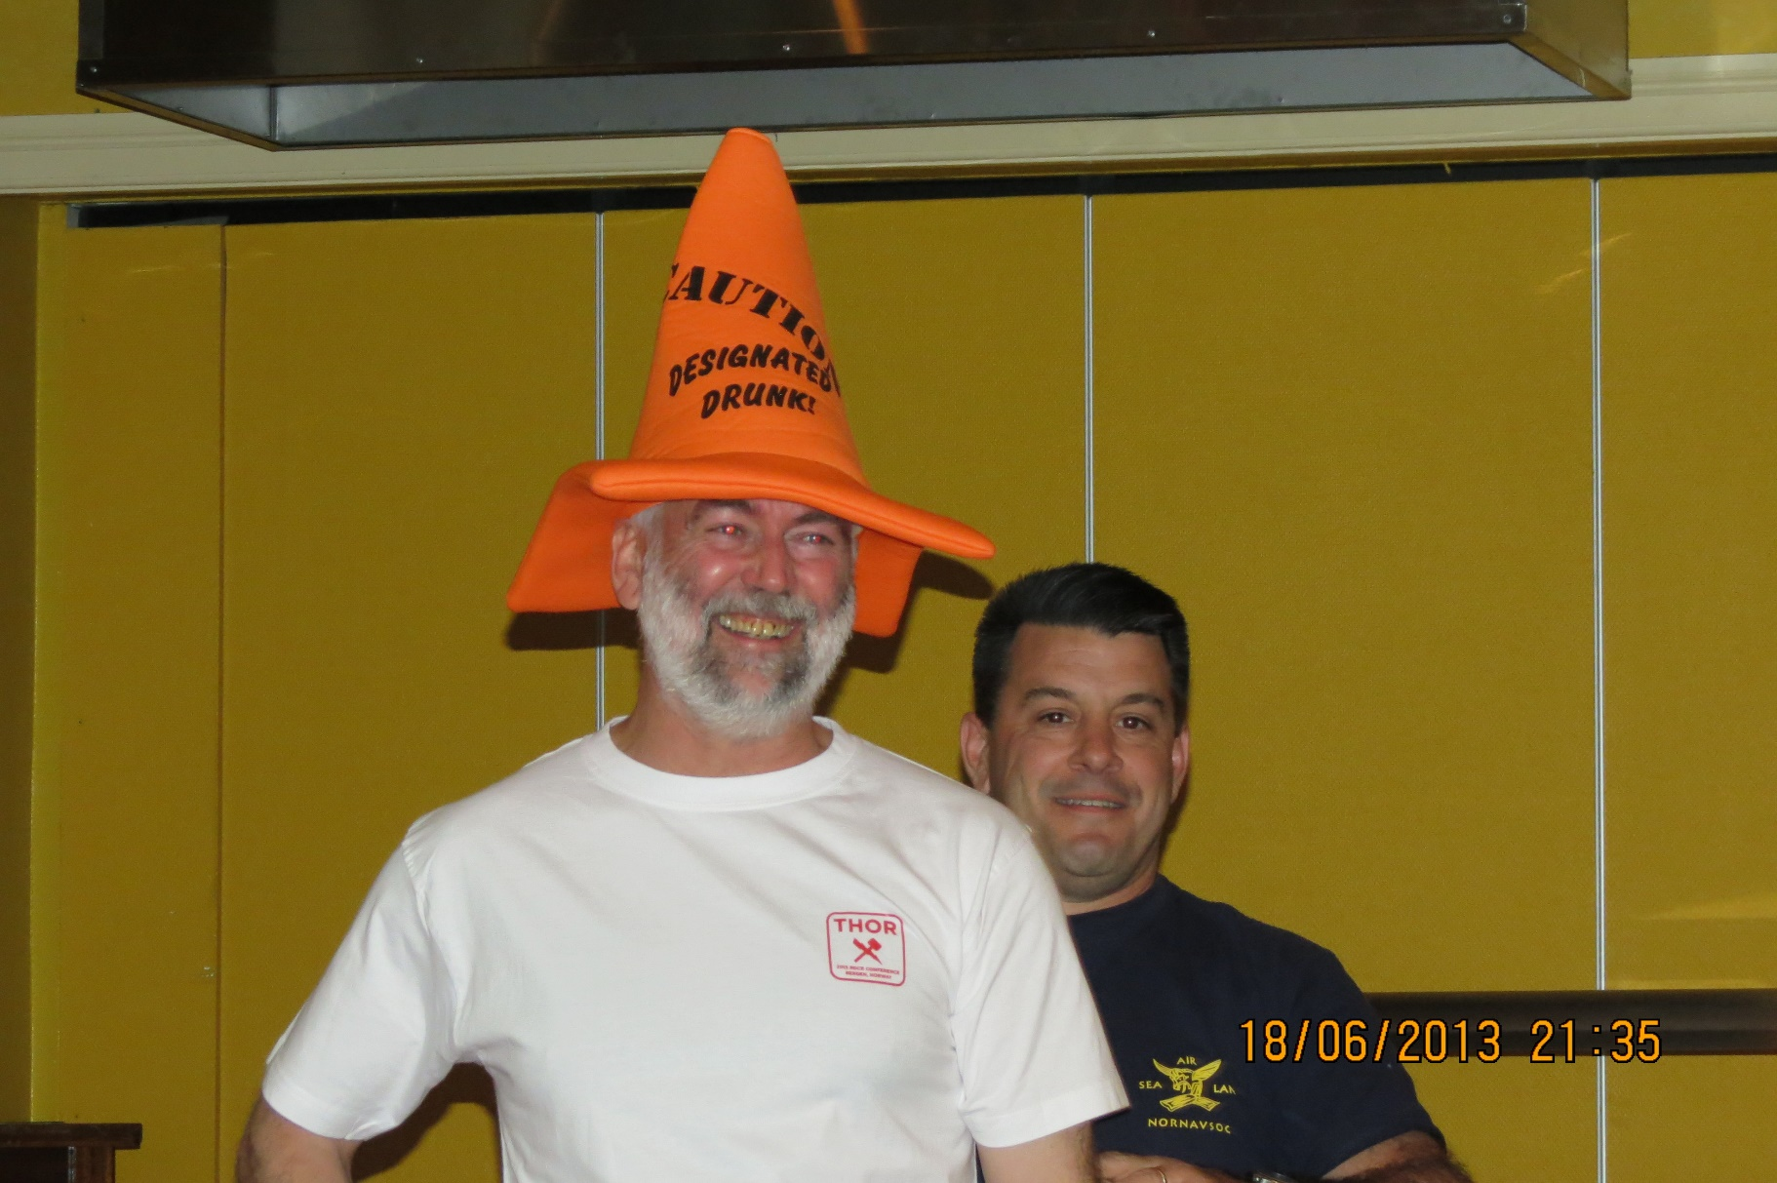

Slide 31
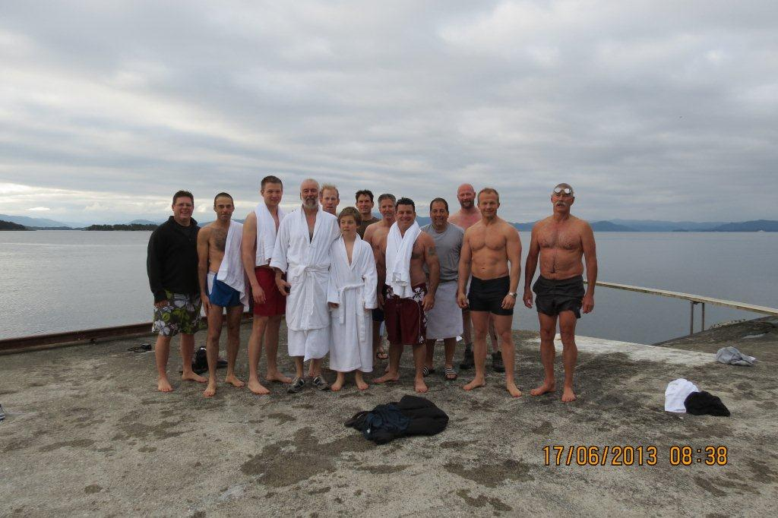
ואז .... פגשנו את THOR אלון

Slide 33
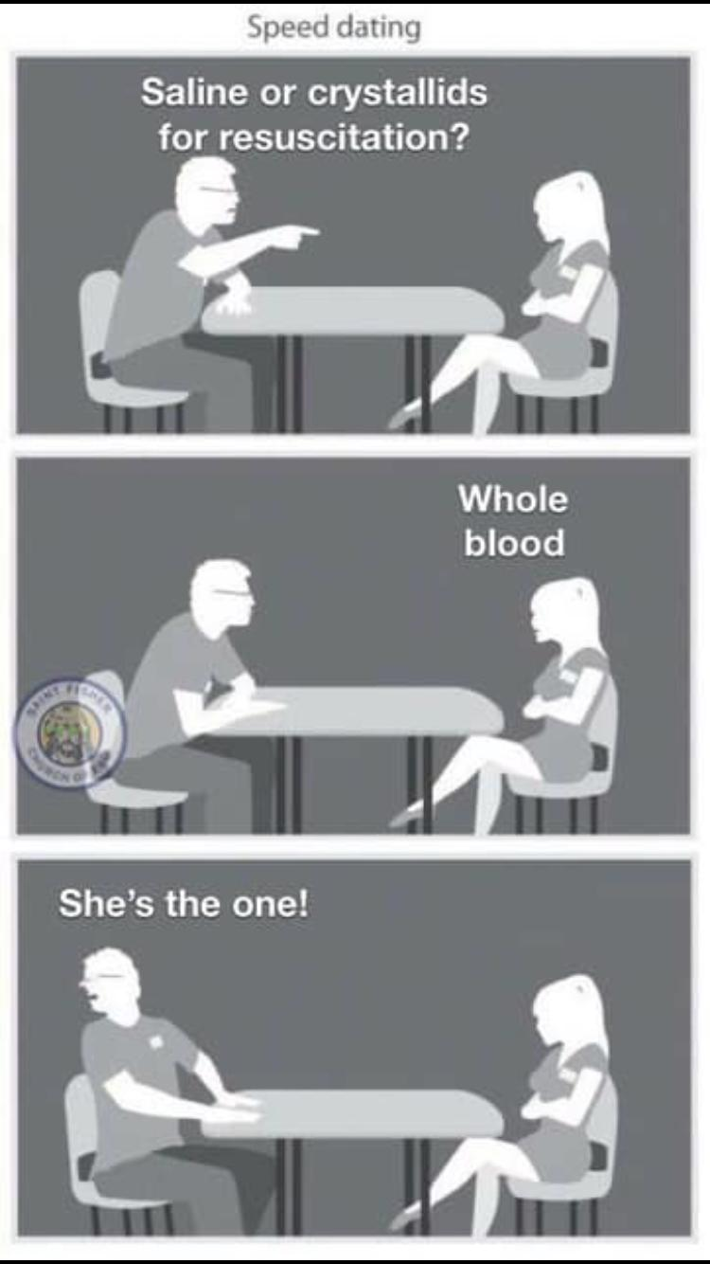

Slide 34
“The big bad wolf”

Slide 35
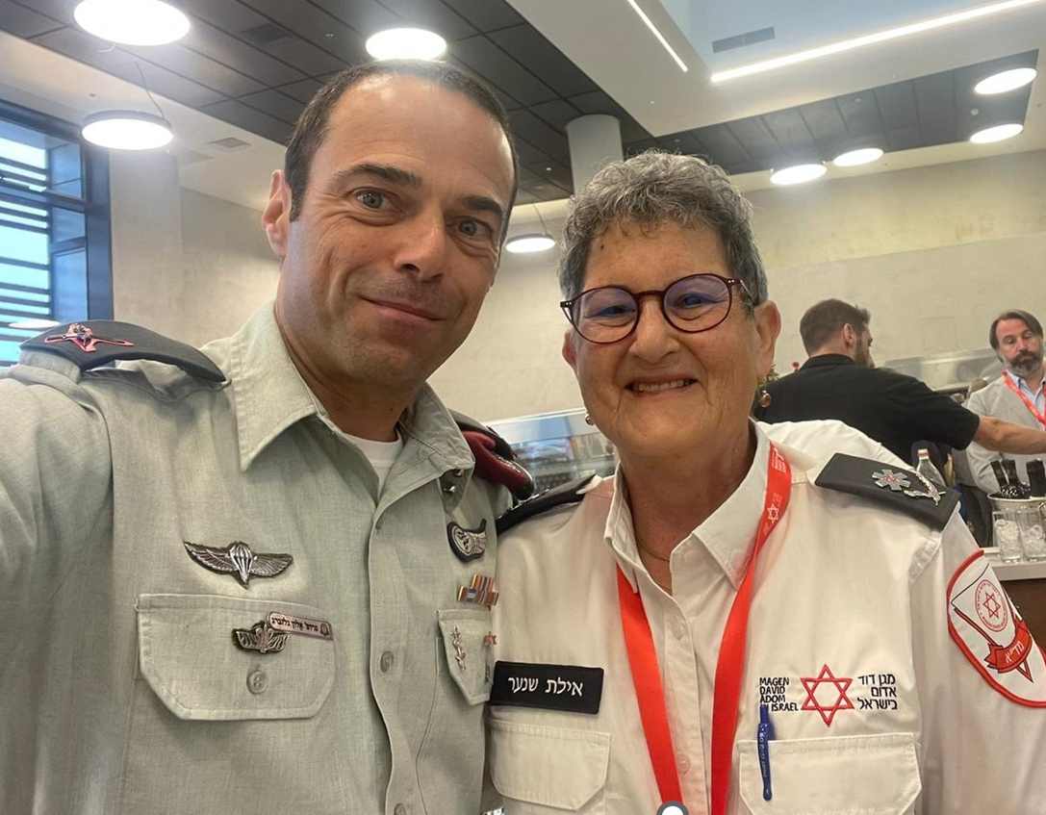
Is neither a wolf nor bad!

Slide 36
Coalitions

Slide 40
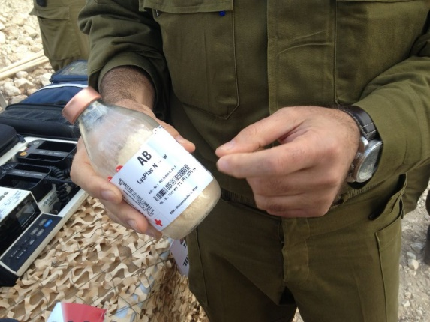
Fast vs. gradual adoption
IDF-MC FOR YOU

Slide 41
IDF-MC FOR YOU
Notes:
Regulatory
Logistic
Implementation
Educating our providers

Slide 43
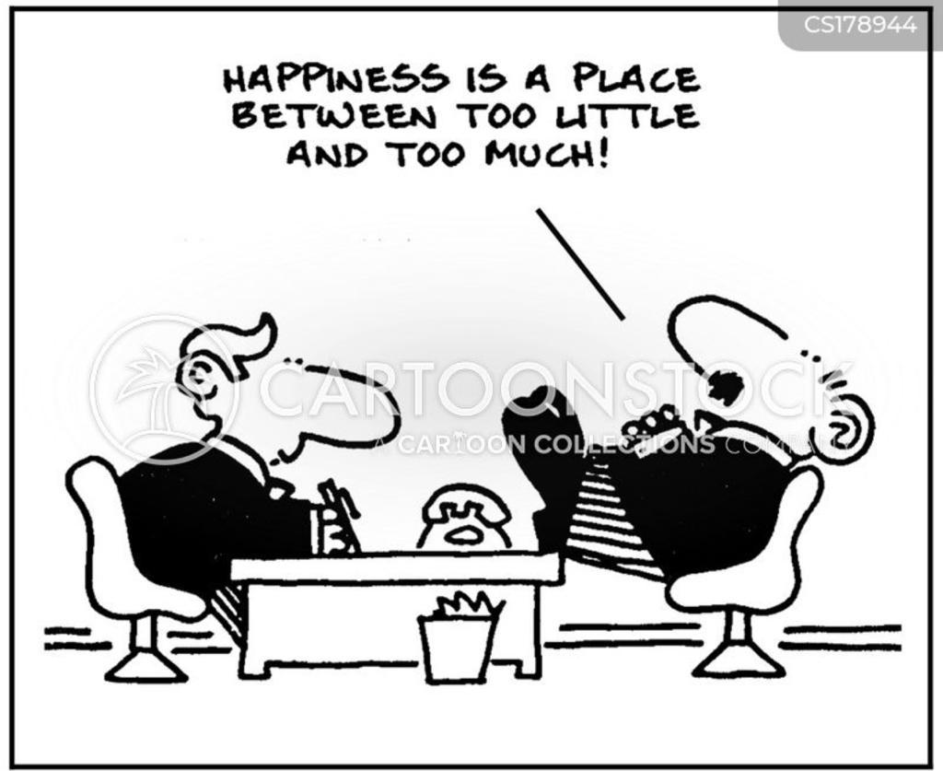

Slide 45
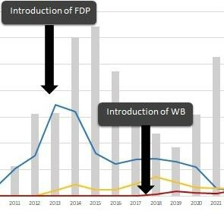
Old habits die hard

Slide 46
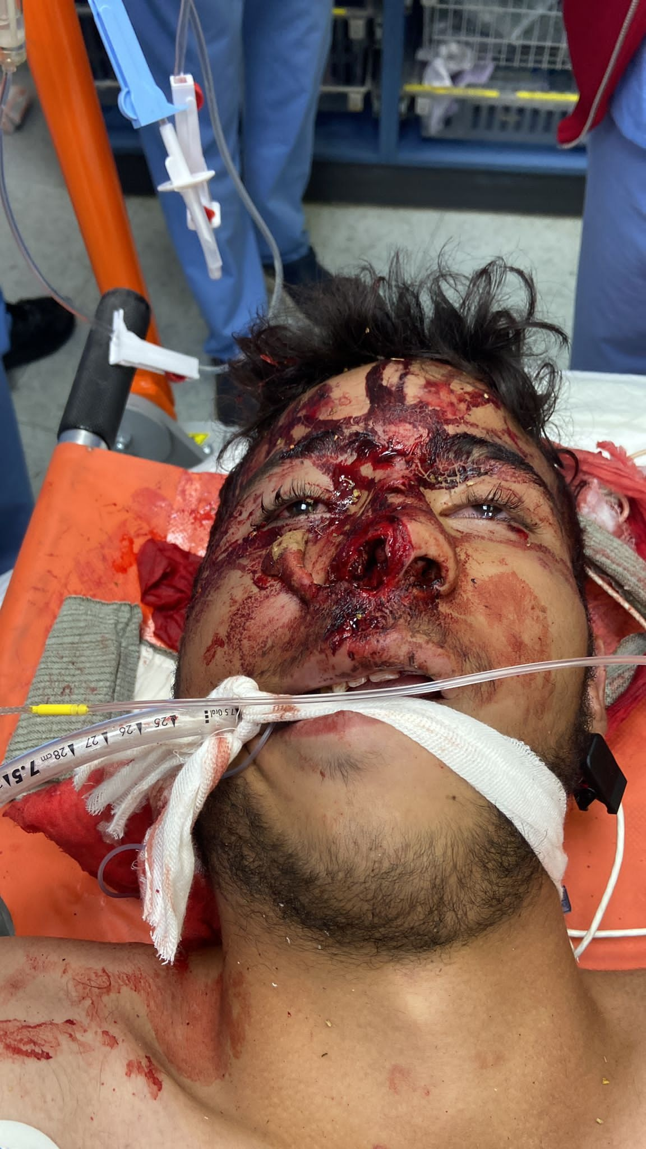

Slide 47
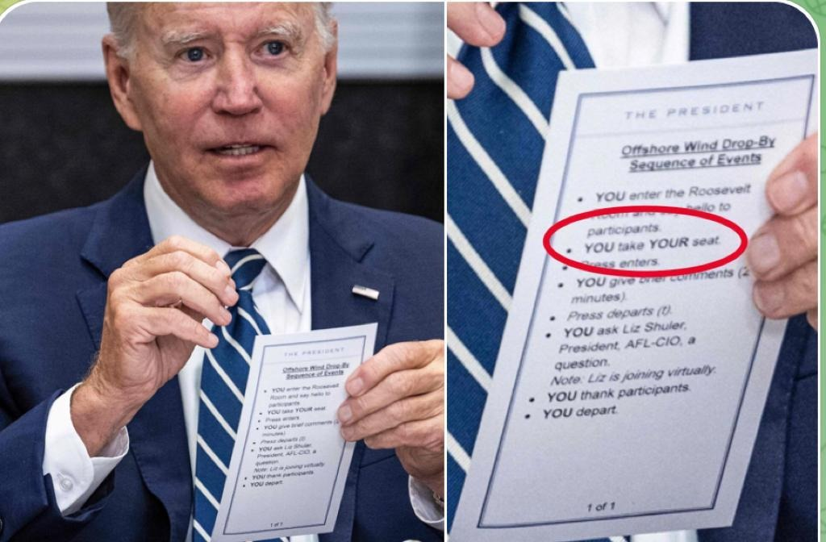

Slide 48
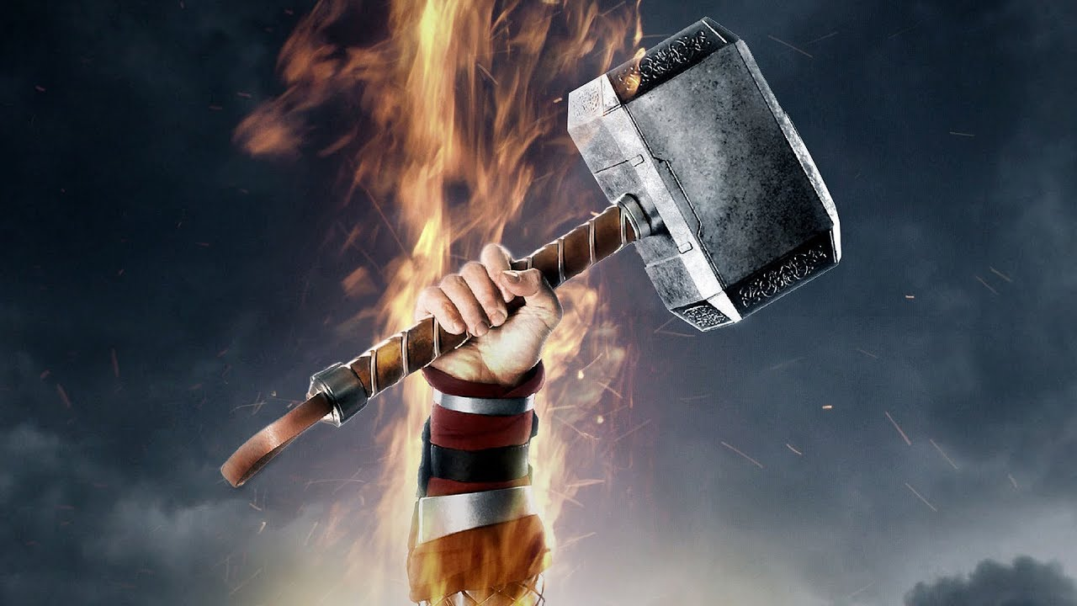

Slide 49
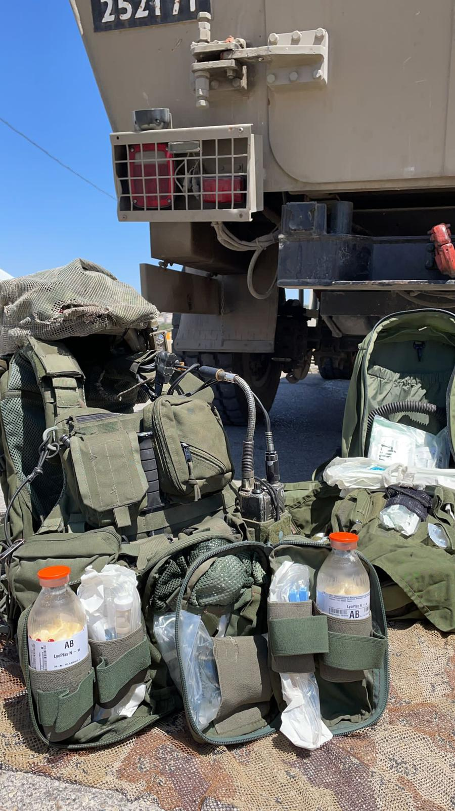

Slide 51
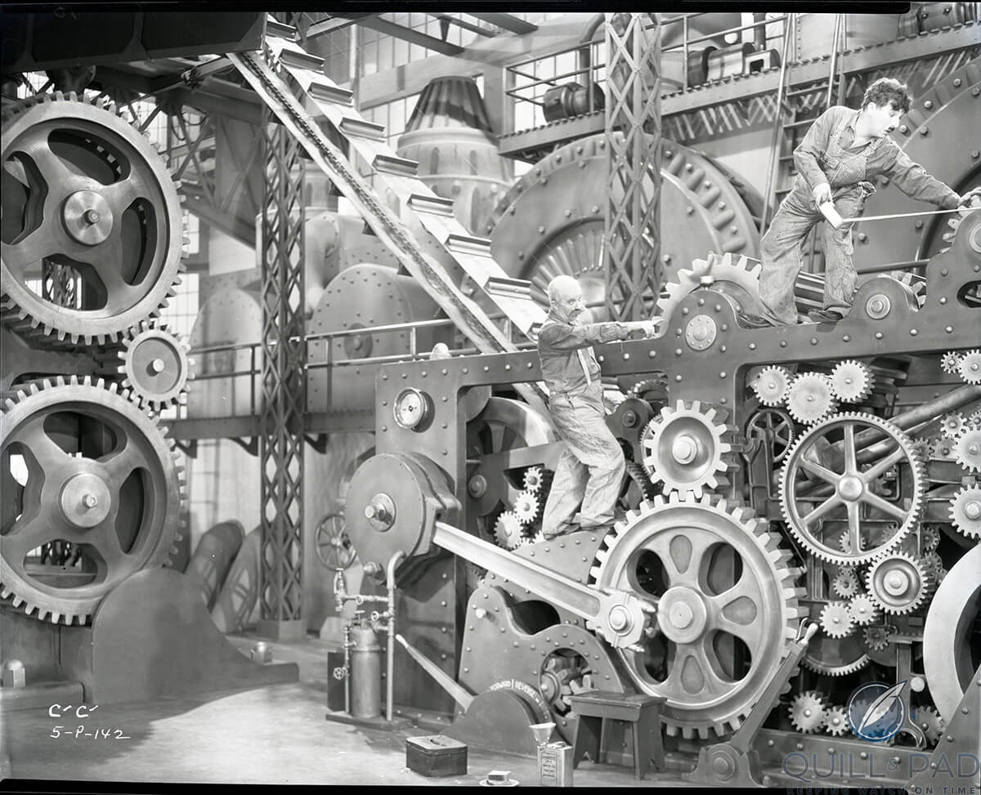

Slide 52
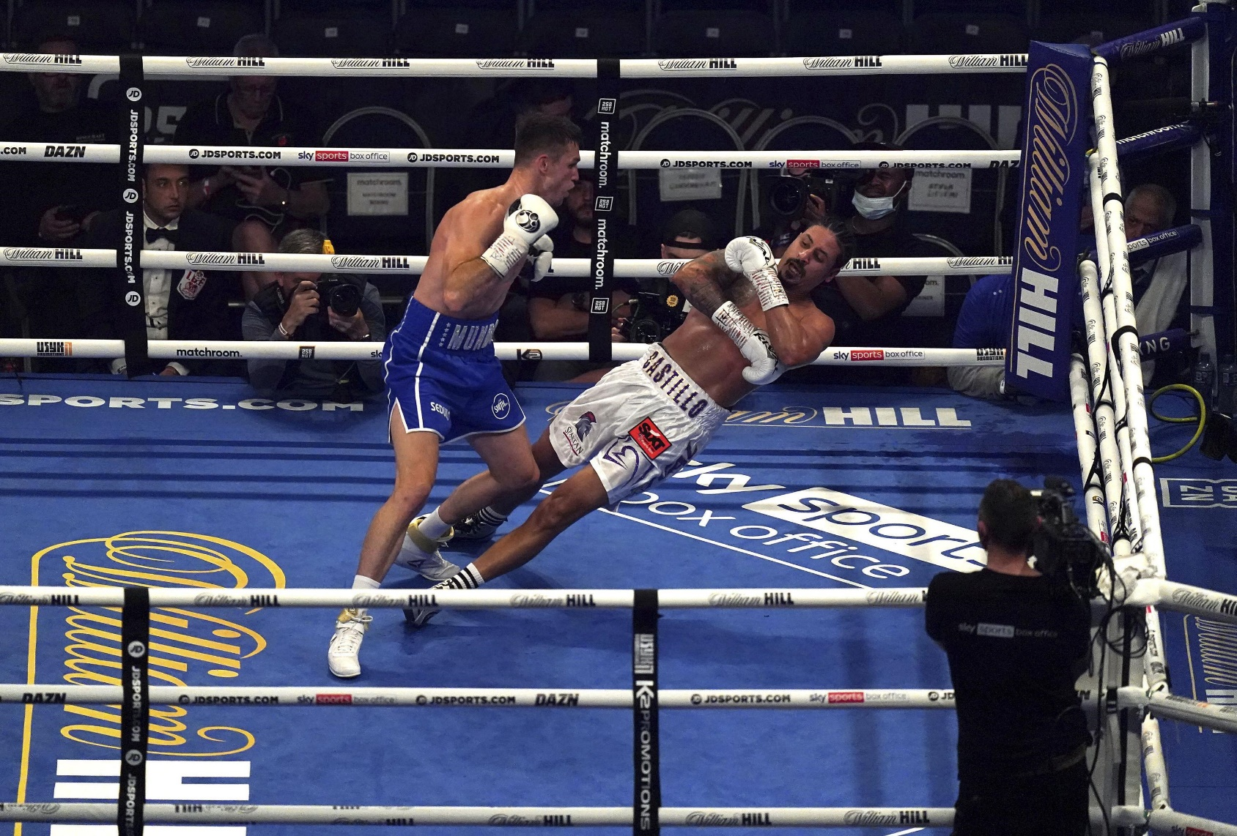
Take some hits
IDF-MC FOR YOU

Slide 53
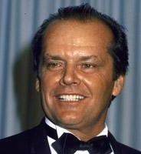
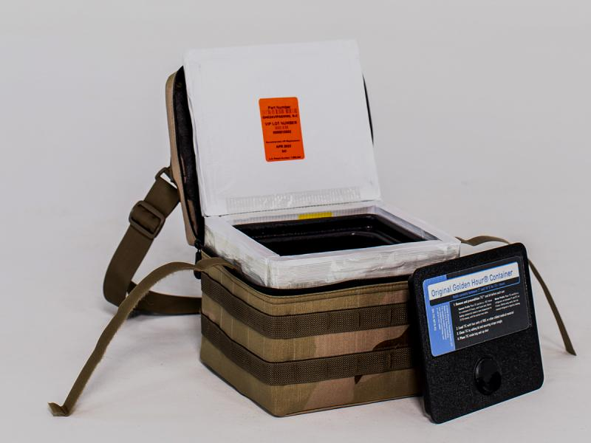
IDF-MC FOR YOU

Slide 56
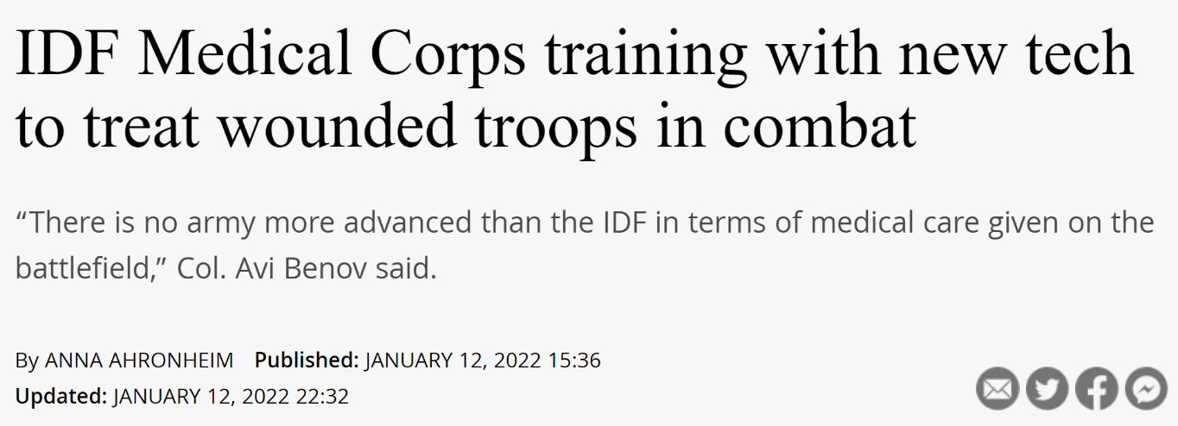
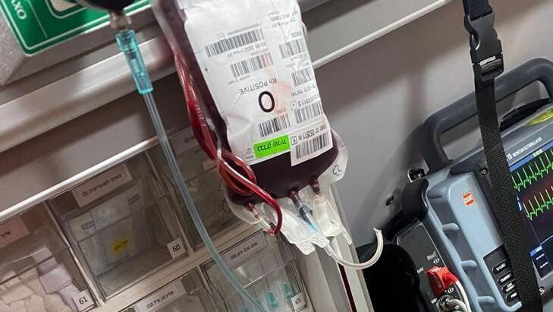
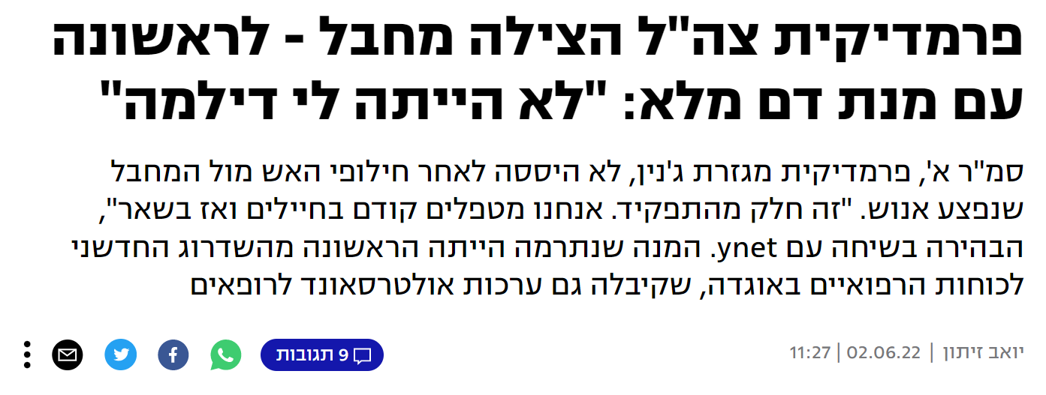
Celebrate your successes
IDF-MC FOR YOU

Slide 57
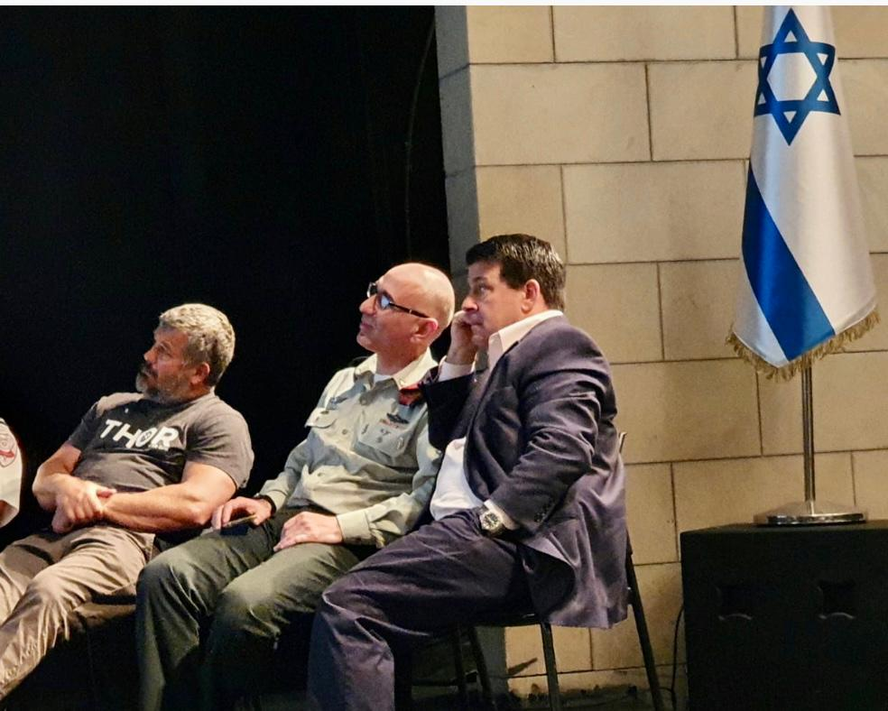
Make sure you get outsiders’ view (reality check!)

Slide 59
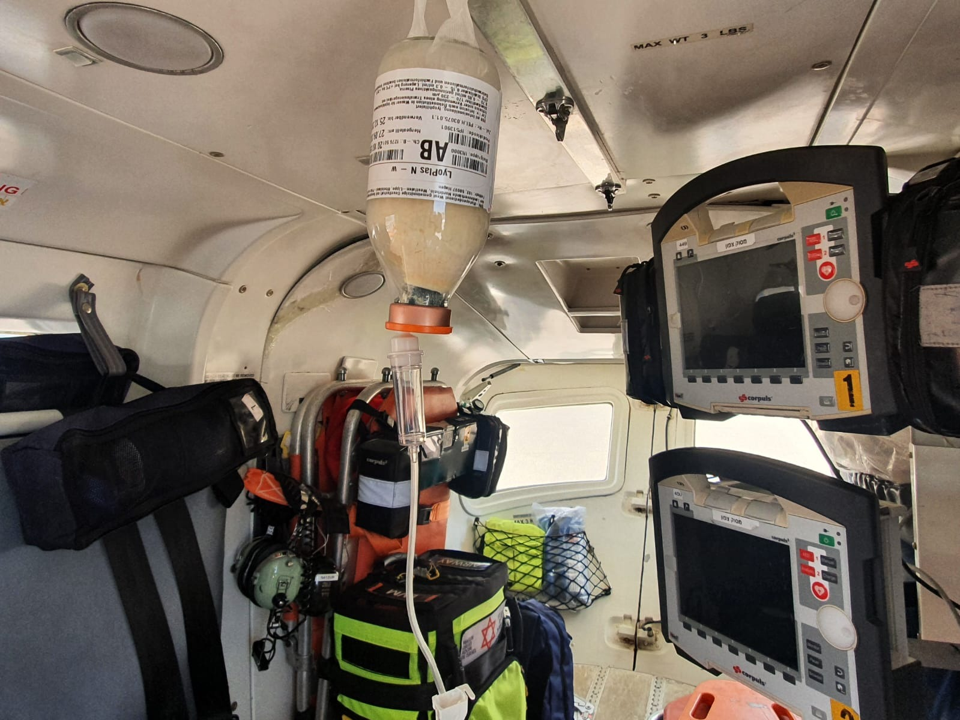
IDF-MC FOR YOU

Slide 60
Up to 2011
PRBC only for aeromedical teams
2012
TXA
2013
FDP
2018
LTOWB for aeromedical teams
2021
LTOWB on ground ambulances
Notes:
From here – consider including or not (AW protocol)

Slide 61
Up to 2011
PRBC only for aeromedical teams
2012
TXA
2013
FDP
2018
LTOWB for aeromedical teams
2021
LTOWB on ground ambulances
Notes:
From here – consider including or not (AW protocol)

Slide 62
Up to 2011
PRBC only for aeromedical teams
2012
TXA
2013
FDP
2018
LTOWB for aeromedical teams
2021
LTOWB on ground ambulances
Notes:
From here – consider including or not (AW protocol)

Slide 63
IDF-MC FOR YOU

Slide 71
Up to 2011
PRBC only for aeromedical teams
2012
TXA
2013
FDP
2018
LTOWB for aeromedical teams
2021
LTOWB on ground ambulances
Notes:
From here – consider including or not (AW protocol)

Slide 72
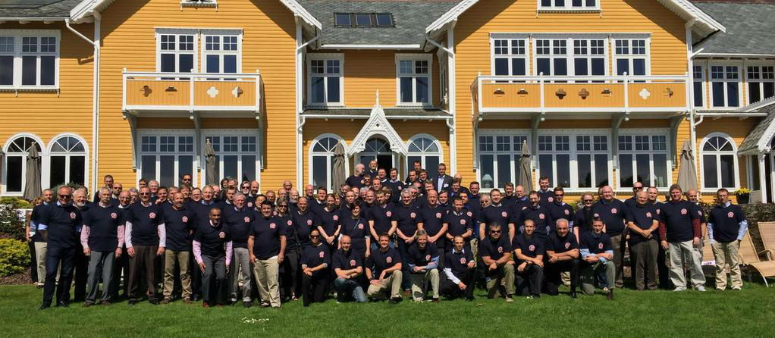

Slide 75
Thank you
BG Prof. Elon Glassberg
IDF Surgeon General
& Chief of the IDF Medical Corpp
sg@idf.il
IDF-MC FOR YOU

