Slide 1




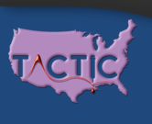
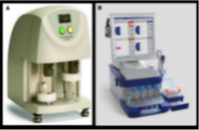
Hypocalcemia in Hemorrhagic Shock
EE Moore
Denver Health / University of Colorado Denver
Research Support : Haemonetics, Instrumentation Laboratory, Hemosonics,
Stago, Diapharma, Prytime, Humacyte & Genentech
Shared IP: Haemonetics; Co-founder: ThromboTherapeutics Inc
Federal Grants: NIH NIGMS RM1, T32; NIH NHBLI UMI; DOD

Slide 2
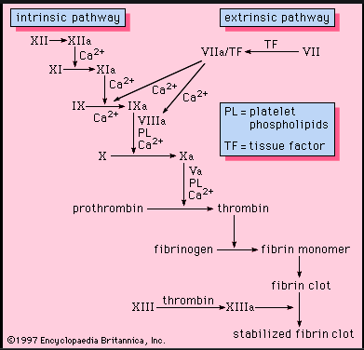
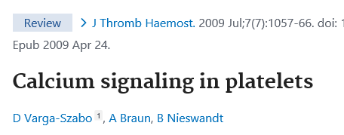
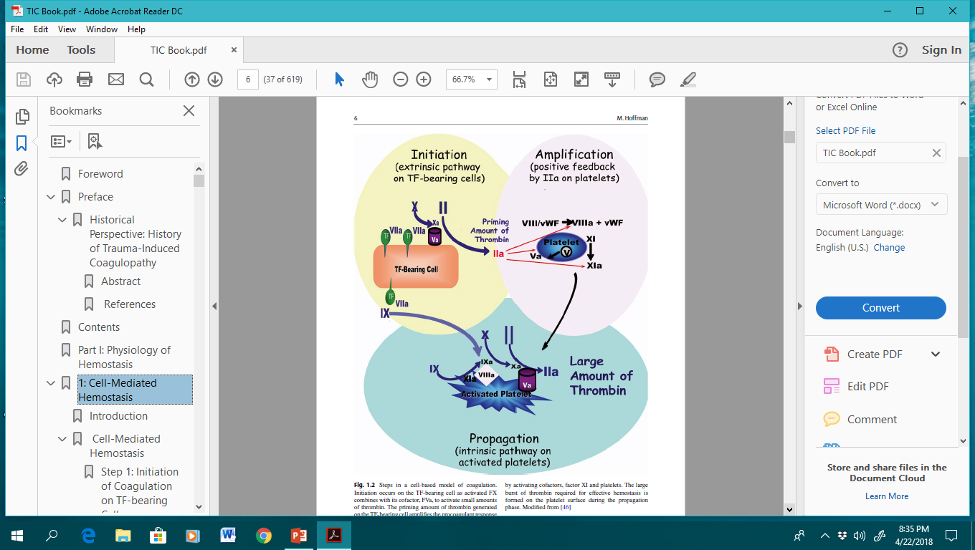
Role of Calcium in Coagulation

Slide 3
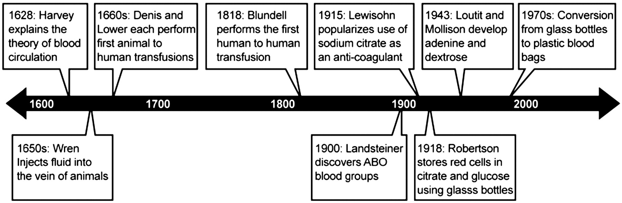
Blood Transfusion
Notes:
One of the major events in the history of blood transfusions in humans was the discovery of citrate as an anti-coagulant, which allowed the storage of blood.

Slide 4
Potential value of citrate in blood transfusions in humans first reported in 1893 by Wright
In 1915, sodium citrate was introduced as an anticoagulant independently by Hustin in Belgium, Agote in Argentina, and Lewisohn in the USA.

Slide 5
Citrate : Blood Storage in WWI
Oswald Robertson, the “Father of Blood Banking”, transported group 4 (type O) blood preserved with dextrose and citrate in glass jars placed in an “ice box” (ammunition boxes with ice and sawdust)

Slide 6
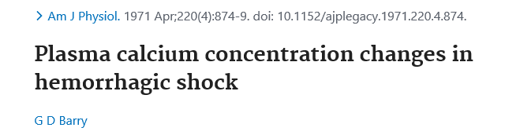
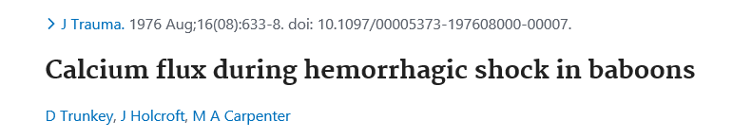
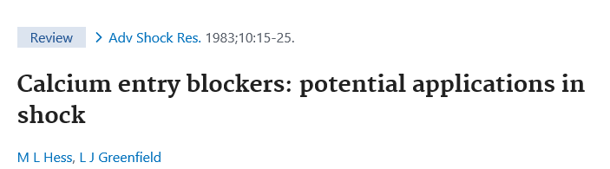
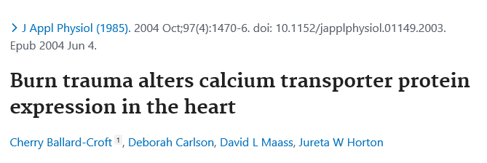
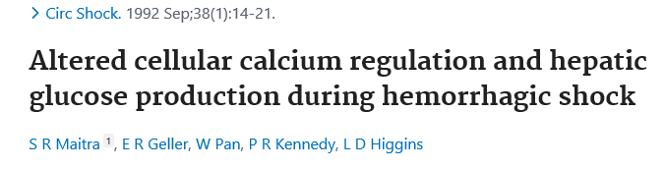
Hypocalcemia in Hemorrhagic Shock

Slide 7
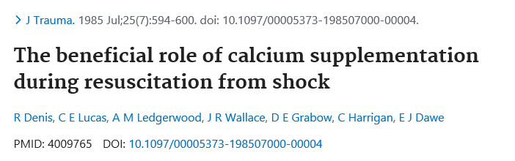
When is Calcium Supplementation Warranted
1983-1985: The Detroit General group (Lucas, Ledgerwood et al) reported the beneficial role of calcium supplementation during resuscitation from hemorrhagic shock
In the current ATLS Shock Chapter

Slide 8
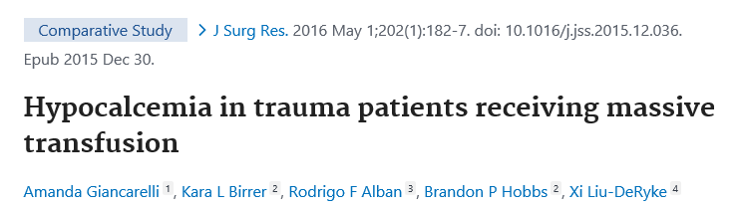
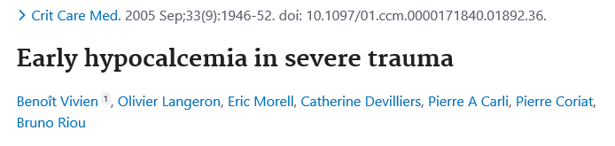
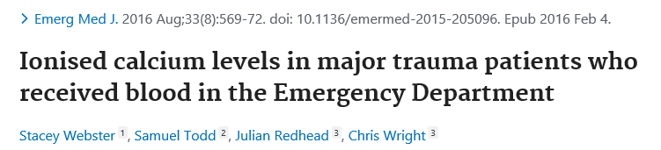
Ca ++ 97 % < 1.1 ; 71 % < 0.9 mmol/L
Ca ++ 74 % < 1.1 mmol/L at arrival
Ca ++ 55 % < 1.1 mmol/L at arrival; 89% if blood product

Slide 9





ADMISSION IONIZED-CALCIUM IN TWO CIVILIAN RANDOMIZED CONTROLLED TRIALS OF PRE-HOSPITAL PLASMA FOR TRAUMATIC HEMORRHAGIC SHOCK

Slide 10
COMBAT : Secondary Endpoints
Secondary endpoints | Control N=60 | Plasma N=65
Variable | Median (IQR) or % | Median (IQR) or % | p-value
Arrival INR | 1.15 (1.08-1.29) | 1.27 (1.11-1.40) | 0.10
INR >1.3 | 24% | 43% | 0.0298
BD >8 mEq/L | 52% | 55% | 0.77
Lactate >5mmol/L | 48% | 51% | 0.77
Hyperfibrinolysis (>3%) | 25% | 24% | 0.93
Physiologic (0.9-3%) | 45% | 44%
Shutdown (<0.9%) | 29% | 33%
40 % Hypocalcemia; 36 % vs 53 %
JTACS 2020

Slide 11
Hypocalcemia is Associated with Impaired Coagulation
 | NORMOCALCEMIA i-Ca >1.0mmol/L Median or % | HYPOCALCEMIA i-Ca <1.0mmol/L Median or % | p-value
INR | 1.20 | 1.31 | 0.11
RAPID TEG -ACT | 121 | 121 | 0.43
RAPID TEG-ANGLE | 71 | 67 | 0.02
RAPID TEG-MA | 58 | 54 | 0.005
RAPID TEG-LY30 | 0.70 | 0.45 | 0.69

Slide 12
Lower i-Ca Levels Associated with Higher Mortality after Adjustment for Confounders
 | p-value | Hazard Ratio | 95% Hazard Ratio Confidence Limits
First i-Calcium level | <.0001 | 0.527 | 0.488 | 0.570
Randomization group | 0.2643 | 0.904 | 0.757 | 1.079
ISS | <.0001 | 1.004 | 1.004 | 1.004
Shock index | <.0001 | 1.000 | 1.000 | 1.000

Slide 13
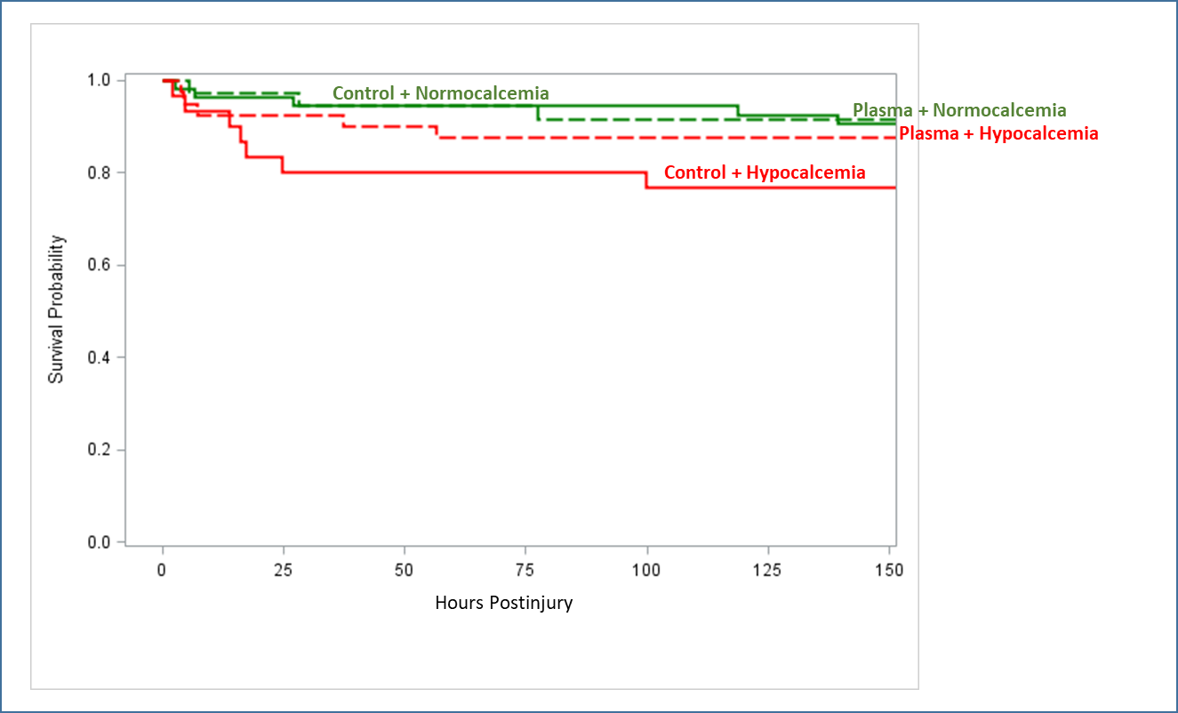

Hypocalcemia: Reduced Survival in Plasma and Control Groups
Survival Probability
Hypocalcemia in red
Normocalcemia in green
Plasma dashed lines _ _ _
Control solid lines ____
\\
JTACS 2020

Slide 14
Mechanisms for Shock Induced Hypocalcemia
Binding to citrate / hepatic clearance
Binding to exogenous albumin
Binding to lactate
Binding to phosphate
Magnesium elevated /depressed
Intracellular flux

Slide 15
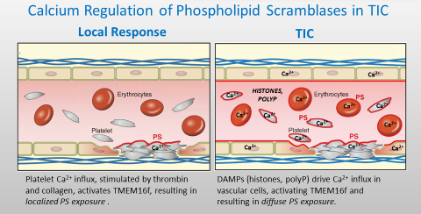
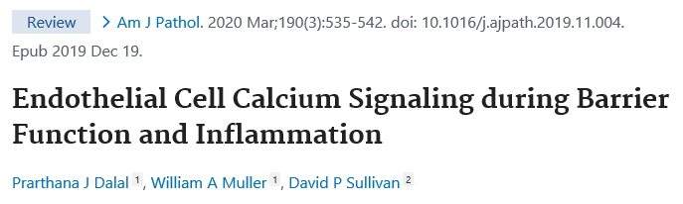
Trauma DAMPS Induce Calcium Influx
Bevers et al
Physiol Rev 2016

Slide 16
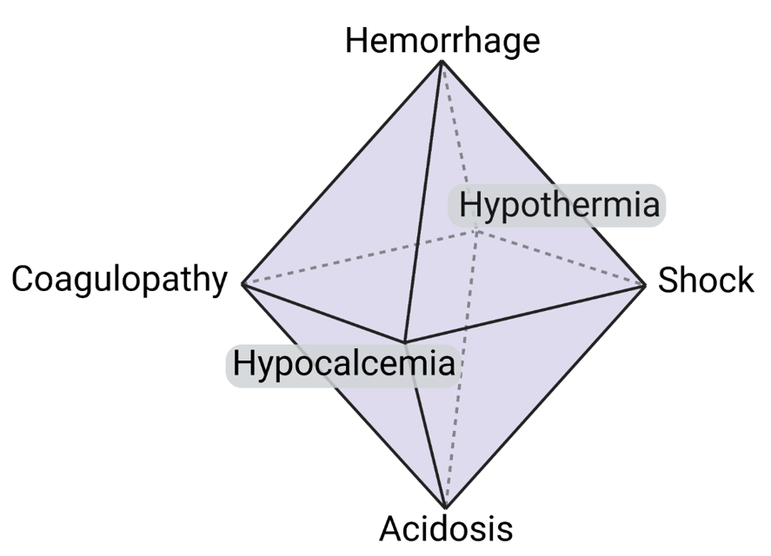
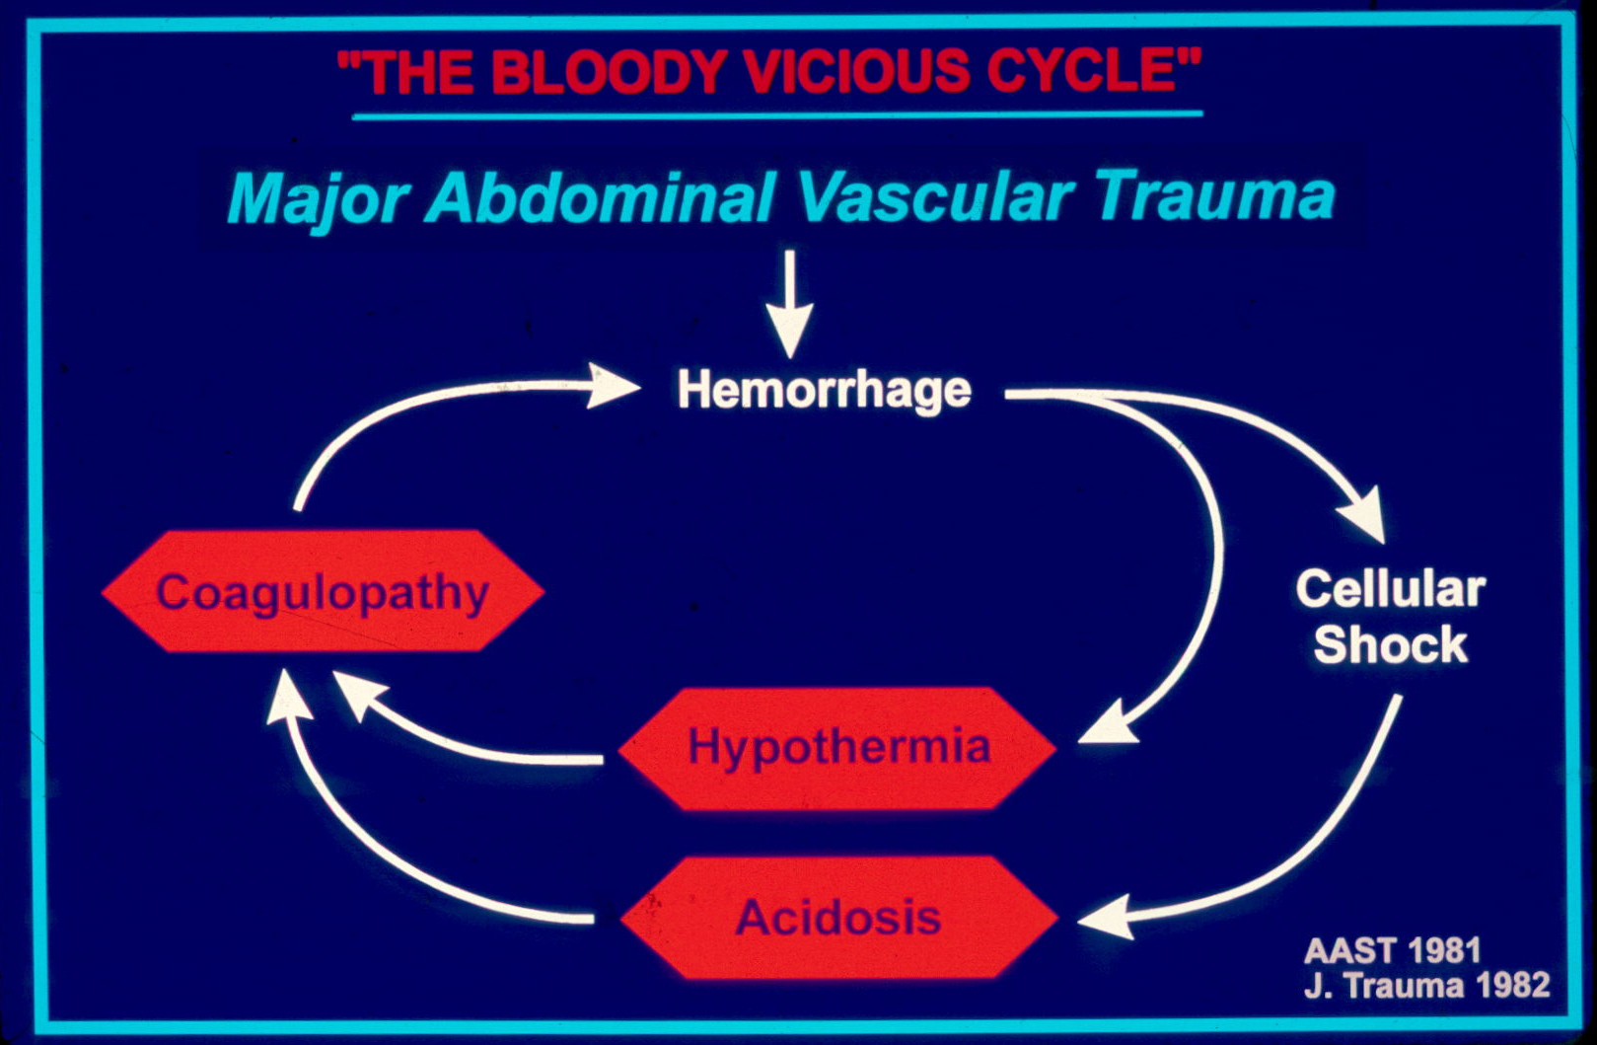
The Death Diamond
The Lethal Triad
TTTTh
J Trauma 1982
Transfusion / THOR 2022

Slide 17
Massive Transfusion Protocol
Calcium Chloride 1 gram
Whole Blood
Citrated rapid-TEG
ACT
> 128
Angle
< 65°
MA < 55
LY30
> 5%
FFP
CRYO
PLT
TXA
Re-assess via citrated rapid-TEG
FFP = fresh frozen plasma CRYO = cryoprecipitate
PLT = apheresis platelets TXA = tranexamic acid

Slide 18
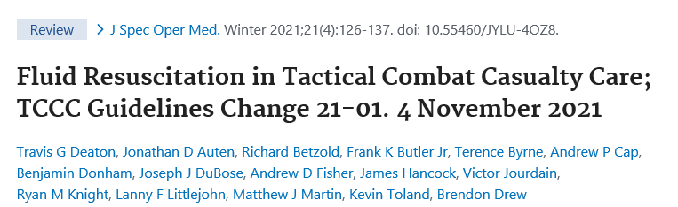
Prehospital Calcium

Slide 19
Conclusion:
Pre-emptive Calcium Administration for Shock
Myocardial contractility
Tissue perfusion
Hemostasis
Strategies to Mitigate Endothelial Calcium Flux

Slide 20

Thank you !!!

Slide 22
Calcium Supplementation
Calcium chloride 1 gram (10ml) = 273 mg elemental calcium
Calcium gluconate 1 gram (10ml) = 93 mg elemental calcium

Slide 23
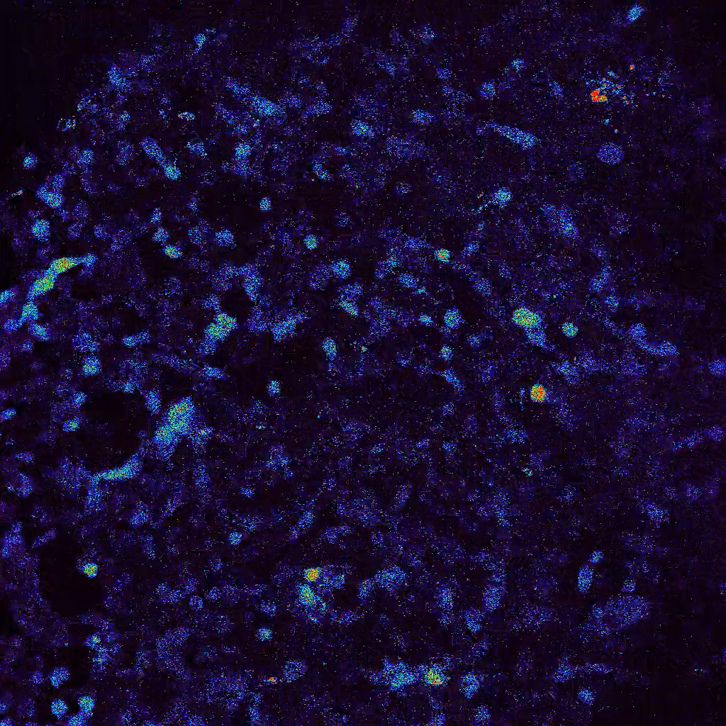
Shock Plasma Provokes Calcium Influx
Trauma + Shock
Trauma without Shock
JTACS In Press

Slide 24


DOD: W81XWH – 12-2-0028
NIH/NHLBI: 1 UM1 HL 120877
Hunter B. Moore, MD, PhD
Ernest E. Moore, MD
Angela Sauaia, MD, PhD
Jason L. Sperry, MD
Mitchell J. Cohen, MD
Michael P. Chapman, MD
Anthony E. Pusateri, PhD
Francis X. Guyette, MD, MPH
Matthew T. Tessmer
Joshua B. Brown, MD, MSc
Matthew Neal, MD
Brian Zuckerbraun, MD

Slide 25
Sodium Citrate Enables Stored Blood Transfusion
1915: Lewinsohn demonstrates the feasibility of using sodium citrate to store blood via calcium binding
1918: Robertson exploited this revelation to store and subsequently transfuse injured soldiers
Concerns of citrate toxicity delayed widespread adoption

Slide 26
Inclusion criterion: SBP<70mmHg or (SBP<90mmHg+HR>108bpm)
Adult patients randomized in the pre-hospital setting to receive Plasma or Crystalloid
  DOD harmonized data: COMBAT and one PAMPer site (Pittsburgh)
  Patients selected with ionized-calcium measured prior to IV calcium
  Hypocalcemia defined <1.0 mmol/L

