Slide 1
Virchow Revisited
M. Margaret Knudson MD FACS
Professor of Surgery, UCSF
Medical Director MHSSPACS

Slide 2
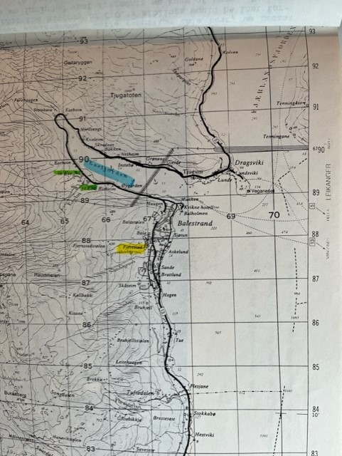

So Grateful to Participate
1845: Esse-Knudson Family History Book
Balestrand Norway: Esse family farm
Just up the road from Bergen
My first trip to Norway!

Slide 3
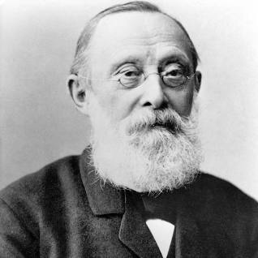
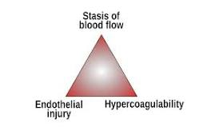
Historical Perspectives
Rudolf Virchow: “Father of Modern Pathology”
Although credited with the triad it was not his original work
First to describe the relationship between DVT and PE (1863)
“Pulmonary emboli arise in the leg, not “in situ”

Slide 4
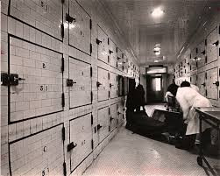
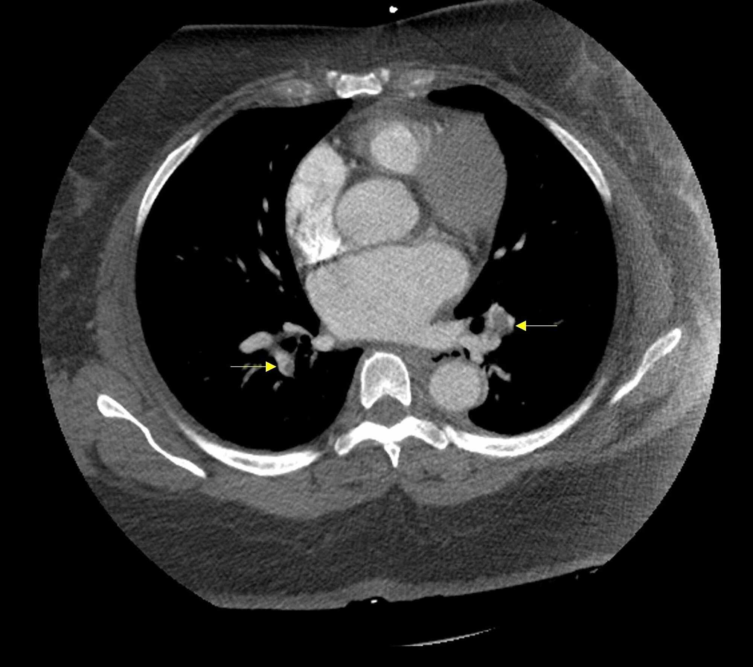
Death From PE After Trauma
First described McCartney, a pathologist at Mayo Clinic (1934)
Noted: association between fractures and death from PE (autopsy studies)
Almost 100 years later: PE remains a major cause morbidity/mortality
#1 reason for readmission post injury

Slide 5
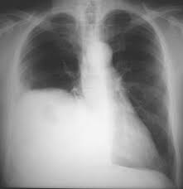
THE INDEX PATIENT 1987/Stanford
60-year-old professor at local college
High-speed MVC; ruptured right diaphragm; liver in chest
Survived initial surgery; severe pulmonary contusion
3 weeks on a ventilator
Finally extubated; stood up, cardiac arrest
Cause of death: PE
His devastated surgeon went to the literature: what to do?

Slide 6
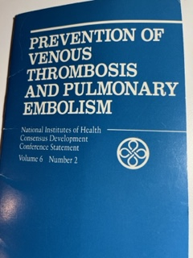
A Review of the Literature: VTE in Trauma
1986 NIH Consensus Conference
“Risks of thromboembolic diseases and PE in trauma: not defined”
“Efficacy and safety of various forms of prophylaxis: not evaluated”

Slide 7
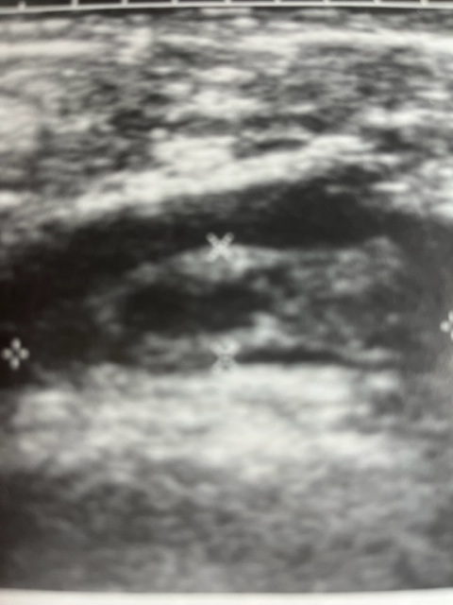
The Stanford Study
113 trauma patients: randomized to LDH or SCDs
Serial ultrasound exams: up to 3 weeks (grey scale)
5 patients with DVT; 4 PE only; 3 both
No differences between prophylactic regimens
High risk patients: older, more time immobilized, more transfusions, prolonged PTT on admission????
Never good to argue with you statistician!!
Knudson, Collins, Goodman: Thromboembolism following multiple trauma. J Trauma 1992

Slide 8

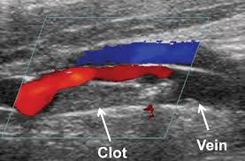
1989: Arrived at SFGH
New Duplex machine! New study design
“We don’t see VTE here in San Francisco”
????40 miles makes that much difference???
No standard of care: able to add a “control group”: no prophylaxis
251 randomized patients: LDH, SCD no better than control
6% had DVT by duplex; 2 additional PE (one fatal)
Subsequent study of 372 patients: LMWH: superior to both
Clearly need larger, multi-center studies
Knudson et al J Trauma 1994 and 1996

Slide 9
Knudson’s Trauma Triad
PARALYSIS
IMMOBILIZATION
VENOUS TRAUMA
FRACTURES
STASIS
ENDOTHELIAL DAMAGE
HYPERCOAGULABILITY
MULTIPLE TRANSFUSIONS
SEVERE INJURIES
Knudson, et al., J Trauma, 1994

Slide 10
1602 Episodes from ACS/NTDB
High Risk Factors (OR:2-3)
Very High Risk: (OR: 4-10)
Age > 40
Pelvic fracture
Lower Extremity fx
Shock on admission
Spinal cord injury
Head injury (AIS > 3)
Major operative procedure
Venous injury
Ventilator days >3
2 or more high risk factors
Knudson et al. Annals of Surgery 2004

Slide 11
3,738 Posttraumatic Pulmonary Emboli: ASA 2011
Incidence of “pulmonary clot” Doubled over 10 years
Suggested a disconnect: DVT and PE
Pulmonary clots: inflammation?
Discussant from the audience: how do you know
those are not primary clots and not embolic?
Knudson, Cohen, Nathens Annals of Surgery 2011

Slide 12
Knudson’s Trauma Square
PARALYSIS
IMMOBILIZATION
MULTIPLE TRANSFUSIONS
SEVERE INJURIES
HYPERCOAGULABILITY
ENDOTHELIAL DAMAGE
VENOUS TRAUMA
FRACTURES
STASIS
INFLAMMATION
CHEST TRAUMA

Slide 13
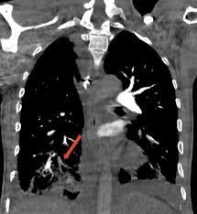
Primary Pulmonary Thrombosis After Trauma
247 patients: both CTPA and CTV (Velmahos)
PE found in 19%; DVT found concomitantly in 7%
Van Gent: 37patients with pulmonary clot
61%: no DVT (63% located in peripheral lung)
Most PT discovered early admission
Velmahos Arch Surg 2009; Van Gent J Trauma ACS 20114

Slide 14
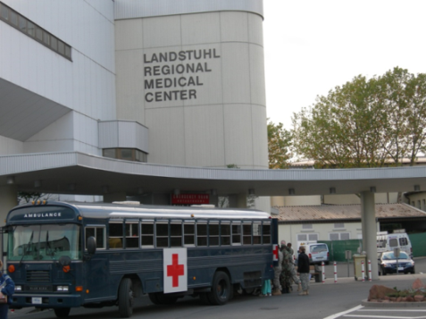
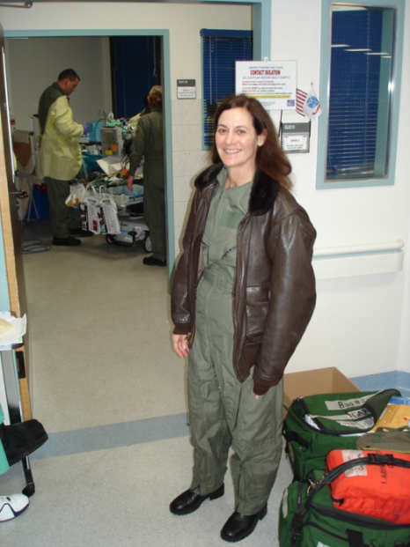
Senior Visiting Surgeons at LRMC

Slide 15
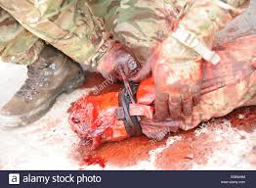
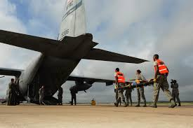
Primary Pulmonary Thrombosis: Military Experience
Lundy: 9.3% of Combat casualties: clot on CTA
Associated with severe injuries
Natural history of PT unclear
Bradley: 11/23 (48%) primary PT observed
Discharged without complications
Lundy: J Trauma ACS 2013
Bradley Amer Surg 2018

Slide 16

The Pathogenesis of Post-Traumatic Pulmonary Emboli
The clott study group:
Funded by the DOD/CDMRP

Slide 17

WHAT IS CLOTT?
Consortium of Leaders in the study Of Traumatic Thromboembolism
17 trauma surgeons/17 level 1 centers
10 years of collaboration
2 studies prior to funding
Variance is the Norm! (JTACS, 2014)
Magnitude of Surveillance Bias with Duplex (JTACS 2016)
Finally funded by DOD/CDMRP for $4.3M for CLOTT 1/2

Slide 18
Study Design: CLOTT Part 1
Pragmatic, prospective, multi-center, cohort observational study (2 years)
ALL Injured patients with identifiable risk factors for VTE enrolled
Must meet age range of combat eligible (18-40 years)
Data collected on CRF previously designed
Entered into UCSF REDCap
VTE risk factors: fractures, major injuries to abdomen, chest, head, spine; venous injuries, shock, major operation
Extensive data: VTE prophylaxis drugs, doses, missed doses etc.
Assess the reason for obtaining CTA where clots were discovered
Management of clots left to discretion of treating physician

Slide 19
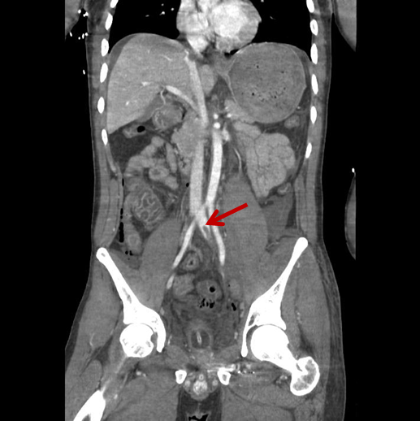
Outcomes of Interest: CLOTT Part 1
Major outcome of interest: the presence, extent, timing, location and treatment of any clot seen on CTA
Secondary outcome: presence of DVT
Definition: pulmonary clot with DVT=PE
Definition: pulmonary clot without DVT=PT

Slide 20
CLOTT -1 Results
7880 patients enrolled
DVT: 277 (3.5%)
PE: 40 (0.5%)
PT: 117 (1.5%)
Among those with PT: 23.9% were present on admitting CTA
Factors found to be independently associated with PT only:
Major chest injury (OR 1.72, p=.007)
Shock on admission (OR 2.75, p<.001)
Knudson et al JAMA Surg 2021

Slide 21
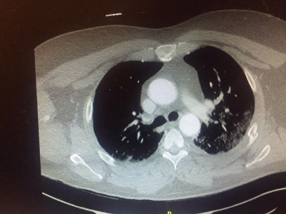
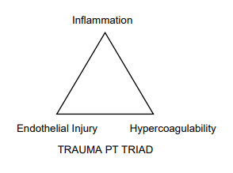
ARE ALL POST-TRAUMATIC PULMONARY CLOTS EMBOLIC?
STUDY POPULATION
METHODS
OUTCOMES
277 with DVT; 40 PE; 117 primary PT; risk factors for PT only= chest trauma and shock
7880 injured patients aged 18-40yrs with VTE risk factors
Prospective observational study ; main outcome of interest: de novo pulmonary thrombi (PT)
Admitted to one of 17 trauma centers in the “CLOTT” research group
Secondary outcomes of interest
Presence of PE (with DVT)
De novo PT are distinct from
traditional VTE paradigm

Slide 22
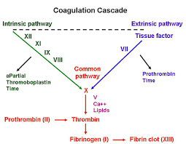
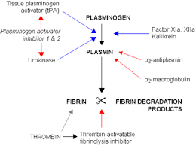
Is Our Approach to VTE Prophylaxis all Wrong?
Prevention of VTE: Clotting System
Prevention of VTE: Fibrinolytic System

Slide 23
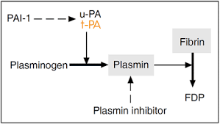
FIBRINOLYSIS SHUTDOWN (SD)
First described in 1964 in surgical patients
Associated with myocardial infarction and trauma
Post-op hip surgery: SD associated with VTE
COVID-19 patients with SD: VTE and Renal Failure
Associated with increased levels of PAI-1
Most severe form: resistant to tPA (tPA-R)

Slide 24
Background for CLOTT Part 2
Patients who are coagulopathic after injury are also more likely to develop VTE (Knudson et al J Trauma 1992)
Recent studies using TEG have demonstrated that critically injured patients frequently exhibit inability to lyse clot (Moore JACS 2016)
Both coagulopathic and hyper-coagulable states associated with increased mortality
The degree of lytic failure can be quantified by TPA-TEG assays

Slide 25
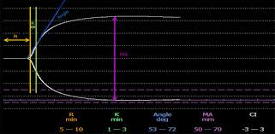
CLOTT-2 STUDY
Purpose: To Describe the injury patterns associated with early SD and tPA-R
Hypothesis: Early SD and/or tPA-R: independent risk factor for the development of post-traumatic VTE complications

Slide 26
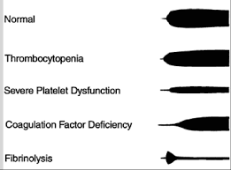
Study Design: CLOTT Part 2
Patients evaluated at 5 CLOTT centers with coag research labs
Eligible patients: admitted to ICU with major risk factors
Serial blood draws for standard and specialized TPA TEG studies over 7 days
Single surveillance duplex exam: DVT
Same CRF as in Part 1 with addition of lab values
Blood samples stored for PAI-1 levels and other studies
SD=kaolin TEG Ly30 < 0.3%
tPA-R=kaolin+TPA 75 ng Ly30< 2.1%

Slide 27
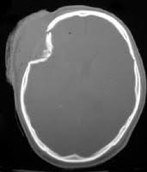
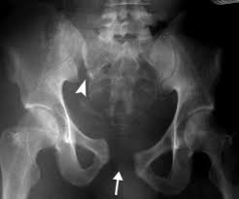
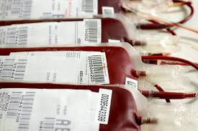
RESULTS
141 patients with paired samples
SD at 12 hours: 52%; SD at 24 hours: 44%
tPA-R at 12 hours: 45.4%; tPA-R at 24 hours: 34.3%
Factors significantly associated with early SD:
-> 4 units FFP/first 24 hours
-brain or pelvic fractures
-major surgery on day of admission
Factors significantly associated with early tPA-R
-> 4 units RBCs/24 hours
-chest injuries or long bone fractures

Slide 28
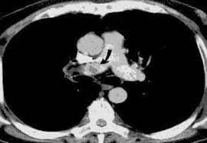
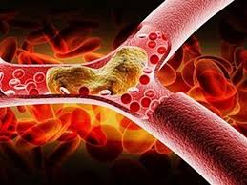
RESULTS
DVT detected in 15 patients; pulmonary clots in 5 (1=both)
Overall VTE rate: 14.2%
tPA-R at 12 hours: independent risk factor for VTE (hazard ratio of 5.57, 95% CI 1.39-22.39)

Slide 29
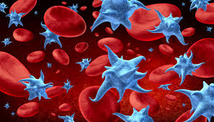

CONCLUSIONS
Patients with injury patterns associated with early tPA-R: high risk for VTE
In these patients, prophylactic measures should be started early
As platelets are one source of PAI-1, consideration should be given to anti-platelet agents as prophylactic measures
The timing of initiation of prophylactic measures may be more important than the agents utilized!

Slide 30
TRAUMA PLATO
TRAUMAtic PuLmonary Artery Thrombi: anticoagulated or Observe
Phase 3, multicenter, randomized, open label, non-inferiority clinical trial
Eligible patients: CTA of the chest on day#1 of admission with pulmonary clot located anywhere except main PA
Lower extremity duplex within 72 hours=no DVT
Randomized within 72 hours to full-dose vs prophylactic AC
Excluding patients with TBI
Under consideration at DoD PRMRP

Slide 31

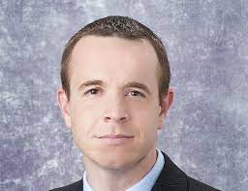
THE FUTURE OF TRAUMA PLATO

Slide 32
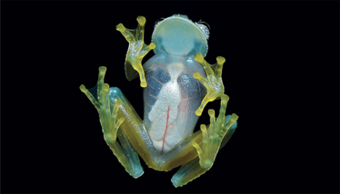
THE FUTURE OF CLOT PREVENTION: THE GLASS FROG
Glass frogs hide their red blood cells in their liver when stressed
They thus become transparent: master of camouflage
How can they restore their circulation without clotting?
“Perhaps these impossibly delicate glass frogs hold the secret to anticoagulant medicine to prevent VTE? “

Slide 33
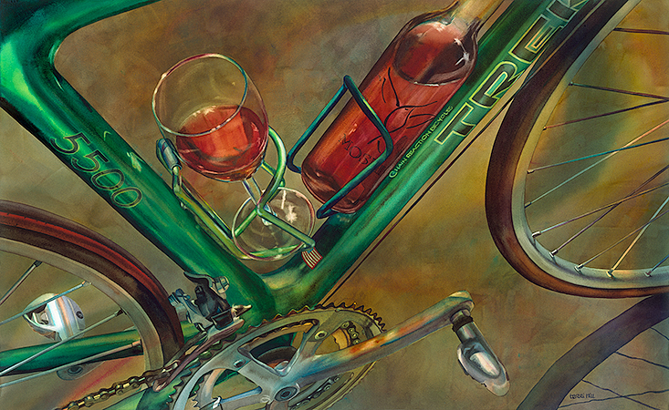
LET ME KNOW WHEN YOU FIGURE IT OUT!

