Slide 1

The Compensatory Reserve:
Potential for Accurate Individual Goal-Directed Resuscitation
Victor A. Convertino, PhD
Senior Scientist
Battlefield Health & Trauma Center for Human Integrative Physiology
Combat Casualty Care Research Program
victor.a.convertino.civ@mail.mil

Slide 2
Objectives
Review the concept of compensatory reserve
Defining the relationship between compensatory reserve and DO₂
Using compensatory reserve to guide resuscitation based on sustaining adequate DO₂

Slide 3
Compensatory Reserve
Provides a metric of the sum total of all compensatory mechanisms that together contribute to protect against inadequate oxygen delivery (DO₂) during low circulating blood volume states
100
80
60
40
20
0
Reduced
Oxygen
Delivery
Compensatory Reserve, %
Zero
CR
Critical
DO₂
=
Point of Decompensation
Moulton et al, J Trauma 75:1053-1059, 2013

Slide 4
Arterial Waveform Features
as a Marker of Compensation
Normovolemic waveform
Hemorrhage waveform
Systolic peak
Diastolic
Ejected wave
Ejected
wave
Reflected
wave
Reflected wave
Ejection wave features = cardiac compensation mechanisms
Reflected wave features = vascular compensation mechanisms
Convertino et al, Shock 45:80-90, 2016

Slide 5
How the Algorithm Works *
Unknown
Individual’s
Arterial
Waveform
Compensatory Reserve = 100%
Identify the most similar waveform
Reserve
to
Compensate
Compensatory Reserve = 50%
* Base on
>200 subjects
with >650,000
waveforms
Compensatory Reserve = 0%
Convertino et al, J Appl Physiol 115:1196-1202, 2013

Slide 6
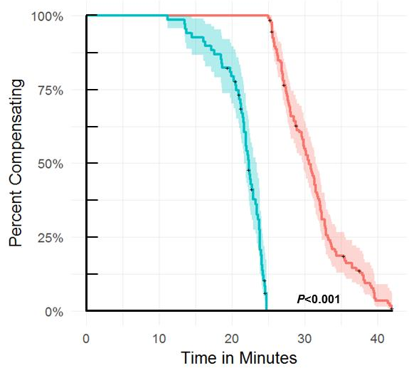
Kaplan–Meier survival curve analysis
100%
75%
Poor Compensators (N = 68)
Percent Compensating
50%
25%
0%
0 10 20 30 40
Time (minutes)
Schiller et al, Exp Biol Med 242:874-883, 2017

Slide 7
Kaplan–Meier survival curve analysis
100%
75%
Poor Compensators (N = 68)
Good Compensators (N = 134)
Percent Compensating
50%
25%
0%
0 10 20 30 40
Time (minutes)
Schiller et al, Exp Biol Med 242:874-883, 2017

Slide 8
Goal-Directed Resuscitation
Controlled Human Hemorrhage Model
Resuscitation
Subject 1
Subject 2
100
100
90
90
80
80
70
70
Compensatory Reserve, %
60
60
50
50
40
40
30
30
0
200
400
600
800
1000
1200
1400
0
200
400
600
800
1000
1200
1400
Blood Loss, ml
Blood Loss, ml
Convertino et al, Shock 44(suppl. 1):27-32, 2015
Convertino et al, Shock 44(suppl. 1):27-32, 2015

Slide 9
Framework for continuum of metabolic relationship of oxygen delivery (DO2), utilization (VO2), and compensatory reserve (CR)
Hemorrhage
Onset of
O₂ Deficit
Delivery
Dependent
VO₂
Delivery
Independent
VO₂
Normal
Resting
State
Death
StO₂ + PCr
SvO₂
OER
Lactate
VO₂
SvO₂
OER
Lactate
0%
CR
100%
DO₂crit
DO₂
Decrease
Hooper et al, Shock 41 (Suppl 1):13-20, 2014

Slide 10
Relationship between DO₂ and Compensatory Reserve
DO₂ = CO X Hgb X SaO₂
DO₂ (mL O₂∙kg⁻¹ ∙min⁻¹) = 0.08 X CR (%) + 5.3
16
R² = 0.93
DO₂ = 13.3 mL O₂∙kg⁻¹ ∙min⁻¹
CRM = 100%
14
12
DO_{2crit} = 5.3 mL O₂∙kg⁻¹ ∙min⁻¹
CRM = 0%
10
DO₂ (mL O₂∙kg⁻¹ ∙min⁻¹)
8
6
4
2
0
0
10
20
30
40
50
60
70
80
90
100
Compensatory Reserve Measurement (%)
Koons et al, Shock 2019 (ePub ahead of print)

Slide 11
Using Compensatory Reserve
To Guide Resuscitation

Slide 12
Relationship between DO₂ and Compensatory Reserve
DO₂ (mL O₂∙kg⁻¹ ∙min⁻¹) = 0.08 X CRM (%) + 5.3
16
R² = 0.93
DO₂ = 13.3 mL O₂∙kg⁻¹ ∙min⁻¹
CRM = 100%
14
12
DO_{2crit} = 5.3 mL O₂∙kg⁻¹ ∙min⁻¹
CRM = 0%
10
8
DO₂ (mL O₂∙kg⁻¹ ∙min⁻¹)
6
4
2
0
0
10
20
30
40
50
60
70
80
90
100
Compensatory Reserve (%)
Koons et al, Shock 2019 (ePub ahead of print)

Slide 13
Targeted Resuscitation using CRM
50 ml/min (N=12)
100
100
90
90
80
80
BV Replaced = 40%
70
CRM = 35%
70
60
60
Compensatory Reserve (%)
Replaced Blood Volume (%)
50
50
40
40
30
30
20
20
10
10
0
End of Hem.
0
End of Hem.
B
End of Res.
B
End of Res.
160
140
SBP ≈ 90 mmHg
120
100
Systolic Blood Pressure (mmHg)
80
60
40
B
End of Hem.
End of Res.
Koons et al, Shock 2019 (ePub ahead of print)

Slide 14
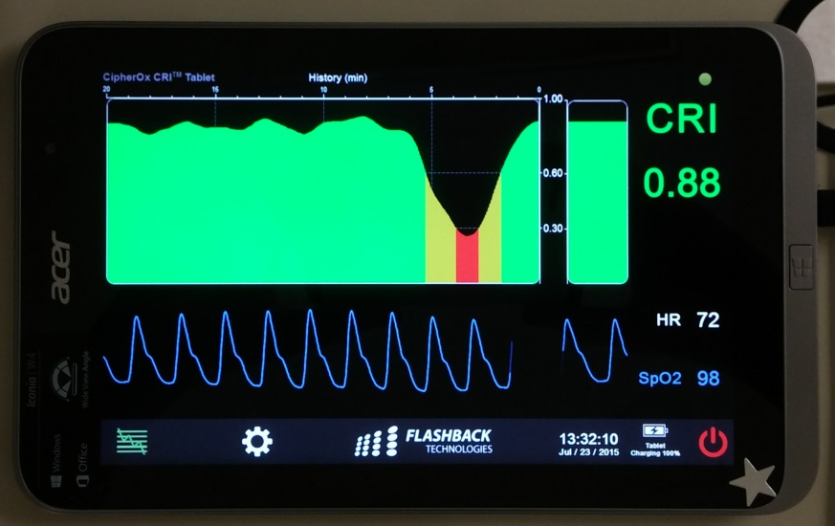
Goal-directed Resuscitation
CRM
88%

Slide 15
Effective Resuscitation =
Sustaining the Compensatory Reserve
above DO₂crit

Slide 16
Summary benefits for measuring the Compensatory Reserve
Early hemorrhage detection
Accurate marker of patient status without baseline
Green-Yellow-Red indications for medics
Non-invasive continuous goal-directed resuscitation
Based upon complex integration of total physiological compensation
Specific to the individual patient (e.g., distinguishes those at highest risk)
FDA-cleared

Slide 17
Thank you

Slide 18
Compensatory Reserve vs. StO₂
StO₂ (AUC = 0.68)
Baseline
CRM (AUC = 0.90)
Decompensation
1.0
*
80
0.8
60
0.6
Sensitivity
Tissue Oxygenation, StO2 (%)
40
0.4
0.2
20
0.0
0
0.0
0.2
0.4
0.6
0.8
1.0
Low Tolerant
High Tolerant
1-Specificity

Slide 19
Baboon Hemorrhage/LBNP
vs. Human LBNP
0
6.25%
-20
-40
12.5%
% Change in Compensatory Reserve
-60
18.75%
Hemorrhage Baboons (N = 12)
-80
LBNP Baboons (N = 12)
25%
LBNP Humans (N = 200)
-100
0
-10
-20
-30
-40
-50
-60
-70
-80
-90
LBNP (mmHg)
Koons et al, Shock 2019 (ePub ahead of print)

