Slide 1
Science Fiction ……………… and back to the future.
Two ways for new blood products
MG Anne SAILLIOL (MD)^{R}, Cl Frédérique DUFOUR-GAUME (MD), Cl Christophe Martinaud (MD, PhD)^{R.} FRANCE
Notes:
Good morning everybody !
First, I would like to thank the organizers for giving me the floor.
Second, you may know that my English is not the best so I would be thankful for being indulgent.
Today, I discuss with you about new blood products.

Slide 2
Who I am ?
No conflicts of interest.
The opinions or assertions contained here are under my whole responsibility.
Director of the Blood Transfusion Center of the French Armies (2008 – 2017).
Director of the Biomedical Research Institute of the French Armies (2017 – 2020).
Retired since September 2020.
Notes:
I am military medical doctor with 2 years of practice in emergency medicine and 22 years in hemobiology-transfusion with a strong activity in research and development.

Slide 3
Overview
Why are new blood products a major step forward ?
1
2
What should be replaced : whole blood or its components?
Science fiction and back to the future, 2 possible paths for new blood products
More or less artificial blood products
Upgrading old blood products in terms of their preparation, storage or use
Notes:
A quick overview of my presentation : we’ll address two consecutive questions :
Why are new blood products a major step forward ?
What should be replaced : whole blood or its components?
Science fiction and back to the future are two research paths for new blood products that I will differentiate by:
more or less artificial blood products
And
- upgrading old blood products in terms of their preparation, storage or use.

Slide 4
Why new blood products ?
Increase resource possibilities
01
1
Reduce adverse effects
02
2
Adapt to the variety of needs
03
3
04
Simplify conservation and implementation methods
4
The ideal substitute : universal compatibility, long shelf life, simple and quick implementation, equivalent efficacy to the original product, absence of adverse effects and perfect microbiological safety
Notes:
Why new blood products ? 4 reasons:
Increase resource possibilities as needs grow and evolve.
Reduce adverse effects, including transmission of pathogens, incompatibilities, refractory states and overloads.
Adapt to the variety of needs: hemorrhage, onco-hematology, hemoglobinopathies, etc.
Simplify conservation and implementation methods.
The ideal substitute should have several characteristics: universal compatibility, long shelf life, simple and quick implementation, equivalent efficacy to the original product, absence of adverse effects and perfect microbiological safety.

Slide 5
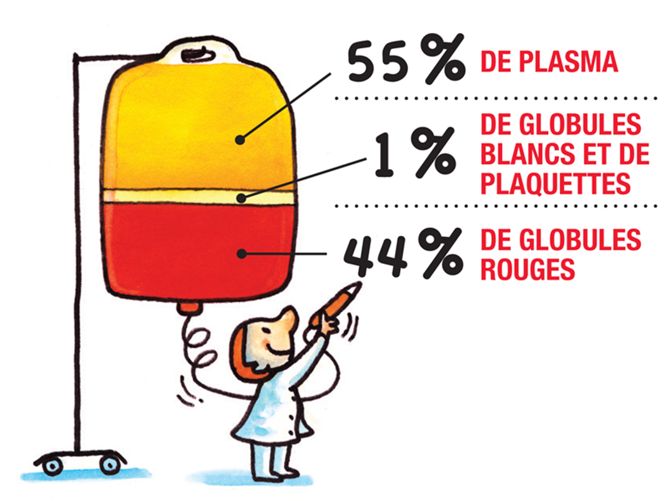
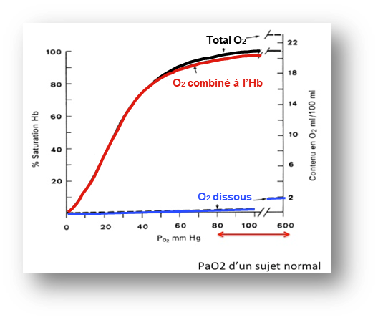
What should be replaced? Whole blood or its components?
Plasma
Leukocytes
Platelets
Stem cells
Erythrocytes
Sang Total
Notes:
What should be replaced, whole blood or its components?
The composition of blood is very complex but can be simplify to 55% plasma, 44% red blood cells and 1% platelets, white blood cells and stem cells.
The main role of red blood cell is the transport of oxygen to the cells via to its hemoglobin. Hemoglobin also traps free radicals.
Platelets allow clot formation, vascular maintenance end have an immunomodulatory role.
Leukocytes are essential in the defense against pathogens.
Stem cells allow cell renewal.

Slide 6
What should be replaced? Whole blood or its components?
Plasma contains lot of elements
Plasma
Leucocytes
Platelets
Cellules souches
Erythrocytes
Notes:
Plasma is not just salt water (Isn't it Phil !). It is a solution of lipids, carbohydrates and proteins. 90% of dry plasma is made up of about 20 proteins including fibrinogen. The remaining 10% are all the products released by the cells.

Slide 7
Science fiction and back to the future, two ways for new blood Products
“Artificial” blood products.
Upgrade old blood products.
Notes:
We will not detail the different processes to respect the time of presentation.

Slide 8
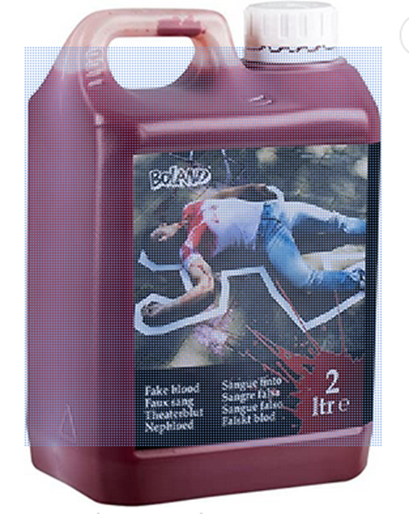
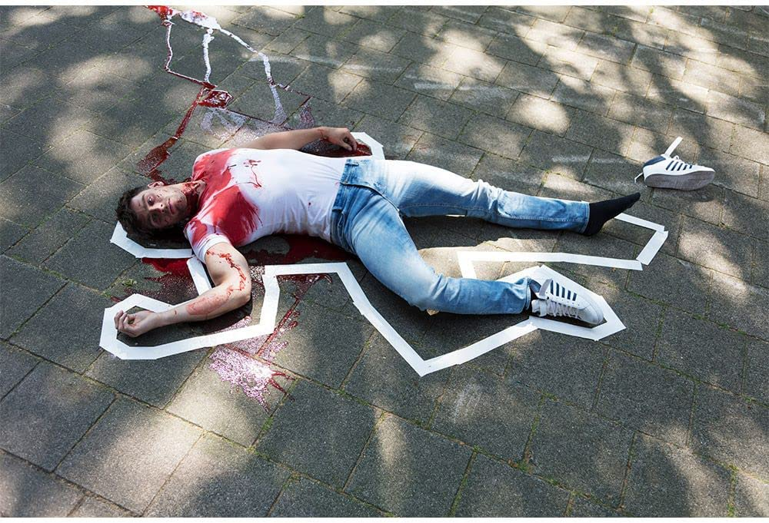
Artificial whole blood
Only for cinema or theatre !
Notes:
The complexity of whole blood explains why, to date, all try to produce artificial whole blood have failed. Today, innovation focuses on the different elements of whole blood.

Slide 9
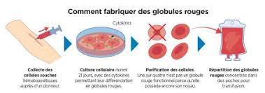
Culture of red blood cells
How to make red blood cells ?
Hematopoietic stem cell collection from a donor
Cell culture for 21 days with addition of cytokines allowing differentiation into erythrocytes.
Purification of the cells, keeping only those without a nucleus.
Distribution of erythrocytes in transfusion bags.
Notes:
A promising line of research is the culture of red blood cells from stem cells selected according to a blood phenotype of interest. Thus, it will be possible to provide a specific treatment to poly-immunized patients or patients with a rare phenotype. The technique allows the production of one hundred blood bags per one stem cell donation, in three weeks
In more, the latest studies have shown a viability of cultured red blood cells twice that of conventional blood donations.

Slide 10
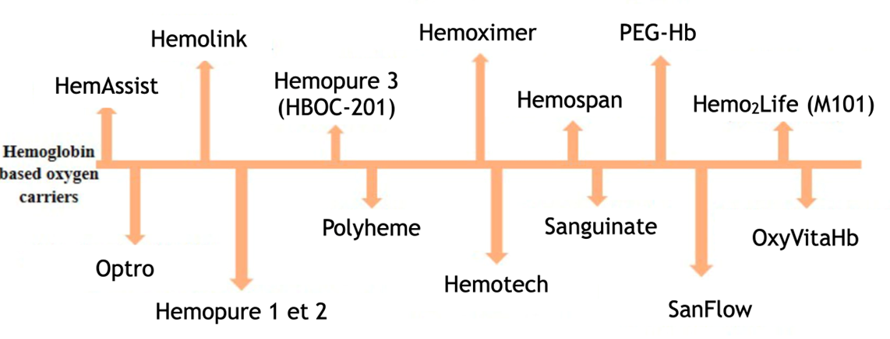
Oxygen transport
without erythrocyte supply
The perfluorocarbons
Several products have been discontinued due to their adverse effects.
Oxygen carriers derived from Hb
Notes:
Let us now focus on the transport of oxygen without the supply of erythrocytes.
Frédérique introduced you to perfluorocarbons and their adverse effects which have stopped most research on these products.
Oxygen carriers derived from hemoglobin could be very useful but they have such a strong affinity for O2 that it limits exchanges with tissues. They also have a strong affinity with nitric oxide which makes them very toxic by vasoconstriction. Other adverse effects are pulmonary arterial hypertension, reduction of cardiac output and inhibition of platelet aggregation.
For the moment, no product has provided proof of its effectiveness without major adverse effects.

Slide 11
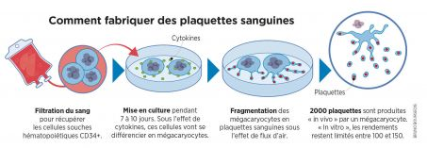
Production of blood platelets
How to produce blood platelets?
Blood filtration to recover CD34+ hematopoietic stem cells
Culture
for 7 to 10 days
Fragmentation of megakaryocytes into platelets under the air flow.
Limited yields between 100 and 150 platelets against 2000 in vivo
Notes:
Cultured platelets would be useful for treating alloimmunized patients, but culture yields remain low and many obstacles must be overcome before considering large-scale production and its application in transfusion.

Slide 12
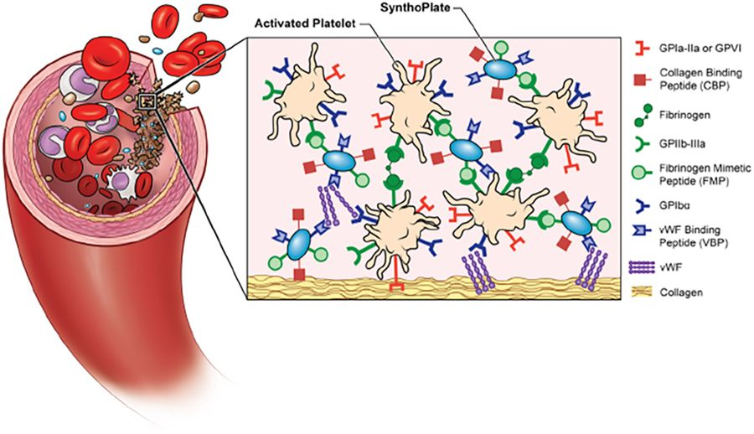
Blood platelet substitutes
Synthoplate
Hickman et al. Sci Rep. 2018
Notes:
Synthoplate is a synthetic product in the form of liposomal vesicles coated with vWF, collagen and fibrinogen receptors, which helps to provide primary hemostasis. But this product does not have an immunomodulatory function or correction of endotheliopathy, unless improving hemostasis is enough to prevent the system from racing.

Slide 13
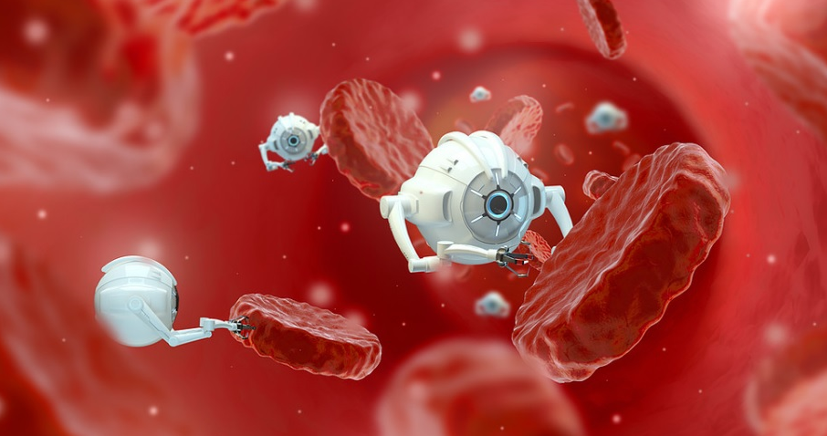
The farther future: Nanorobots
The respirocytes perform all the important functions of red blood cells.
The clottocyte mimics the natural process of hemostasis
Microbivore performs phagocytosis to destroy pathogens.
Notes:
The nanorobots would be extremely small and circulate inside the human blood. They would be equipped with special sensors to detect their targets and could be programmed to diagnose and treat various diseases.
3 types of nanorobots are described: respirocytes, clottocytes and microbivores.

Slide 14
Science fiction and back to the future, two ways for new blood Products
New blood products more or less presenting as artificial.
Upgrade old blood products.
Notes:
We continue with the modifications made to the old products in terms of preparation, conservation or use.

Slide 15
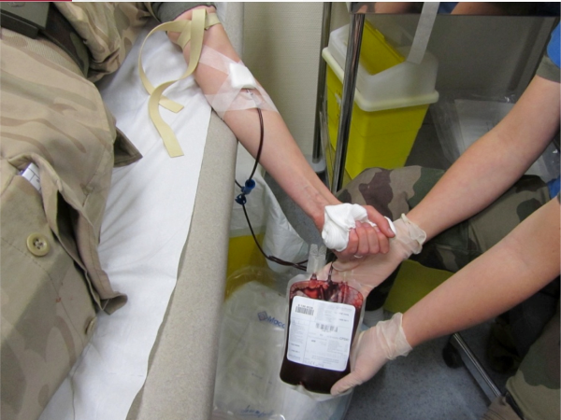
Different whole blood preparations
Low titer O Whole blood, leucocyte depleted, stored for 21 days between 4°C and 6°C.
Easy to implement
Efficacy for the hemorrhagic trauma patient.
"Warm" whole blood collected in the field.
Adapted to situations of extreme isolation or shortage of blood bank products.
Photochemical treatment of whole blood for inactivation of pathogens
Use of Riboflavine is under clinical development.
Notes:
Let's see the different types of whole blood preparation.
You know LTOWB

Slide 16
Different red blood cells preparations
Photochemical treatment of red blood cells for inactivation of pathogens
Use of a degradable alkylating agent, S-303, under clinical development
Universal red blood cells by enzymatic elimination of membrane antigens A, B and D
Still under study
Notes:
Different preparations of red blood cells are in development:
- Photochemical treatment of red blood cells for pathogen inactivation uses a degradable alkylating agent, S-303, in clinical development.
- Canadian researchers are working on universal red blood cells by enzymatic elimination of membrane antigens A, B and D.

Slide 17
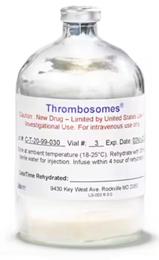
Different platelet preparations
Photochemical treatment of platelets for inactivation of pathogens.
Platelets stored at +22°C, with gentle agitation
Cold stored platelets (+4°C) and Frozen Platelets (-80°C)
Thrombosomes (room temperature, 3 years) :
Group O platelets, freeze-dried with trehalose.
Notes:
3 new types of pads are already distributed:
Platelets with photochemical treatment to inactivate pathogens.
Platelets stored at +22°C, with gentle agitation to retain most of their properties for 5 to 7 days.
The other preparations prolong the shelf life of the platelets but activate them, which reserves them for hemorrhagic situations where they will promote the formation of the clot. this is the case for cold platelets, frozen platelets and thrombosomes.
Thrombosomes are made by pooling the platelet units of 10 group O blood donors, removing the plasma, and adding trehalose to stabilize the cells during lyophilization. The dry product is heat-treated to reduce the risk of viral transmission, then tested for the presence of bacteria before being released for use. It can be kept for 3 years at room temperature. Phase 2 clinical trials are underway in Denmark.

Slide 18
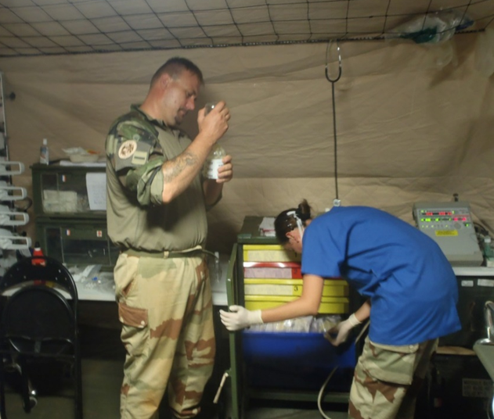
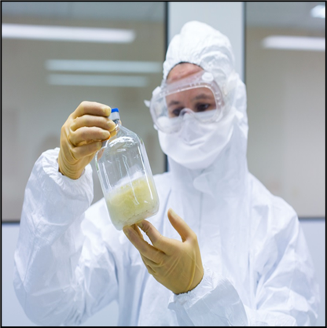
Therapeutic plasmas or derivatives
Freeze dried plasmas:
Storage at room temperature.
Easy and speed reconstitution.
Universal or not for blood group.
Single donor or mixture of donations (less than 11 or more than 1000).
Secured by quarantine or pathogen inactivation.
Labile Blood Products (haemovigilance) or Drugs (pharmacovigilance).
Pathogen Reduced Cryoprecipitated Fibrinogen Complex
Notes:
In the word, there are many types of therapeutic plasma with very different security processes and storage conditions.
Among them, freeze-dried plasmas are distinguished by their storage at room temperature and their easy and rapid reconstitution. They may or may not be universal for blood type, from a single donation or from a mixture of donations (less than eleven or more than a thousand), secured by quarantine or inactivation of pathogens. Finally, they will have the status of labile blood products controlled by haemovigilance or drugs controlled by pharmacovigilance.
At last, a new plasma derivative is available for the treatment of haemorrhages : the Pathogen Reduced Cryoprecipitated Fibrinogen Complex.

Slide 19
The future may be
Use machine learning and data base to give the best product to the patient.
Notes:
The future may be

Slide 20
Thank you for your attention
Please, could you ask the questions in French ? ☺

