Slide 1
Vasopressors in Traumatic Hemorrhagic Shock Early phase of care (pre-surgical)
Bergen, June 25th 2019
Christophe MARTINAUD (MD, PhD, OF-5)
French Military Blood Institute
Nicolas PRAT (MD, PhD, OF-5)
Frédérique DUFOUR-GAUME (MD, OF-3)
Tobias GAUSS (MD, PhD)

Slide 2
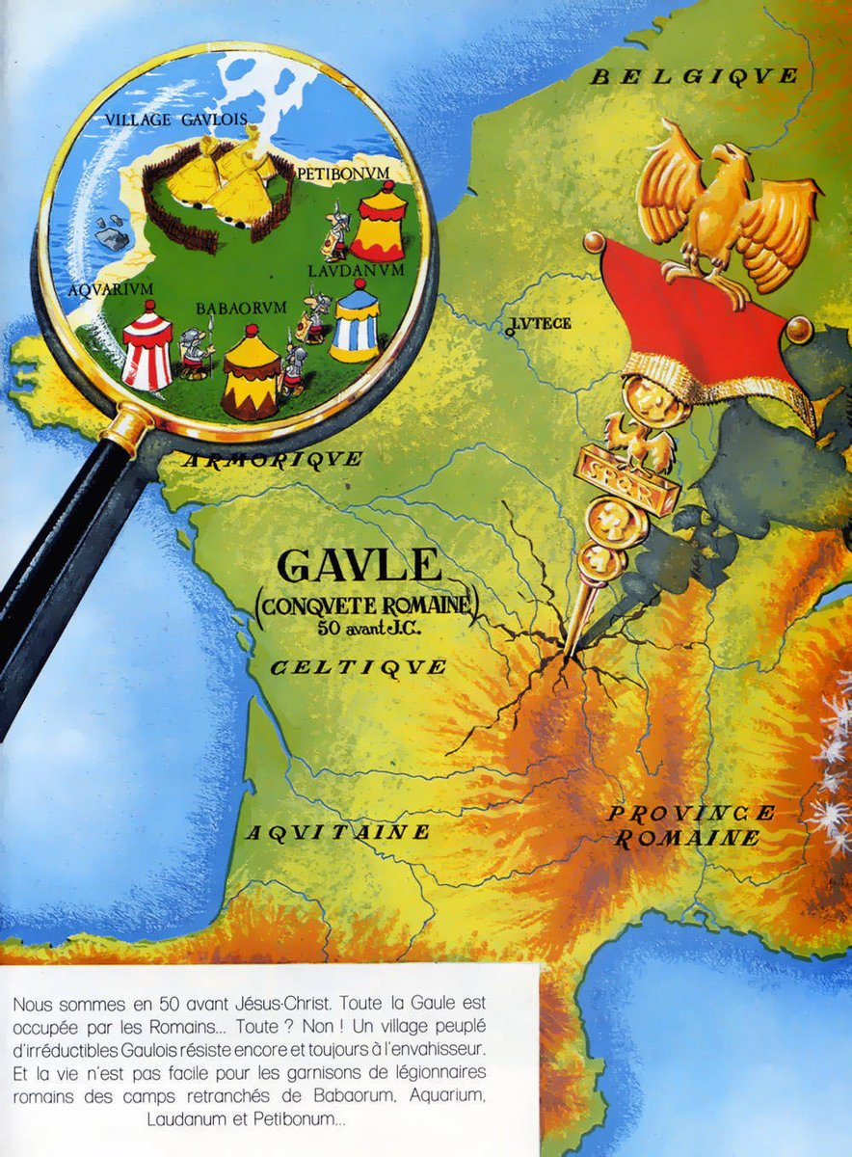
Disclaimer:
The opinions or assertions contained herein are the private views of the author and are not to be construed as official or as reflecting the views of the French Department of Defense.
Conflict of interest:
None

Slide 3
Traumatic hemorrhagic shock
Acute and severe blood loss
Hypovolemic shock
➘ Venous return / ➘ Preload / ➘ Cardiac Output
➘ Tissue perfusion
=
Tissue hypoxia
Stimulation
=
compensated shock
Systemic inflammatory syndrome
+
Endotheliopathy
+
Coagulopathy
Inhibition
=
decompensated shock
TIME
Enhanced by trauma
Adrenergic system
Irreversible shock
Multiple organ faillure
Notes:
Passer très rapidement: tout le monde connait!

Slide 4
Vasopressors in Hemorrhagic Shock
Epinephrine
α and β stimulation
Inotropic +
Tachycardia
Difuse Vasoconstriction
All route possible
Possible bolus titration
Ok for prehospital austere environment
Risk of tachyphylaxis
Risk of excessive vasoconstriction
ENDOGENOUS CATECHOLAMINES
NorEpinephrine
Mainly α stimulation
Moderated tachycardia
Vasoconstriction +++
Redistribution to heart, brain, kidneys
Splanchnic venous sector
IV Syringe pump
Risk of excessive vasoconstriction
Vasopressine
Vasoconstriction +++
Redistribution to heart, brain, spleen > NorEpinephrine
No pulmonary vasoconstriction
No cardiotropic action
Derived from ADH
IV Syringe pump
NOT ADRENERGIC SYSTEM

Slide 5
Vasopressors in Hemorrhagic Shock
Epinephrine
α and β stimulation
Inotropic +
Tachycardia
Difuse Vasoconstriction
All route possible
Possible bolus titration
Ok for prehospital austere environment
Risk of tachyphylaxis
Risk of excessive vasoconstriction
ENDOGENOUS CATECHOLAMINES
NorEpinephrine
Mainly α stimulation
Moderated tachycardia
Vasoconstriction +++
Redistribution to heart, brain, kidneys
Splanchnic venous sector
IV Syringe pump
Risk of excessive vasoconstriction
Not only a vasopressor, but a real neurohormone
Vasopressine
Vasoconstriction +++
Redistribution to heart, brain, spleen > NorEpinephrine
No pulmonary vasoconstriction
No cardiotropic action
Derived from ADH
IV Syringe pump
NOT ADRENERGIC SYSTEM
Myburgh et al. Crit Care 2010

Slide 6
Vasopressors in Hemorrhagic Shock
Epinephrine
α and β stimulation
Inotropic +
Tachycardia
Difuse Vasoconstriction
All route possible
Possible bolus titration
Ok for prehospital austere environment
Risk of tachyphylaxis
Risk of excessive vasoconstriction
ENDOGENOUS CATECHOLAMINES
NorEpinephrine
Mainly α stimulation
Moderated tachycardia
Vasoconstriction +++
Redistribution to heart, brain, kidneys
Splanchnic venous sector
IV Syringe pump
Risk of excessive vasoconstriction
Best choice for Hemorrhagic Shock
Vasopressine
Vasoconstriction +++
Redistribution to heart, brain, spleen > NorEpinephrine
No pulmonary vasoconstriction
No cardiotropic action
Derived from ADH
IV Syringe pump
NOT ADRENERGIC SYSTEM

Slide 7
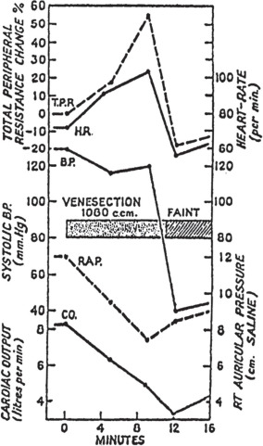
Role of vasopressors during the 2 stages of HS
Stage 1
Stage 2
Stage 1: Compensated shock
Initial stage of blood loss : hypovolemia compensation for tissue perfusion
Carotid/Aortic (high pressure) receptors
➪ brainstream
➪ Adrenal gland
➪ Epinephrine and norepinephrine
Pre-capillary vasoconstriction + venous recruitment + perfusion redistribution
➚ heart rate + ➚ Inotropism
Stage: Decompensated Shock
> 30% blood loss or ➘ 55% of cardiac output baseline: maintain of heart pump function
Mainly very low venous return but also opioïd receptors, NO, etc.
➪ vagal stimulation and sympathetic inhibition :
➪ drop in systemic resistances, hypotension
➘ heart rate + ➘ Inotropism
Barcroft et coll., Lancet 1944;1:489-91
Notes:
3 phases dans le choc, la dernière étant le choc irréversible.

Slide 8
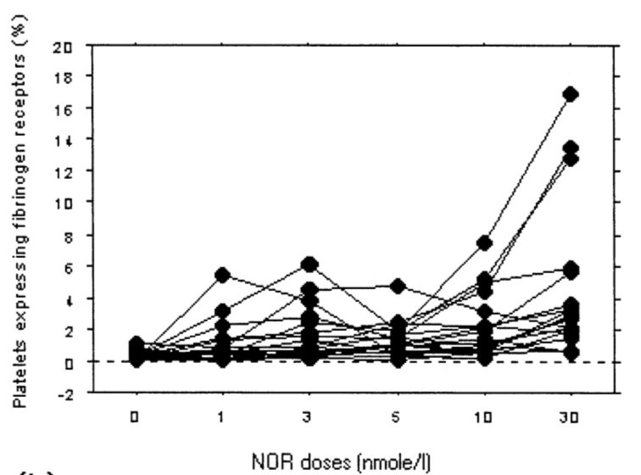
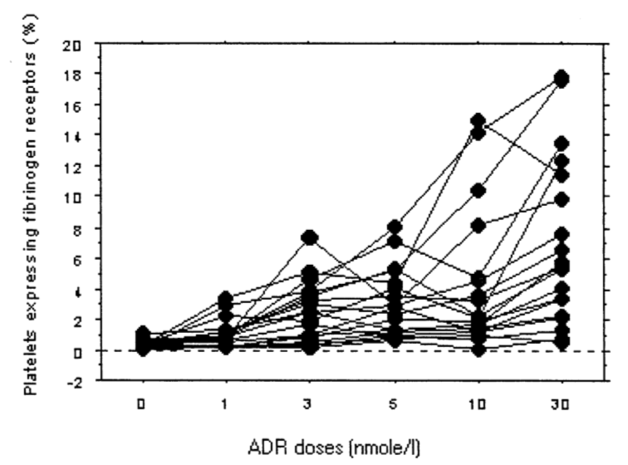
Vasopressors in Hemorrhagic Shock: side effects
Platelet Activation
The activation increased with the increase in Epi and NorEpi concentrations
The activation of platelets may also positively correlate with the degree of injury
But the degree of effects varied among different individuals
No (known) direct effect of vasopressin or analogues
Lam et al. Resuscitation 2002

Slide 9
Vasopressors in Hemorrhagic Shock: side effects
Shock induced endotheliopathy worsened by Epi, NorEpi
Endothelial activation
Endothelial damage and capillary leakage dysfunction
➪ Participation to SIRS, coagulopathy and fluid extracellular diffusion
Johansson et al. Critical Care 2017

Slide 10
Current practices in HS resuscitation
Therapeutic goal: ensuring tissue perfusion
✘ Stop the bleeding
➪
Compression + TXA => Clot
✘ Allow for 02 carrying / Blood failure
➪
Blood transfusion
✘ Compensate hypovolemia
➪
Fluid therapy / crystalloids
✘ Maintain cardiac output: heart rate and contractility
Vasopressors ?
✘ Balance between preload and tissue perfusion
Notes:
Change dernière phrase: le maintien de la perfusion tissulaire depend de la VC et du CO…

Slide 11
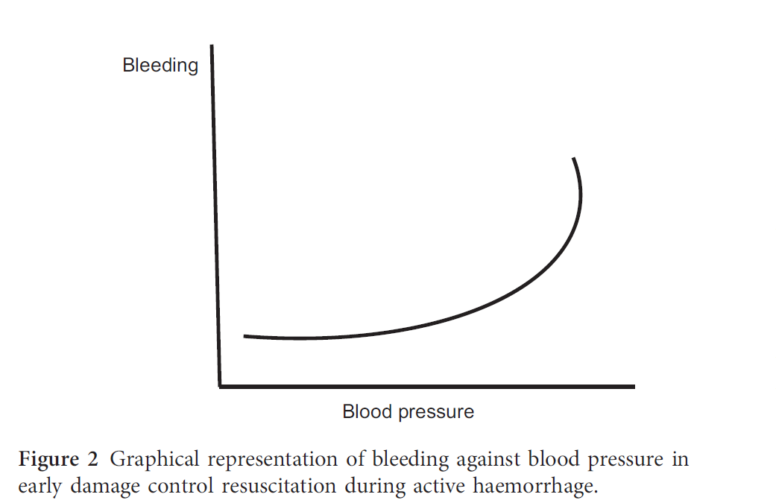
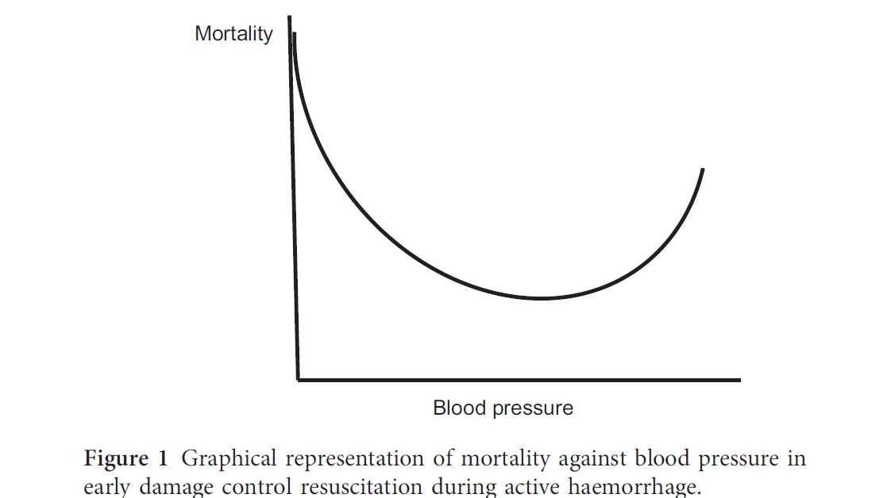
Current practices in HS resuscitation
Fluid therapy
Maintain ABP or tissue perfusion and avoid to «POP THE CLOT»
➪ « hypotensive resuscitation » with controlled fluid resuscitation :
Maintain of SBP between 80/90 mmHg
Permissive hypotension for active hemorrhage in trauma
Nevin et al. Anaesthesia 2017
Notes:
Position de Brohi, mais pas d’indication precise: objectifs?
Valeurs validées par etude Clinique? Reprendre papier Holcomb ?
Plus métaanalyse tran hypotension
Insister sur risqué hypotensive
Voire papier blast!

Slide 12
Current practices in HS resuscitation
Fluid therapy
Maintain ABP or tissue perfusion and avoid to «POP THE CLOT»
➪ « hypotensive resuscitation » with controlled fluid resuscitation :
Maintain of SBP between 80/90 mmHg
At the end of the day…
no strong clinical evidence of effectiveness
how ?
how long ?
how much ?
Notes:
Position de Brohi, mais pas d’indication precise: objectifs?
Valeurs validées par etude Clinique? Reprendre papier Holcomb ?
Plus métaanalyse tran hypotension
Insister sur risqué hypotensive
Voire papier blast!

Slide 13
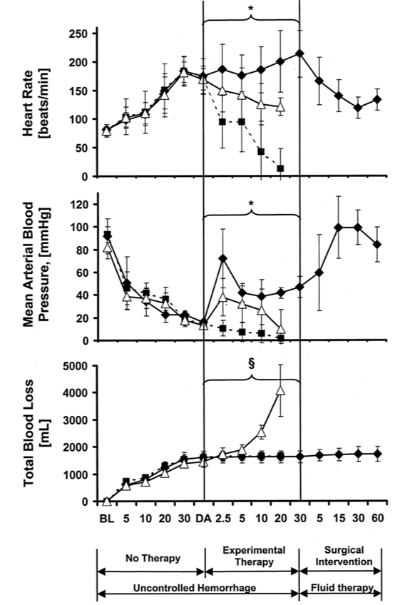
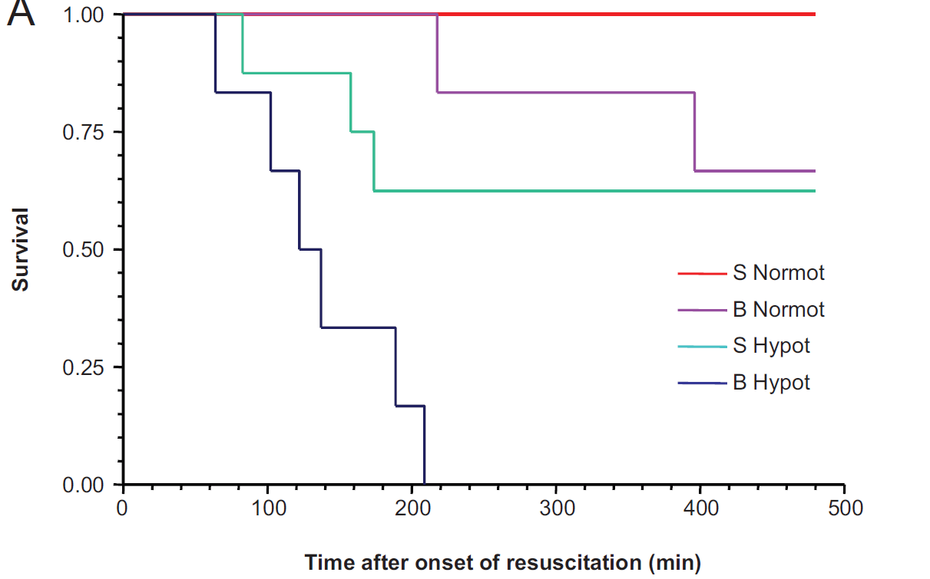
Current practices: which role for vasopressors ?
✘ Ineffective Fluid Therapy ?
vasopressin
✘ Which role for vasopressors ?
fluid resuscitation △
saline placebo ■
Pulmonary blast + hemorrhage
- SBP of 100 vs. 80 mmHg
- 8 hours ...
- Mortality arise after 60 min …
Garner et al. Annals of Surgery 2010

Slide 14
Current practices: which role for vasopressors ?
Animal models limits
Different distribution of adrenergic receptors according to the animal species
➪ Different distribution of sympathetic /vagal responses according to the animal species
➪ No projection from animal models to Human
Local experimental trauma ≠ clinical polytrauma
Drugs tested in animal models are not the usually ones used in clinical pratice
Notes:
Animal models
✘ Different distribution of adrenergic receptors according to the animal species
➪ Different distribution of sympathetic /vagal responses according to the animal species
➪ No projection from animal models to Human
✘ Local experimental trauma ≠ clinical polytrauma
✘ Drogs tested in animal models are not the usualy ones used for clinical polytrauma

Slide 15
Current practices: which role for vasopressors ?
Clinical studies advocate against their use
Conclusion: no need !
Side effects
Vasoconstriction ++ with downstream hypoperfusion and visceral suffering
Inflammatory syndrom and endotheliopathy
2. Increased mortality !
✘ Necessary to match databases with gravity scores and adjuvant treatments (blood transfusion, fluid therapy…)
✘ Necessary to study effects on short but also long term

Slide 16
Current practices: which role for vasopressors ?
Clinical studies limits advocate against their use
Meta-analysis
8,001 records from electronic databases + 2 records from other sources | 6 studies included in quality synthesis | 3 USA 2 France 1 Greece
Quality assessment
Overall quality of evidence | -Short term mortality -Fluid requirements -Blood product requirements -Mechanical ventilation | Very low for all the 6 studies

Slide 17
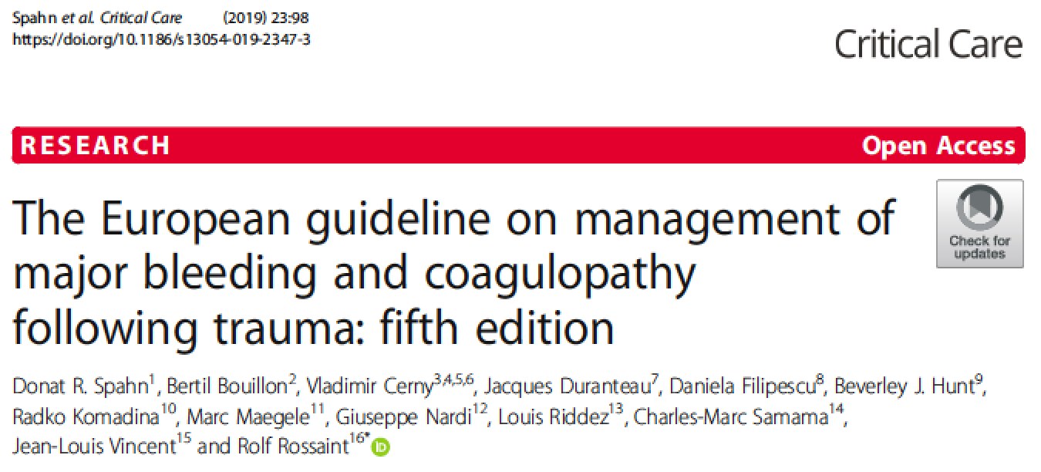
European guidelines

Slide 18
European guidelines

Slide 19
European guidelines: application in France
Trauma patients with uncontrolled massive hemorrhage
With or without TBI
Distance to surgery +++ (>> 15 minutes)
Administrated if ABP still low despite fluid resuscitation (1500mL)
Limited access to blood products in prehospital settings
Intubation and sedation in prehospital settings
« play and run »

Slide 20
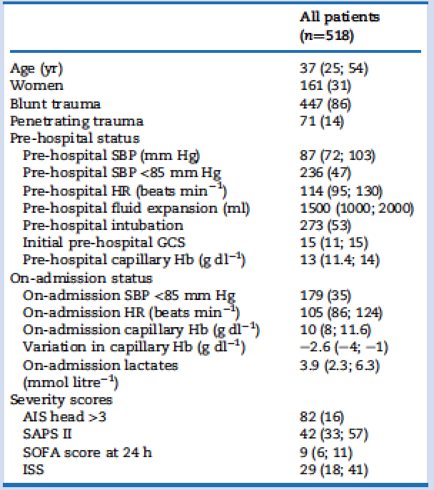
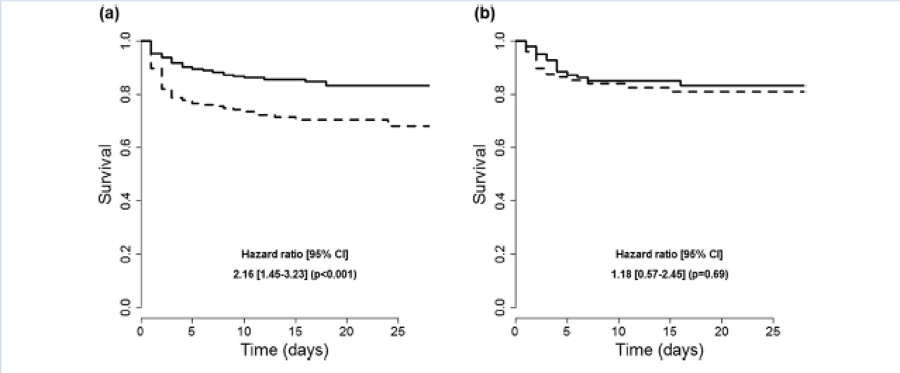
European guidelines application: impact on mortality
norAdr
Survival before propensity score
Survival after propensity score
Retrospective analyse from the Traumabase Database
Hemorrhagic shock defined as transfusion ≧ 4 pRBC – 6 hours
6353 patients screened – 518 analyzed (40% with NorAd)
Jan 2010 to Dec 2015
Gauss et al. Br J Anestheisa 2018
Notes:
May incluced TBI patients.
Seuls les GCS inférieur à 3 sont exclus

Slide 21
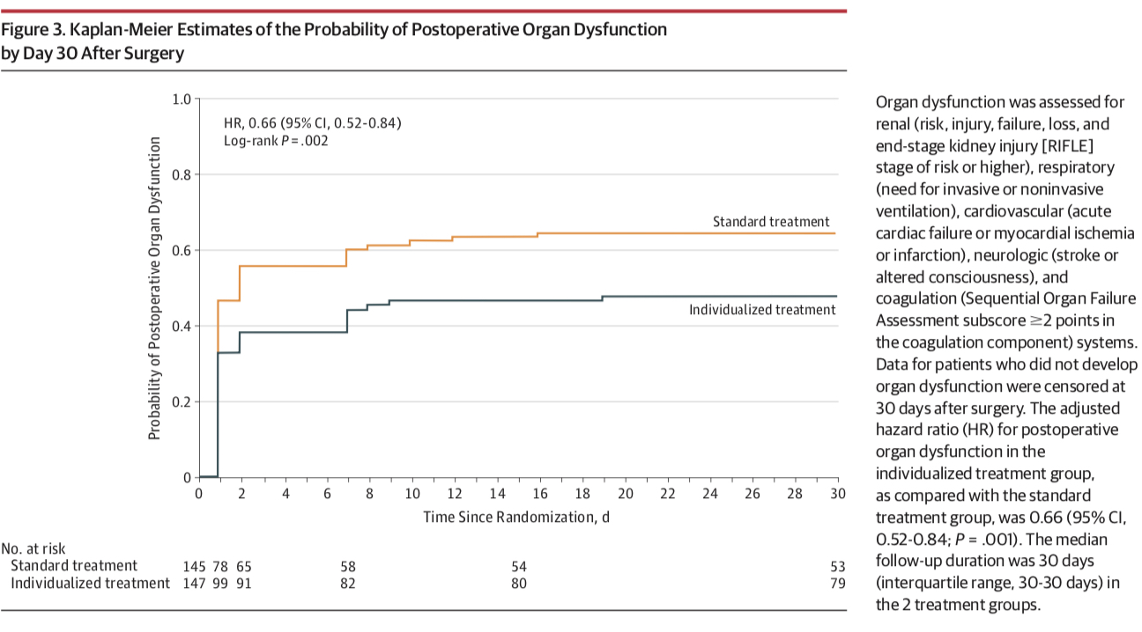
To summarize: Possible indications for vasopressors
✘ Use of anesthetic agents
Inhibition of phase I ( no shock compensation)
✘ Other causes of vasoplegia
(Neurogenic shock)
✘ Abdominal penetrating injury
Splanchnic vasoconstriction (vasopressin++)
✘ TBI
Higher SBP targets
No deleterious effects of catecholamines on cerebral blood flow
✘ Reduce Fluid therapy
Avoid SDRA, brain edema…
✘ Long time before surgical control > 1 Hour
- Exhaustion of sympathetic system capacity
- Endotheliopathy (NO…)
✘ Myocardial dysfunction associated with hemorrhagic shock
Futier et al. JAMA 2017

Slide 22
Conclusions
No real evidence of harmfulness, but no evidence of total effectiveness
Need for trauma care tailoring (use depending on patient and availability of cares) : Vasopressors (NorEpi) needs to be used « as needed »
Need for RCT, but known design issues due to numerous possible treatment protocols (drugs, dosages, timing…)

Slide 23
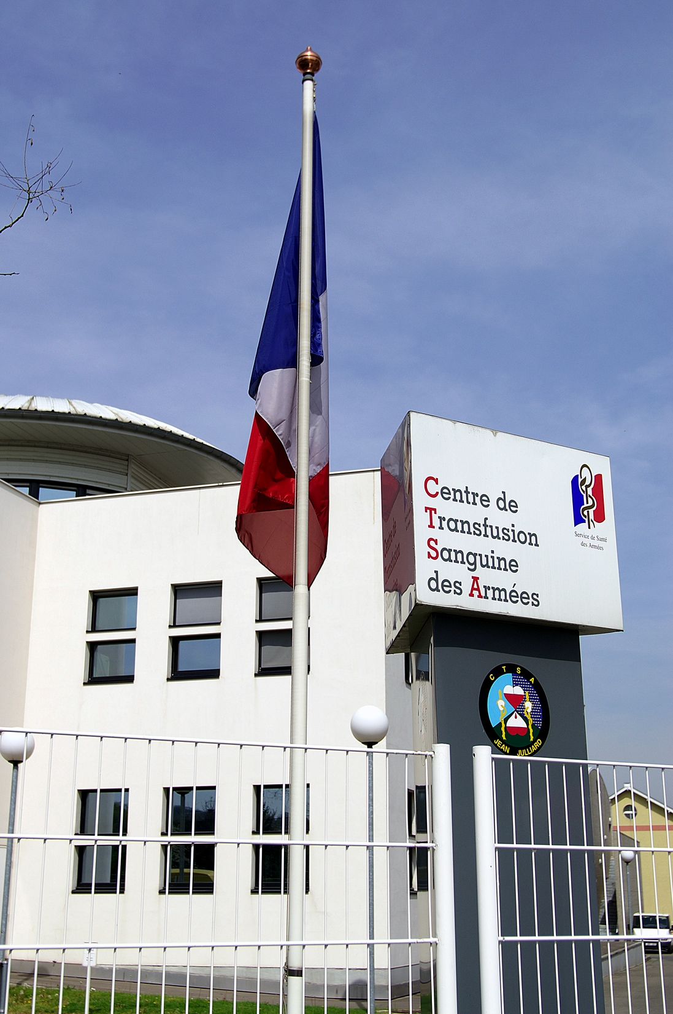
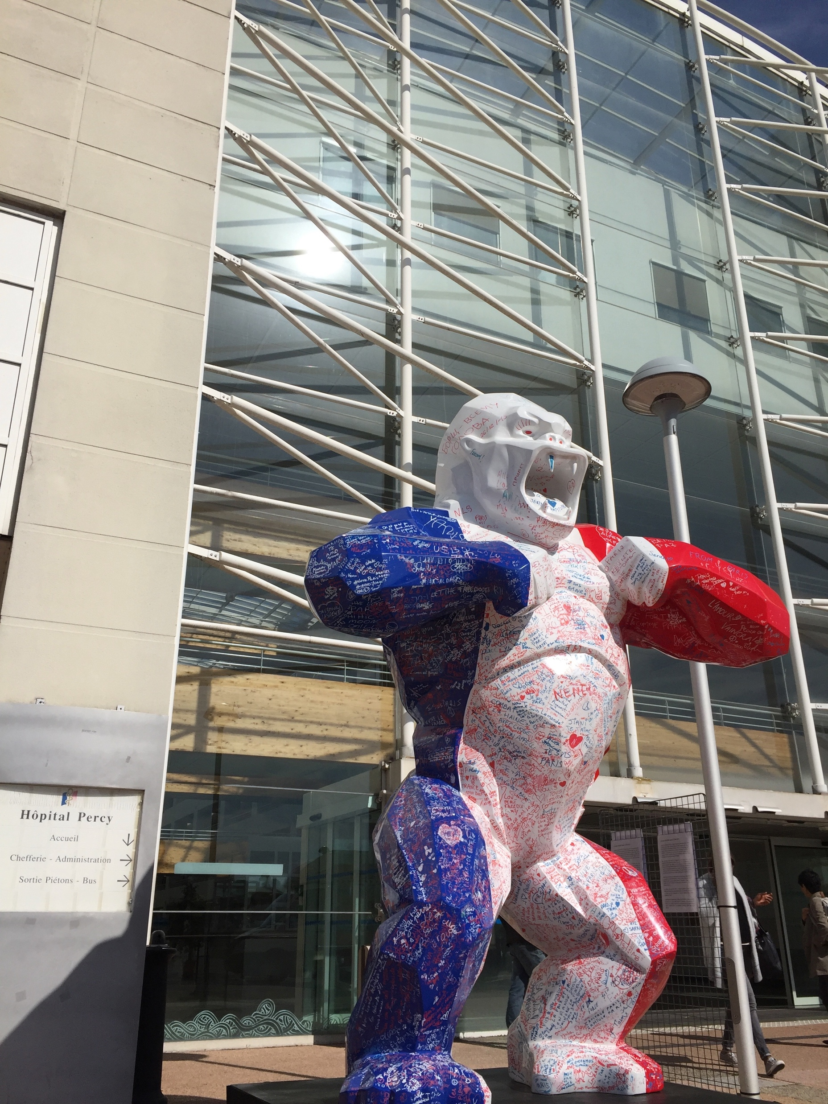
Acknowledgments
Sylvain AUSSET (MD, OF-6)
Pierre PASQUIER (MD, OF-4)
Mathieu BOUTONNET (MD, OF-4)
Frédérique DUFOUR-GAUME (MD, OF-3)

