Slide 1
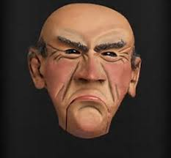
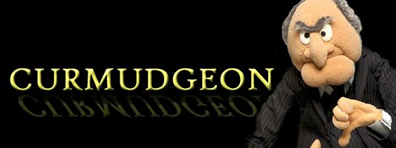
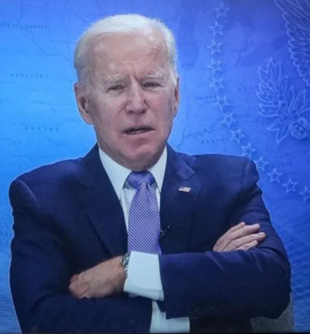
Reflections of a curmudgeon
Or maybe not

Slide 2
Disclosure(s)
THOR - thank you
I trashed my entire slide deck on Monday and rewrote for Tuesday
I am now rewriting my slides for today this morning. A tribute to a constantly learning process packed into this meeting.
My comments and hyperbole are entirely my responsibility
I will depend on the members of the audience who attended to vector check my direction
This is meant to be a dialogue
I “used to be” a paramedic…. I am not a SF capable provider

Slide 3
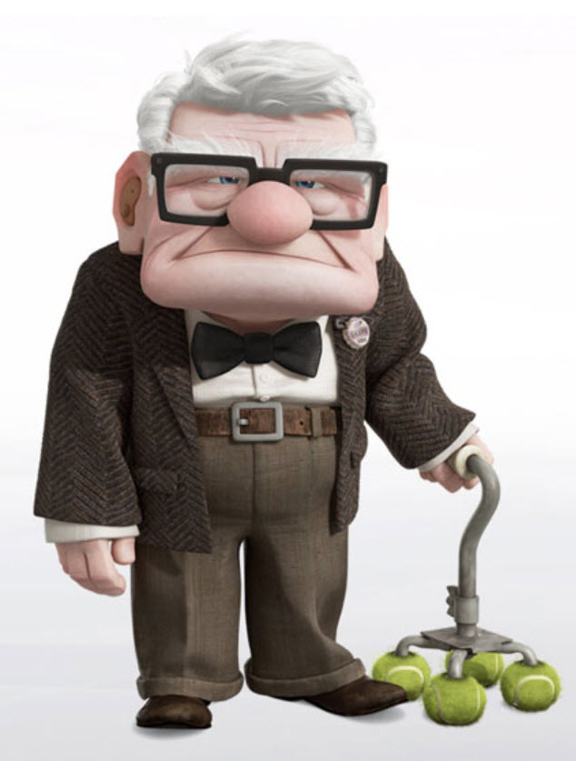
curmudgeon
Old, cranky, and more than a little stubborn, a curmudgeon is the gruff, grey-haired neighbor who refuses to hand out candy at Halloween and shoos away holiday carolers with a "bah humbug!“
Don't worry though, you’ll know a curmudgeon when you see one: He’ll be ill-tempered and miserly, eager to shake his fist and spout disagreeable opinions.
a crusty irascible cantankerous old person full of stubborn ideas
Someone who when driving a car is constantly pumping the brakes
Perhaps I can convince you that there is a reason for concern for some of these stubborn ideas

Slide 4
OK So the other title for this little discourse
You stabbed who? With what????
Don’t just do something----stand there
Primum non nocere

Slide 5
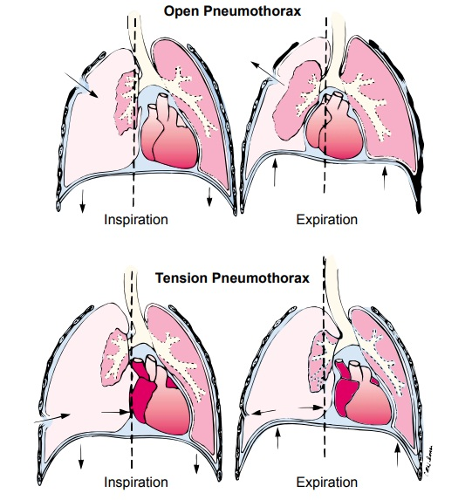
Physiology of tension ptx Christopher bjerkvig
Debate regarding the physiology of tension PTX
Can a tension PTX evolve in the patient who is spontaneously breathing ?
Data appears to be a Castle made of Sand
What are the HARD SIGNS of tension PTX

Slide 6
Dr gurney jts/dodtr
Presented a very compelling case of penetrating projectile injury to left chest
Symptomatic relief following placement of NDC in an awake medic
Soldier subsequently had 19 (!!!!!) NDC completed in field
Subsequent CT demonstrated (unequivocally) that patient had no true thoracic domain injury, a fragment in the diaphragm and a small iatrogenic PTX
DATA AVAILABLE FROM JTS DODTR IS VERY INCOMPLETE
SUGGESTS----…..
PERHAPS TEN TO TWENTY NDC COMPLETED FOR EVERY ONE POTENTIAL PTX
EVEN GREATER RATIO OF NDC TO TRUE DOCUMENTED LETHAL TENSION PTX

Slide 7
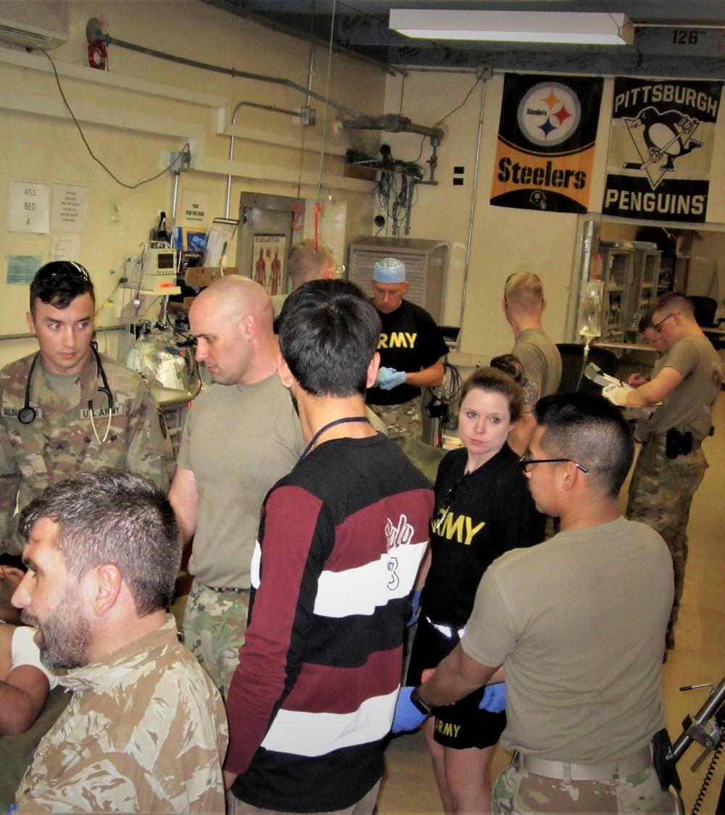
Shoulda done it long ago
Reflected on the 10 to 15 critically ill combat injured soldiers our team cared for during the rotation
10/10 had invasive airways placed
only one had a GCS < 8
6/10 had patent airways and reasonable mechanics (sic)
1/10 airways not in the airway
1/10 airway initially properly placed but lost enroute
8/10 patients had at least one needle decompressive thoracostomy placed

Slide 8
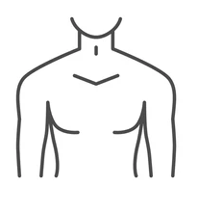
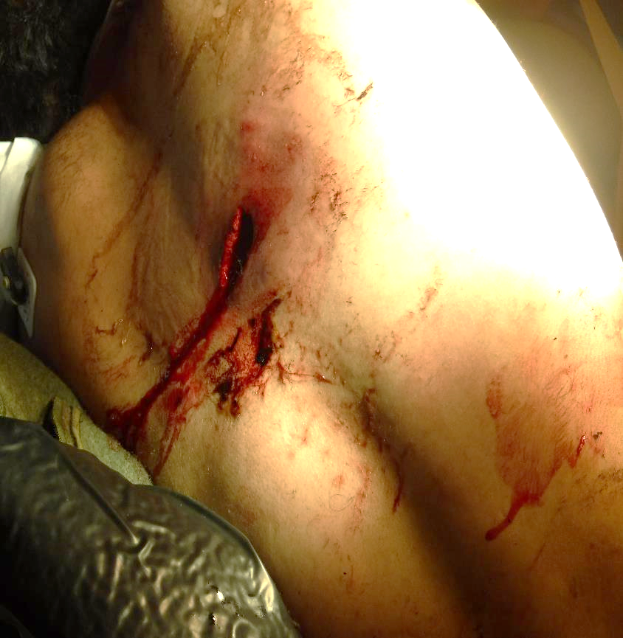
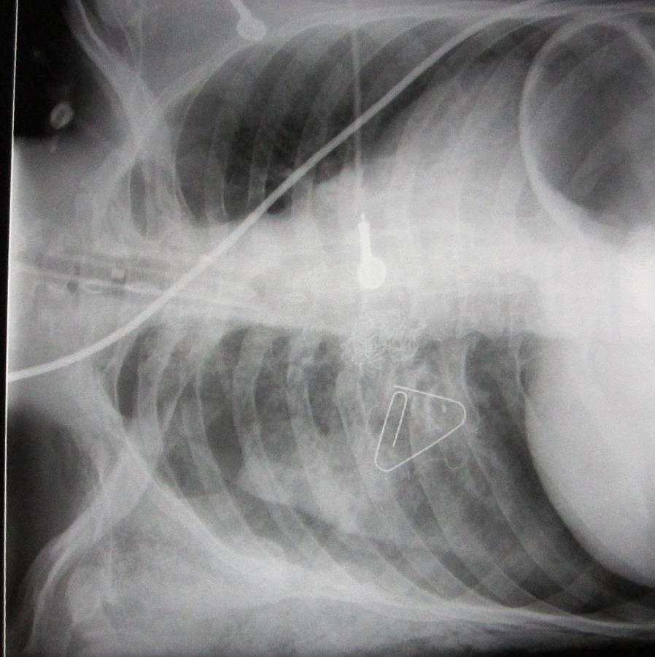
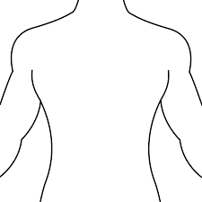
What? Huh? Wth?

Slide 9
Needle thoracostomy
Here come’s the curmudgeon part
If I think it is used too frequently in the deployed setting--- double that down in spades in my civilian practice
Dr. Gurney presented our JTS data
Previously reported incidence – 3-5%
Data from OIF/OEF – 0.3 – 0.5%
A setting that emphasizes sensitivity at the cost of specificity
Risks of proceeding to NDC in setting of false positive

Slide 10
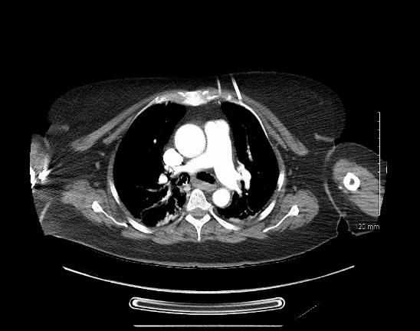
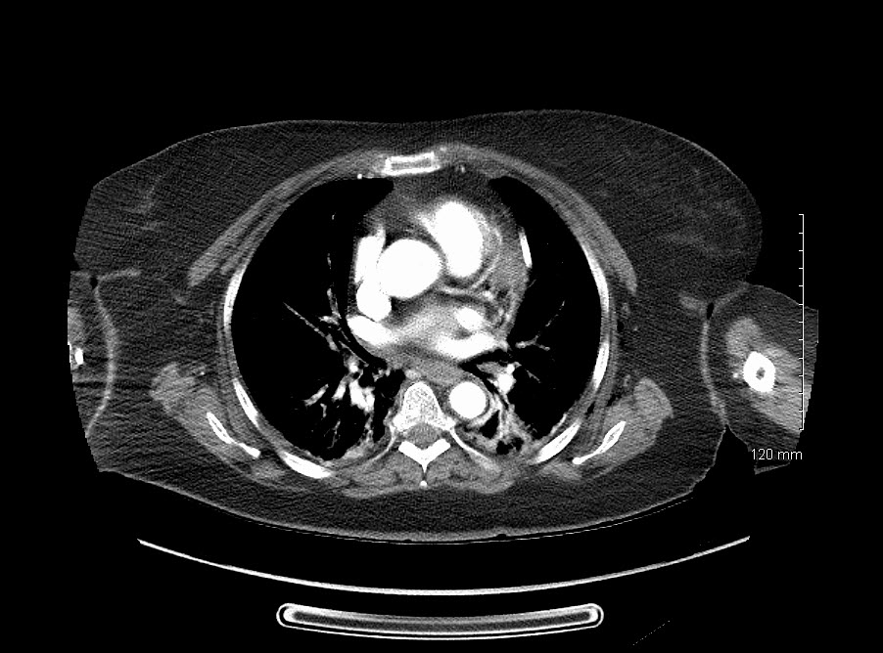
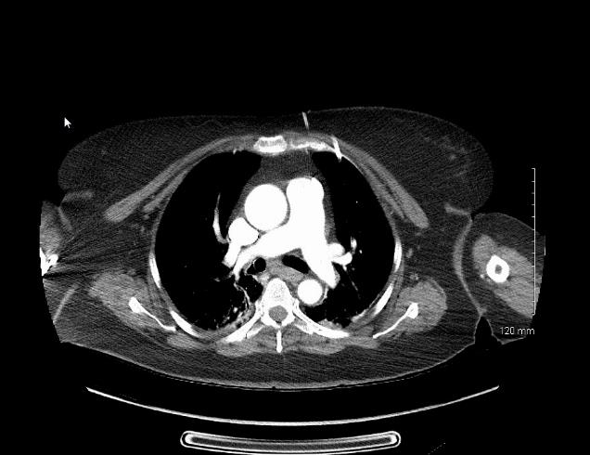
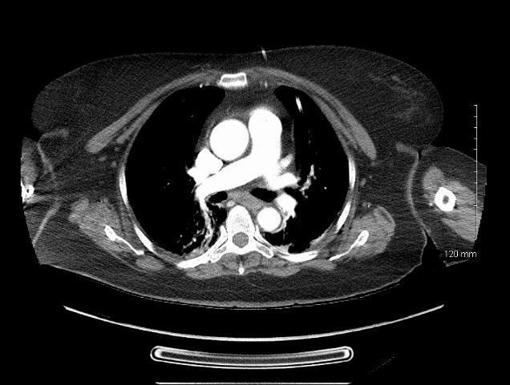
Shock and awe

Slide 11
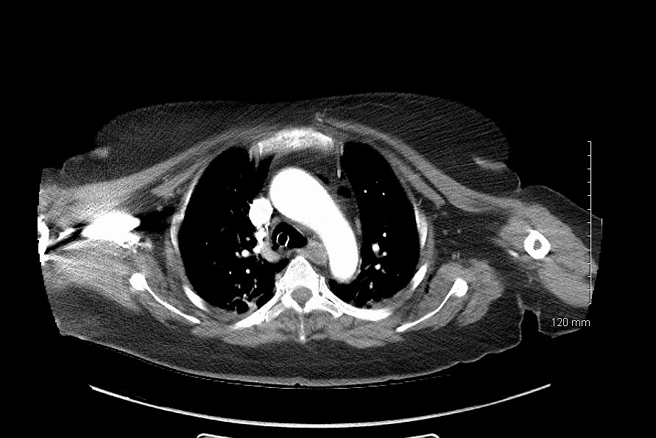
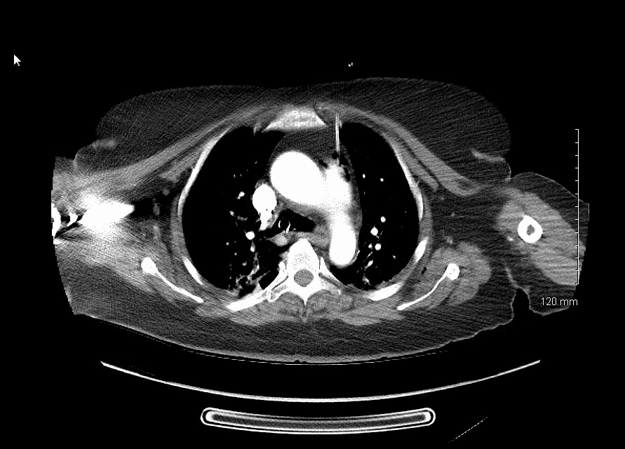
What about the other needle?

Slide 12
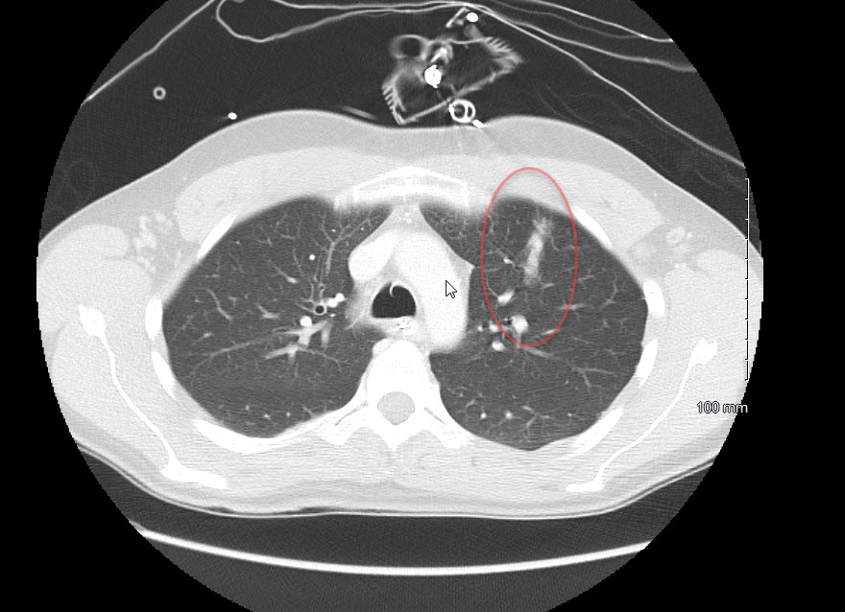

Slide 13
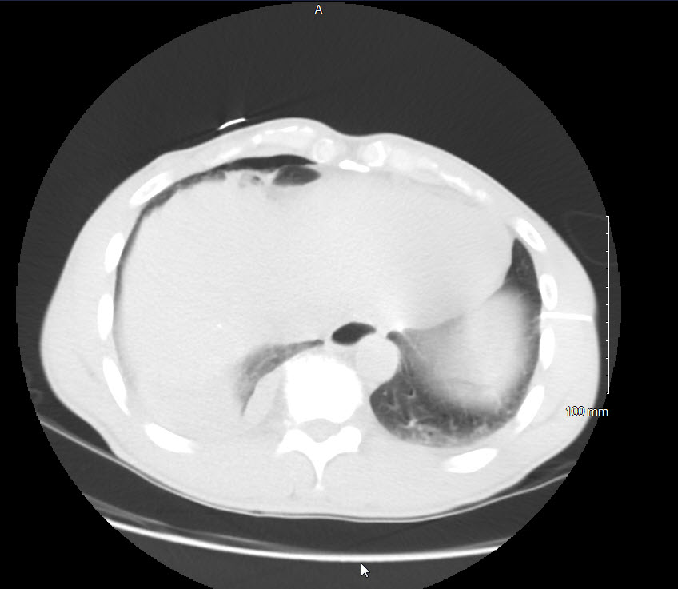
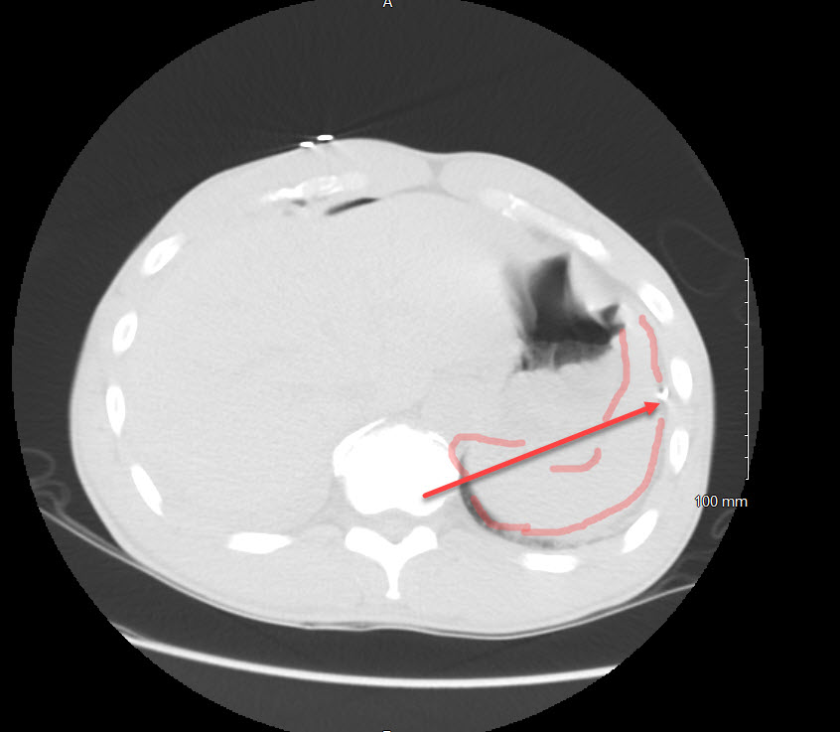

Slide 14
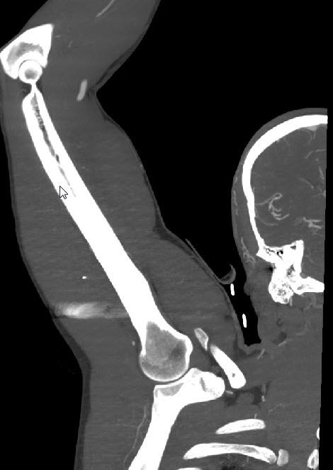
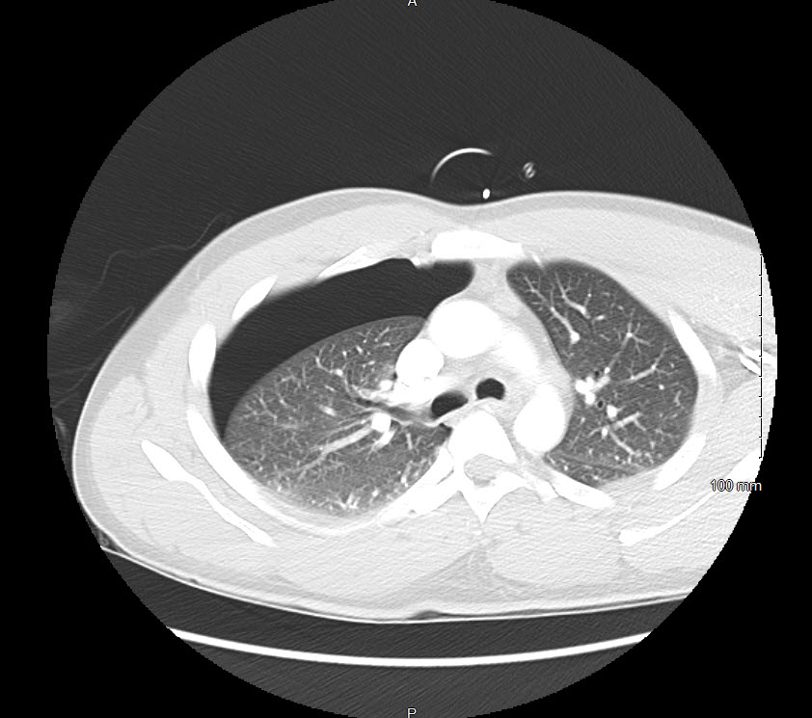

Slide 15
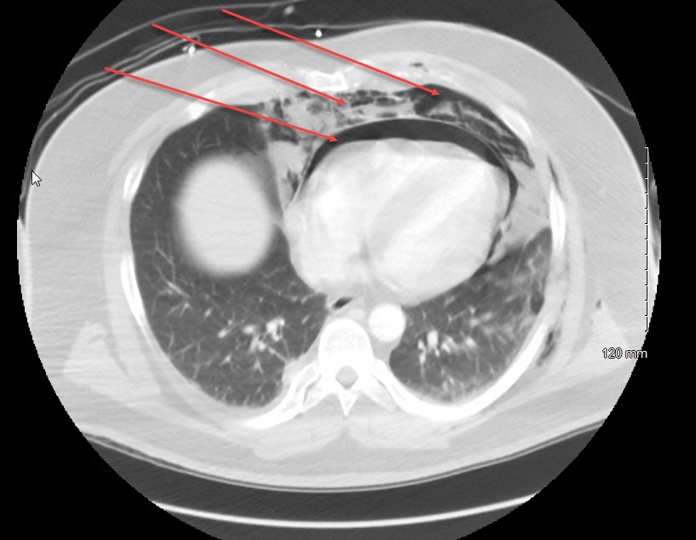
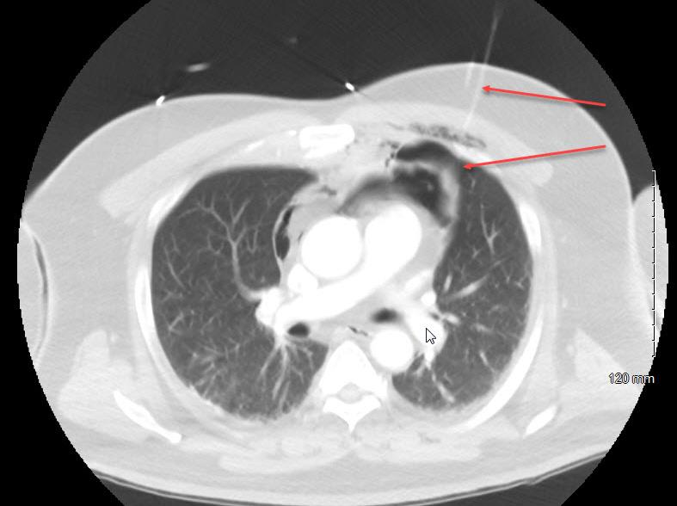

Slide 16
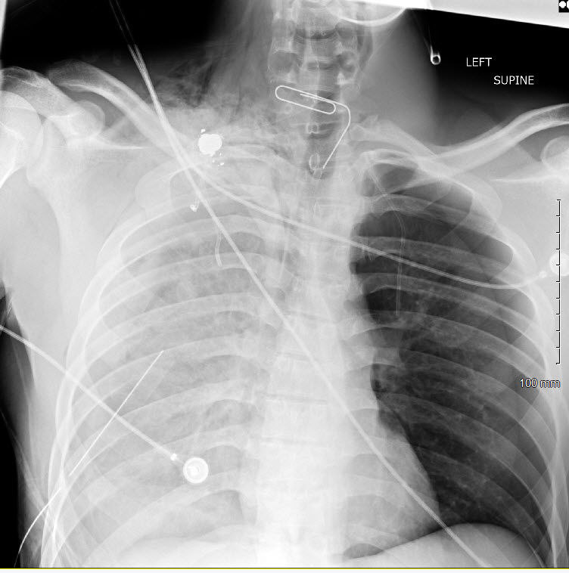

Slide 17
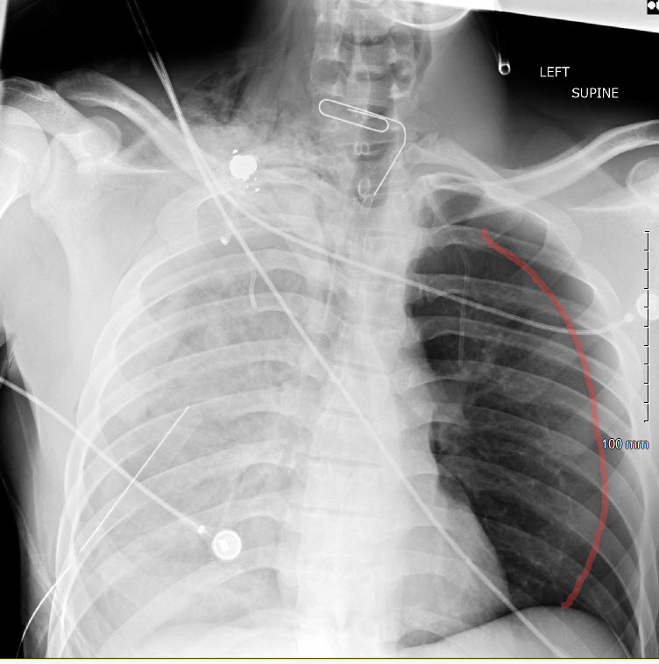

Slide 18
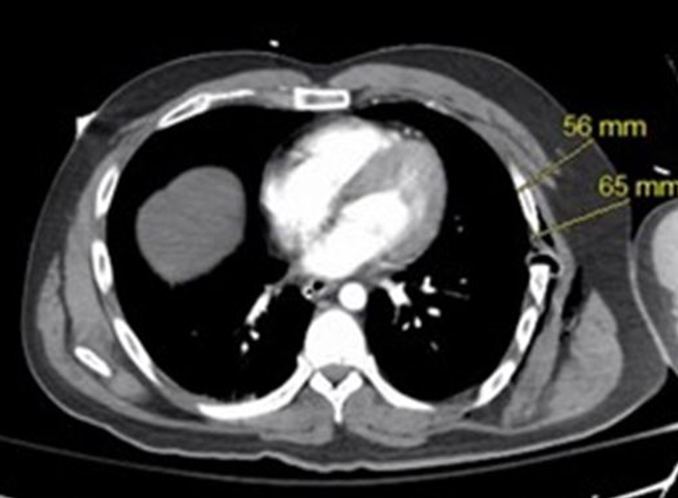
PAT THOMPSON’S PRESENTATION DATA
5.3 CM

Slide 19
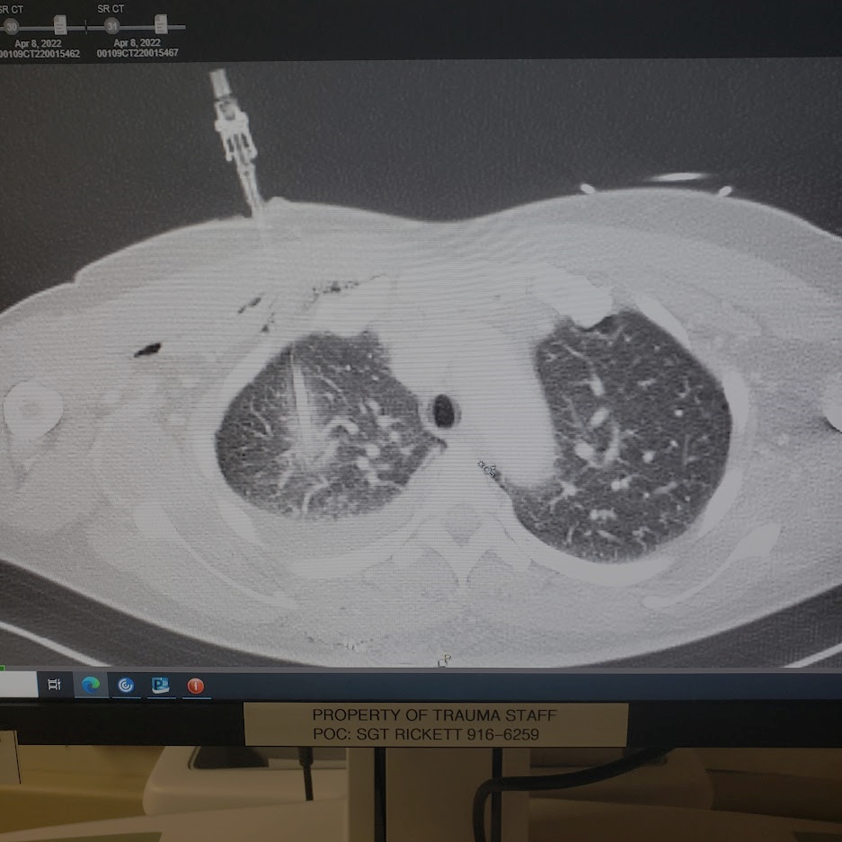
If our criterion for placement are sensitive and not specific
Are we creating more PTX’s than we are fixing ?
Shouldn’t we regard this as a stab wound to the chest?
Not so Friendly Fire?

Slide 20
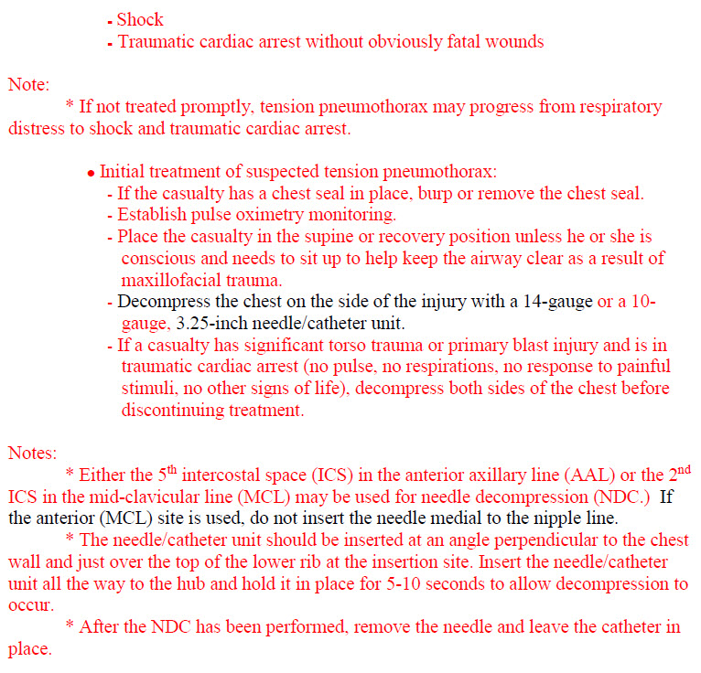
THE EVIL DOWNSIDE OF GUIDELINES
Absolve you of critical thinking ?
Absolve you as responsible for
the decision to intervene?
Guidelines err on side of sensitivity
At the expense of specificity

Slide 21
SHIFTING RESPONSIBILITY
LSI
Airway
LSI
Blood component(s)
LSI
LTOWB
LSI
Tension PTX
LSI
tourniquets
Point of Injury
LSI
surgery
advanced medical/surgical care
LSI
Hemorrhage control
En route Care/Transport
En route Care/Transport

Slide 22
Confessions of a catholic/surgeon/medic
Surgeons– certainly older ones; were submitted/subjected/participated in a unique confessional called Morbidity and Mortality conference
It is a unique way of forming a surgical conscience
I was taught of the “sacred privilege” of the knife

Slide 23
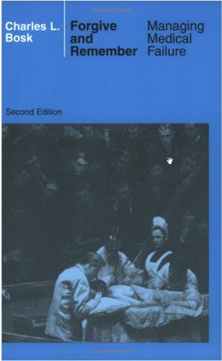
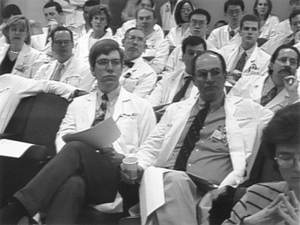
Truth and Consequences
We owe it to our patients…..
and to our medics

Slide 24
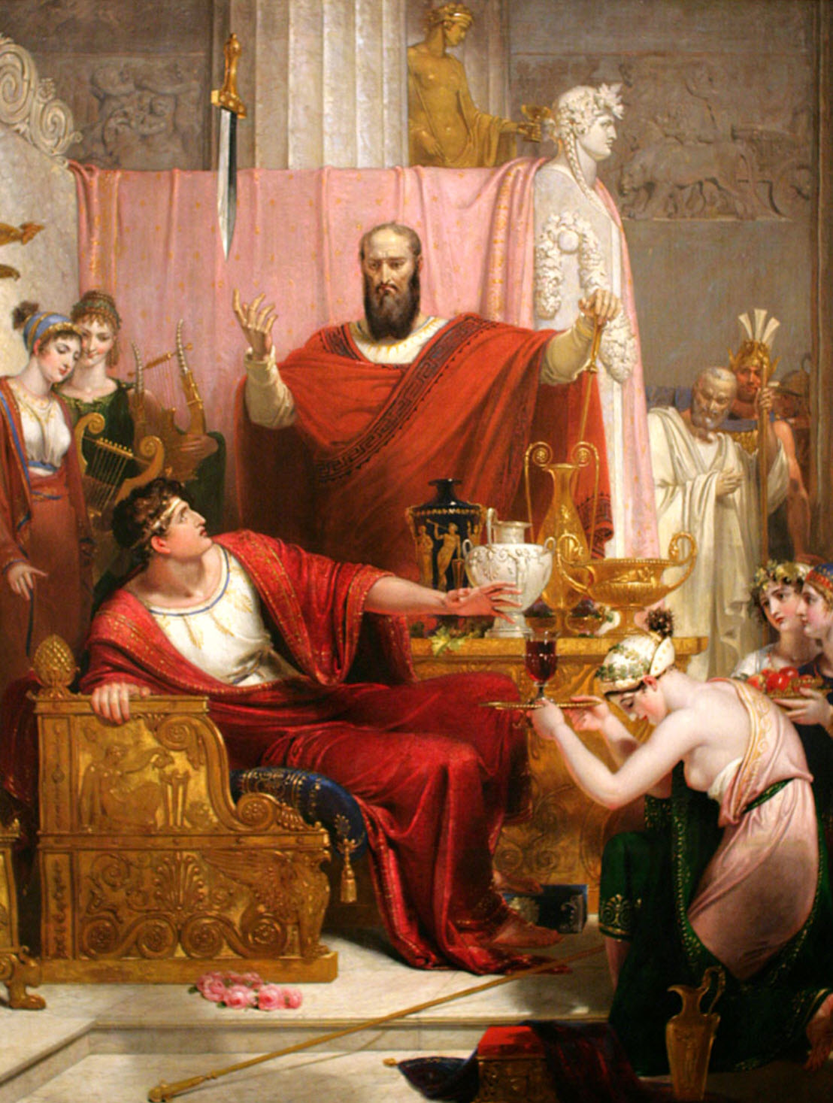
The sword of Damocles
With great power comes great responsibility
Voltaire
The price of greatness is responsibility
Winston Churchill
Would we allow this procedure to be done in the hospital without….
documentation
follow up
improvement plan

Slide 25
This guy is a genius--- I wish I had written this

Slide 26
Sometimes, the hardest thing in the world is to sit on your hands and watch, and do nothing
“Junior--- I want you to sit in a chair next to that patient’s bed; and sit on your hands and do nothing for the next five minutes”
James Hurst MD to Jay Johannigman -- many years ago

Slide 27
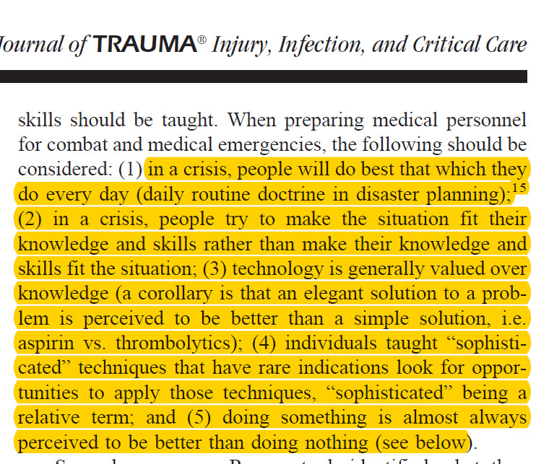

Slide 28
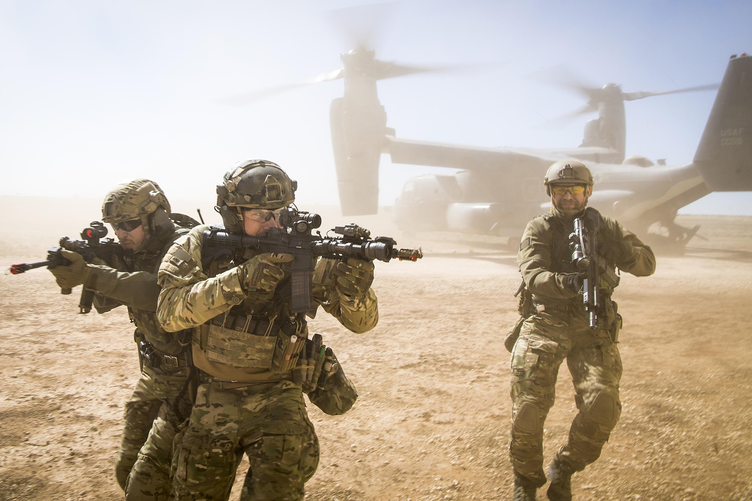
The “doer”
A highly skilled group who readily
achieve a fund of knowledge and
combine this with extraordinary
motor skills.
If they are told to put lead on target
There will be lead on target
If you tell them they should do
Something when they spot equivocal
findings– they will do something

Slide 29
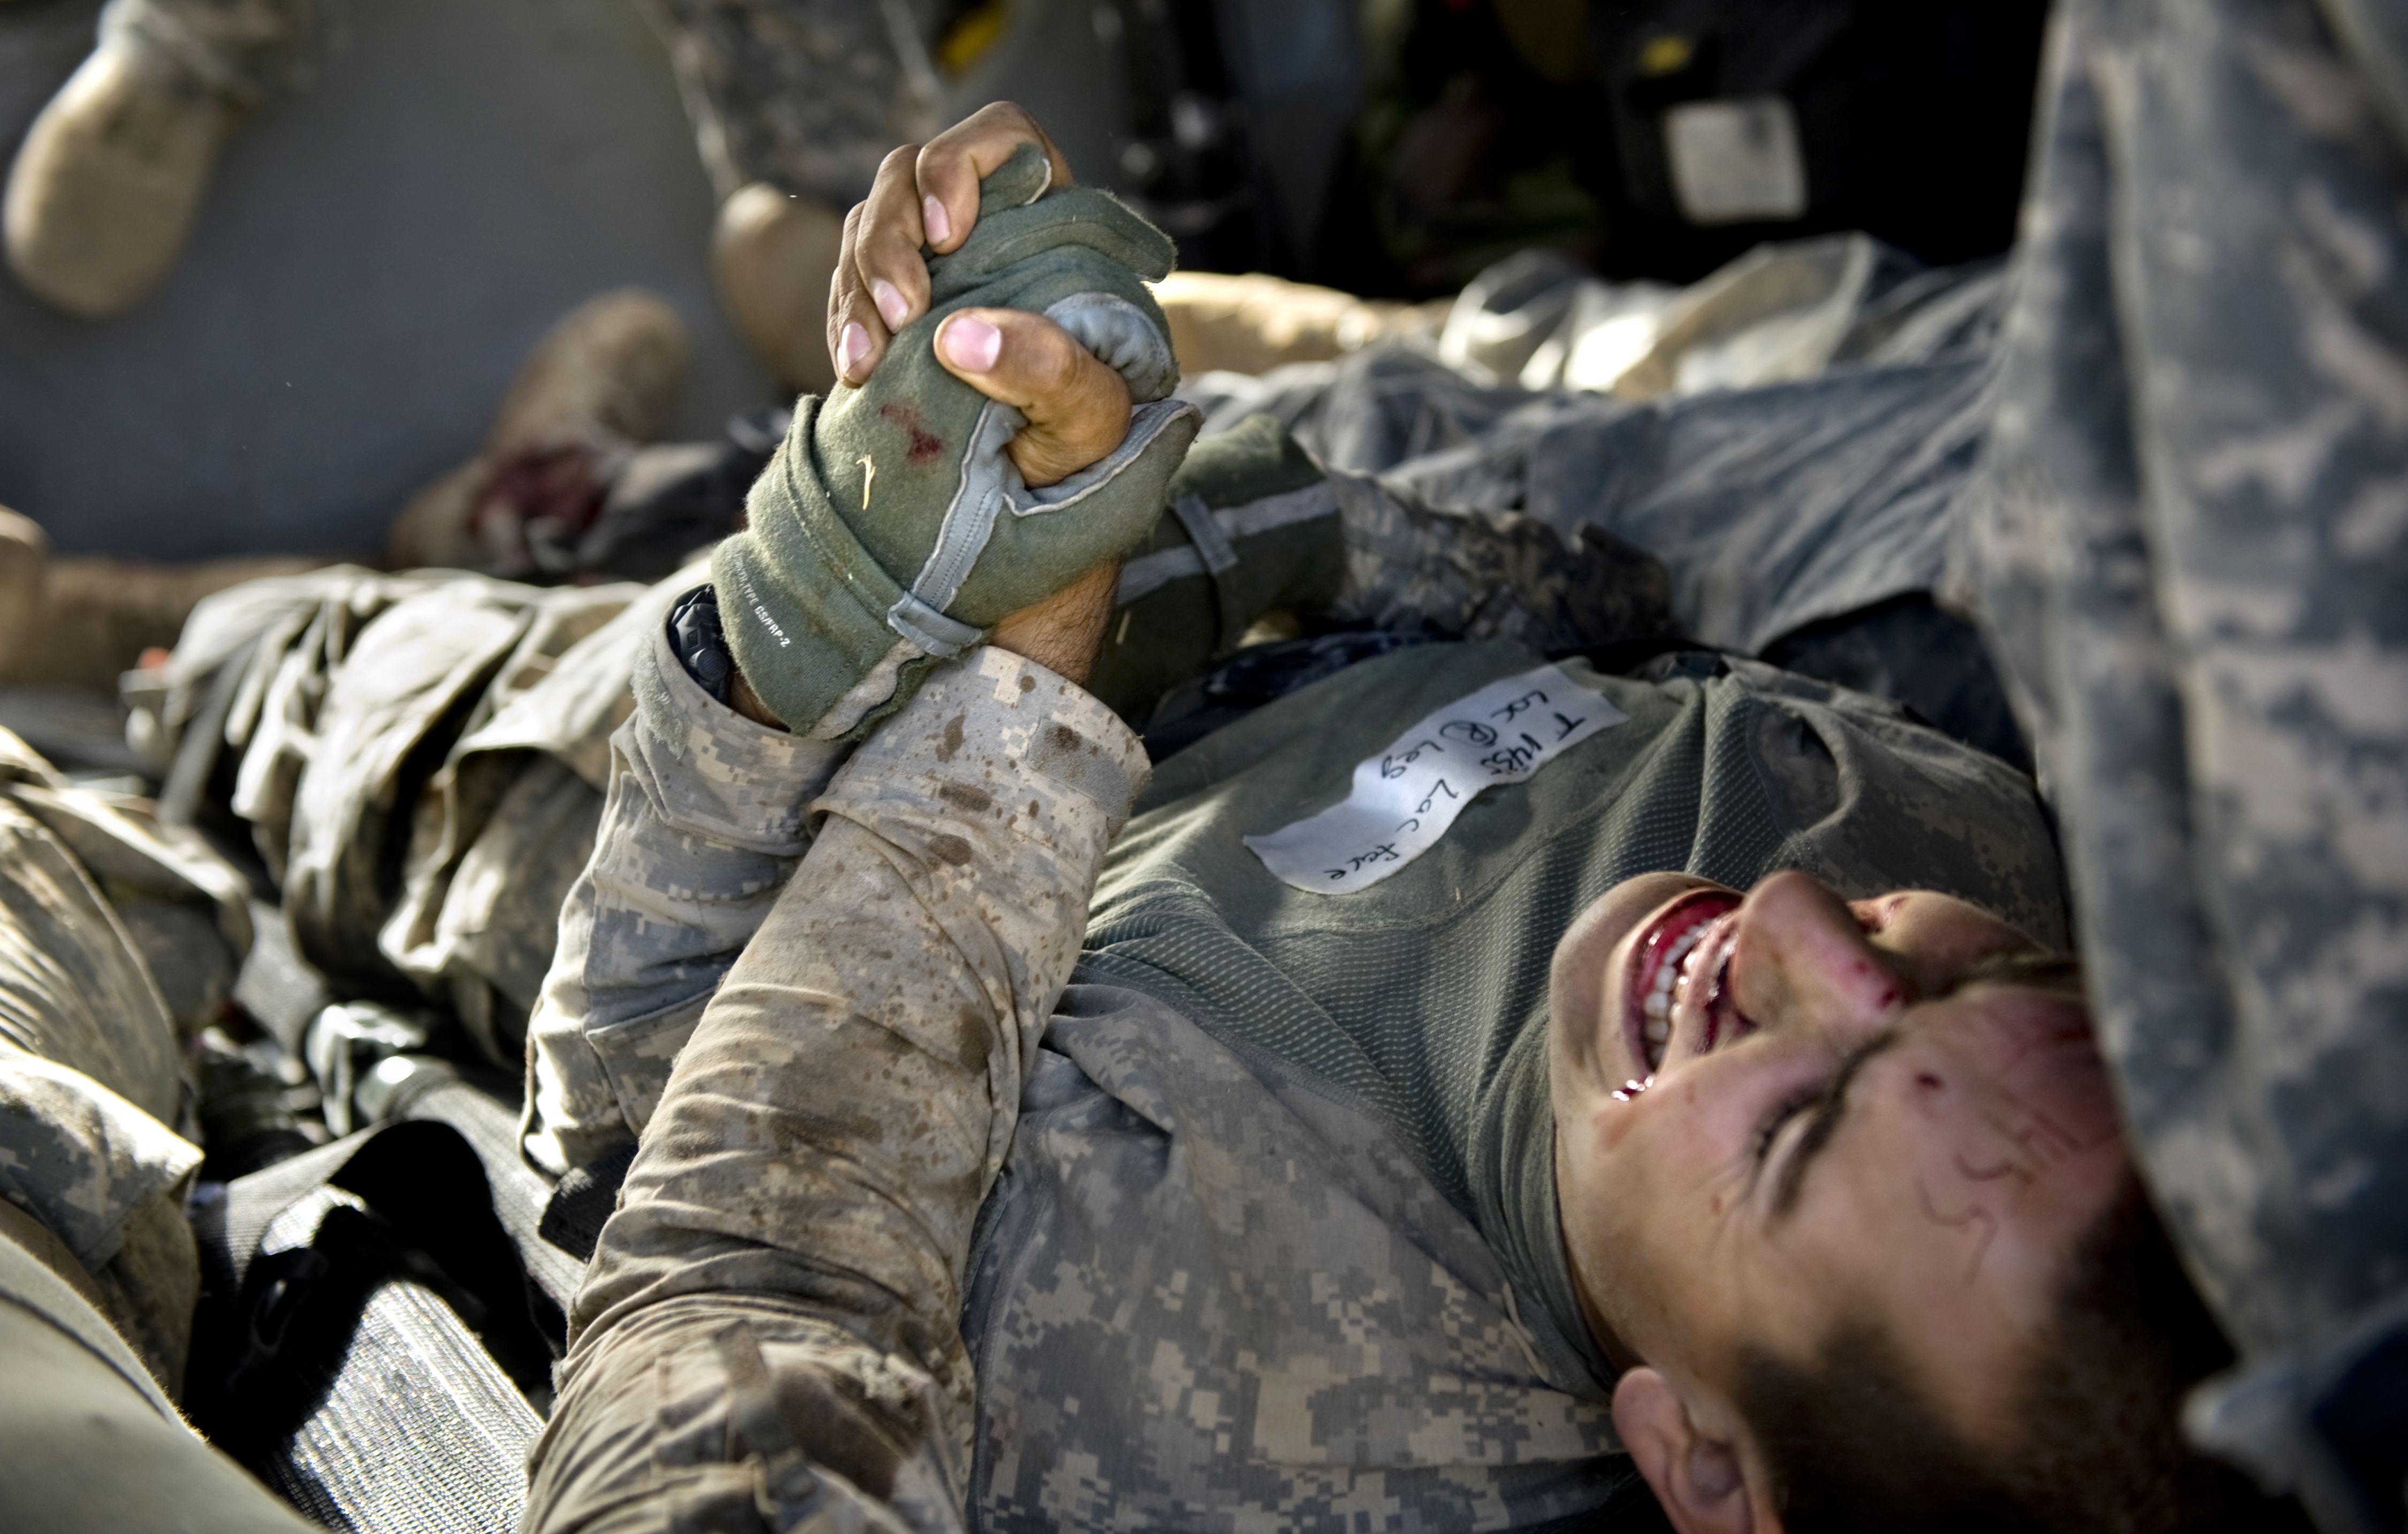
Religion is usually defined as a social-cultural system of designated behaviors and practices, morals, beliefs, worldviews, texts, sanctified places, prophecies, ethics, or organizations, that generally relates humanity to supernatural, transcendental, and spiritual elements

Slide 30
Why
Why do we assume that doing something is better than doing nothing
We somehow think that technology trumps common sense
Sometimes the hardest thing in the world is to sit on your hands and watch

Slide 31
CURMUDGEON HYPERBOLE
STOP- NEEDLE DECOMPRESSION IN SPONTANEOUSLY BREATHING PATIENTS
STOP - LEFT SIDED 5TH ACL APPROACH
START - Leave all prehospital needles in place until after CT scan
START - Collect data on all needles placed
TODAY’S SUMMATION AND WAY AHEAD

Slide 32
HOUSTON – WE HAVE A PROBLEM
THOR – WE HAVE A PROBLEM
Diagnostic Criterion need to be more precise
Technical solutions/devices must be resolved
Data Dilemma must be addressed
Educational issues must be examined

Slide 33
Diagnostic criterion
“HARDER SIGNS”
? CONTINUE TO ENDORSE NDC IN SPONTANEOUSLY BREATHING PATIENTS??
SUBCUTANEOUS CREPITANCE AS HARD SIGN??
ONLY IF UNRESPONSIVE TO HEMORRHAGIC SHOCK RESUSCITATION(THE 88% RULE)

Slide 34
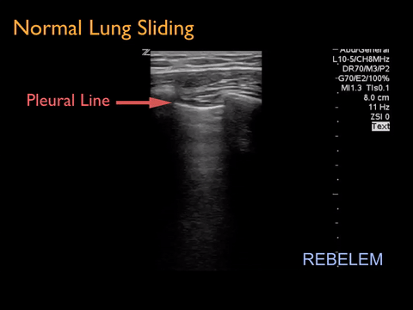
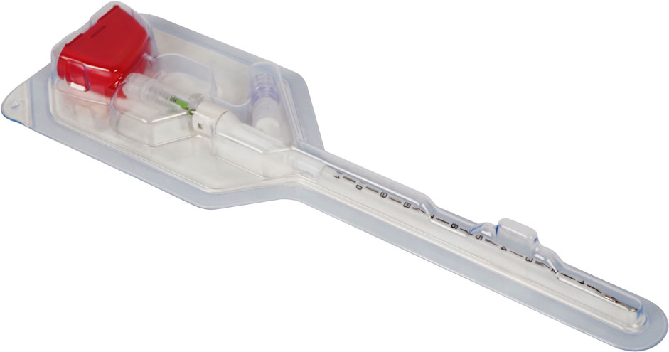
Technical solutions
CAN WE MORE RELIABLY INDENTIFY THE TENSION PTX IN THE FIELD
ULTRASOUND
EFAST
CAVAL DISTENSION
NEEDLE PLACEMENT UNDER GUIDANCE?
TECHNICAL SOLUTIONS FOR DECOMPRESSION
SIGNIFICANT DATA NOW EXISTS THAT WE ARE AS LIKELY TO WOUND AS TO RELIEVE
???? STOP THE USE OF THE LEFT 5TH ICS APPROACH WITH EXISTING NEEDLE
VERES NEEDLE TECHNOLOGY
NOVEL AI/TECHNOLOGY SOLUTIONS
TROCAR OR THORACIC PORT SOLUTIONS

Slide 35
DATA DILEMMA
DR. SHACKELFORD-
ONE TC3 CARD SUBMITTED OVER THE LAST YEAR
LESS THAN 10% OF PRE-HOSPITAL LSI’S ARE CAPTURED
PROBABLY EVEN FEWER OF ATTEMPTED NDC ARE CAPTURED
LITLLE TO NIL ROLE II ONWARD DATA/IMAGING CAPTURED
PLACEMENT OF A NDC IN THE FIELD USUALLY RESULTS IN INJURY CODING AS PTX WHEN NONE MAY HAVE BEEN PRESENT
THE “CHICKEN OR THE EGG”

Slide 36
EDUCATIONAL DILEMMA
SIMPLE PTX PTX / RESPIRATORY DISTRESS PTX /VASCULARCOMPROMISE
TACHYPNEA
TACHYCARDIA
HYPOTENSION
JVD
SUBCUTANEOUS EMPYSEMA

Slide 37
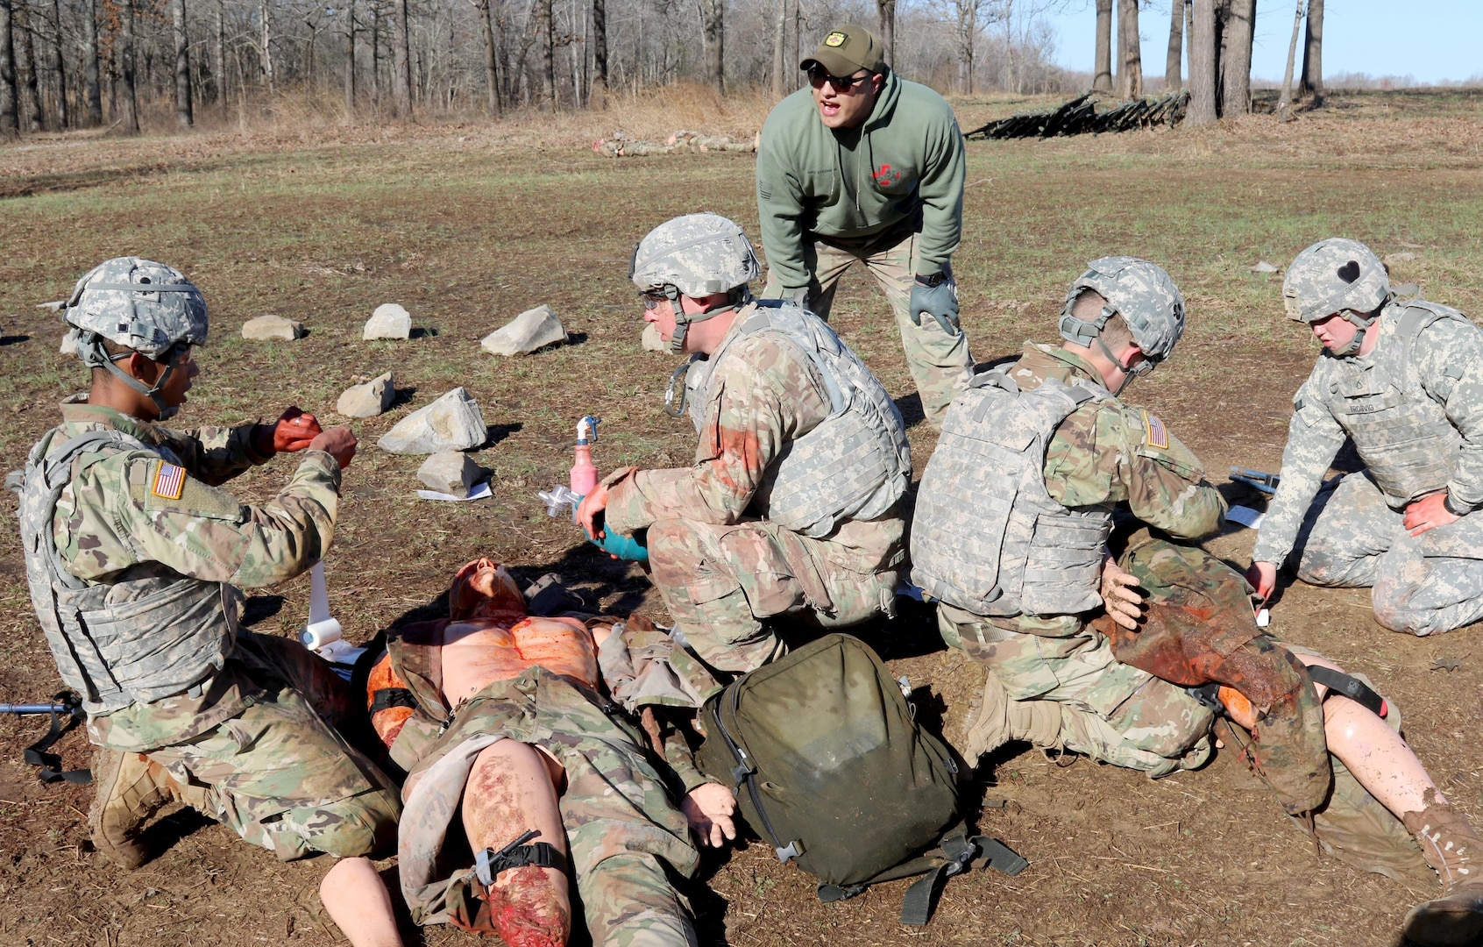
EDUCATIONAL DILEMMA A 1% INJURY TESTED 100%
Where’s your NDC?
EMPHASIZE COGNITIVE RATHER THAN MOTOR SKILLS
DON’T JUST DO SOMETHING
THNK BEFORE WE DO
THE “DO’ER” CULTURE

Slide 38
We must remember the sanctity of what we do
No higher calling than to serve those who put themselves in harms way
The privilege of the knife
Phil, Geir, Elon (אח צעיר), Kevin
Primum non Nocere
I thank you

