Slide 1
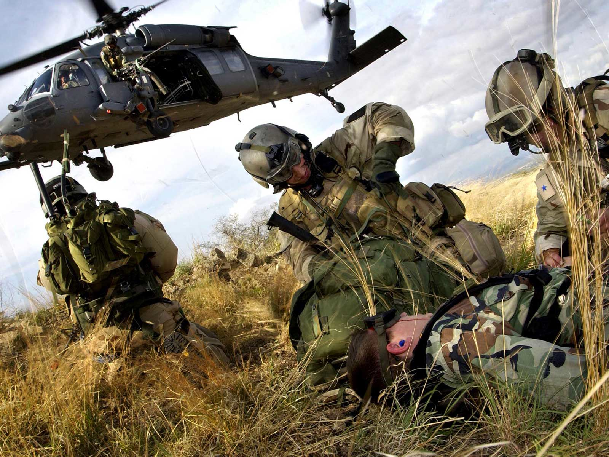
Ever Adapting for the Warfighter:
Future Battlespace Preparedness
Col Michael Davis, MD, FACS
Director, US Combat Casualty Care Research Program
THOR-RDCR June 24, 2019
https://ccc.amedd.army.mil

Slide 2
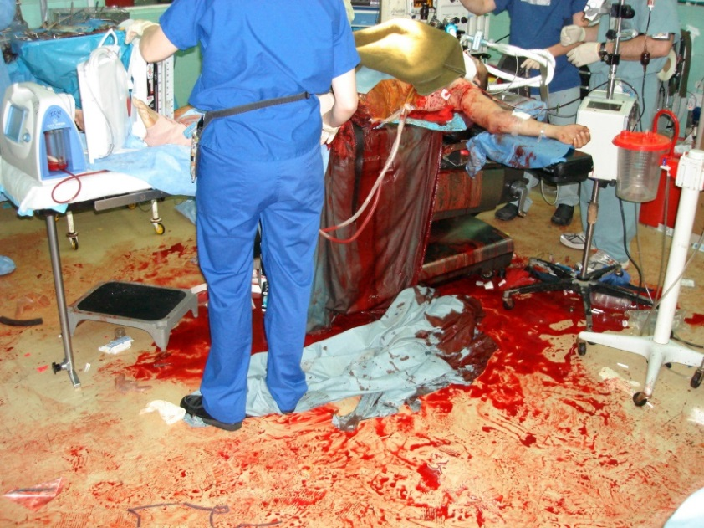
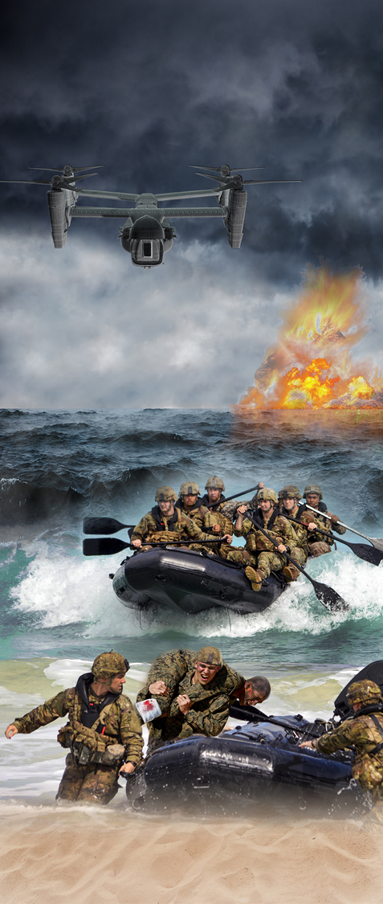
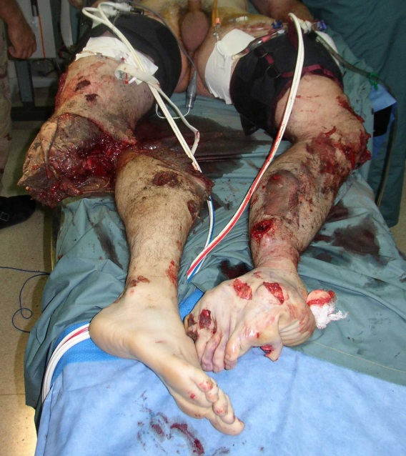

Slide 3
CCCRP PORTFOLIOS
Neurotrauma (TBI)
BRISCC
En Route Care
Prolonged Field Care
Portfolio Manager -Dr. JB Phillips Asst. Portfolio Manager -Dr. Nsini Umoh CTR Asst. Portfolio Manager
-Dr. Casey Moritz CTR Portfolio Asst.
-Dr. Lucas Glover CTR
Portfolio Manager
-Dr. Crystal Hill- Pryor
Asst. Portfolio Manager
-Dr. Todd Getz CTR
Portfolio Manager
-Maj Cubby Gardner
Portfolio Manager
-Dr. Anne Ritter
Asst. Portfolio Manager
-Dr. Robin Walker

Slide 6
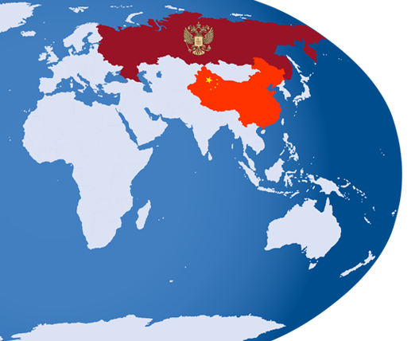

Slide 7
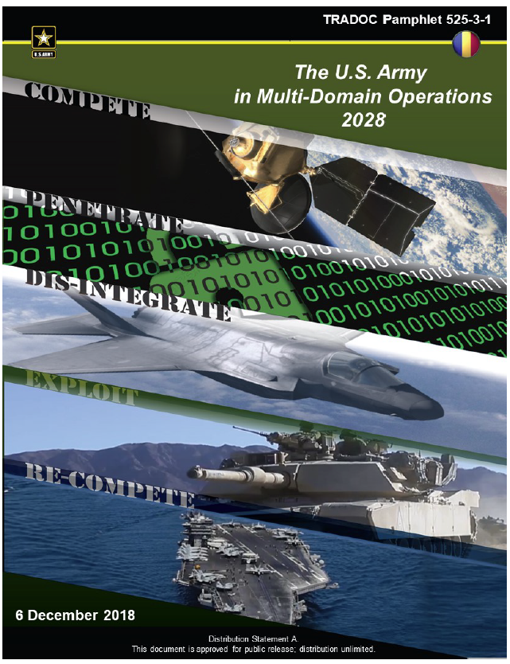

Slide 8
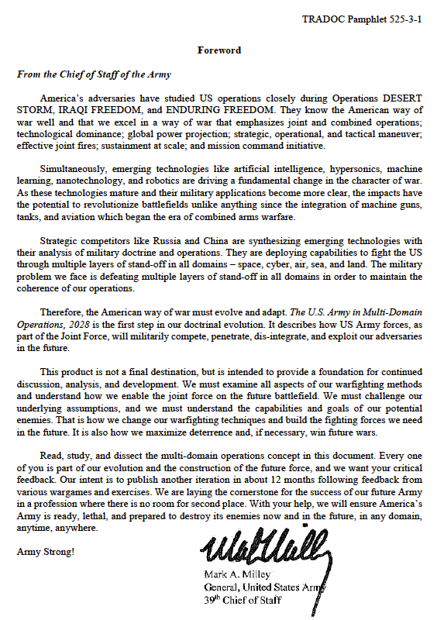

Slide 9
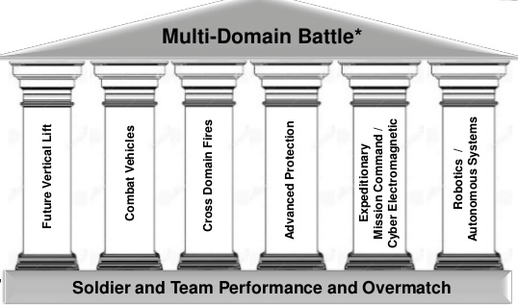

Slide 10
Medical Support

Slide 11
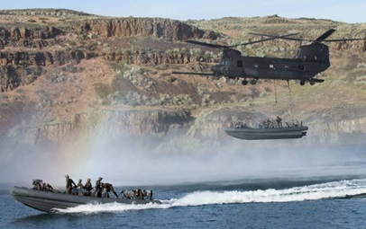
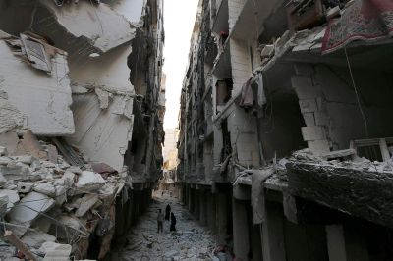
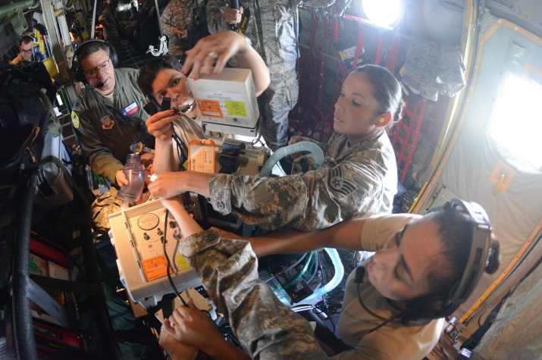
MULTI-DOMAIN OPERATIONS
LACK OF AIR SUPERIORITY/ ON DEMAND EVACUATION X 72H
CONTESTED COMMUNICATIONS
HIGHLY MOBILE BATTLEFIELD
LARGE CASUALTY VOLUMES (>10,000/ 60 DAYS)
MORE LETHAL BATTLEFIELD
HIGHLY CHALLENGING LOGISTICS
DOCTRINE OF “GOLDEN HOUR” NOT ATTAINABLE

Slide 12
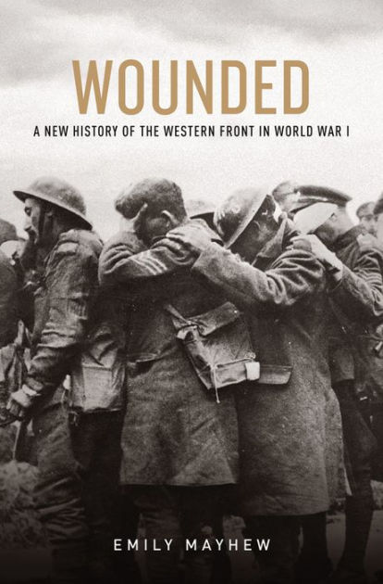
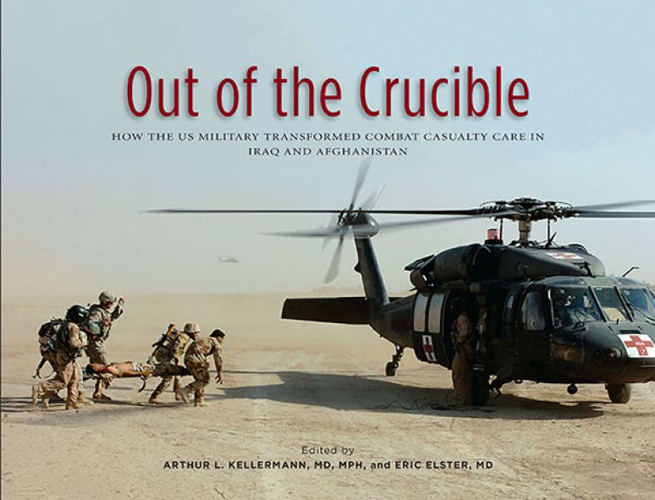

Slide 14
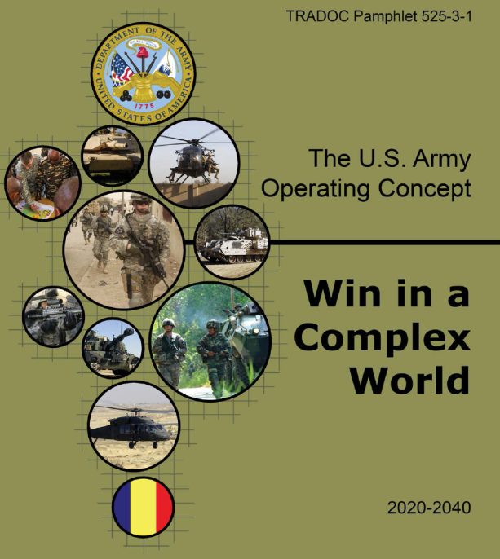
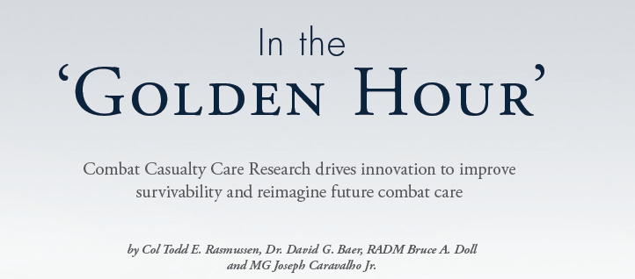
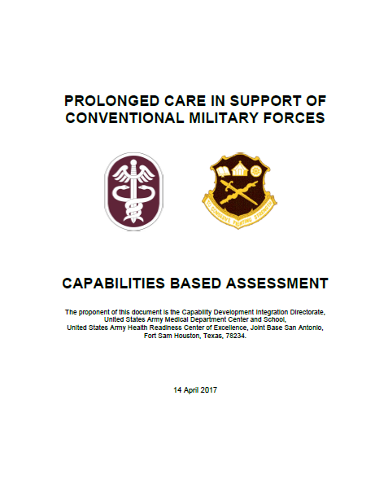
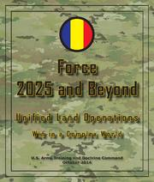
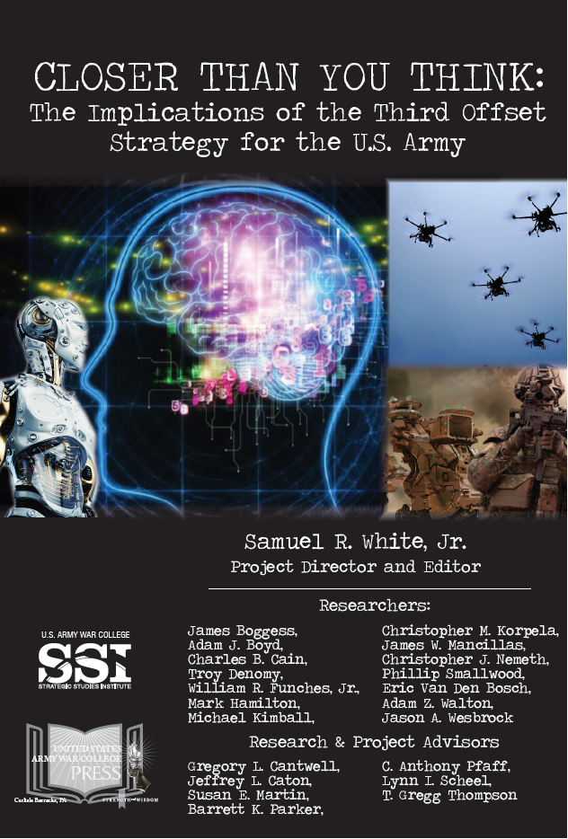
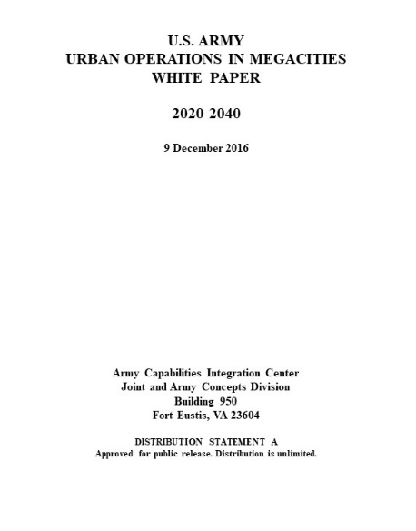
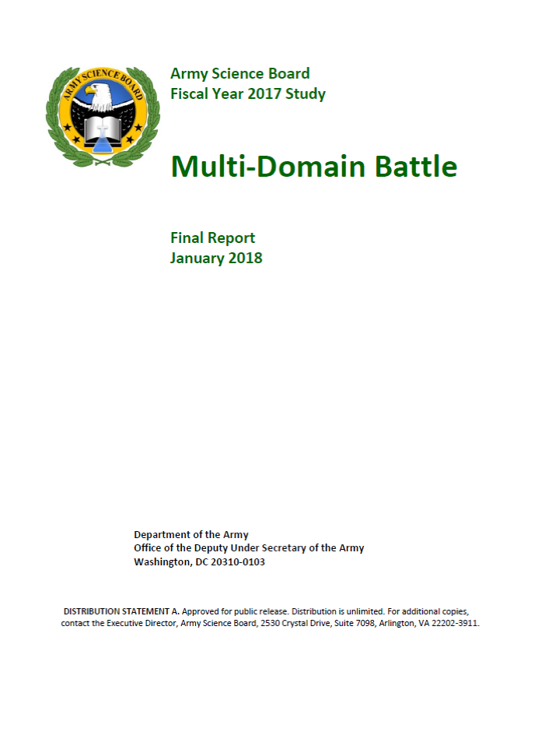
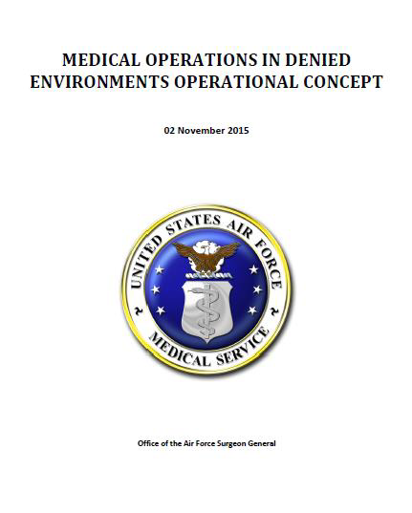
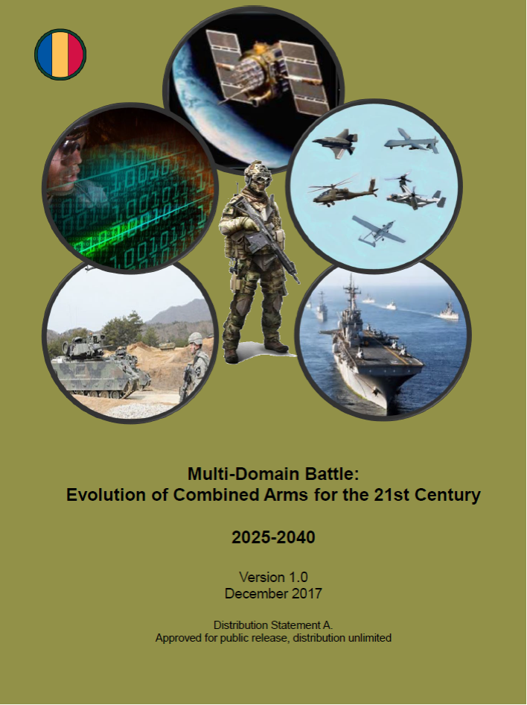
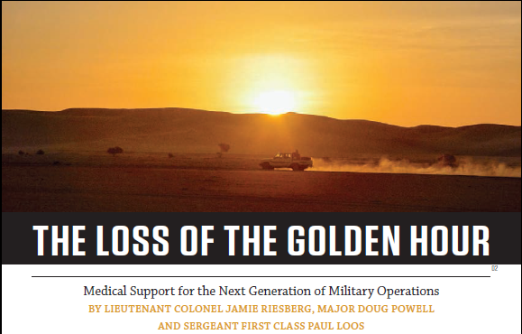

Slide 15
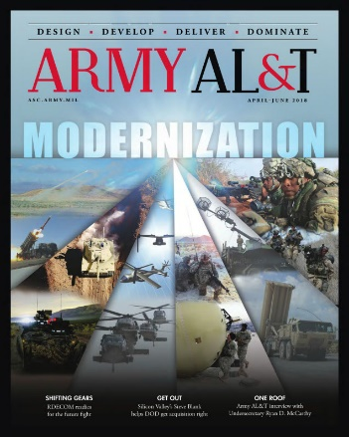
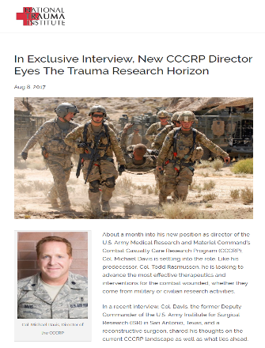
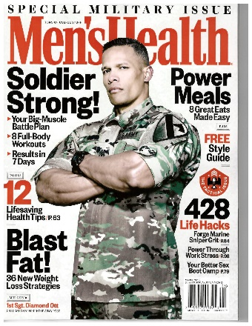
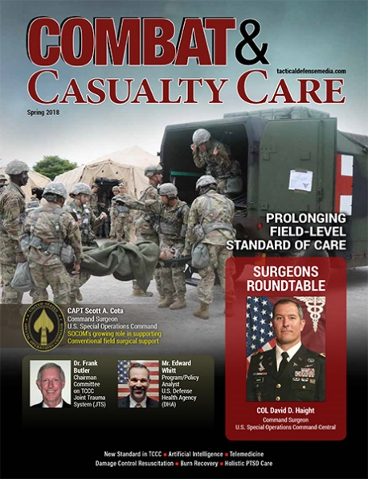
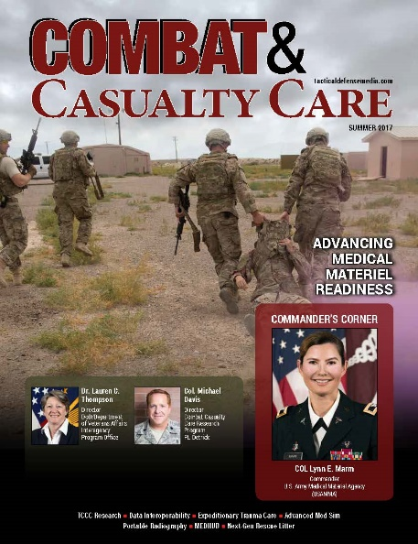
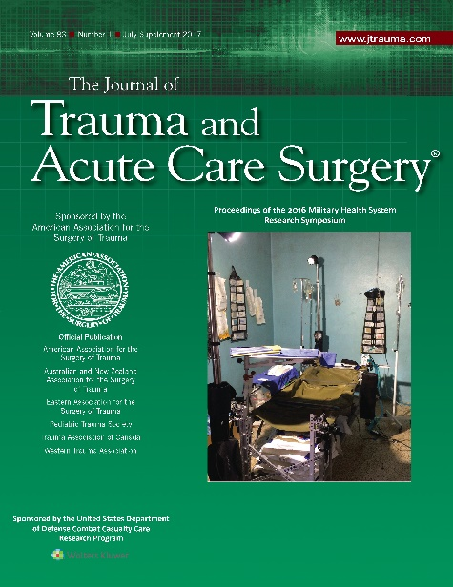
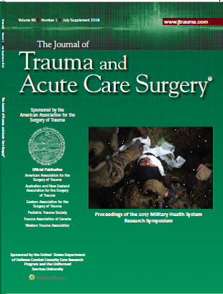

Slide 16
Challenges Posed By MDO
TCCC
Casualty volume- triage
Lethality of the battlefield
Combined injury
Prolonged Care
Casualty Volume
Delay to damage control surgery
Secondary sequela of injury

Slide 17
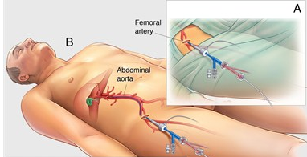
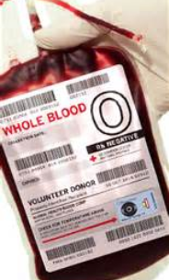
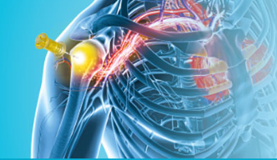

Slide 18
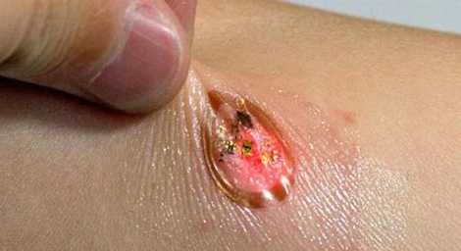
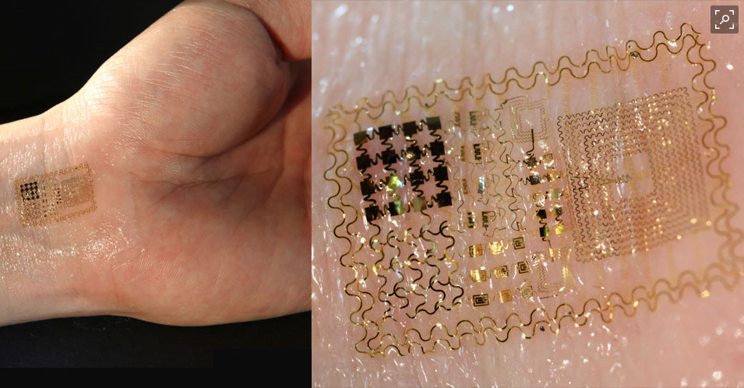
Advanced Biosensors

Slide 19
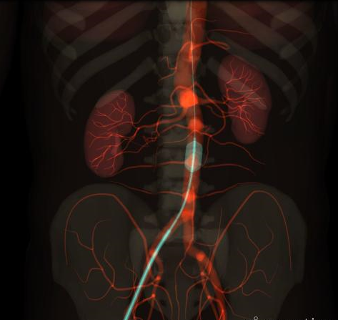
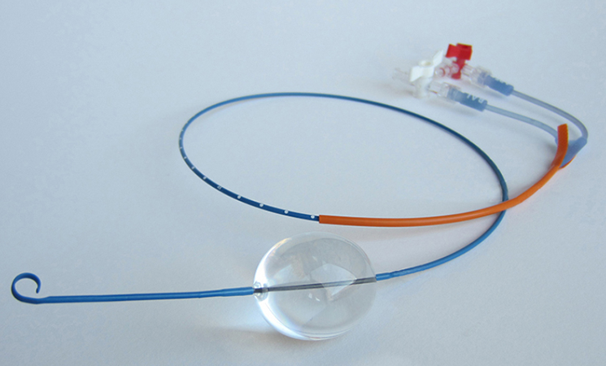
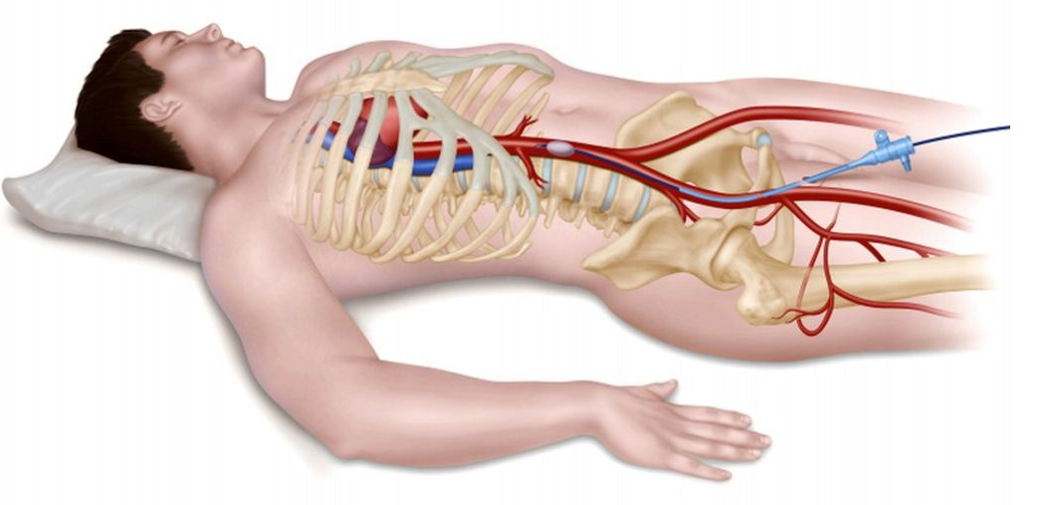
REBOA (Next Generation)

Slide 20
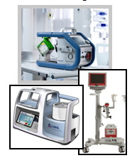
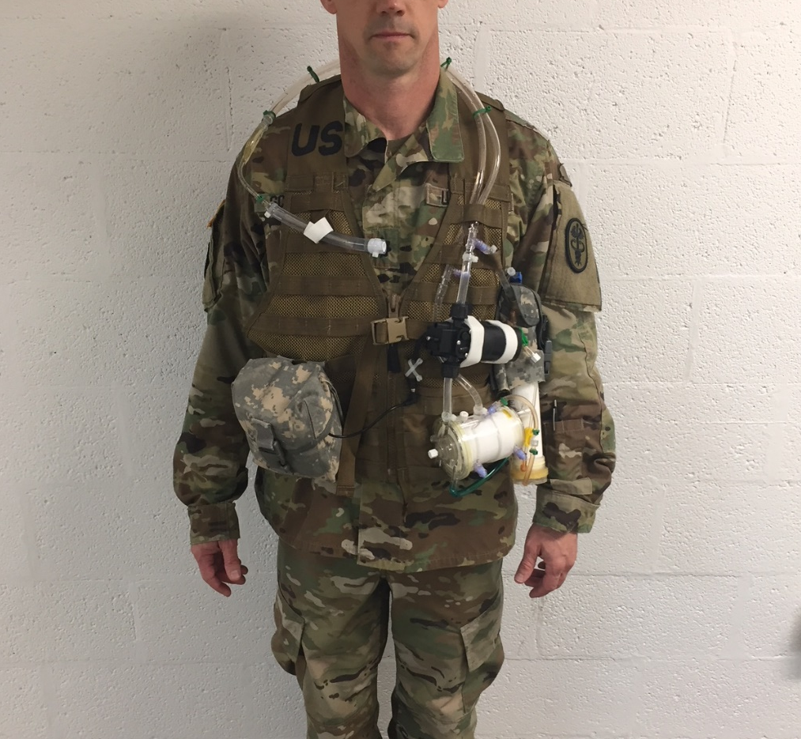
Extracorporeal Life Support (ECLS)

Slide 21
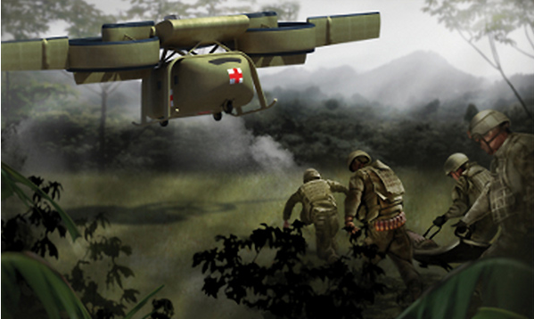
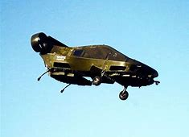
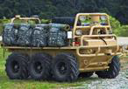

Slide 22
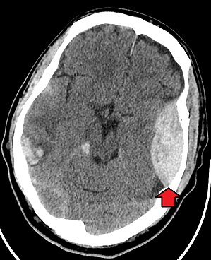
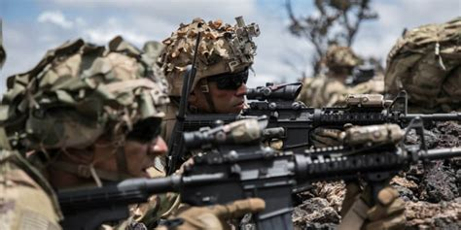
Robotic support
MEDEVAC re-configuration for MDO
Field device to determine anatomic location of hemorrhage
Device to non-invasively measure cerebral perfusion/ detect EDH, SDH, ICH
Automated cranial decompression
Non-neuro-invasive neuro-assessment devices to determine RTD decisions in the battlefield
Non-opioid analgesia solutions with limited side effects
Optimal analgesia solutions for TBI patients
Rapid pain management solutions that do not compromise cognition or affect hemodynamics
Automated anesthetic capabilities that can be implemented at Role 1/PFC
Tool to enable regional nerve blocks at Role 1 with limited training
New long-lasting (>2 hr.) analgesics for prolonged care
High fidelity cricothyrotomy/airway model

Slide 23
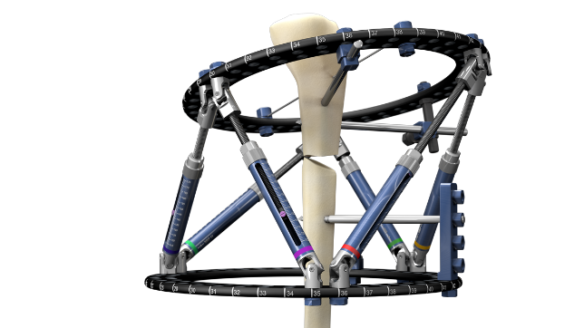
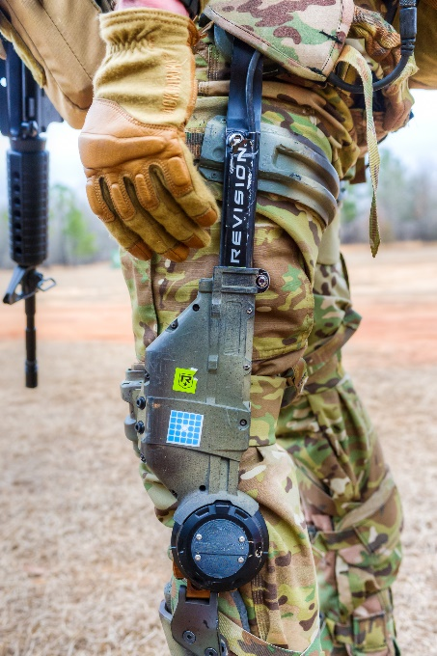
Tactical cricothyrotomy kit with functional field suction
Tactical medical light
High fidelity hearing protection
Improved hemostatic pressure bandages
Hemorrhage control drugs
Ligation/surgical repair capabilities at POI
AI/Decision support tools for effective tourniquet conversion
Advanced external skeletal fixation/ exoskeleton
Diagnostics and therapeutics for compartment syndrome
Field amputation
Autonomous critical care support systems for unmanned evacuation platforms
Gas mask with airway access for trauma care
MOPP-4 with fluid resuscitation capability

Slide 24
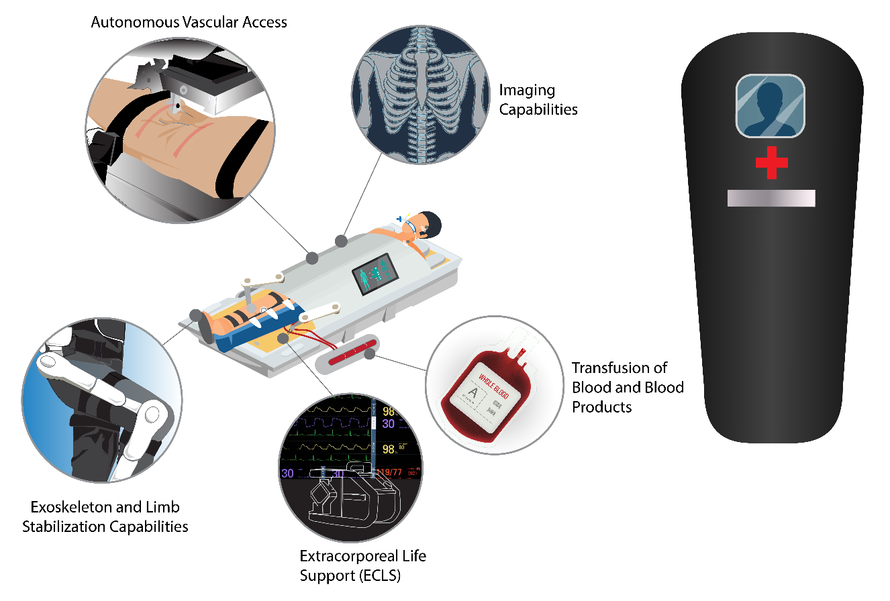
Miniaturized medical mini-tools
Sustained O2/ventilation
Drugs to control airway secretions/inflammation
Large animal platforms for in-vivo training for PFC conditions
Organ preservation drugs
Automated tourniquet/smart tourniquets
Walking blood banks
Drugs to support hemostasis
Improved junctional bleeding control
Field expedient vascular clamps
Ability to visualize hemorrhage source
Non-compressible torso hemorrhage control
Manufacturing/production of medical materials on-site
Unmanned extraction
Algorithms and decision support for triage
Field expedient pelvic fixation

