Slide 1

CHIlled Platelet Study
Philip C. Spinella, MD, FCCM
Professor, Dept of Surgery and Dept of Critical Care Medicine
Co-Director, Trauma and Transfusion Medicine Research Program
University of Pittsburgh
June 2023

Slide 2
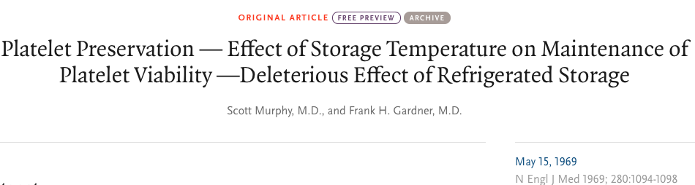
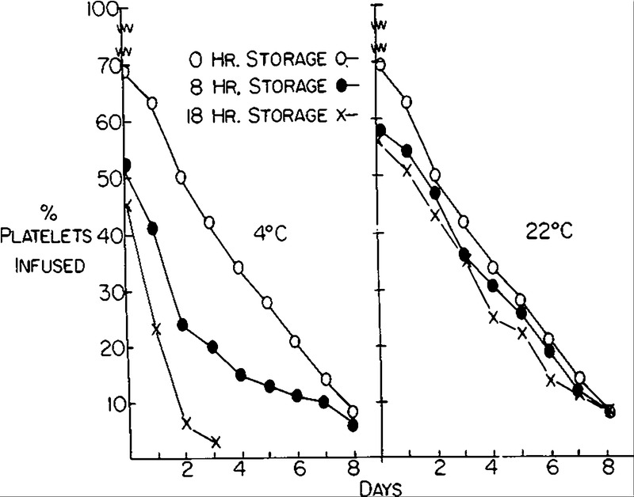
How Do You Define Function?
“The use of cold platelets should be abandoned…for transfusion purposes”

Slide 3
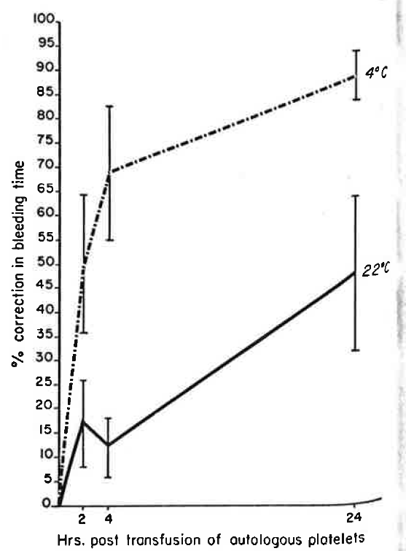
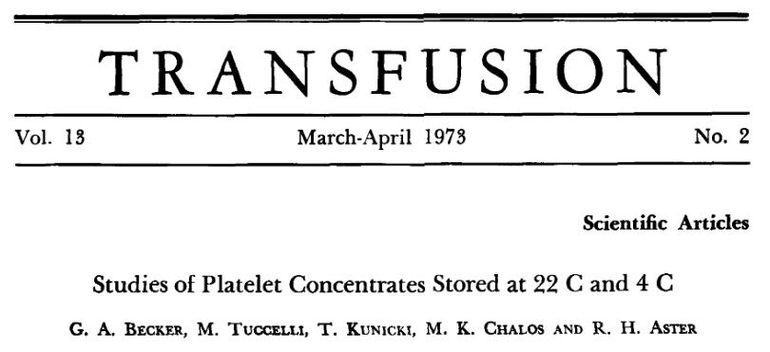
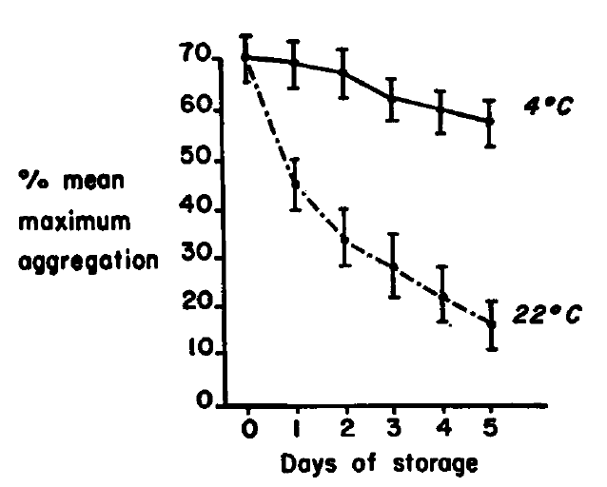
Traded Circulation Time for
Reduced Hemostatic Efficacy
Light Transmission Aggregometry
Notes:
We have known for 50 years that a cold stored platelet does improve hemostatic function. Aggregometry results indicate cold platelets have increased aggregation compared to RT platelets and in an RCT examining adults on aspirin or who were thrombocytopenic cold platelets significantly reduced bleeding time compared to RT platelets.

Slide 4
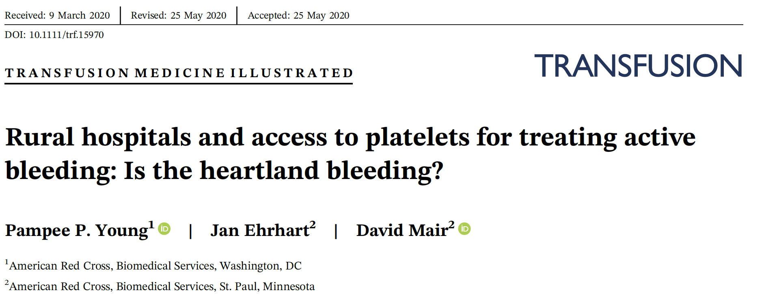
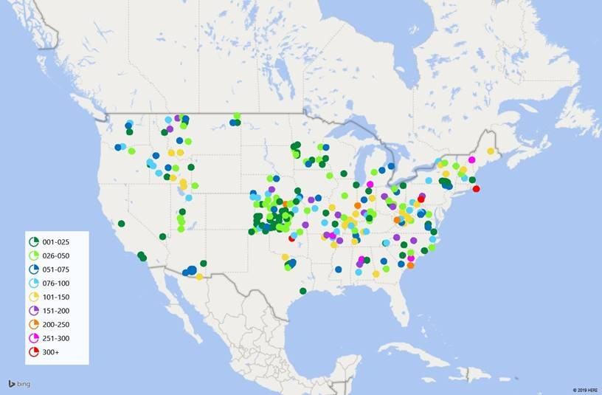
Traded Circulation Time for Availability
Lack of Platelet Availability at Non-Tertiary Care Medical Centers
  5 day shelf life
249 hospitals American Red Cross supplied do not have platelets
Contributing to preventable deaths from hemorrhage?
4

Slide 5
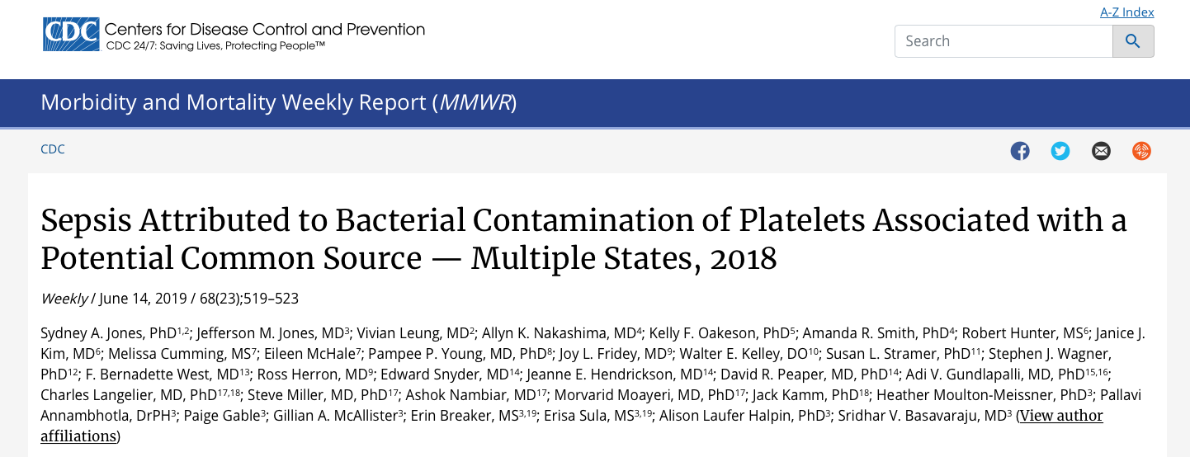
Traded Circulation Time for Reduced Safety

Slide 6
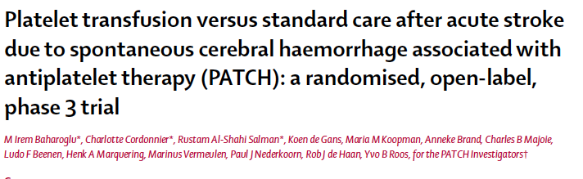
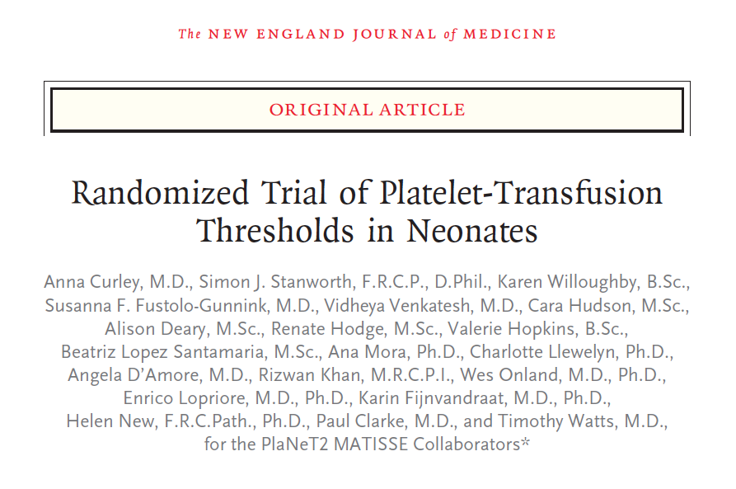
Increased morbidity and mortality with increased room temp platelet use in both RCTs of patients with intracranial bleeding!
Notes:
Potential Explanation for findings include
Platelets at 22C don’t work very well and wont reverse platelet inhibition
Small sample size and may not be generalizable
Imbalances between study groups, while not statistically significant appear clinically relevant.
Platelet transfusion could worsen ischemic areas
Potential larger risk with a warm platelet than with standard therapy.
Severe bleeding outside of the brain is different than intracranial hemorrhage with platelet inhibition

Slide 7
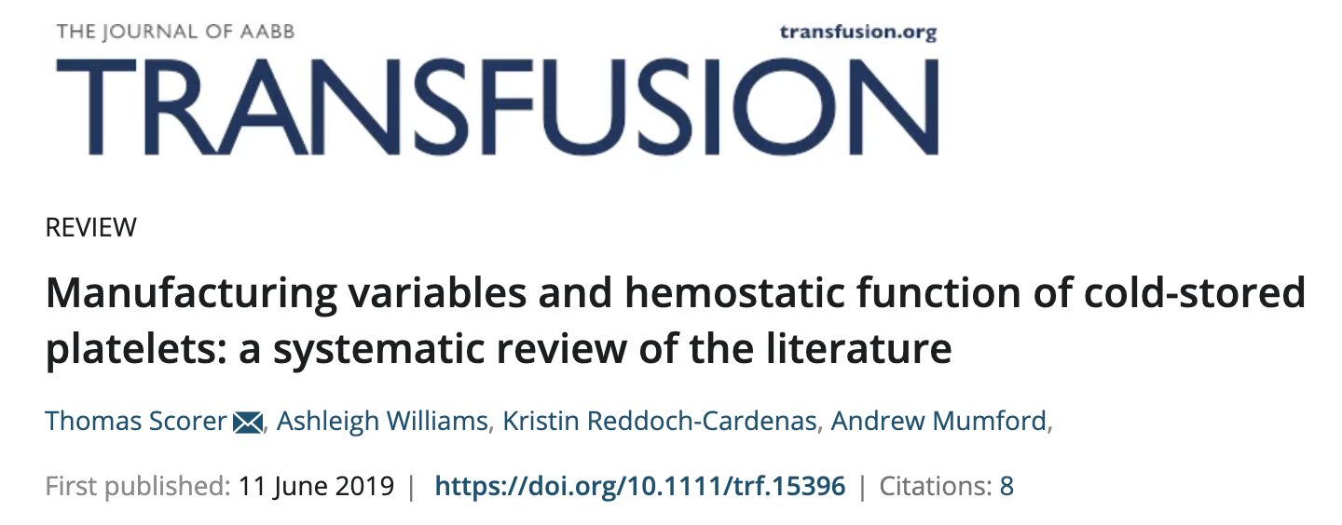
In the past decade there has been renewed interest in the use of cold platelets for bleeding patients
There are countless in vitro and a few animal studies that support hypothesis that a cold-stored platelet can reduce bleeding without increasing adverse thrombotic events compared to RT-stored platelets.

Slide 8
Cold vs Warm Platelets in
Microfluidic Chamber
Thomas KA, Spinella PC, Shea S. Unpublished

Slide 9
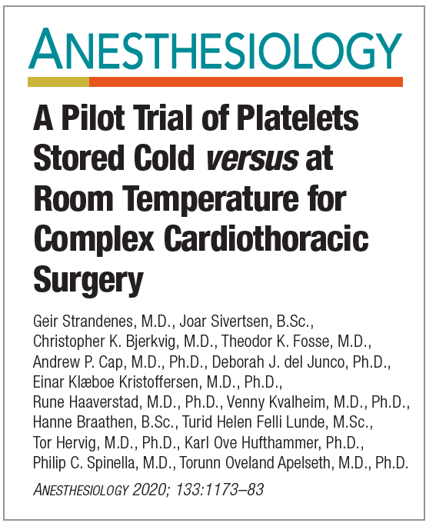
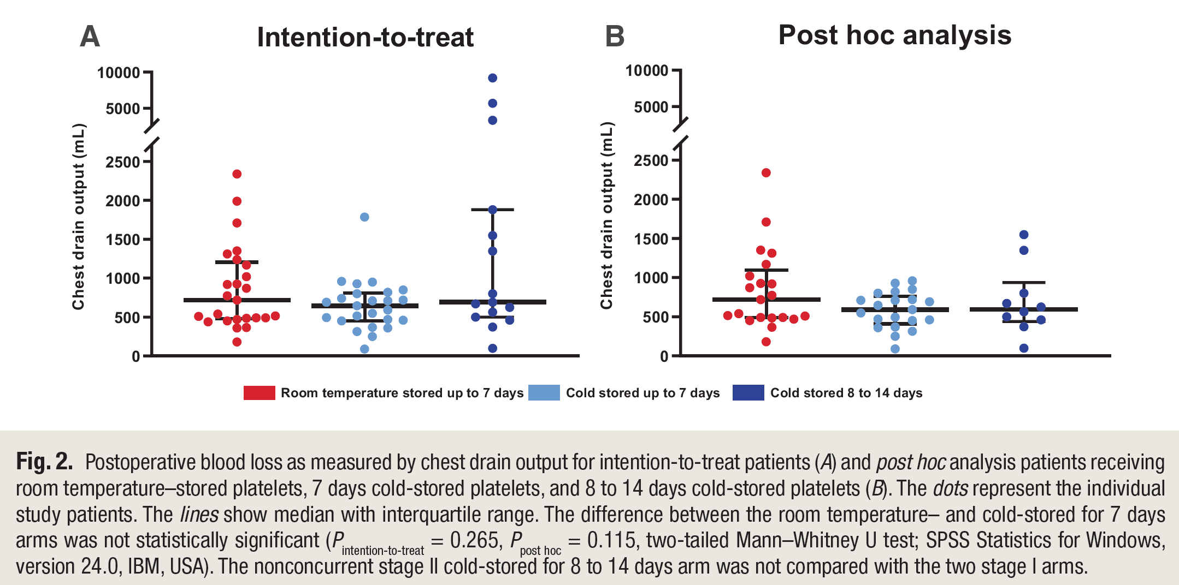
Pilot Study of CSP vs Room Temperature in Complex Cardiothoracic Surgery
Notes:
Recently a pilot RCT indicated that it was feasible to perform a large trial examining cold vs RT platelets in CT surgery patients and suggested safety concerns were low due to no differences in adverse events or transfusion reactions in this small single center study.

Slide 10
Phase 3, multi-center, international, randomized, partially blinded, adaptive, non-inferiority study

Slide 11
Study Design
1000 subjects (competitive enrollment)
  Pediatric & adults subjects
Randomization is 2:1 cold stored to room temperature platelets
Inclusion criteria
  29 days to 85 years
  Platelets transfused for active bleeding
  Complex cardiac surgery requiring cardiopulmonary bypass

Slide 12
Study Exclusion Criteria
Expected order for washed or volume reduced platelets;
Patient with known anti-platelet antibodies (e.g., anti-HPA-1a, ITP);
Platelet transfusion refractoriness due to anti-HLA antibodies;
Known or suspected pregnancy;
Previously randomized in this study;
Conscious objection or unwillingness to receive blood products;
Known IgA deficiency;
Known congenital platelet disorder;
Known congenital bleeding disorder (e.g., Hemophilia A, von Willebrand disease, Ehlers-Danlos syndrome);
Planned post-operative extracorporeal membrane oxygenation (ECMO), ventricular assist device (VAD), and/or continuous renal replacement therapy (CRRT)/hemodialysis;
Patients intended to receive whole blood either intra-operative or post-operative for bleeding.

Slide 13
Study Design
Partially blinded study
Eligibility period
  During surgery or within the first 24 hours following ICU admission
Intervention period
  24 hours from the start time of the first platelet transfusion
Maximum of 6 units (or 6 doses)
    One pediatric dose = 10-15 mL/kg,
    Max pediatric dose = 6 x15 mL/kg= 90ml/kg

Slide 14
Study Design
Maximum storage duration of cold-stored platelets (CSP)
  Study start, maximum storage duration is 7 days
  After each successive cohort of 200 patients, an interim analysis will be conducted that allows the maximum storage duration of cold-stored platelets to change depending on the accumulating trials results
  Duration may be extended during the study up to a maximum of 21 days

Slide 15
Intervention
Apheresis collected platelets only
  All apheresis collection platforms studied
CSP stored at 4ºC
  8 hrs for time to placement at 4ºC non-PRT
  24 hrs for time to placement at 4ºC PRT

Slide 16
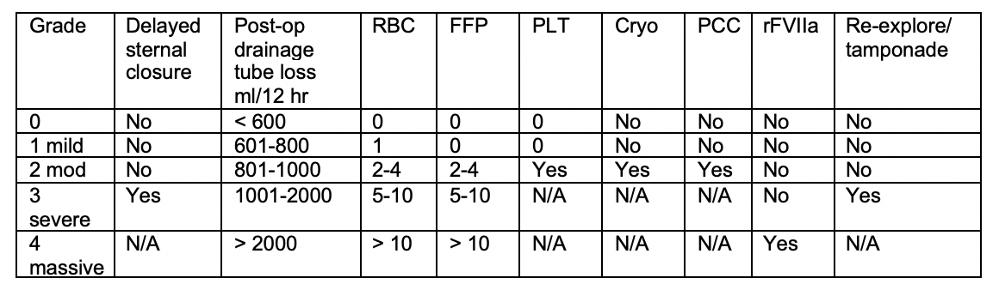
Primary Outcome
Score calculated after the first platelet transfusion
Dyke C, et al. Universal definition of peri-operative bleeding in adult cardiac surgery. JTCVS 2013.

Slide 17
Efficacy Assessments (continued)
Secondary Outcomes
  Chest tube output for 24 hours
Exploratory Outcomes:
  Total blood product administration at 72 hours
  Total dose of individual hemostatic adjuncts at 72 hours
  Relative change in hemostatic parameters at 6 and 24 hours
    CBC, PT/INR, PTT, fibrinogen & TEG with platelet mapping

Slide 18
Safety Assessments
Morbidities within 7 days of 1st study platelet transfusion:
  Acute respiratory distress syndrome (ARDS)
  Need for and duration of renal support
  Renal failure
  Septic shock
Transfusion associated AEs within 7 days of 1st study platelet transfusion

Slide 19
Safety Assessments (continued)
Arterial thrombotic events (stroke, MI) within 7 days of 1st study platelet transfusion
Venous thrombotic events within 7 days of 1st study platelet transfusion
28-day all-cause mortality

Slide 20
Current Enrollment Status
(as of 24 May 2023)
Metric | Total
Active Sites | 20
Randomized Patients | 549
Enrolled (dosed) Patients | 242 (161 CSP/81 RT)
Consent rate 65%
10 of 1368 CSP units wasted for aggregates
  9 group A and 1 AB donor
No Unexpected and Related Serious Adverse Events
Expected trial completion Jan 2025

Slide 21
All Platelets Transfused by Type
Platelet Type | Overall
PRT-AMICUS-PAS | 58%
PRT-TRIMA-Plasma | 21%
Trima-Plasma | 17%
AMICUS-PAS | 2%
AMICUS-Plasma | 2%
Trima-PAS | 0%
Suppliers: ARC, NYBC, Mayo Clinic, Vitalant, OBI, One Blood
Pending contracting: Carter and Versiti

Slide 22
In Vitro PLT Function Study
Compliment trial data
Platelet Function/Thrombin Generation Assays
Compare RTP to CSP
All 7 Platforms
  Trima
    PRT, Plasma, PAS
  Amicus
    PRT, Plasma, PAS
  Haemonetics

Slide 23
Questions?

