Slide 1


“Overview of TRACIR: TRAuma Care In a Rucksack”
A closed loop autonomous and robotic controlled cardio-pulmonary resuscitation platform
Ronald Poropatich, MD, MS
Colonel/Retired/US Army
Professor of Medicine
Division of Pulmonary, Allergy, and Critical Care Medicine
Director, Center for Military Medicine Research, Health Sciences
University of Pittsburgh
27 June 2022

Slide 2
Acknowledgements
Critical Care Medicine
Michael Pinsky (Scientific PI)
Emergency Medicine
Frank Guyette
Lenny Weiss
David Salcido
Commercialization Manager
Jan Berkow
CMU Auton Lab
Artur Dubrawski

Slide 3

Problem to Solve
How can we initially treat & stabilize a casualty at point of injury using autonomous & robotic systems & clear the battlespace via unmanned evacuation?
Case example for a 4 year U.S. Army funded research program with civilian application
(DOD Funding: W81XWH19C0101)

Slide 4
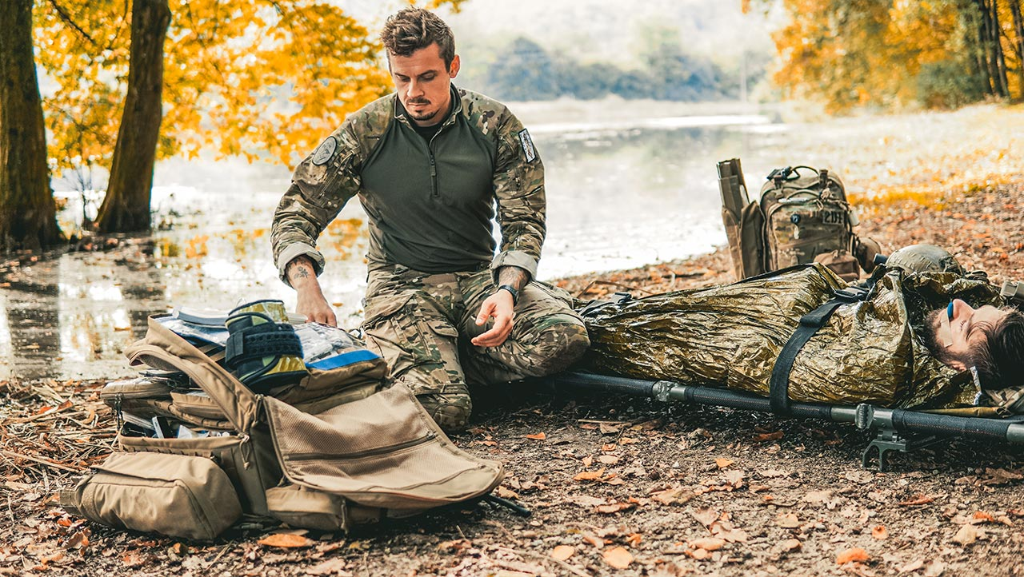
Military Market Needs
Resource Constrained High Acuity Care
25% of battlefield deaths preventable; 88% of these are from hemorrhage
*Non-battlefield injuries responsible for 34% of casualties and ~12% of mortalities
Increased survivability requires providing critical care near the time of injury
Highest critical need in austere field setting is for high acuity decision making
*A 12-Year Analysis of Nonbattle Injury Among US Service Members Deployed to Iraq and Afghanistan; Tuan D. Le, MD, DrPH et al; JAMA Surg. 2018 Sep; 153(9): 800–807.
Page 3

Slide 5
Initial Capabilities Document (ICD)
For
Autonomous Care & Evacuation (ACE) Support of
Combat Casualty Care
5 January 2021
Validation Authority: Joint Capabilities Board (JCB)
Proposed Milestone Decision Authority: Defense Health Agency
Sponsor Organization: Office of the Assistant Secretary of Defense for Health Affairs (OASD/HA)
Point of Contact:
CAPT Travis Polk, MD - JPC6/Combat Casualty Care Research Program
Dr. Terry Rausch – Research & Development Policy & Oversight, OASD/HA

Slide 6
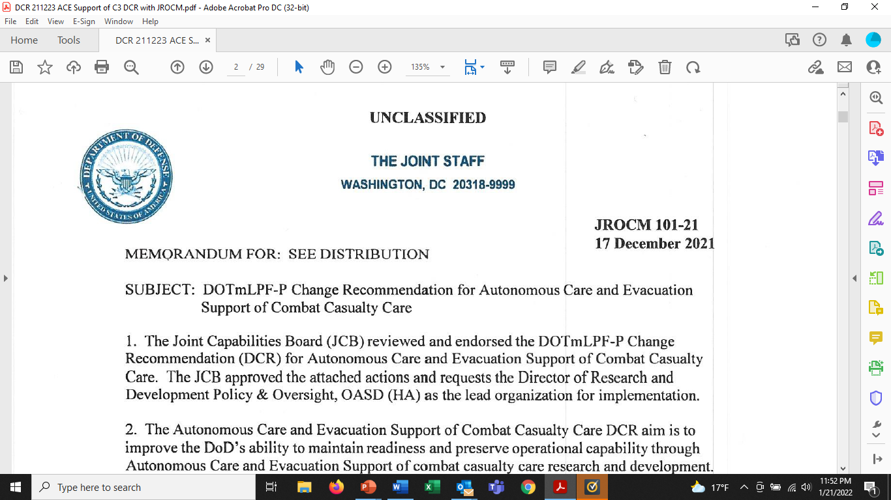

Slide 7
Areas of focus to support Autonomous Care & Evacuation
High-level recommendations include conducting R&D to:
• Develop semi-autonomous, autonomous, robotic, and/or telemedicine solution sets that will enhance pre-hospital capability and capacity in future operating environments, including Prolonged Care or austere environments.
• Develop lightweight, energy-efficient autonomous or robotic devices to provide damage
control procedures (e.g., control bleeding) and resuscitative care throughout the continuum of care.
• Develop autonomous solutions that cognitively offload Combat Casualty Care providers in order to enable increased capabilities and capacity.
• Develop telemedicine capabilities to support mental health resilience of forward deployed warfighters and facilitate reach back to stress management teams.

Slide 8
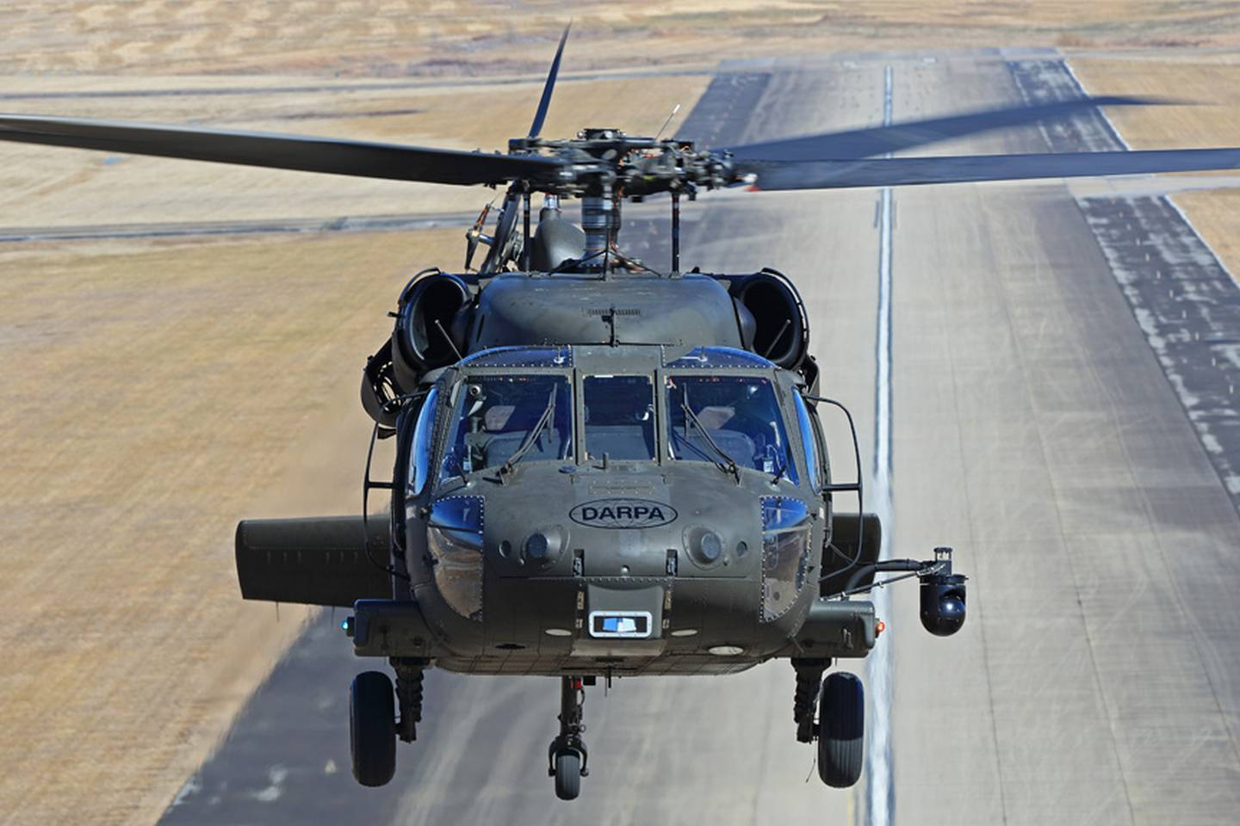
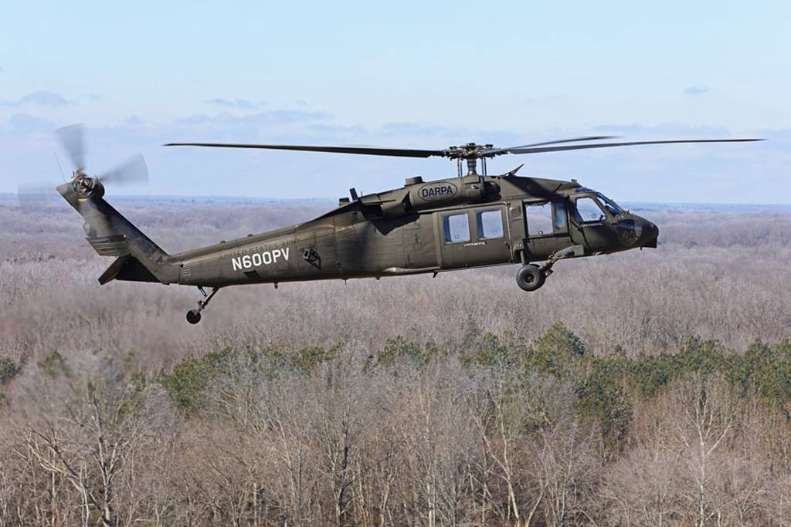
Sikorsky UH-60A Blackhawk Optionally Piloted Vehicle takes its first unmanned flight on Saturday, Feb. 5, 2022. (Lockheed Martin)
A UH-60 Alpha-model Black Hawk helicopter flew for the first time entirely unmanned as part of the Defense Advanced Research Projects Agency’s Aircrew Labor In-Cockpit Automation System (ALIAS) program
The aircraft performed pre-flight checks, took off and ran through a simulated Light Detection and Ranging (LiDAR) system depicting the congested and complex New York City skyline. The 14,000-lb aircraft responded autonomously to the simulated skyscrapers, weaving through Manhattan

Slide 9
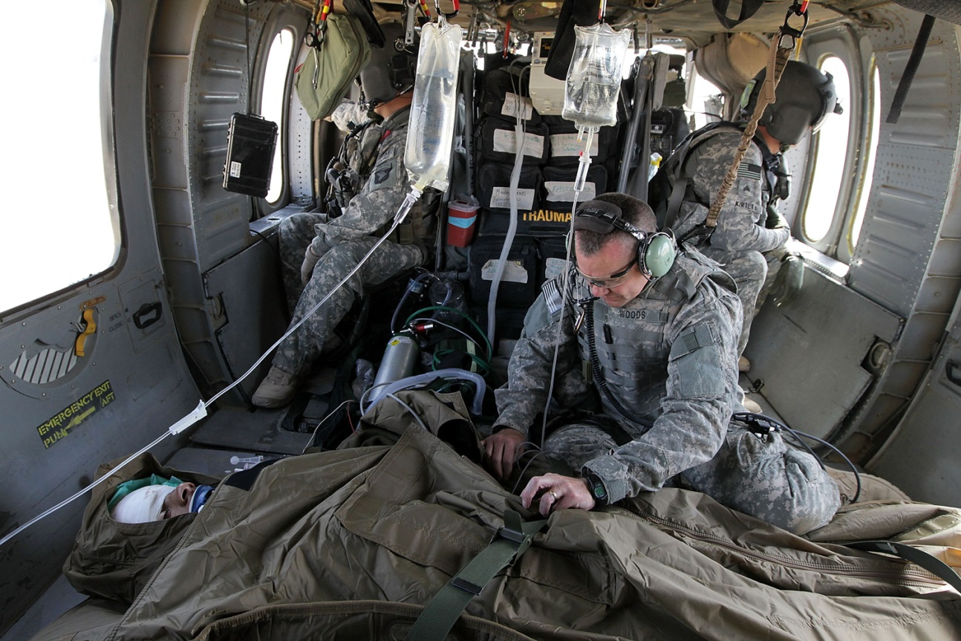
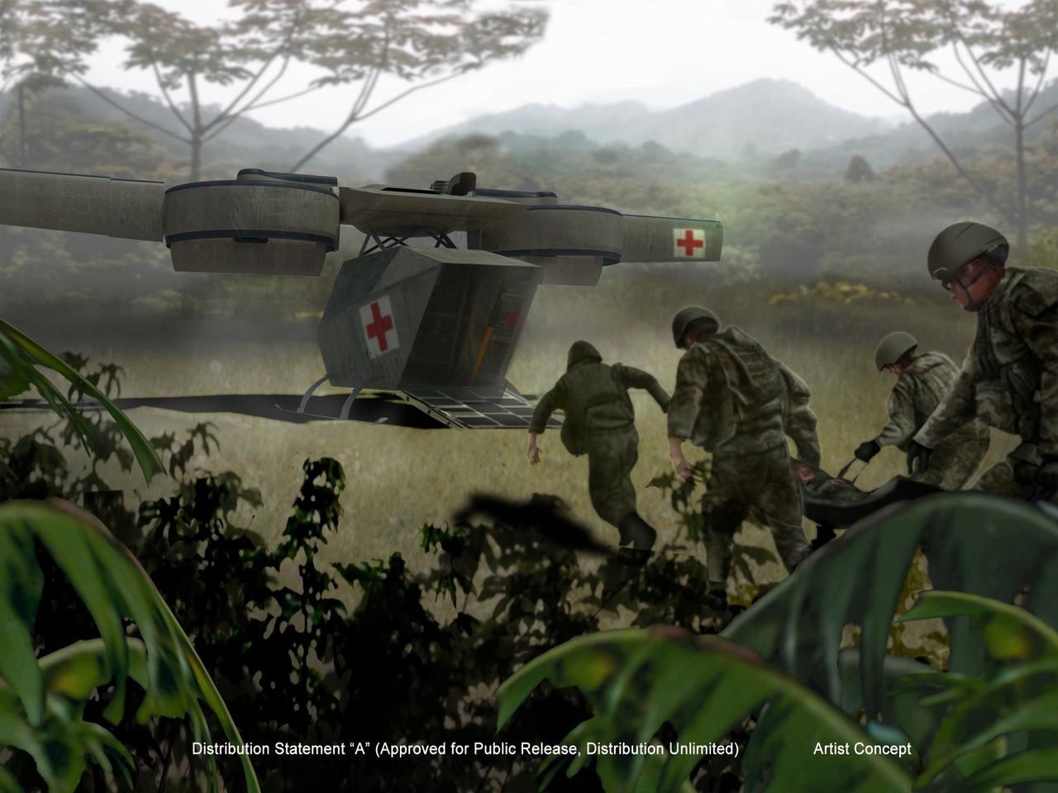
MEDEVAC
CASEVAC

Slide 10
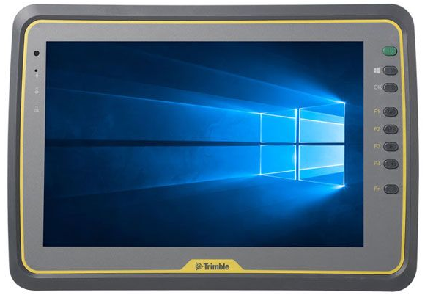
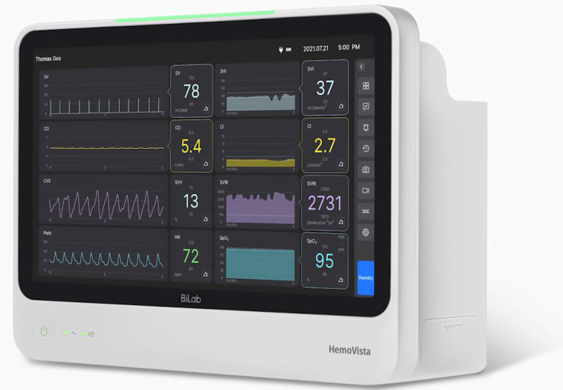
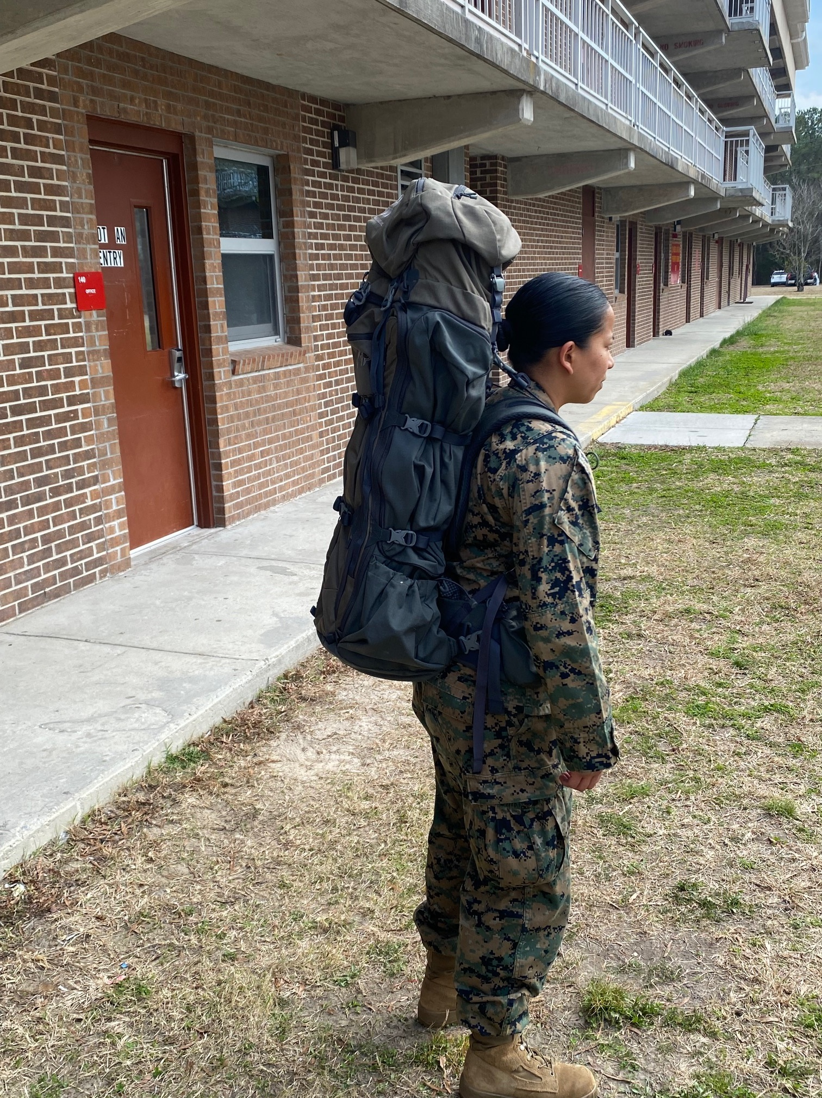
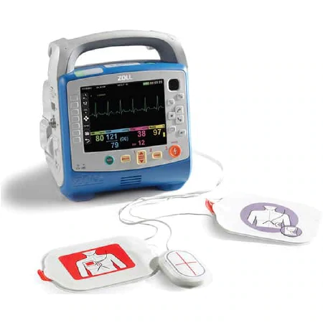
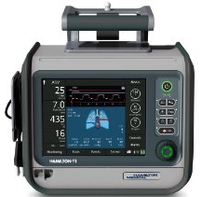

Trauma Care in a Rucksack (TRACIR) Concept
Physiological Closed-Loop Control (PCLC) Device
Software as a Medical Device application resides either on a portable ruggedized tablet computer or on a centralized server with thin client access to manage a small ward.
TRACIR “Rapid Assess & Treat” Closed-loop Control Software
Zoll Patient Monitor integrated with key physiological sensors
(future sensors) Combined Impedance Cardiography & Tomography: Catheter Accuracy for Hemodynamic & Ventilatory Monitoring (Bilab Healthcare)
Future integrated equipment bundle with shared power & communications to address portability needs
FDA Cleared Equipment Bundle
Zoll Impact Ventilator
NeuroWave Infusion Pumps

Slide 11
Use of Machine Learning to Diagnose and Treat Critical Illness
NIH (R01) and DoD Funding Timeline
Agency
Study Population
DCAP
DCAM
ICU
2009
NSF
Dubrawski/Clermont
PPINNC-3
SDU
PPINNC-1
PPINNC-2
NR
Hravnak/Pinsky/Dubrawski
Hravnak/Pinsky/Dubrawski
Clermont/Al-Zaiti
MLADI
ICU
RAPTOR
STAT
MedEvac
GM/HL
Pinsky/Clermont/Dubrawski
MLORD
OR
HL
Cannesson/Pinsky/Dubrawski
ADMIT
STAT
MedEvac
Federally-Funded Research
HL
Pinsky/Guyette+EM/Dubrawski
TRACIR 6.2
STAT
MedEvac
US Army
Poropatich/Pinsky/Guyette+EM/Dubrawski
HL
AID-ART
ICU
Murugan/Clermont
SPARK-ICU
ICU
HL
Kamaleswaran/Clermont
2012
2013
2014
2015
2016
2017
2018
2019
2020
2021
2022
2023
2024
2025
May 10, 2022 Copyright © 2022 University of Pittsburgh. Proprietary and confidential. For official use only

Slide 12
TRACIR Personnel – Team Science
Pitt-led project
University of Pittsburgh
Pulmonary/Crit Care Medicine
Ron Poropatich
Critical Care Medicine
Michael Pinsky (Scientific PI)
Gilles Clermont
Emergency Medicine
Frank Guyette
Lenny Weiss
David Salcido
Surgery
Greg Watson
Animal Research Lab
Lisa Gordon
Project Manager
Howard Stein
Commercialization Manager
Jan Berkow
Fiscal Management
Brian Smith
Carnegie Mellon University
Robotics Institute
Artur Dubrawski
Howie Choset
John Galeotti
Luke Scuilli
National Robotics Engineering Center
Herman Herman
Robert Toth
University of Arizona
Engineering
Wolfgang Fink
* Denotes prior military

Slide 13
TRACIR Construct
DoD, Industry & Academia Collaborations
Cloud
Computing
Bandwidth/compression
Cyber-Security
HIPAA
UAV/UGV
Robotics
EHR
integration
Autonomous/Semi-autonomous
Machine Learning
StatMedEvac Database
Telehealth
Medical
Devices
ECMO
Biosensors
Catheters

Slide 14
Scientific Overview
To demonstrate feasibility of a semi-autonomous cardiovascular-respiratory data-driven knowledge system to recognize and treat polytrauma
  Personalized Resuscitation
To incorporate this knowledge system as part of a device platform design to demonstrate the feasibility of an autonomous cardiopulmonary trauma resuscitation tool for prolonged field care
  Self-learning of subject specific response to treatments: Personalized Medicine
3. Research Components of TRACIR
  Large animal lab closed-loop control (Cardiopulmonary Research Lab): validate effectiveness
  STAT MedEvac database: clinical correlates and signatures
  Lower Body Negative Pressure lab (Human Applied Physiology Lab): calibrate measures
  Clinical testing: ER and Paramedic/nurse dyads simulation: testing interface
May 10, 2022 Copyright © 2022 University of Pittsburgh. Proprietary and confidential. For official use only
Notes:
Assigned to Michael
Big Picture Overview

Slide 15

Project Triad
Swine Model
LBNP
StatMedevac
Experimental Manipulations
Greater than the sum of its parts.

Slide 16
Porcine Lab Biosignals
Summary of Devices Being Evaluated
Define Instability/Stability
Heart rate variability
CVInsight™ Stress Index
Compensatory Reserve Monitor
ML-based fused parameters using inputs from all devices including pulse oximeter pleth signal
Guide Resuscitation
Pulse oximeter plethysmograph PVI
  Masimo™, Nonin™
Non-invasive arterial pressure (PPV)
  CNAP™
Cardiac Output (incl. SVV and ΔCO)
  LiCOrapid™, NICOM™, Hemovista™
Ventilation
  ET CO₂, SpO₂

Slide 17
Summary of Devices Dropped from Evaluation
Define Instability/Stability
Microtrend™ PtCO₂
Inspectra™ StO₂ VOT
Daxor ™ Volume measures
Guide Resuscitation
Non-invasive arterial pressure (PPV)
  Clearsight™
Cardiac Output (incl. SVV and ΔCO)
  Clearsight™
Urine output and Intraabdominal Pressure
  Traumacath™
Ventilation
  Microtrend™ PtCO₂

Slide 18
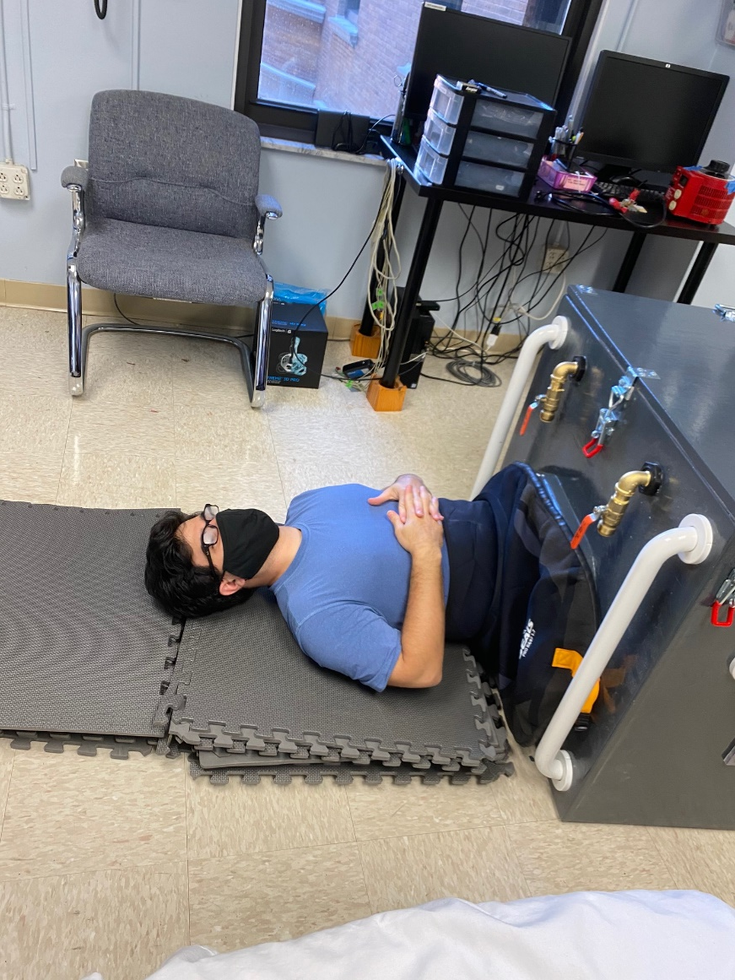
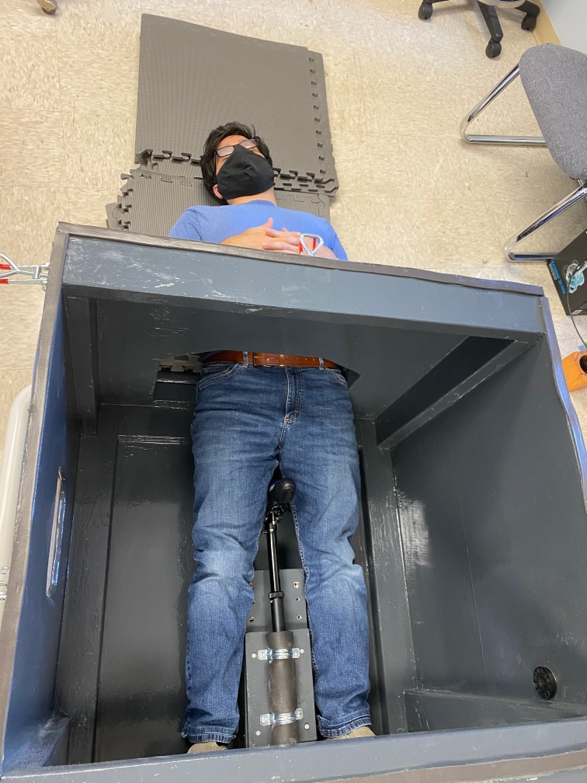
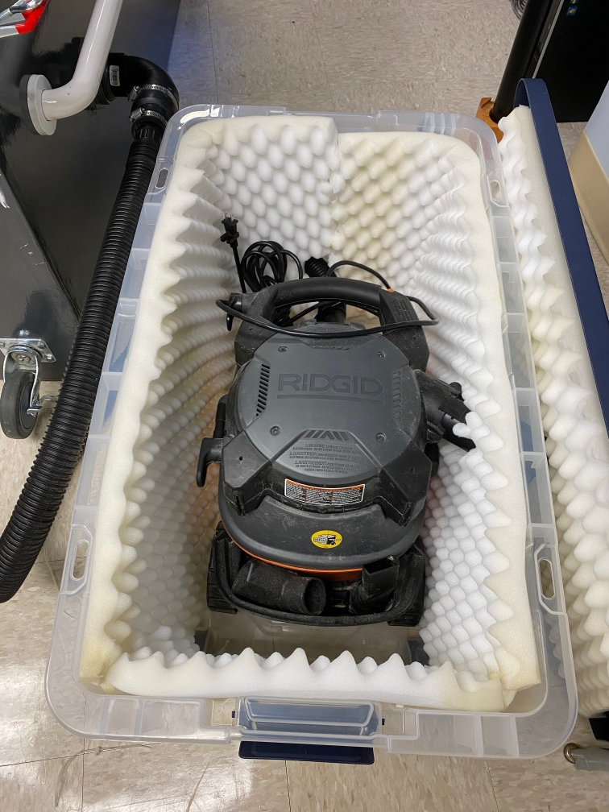
Lower Body Negative Pressure Chamber (LBNP)
  Validated model to assess hemorrhage in human volunteers
  Assembled and tested a new LBNP chamber at Pitt
  IRB proposal completed - Human subject enrollment commenced in April 2021
  CRADA with USAISR (Vic Convertino) and data sharing in place
Notes:
Assigned to Michael, David, & Kate
Include Pictures of LBNP machine with/without person
Summary of StatMedevac data to date
What results have you accomplished up to this date?
The tasks necessary to reach your objectives.

Slide 19

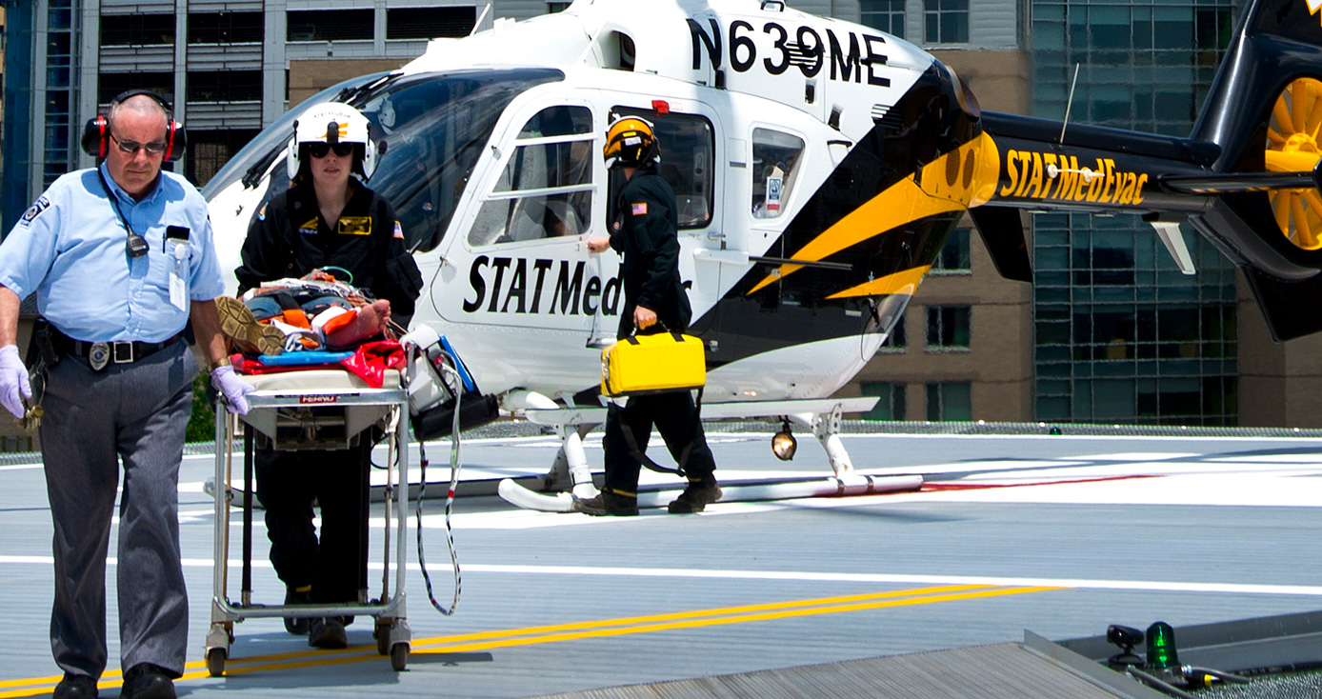
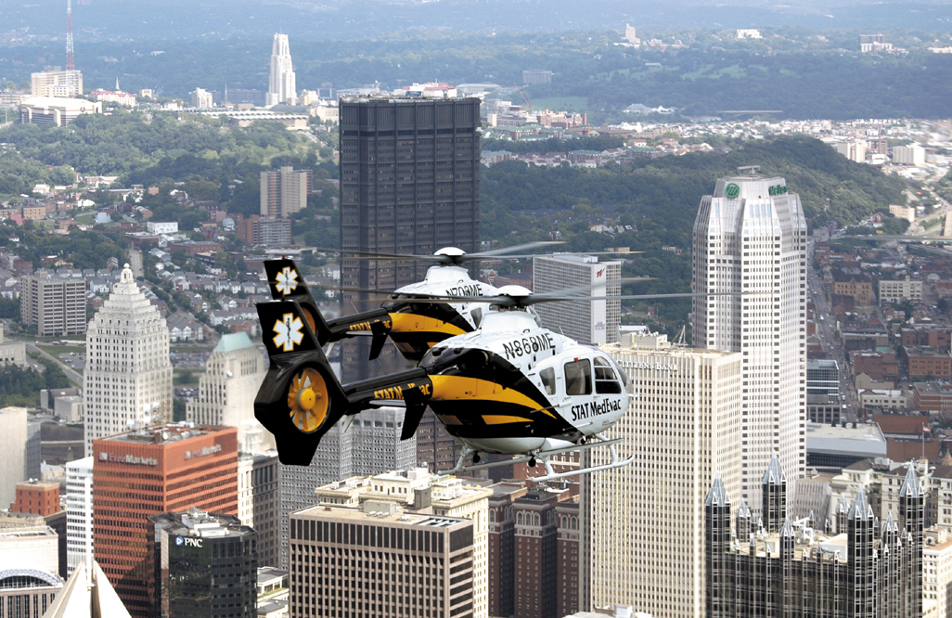
- 23 helicopters in the inventory covering 4 states
- 13,000 Missions/year – over 20 years experience
- Communications center– Medical Officers on-call 24/7
  44% cases with MD consult
Notes:
STAT MedEvac is widely recognized as one of the premier air medical and critical care transportation services in the country.
It currently operates 17 helicopter bases in four states. Expanding to 18 and 19. and one more state.
The organization transports almost 13,000 critical patients a year and has flown over 120,000 missions since it began operations in 1984.
Military style in a civilan world.
Accountability for quality care. Efficiency and speed.
Protocols evolve, communications center– 3 MODCs 24/7
44% cases with MD consult
EMS Charts detailed care; Zoll monitors constant waveform collection
Video laryngoscopy archived video files
Simulation
Acute care interhospital/scene care
Prolonged care:
Often in hospital for 1 day- several days siting there.
Our average flight is 36 minutes; often up to an hour, and many times missions can be several hours by ground.

Slide 20

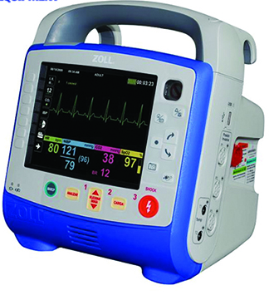
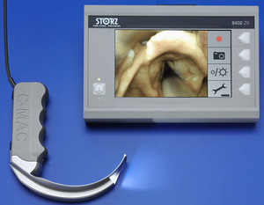
In flight Data Archiving
EMS Charts = timestamped, detailed care
Zoll monitors with continuous waveform collection @ 250 Hz
  Q5 min Vitals
  SpO2, EKG, EtCO2, thoracic impedance, arterial waveforms (if a-line)
Video laryngoscopy archived video files

Slide 21
The Cohort: ages 18-50 with trauma (POI to Level 1 Trauma hospital)
STATMedevac
Transports
Life Saving
Interventions
(LSI) (+)
Qualifying
Conditions
Transported to UPMC Presby
(Level 1 Trauma)
Have Signals
Life Saving
Interventions
(LSI) (-)

Slide 22
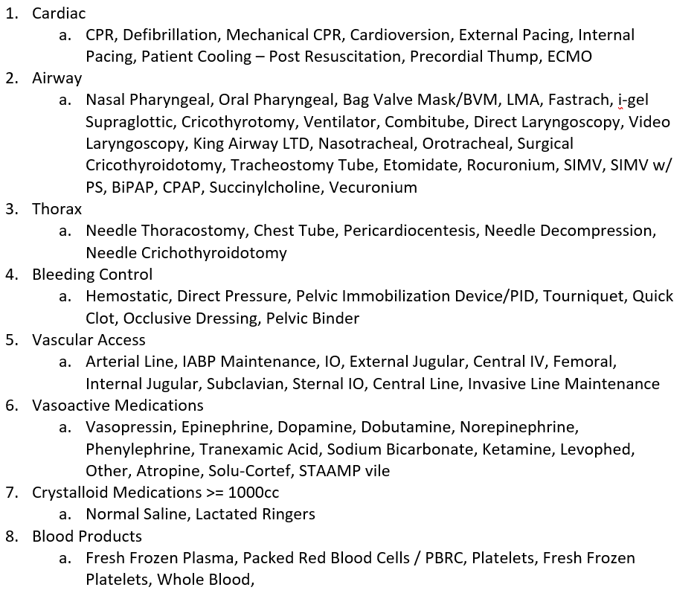
Life-Saving
Interventions
Categorization

Slide 23
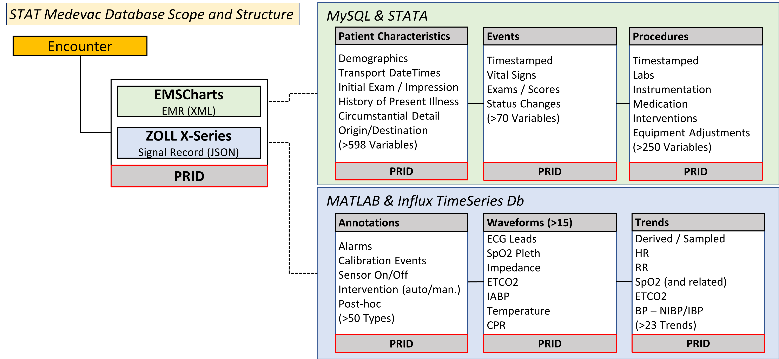
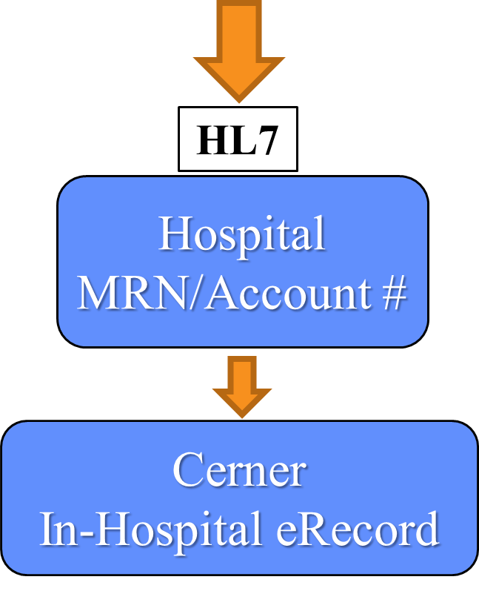

Slide 24
STAT Medevac Consort Diagram
All STAT Medevac Dispatches
N = 107,359
Excluded, n = 13,483 (Total Unique)
Age < 18 years, n = 12,763
Not Transported, n = 701
Missing Destination, n = 691
Eligible Patient Encounters
n =93,876
Linked to Hospital Records
n =62,753
Not Linked
n =31,123
UPMC Trauma Center:
  Presbyterian
  Mercy
  Hamot
  Altoona
Trauma, n = 20,313
Medical, n = 42,440
Current Dataset as of 22 June 2022

Slide 25
STAT Medevac Consort Diagram
All STAT Medevac Dispatches
N = 107,359
Excluded, n = 13,483 (Total Unique)
Age < 18 years, n = 12,763
Not Transported, n = 701
Missing Destination, n = 691
Eligible Patient Encounters
n =93,876
Linked to Hospital Records
n =62,753
Not Linked
n =31,123
UPMC Trauma Center:
  Presbyterian
  Mercy
  Hamot
  Altoona
Trauma, n = 20,313
Medical, n = 42,440
Current Dataset as of 22 June 2022

Slide 26
Precision Resuscitation
Identify when a patient has inadequate blood/oxygen flow to the tissues to meet their metabolic demand
Define if cardiac output will increase with fluid resuscitation, and if so by how much
Define if vasomotor tone is decreased or normal
Define if ventricular function can handle the demands without going into failure

Slide 27
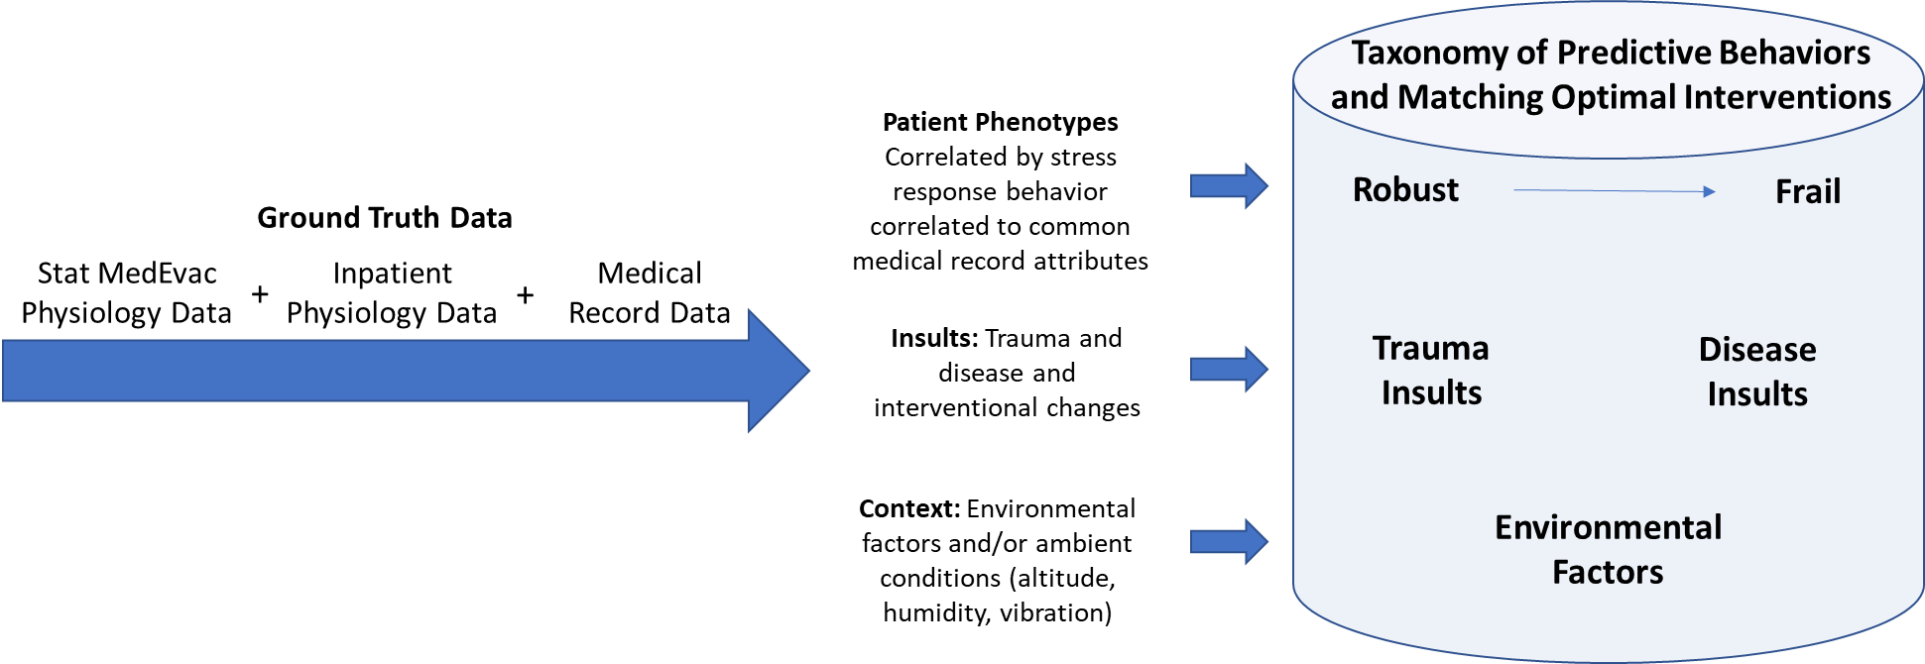
Bio-signature & Interventional Protocol Development
Pre-hospital trauma data (Ground truth, >20,000 patients) is collected, cleansed of artifact, combined with in-patient data and organized into a controlled de-identified patient registry
Supervised machine learning is applied to identify common bio-signatures
Bio-signatures are translated into rule-based algorithms to enable their use for event recognition
Page 6

Slide 28
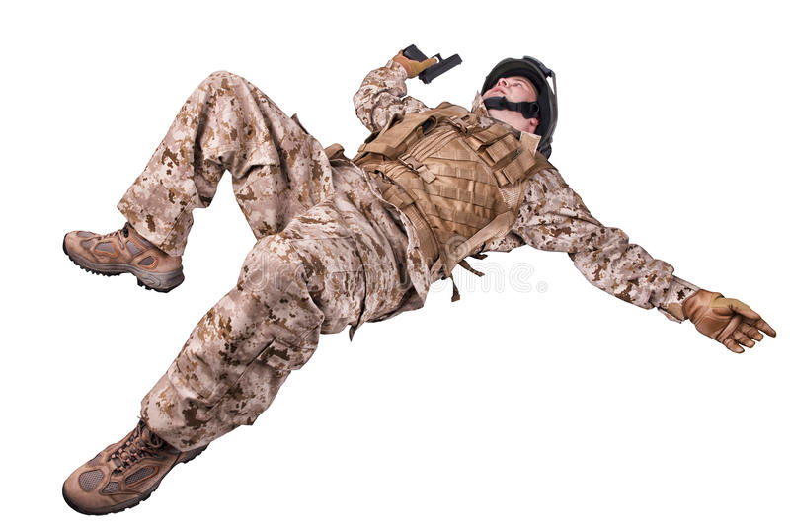
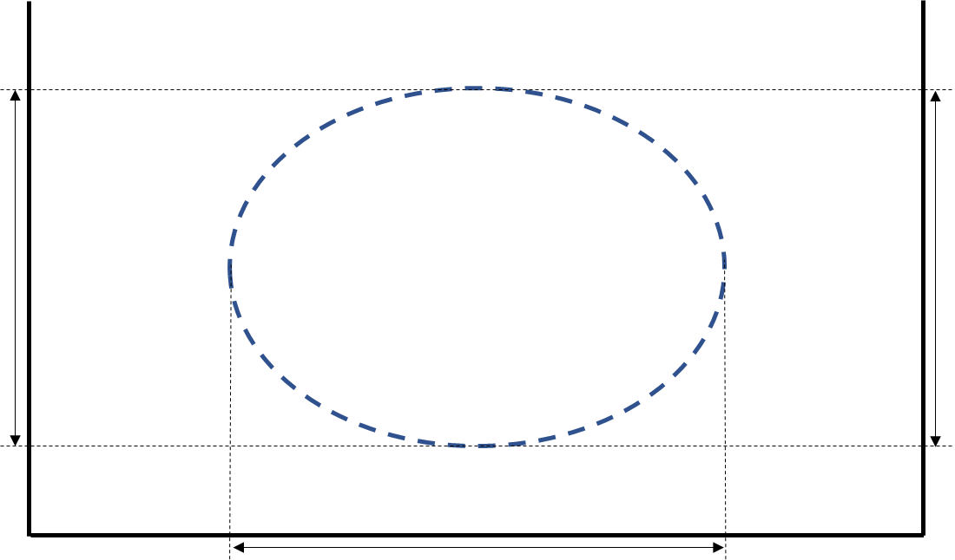

TRACIR Provides a Novel Precision Medicine Approach to Casualty Care
Non-invasive sensors enable ongoing recognition of an evidence-based bio-signature
Bio-signature algorithms characterize the degree of compensatory mechanism activation
Bio-signatures are then matched to an optimal treatment protocol based upon ground truth data
Key value: patient-specific continuously optimized autonomous care
Cardiovascular Compensatory Bio-signature
Tissue Metabolic Adequacy
Effective Circulatory Volume
Taxonomy of
Bio-signatures & Matching Evidence-based Treatment Protocols
Small Artery
Constriction
Injury due to Hemorrhage
Effective Cardiac Ejection
Page 8

Slide 29
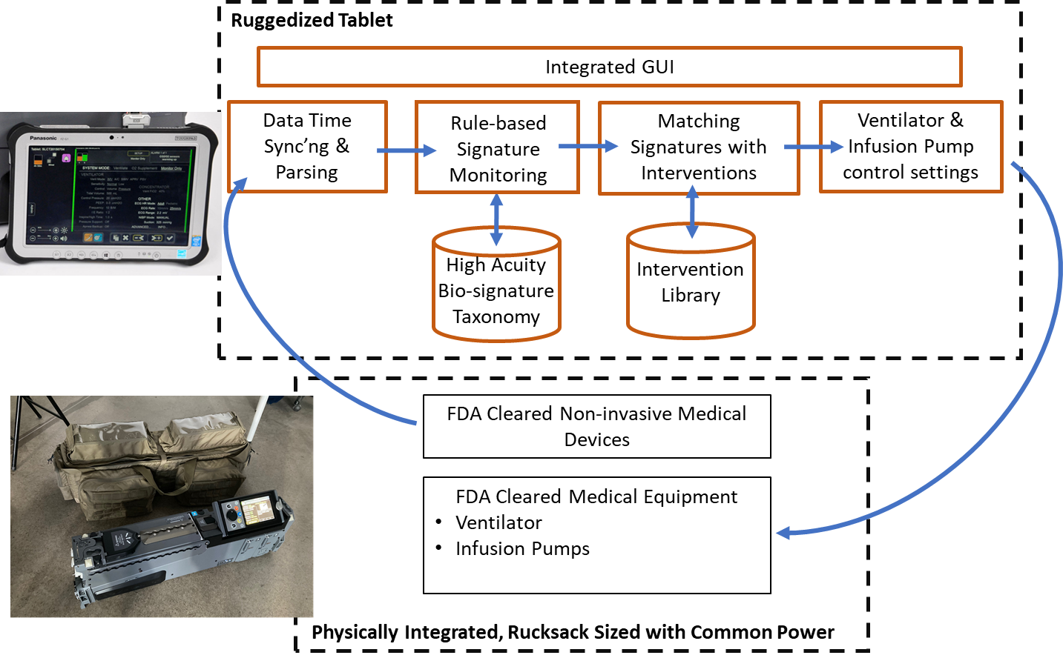
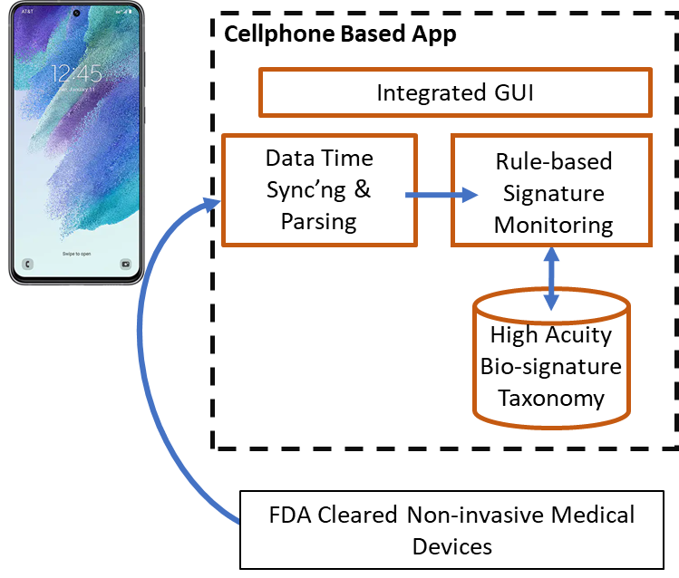
“Software as a Medical Device” Product
Integrated with FDA cleared non-invasive medical devices, ventilator, and infusion pump(s) for patient management
Triage (RAPTER*)
Resuscitation (Assess & Treat High Acuity Patients)
Integrated with FDA cleared non-invasive medical devices for Triage (Lifeware Labs)
*Rapid Assessment for Prehospital Triage of Evacuation & Medical Resources (RAPTER)
Page 7

Slide 30
Programmatic Overview
Identify signatures of health and disease
(track response to therapy, stopping rules)
Closed Loop Resuscitation from Shock Using
Functional Hemodynamic Monitoring (ReFit)
Iterative design:
Invasive to non-invasive
Cardiovascular to Cardiorespiratory
STAT MedEvac Database
(n>62,000, UPMC only)
(ground truth, defining response trajectories)
ReFit 1
(n=20) delivered to DoD 2/20
(Invasive monitoring guided resuscitation)
MLADI-PPINNC ICU/SDU Database
(n=18,000, UPMC only)
(ground truth, defining response trajectories)
ReFit 2
(n=20) delivered to DoD 4/22
(Non-Invasive monitoring guided resuscitation)
Lower Body Negative Pressure Studies
(n=20, UPMC +200 ISR)
(calibrate non-invasive monitor signature trajectories)
ReFit 3
(n=20) planned delivery to DoD 11/22
(Non-invasive monitoring guided cardiorespiratory resuscitation, uncontrolled bleeding)
May 10, 2022 Copyright © 2022 University of Pittsburgh. Proprietary and confidential. For official use only
Notes:
Assigned to Michael
Big Picture Overview

Slide 31
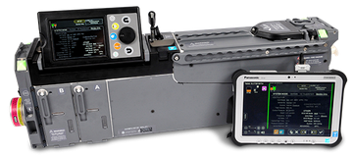
TRauma Care In a Rucksack (TRACIR) Program
Starting Yr 4 of 4-year USAMRDC contract (W81XWH19C01013); Jose Salinas, PhD/USAISR is the COR
Deliverables:
  To develop a closed-loop high acuity patient management solution prototype for a Role 2/Forward Surgical Team
  Diagnose trauma injuries & drive automated personalized titrated interventions; uses both animal and human hypovolemia models
Consists of:
  Software as a Medical Device application loaded on a ruggedized tablet or monitor
  Equipment enclosure that includes FDA cleared non-invasive sensors, fluid infusion pumps for pharma & blood products, and a ventilator
Year 4 goals:
  To run TRACIR software in Emergency Department alongside usual care for trauma patients (TRL4)
  To incrementally refine the “bio-signature” algorithms
  To “blindly” run TRACIR software in a rotary wing medevac helicopter during trauma/casualty care transport (TRL5)
Hardware Enclosure: FDA cleared devices include non-invasive sensors, ventilator (Thornhill Medical), infusion pumps (NeuroWave)
Ruggedized Tablet Software Applications: “Rapid Assess & Treat”™ semi-autonomous control software plus manual screens for FDA cleared devices [future: to be placed on Zoll Monitor]

Slide 32
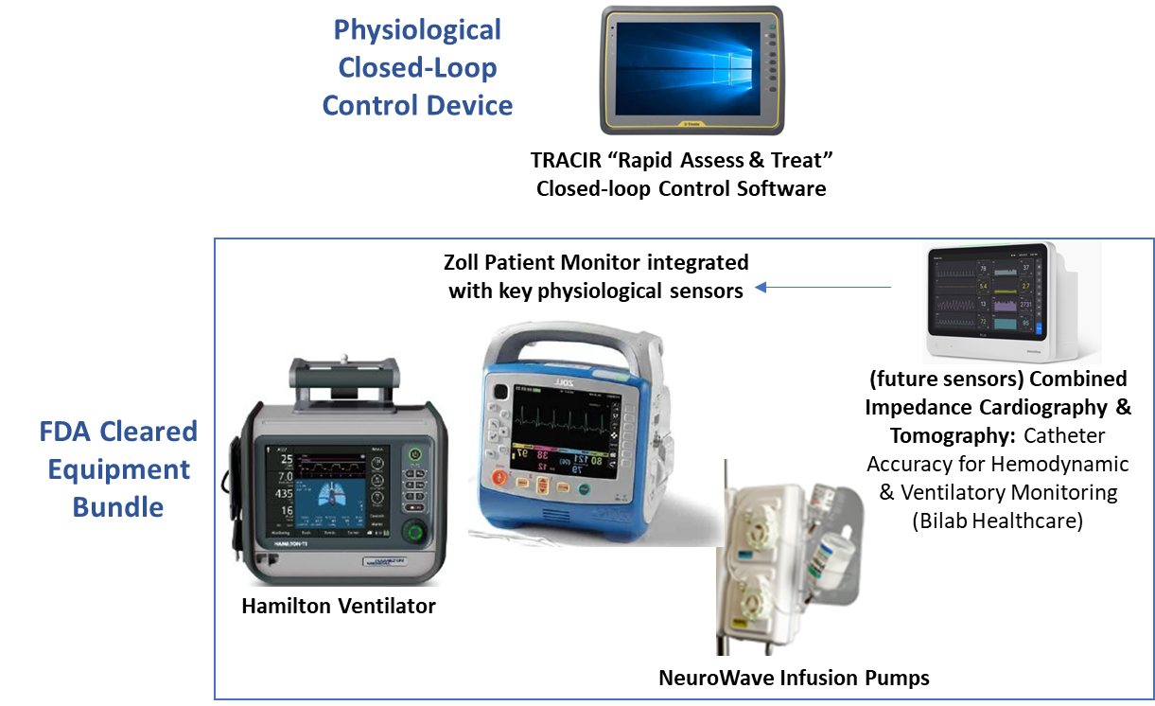
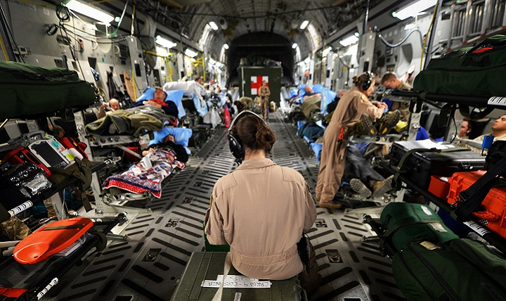
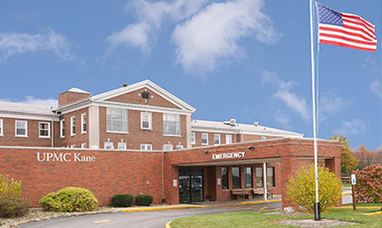
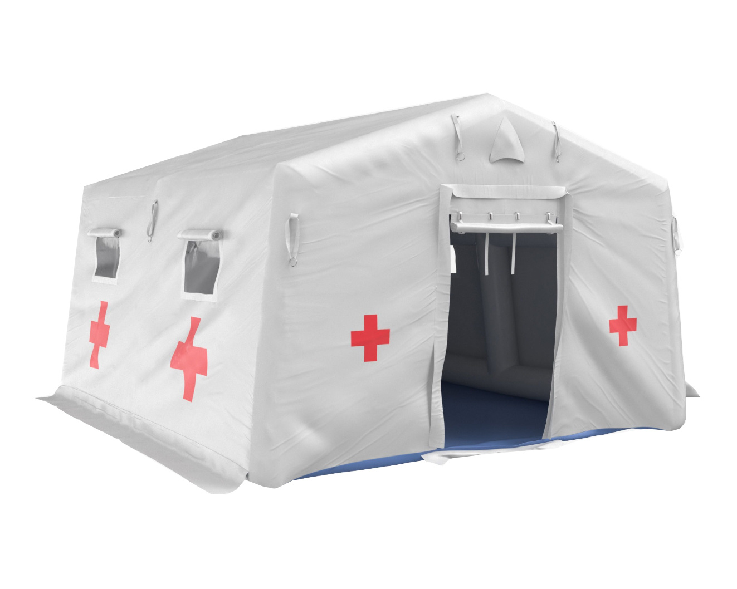
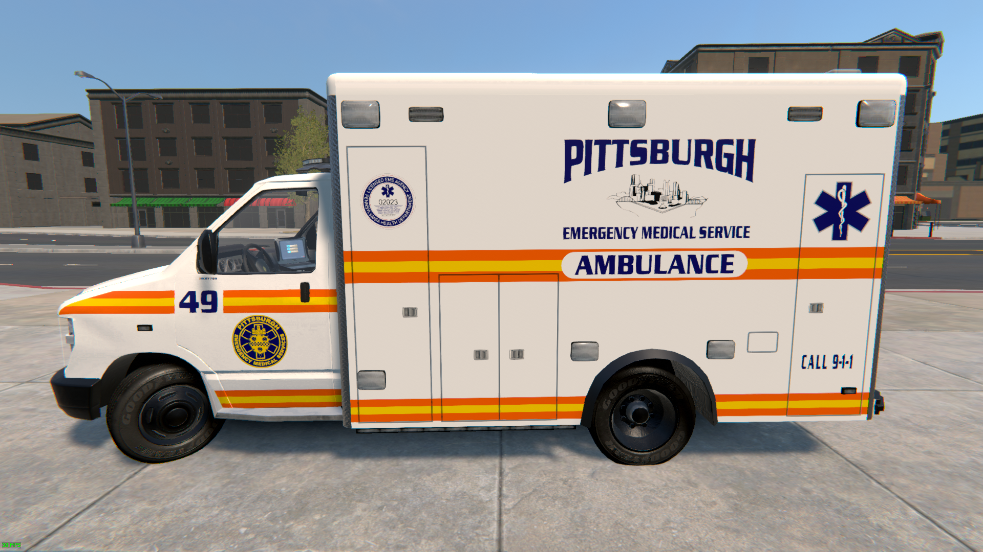
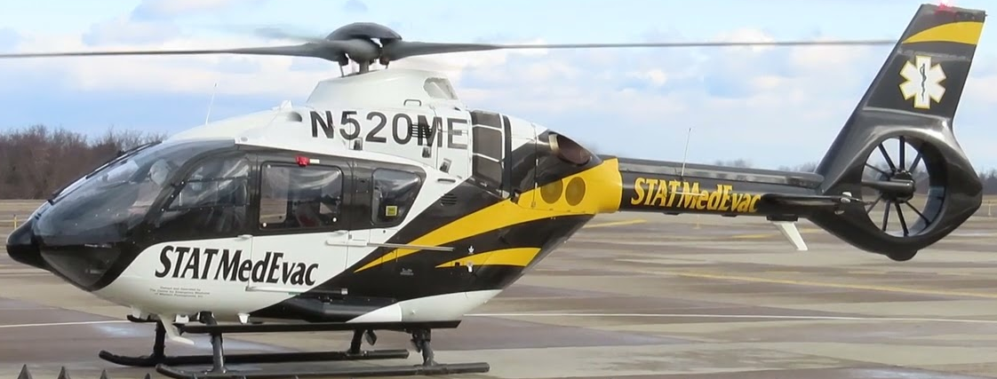
TRACIR Use Cases
Military Fixed Wing Long Duration Casualty Transport
Civilian Tele-ED Applications
Military or Civilian Ground Vehicle Casualty Transport
Military Field Tent or Mass Casualty Response
Military or Civilian Air Casualty Transport

Slide 33
Conclusions
Functional Hemodynamic Monitoring-guided resuscitation allows for clear decision rules easily populating a closed loop control system
Standardizes resuscitation approach while allowing personalized fluid and vasopressor resuscitation
Human studies underway using Lower Body Negative Pressure chamber
Human studies in UPMC ER and en route helicopter transport planned in year 4
Deliverables will be modified by CMU robotic progress (AI driven access for airway, vascular access, and needle thoracostomy)
Industry/USAF proposals are under review to advance TRL and en route care/PFC capability

Slide 34
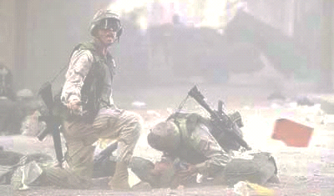
TRACIR & RoboTRAC Overview
Primary Goal: Support Our Warfighter
We are developing modular autonomous trauma care
capabilities for prolonged field and en-route care
Approach:
Stabilize
Sense
Plan
Act
Non
-
Invasive
Sensing
Modalities
Compliant Robotics Platforms
Personalized
Hemodynamic
AI
Precise
Monitoring
Algorithms
Trauma Care
Self-configurable Robotic Platform for Vascular and Airway Access, Thoracostomy

Slide 35



Close Collaboration
Among Roboticists, AI Experts & Clinicians
TRACIR
Trauma Care in a Rucksack
RoboTRAC
Autonomous Trauma Care
in the Field
CMU
FHM closed loop control
AI of STAT MedEvac data to define health and disease
CMU
Autonomous vascular access
Needle thoracostomy
Airway access
U Pitt
FHM porcine lab
STAT MedEvac database
Validation in LBNP
U Pitt
Clinical context
Porcine live animal testing

Slide 36
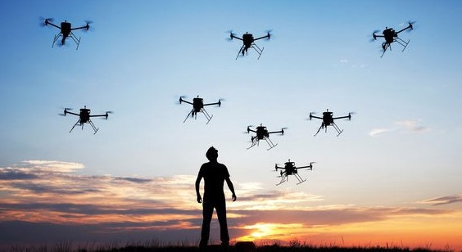
Questions?
Ron Poropatich, MD
301-789-4400
rkp19@pitt.edu

