Slide 1
An Oxymoron?
Hypotensive Resuscitation
Col Tom Woolley
Defence Professor of Anaesthetics and Critical care

Slide 2
You can’t be hypotensive and be resuscitated
Lets change the name to “permissive hypotension”

Slide 3
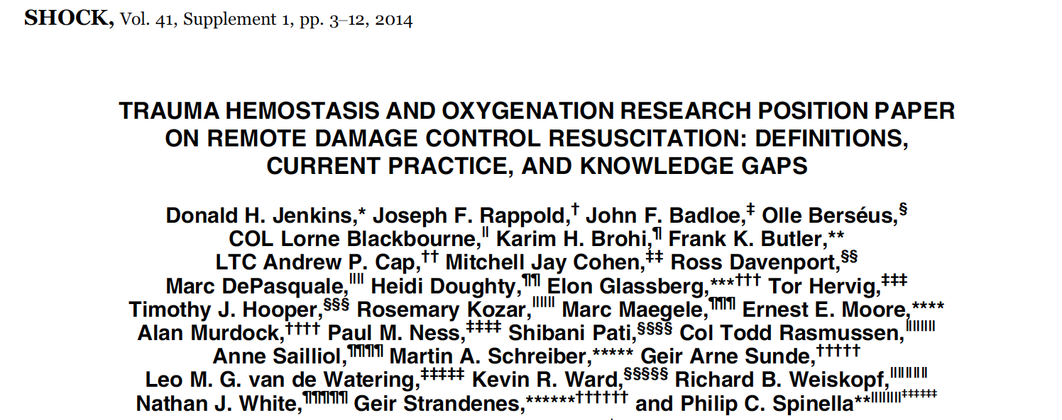
Hypotension in trauma
Hypotensive resuscitation is based on the assumption that in patients with noncompressible hemorrhage, raising blood pressure above a critical value may result in increasing hemorrhage including “popping” of naturally formed clots at the site of injury.

Slide 4
Medline Search:
Damage Control resuscitation
  1758 results
Hypotensive resuscitation
  696 results
Permissive Hypotension
  174 Results
Permissive OR HypoT
  844 results
DCR AND Hypot OR Permissive
  749 results

Slide 5
Permissive OR HypoT
844 results
844
Clinical Trial
Review
54
186
9

Slide 6
Citation Network
Evidence cluster 1
Evidence cluster 2
Evidence cluster 3
Evidence cluster 4
Evidence cluster 5
Evidence cluster 6
Evidence cluster 7
Current theory

Slide 7
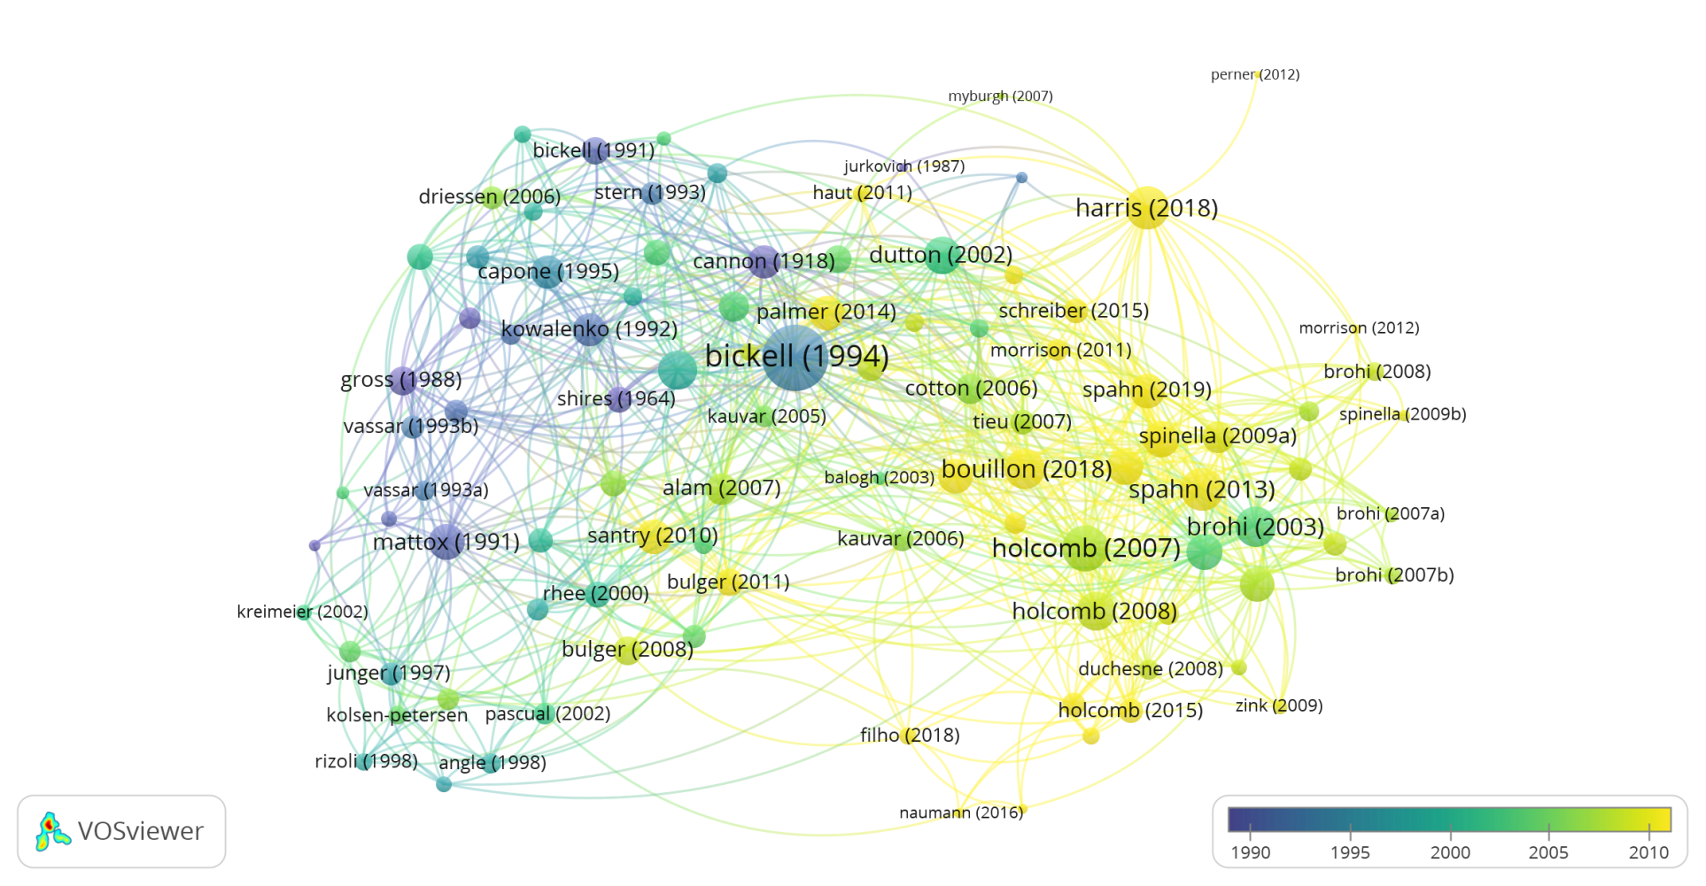
Pemissive Hypotension

Slide 9
What does this all mean?
Human data is all over the place
The “myth” is a self licking lollipop
The animal evidence is better
THERE IS NO DECENT EVIDENCE TO SUPPORT PERMISSIVE HYPOTENSION

Slide 10
Question?
If we didn’t have “permissive hypotension” would the current evidence pass “The Burden of Proof?”
No
Lets start again

Slide 11
Lets think about the patient!

Slide 12
What does a bleeding trauma patient look like?
Vasoconstricted
Poor tissue oxygen delivery
Increasing oxygen debt
  Can only be paid of by volume resuscitation and surgery

Slide 13
Does it really matter?
mortality 5% greater for every 10mmHg below 110 mmHg

Slide 16
What does a bleeding trauma patient look like?
Vasoconstricted
Poor tissue oxygen delivery
Increasing oxygen debt
  Can only be paid of by volume resuscitation and surgery
“Minutes matter”
First do no harm
  Waiting is harmful

Slide 17
I don’t understand:
A patient needs resuscitating to save their life and you are choosing NOT to do so.
Why would you do that?

Slide 18
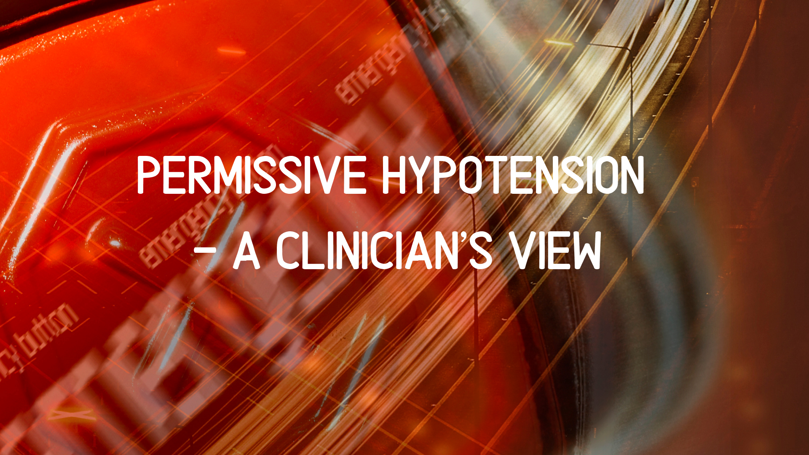

Slide 19


Slide 20


Slide 21
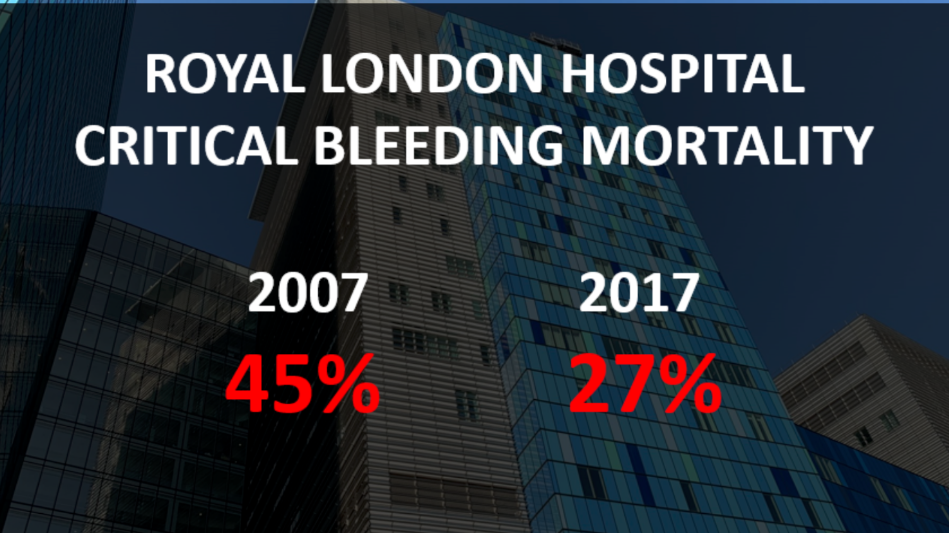

Slide 22


Slide 23
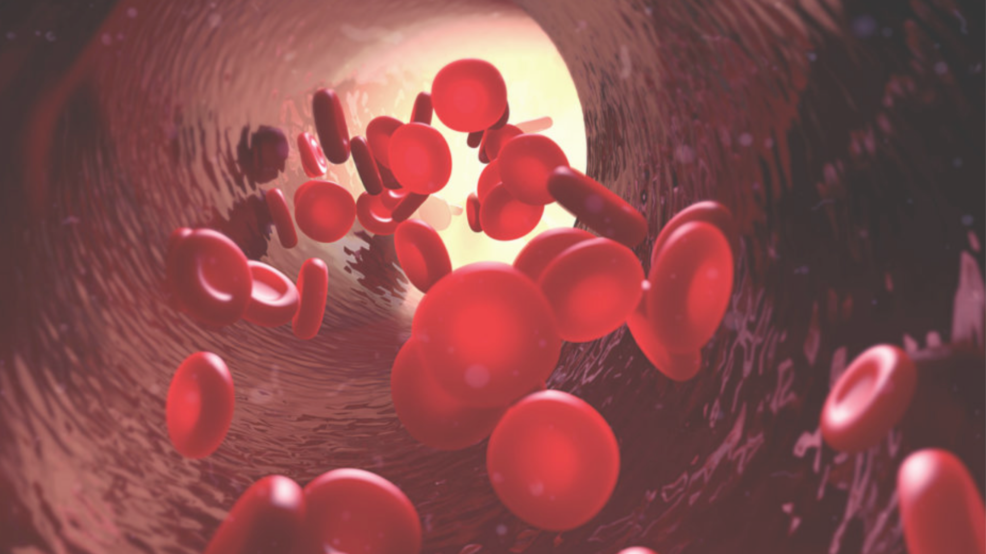

Slide 24
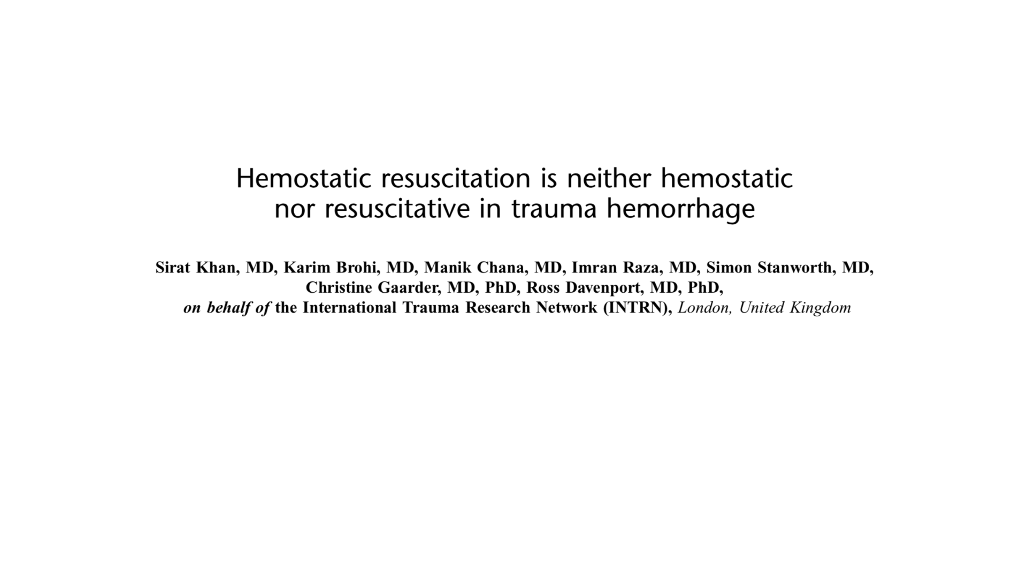

Slide 25
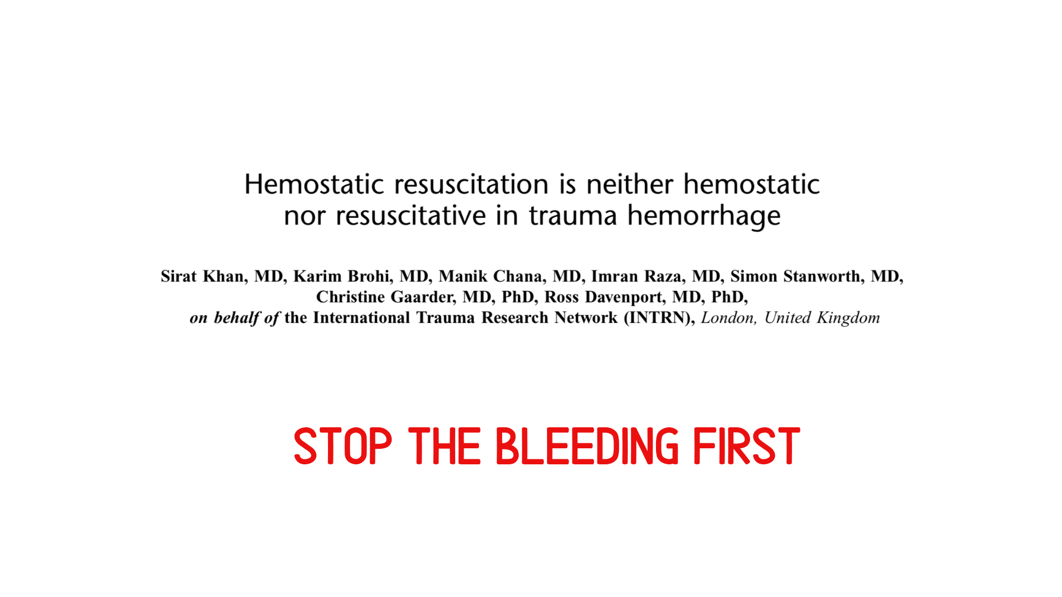

Slide 26
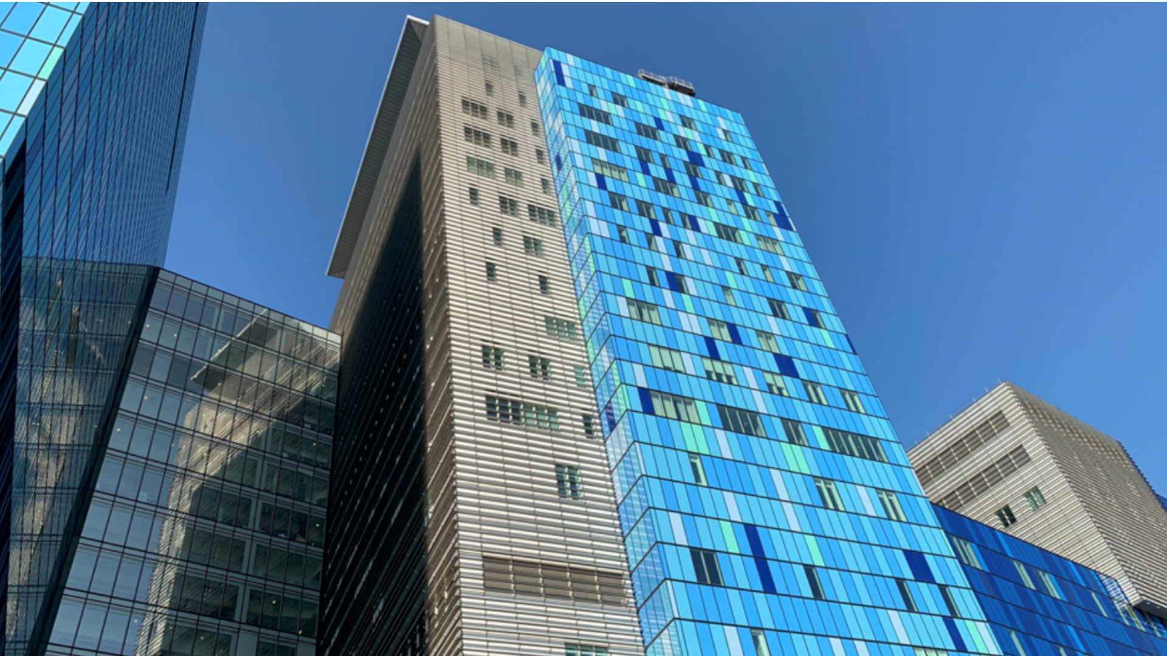

Slide 27
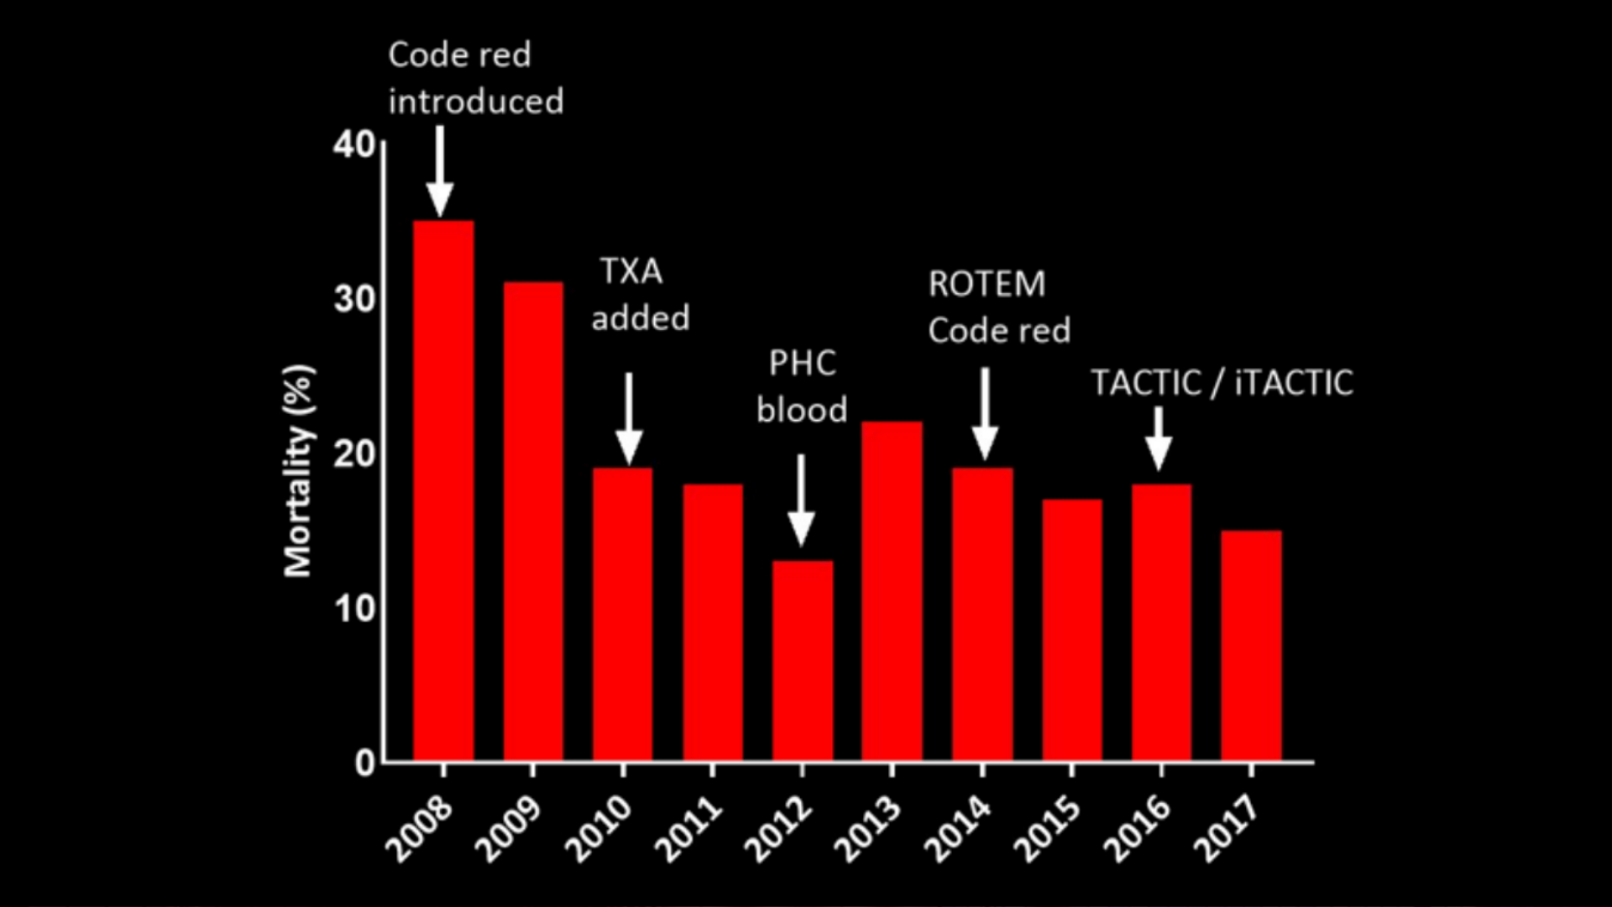

Slide 28
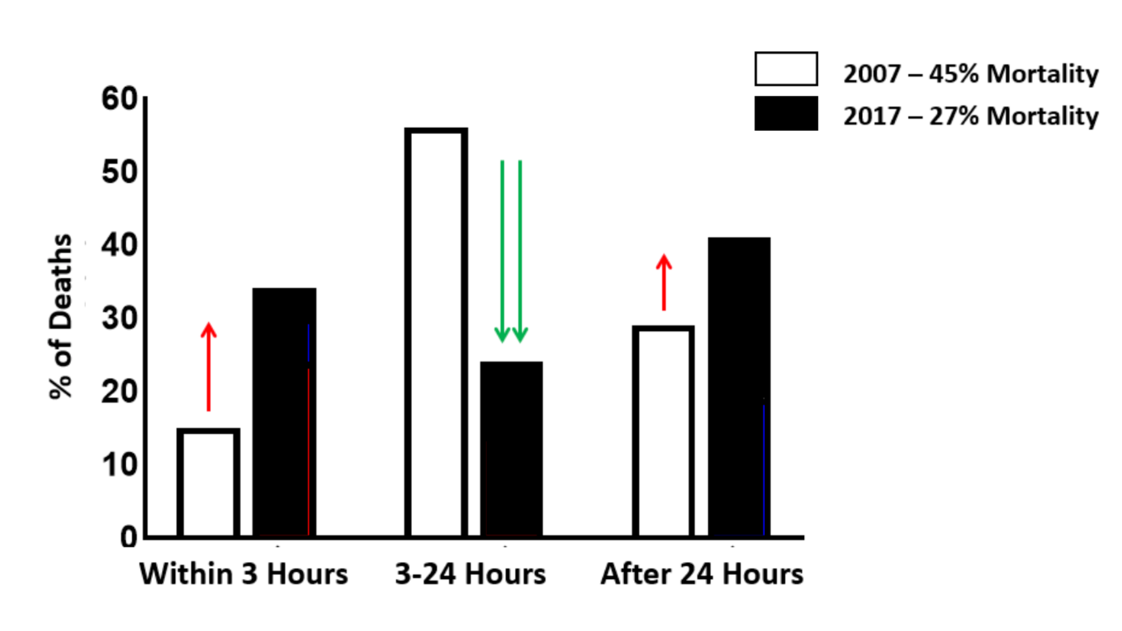

Slide 29
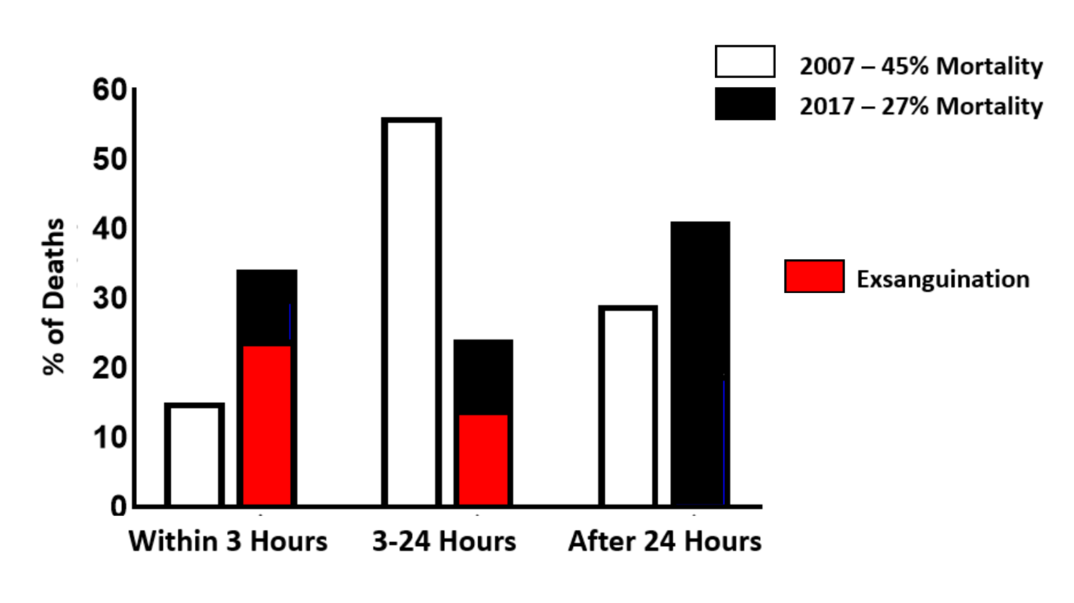

Slide 30
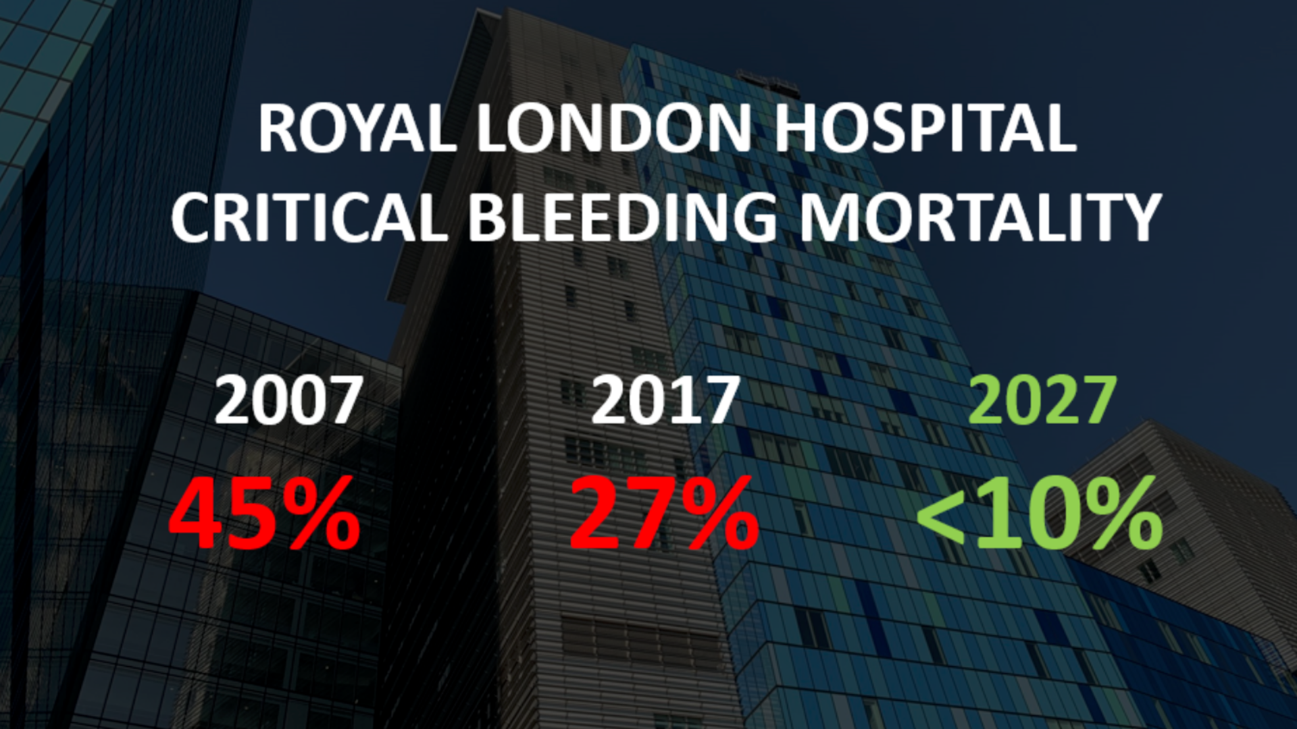

Slide 32


