Slide 1

Experimental research and passage to Humans in transfusion and developing new blood products without repeating past mistakes
French Armed Forces Institute of Biomedical Research (IRBA)
MC DUFOUR-GAUME Frédérique
Vet CARDONA Vénétia
MC PRAT Nicolas
Notes:
Thank you very much for this opportunity to speak about experimental research and passage to Humans in transfusion. I would like to discuss how to choose the right animal model and why it is so important to learn from it.

Slide 2
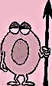
Links of interest
The opinions expressed here are those of the authors.
Notes:
First, let us remember that this presentation is an opportunity to discuss possible different points of view.

Slide 3
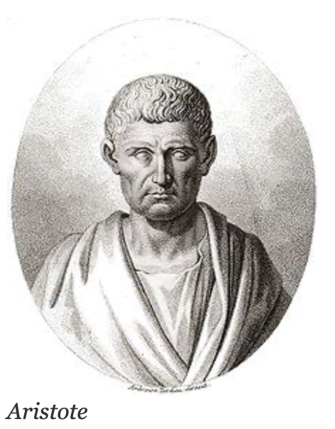
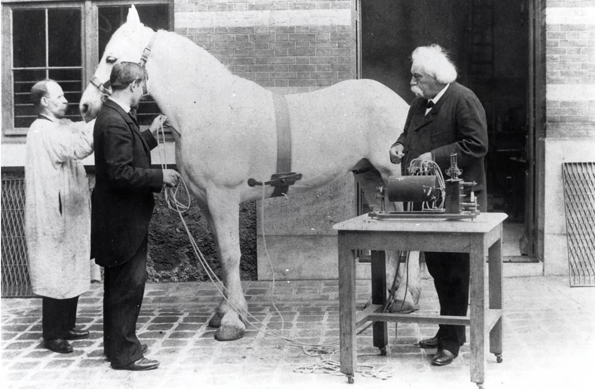
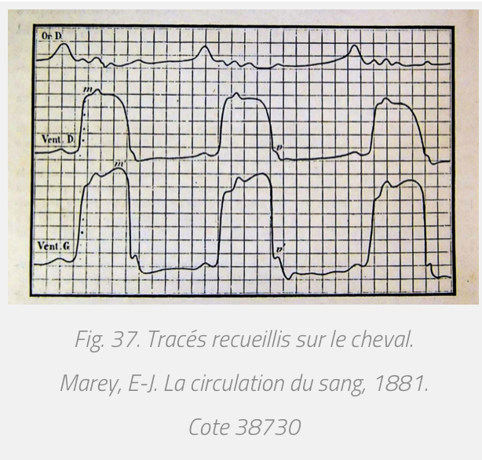
Historical use of animal models for research
✗ 4th century B.C : First animal testing known
Use of animals to understand human mechanisms
✗ 19th century : Auguste Chauveau and Jules Etienne Marey
Cardiac physiology on horse model
First ECG
Development of cardiac catheterization
ECG tracing from horse, Marey and Chauveau, 1881
✗ 20th century : preclinical studies for every new drug
Pharmacodynamics, pharmacokinetics, toxicity
In vitro AND in vivo studies
Animal model before any test of new drug on Humans
Notes:
The first writings known about animal testing were written in the 4th century before J.C.. At that time, animals were used for physiology, to understand throughout them our own mechanisms.
Then, during the 19th century, Auguste Chauveau and Jules Etienne Marey used horses to develop modern cardiac physiology, with the first electrocardiogram and catheterization.
And now, animal experiments are still necessary for pathophysiology but also required for every new drug to test pharmacodynamics, pharmacocinetics, and toxicity before any test on Humans.

Slide 4
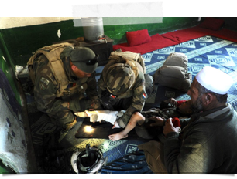
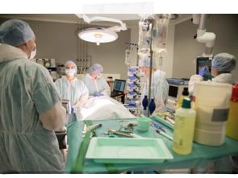
Why animal models to study transfusion ?
Transfusion of trauma patients
✗ Immediate and vital emergency treatment
✗ Austere environment
✗ Complex injuries, heterogeneous population
hard-to-implement clinical trials
Animal model = acceptable substitute
✗ Severity of injuries under control
✗ Environment under control
Homogeneous population
=> Model under control, reproductibility, respect for the scientific process
Notes:
In the context of transfusion, we need animal models because transfusion of trauma patients is an immediate and vital emergency treatment, very often used in austere environment, for patients with complex injuries in an heterogenous population. So clinical trials are very hard to implement, not to say almost impossible.
Animal models are acceptable substitutes with which it is possible to control the severity and kind of injuries, the environment and the characteristics of the population.
So with animal models, we can respect scientific process.
Yes, but…

Slide 5
Yes but…
Differences from Humans are not only aesthetic…
Notes:
Differences from Humans are not only aesthetic…

Slide 6

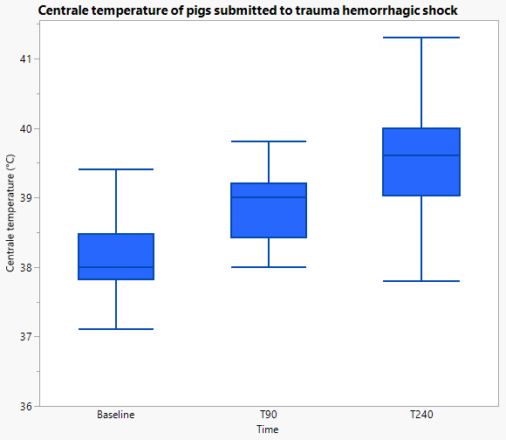
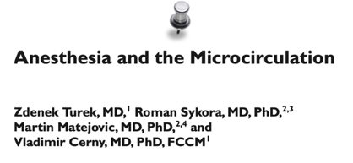
Key differences for trauma hemorrhage models
✗ Not the same physiology
Thermoregulation in young pigs during a model of trauma hemorrhage.
(min)
✗ Anesthesia is necessary for animal confort and rigorous experiment
↳ « Alterations in microvascular reactivity, nitric oxide pathways, and cytokine release are presumably the main mechanisms of anesthetic-induced tissue perfusion changes. »
✓ Species differences
✓ Different anesthetic agents = different physiological consequences
Notes:
For trauma hemorrhage models, there are some key differences :
First, physiology. For exemple, thermoregulation in young pigs during our trauma hemorrhage model is clearly not representative of hypothermia in human patients…
Second, anesthesia is, according to international directives, necessary for animal confort but also rigorous experiment. The problem is that any drug has consequences on animal physiology, and these consequences are species dependent and not the same from one drug to another.

Slide 7

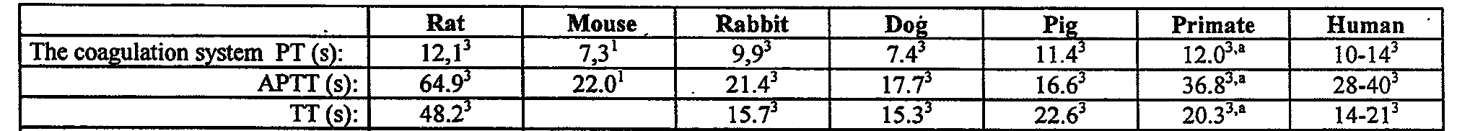
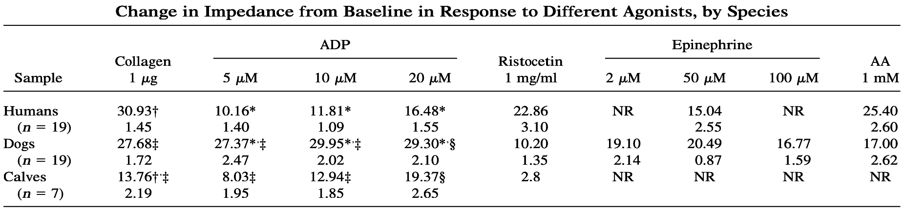
Key differences for trauma hemorrhage models
✗ Not the same coagulation times, nor blood volumes
Olsen, 1999
✗ Different responses to platelet aggregation agonists
Collagen
ADP
Ristocetin
Epinephrine
AA
Humans
NR
NR
Dogs
27.68
27.37
29.95
29.30
Calves
13.76
8.03
12.94
19.37
NR
NR
NR
NR
Soloviev, 1998
Notes:
Another key point is hemostasis. Either coagulation times or blood volumes, there is no perfect animal model except perhaps primates but there is a question of ethics and availability.
And about platelet agregation, it is not better.

Slide 8
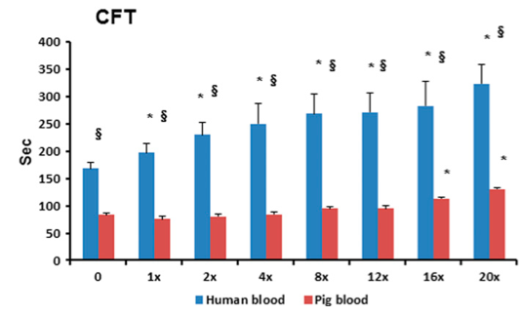
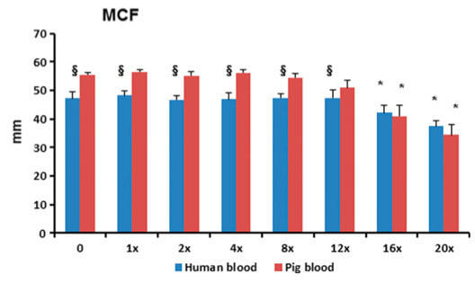
Key differences for trauma hemorrhage models
✗ Not the same response to treatments : exemple of Ibuprofen
Platelet aggregation
ROTEM
Wenjun, 2016
Notes:
More than physiology, the response to treatments can also be different from Humans. Indeed, here we see the platelet aggregation and ROTEM results on Humans and pigs after administration of ibuprofen, a non-steroid anti-inflammatory molecule. These functional results indicate different responses from the same treatment.

Slide 9
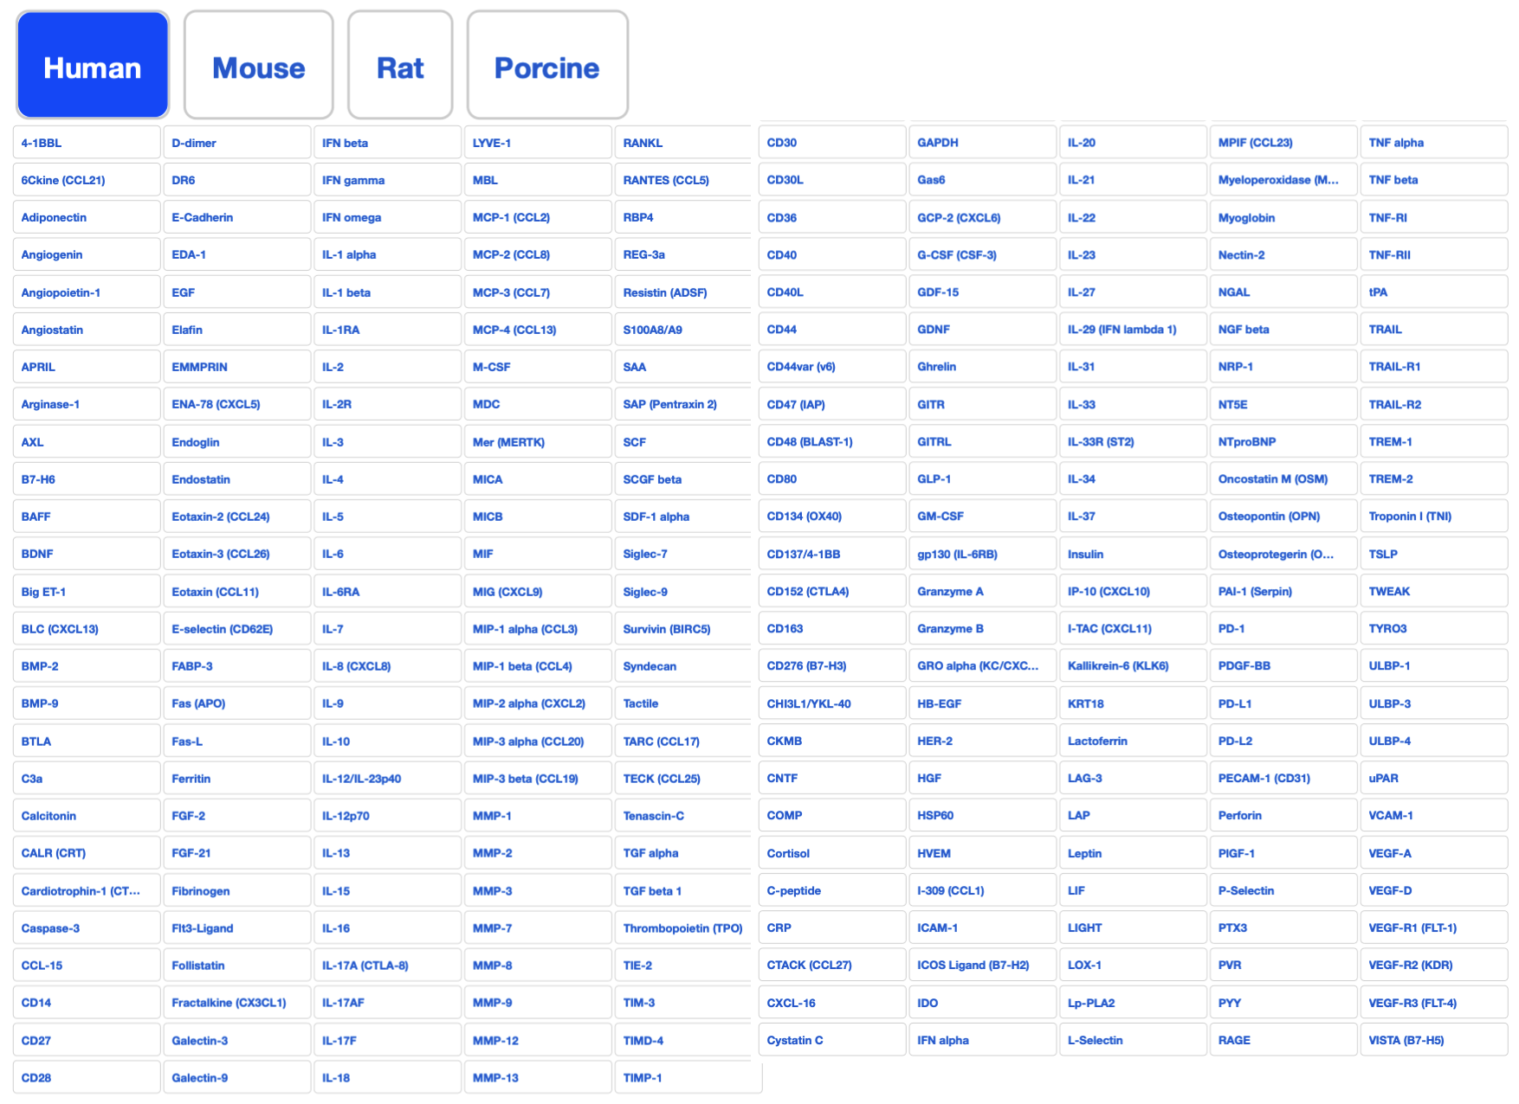
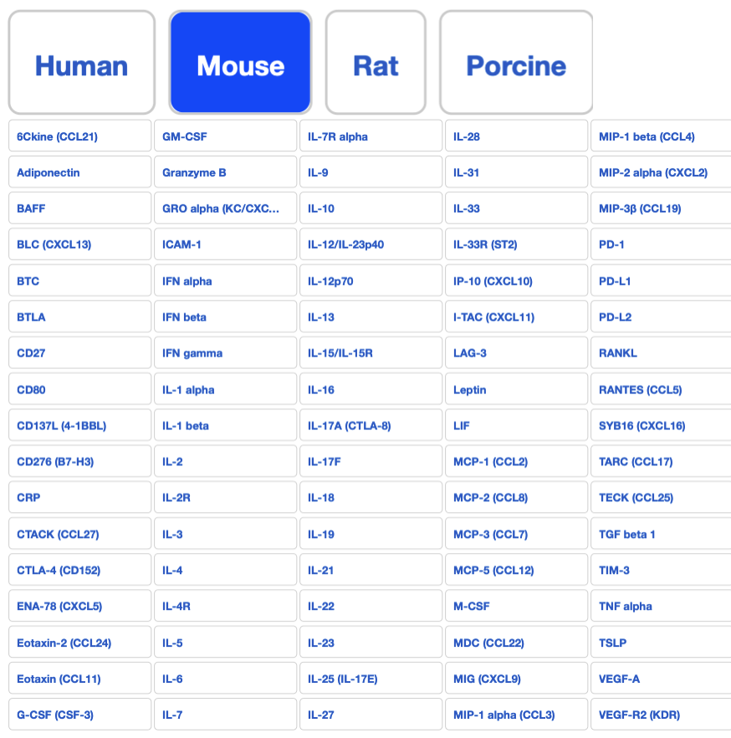
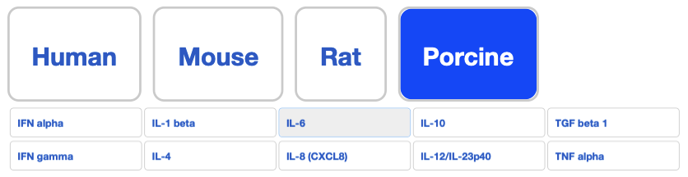
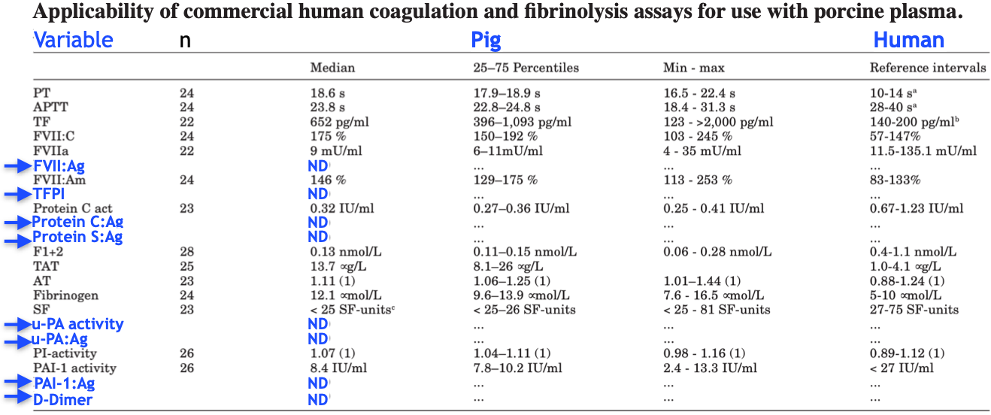
Key differences for trauma hemorrhage models
✗ Availability of reagents : biochemistry, ELISA, W.B, flow cytometry…
Exemple of multiplexes available for human, mouse and porcine samples.
« We found that 11 of 12 functional assays, but only 3 of 10 immunoassays, were applicable to porcine plasma »
Bloch Münster, 2002
Applicability of commercial human coagulation and fibrinolysis assays for use with porcine plasma.
Notes:
Another important problem is the availability of reagents for biological assays.
Here, there is an exemple of multiplexes available for Human, mouse and porcine samples. You can see there is not the same offer depending on the species.
And if, as a last resort, you think about using human biological tests for your animal model, don’t forget that for functional assays, why not, but for immunoassays you can have little opportunity to succeed…

Slide 10

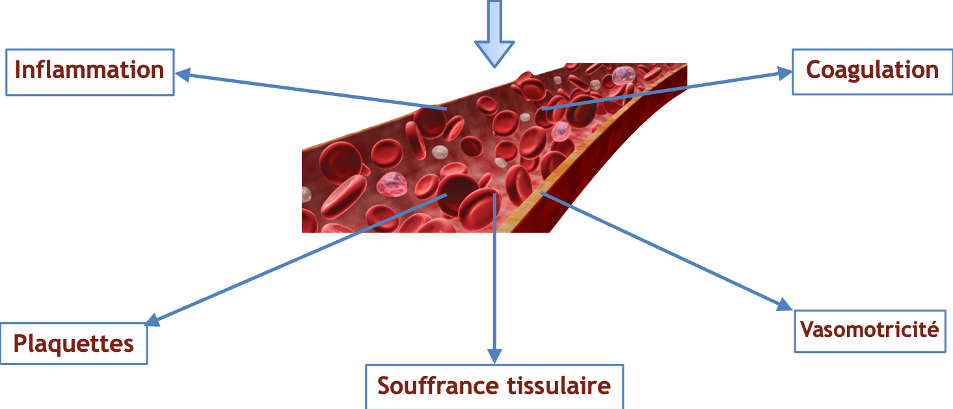
How to choose the good animal model?
What do we want to study ?
✗ Trauma + Hemorrhage + Shock
-40% or 60% of total blood volume, or blood pressure objective ?
-Trauma of soft-tissues, bone, with or without brain trauma ?
Trauma + Hemorrhagic shock
Inflammation
Coagulation
Platelets
Vasomotion
Tissue suffering
Notes:
So, now we know that the work with animal models is complex and frustrating,
Let us to see how we can choose a good model anyway.
In fact, to choose the good model, we only need to answer some questions.
First, what we want to study?
To mimic war injuries, the better is a model with trauma more hemorrhage more shock
So we can choose almost 40% of blood volume spoliation and better 60%, or a blood pressure objective, as you want
And we need to select the kind of injury, and if we want to study brain trauma or not because it is not the same pathophysiology.

Slide 11
How to choose the good animal model?
What do we want to study ?
✗ Trauma + Hemorrhage + Shock
✗ Pathophysiology and complications
-Cardiovascular, microcirculation
-Coagulopathy, platelet dysfunction
-Endotheliopathy
-Organ failure…
Trauma + Hemorrhagic shock
Inflammation
Coagulation
Platelets
Vasomotion
Tissue suffering
Notes:
We can also study several levels of pathophysiology and complications. Depending on the objectives, we need to choose adapted species and experimental assays.
For exemple, rabbits are good models for coagulopathy, whereas pigs are very good for cardiovascular studies.
And if we want to study tissue suffering, we need specific reagents for immunoassays or enzyme reactions.

Slide 12
How to choose the good animal model?
What do we want to study ?
✗ Trauma + Hemorrhage + Shock
✗ Pathophysiology and complications
✗ Time of focus
-Golden hour
-Early complications (<24H)
-Late complications (several days/weeks)
Trauma + Hemorrhagic shock
Inflammation
Coagulation
Platelets
Vasomotion
Tissue suffering
Notes:
We also need to know the time we want to focus. Because mechanisms involved and measurable are not the same at the beginning of the golden hour or after several days and late complications.

Slide 13
How to choose the good animal model?
What do we want to study ?
✗ Trauma + Hemorrhage + Shock
✗ Pathophysiology and complications
✗ Time of focus
✗ Treatment
-Available capacities
-Delay before treatment
-Species specific aphaeresis
Trauma + Hemorrhagic shock
Inflammation
Coagulation
Platelets
Vasomotion
Tissue suffering
Notes:
And the same for treatments
Timing should simulate life reality because prevention si not care and the available capacities are not the same according to pre-hospital or hospital situation we want to reproduce.
And if we want to study transfusion of different kinds of blood products it is possible to do specific animal aphaeresis, but it is easier with pigs than with mice.
Answers of all these questions do not achieve to one model but to several modelS. Keeping it in mind is important because some times extrapolation to all patients from one specific model is not a so good idea.

Slide 14

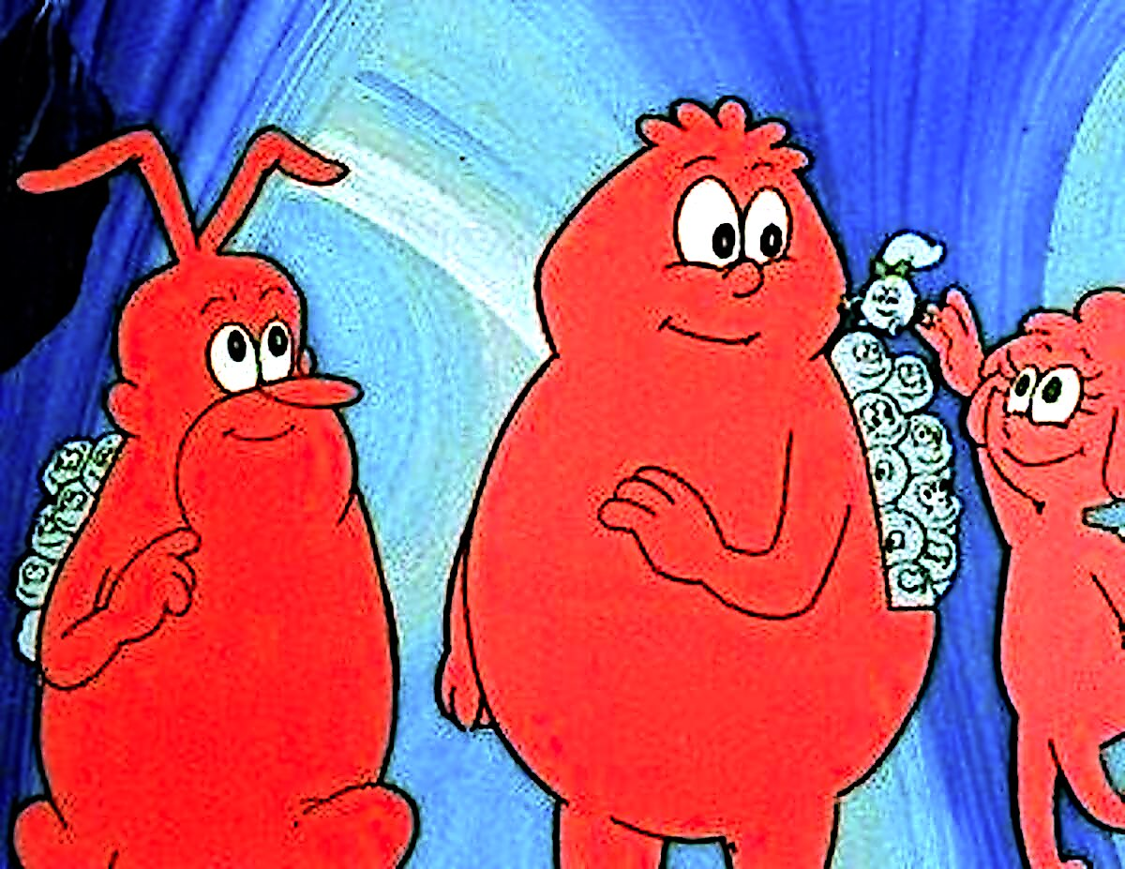
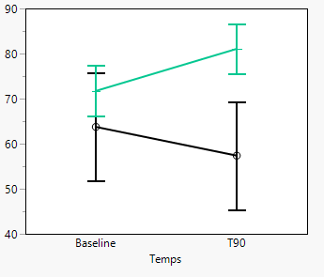
What about the outcomes?
What about « incoherent » outcomes?
The model is not « perfect » => tell the truth, all the truth
We are not guilty, just witnesses of nature complexity…
✗ Submission to international scientific community
  => somebody can improve the model.
  => another one will not wast time nor energy.
        Choc
Sham
Platelet agregation (collagen)
Platelet aggregation in a porcine model of trauma hemorrhage
Area under the curve (AU)
Time
Notes:
Imagine we have a good model, with good pathophysiology, good times, and so on and so forth,
What about outcomes?
When outcomes are exactly as expected, nobody see their publication as a problem.
But what about incoherent outcomes?
I think, they are as important as the good ones. Because, the model is not perfect, and we are not guilty, just witnesses of nature complexity…
For exemple, if somebody knows why the platelet aggregation of our pigs increases during shock instead of decreasing, you’re welcome!!
Moreover, submission to international scientific community is an opportunity for somebody to improve the model.

Slide 15
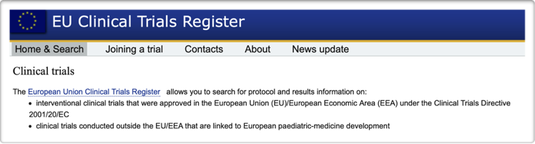
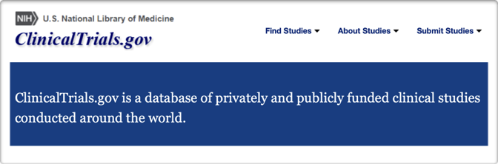
What about the outcomes?
What about « negative » outcomes of preclinical studies ?
✓ Clinical trials
Result-related information:
✗ Posted within 6 months (pediatric), or within 1 year of the end of the trial (EU).
✗ Submission for trials of unapproved products (USA).
✓ Research on animal models : no rule!
Notes:
And worse than incoherent results, what about « negative » results?
They are even more important because of the passage to Humans.
Indeed, for clinical trials, all result related information has to be published within at least 1 year of the end of the trial. And in the USA, this includes submission for trials of unapproved products.
But surprisingly, for research on animal models, there is no rule!
Eventhough we know that toxicity on an animal model will probably be the same on Humans.
Have a look on 2 examples.

Slide 16

Perfluorocarbons (PFC)
What about the outcomes?
What about « negative » outcomes of experimental therapy studies ?
-Transport of O2 and CO2
-Size << red blood cells : microcirculation
Pulmonary and blood troubles with thrombopenia and neutropenia
Despite the adverse effects, products for human use were developed:
Fluosol-DA 20%
OxygentTM (Alliance Pharmaceutical Corporation,San Diego, CA)
Oxycyte® (Synthetic Blood International, Costa Mesa, CA)
Despite the poor results in animals, clinical studies were started and then stopped due to excessive mortality. Poor animal results should have banned clinical studies
Adverse effects
Animal models patients
➠
Notes:
First, perfluorocarbons,
They are composed of carbon and fluor atoms which give them the ability to carry oxygen and carbon dioxide. And their size is perfect for microcirculation.
But, they also provoke side effects with severe pulmonary and blood troubles.
These effects were known for a long time, and despite this fact, several products were developed and clinical trials were started. And adverse effects on animal models were reproduced on patients…

Slide 17
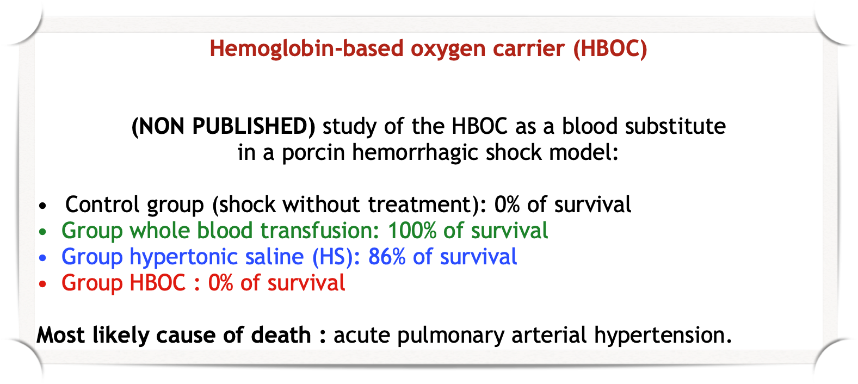
What about the outcomes?
What about « negative » outcomes of experimental therapy studies ?
Study of the HBOC as a blood substitute in a porcin hemorrhagic shock model:
Despite the absence of publication, the vigilance of the health authorities prohibited a clinical study
Notes:
Another more recent exemple is about Hemoglobin-based oxygen carriers.
A study was conducted with an HBOC as a blood substitute in a porcin hemorrhage model.
In this study, whereas hypertonic saline, the worst treatment possible, achieved to 86% of survival, in the HBOC group the survival was 0% with all the signs of acute pulmonary arterial hyperpression as the likely cause of death. These results contradicted the ones obtained in rat model. This contradiction between the two animal models was likely another story of depakote. Depakote is an anti-epileptic molecule that provoked foetal impairments when it was administered to pregnant women; despite no one in toxicity studies on rodent model. When they investigated on these impairments, they discovered that the right model was not rats but rabbits, in which there were the same foetal impairments than in Humans. That is why, despite positive results on a rat study with this HBOC, negative results and toxicity on pig model should be suffisant to delay any passage to Humans, but not! and thanks to the vigilance of the French health authorities a clinical trial for severe COVID-19 patients was prohibited just before it started. In this situation, the pandemic emergency failed to remember the Hypocrate sentence, primum non nocere « first do not harm ».

Slide 18
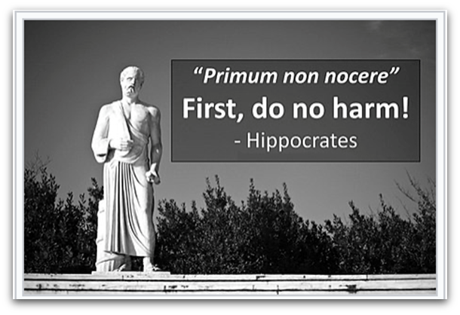
Conclusion
Learning from animal studies is critical for patients
✗ The rule for every new drug : animal model before any test on Humans.
✗ Animal models and transfusion : acceptable substitutes to study complex injuries and treatment of medical emergencies.
✗ Differences from Humans are not only aesthetic…
=> Choose a suitable model
=> Manage its strengths and weaknesses
✗ What about « negative » outcomes of experimental therapy studies ?
Using the same rules than for clinical trials would make good progress.
All preclinical results should be published.
Pharmacodynamics, pharmacokinetics, toxicity
➠
Notes:
In conclusion,
Learning from animal studies is critical for patients.
The rule for every new drug is to use animal models before any test on Humans.
Specially for transfusion, animal models are acceptable substitutes to study complex injuries and treatment of medical emergencies.
It is hard to choose a suitable model and to manage its strengths and weaknesses but it is so important
And more than any other thing, all preclinical results should be published, this would help to make good progress and protect patients, from toxicity of new drugs before any clinical trial.

Slide 19

Questions?
frederique.dufour-gaume@def.gouv.fr
Notes:
Thank you for your attention

