Slide 1
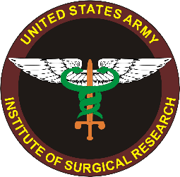
“Anti-shock” Drug Strategies for Treatment of Trauma
James A. Bynum, PhD
Chief, Blood and Shock Resuscitation
U.S. Army Institute of Surgical Research
james.bynum.civ@mail.mil
PI Contributors:
Xiaowu Wu, MD
Lusha Xiang, MD
Evan Ross, MD

Slide 2
Disclaimers
The views expressed in this presentation are those of the author(s) and do not reflect the official policy or position of the U.S. Army Medical Department, the Department of the Army, DoD, or the U.S. Government.
The authors declare no conflicts of interest.

Slide 3


Tyranny of Time
Remote, austere settings are a given…
but delivering combat casualty care is getting more complicated!

Slide 4
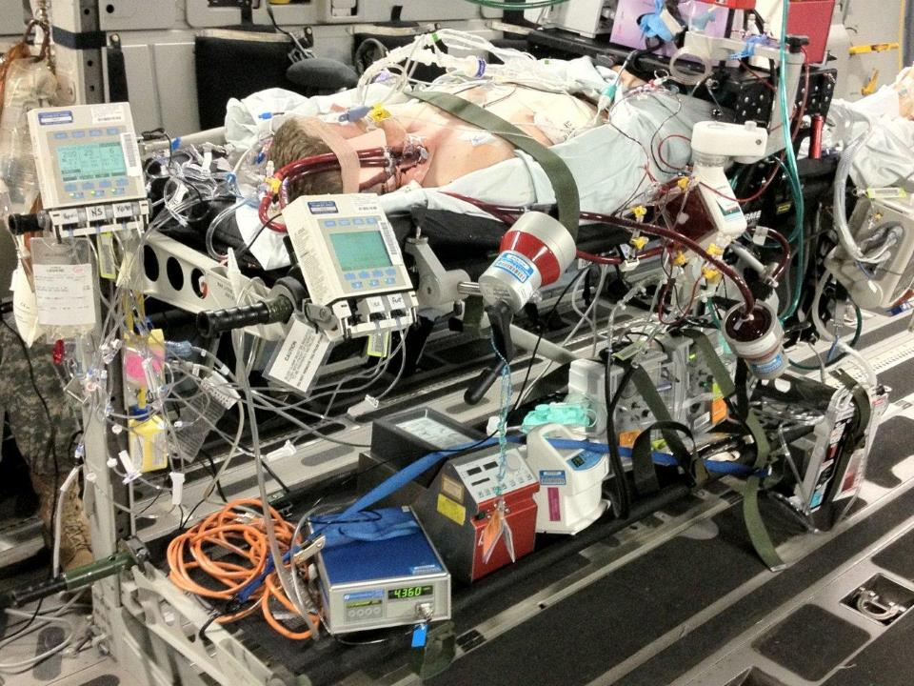
The Challenge

Slide 5
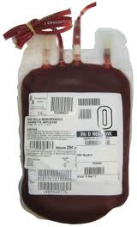
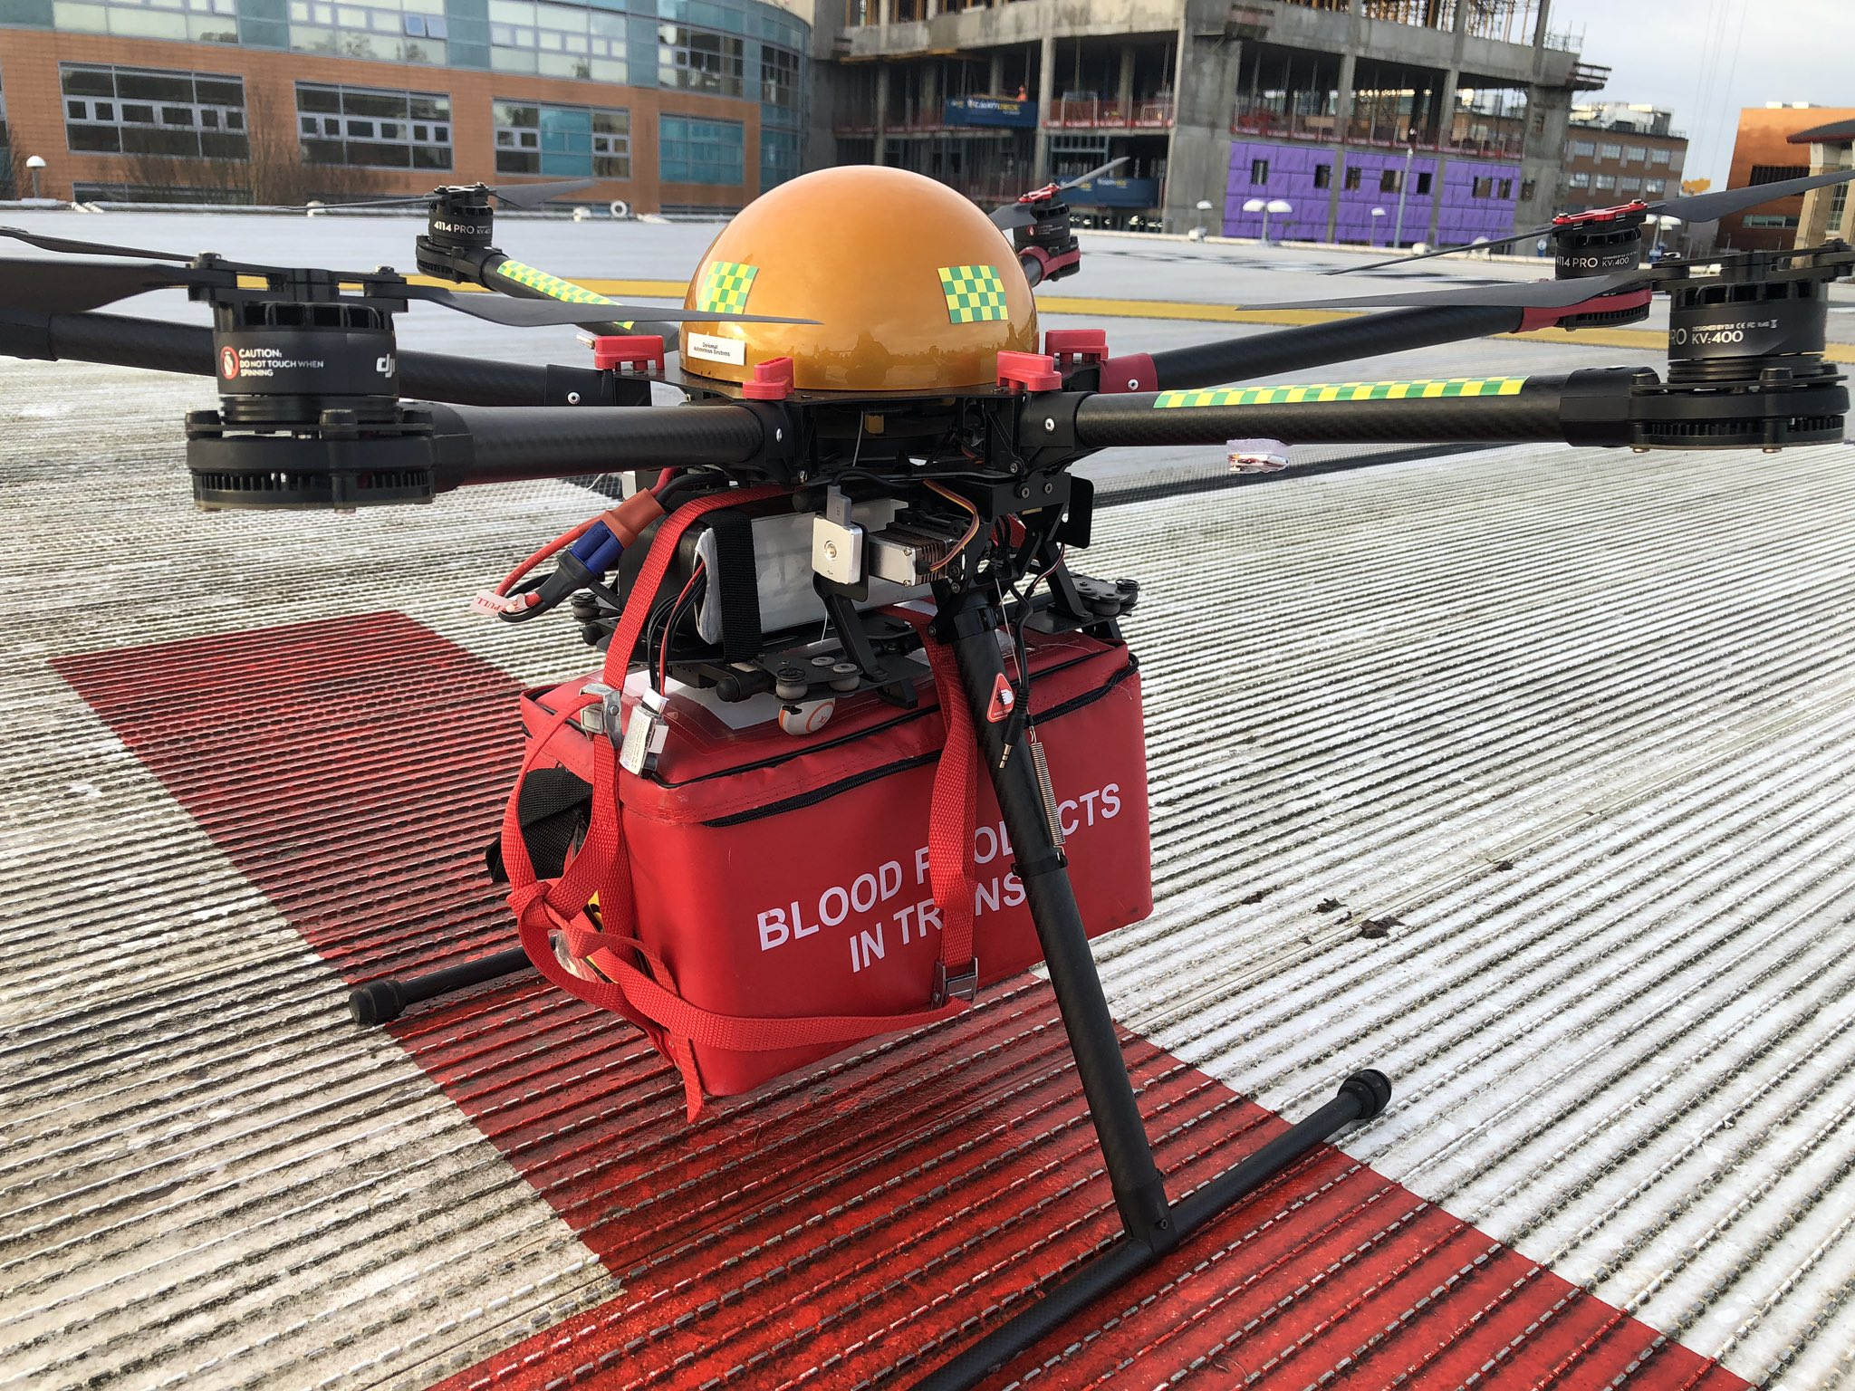
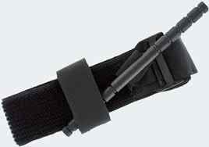
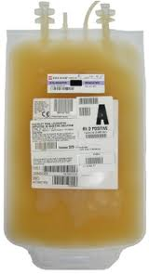
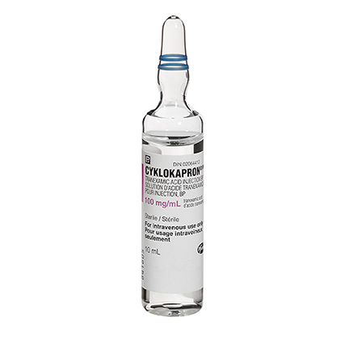
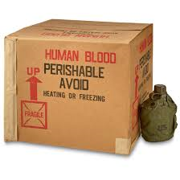
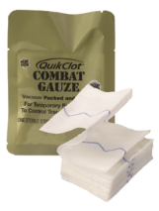
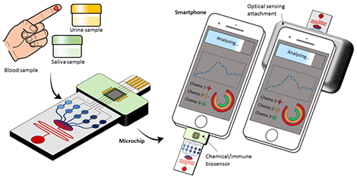
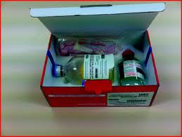
The Toolkit
Cold
Platelets
TXA
CAT Tourniquet
Drone Delivery of Blood
LTOWB
French FDP
Hemostatic
Dressings
Blood Diagnostic/Triage Devices

Slide 6
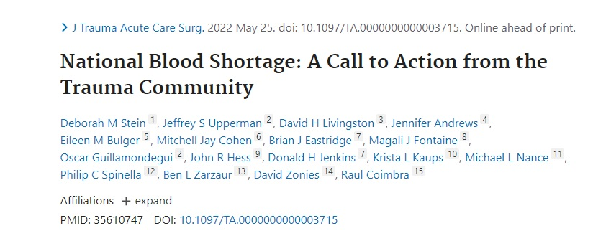
Need Strategy for “Blood Multipliers”!
“Only ~5% of eligible people donate blood yearly, and 45% of donations come from individuals over 50!”

Slide 7
Current Candidates Under Evaluation
Prolyl Hydroxylase Domain Inhibitors (PHDi): improves hypoxia adaptation, treats hyperlactatemia, treats renal anemia.
Bradykinin Receptor Antagonist (Icatibant): protects endothelial integrity, attenuates vascular permeability.
Albumin (25%): expands volume with limited fluid.
Plasma (FFP or FDP): resuscitation, improves coagulation, attenuates endotheliopathy.
Tranexamic Acid (TXA): treats hyperfibrinolytic ATC and active traumatic bleeding, attenuates inflammatory response, protects endothelial integrity.
Calcium (Calcium Gluconate, or Calcium Chloride): improves hemostasis, maintains neuromuscular and vascular membrane stability, improves cardiac conduction, myocardial contractility, and vascular reactivity.
James Bynum, PhD, james.bynum.civ@mail.mil

Slide 8
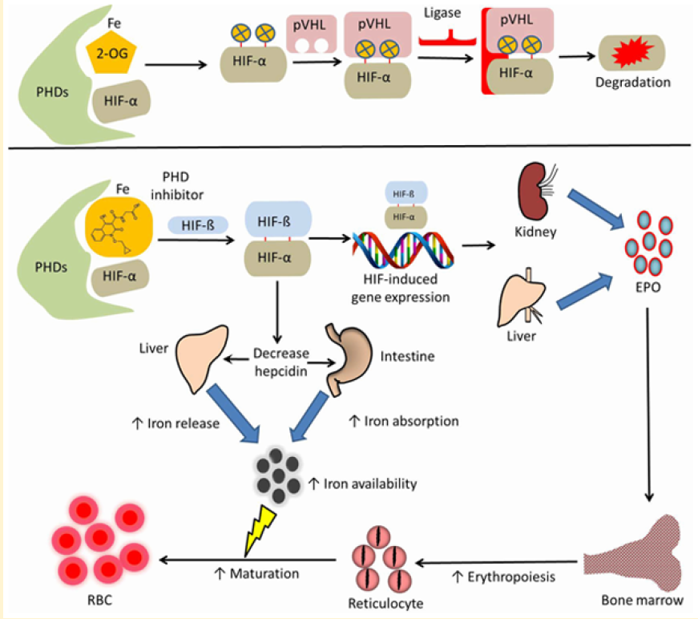
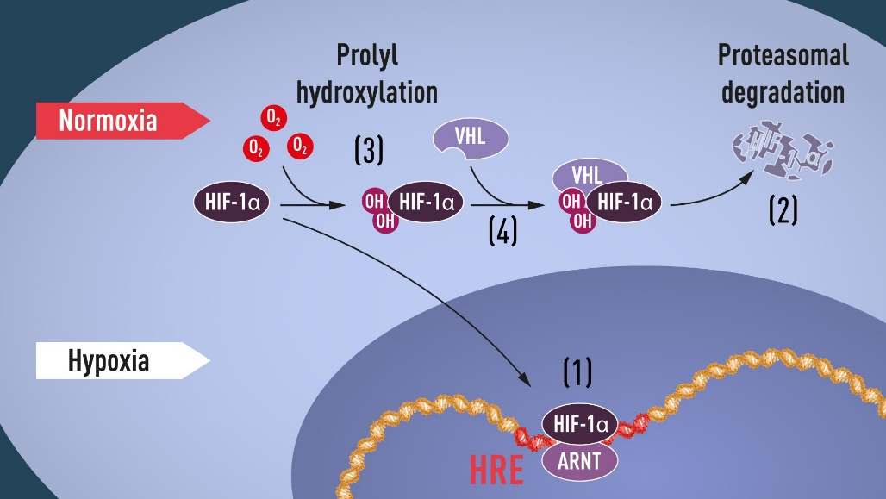
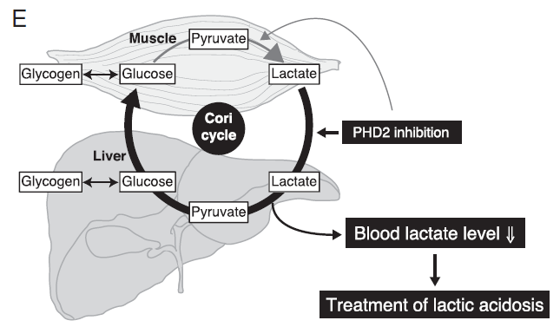
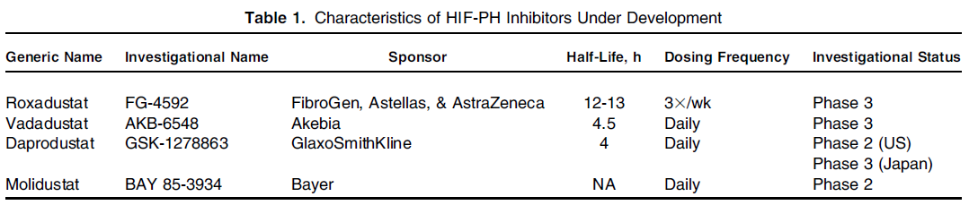
Prolyl Hydroxylase Domain Inhibitors (PHDi)
Improve Adaptation to Hypoxia
Erythropoietic Effects
Metabolic Reprogramming
nobelprize.org
Joharapurkar AA, et al, J Med Chem 2018
Suhara T, et al, PNAS, 2015
2019 Nobel Prize in Physiology/Medicine to William G. Kaelin Jr.
Sir Peter J. Ratcliffe
Gregg L. Semenza
for their discoveries of how cells sense and adapt to oxygen availability
Gupta N, AJKD 2017

Slide 9
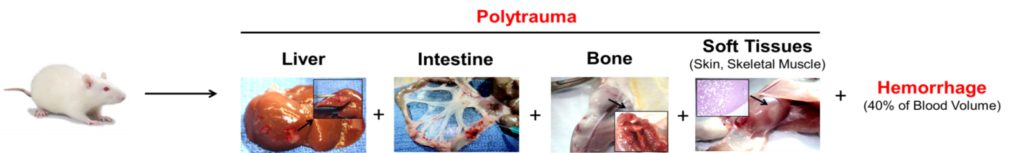
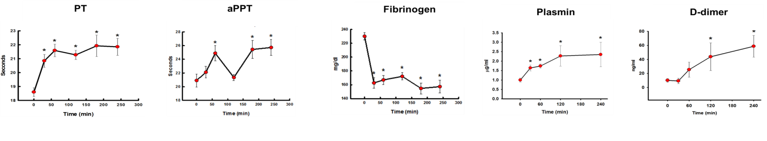
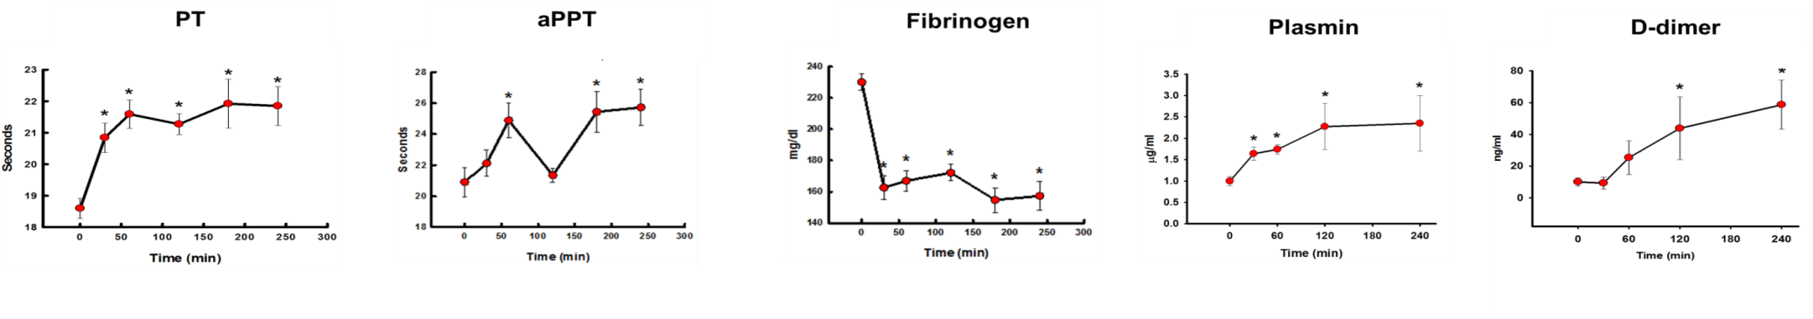
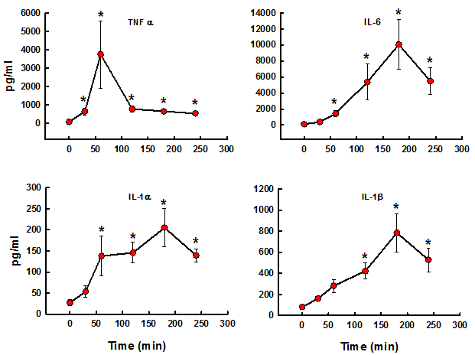
Acute Sub-lethal Model
(Trauma/Hemorrhage with Acute Traumatic Coagulopathy)
Polytrauma/Hemorrhagic Shock Model:
ATC
(Acute Traumatic Coagulopathy)
Darlington DN, Shock 2013
Inflammatory Response
Tissue Hypoxia
Mitochondria Dysfunction
Multiple Organ Failure
Mitochondria Function (Kidney)
e.g.
Kidney Function Test
Trauma/Shock
Trauma/Shock
Darlington DN, Shock 2013
Wu X, MHSRS 2019

Slide 10
Preliminary Studies
Oral Administration of PHDi Immediately Prior to Trauma
(In Polytrauma/Hemorrhagic Shock Model)
*
*
*
*
PHDi or Vehicle
Administration of PHDi prior to trauma and hemorrhage attenuates lactate elevation.

Slide 11
PHDi Mitigates Hyperlactatemia and Coagulopathy in Polytrauma/Hemorrhage Non-Lethal Model– (Non-Resuscitated)
IV Administration of PHDi 20 min AFTER Polytrauma/Hemorrhage (40%)
Vehicle (n=7)
PHDi (n=8)
Bottom line: PHDi alone (no resuscitation) improves ATC

Slide 12
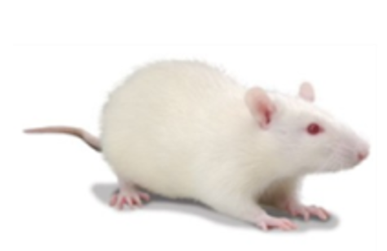
Lethal Hemorrhagic Shock Model in Rats
Fixed-Volume Hemorrhage at Fast-to-Slow Pattern
Sprague Dawley
Total Amount of Hemorrhage
40%
40%
20%
Isoflurane Anesthesia
0
2
4
6
8
10
13
16
19
22 min
Time to Death: 60%EBV: 43±3min; 65%EBV: 30±4min
EBV: Estimated Blood Volume

Slide 13
PHDi Improves Survivability in Lethal Hemorrhagic Shock Model
IV Administration of PHDi 20min after 60% Hemorrhage, Followed by Fresh Whole Blood (2U) Resuscitation at 60min if Survived
60min-Survivability:
Vehicle: 15% (2/13), PHDi: 62% (8/13),
p=0.028
240min-Survivability:
Vehicle: 8% (1/13), PHDi: 46% (6/13),
p=0.044
James Bynum, PhD, james.bynum.civ@mail.mil

Slide 14
Combat Significance
60min-Survivability | Survived | Died | Survivability
Vehicle | 2 | 11 | 15.4%
PHDi | 8 | 5 | 61.5%
Chi-Square Test | p=0.028

Slide 15
Survivability Among All Treatment Groups
Fully resuscitated controls
The PHDi vehicle controls don’t survive 1hr to get WB!
All these groups get WB – 2 unit equivalent
Drug Treatment
Fresh Whole Blood (20% of EBV)
Bottom line: single dose of PHDi 20 min after hemorrhage plus 2U WB @1hr gives 65% survival @2hrs, 50% @4hrs.

Slide 16
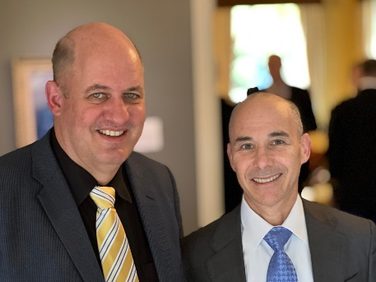

PHDi COVID CLINICAL TRIAL
Vadadustat Study Targeting ARDS Therapy in COVID‐19
MAR 11,
2020
COVID-19
Declared
APR 2020
Research Plan with Akebia
APR 15,
2020
Filed for FDA IND
JUN 1,
2020
IND
Received
AUG 22,
2020
First patient
JAN 1,
2021
DoD Funding
MAR 1,
2021
438 PTS
Randomized

Slide 17
PHDi Treatment/Prevention of ARDS
PIs: Bentley Bobrow, MD | Holger Eltzschig, MD, PhD
Duration: 2 years
Title: Vadadustat for the prevention and treatment of acute respiratory distress syndrome (ARDS) in hospitalized patients with Coronavirus Disease 2019 (COVID-19)
The current proposal is focused on the hypothesis that pharmacologic activators of the transcription factor “hypoxia-inducible factor” (HIF) can be used for the prevention or treatment of acute respiratory distress syndrome (ARDS) in hospitalized patients with COVID-19.
  Specific Aim 1: Study the effectiveness of vadadustat in preventing or treating ARDS in a randomized, double-blinded, placebo-controlled clinical trial of COVID-19 patients.
  Specific Aim 2: Determine the impact of vadadustat treatment of COVID-19 patients on the expression of known HIF target genes.
  Specific Aim 3: Measure the consequences of vadadustat treatment of COVID-19 patients on their inflammatory profile.

Slide 18
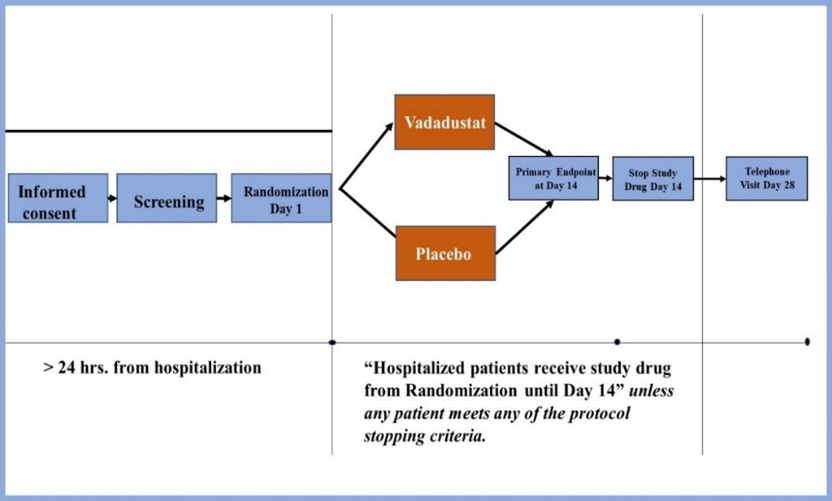
PHDi CLINICAL STUDY DESIGN
Consented patients randomized in a 1:1 ratio to vadadustat 900 mg or placebo
Safety analysis after patient 30, 120, and 400 patients
External DSMB to determine further patient screening and enrollment.

Slide 19
Conclusions
Acute (single dose) administration of PHDi significantly improves mortality in a combat relevant model of lethal hemorrhage.
The results of these studies provide a novel approach towards addressing the challenges of limited access to blood products in an MDO environment (Blood Multiplier!).
Ongoing studies will evaluate dosage and timing for treatment optimization, further explore combined resuscitation strategies with other blood products/pharmaceutics to mitigate coagulopathy, and regulate hemodynamics and metabolic changes in response to severe hemorrhagic shock.

