Slide 1
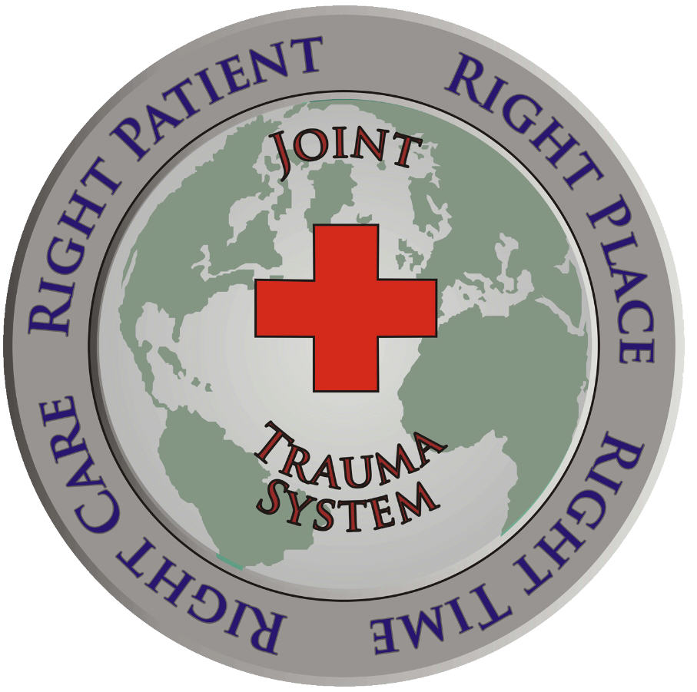
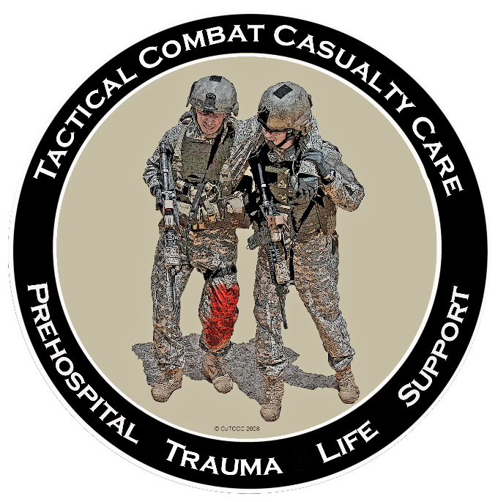
UNCLASSIFIED
Advanced Resuscitative Care in TCCC
Dr. Frank Butler
THOR
24 June 2019

Slide 2
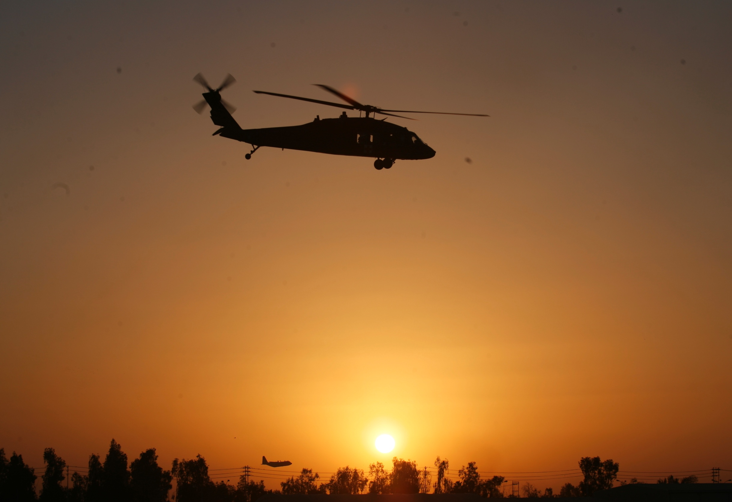
UNCLASSIFIED
Disclaimers
“The opinions or assertions contained herein are the private views of the author and are not to be construed as official or as reflecting the views of the Departments of the Army, Air Force, Navy or the Department of Defense.”
No financial interests in items discussed

Slide 3
THANKS - To The THOR
Working Group!
UNCLASSIFIED
Photo: CDR Geir Strandenes - 2016
THOR 2016

Slide 4
Tourniquets: The Magnitude of the Issue
UNCLASSIFIED
“The striking feature was to see healthy young Americans with a single injury of the distal extremity arrive at the magnificently equipped field hospital, usually within hours, but dead on arrival. In fact there were 193 deaths due to wounds of the upper and lower extremities, …… of the 2600.”
CAPT J.S. Maughon
Mil Med 1970
* Extremity hemorrhage math in Vietnam:
193 of 2600 = 7.4% x 46,233 fatalities = 3,421
preventable US deaths from extremity hemorrhage
4
4
Notes:
3,421 is a staggering number
When all of those deaths were potentially preventable
How would a Medical Center react if you had a meningitis or a pyelonephritis patient come in -
you didn’t get around to starting antibiotics and they died?

Slide 5
Battlefield Trauma Care in the US Military: 1992-2001
UNCLASSIFIED
Medics were taught NOT to use tourniquets
There were no hemostatic dressings fielded.
Potentially dangerous Civil War-vintage technology for battlefield analgesia (IM morphine) was used.
Large volume crystalloid fluid resuscitation for shock was used for casualties in shock – this is now known to increase the likelihood of death from non-compressible torso hemorrhage.
And much more
TCCC recommended major changes in 1996
5
Notes:
Show of hands

Slide 6
TCCC Lessons Learned:
THOR 2016
UNCLASSIFIED
2. It doesn’t matter how good the plan is – if nobody’s using it.

Slide 7
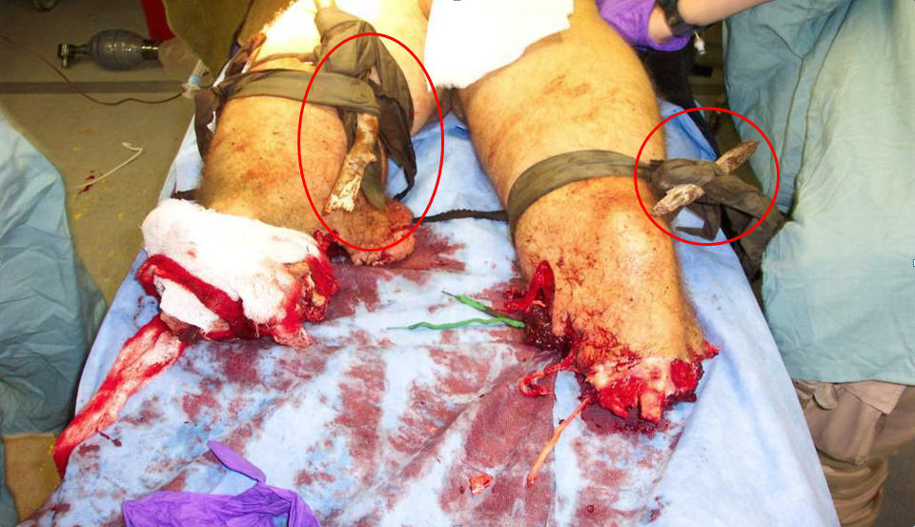
Most of the U.S. military went to war in Afghanistan and Iraq without tourniquets.
Lest We Forget
UNCLASSIFIED

Slide 8
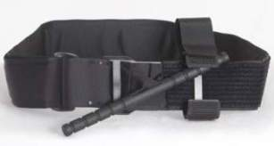
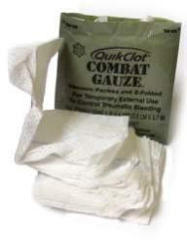
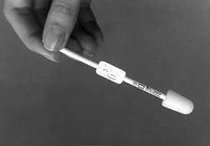
Tactical Combat Casualty Care in the US Military: 2019
UNCLASSIFIED
Phased care in TCCC
Aggressive use of tourniquets in CUF
Combat Gauze as hemostatic agent
Aggressive needle thoracostomy
Sit up and lean forward airway positioning
Extraglottic airways – i-gel
Surgical airways for maxillofacial trauma
Hypotensive resuscitation with blood products
IVs only when needed/IO access if required
PO meds, OTFC, ketamine as “Triple Option”
for battlefield analgesia
Hypothermia prevention; avoid NSAIDs
Battlefield antibiotics
Tranexamic acid – given ASAP when indicated
Junctional Tourniquets/XStat
8

Slide 9
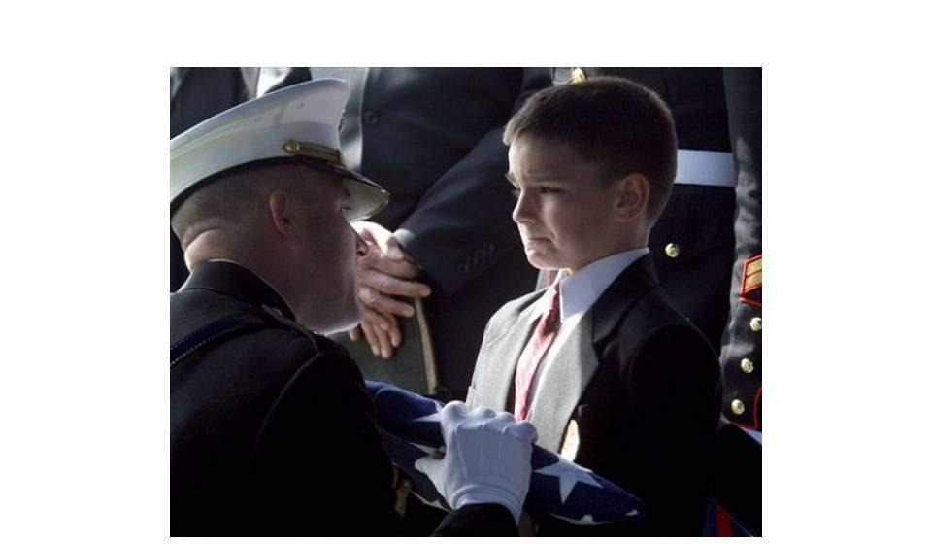
UNCLASSIFIED
The Goal
Thanks:
SFC (R)
Dom
Greydanus
ZERO Preventable Deaths!

Slide 10
Preventable Prehospital
Deaths in Combat Casualties
UNCLASSIFIED
For 100 Preventable Combat Deaths (Eastridge 2012):
7 are due to airway obstruction
1 is due to tension pneumothorax
92 are due to hemorrhage
12 are due to extremity hemorrhage
18 are due to junctional hemorrhage
62 are due to non-compressible torso hemorrhage
22 are due to thoracic bleeding
Might be helped by whole blood resuscitation
40 are due to abdominopelvic bleeding
And might be saved by ARC – if done quickly

Slide 11
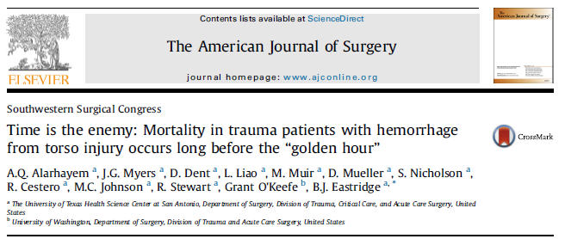
For NCTH, Sooner Is Better.
Period.
UNCLASSIFIED
Many casualties with NCTH do not survive their “Golden
Hour!”
“In this analysis, we noted a precipitous incremental rise
in patient mortality in patients with high-grade injuries at
prehospital times 0-15 and 16-30 min, irrespective of
mechanism.”

Slide 12
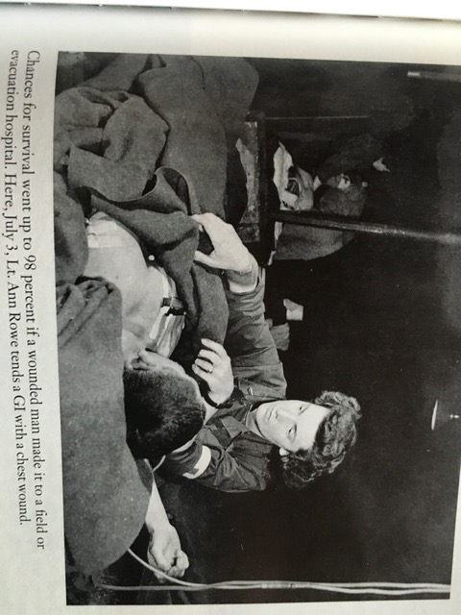
If We Can Just Get the Casualty to the Hospital Alive…..
UNCLASSIFIED
Stephen Ambrose – Citizen Soldiers – Normandy 1944
But - 13% of the fatalities in the Eastridge study
were DOWs

Slide 13
Hemorrhagic Shock and Mortality AFTER Reaching the MTF
UNCLASSIFIED
Martin 2008 – 32% of deaths in Level 3 MTFs
are due to hemorrhage (Military)
Buehner 2017 – Hypotension on arrival at a
Level 3 MTF = 23% mortality (Military)
Harvin 2018 – Emergent trauma laparotomy +
hypotension = 46% mortality (Civilian)
Marsden 2018 - Emergent trauma laparotomy
+ hypotension = 26% mortality (Military)

Slide 14
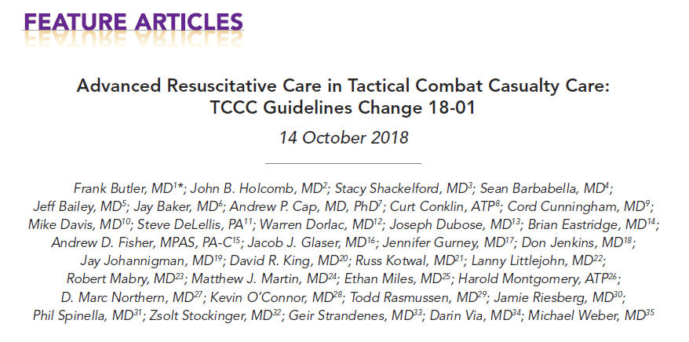
Advanced Resuscitative
Care in TCCC - 2019
UNCLASSIFIED
Journal of Special Ops Medicine 2019
THANKS to the ARC author team!

Slide 15
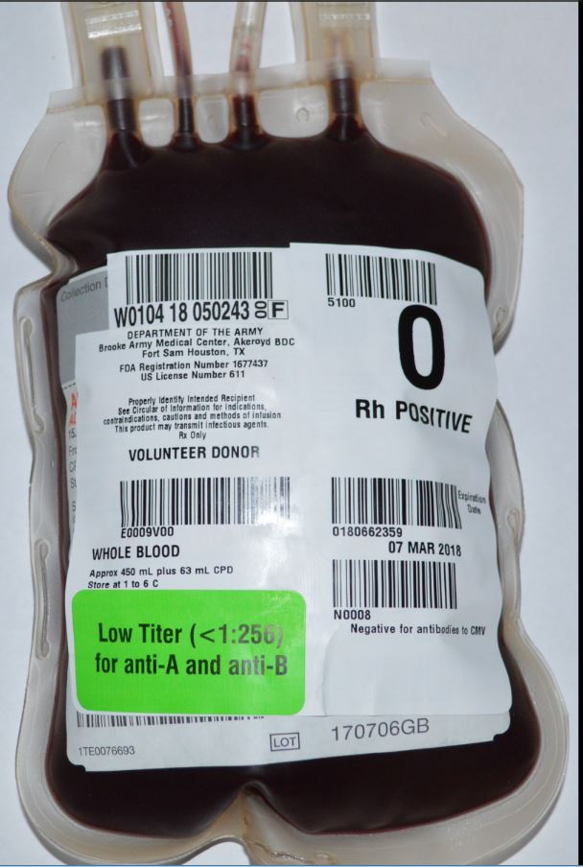
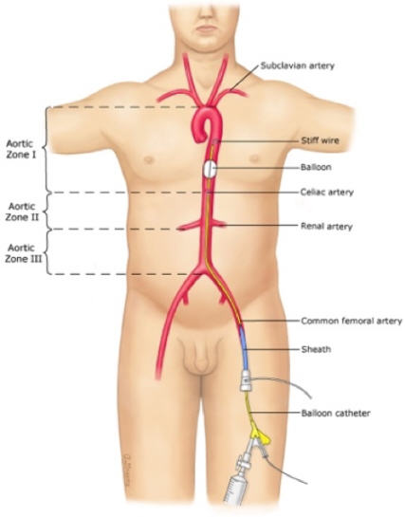
Advanced Resuscitative
Care in TCCC - 2019
UNCLASSIFIED
Prehospital whole blood – Given ASAP when
needed
Far- Forward Zone 1 REBOA

Slide 16
Whole Blood for
Hemorrhagic Shock
UNCLASSIFIED
A proven lifesaver
Prehospital whole blood now
transitioning to the civilian sector
No Golden Hour for internal
hemorrhage - MINUTES MATTER!
The overwhelming majority of
US ground forces DO NOT HAVE
whole blood at the point of injury!
Whole Blood - don’t go to war without it!

Slide 17
Far-Forward Blood:
MINUTES MATTER
UNCLASSIFIED
“Among medically evacuated US military combat causalities in Afghanistan, blood product transfusion prehospital or within minutes of injury was associated with greater 24-hour and 30-day survival than delayed transfusion or no transfusion.”
Shackelford et al
JAMA 2017
Notes:
This is a study that was published in JAMA in 2017 that shows the importance of EARLY blood transfusion.

Slide 18
Far-Forward Blood: MINUTES MATTER
UNCLASSIFIED
“Regardless of conflict, early delivery of blood transfusion was associated with increased survival. Thus, timely treatment capability was paramount for casualty survival on the battlefield of Iraq, as it was in Afghanistan.”
Kotwal J Trauma
2018

Slide 19
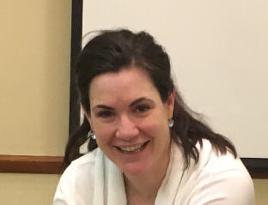
Far-Forward Whole Blood: MINUTES MATTER
UNCLASSIFIED
COL Jennifer Gurney et al
She is at THOR - I will let her tell you!

Slide 20
Far- Forward Whole Blood Options in Order of Preference
UNCLASSIFIED
#1 FDA-Compliant cold-stored LTOWB
#2 LTOWB from a walking blood bank
#3 Untitered Type O whole blood from a walking
blood bank
#4 Type-specific whole blood from a walking
blood bank
20

Slide 21
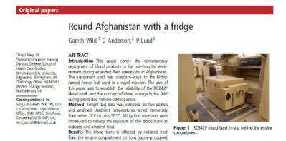
Cold-Stored Low-Titer Type O Whole Blood (LTOWB)
UNCLASSIFIED
The best option for far-forward blood.
Identify Type O, Low-titer donors.
Collect the blood in CONUS or closer to theater.
Screened for pathogens (FDA compliant).
Advocates: Cap, Holcomb, Jenkins, Spinella, Strandenes, THOR, AABB
Blood can be moved far-forward in a long-duration or powered blood cooler.
Notes:
This is the latest development in providing FDA-compliant whole blood far forward in theater. Donated blood is preserved in electrically powered blood coolers and moved far forward in a new non-powered, 50-hour container.

Slide 22
75th Ranger Regiment: Type O Low or “ROLO” Program
UNCLASSIFIED
Fresh low-titer Type O whole blood is another option for far-
forward whole blood.
75th Ranger Regiment “ROLO” program:
Type O, Low-Titer Anti-A, Anti-B antibodies
Donors pre-screened for type, titers, and infectious diseases
The donor pool is used to transfuse casualties in shock.
Notes:
The 75th Rangers have provided whole blood transfusion far forward by identifying type O, low-titer donors ahead of time, and collecting blood from then when needed on the battlefield.

Slide 23
Whole Blood in TCCC in
The 75th Ranger Regiment
UNCLASSIFIED
“The Regiment has 11 cases of prehospital whole blood
transfusions to date – all cold-stored WB units.”
Notes:
Despite their pioneering ROLO programs, most whole blood transfusions in the Ranger Regiment to date have been cold-stored, FDA-compliant whole blood.

Slide 24
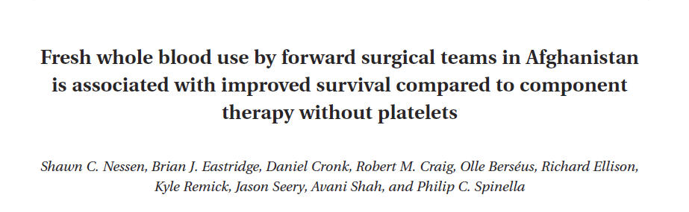
Untitered Type O Whole Blood
UNCLASSIFIED
Can also use untitered Type O whole blood from
a walking blood bank
Commonly done by forward surgical teams
Risk of reaction due to incompatible ABO
antibodies is very low
Nessen et al
Transfusion 2013
24

Slide 25
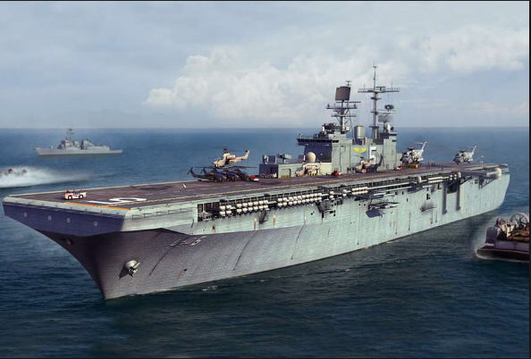
Type Specific Whole Blood
UNCLASSIFIED
MASCAL fm helo crash
15 August 2017
4 casualties transfused
16 units RBCs
10 FFP
54 units type-specific WB
No casualty in shock
given NS, LR, or
Hextend
* ABO mismatch may cause fatal hemolytic reaction
USS Bataan (LHD-5)
Miller et al
J Trauma 2018
25

Slide 26
Indications for Whole Blood in ARC
UNCLASSIFIED
“- Casualty has known prior external hemorrhage (even if
that hemorrhage is now controlled) or suspected
noncompressible torso hemorrhage (NCTH)
AND
- Systolic Blood Pressure (SBP) is less than 90 mmHg
OR
- Point of Injury lactate is 4 mmol/L or greater”

Slide 27
Resuscitative Endovascular Balloon Occlusion of the Aorta (REBOA)
UNCLASSIFIED
How do you stop bleeding
from an injured blood vessel
or organ inside the abdomen
or pelvis? Stop the blood
from reaching the site of the
injury!
Insert a balloon catheter into
the femoral artery, advance
the balloon into the chest,
and then inflate it.
Blood flow is stopped at the
site of the inflated balloon –
think “internal tourniquet.”

Slide 28
REBOA: Resuscitative Endovascular Occlusion of the Aorta
UNCLASSIFIED
Zone 2 - Between
the celiac trunk
and the lower
of the two renal
arteries
Zone 1 - Between the
left subclavian artery
and the origin of the
celiac trunk
Zone 3 - From the
lower of the two
renal arteries to
the bifurcation
of the aorta
Aortic Occlusion Zones

Slide 29
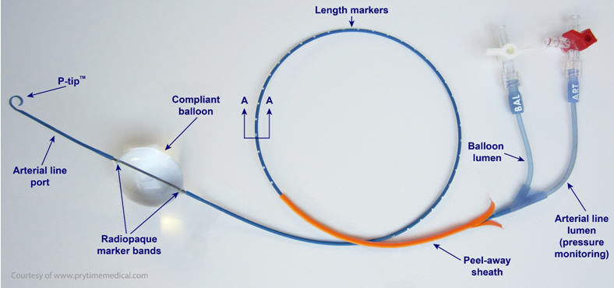
ER – REBOA ™
UNCLASSIFIED
* Photo courtesy PRYTIME Medical

Slide 30
Manley et al; JSOM 2017 Far-Forward REBOA
UNCLASSIFIED
* All 4 casualties survived to next level of care

Slide 31
Northern et al - J Trauma 2018 Far-Forward REBOA
UNCLASSIFIED
20 combat casualties treated with prehospital REBOA; mean SBP 71
Large majority Zone 1; 19 of 20 successful; #20 balloon rupture
Mean SBP increase on balloon inflation was 56 mmHG
Mean balloon time was 21 minutes (range 7-34 min)
No procedural complications – 7 done by EM physicians
Also resuscitated with whole blood
100% survival to the next level of care

Slide 32
REBOA – But Isn’t That Potentially Dangerous?
UNCLASSIFIED
Yes!
So - how do we make it safer?
Better patient selection
Optimized procedures
Intermittent occlusion

Slide 33
REBOA in ARC - Indications
UNCLASSIFIED
1. Relevant Tactical Field Care interventions (external hemorrhage
control, pelvic binding, and TXA) have been accomplished; AND
2. Advanced monitoring (Electronic blood pressure measurement) has
been established; AND
3. ARC resuscitation has been previously initiated with whole blood if
feasible or other blood products as noted previously; AND
4. SBP remains < 90 mmHg immediately after 1 unit of whole blood or 1
unit each of RBCs and plasma have been administered as quickly
as possible; AND
5. The casualty has penetrating or severe blunt force injury to the
abdomen or pelvis and a positive FAST exam or is judged to be at
high risk for NCTH or is noted to have difficult-to-control junctional
hemorrhage. AND
6. Intra-thoracic bleeding and cardiac tamponade have not been found
on bilateral chest tube insertion and an EFAST exam.

Slide 34
REBOA in ARC
UNCLASSIFIED
CALL YOUR RECEIVING TRAUMA SURGEON BEFORE PERFORMING REBOA IF AT ALL POSSIBLE!
EARLY common femoral artery access if REBOA is being considered.
Admission Orders to the MTF should include: “Check and document distal pulses and doppler signals in both legs hourly.”
All REBOA in TCCC is ZONE 1. A negative FAST exam does NOT definitively rule out intra-abdominal bleeding from a site proximal to the aortic bifurcation.

Slide 35
Zone 1 vs Zone 3 REBOA: Hemodynamics
UNCLASSIFIED
CONCLUSIONS: In our swine model of hemorrhagic shock, Zone 3 REBOA provided minimal proximal hemodynamic support when compared with Zone 1 REBOA, albeit with less ischemic burden and instability upon reperfusion. In cases of impending hemodynamic collapse, Zone 1 REBOA placement may be more efficacious regardless of injury pattern, whereas Zone 3 should be reserved only for relatively stable patients with ongoing distal hemorrhage.

Slide 36
Intermittent Occlusion
UNCLASSIFIED
If we are concerned about ischemia distal to the occlusion – and we are – why not look for ways to limit that?
“We hypothesized that the development of alternative strategies involving intermittent aortic occlusion and restoration of flow based off simple bedside measurements may significantly extend the tolerable duration of zone 1 REBOA placement.’’
Kuckelman et al J Trauma 2018

Slide 37
Kuckelman 2018 Zone 1 REBOA + Survival
UNCLASSIFIED
Abdominal NCTH model
Controls – 100% mortality (Mean time to death 15 min after hemorrhage initiated)
60 minute REBOA – 100% mortality (Mean 63 min – 3 min after balloon deflated)
120 minutes of intermittent (15 min inflation -then repeated 3 min deflation/10 min inflation) cycles of Zone 1 REBOA had 100% survival

Slide 38
The Rasmussen Modification
UNCLASSIFIED
Rather than follow the exact protocol used at Madigan for intermittent REBOA, Col Todd Rasmussen from USU proposed the following:
After the initial 15 minute inflation period,
when the balloon is deflated - if the systolic blood
pressure (SBP) remains above 80 mmHg, there is
no need to re-inflate the balloon.
BUT - what if SBP does drop below 80 mmHG? That presents two options.

Slide 39
The Modified Madigan Technique: Option 1
UNCLASSIFIED
If the SBP drops below 80 mmHg after balloon deflation, re-inflate the balloon and continue resuscitation with whole blood.
As long the periods of balloon deflation continue to be 3 minutes or more, use 10- minute inflation periods (as per Kuckelman) followed by another deflation up to a maximum of 120 minutes.

Slide 40
The Modified Madigan Technique: Option 2
UNCLASSIFIED
If the SBP drops below 80 mmHg immediately after balloon deflation, re-inflate the balloon and continue resuscitation with whole blood.
If the casualty does not maintain an SBP of 80 mmHg or higher for at least 3 minutes of balloon deflation, then use a maximum of 30 minutes total balloon inflation time.

Slide 41
ARC is a TEAM Effort!
UNCLASSIFIED
ARC is NOT envisioned as a single combat
medic working out of an aid bag.
Too complex; too much equipment
ARC requires a specially trained and
equipped TEAM. This team would not require
(or replace) a surgeon, but may serve to keep
the casualty alive for several hours until he
or she reaches a surgeon for definitive care.
The US military HAS such teams!

Slide 42
The Biggest Challenge in ARC
UNCLASSIFIED
Getting specially trained and equipped teams with an ARC capability as close as possible to the point of wounding
MINUTES MATTER!
Options:
Advanced trauma care teams prepositioned with maneuvering combat forces
Loitering insertion helicopter
Advanced capability TACEVAC platforms
Others?
42

Slide 43
Implementing ARC in the US Military
UNCLASSIFIED
Joint Special Operations Command – Oct 2018
160th Special Operations Aviation Regiment – Oct 2018
Special Forces SORT Teams – Fall 2018
Marine Corps FRSS/STP units – March 2019
US Army Critical Care Flight
Paramedic Task Selection
Board – recommended
ER-REBOA balloon
management as a new Critical
Skill – 2019

Slide 44
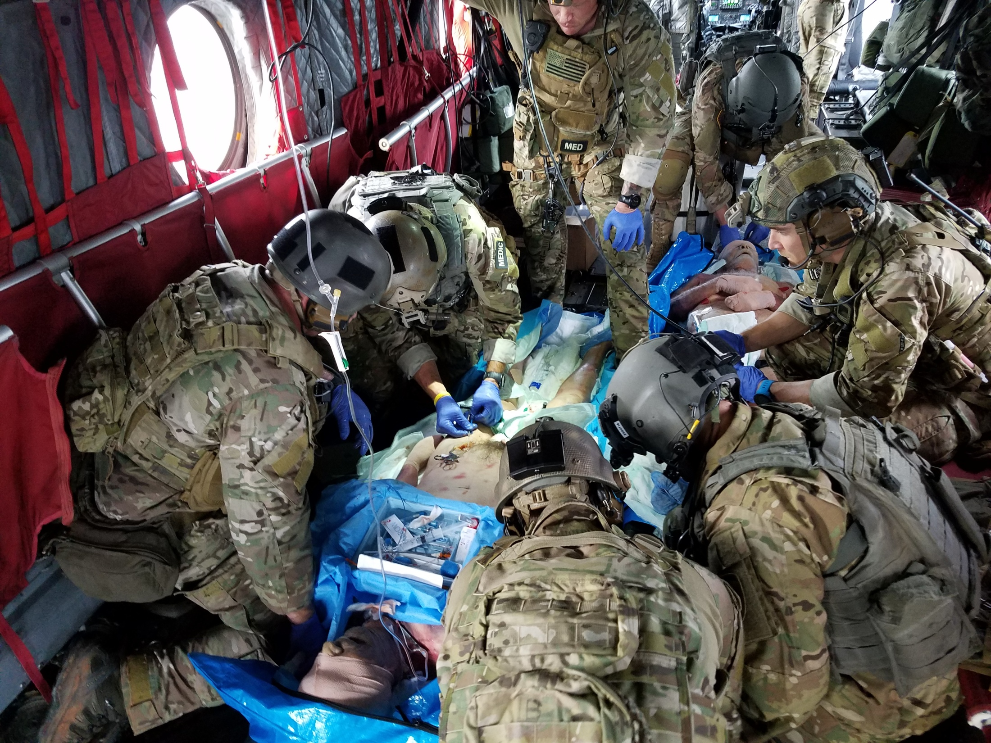
ARC in the 160th SOAR
UNCLASSIFIED
Photo: LTC Ted Redman

Slide 45
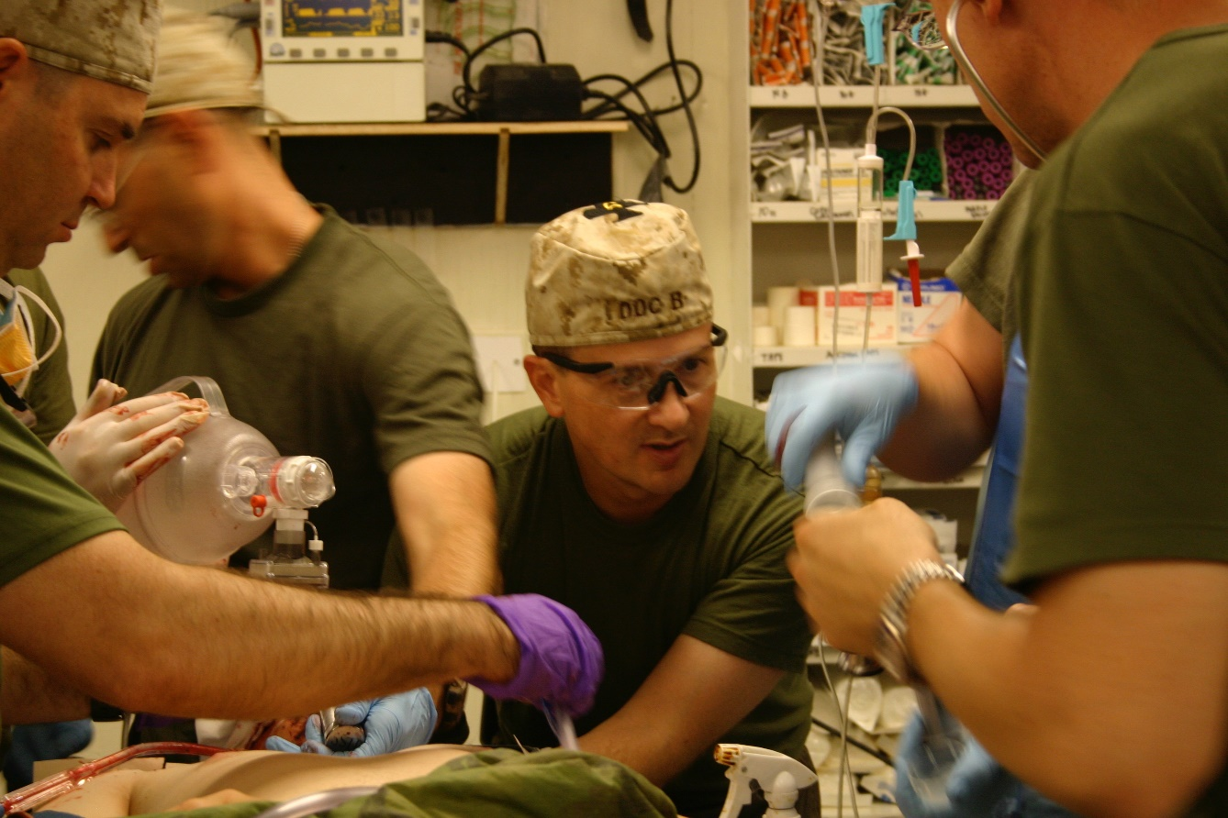
Advanced Resuscitative Care
in the USMC
UNCLASSIFIED
Photo:
CAPT Sean
Barbabella
On 25 March 2019, Senior Medical Leaders at the USMC MEF
and MARFOR level unanimously voted to adopt and implement
Advanced Resuscitative Care. An Urgent UNS submission is
being prepared to implement REBOA for USMC FRSS and STP
units and whole blood for all USMC combat units.

Slide 46
Training for ARC: The RAPToR Course
UNCLASSIFIED
Dr. Zaffir Qassim: 443.562.6205
Sept 9-10 in Houston
“Designed to train ARC”
Whole blood transfusion
REBOA at point of injury.
Training on both simulator
and cadaver models
Cutdown training
Faculty: Qassim, Holcomb,
Dubose, Fisher, etc
Open to military and civilians
Physicians of all specialties
Possible NAEMSP affiliation under discussion

Slide 47
ARC in TCCC:
The Long View
ARC
UNCLASSIFIED
This is a first step into ARC.
Anticipate continued
advances in whole blood
availability.
Also - anticipate increases in
the time that hemorrhage
can be controlled with
Zone 1 REBOA based
on further advances in
intermittent and partial
REBOA techniques.
The true physiological limit of
intermittent Zone 1 REBOA
remains to be determined.
Options for the management of noncompressible
hemorrhage in TCCC currently being evaluated

Slide 48
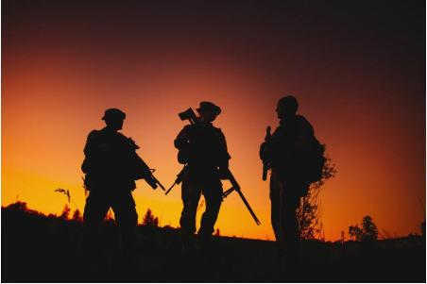
Thank You!
48
UNCLASSIFIED

