Slide 1

Analysis of the victimology of the Paris attacks: Medical care for the wounded
& avoidable mortality
Prof Mathieu RAUX, MD PhD
Salle de Surveillance Post-Interventionnelle et d’Accueil des Polytraumatisés
Département d’Anesthésie Réanimation
SAMU de Paris – SMUR Pitié
Groupe Hospitalier Pitié Salpêtrière
Assistance Publique – Hôpitaux de Paris
Sorbonne Université

Slide 2

Conflict of interest disclosure
Submitted for publication to Intensive Care Med
CONFIDENTIAL

Slide 3




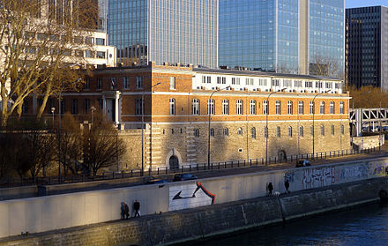

Collaboration

Slide 4
Flow chart

Slide 5
Severity
KIA and hospital triage

Slide 6
Severity
Lesions in those who reach hospital
ISS
TRISS

Slide 7
Severity
Lesions in those who reach hospital
ISS 2 [1-9]
ISS>15 49 (15%)

Slide 8
Delay
Casualties severity in those who reach hospital
Delay to hospital
Delay to first surgery

Slide 9
Therapeutics
Timing for surgery

Slide 10
Therapeutics
Hospital requirements in those who reach hospital

Slide 11
Mortality
Casualties who reach hospital
 | Whole cohort n=337 | Explosion n=51 | Gunshot wounds n=286 | p value
Expected mortality | 10 (3%) | 1 (2%) | 0 (3%) | > 0.99
Observed mortality | 7 (2%) | 0 (0%) | 7 (2%) | 0.60

Slide 12
Mortality
Whole cohort
Died on scene (KIA)
n=123
Died in hospital (DOW)
n=7
Forensic exam
n=125
Autopsies
n=30
External exam
n=81
CT-scan alone
n=3
Autopsies
n=7
External exam
n=0
CT-scan alone
n=0
+ CT-scan
n=8
+ CT-scan
n=25
+ CT-scan
n=0
+ CT-scan
n=0

Slide 13
Avoidable mortality
Whole cohort
Potentially salvageable
or salvageable
6% CI₉₅ [2;12] %
Died on scene (KIA)
Potentialy salvageable or salvageable
n=5/123
4% CI₉₅ [1;9]
Died in hospital (DOW)
Potentialy salvageable or salvageable
n=1/7
14% CI₉₅ [0;58]

Slide 14

Avoidable mortality
Whole cohort
Upper airway obstruction n=2
Tension pneumothorax n=2
Lower leg vascular lesion n=3

Slide 15
Conclusion
What have we learnt ?
Distribution 50% RE / 25% AE / 25% KIA
Delays to reach hospital were tooooooo long
15% required high intensity ressources
60% required surgery, starting with hemostatic
Mortality as expected despite MCE
6% avoidable mortality

