Slide 1
Pre-hospital case presentation(s)

Slide 2
Introducation
Who are we?
Capabilities carried by “my” teams?
What would be a typical incident they are dispatched to?
Which protocol do they follow?

Slide 3
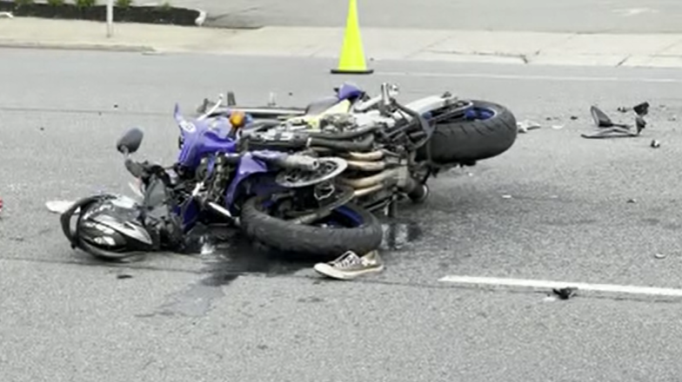
Motorcyclists crash
Accident: 11:38
911 call 11:40
MVA, MC,. Hit a brick wall after losing control of MC. Helmet
HEMS Dispatch 11:42
Expected response time 5 min= 9 min post accident

Slide 4
Motorcyclists crash
Accident: 11:38
911 call 11:40
MVA, MC,. Hit a brick wall after losing control of MC. Helmet.
HEMS Dispatch 11:42
Both ground and Air units launched
Expected response time 5 min= 9 min post accident

Slide 5
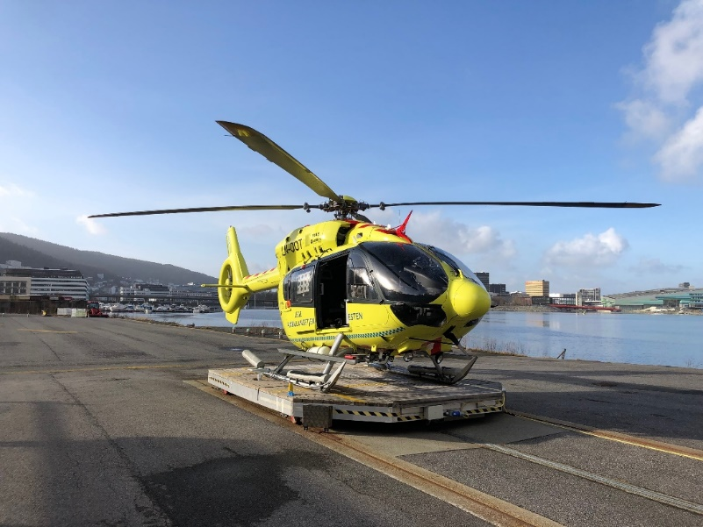
Motorcyclists crash
Accident: 11:38
911 call 11:40
MVA, MC,. Hit a brick wall after losing control of MC. Helmet.
HEMS Dispatch 11:42
Both ground and Air units launched
Expected response time 5 min
=9 min post accident

Slide 6
Motorcyclists crash
Accident: 11:38
911 call 11:40
MVA, MC,. Hit a brick wall after losing control of MC. Helmet.
HEMS Dispatch 11:42
Both ground and Air units launched
Expected response time 5 min
=9 min post accident
Thoughs?

Slide 7
Motorcyclists crash
Accident: 11:38
911 call 11:40
MVA, MC,. Hit a brick wall after losing control of MC. Helmet.
HEMS Dispatch 11:42
Difficult to find suitable landing site
Arrive to the scene 11:52 (=14 minutes post injury)

Slide 8
Motorcyclists crash
Accident: 11:38
911 call 11:40
MVA, MC,. Hit a brick wall after losing control of MC. Helmet.
HEMS Dispatch 11:42
Difficult to find suitable landing site
Arrive to the scene 11:52 (=14 minutes post injury)

Slide 9
14 minutes post injury
A young man in recovery position on stretcher
Very very (!) pale /ashgrey
Not responding. Shallow breathing
Helmet is removed

Slide 10
First assessment
Situation: Unknown mechanism of injury. Hard stop in brick wall. 50 km/t
A: Patent.
B: 8-9 Breaths\min– superficial.
C: Pale, white lips. No palpable pulses. EKG 3 avl : Sinus rythm - 120. Unsuccesful BP reading.
D: Unconcious. Equal pupils. GCS 6 (E1V2M3).
E: Fracture (dislocation)- left wrist, Femur fracture.

Slide 11
First assessment
Situation: Unknown mechanism of injury. Hard stop in brick wall. 50 km/t
A: Patent.
B: 8-9 Breaths\min– superficial.
C: Pale, white lips. No palpable pulses. EKG 3 avl : Sinus rythm - 120. Unsuccesful BP reading.
D: Unconcious. Equal pupils. GCS 6 (E1V2M3).
E: Fracture (dislocation)- left wrist, Femur fracture.

Slide 12
What about....?
More than one casualty?
Response time of 53 minutes…. ;)
C spine control?
Not sure if breath sounds are equal
POI US?

Slide 13
First assessment
Situation: Unknown mechanism of injury. Hard stop in brick wall. 50 km/t
A: Patent.
B: 8-9 Breaths\min– superficial. Equal respiratory sounds. Stab thx. No subcutaneous emfysema. Clavicula bilat ua.
C: Pale, white lips. No palpable pulses. EKG 3 avl : Sinus rythm - 120. Unsuccesful BP reading. Rigid abdomen. Pelvis ok.
D: Unconcious. Equal pupils. Flection in upper ekstremity on pain stimulus. GCS 6 (E1V2M3).
E: Fracture with large dislocation in left wrist. Femur fracture.

Slide 14
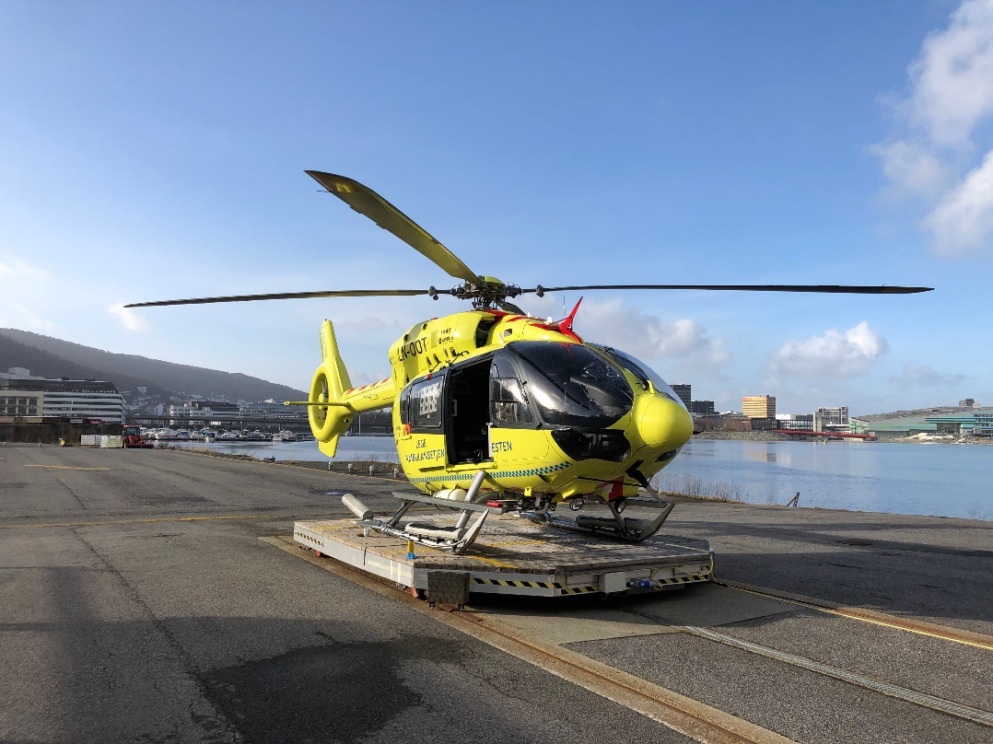
On scene:
Prioritized - rapid evac.
Oxygen.
Really difficult to get IV access.
Sternal IO - FAST responder.
Eventually large bore IV cannula in Ext .jug
Tranexamic acid 1g , Calcium 5mmol , 1 unit LTOWB.
Regains radial pulse.
Trauma bay delivery 12:16
38 minutes post injury

Slide 15
Trauma bay:
Arrival 12:16
A: Patent
B: Equal breath sounds.
C: No external bleeding. Cold. Weak radial pulse 115.
First BP 135/85 (False reading??)
FAST US – free fluid in abd.
D: GCS 6 (E1V2M3)
E: Fx left femur and left wrist

Slide 16
Labs (35min post injury.....24 hours):
pH 7,26
pCO2 7,3kpa
Laktat 1,8 – 1,4 – 1,6mmol/l
Hb 11,3 – 12,1
Plt 211 – 115 – 85
Ionised Ca : 1,04mmol (in spite of 5mmol administered in enroute)
CK 1169-2992-5354
INR 1,2-1,2-1,3
Fibrinogen 1,7 – 2,3 (Recieved fibrinogen concentrate in OR)

Slide 17
In trauma bay
4 units of low titer O
Intubated 12:38 after 3 units of LTOWB
CT

Slide 18
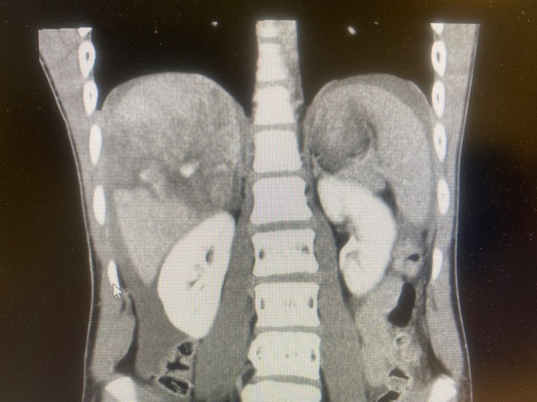
CT:
Large amount of fluid in abdomen
Shattered liver (AAST grade 5).
Right upper kidney injury.
Small contusion/bleeeding in left temporal lobe.

Slide 19
Trauma laparotomy
Blood
Packed all quadrants.
Attemps to mobilize the liver .... eventually packing and hemostasis.
Gets 4U of LTOWB and 1 g fibrinogen in surgery.
Duration 40min
ICU

Slide 20
Follow up:
Normal TEG in the following hours/days in the ICU. (Marginally reduced MA)
Stabile hemodynamics. No pressors. Easy to manage on the ventilator. Normal kidney functions.
Went back to the OR later in the evening for intramedullar nailing of the femur.
After two weeks – still in the ICU. Nor organ dysfunctions but MRI shows DAI grade 2-3. Eventually normal response.
Discharged to rehabilitation on day....
Back in school after 6 months.

Slide 21
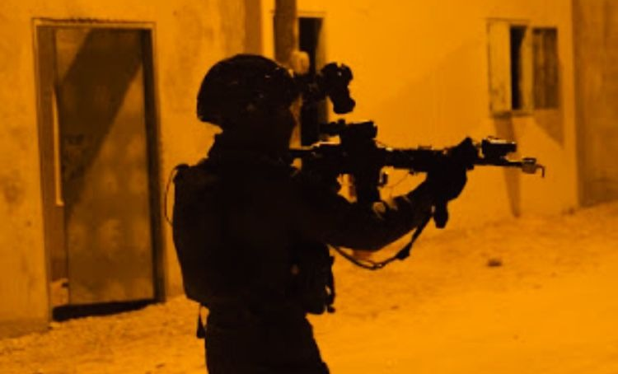
Case presentation – 4:01 AM
A soldier sustained multiple gunshot wounds from close range
Paramedic + medics (on scene)
Additional medical teams:
Military Ambulance with ALS Capabilities
Civilian ALS ambulance (MDA)
MedEvac Helicopter

Slide 22
POI CARE
Casualty no.1
Moved to cover
Gunshot wound to left upper chest and two exsanguinating wounds on the gluteal region recognized
Control of hemorrhage with Hemostatic dressing (Quikclot- Combat Gauze)
Vitals: HR 110, RR 18, Sat 98%

Slide 23
POI CARE
Casualty no.1
Moved to cover
Gunshot wound to left upper chest and two exsanguinating wounds on the gluteal region recognized
Control of hemorrhage with Hemostatic dressing (Quikclot- Combat Gauze)
Vitals: HR 110, RR 18, Sat 98%,
Rapid evacuation from Scene via armored vehicle (10 min)

Slide 24
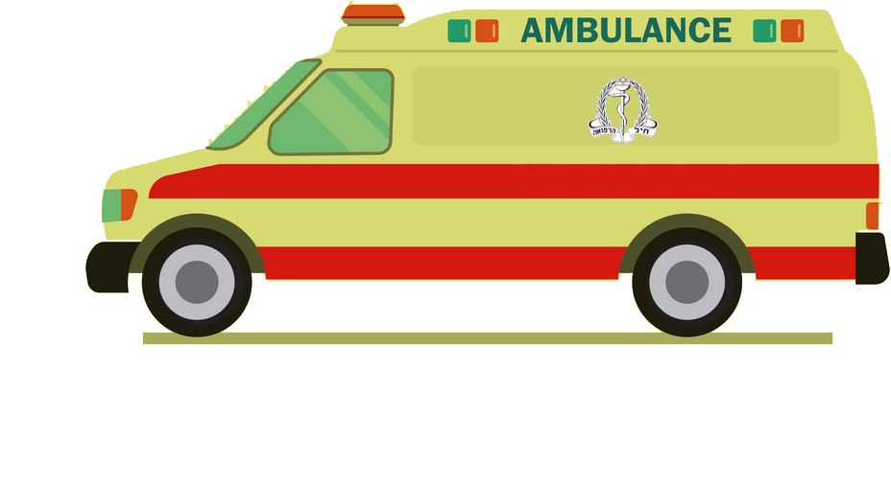
En-route care
Arrival to a Military Ambulance led by a paramedic
Re-Assessment:
HR 140, BP 70/40, Sat 74%, GCS 10
Decreased Breath sounds Lt. chest
GCS deteriorated (10)

Slide 26
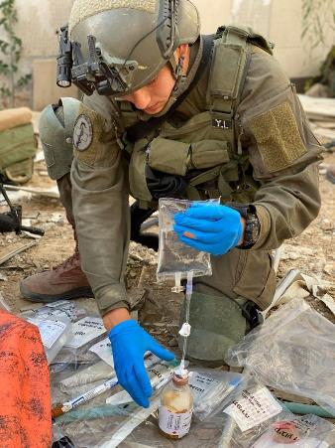
En-route care
Tx:
1 UNIT FDP + 1 gr TXA
Lt Needle Decompression (TPAK 10G)
IV 25 mg Ketamine for Analgesia
Re-Assessment: HR 110, BP 91/65, Sat (w. Supplemental O₂) 99%
Transfer to Helipad

Slide 27
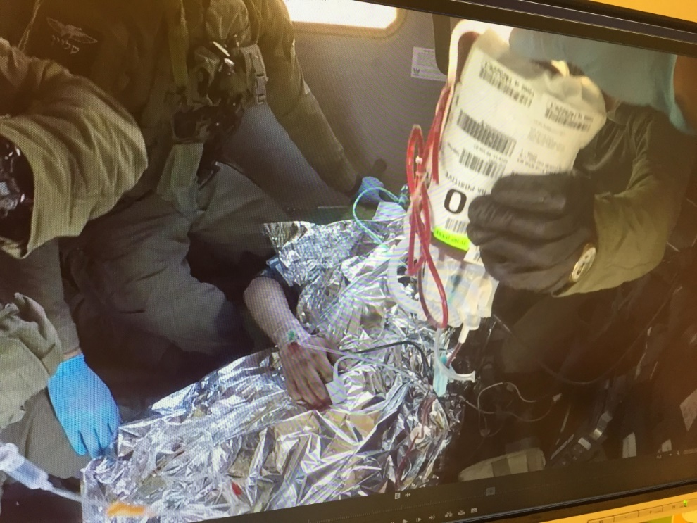
MedEvac +89min
A physician (Anesthesiologist) led airborne team (CSAR)
Re- Assessment :
HR 130, BP 75/53, RR 26

Slide 28
MedEvac +89min
A physician (Anesthesiologist) led airborne team (CSAR)
Re- Assessment :
HR 130, BP 75/53, RR 26
Onboard Tx:
1 Unit of Cold Stored Low Titer O+ whole blood
Active warming (`Ready-Heat`)
9 min flight to Level 1 Trauma Center
Vitals (prior to arrival): HR 110 bpm, BP 100/70 mmHg

Slide 29
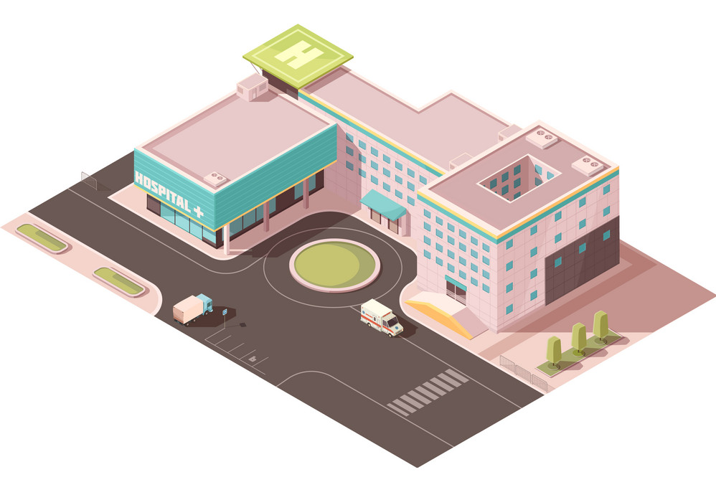
Trauma Center (+ 89 min)
SBP 85

Slide 30
Trauma Center (+ 89 min)
SBP 85
Intubation (→ SBP dropped to 40)

Slide 31
Trauma Center (+ 89 min)
SBP 85
Intubation (→ SBP dropped to 40)
Massive Transfusion Protocol + TXA (1 gr, 2nd dose)
CXR -bilateral PTX + bullet
Bilateral Chest Tubes (Rt. chest > 600ml blood)
pH 7.2
OR for Emergent Rt Thoracotomy w RLL lobectomy and Laparotomy (diagnostic)

Slide 32
Hospitalization
ICU
RE- THORACOTOMY FOR HEMMORRHAGE CONTROL (pod 1)
TBCT demonstrated multiple crush fractures (T7- T12) + spinal cord injury
Paraplegic
Discharged at POD 15 for rehabilitation

Slide 33
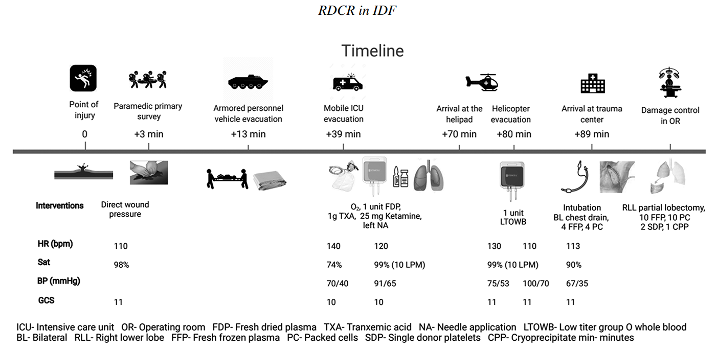
Injuries Sustained
Diagnoses
TRAUMATIC HEMOTHORAX
TRAUMATIC LACERATION OF LUNG WITH PNEUMOTHORAX
FRACTURE VERTEBRA T7-T12 W CORD INJURY
FRACTURE OF 5 RIBS
OPEN WOUND OF BUTTOCK + Blood loss >20%
OPEN WOUND OF FACE
ISS 34

Slide 34
Lessons Learned
RDCR- As forward as possible→ Further implementation of WB in ground forces
Intubation in casualties with hemorrhagic shock → the next “preventable cause of death”?
Algorithms should always be put to the test

Slide 35
Lessons Learned
RDCR- As forward as possible→ Further implementation of WB in ground forces
Intubation in casualties with hemorrhagic shock → the next “preventable cause of death”?
Algorithms should always be put to the test
A severely injured casualty that might have not survived a decade ago?

Slide 36
Pre-hospital case presentation(s)

