Slide 1
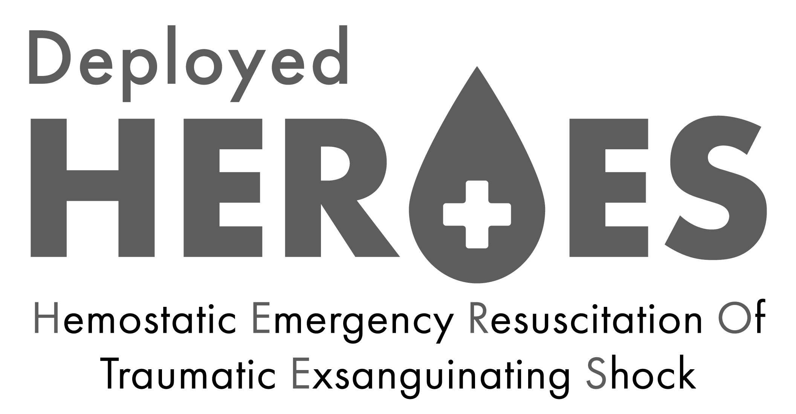
Finding the Bleeding Edge:
Blood Transfusion and Futility ….is there a point of no return?
Jennifer M. Gurney
COL, MD, US Army
Joint Trauma System

Slide 2
Disclosures
The following are the private views of the author and are not intended as official policy of the Department of the Army, Defense Health Agency, or the Department of Defense.
No financial disclosures.
No conflicts of interest.

Slide 3
This work is supported by the Assistant Secretary of Defense for Health Affairs through the Defense Medical Research and Development Program under Award No. W81XWH2020045
Amanda M. Staudt, PhD
Andrew P. Cap, MD, PhD
Philip C. Spinella, MD
Matthew J. Martin, MD
John B. Holcomb, MD
Jennifer D. Trevino, MBA
Deborah J. Del Junco, PhD
Andrew J. Rohrer, DO
Martin A. Schreiber, MD
Jason B. Corley, MS

Slide 4
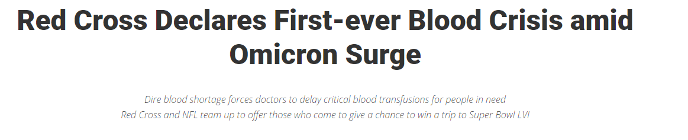
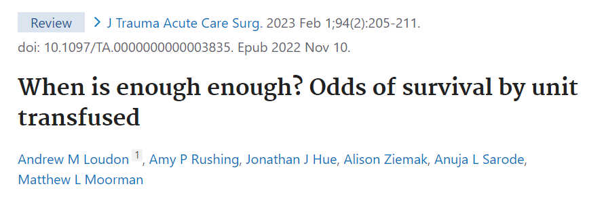
Background
Notes:
Thanks the authors for looking at this crucial element of trauma care and resourcing….certainty from a military standpoint – resource limitations is something we always must consider
We saw this at the AAST and it did not make sense for the combat casualty population that the HEROES team was studying….therefore…..

Slide 5
Background
Notes:
This is not a new questions….this is a questions that has been ongoing as we better understand the epidemiology of trauma and death from traumatic hemorrhage.
This study out of MHG is actually similar to our analysis…..they could not find a futilitly threasholod based on there data form over 25 years agoa….but the question still remains…based on the fact that globally blood is a limited resourse…if transfusion is known to be futile…then using blood on known futilie efforts is potentially not providing this precious resource for those with a chance of survival.
(point…we are not criticizing anyone for asking the questions….AND these two studies have good data and good analysis and theya re completely contradictory…indicating that addional research needs to be done in this are. )

Slide 6
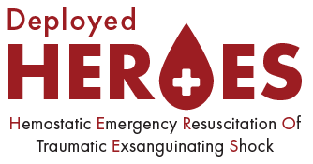
Methods
Retrospective, observational
Data:
Department of Defense Trauma Registry (DoDTR)
Armed Forces Medical Examiner System (AFMES)
Forensic Pathology → Definitive ISS for the majority
Setting: US military MTFs in combat settings
Population: All combat casualties / 2002 to 2020
Notes:
Because of these disparate viewpoints, the know risk of death from hemorrhage in the military population and the total relevance of this question for the miliatyr – the DH team decided to investigate if there was a clear futility threshold
And investigated the decedents …..IT IS SO IMPORTANTN TO LOOK AT THOSE WHO DIED…because if you really want to understand the epidemiology of trauma and hemorrhage…then, investigating those we do not see as trauma surgeons with PS injuries is part of the puzzle(when you are looking retropsecitively looking back the the clinical records…the ISS is could be very underestimated because they have to survive long enough to get the diagnosis…..these decednets were included in this analysis which gives us a better understanind for the actually sever of their injuies and their mechanism of their death. ……and these patients were included in this analysis.
You don’t know unless you looks. And similarly to the presentation yesterday by Dr. Schneider on the elederly patients who fell from standing and receivined a trauma pan scan…..you dint don’t know unless youlook…..this emphasizes the imporatnet of appropriate data driven decision making and analysis….have to look at the full data set…

Slide 7
Methods
Eligibility: ≥1 unit of blood
Intervention- total blood product transfused from POI → 24 hours after admission
Outcome- status at 24 hours from admission
Medical futility: a state in which blood transfusion provides no survival benefit to the patient
Notes:
>/= 1 unit of any blood product
Variables:
Intervention- total blood product transfused from the point of injury until 24 hours after admission from the 1st MTF with DCR capabilities
Outcome- discharge status at 24 hours from time of injury
Medical futility was defined as a state in which an intervention (i.e., blood transfusion) provides no benefit (i.e., survival) to the intended patient

Slide 8
Results
Notes:
This was not a complicated analysis….while in the DH study, we do sophistical analyses…this was not one of them. We just wanted to determine if there was a transfusion futility threshold
We really waned to just answer one simple queston the combat casualty care poupuation. n

Slide 9
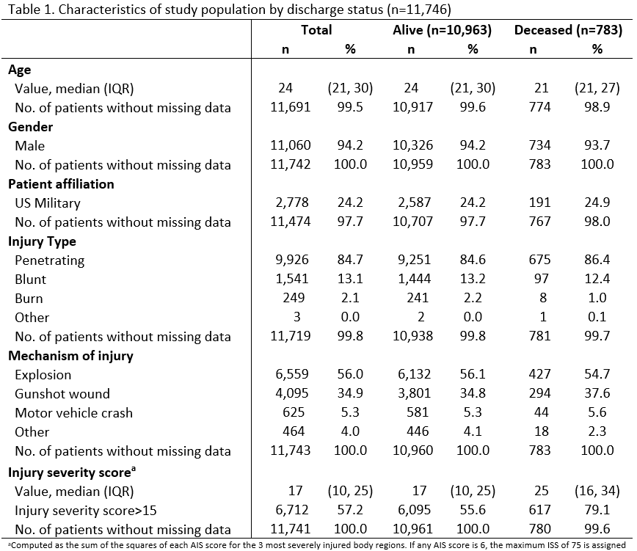
Notes:
So…Using descriptive statistics…. Our patient population was compared by who lived and who died withing the first 24 hours. As you can see….To our knowledge, this is the first Department of Defense-wide analysis of the relationship between the units of blood products transfused and mortality for patients injured during combat operations.
Of the 76,423 patients in the DoDTR, 11,746 (15.4%) received at least one unit of blood and were included in this study (Table 1).
The median (IQR) age was 24 (21, 30) years, and most patients were male (94.2%) with penetrating injury (84.7%). The primary mechanism of injury was explosion (56.0%) followed by gunshot wound (34.9%). The median ISS (IQR) was 17 (10, 25) with 57.2% of the study population having an ISS greater than 15. The study population was stratified by discharge status, and 783 (6.7%) patients died. Patients who died had higher ISS compared to patients who survived [median (IQR), 25(16, 34) versus 17(10, 25)]. Among the 296 fatalities with a definitive AFMES-assigned ISS (IQR), median DoDTR-assigned ISS was lower (29 (22, 38)) than the median AFMES-assigned ISS (33 (26, 42)).
We do not do stastiacal tests (p value) on things that are not our main object

Slide 10
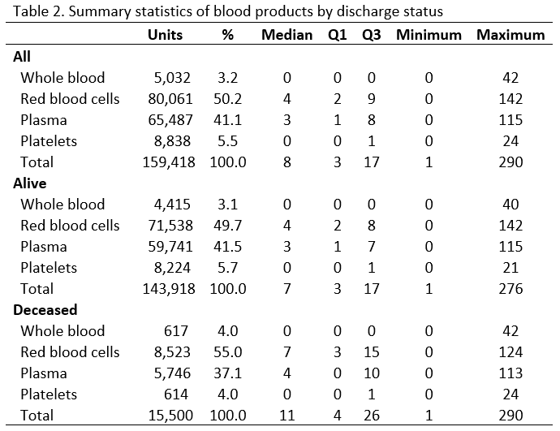
Notes:
Now, looking at our transfusion specific data.]
Of 160K units of blood transfused to CC – the majority was RBC….wgik
\AVAILABILITY
Median (IQR) units of total blood products transfused was 8 (3, 17) (Table 2). The maximum total units of blood product transfused was 290. When stratified by discharge status, deceased patients received more median blood products compared to patients who survived [median (IQR), 11(4, 26) versus 7(3, 17)].
Broken down by type of blood product, median (IQR) was 4 (2, 9) units for red blood cells, 3 (1, 8) units for plasma, 0 (0, 1) units for platelets, and 0 (0, 0) units for whole blood.
Most blood products transfused were red blood cells (50.2%), followed by plasma (41.1%), platelets (5.5%), and whole blood (3.2%).
In support of our initial hypotheses, and contrary to the findings by Loudon et al. (12), we identified no reliable threshold for the number of blood products transfused that would reliably indicate futility and that could be utilized to halt resuscitative efforts. Our results are consistent with several other studies that reported no evidence of medical futility in transfusing large quantities of blood products (6-8).
Overall, 3,307 (28.2%) patients in the dataset received >15 units of blood product. Historically, this coincides with recent military planning estimates of blood requirements per wounded in action for large scale combat operations. This demonstrates the importance of far forward blood transfusion capability for deployed military operations and that a reliable and robust transfusion capability is integral to saving the most lives from combat trauma.
Blood is a crucial to save lives from traumatic injury and maintaining an agile and plentiful blood supply, especially in far forward combat environments is expensive and substantially resource intensive. The military has added resilience in deployed trauma system with the implementation of pre-deployment donor testing to enable collections from a walking blood bank. Notably, several studies demonstrate that there is improved survival with the incorporation of warm, fresh whole blood (WFWB) into the transfusion strategy (14-17). WFWB is also resource intensive and is available in limited supply due to inconsistent donor availability. WFWB from walking blood bank counted for <4% of blood units transfused and while it affords agility and resilience in the deployed trauma system, cold stored blood products are the backbone of blood product support from the Department of Defense’s Armed Services Blood Program. Excessive reliance on the walking blood bank invites risk of critical blood shortages and increased combat mortality. Thus, from a military operational context, small damage control resuscitation teams should be equipped with enough blood required to care for at least one massive transfusion patient- even in times with low operational tempo.

Slide 11
Cumulative mortality and number of patients by units of blood transfused
Notes:
This is the distribution of the population the cumulative mortality. The more blood you receive – the higher the chance of dying. It’s the @ mortality in each group and it keeps adding up. The cumulative percent 24-hour mortality by units of blood product transfused is shown in a combination graph with number of patients by units transfused in Figure 1. Most patients (60.9%) received less than or equal to 10 units. This demonstrates the distrbutionand the % mortality in the CCC poupulatin….Also shows how queitons a bleeding patient can reachc certain percentages
This curse is not suprirsing b/c the more untis receive the more likely the risk of exsanguiating rauna.
Dmonstrates consistent percent mortality btw groupps. b/c of the groups.
This is still a descriptive grah that shows that there is ahuge bumber of blood produtss need for some ptients.
Patient mortality was plotted against units of blood transfused to determine the point beyond which there were no survivors. Units of blood transfused were stratified into groups of 5 units transfused until 116 units, where the final group includes mortality among all patients who received 116 or more units of blood. The cut-point of 116 units was chosen because this was the point where data insufficiency made calculations of confidence intervals infeasible.
Units of blood transfused were summarized by number of patients, cumulative percent mortality,
Data from military populations demonstrate that there is not a clear-cut point or futility threshold for blood transfusion. In this retrospective analysis, survival among all patients requiring a transfusion was 93.3% and approximately one out of five survivors received more than 20 units of blood products in a 24-hour period.
Of those who died, 31.3% received >20 units of blood products. Most patients who died received between 1-15 units.
The reason for the highest mortality proportions to be in the lowest transfusion recipients may be that the casualties did not have survivable injuries or that the casualties did not survive long enough to receive more blood products or to achieve hemorrhage control. Those who died early, prior to receiving large volume transfusion, demonstrates the existence of survival bias that confounds many efforts in transfusion outcomes research (13).

Slide 12
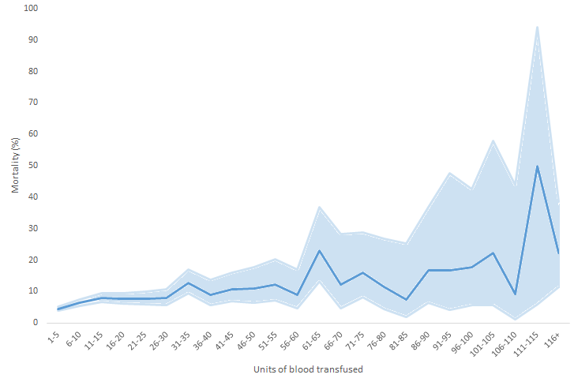
Percent mortality with 95% confidence intervals by units of blood transfused
58 pts → > 100 units
20.7% mortality
80 pts → 81-100 units
13.8% mortality
80 pts → 81-100 units
13.8% mortality
No reliable futility threshold to suggest halting resuscitation
166 pts → 61-80 units
16.3% mortality
493 pts → 41-60 units
10.8% mortality
1605 pts → 21-40 units
8.9% mortality
Notes:
Dhos @ mortality in each group….NOT cumulative.
Numer of people that deied in each group and shows the chgances per group and the bgieest cahgnes occur
Blue line shaded is 95% confidence inerval
Units of blood transfused were summarized by percent mortality (95% confidence intervals),
Percent 24-hour mortality increased as units of blood product transfused increased (Figure 2). Less than 10% of the total patients received more than 30 units of blood products; therefore, confidence intervals in Figure 2 are wider as transfusion volume increases beyond 30 units.
Of the 1,605 patients who received between 21-40 units, 8.9% died. Of the 493 patients who received between 41-60 units, 10.8% died. Of the 166 patients who received between 61-80 units of blood, 16.3% died. Of the 80 patients who received between 81-100 units, 13.8% died. Of the 58 patients who received over 100 units, 20.7% died.
In support of our initial hypotheses, and contrary to the findings by Loudon et al. (12), we identified no reliable threshold for the number of blood products transfused that would reliably indicate futility and that could be utilized to halt resuscitative efforts. Our results are consistent with several other studies that reported no evidence of medical futility in transfusing large quantities of blood products (6-8).
When analyzed by units of blood product transfused, the percent of patients who died increased steadily until about 80 units. Patients who received between 81 and 100 units had a lower mortality proportion than those who received 61-80 units (13.8% vs 16.3%). This inconsistency in percent mortality argues against a futility threshold in the combat casualty population. The group with the largest percent mortality was in the casualties who received greater than 100 units of blood (20.7%). However, close to 80% of patients who received greater than 100 units of blood survived, which supports the importance of an ultra-massive transfusion capability being present in the deployed environment. Concerns about blood wastage are reasonable given it is an expensive and precious resource, and deceased patients received about 50% more blood than those who survived; however, this represented only 10% of total blood transfusion

Slide 13
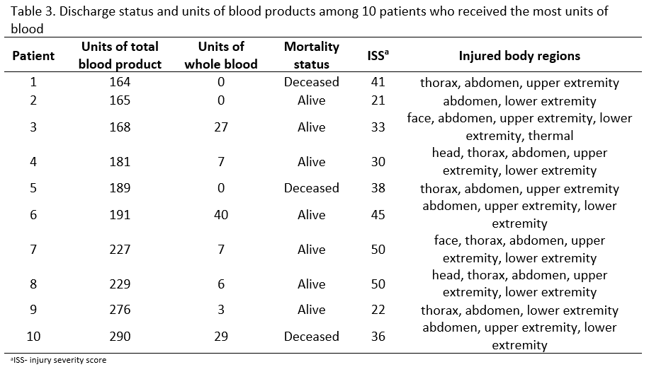
Notes:
Then we wanted to get an idea of the top 10 of WHO received the highest # of units in the DOD….who lived and who died did not have to do with the number of blood units…..this exploratory analysis is step in building a model to underatnd risk of death. (exploratory analysis with an intent of better understanding this population by building regrsionns model….but this analysis started wand ended with one question: is there a ftulity cutpoint for transfusion….Among the 10 patients who received the most units of blood products (164 units to 290 units), 7 survived (Table 3).
The maximum total units of blood product transfused to a survivor was 276 units.
A futility threshold in the number of units of total blood products transfused may exist at 277 units, but our study population did not have enough patients who received more than 276 units to determine if patients can survive after being transfused 277 or more units of blood products.
Regarding specific types of transfusions among the 10 patients who received the largest number of units, 2 of the 3 decedents did not receive whole blood, while only 1 of the 7 survivors did not receive whole blood.

Slide 14
Limitations
Very basic descriptive analysis; needs more study
Did not look at ratios or other factors that impact survival
Transfusion timing is not available; yet…
Blood transfusion measured from the point of injury until 24 hours after admission from the 1st MTF with DCR capabilities → ideal measurement would be from point of injury to the end of damage control resuscitation
Survival may be better in military population → young, few comorbidities, and good physiologic reserve
Notes:
Limitations
- survival bias from not having transfusion timing → not capturing the full amount of transfusions received if pts would have survived longer
Further examination of isk factors for mortality → we do need to do further examinintin of risk fartors for moatrality of those who received transfusion. The number of units of blood received ….physiologically you can receive an endless about of blood…so # of units transfused cannot be built into the regression model. A regression model would include: time, ISS, MOI….BUT CANNOT include # of units of blood transfused
Number of confounders

Slide 15
Conclusions
First DoD study to examine relationship between unit of blood transfused and mortality; needs further analysis
No clear threshold for futility
Survival for all combat casualties that required transfusion was 93%
Of those who died, 31% received > 20 units of blood – most patients who died received 1-15 units of blood
Notes:
Most patients who died received between 1-15 units of blood. The reason for the highest mortality proportions to be in the lowest transfusion recipients include the fact that the vast majority of transfused patients had an ISS between 1-15 or that the casualties did not survive long enough to receive more blood products or to achieve hemorrhage control. Those who died early, prior to receiving large volume transfusion, demonstrates the existence of survival bias that confounds many efforts in transfusion outcomes research

Slide 16
Conclusions
79.3% of combat casualties who received >100 units survived
Discontinuation of short-term care cannot be justified based on the need for transfusion…. of up to 176 units
These findings underscore the importance of adequate on-hand blood product supplies for massive transfusion
Planning factors and resourcing for the combat environment

Slide 17
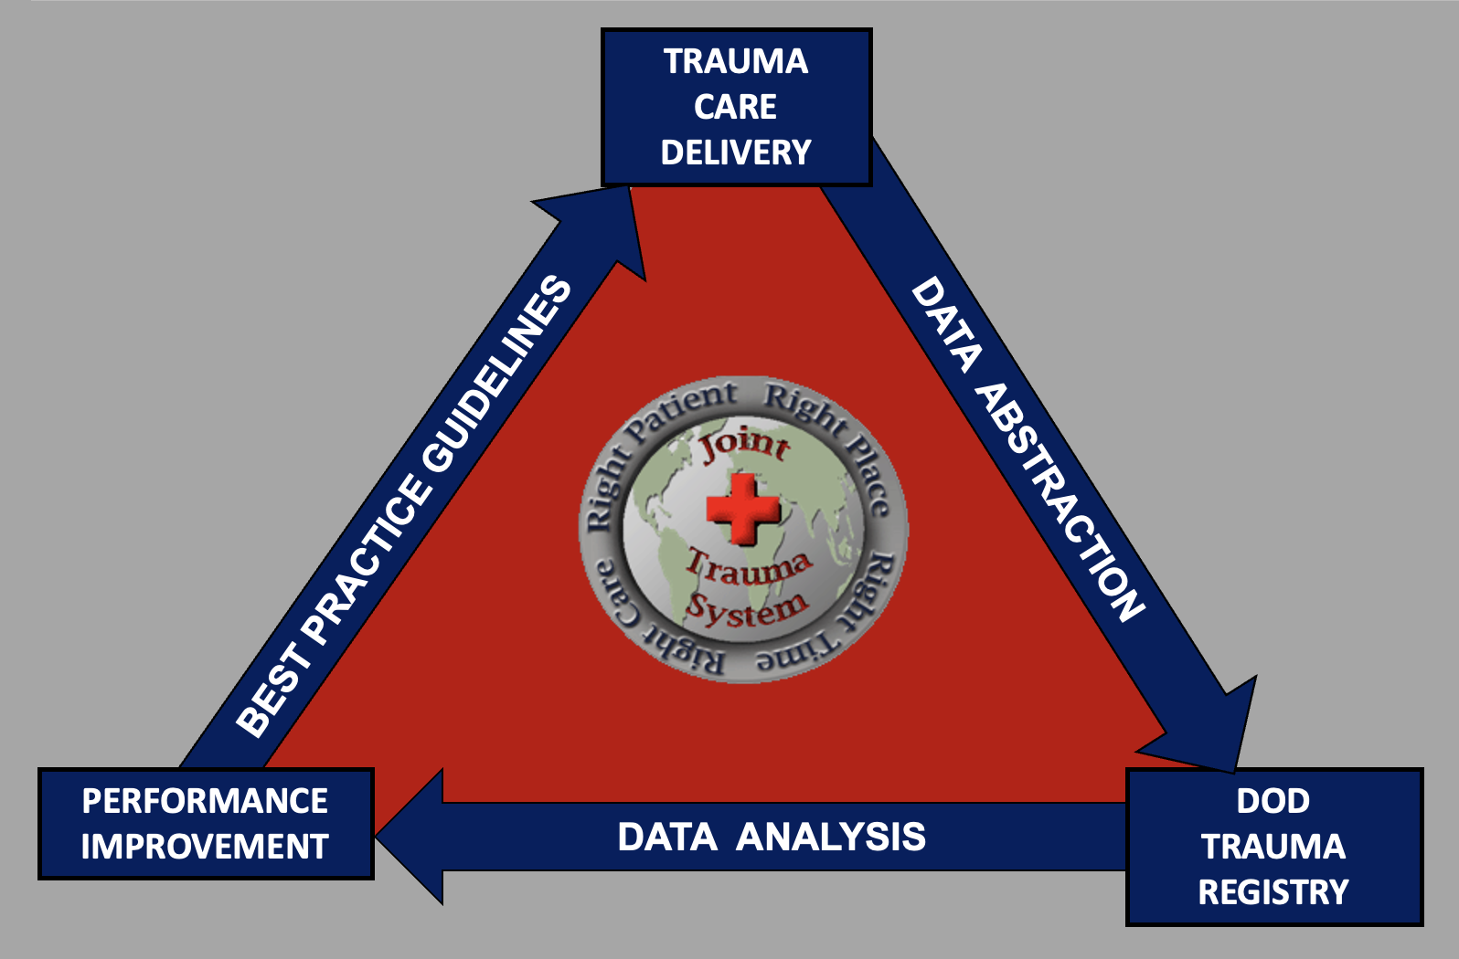
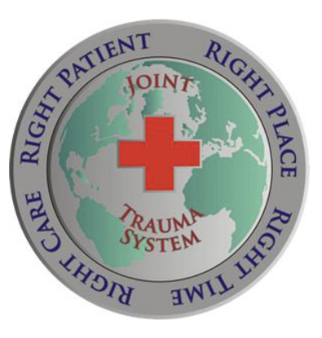
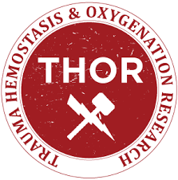
Saving
Lives
With
Data

Slide 18
Saving
Lives
With
Data
Requires good data

Slide 19
Bad use of Data

Slide 20
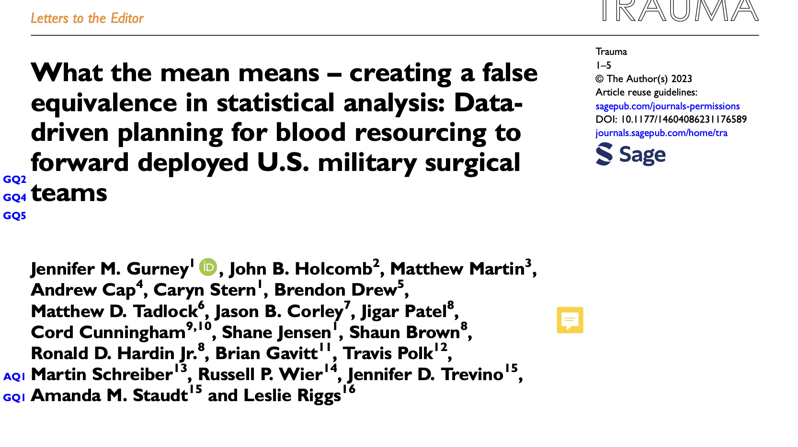

Slide 21
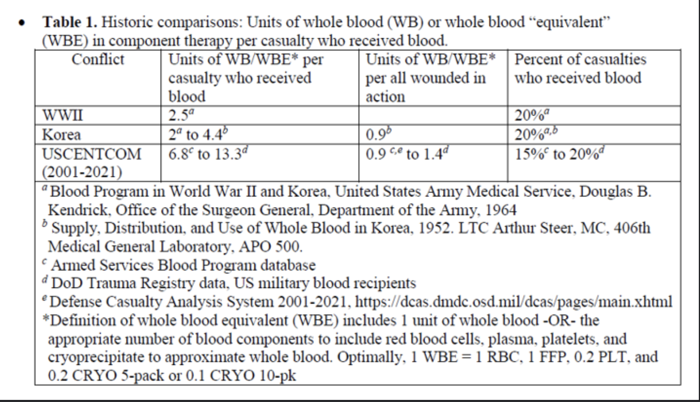
Good Data

Slide 22
Conclusions
79.3% of combat casualties who received >100 units survived
Discontinuation of short-term care cannot be justified based on the need for transfusion…. of up to 176 units
These findings underscore the importance of adequate on-hand blood product supplies for massive transfusion
Planning factors and resourcing for the combat environment

Slide 23
Conclusions
79.3% of combat casualties who received >100 units survived
Discontinuation of short-term care cannot be justified based on the need for transfusion…. of up to 176 units

Slide 24
So what?
Can this be operationalized?
Notes:
Limitations
- survival bias from not having transfusion timing → not capturing the full amount of transfusions received if pts would have survived longer
Further examination of isk factors for mortality → we do need to do further examinintin of risk fartors for moatrality of those who received transfusion. The number of units of blood received ….physiologically you can receive an endless about of blood…so # of units transfused cannot be built into the regression model. A regression model would include: time, ISS, MOI….BUT CANNOT include # of units of blood transfused
Number of confounders

Slide 25
Understanding death
Notes:
Understanding death – strategy for saving lives

Slide 26
What USSCOM mortality data do we have?

Slide 27
100 Cases for Review

Slide 28
Preventable Death
Non-preventable death: A death that occurred from a survivable or potentially survivable injury when the tactical situation prevented prompt or optimal medical care.
Potentially preventable death: A death that occurred from a survivable or potentially survivable injury when the tactical situation limited prompt or optimal medical care.
Preventable death: A death that occurred from a survivable injury when the tactical situation did not limit prompt or optimal medical care.

Slide 29
Survivability
Non-survivable injury: An injury so severe the casualty would not have survived even if all required medical resources were available and appropriate medical care was optimally administered.
Potentially survivable injury: An injury that the casualty might have survived if all required medical resources were available & appropriate medical care was optimally administered.
Survivable injury: An injury that the casualty should have survived if all required medical resources were available and appropriate medical care was optimally administered.
Notes:
DHA-PI 6040.3 Joint Trauma Lexicon

Slide 30
Injuries are survivable.
Death is preventable.

Slide 31
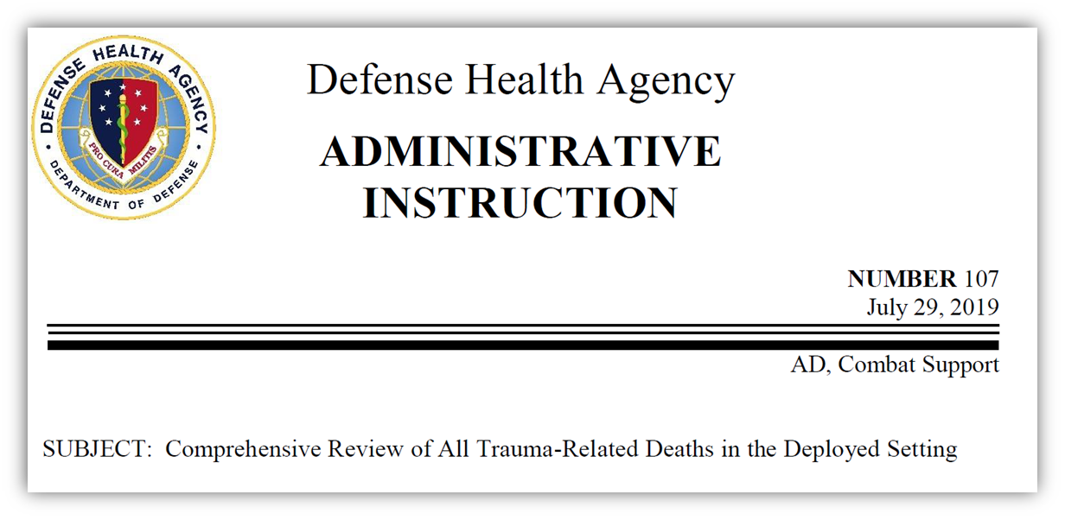
MTMR – Military Trauma Mortality Review
Panel reviews pertinent data from:
Medical records
Autopsy reports
Autopsy photos
Panel historically consists of:
Trauma surgeons
Forensic pathologists
Prehospital and emergency medicine specialists
Epidemiologist

Slide 32
Potential Prehospital Interventions (n=74 fatalities)
169 Interventions

Slide 33
Approximately how much whole blood would have been needed for each casualty?
>10 units (74%)
5-10 units (20%)
1-4 units (1%)
Not recommended (5%)

Slide 34
Notes:
Strategy without tactics is
Tactics without strategy is the noise before defeat
To achieve our objectives need a strategy, an overall approach – a conceptual scaffolding informed by data , tailored to our goals and gives options. Specific tactics flow from strategy and strategy derives from objective.
Objective → save lives vs. increase operational end strength
Shortcut right to the tactics…..
Understand futility
Phase shift → physiology to logistics → the strategy

Slide 35
What’s the Objective?
Notes:
Strategy without tactics is
Tactics without strategy is the noise before defeat
To achieve our objectives need a strategy, an overall approach – a conceptual scaffolding informed by data , tailored to our goals and gives options. Specific tactics flow from strategy and strategy derives from objective.
Objective → save lives vs. increase operational end strength
Shortcut right to the tactics…..
Understand futility
Phase shift → physiology to logistics → the strategy

Slide 36
What’s the Objective?
Save Lives
Preserve Operational (Combat) end strength
Notes:
Strategy without tactics is
Tactics without strategy is the noise before defeat
To achieve our objectives need a strategy, an overall approach – a conceptual scaffolding informed by data , tailored to our goals and gives options. Specific tactics flow from strategy and strategy derives from objective.
Objective → save lives vs. increase operational end strength
Shortcut right to the tactics…..
Understand futility
Phase shift → physiology to logistics → the strategy

Slide 37
What’s the Objective?
CENTCOM
COIN
LSCO
Notes:
Strategy without tactics is
Tactics without strategy is the noise before defeat
To achieve our objectives need a strategy, an overall approach – a conceptual scaffolding informed by data , tailored to our goals and gives options. Specific tactics flow from strategy and strategy derives from objective.
Objective → save lives vs. increase operational end strength
Shortcut right to the tactics…..
Understand futility
Phase shift → physiology to logistics → the strategy

Slide 38
What’s the Objective?
Notes:
Strategy without tactics is
Tactics without strategy is the noise before defeat
To achieve our objectives need a strategy, an overall approach – a conceptual scaffolding informed by data , tailored to our goals and gives options. Specific tactics flow from strategy and strategy derives from objective.
Objective → save lives vs. increase operational end strength
Shortcut right to the tactics…..
Understand futility
Phase shift → physiology to logistics → the strategy

Slide 39
What’s the Objective?
No Futility Cut point
Physiology Prevails
CENTCOM
COIN
Prolonged Casualty Care
Logistics Prevail
LSCO
Notes:
Strategy without tactics is
Tactics without strategy is the noise before defeat
To achieve our objectives need a strategy, an overall approach – a conceptual scaffolding informed by data , tailored to our goals and gives options. Specific tactics flow from strategy and strategy derives from objective.
Objective → save lives vs. increase operational end strength
Shortcut right to the tactics…..
Understand futility
Phase shift → physiology to logistics → the strategy

Slide 40
Phase Shift
Phase shift is a common term in the study of waveforms and communication of signals. It refers to the displacement of two signals when propagated in a time domain. This displacement can be caused by a signal processing device or a low- or high-pass filter that performs certain operations on the signal, causing the output signal phase to shift from its original input signal phase.
COIN
No Futility Cut point
Physiology Prevails
LSCO
Futility
Cut point
Logistics Prevail
Notes:
Strategy without tactics is
Tactics without strategy is the noise before defeat
To achieve our objectives need a strategy, an overall approach – a conceptual scaffolding informed by data , tailored to our goals and gives options. Specific tactics flow from strategy and strategy derives from objective.
Objective → save lives vs. increase operational end strength
Shortcut right to the tactics…..
Understand futility
Phase shift → physiology to logistics → the strategy

Slide 41
Phase Shift
Phase shift is a common term in the study of waveforms and communication of signals. It refers to the displacement of two signals when propagated in a time domain. This displacement can be caused by a signal processing device or a low- or high-pass filter that performs certain operations on the signal, causing the output signal phase to shift from its original input signal phase.
COIN
No Futility Cut point
Physiology Prevails
LSCO
Logistics Prevail
Futility Cut point
Notes:
Strategy without tactics is
Tactics without strategy is the noise before defeat
To achieve our objectives need a strategy, an overall approach – a conceptual scaffolding informed by data , tailored to our goals and gives options. Specific tactics flow from strategy and strategy derives from objective.
Objective → save lives vs. increase operational end strength
Shortcut right to the tactics…..
Understand futility
Phase shift → physiology to logistics → the strategy

Slide 42
Medical Tactics
Tactics are derived from strategy
strategy is derived from the objective
What are the medical objectives for Large Scale Combat Operations?
What are the medical objectives for PCC?
→ Physiology vs. Logistical Constraints
Life saving interventions delivered too late are no longer life saving
Strategy without tactics is the slowest route to victory.
Tactics without strategy is the noise before defeat
Sun Tzu
Notes:
Strategy without tactics is
Tactics without strategy is the noise before defeat
To achieve our objectives need a strategy, an overall approach – a conceptual scaffolding informed by data , tailored to our goals and gives options. Specific tactics flow from strategy and strategy derives from objective.
Objective → save lives vs. increase operational end strength
Shortcut right to the tactics…..
Understand futility
Phase shift → physiology to logistics → the strategy

Slide 43
Future Directions
Better understanding of injury patterns
Risk factors for massive transfusion
Understand futility in the operational context
Triage / Physiological predicators of mortality
Timing of interventions / understanding futility
Lifesaving interventions delivered too late are no longer lifesaving
Time is a triage tool

Slide 44
Saving
Lives
With
Data

Slide 45
Thank you!

Slide 46
Finding the Bleeding Edge:
Blood Transfusion and Futility ….is there a point of no return?
Jennifer M. Gurney
COL, MD, US Army
Joint Trauma System

Slide 47
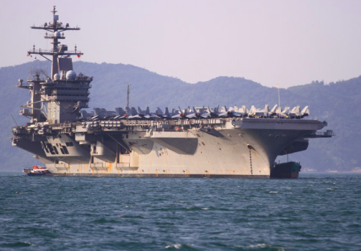
Future Considerations

Slide 48
Finding the Bleeding Edge: 24-hour Mortality by Unit of Blood Product Transfused in Combat Casualties from 2002-2020
Hypothesis/Methods
Results (N=11,746)
Conclusion
Wide range of BP per patient (1-290)
Combat casualties (CC)
Need for blood products (BP)
Mortality for > 100 units group
Is there a reliable “futility” point by # of units transfused?
21%
Among injured combat casualties there is no reliable “futility threshold” based on the number of blood products transfused
DOD Trauma Registry (2002-2020)
No reliable cutpoint with mortality > 50%
All CC with >/= 1 unit BP transfused within first 24 hrs
Main outcome = 24hr mortality

Slide 49
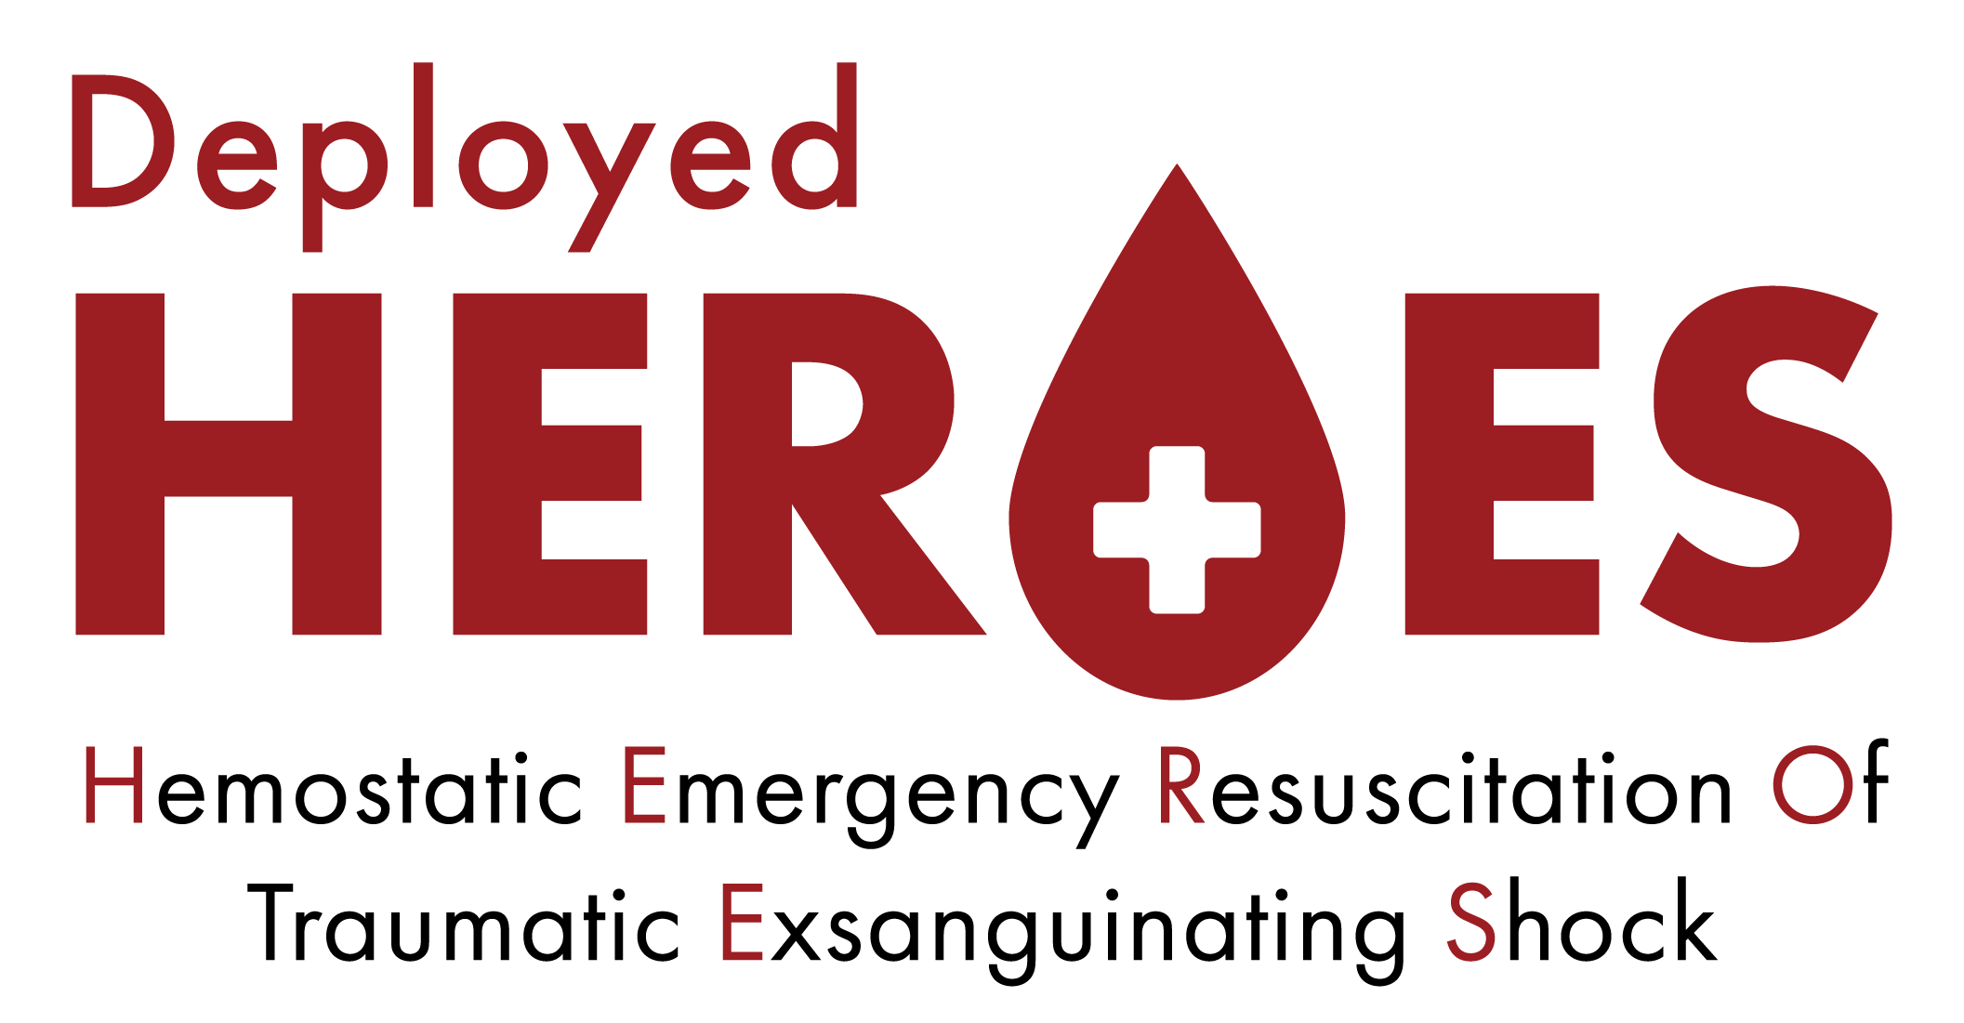
Finding the Bleeding Edge: 24-hour Mortality by Unit of Blood Product Transfused in Combat Casualties from 2002-2020
Hypothesis/Methods
Results (N=11,746)
Conclusion
Wide range of BP per patient (1-290)
Combat casualties (CC)
Need for blood products (BP)
Mortality for > 100 units group
Is there a reliable “futility” point by # of units transfused?
21%
Among injured combat casualties there is no reliable “futility threshold” based on the number of blood products transfused
DOD Trauma Registry (2002-2020)
No reliable cutpoint with mortality > 50%
All CC with >/= 1 unit BP transfused within first 24 hrs
Main outcome = 24hr mortality
Gurney, et al.
Western Trauma Association
March 2023
Author twitter handles:
@docmartin22, @JointTraumaSyst, @usa_isr, @MartinSchreib10

