Slide 1

Advanced Biosensing,
Smart Tourniquets,
And Decision Support
Conor L. Evans
Wellman Center for Photomedicine
Massachusetts General Hospital
Harvard Medical School

Slide 2
Acknowledgments
Alice Chao
Dan Greenfield
Rachel Kelleher
Xiaolei Li
Saara Luna
Tucker Raymond
Julia Slade
Michele Wei
Anna Wiatrowski
Dr. Juan Cascales
Dr. Fotis Iloupilous
Dr. Matthias Muller
Dr. Isaac Pence
Dr. Badri Prashad
Dr. Fei Peng
Dr. Manolis Rousakis
Dr. Dandan Tu
Alumni
Avery Goss
Helen Keshishian
Dr. Zongxi Li
Dr. Haley Marks
Dr. John Nguyen
Current Team
Dr. Sam Lin
Dr. Rodney Chan
Dr. Christine Huang
Notes:
2

Slide 3




Acknowledgments
Notes:
3

Slide 4
Quantitative Tissue Physiology Measurements are Critical in the Care of Wounded Warriors and Civilians
Wounded warriors experience injuries that result in major changes to perfusion, leading to ischemia
Knowledge of tissue condition important in triage and field medicine
Especially important for prolonged critical care scenarios
There are current no technologies available far forward or at the point-of-injury that measure blood gases or tissue oxygen concentrations
Technologies need to be simple: simple to use, simple to understand and must augment and aid for decision support

Slide 5
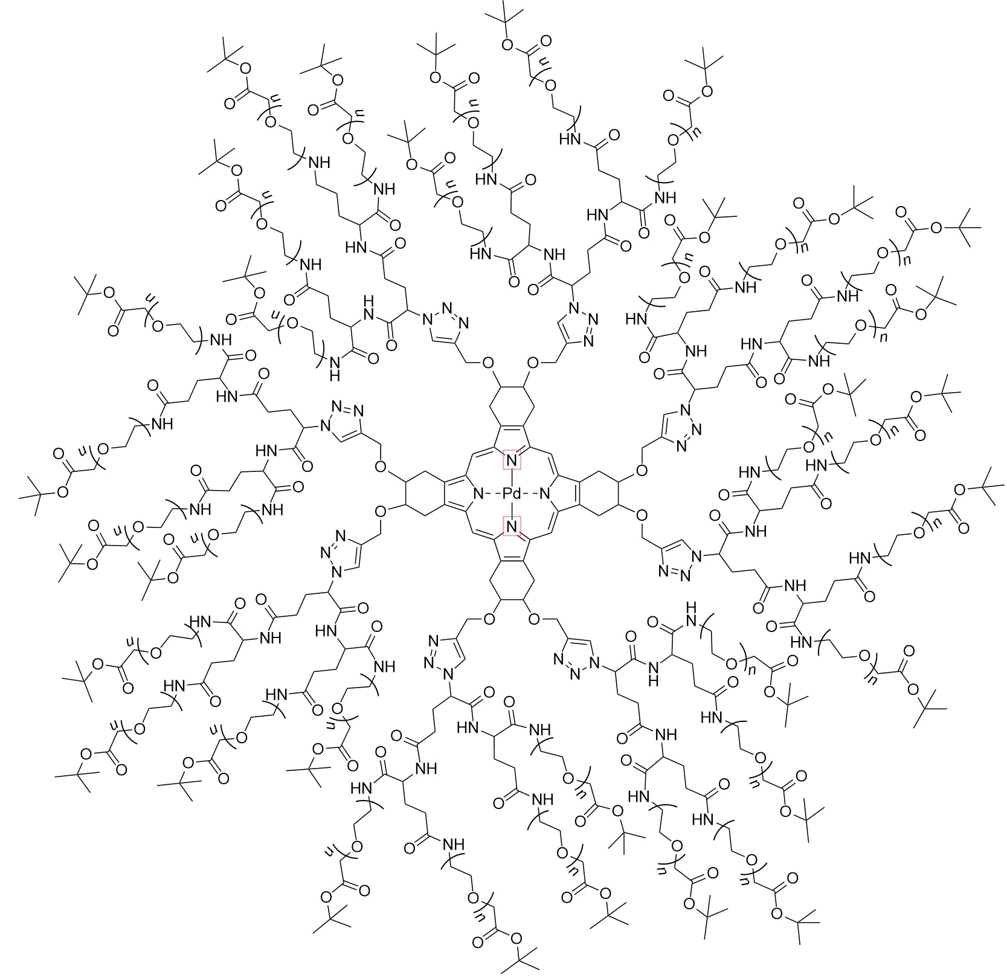
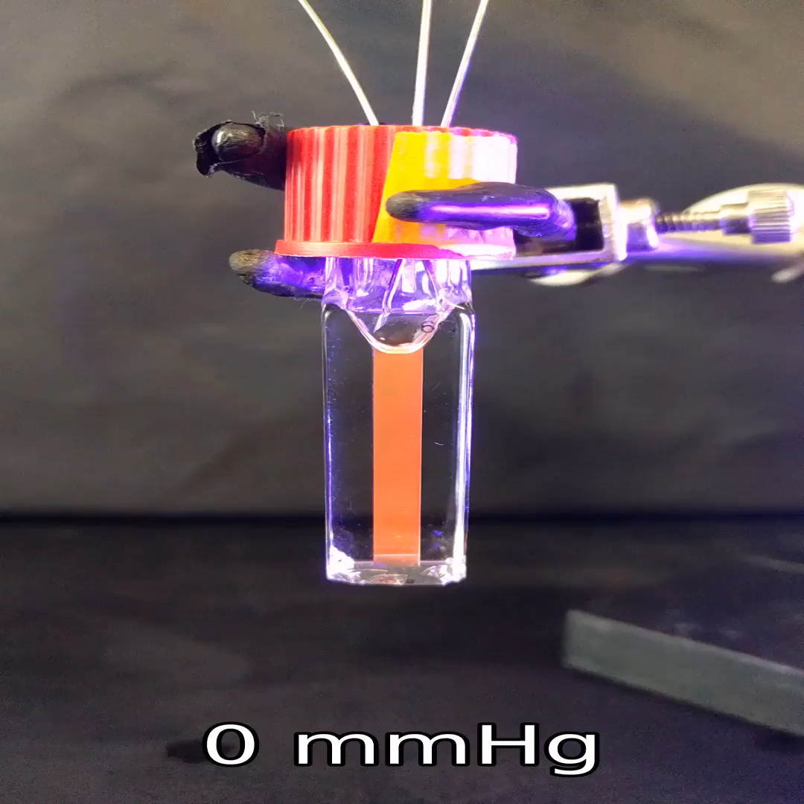
Ultrabright Molecular Sensor For
Simple, Rapid, and Accurate Oxygen Sensing
Extremely bright oxygen sensing phosphor lets you “see” oxygen directly
Synthesis compatible with cGMP, scalable, and have a commercial synthetic partner
Flexible chemistry – can be made into wide range of materials
Tunable chemistry for application to detecting oxygen across physiological conditions
Taken with an iPhone
Molecule and synthesis patented

Slide 6
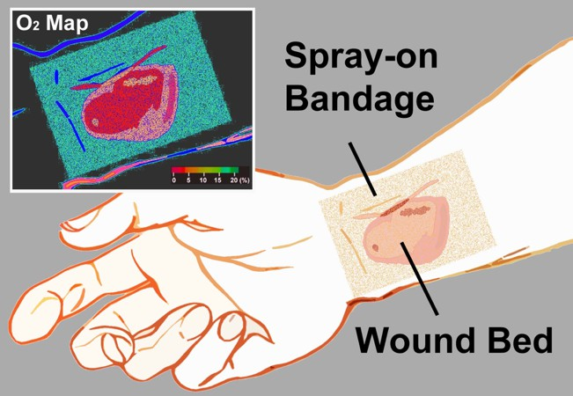
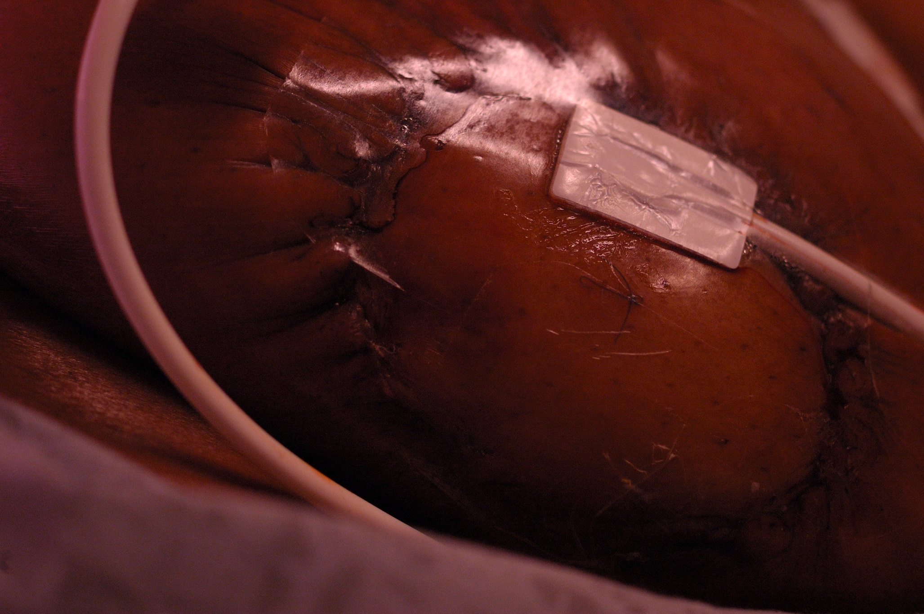
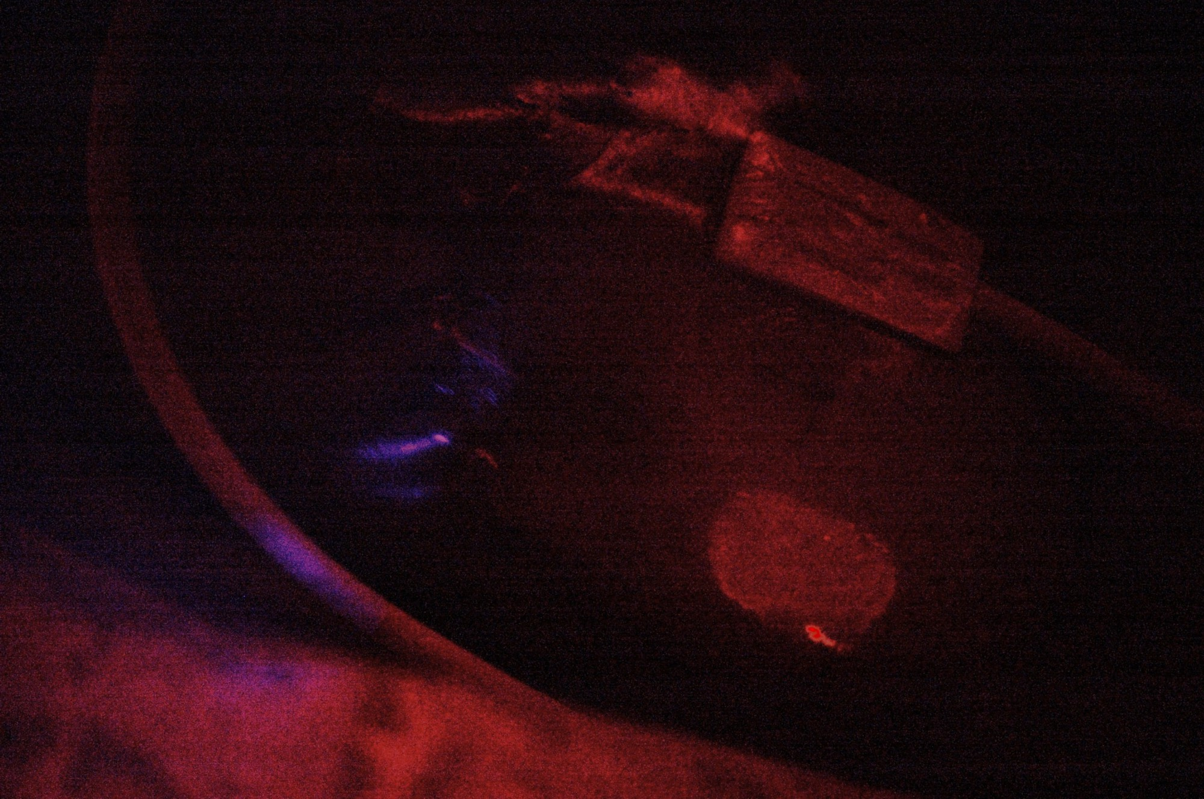
Color-Changing Wound Dressings to See and Quantify Tissue Oxygen
Standard photography
Bandage is transparent
Blue illumination
Bandage glows
In a first-in-human study, this technology was found to provide equivalent results compared to near-infrared oximetry
(p < .0001, Science Advances)

Slide 7
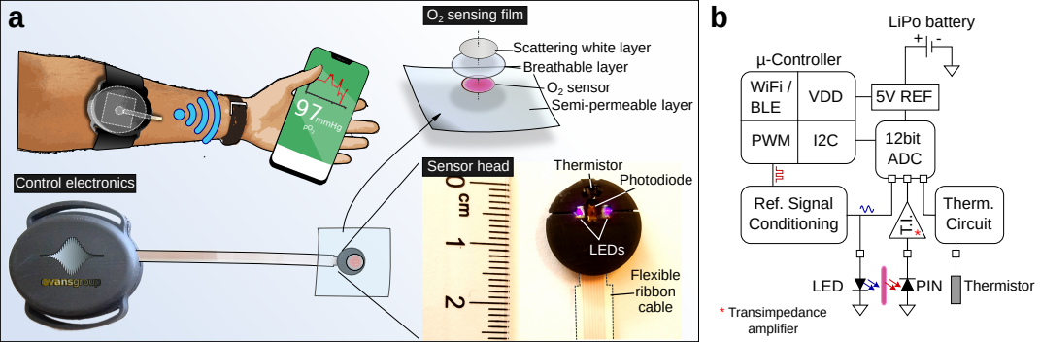
Truly Wearable Sensor for Monitoring
Tissue Oxygen at the Point of Injury
Small 1.5 cm sensor sticks onto skin to measure limb oxygen transdermally.
All-in-one device can display or transmit oxygen readings to smartphones, computers, etc
Can be further miniaturized to the size of a dime
Now completed 4 human studies;
Ready for future testing in solider populations

Slide 8

Extraordinary Sensitivity in First-in-Human Clinical Study
Subjects undergo a blood pressure cuff occlusion and isometric hand grip exercise (IHE)
Sensor detects change in tissue pO2 in the leg due to strenuous exercise of the hand

Slide 9
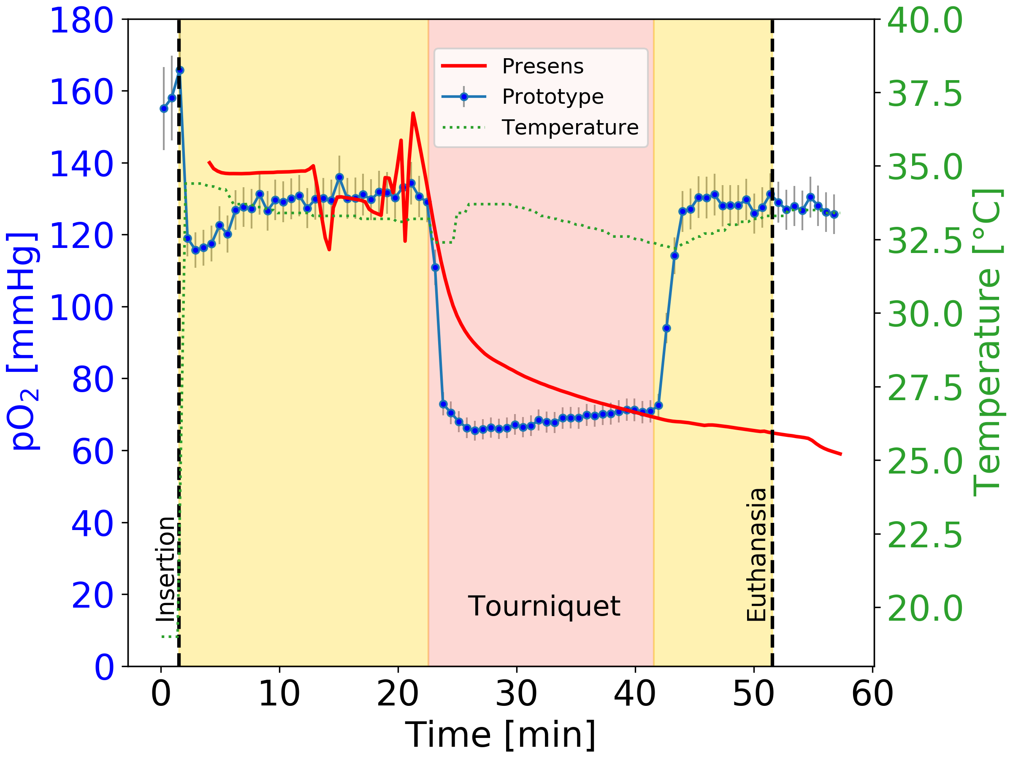
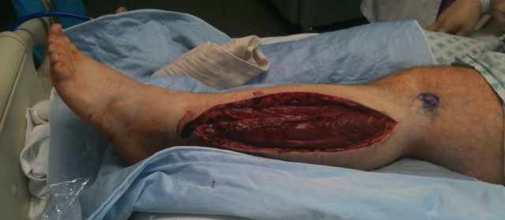
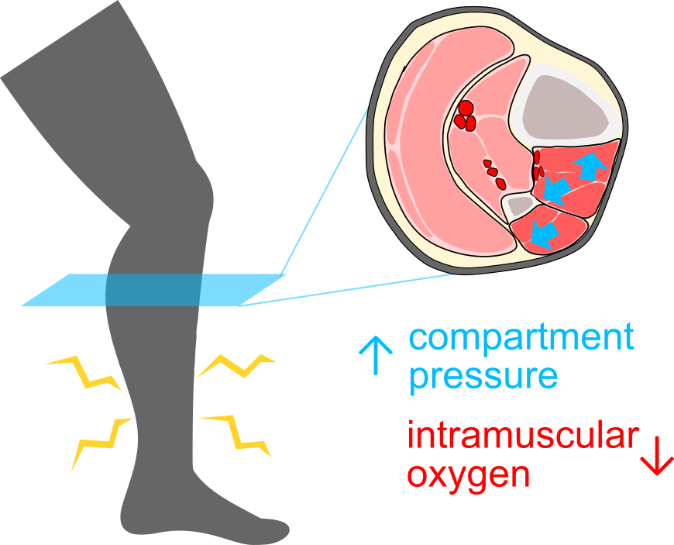
Portable, Fieldable Compartment Syndrome Detection
Gold-standard based on pressure sensors
  can be unreliable and
  do not work during air transport
Inability to diagnose leads to prophylactic fasciotomies
Damage caused by compartment syndrome due to ischemia

Slide 10
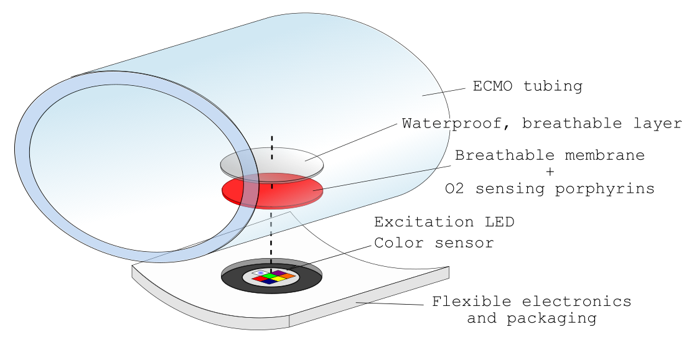
Simple, Lightweight, Miniature Sensor for
ECMO/ECLS Quantify Blood pO₂
Lightweight, flexible blood oxygen sensors built directly into the ECMO/ECLS circuit provide direct measurement of oxygenation and tissue oxygenation changes (inlet/outlet).
Now validated in ex vivo organ perfusion studies

Slide 11
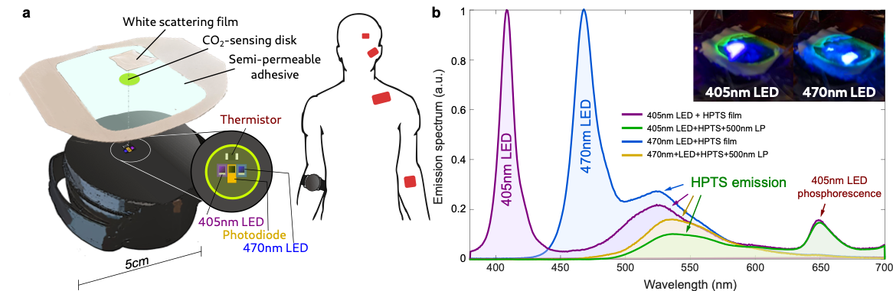
New Wearable Sensors for pCO₂
Now building dual pCO₂/pO₂ sensors for continuous, wearable blood gas measurements for field measurements and triage
Many applications in civilian medicine – plastic surgery (flaps) and vascular surgery

Slide 12
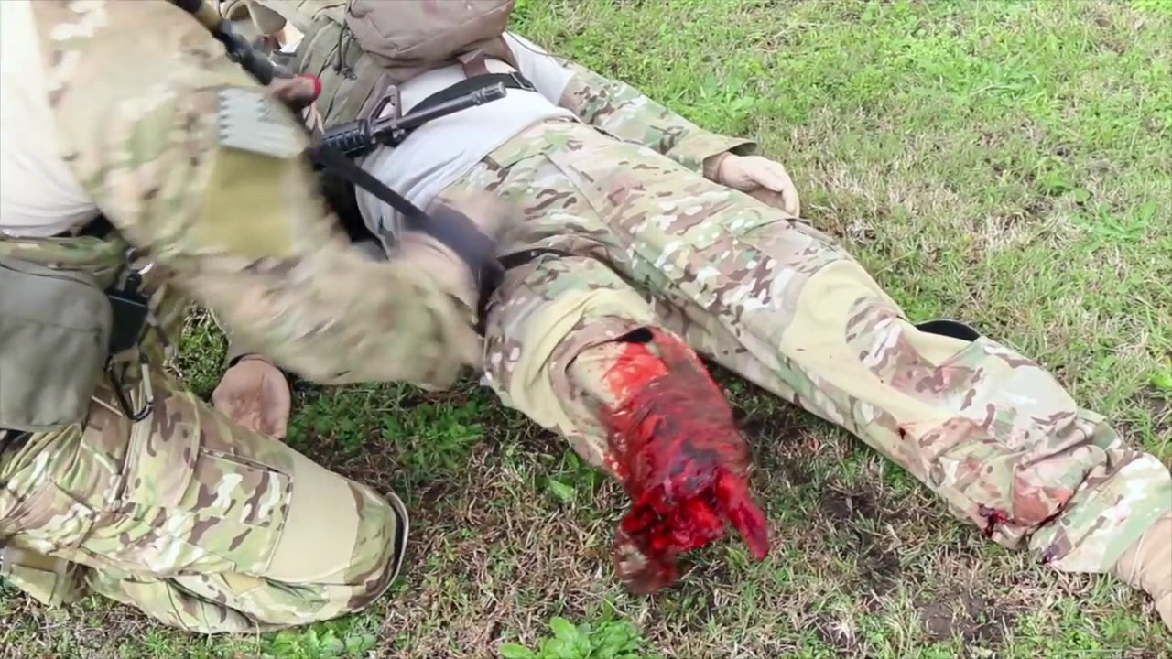
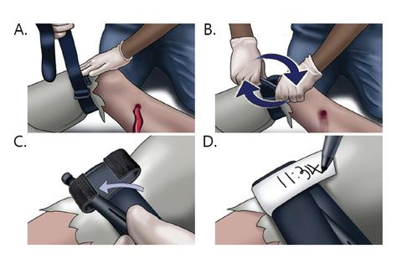
Real-time sensing toolkit for optimal tourniquet application
Emergency Tourniquets stop severe arterial bleeding before definitive care can be administered
Current Assessment:
  Visual confirmation
  Pulse Check
Common Mistakes:
  Under-tightening → Continued bleeding
  Over-tightening → Poor circulation, ischemia, tissue necrosis
  Prolonged wear → Compartment syndrome, loss of limb
Need: “Smart” Emergency Tourniquet

Slide 13
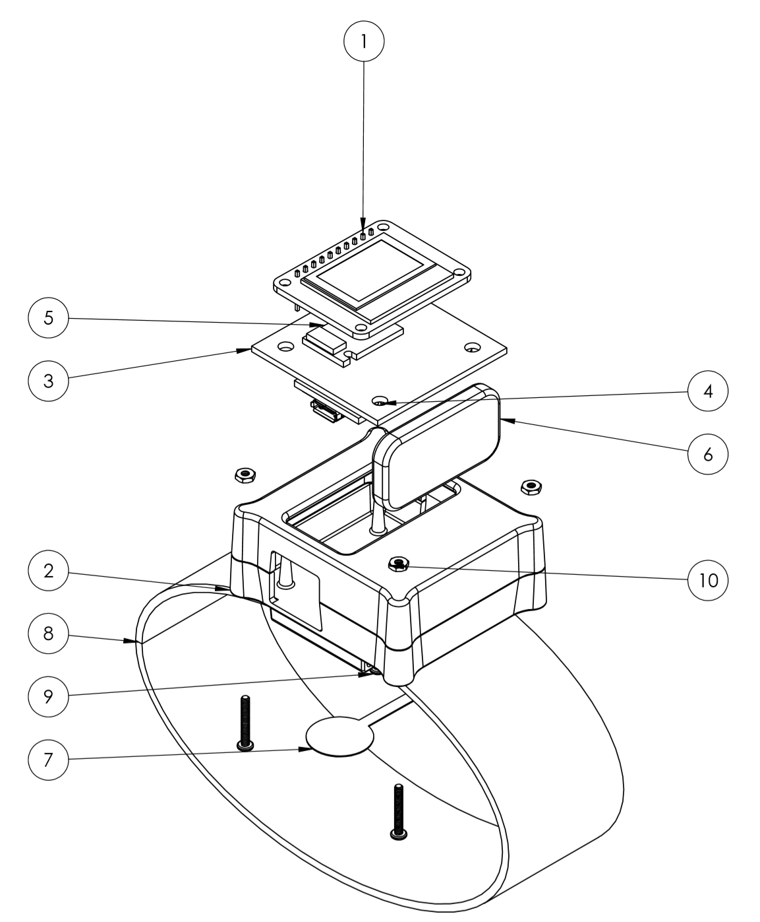
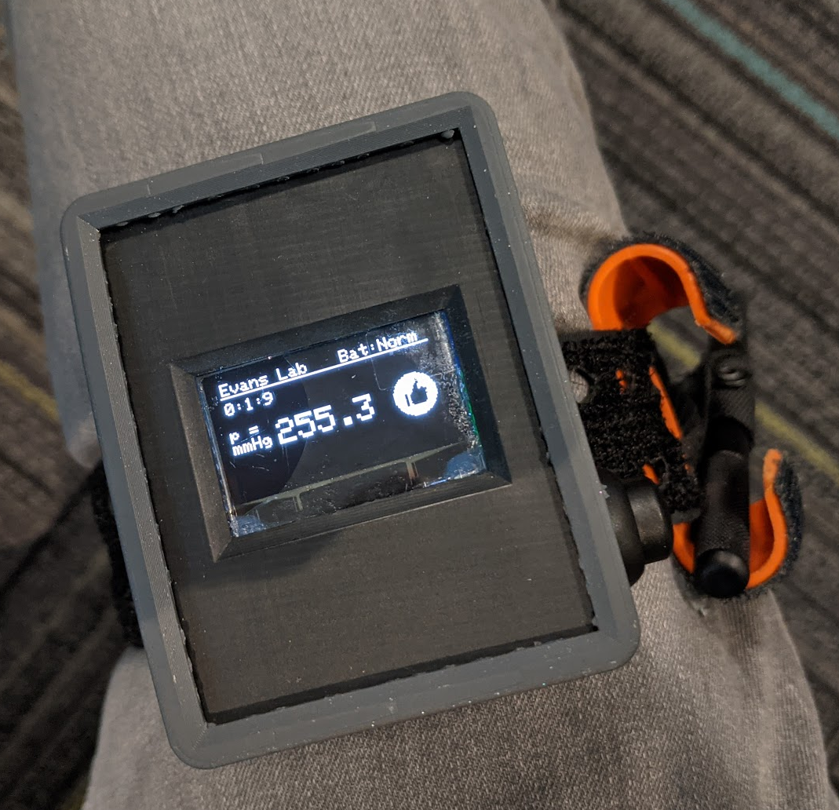
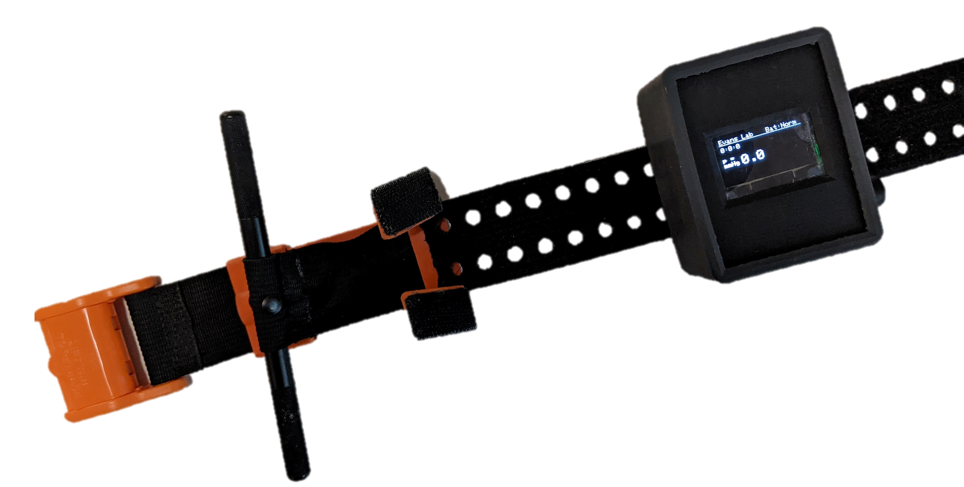
Tourniquet Clip for Measuring
Application Pressure and Limb Oxygenation
Pressure-Sensing Prototype for rapid Tourniquet application feedback
Successfully completed both 2021 and 2022 Army Expeditionary Warrior Experiment

Slide 14
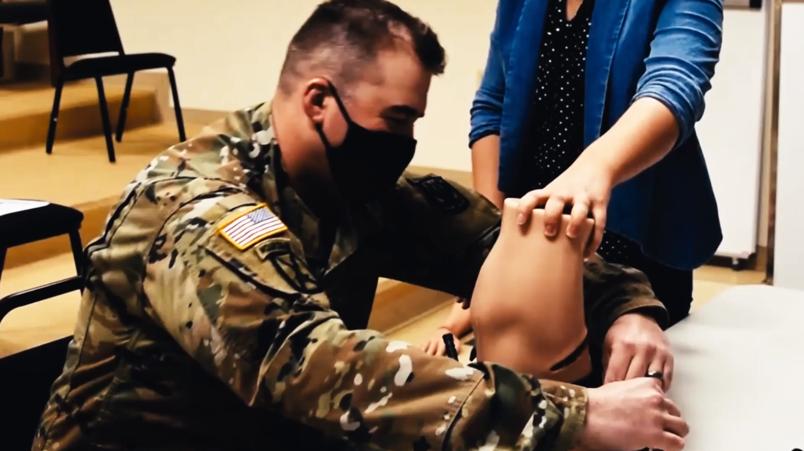
Results: Army Expeditionary
Warrior Experiment 2021 & 2022
More than 80 Subjects
Blinded | Unblinded Data
  Applied Pressure (mmHg)
  Application Speed (sec)
2021 Data

Slide 15
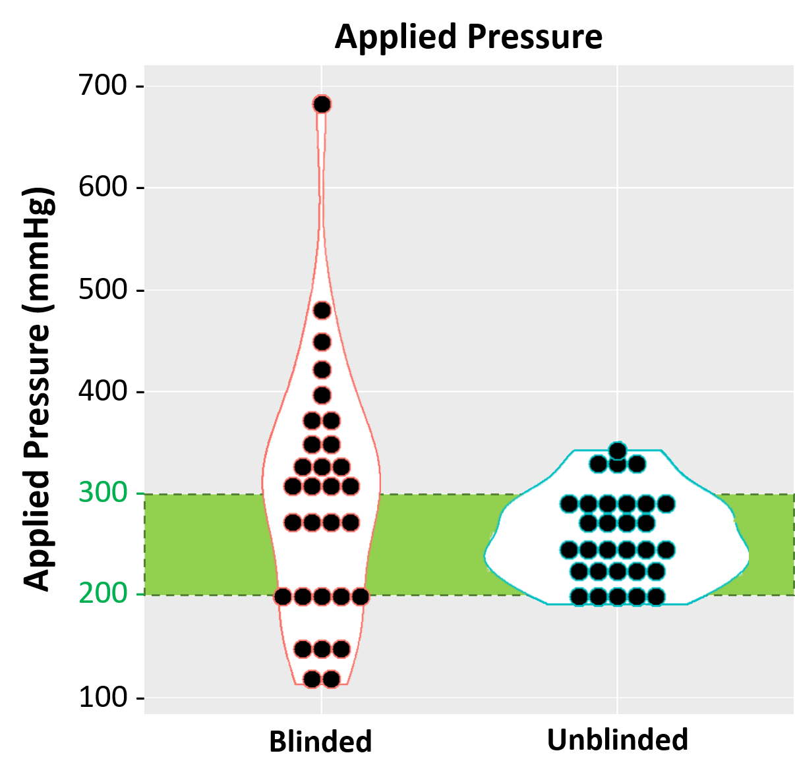
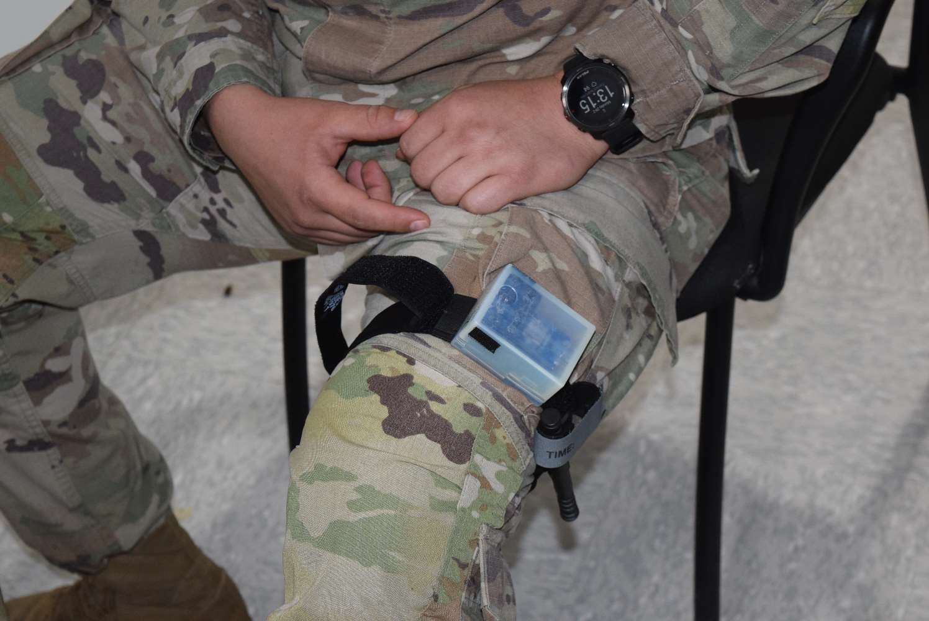
Results: Visualization of Data
Observations:
Blinded pressures exhibit significantly high variance (p << 0.05)
No significant difference in means or variance regarding application speeds
Success Rate (Assuming 180 to 300 mmHg cutoff)
Blinded | WITH TiMON
33.33% | 86.67%

Slide 16
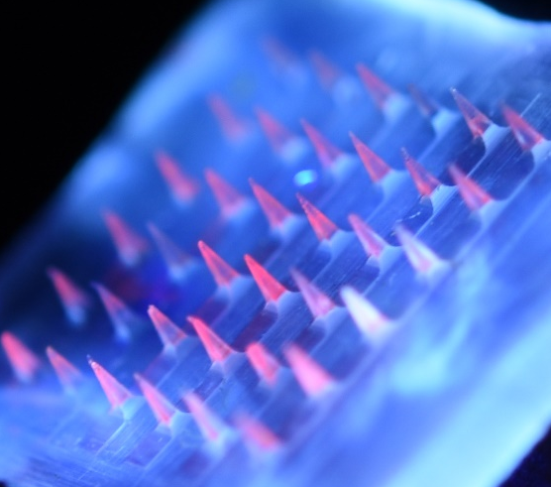
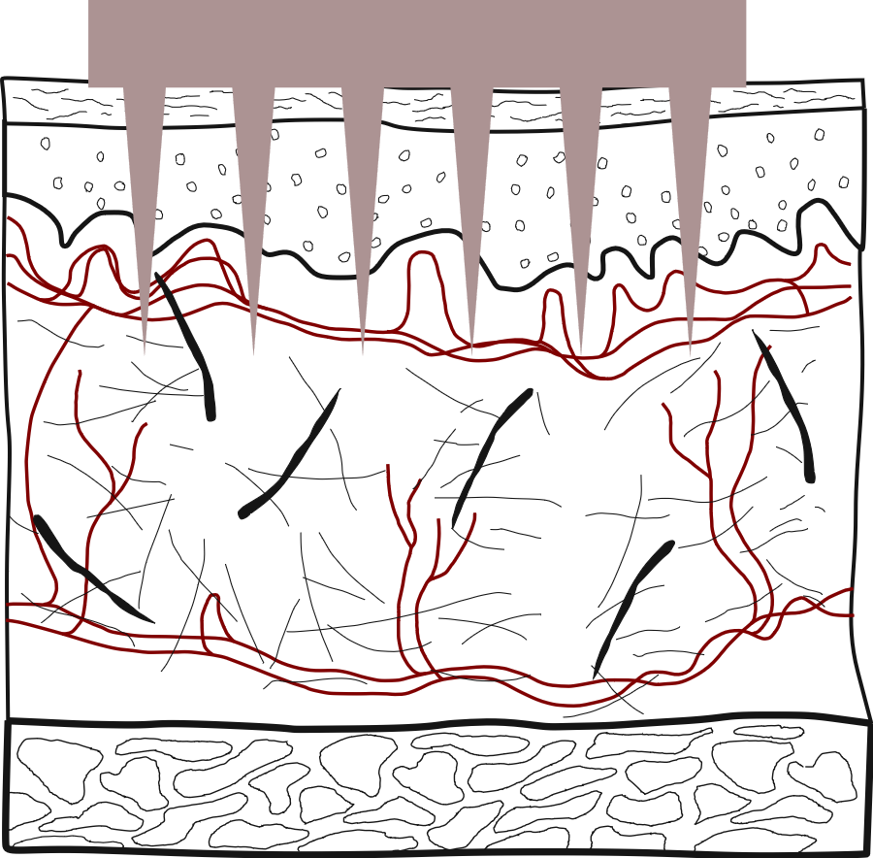
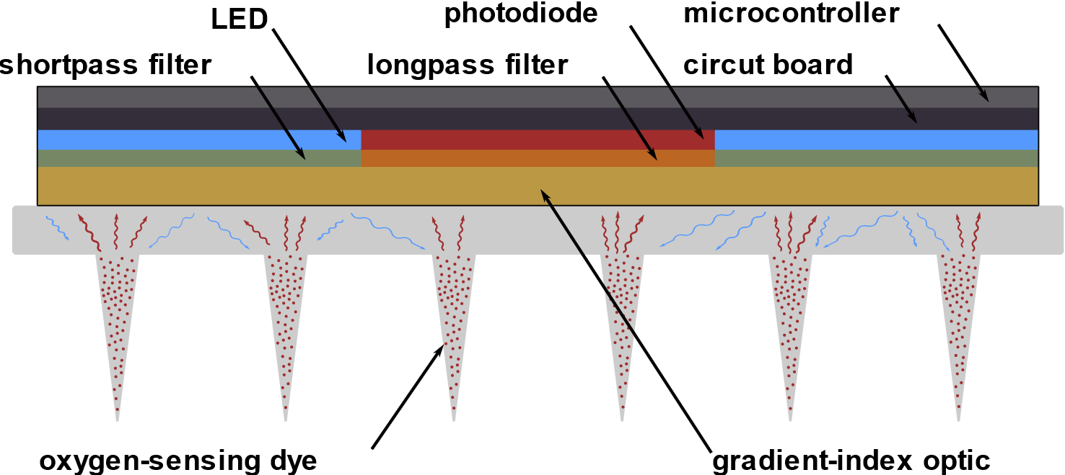
Tourniquet pO₂ measurement
The tips of each microneedle contain the
oxygen sensing porphyrin to detect pO₂
Direct monitoring of pO₂ in the tourniqueted limb to assess limb ischemia

Slide 17
Next Steps and Future Work
Validation of pO₂/pCO₂ sensing technology in trauma
  Civilian:
    Critical care/ICU
  Military
    Field medicine
    En route care
Integration of measurements with AI/ML
  ”Cognitive Offloading” – augment the clinician and medic with decision support
Translation and Commercialization
  Working with multiple companies including 3M on next-stage commercialization of the oxygen sensing technology
  Looking for commercial partners for tourniquet platform technology

