Slide 1
Prolonged field care experience and data
Prehospital challenges in Sahel (2013 – 2017)
S Travers, C Carfantan, A Luft, C Martinaud, P Pasquier, C Bay, A Sailliol, S Ausset
2019 Remote Damage Control Resuscitation symposium, Bergen, June 23
Notes:
Good morning, thank you very much for your invitation

Slide 2
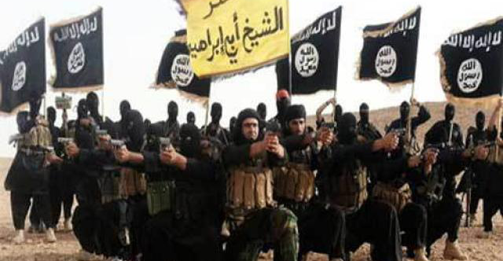
French Military Health Service experience in Sahel
Prehospital data
Specific casualty management difficulties
Notes:
In order to share with you FMHS experience during previous years in Sahel
With a focus on prehospital data and specific casualty management difficulties

Slide 3
What casualties need…
Howard et al. Jama Surg 2019
Notes:
So we all know what we have to do to improve casulaty survival
And thanks to US military data, we’re now able to better understand the respective contribution of hemorrhage control, early evacuation or blood transfusion for instance

Slide 4
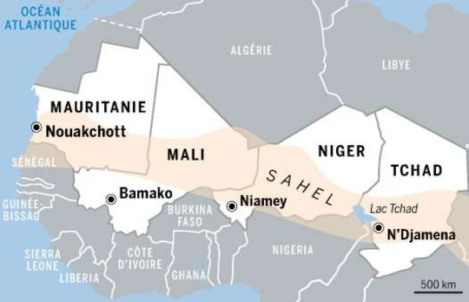
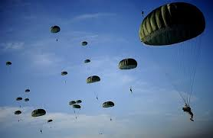
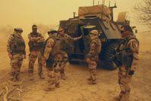
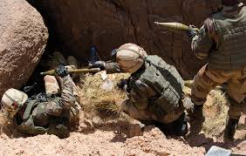
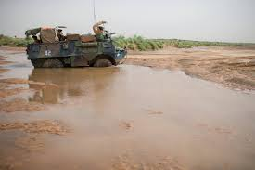
Field realities
4000 French soldiers
Five countries
> 5 million square kilometers
Notes:
But the difficulty we had in Sahel was to deploy and to dispatch medical support for 4000 French soldiers spread over five countries in a five million square kilometers area, wich is the equivalent of more than one half of United state surface area

Slide 5
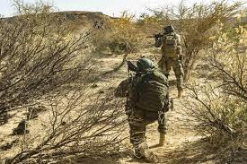
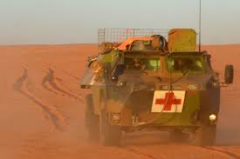
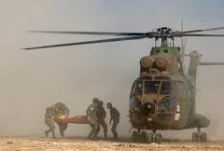
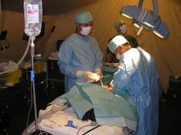
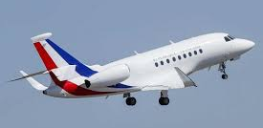
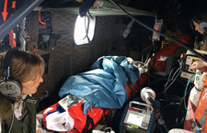
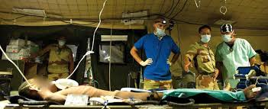
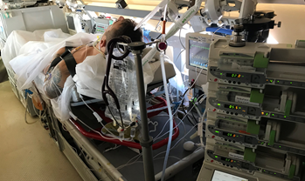
Medical support
Notes:
And despite the presence of medics and medical teams in every combat units, the deployment of several forward surgical teams with numerous medevac helicopters, forward and tactical medevac planes and then strategic medevac planes

Slide 6
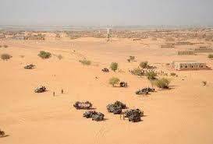
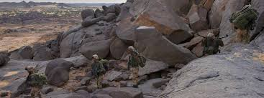
The « tyranny of distances » …
 | Barkhane area | Gao | Tessalit | N’Djamena | Others Role 2
Median distance Point of Injury - Role 2 | 290 km [100-455] | 316 km [150-455] | 83 km [55-120] | 776 km [482-1100] | 100 km [75-220]
Carfantan C. Injury 2016
Notes:
The median distance between point of injury and role 2 to is about 300 km on the whole area and sometimes more than 1000 km for several very remote places

Slide 7
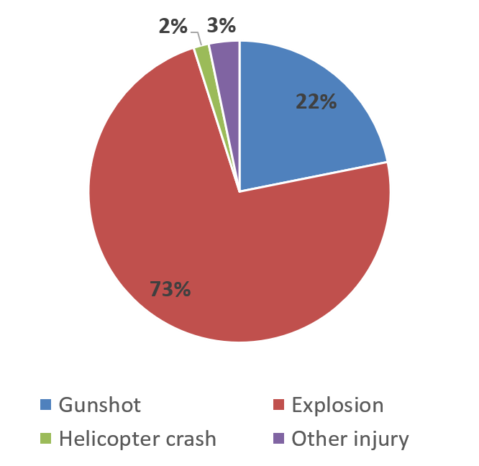
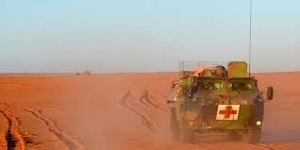
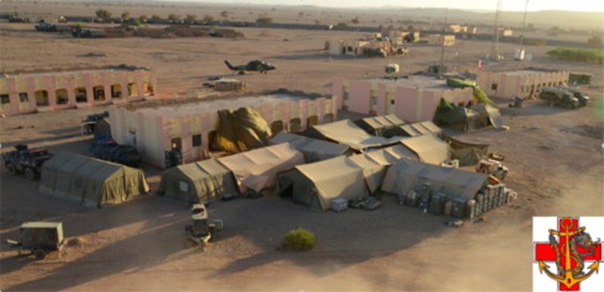
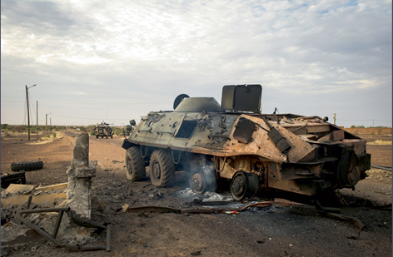
2013 - 2017 data
183 combat related casualties in a delimited area of Sahel operations
11 (9,1%) Killed In Action
172 Wounded In Action
Case Fatality Rate 9,8%
- 7 (6,4%) Died of Wounds
- 62 (36%) Return To Duty
- 103 Stratevac to France
Travers S. Transfusion 2019
Notes:
In order to describe specific chalenges of prolonged field care, we retrospectively analyzed prehospital data of 183 French combat related casualties in a delimted area of sahel operations
They were mainly youg men, injured by explosion or gunshots
9% were killed in action
6.4% died of wound,
36% return to duty
And the other were evacuated to Role 4 in France

Slide 8
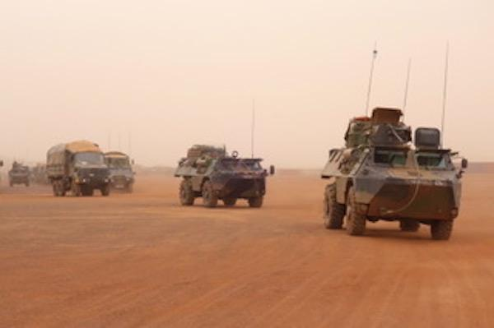
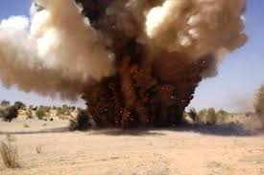
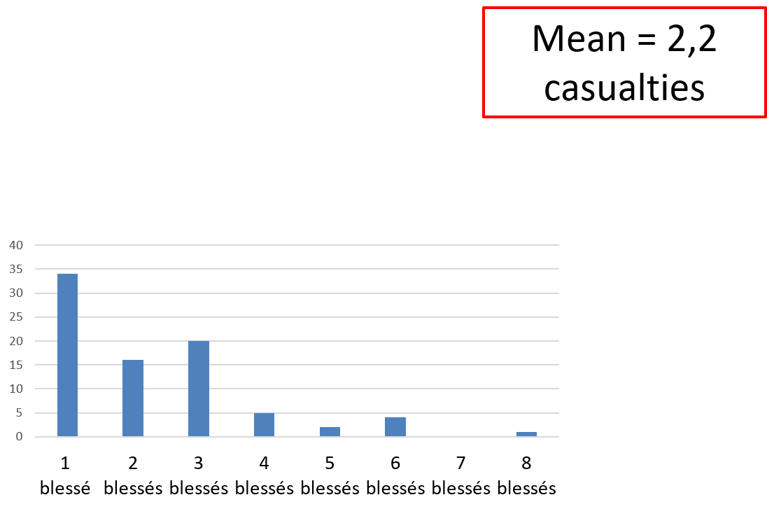
Tactical Combat Casualty Care
TCCC performed by combatants, medics, nurses and physicians embedded in combat units
- Medical team on scene for 80% of the casualties
Difficulty in gaining access due to tactical context for 10 casualties (> 1 h for three of them)
Number of casualties per MEDEVAC request
Notes:
Tactical Combat Casulaty care was performed by combattants, medics, nurses and doctors embedded in combat units
The number of French injured involved for each event ranged from 1 to 8 with very often additional casualties among civilian or military from other nationalities.
Tactical situation was the main cause for delayed initial care.
Most of the casualties were directly evacuated from the field to Role 2 without going through a medical station

Slide 9
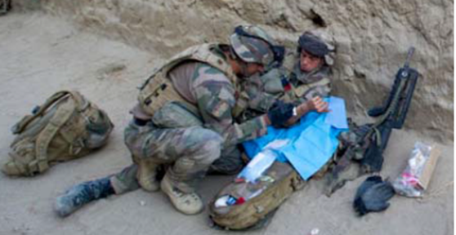
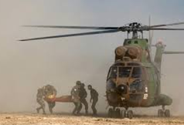
Field triage
46 Alpha (immediate) casualties :
- Median ISS 20 [16-41]
- Died of wounds 7 (15,2%)
- Admitted in Role 2 MTF and evacuated 36 (78,3%)
- Return to duty < 72h 3 (6,5%)
32 Bravo (delayed) casualties :
- Median ISS 9 [7-13]
- Died of wounds 0
- Admitted in Role 2 MTF and evacuated 26 (81,3%)
- Return to duty < 72h 6 (18,7%)
94 Charlie (minimal) casualties :
- Median ISS 4 [3-4]
- Died of wounds 0
- Admitted in Role 2 MTF and evacuated 41 (43,6%)
- Return to duty < 72h 53 (56,4%)
Notes:
The initial field triage seemed to be quite relevant since only 6% of immediate casualties return to duty and since no dead of wounds was reported among delayed or minimal casualties

Slide 10
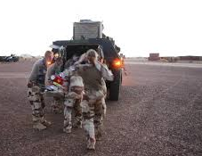
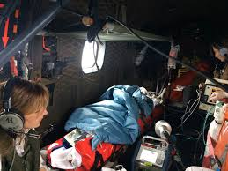
Evacuation times
Median time [IQR] from injury to surgical facility (N= 46 critical casualties) MEDEVAC time > 120 min MEDEVAC time > 240 min Median time from injury to surgical facility based on context and organizational Ground transportation (N=4) Rotary wing (N=29) Time from injury to take off Time on point of injury Flight time from point of injury to surgical facility Rotary wing followed by fixed wing (N=11) Ground followed by fixed wing (N=2) Median time [IQR] from injury to arrival in Role 4 hospital | 2h10 [1h10-4h12] 26 (57%) 12 (26%) issues: 22 min [16-31] 2h05 [1h10-2h22] 32 min [15-42] 13 min [4-14] 30 min [23-50] 5h15 [4h12-5h33] 6h20 [6h20-6h20] 25h [23-34]
Notes:
Median time from injury to surgical facility was a around 130 minutes for critical casualties and unfortunately more than 2 hours for half of them and more than 4 hours for 12%
These delays were closely related to each context and specific organizational issues
With very short time fo small distances allowing immediate ground evacuation, longer but acceptable times with helicopters and very longer times until 5 to 6 hours when complex medevac with helicopter or ambulance then plane was the only solution for very long distances
Overall, the time between injury to role 4 in France was 25h for critical casualties which is consistent with the objective to keep a low logistic footprint in the area involving a global strategy of damage control surgery in the field, very early stratevac and definitive surgery in metropolitan hospitals

Slide 11
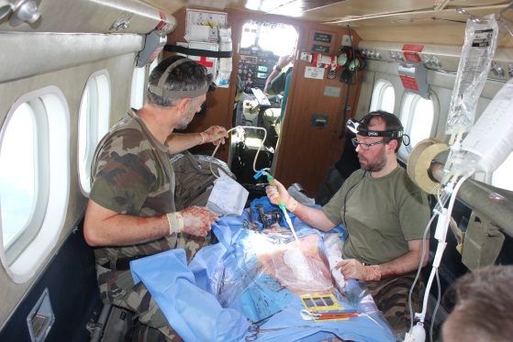
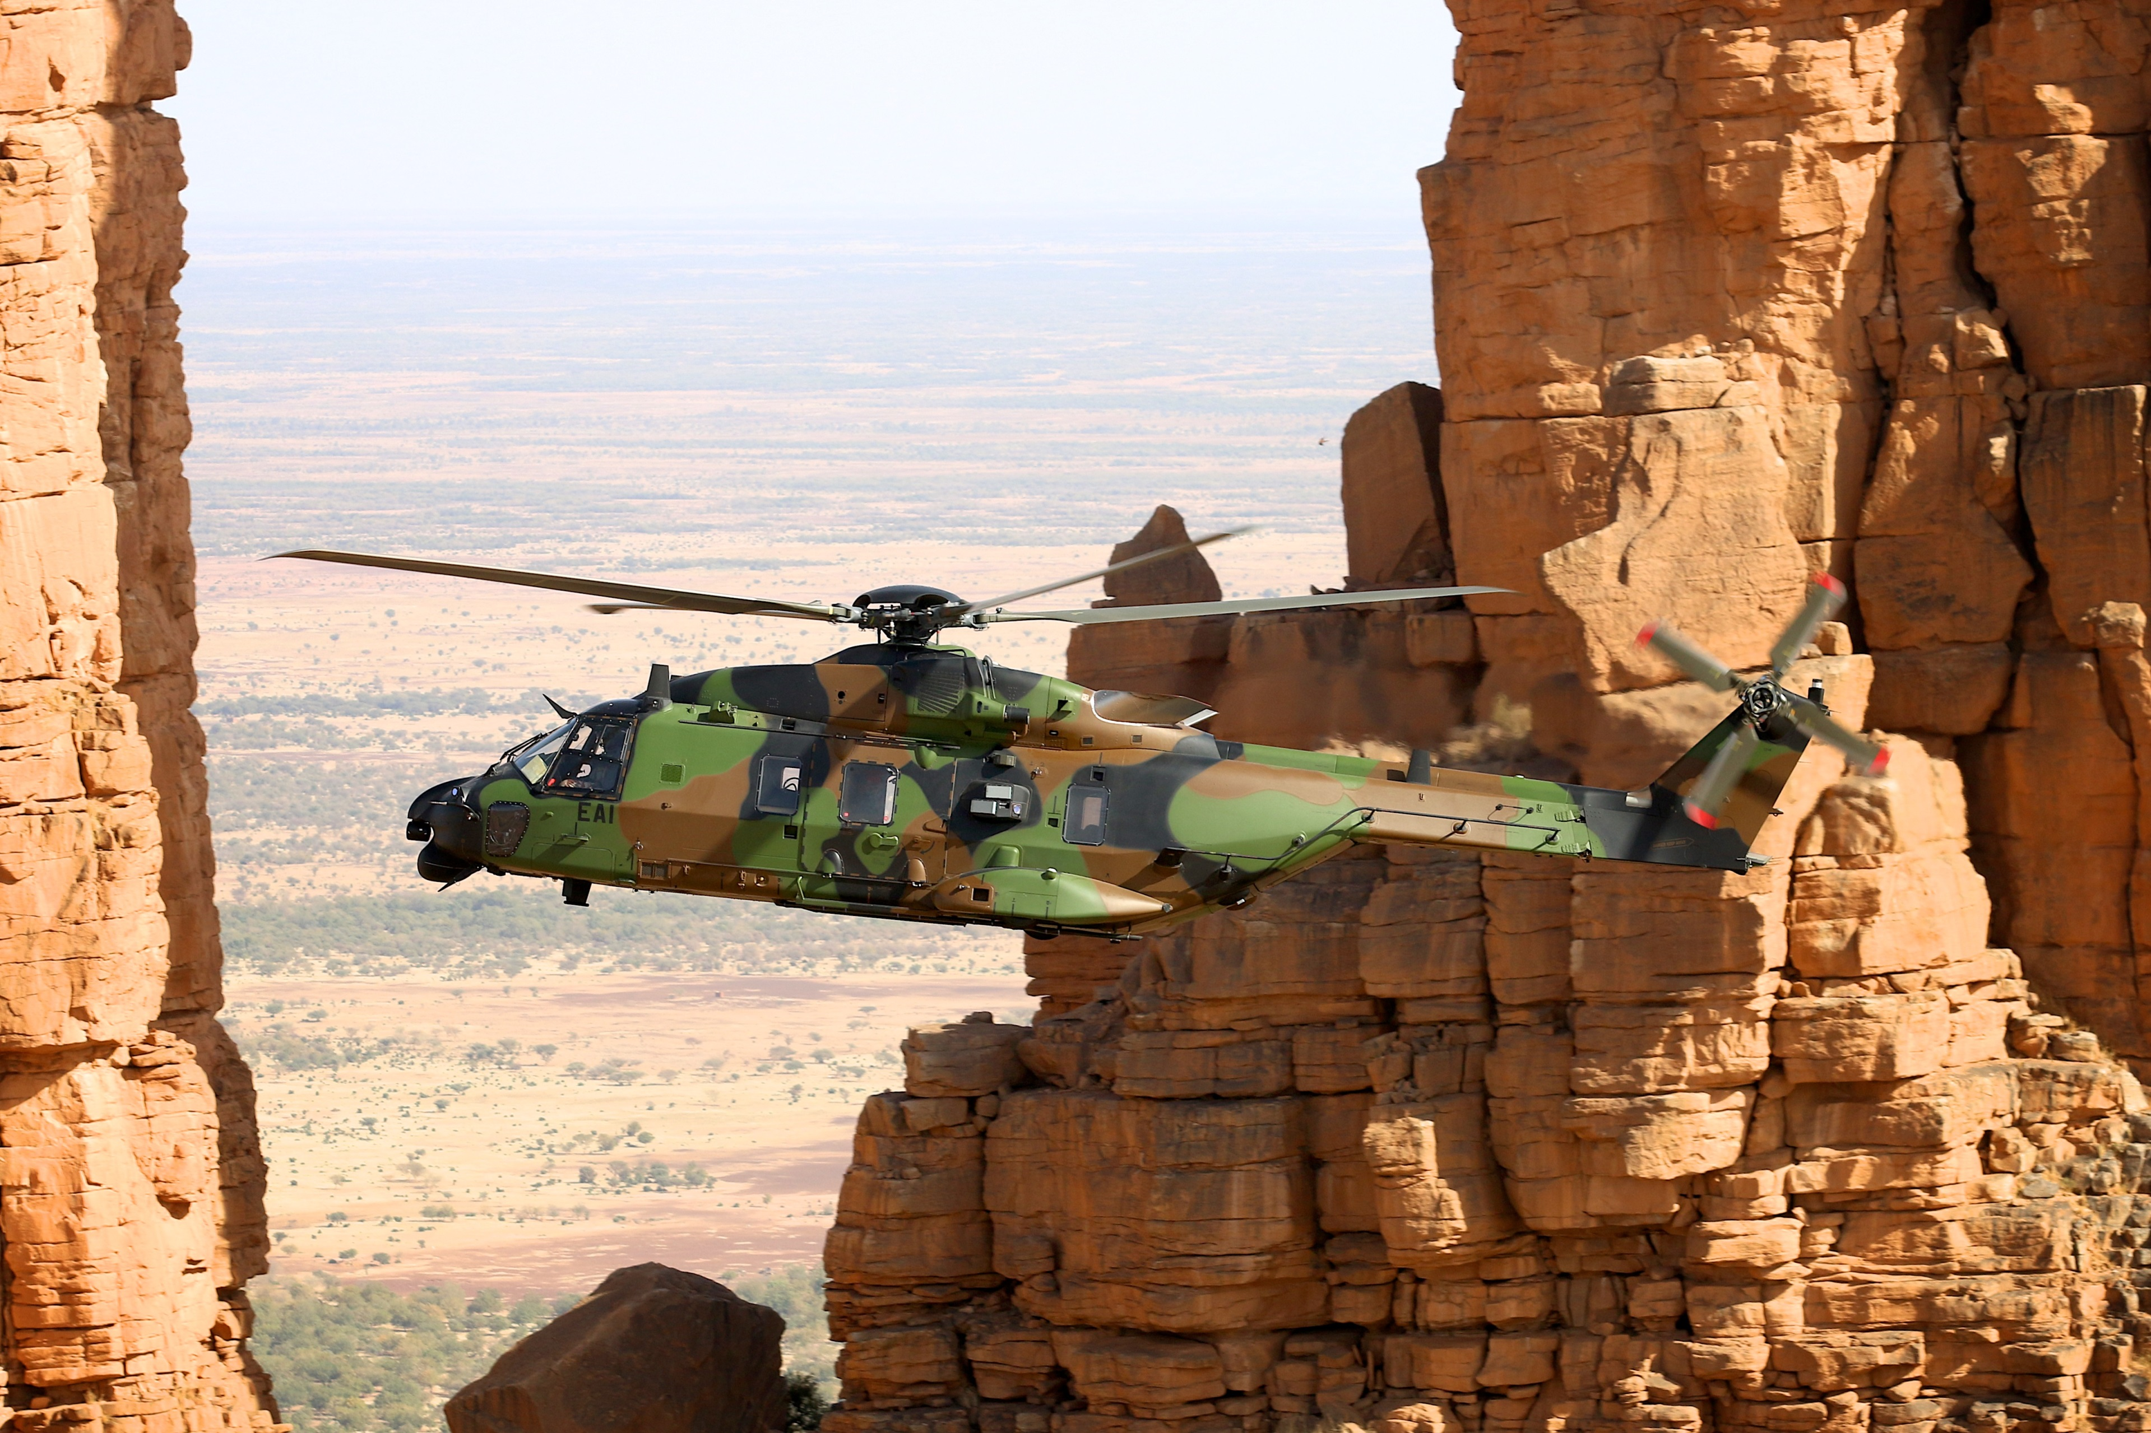
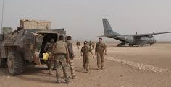
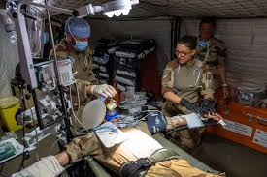
Room for improvement …
Median time from injury to surgical facility (critical casualties) by years
Notes:
Increasing the number of aircrafts and surgical teams was of course the solution to reduce these times but we had to face logistical limitations when operations and smaller units were spread over a wider and wider area.
As for many other countries, the current discussions focus on even smaller and mobile surgical teams, and their distribution closer to risk areas to ensure first hemostasis before or sometimes if needed during air evacuation

Slide 12
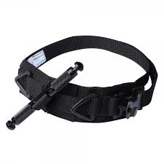
Consequences of longer delays
Prolonged management of hemorrhagic shock, traumatic brain injury …
Specific issues :
31 tourniquets placed on 18 casualties
Median time before conversion : 01h30 [1h02 - 4h22]
Rhabdomyolysis or compartment syndrome described for 4 casualties (all for tourniquet time > 120 min)
Education, training, regular practice, equipment…
Number of casualties by tourniquet time (available data for N=14)
Reassessment and conversion before evacuation…
Notes:
The consequences of theses longer delays are mainly in the field of education and training
With some specific issues like reevaluation and conversion of tourniquets
We observed, as already described, that no complication occurred if tourniquet was removed before 2 hours, but that worse consequences were possible beyond 2 hours when tourniquet could not be loosened before long distance evacuation and it was ufortunately the case for 4 of these casualties

Slide 13
Transfusion strategies
 | Plasma | RBCs | Fibrinogen | Fresh whole blood
Field | 3 | 0 | 0 | 0
Helicopter MEDEVAC | 4 | 1 | 0 | 0
Fixed wing MEDEVAC | 5 | 3 | 3 | 1
Forward surgical units | 63 | 75 | 24 | 28
Falcon STRATEVAC | 3 | 2 | 0 | 2
Locations of transfusion for 20 critical casualties (number of blood products delivered)
Notes:
20 casualties received also blood products, mainly in forward surgical units and earlier in prehospital setting for 8 of them.

Slide 14
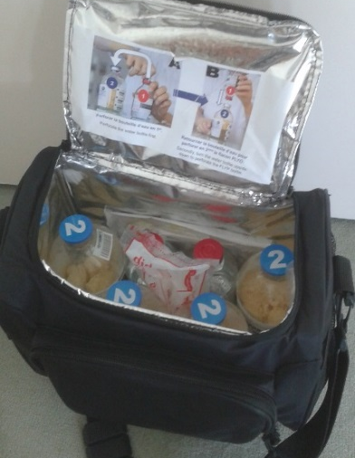
Lyophilized Plasma
 | Plasma | RBCs | Fibrinogen | Fresh whole blood
Field | 3 | 0 | 0 | 0
Helicopter MEDEVAC | 4 | 1 | 0 | 0
Fixed wing MEDEVAC | 5 | 3 | 3 | 1
Forward surgical units | 63 | 75 | 24 | 28
Falcon STRATEVAC | 3 | 2 | 0 | 2
Locations of transfusion for 20 critical casualties (number of blood products delivered)
Available for all Role 1 since 2016
Stored at ambiant T° during 2 years
Universal for all blood groups
One failure during field reconstitution
Now includes in every predeployment training
Vitalis V et al. Injury 2017
Sailliol A et al. Transfusion 2013
Martinaud C et al. Anesthesiology 2012
Notes:
Lyophilized plasma was the first blood products in prehospital setting and was confirmed to be very suitable for these austere settings since it can be stored in very hot and wet environnment. Since 2016, lyophilized plasma is available in every role 1.
We observed one failure of reconstitution in the field which justified the implementation of specific training for all teams before deployment

Slide 15
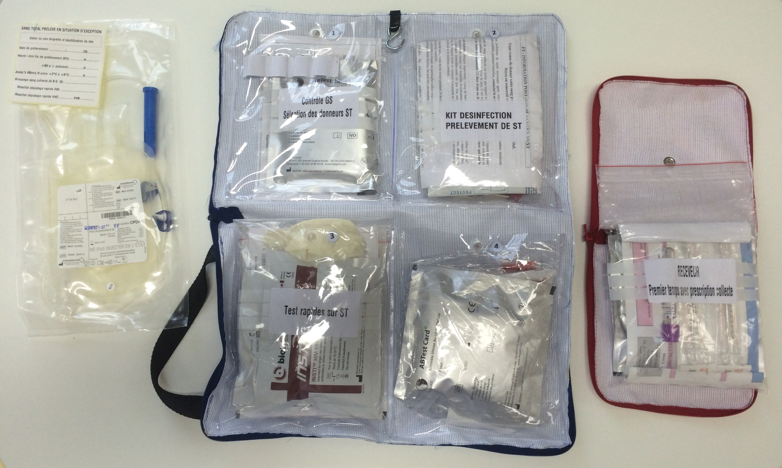
Fresh whole blood
 | Plasma | RBCs | Fibrinogen | Fresh whole blood
Field | 3 | 0 | 0 | 0
Helicopter MEDEVAC | 4 | 1 | 0 | 0
Fixed wing MEDEVAC | 5 | 3 | 3 | 1
Forward surgical units | 63 | 75 | 24 | 28
Falcon STRATEVAC | 3 | 2 | 0 | 2
Locations of transfusion for 20 critical casualties (number of blood products delivered)
Prescreened donors before deployment
On site collection :
For Role 2, collected by Role 1 teams
In the field by prehospital teams
Intensification of predeployment training in order to :
Minimize the time between blood collection and transfusion
Prepare a single team to concurrently manage casualties and blood collection
Ausset S et al. Anesthesia 2009
Garcia Hejl C et al. J Trauma Acute Care Surg 2015
Daniel Y et al. J Trauma 2017
Daniel Y et al. JR Army Med Corps 2016
Notes:
Fresh whole blood was frequently used in role 2 after on site collection from preselected donors.
The procedure and special kits were planned to be used on the field, but a real difficulty remains for a single team or a single medical provider to concurrently manage several critical casualties and whole blood collection on the ground
Specific drill is now also include in all predeployment training

Slide 16
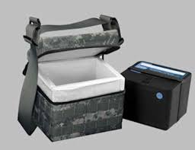
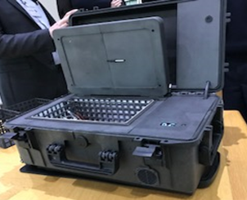
Cold storage in the field
 | Plasma | RBCs | Fibrinogen | Fresh whole blood
Field | 3 | 0 | 0 | 0
Helicopter MEDEVAC | 4 | 1 | 0 | 0
Fixed wing MEDEVAC | 5 | 3 | 3 | 1
Forward surgical units | 63 | 75 | 24 | 28
Falcon STRATEVAC | 3 | 2 | 0 | 2
Locations of transfusion for 20 critical casualties (number of blood products delivered)
At least 2 RBCs and 2 Plasma in Helicopters and planes when dispatched from Role 2
New procedures for forward cold storage allowing :
All MEDEVAC teams and occasionally ground teams to carry RBC’s
Rotation with blood bank
Next step = cold stored low titer and leukoreduced group O whole blood
Notes:
Cold storage of RBC was possible in all our aircrafts when they were deployed from role 2 blood bank which explains why some of our wounded were not transfused when the medevac had no blood on board due to reorientation or dispatch from another place far from role 2 blood bank. New procedure but only since last year now allow cold storage in more isolated places with temperature monitoring and blood products rotation between medevac teams and blood bank to avoid wastage

Slide 17
Conclusion : capability gaps identified
Reduction of time before surgery
Number of Aircrafts and surgical teams
Forward surgical skills, surgery on board, …
International collaborations
Ground deployment of enough and sufficiently trained medics and medical teams
Initial and predeployment training, number of trained staff
Regular hospital and EMS practice between deployments
Optimization of prehospital transfusion strategies
Lyophilized plasma
Whole blood collection procedures and training
Cold storage procedures in remote areas
Notes:
To conclude, main challenges identified for medical support in very remote areas, were :
- The mandatory reduction of time before surgery wich is linked with the number and the distribution of aircrafts and surgical teams, but also with new concepts to bring surgical skills as forward as possible
The ground deployment of enough and also sufficiently trained medics and medical teams with enough education, training and finally or perhaps especially regular practice between deployments
And the optimization of prehospital transfusion strategies with more and more field solutions but also procedures, equipment and training issues

Slide 18
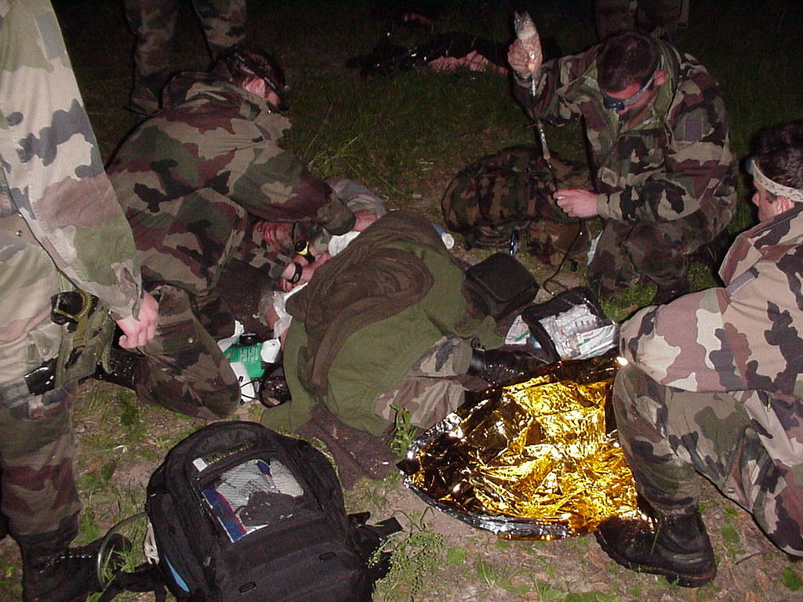
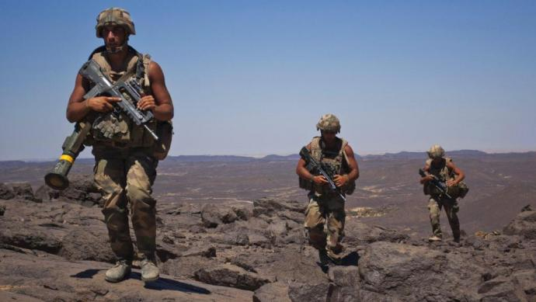
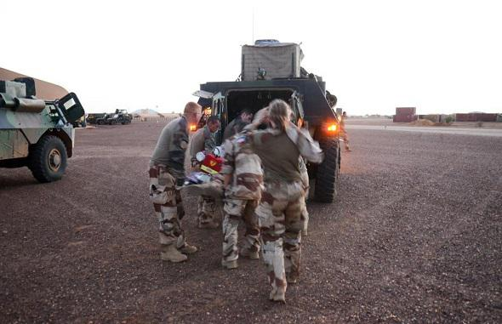
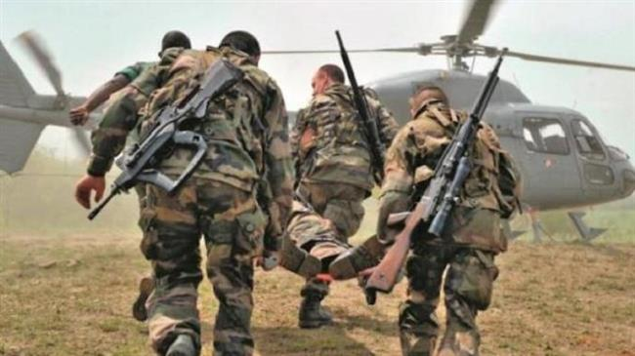
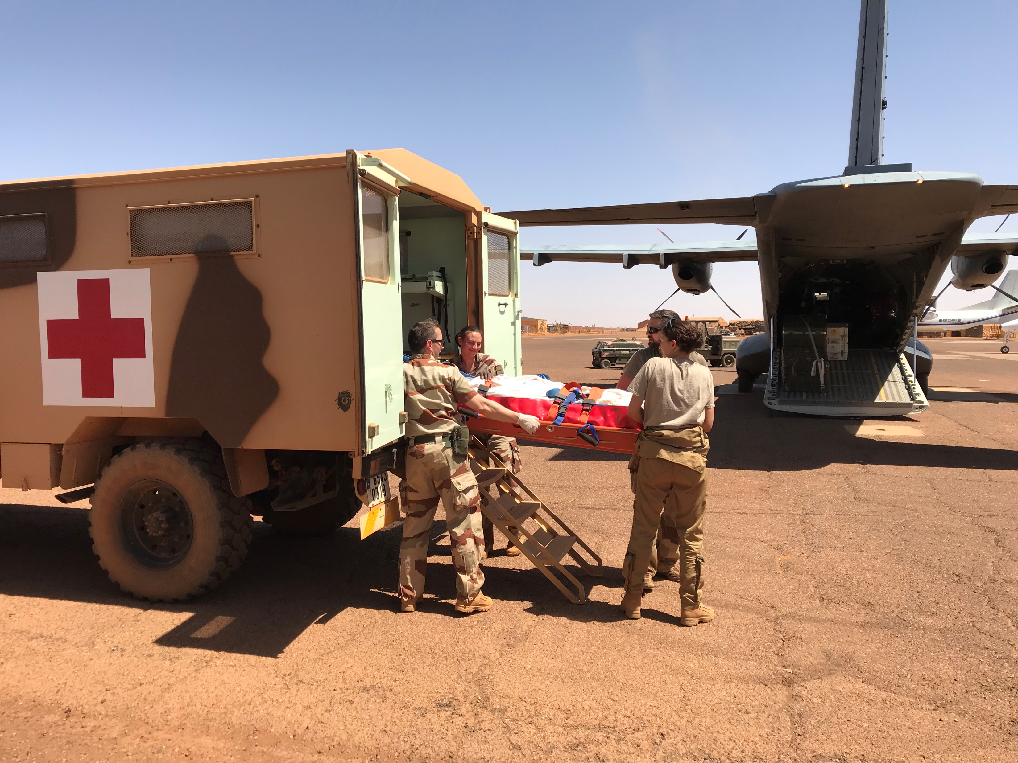
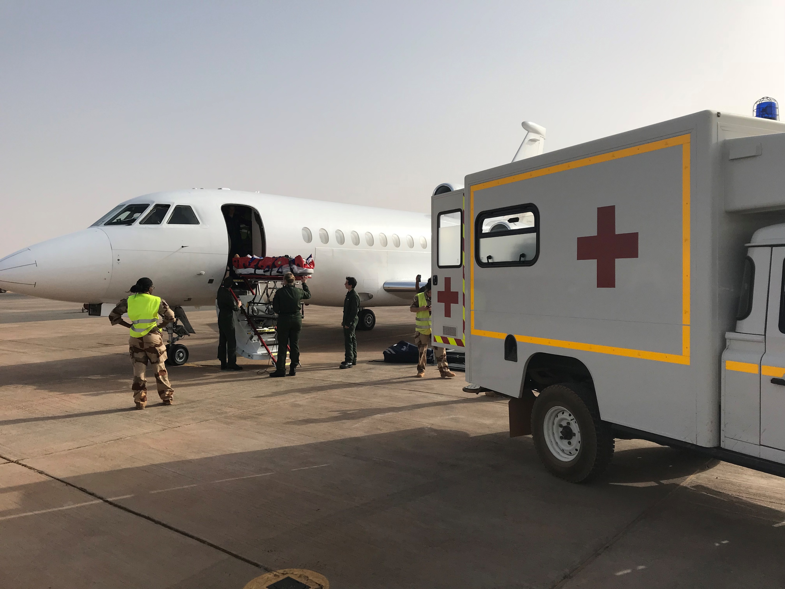
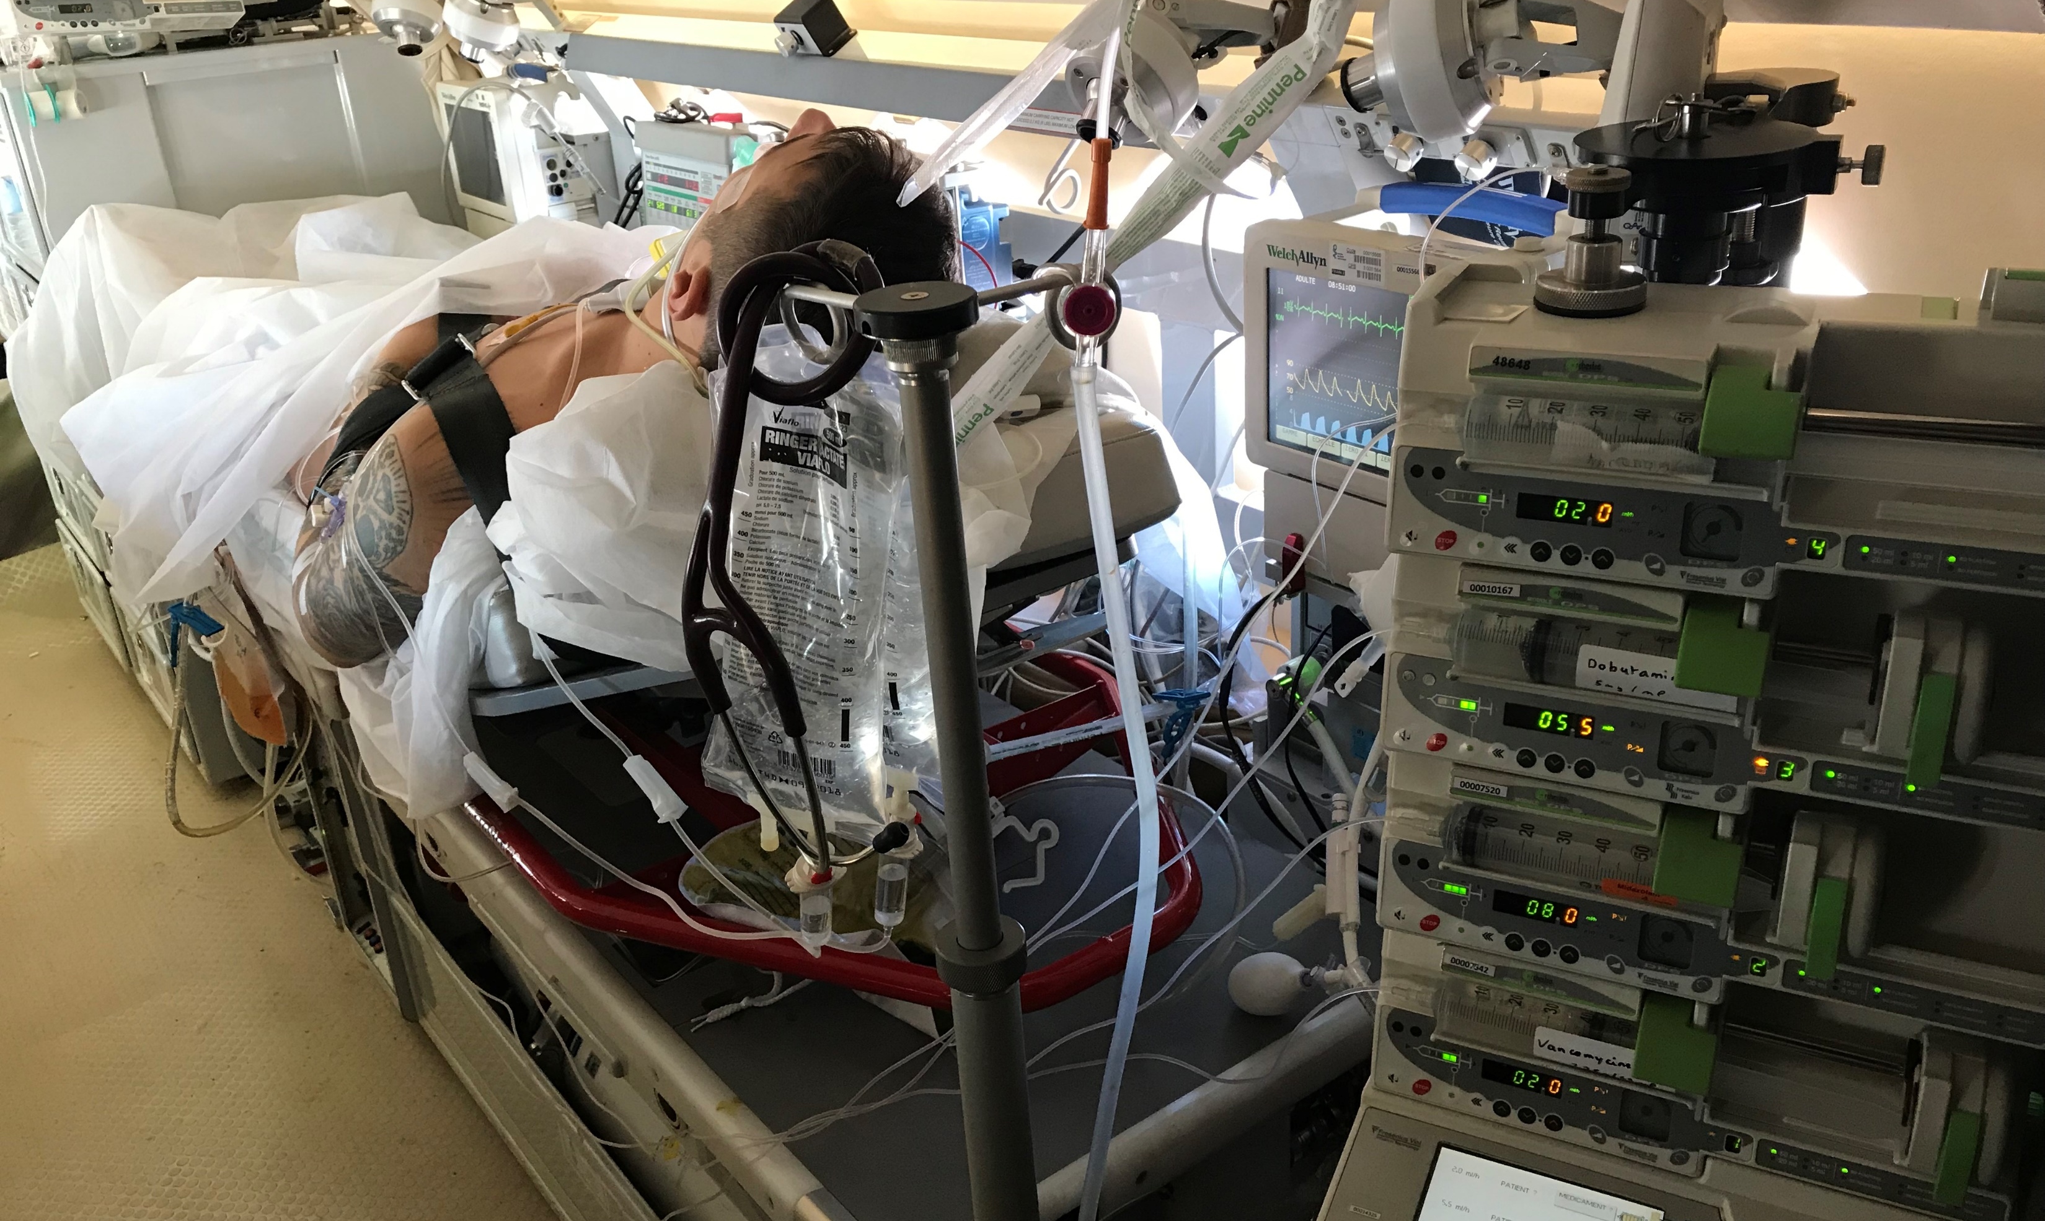
Aknowledgment
Notes:
Just want to thanks all the combatants and care providers who took care of these 183 causalties

Slide 19
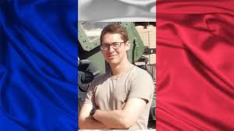
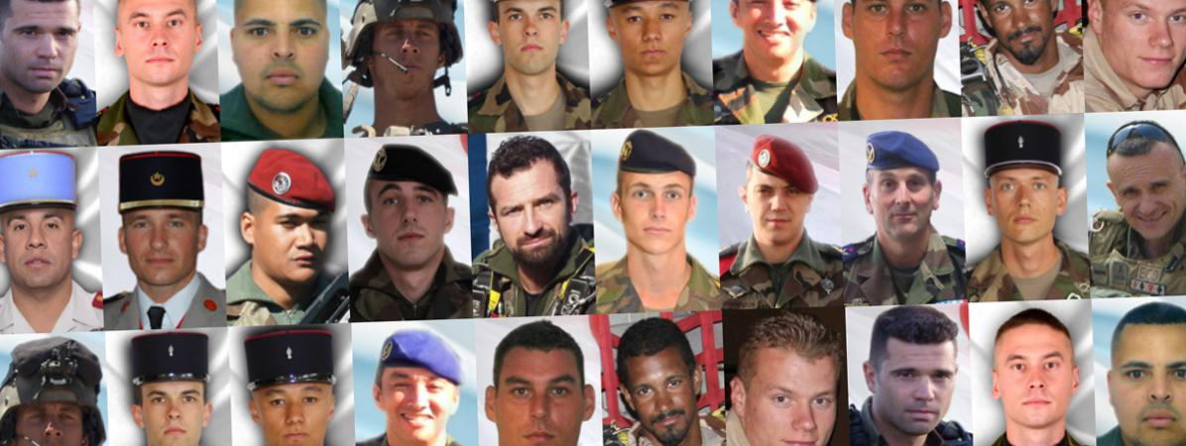
In Memoriam
Notes:
And remember those who loose their life during these years in Sahel
with one of the last one a few weeks ago who was a young military doctor during his first rotation

Slide 20
Notes:
Thank you very much

