Slide 1
Study Updates

Slide 2
CHIPS
RCT in complex cardiac surgery patients
Cold platelets vs room temp platelets
Up to 21 days storage for CSP
1000 patients
Primary outcome is bleeding score

Slide 3
CHIPS
12 sites of 22 activated
Jan 2022 started enrolling
28 patients enrolled

Slide 4
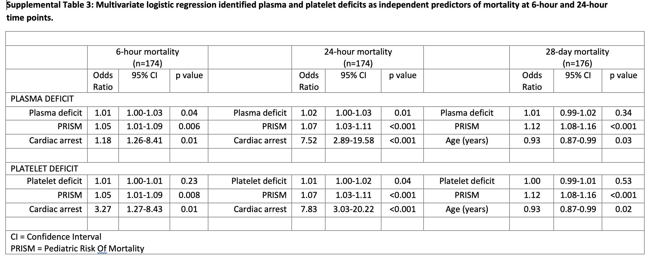

Slide 5
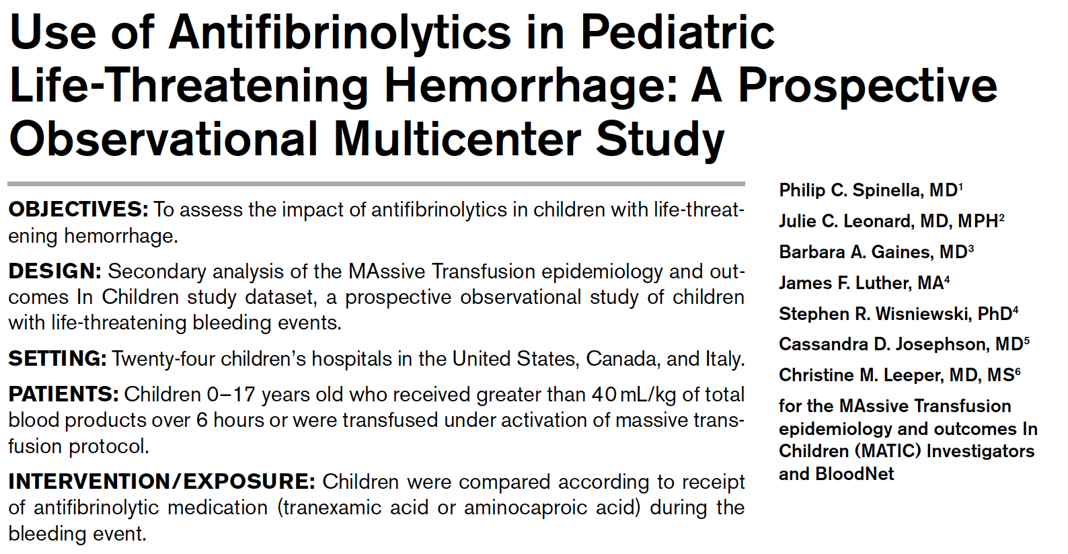
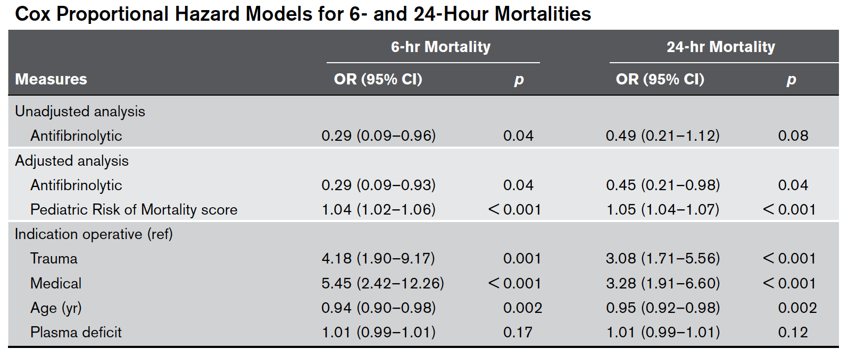
Crit Care Med. 2021

Slide 6
LTOWB is independently associated with 24-hour survival
Cox Regression Analysis
Cox Regression | 24-hour adjusted mortality
Survival Predictor | HR | 95% CI | p
LTOWB Use | 0.50 | (0.27, 0.95) | 0.033
ISS | 0.97 | (0.95, 0.99) | 0.015
MCF | 0.95 | (0.94, 0.97) | <0.001
LTOWB
CT
Notes:
Here we report our adjusted analysis of whole blood and component therapy use in hemostatic resuscitation of massively bleeding patients. We adjusted for injury severity score (ISS) and hemostatic dysfunction via rotational thromboelastometry measurements of maximum clot formation (MCF). With this Cox regression analysis whole blood over component therapy was independently associated with 24-hr survival, and whole blood use also trended towards improved 28-day survival.
Extra:
We hypothesize that with LTOWB use in hemostatic resuscitation, we are able to acutely rescue very sick and hypercoagulable patients that otherwise would not have survived, and the significance of their pathophysiology and its downstream effects then persist, hindering long-term survival. Furthermore, as we continue to enhance our hemostatic resuscitation standard of care and treatment approaches, we will continue to resuscitate sicker patients, and the care of these patients will continue to evolve and improve. Early identification of these patients that are less likely to survive long-term, for example, we might propose hypercoagulable patients at admission, may help shape different protocols of care.
To select this final adjusted model, significant parameters from the univariate analysis were selected, and highly co-linear parameters were eliminated. Backwards stepwise selection of multivariable logistic regression models were employed to arrive at this final fitted model. This final model includes covariates of whole blood use ISS and MCF.

Slide 7
Plasma REsuscitation for Sepsis Study (PRESS)
Phil Spinella, MD, FCCM
Professor, Surgery and Critical Care Medicine
Co-Director, Trauma and Transfusion Medicine Research Center
Associate Medical Director, Center for Military Medicine Research
University of Pittsburgh

Slide 8
Objectives
Rationale
Trial Concept
Feedback

Slide 9
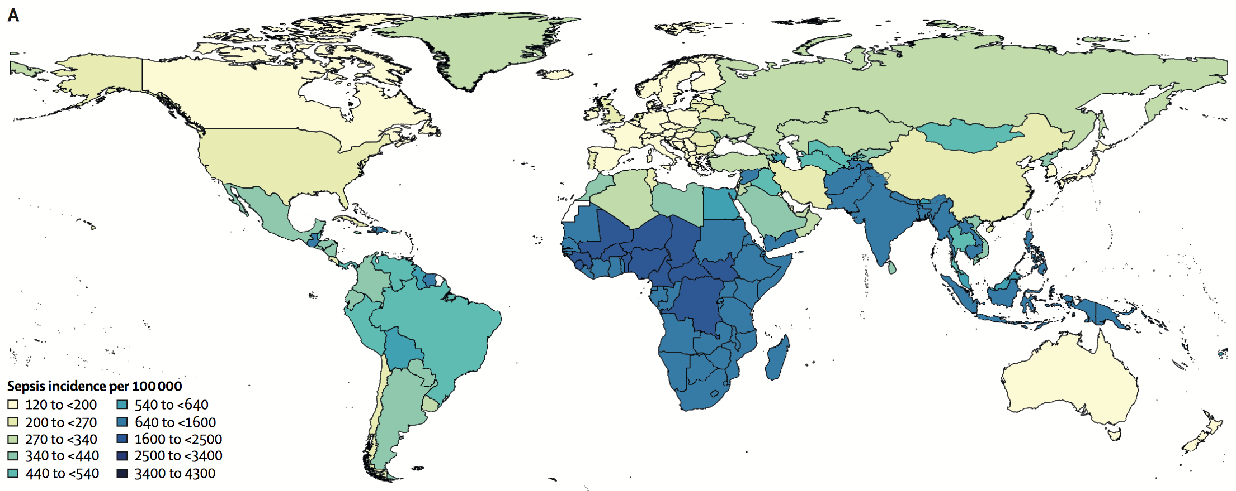
Sepsis
Per year
48 million cases worldwide
2 million cases in the US
Septic Shock High Mortality – 40%
230,000 deaths per year in the US
High Morbidity
33% readmitted in 90 days
Cost of 15 billion dollars/year in US
Figure 1. 48 million sepsis cases worldwide. Rudd, Seymour, Angus and colleagues, 2020, THE LANCET
http://www.hcup-us.ahrq.gov/reports.jsp.

Slide 10
Shock-Inadequate Oxygen Delivery to Meet Demand
Oxygen Delivery
(HR x stroke volume) x (Hb x SaO2 x 1.34)+PaO2(0.003)
Oxygen Delivery
(HR x stroke volume) x (Hb x SaO2 x 1.34)+PaO2(0.003)
Preload
Myocardial contractility
Afterload
Bone marrow
Hemolysis
Uptake
Pulmonary Gas Exchange Function
Microvascular Perfusion
Hydrostatic Pressure
Oncotic Pressure
Endothelial Integrity
Microvascular Thrombi Inflammation

Slide 11
Septic Shock
Want a Treatment
Improves O2 Delivery
Oxygen delivery impaired
Vasodilation
Reduced myocardial contractility
Reduced intravascular volume
Reduced hemoglobin (bone marrow suppression)
Reduced RBC function
Reduced arterial saturations (pneumonia/edema)
Endothelial injury
Glycocalyx injury
Inflammation
Increased fluid permeability
Diffuse microvascular thrombi

Slide 12
Importance of Timing of Volume Resuscitation – Septic Shock
Sepsis is not all the same
4 phenotypes: demographics, biologic response, outcomes
“Early” fluid resuscitation of shock
3 fold reduction in death in children (within 30 min)
No effect in adults (median time of 2.5 hrs)
Differences in Results
Age-based?
Timing-based?
Amount of Intravascular volume depletion based?
Phenotype based?
Seymour et al. JAMA, 2019
Seymour et al, AJRCCM, 2020
Seymour et al., NEJM, 2017
Oliveira et al., Ped Em Care. 2008

Slide 13
Fluid Resuscitation of Septic Shock-Controversy
Crystalloids
Temporary improvement in preload
By the time hemodynamics improved may have significant tissue edema
When to stop is difficult to know
Volume overload consistently associated with worse outcomes
Therapeutic window is VERY NARROW

Slide 14
Plasma
Plasma in 1940-50’s well recognized as optimal product for volume expansion
In 1950-60s plasma (pooled) and caused epidemic of transfusion transmitted hepatitis
Crystalloid and colloids development expanded in 1960s promoted as volume expanders
AABB standards state that plasma should not be used as a volume expander

Slide 15
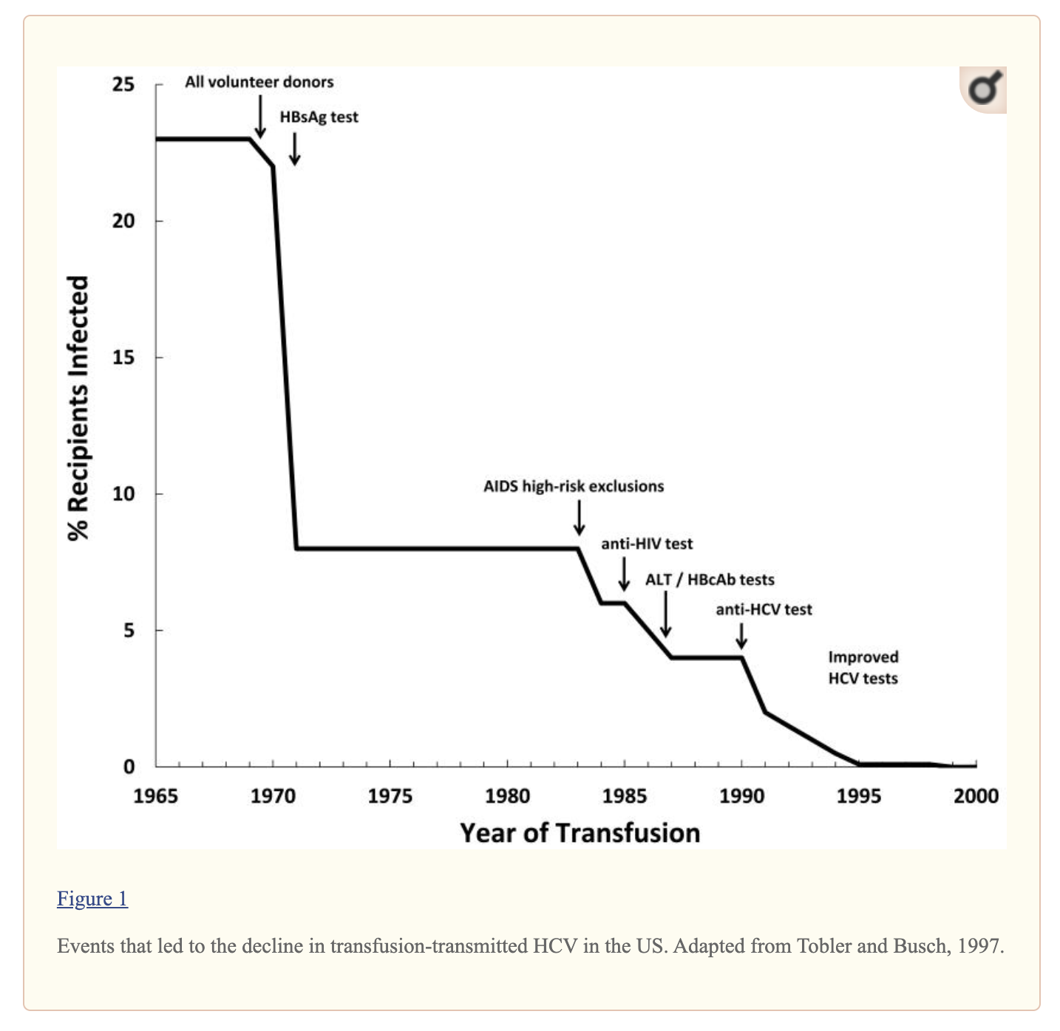
Plasma Risks Have Diminished
1965 - Present
Single donor plasma
More accurate testing for transfusion transmitted disease
Reduced risk of HCV transmission from 23% to 1 in a million

Slide 16
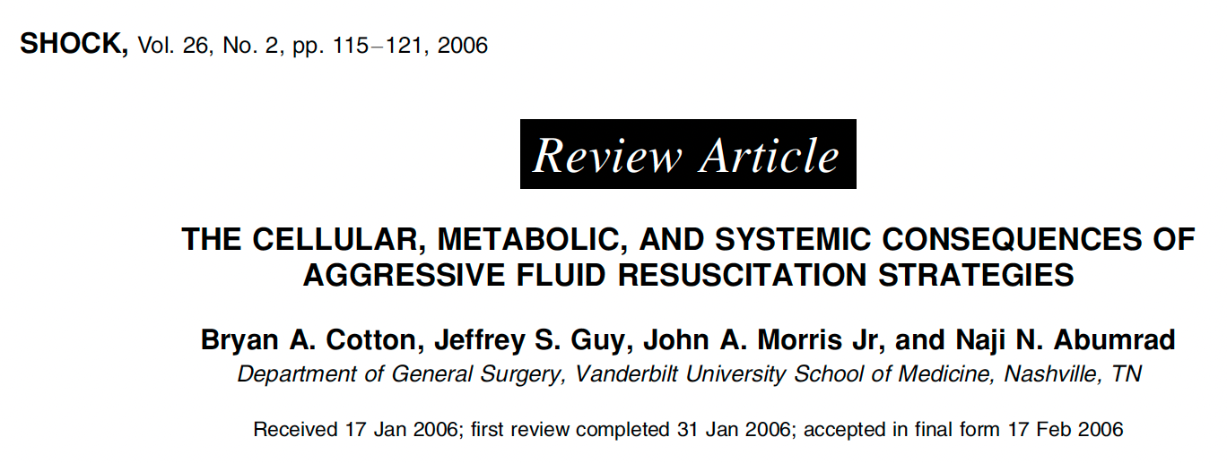
Increased Awareness of the risks of crystalloids
1980-Present
Increased awareness of adverse effects of crystalloids emerged

Slide 17
Back to the Future Again!
Plasma for septic shock resuscitation
Efficacy
Plasma exchange for septic shock (thrombocytopenia) and may improve outcomes.
Plasma effects on endothelium in traumatic hemorrhagic shock
Early plasma improves survival in traumatic shock
Safety
Pathogen reduced plasma
TRALI dramatically reduced
Immediate access to plasma
Thawed plasma and dried plasma
Trung NC. et al. Crit Care Med. 2008; 36(10):2878-2887
Fortenberry J. et al. Crit Care Med 2019; 47(3): e173-e181
Keith PD, et al. Crit Care. 2020;24:518

Slide 18
Plasma Compared to Crystalloids: Animal Models
Plasma causes less pulmonary capillary leak compared to crystalloids
Controlled hemorrhage in mice
Plasma causes less tissue (lung and muscle) edema compared to LR
Controlled hemorrhage in rats
Plasma improves volume expansion better than crystalloids
Controlled hemorrhage/tissue injury in rats
Plasma improves oxygen delivery compared to crystalloids
Sepsis model in rats
Chang R. et al. Shock. 2018, Jan. 49(1): 53–61.
Kendrick CL, et al. J Trauma Acute Care Surg. 2015;
Nelson et al. Intensive Care Medicine Experimental (2016)
Peng Z, et al. SHOCK, Vol. 40, No. 3, pp. 195-202, 2013
Watawa K, et al. TRANSFUSION Vol 53, Jan 2013 Suppl. 53:80S-90S

Slide 19
Plasma Compared to Crystalloids: In Vitro and In Vivo Animal Models
Plasma results in less pulmonary neutrophil inflammation compared to crystalloids
Controlled hemorrhage in mice
Plasma results in less endothelial injury and/or repairs the endothelium more effectively compared to either NS, LR
Controlled hemorrhage in mice and rats
Plasma restores hemostatic balance for hyper & hypocoagulable states
In vitro experiments
Alam HB, et al. Surg Clin N Am 87 (2007) 55–72.
Cardenas JC, et al. SHOCK, Vol. 45, No. 2, pp. 166–173, 2016
Pati S, et al. J Trauma Acute Care Surg. 2016;80: 576–585
Peng Z, et al. SHOCK, Vol. 40, No. 3, pp. 195-202, 2013
Torres et al. Critical Care (2017) 21:160
Watawa K, et al. TRANSFUSION Vol 53, Jan 2013 Suppl. 53:80S-90S

Slide 20
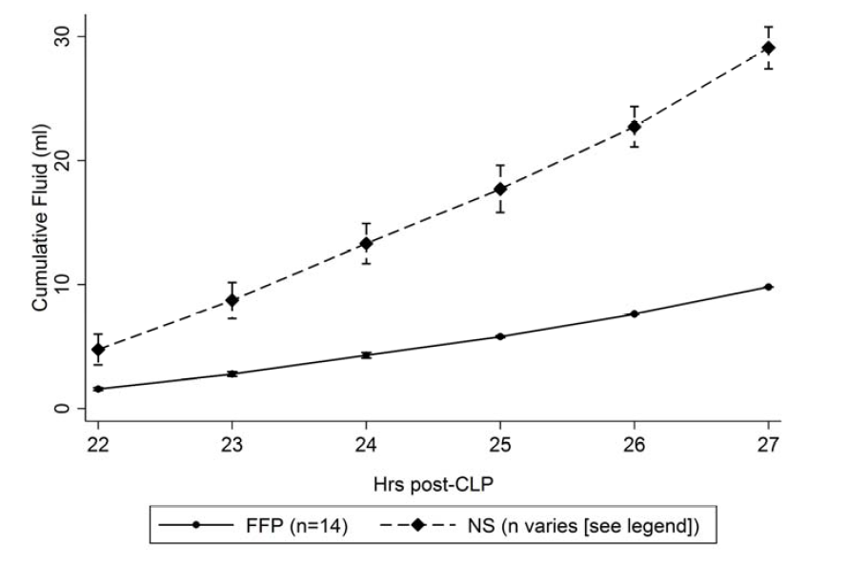
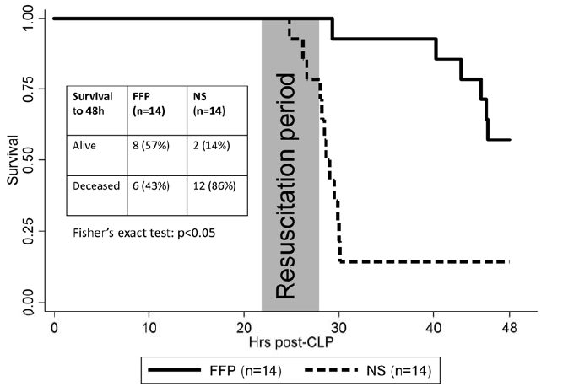
Rat CLP Sepsis Model: Plasma Improves Survival Vs Crystalloids
Plasma vs NS resuscitation improved
Lung function and reduced capillary leak
PaO2/FiO2 and lung wet to dry weights
48 hour survival with a third of the fluid volume
57% vs 14%, respectively, (p<0.05).
Chang R. et al. Shock. 2018, Jan. 49(1): 53–61.

Slide 21
Reduced Catecholamines with Plasma Resuscitation
Chang R. et al. Shock. 2018, Jan. 49(1): 53–61.

Slide 22
Reduced Inflammation with Plasma Resuscitation
Chang R. et al. Shock. 2018, Jan. 49(1): 53–61.

Slide 23
Reduced Endothelial Activation with Plasma Resuscitation
Chang R. et al. Shock. 2018, Jan. 49(1): 53–61.

Slide 24
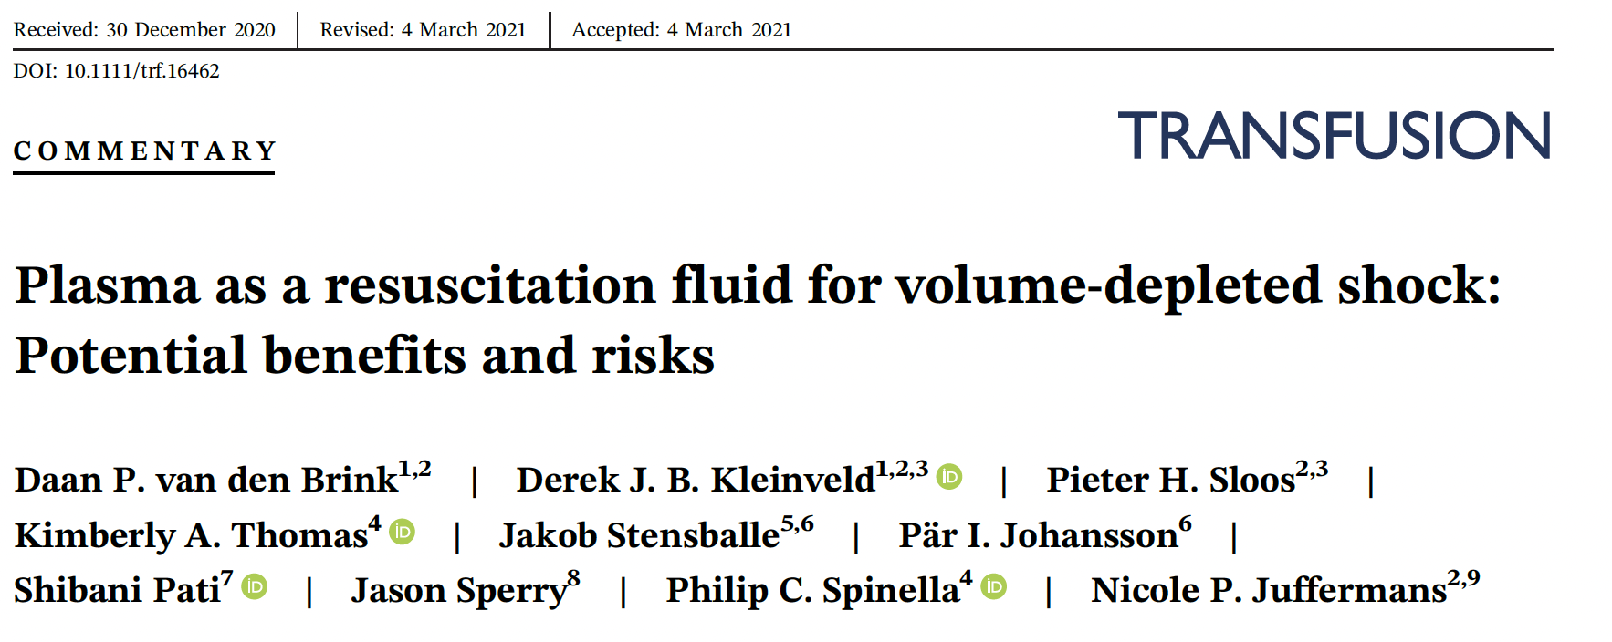
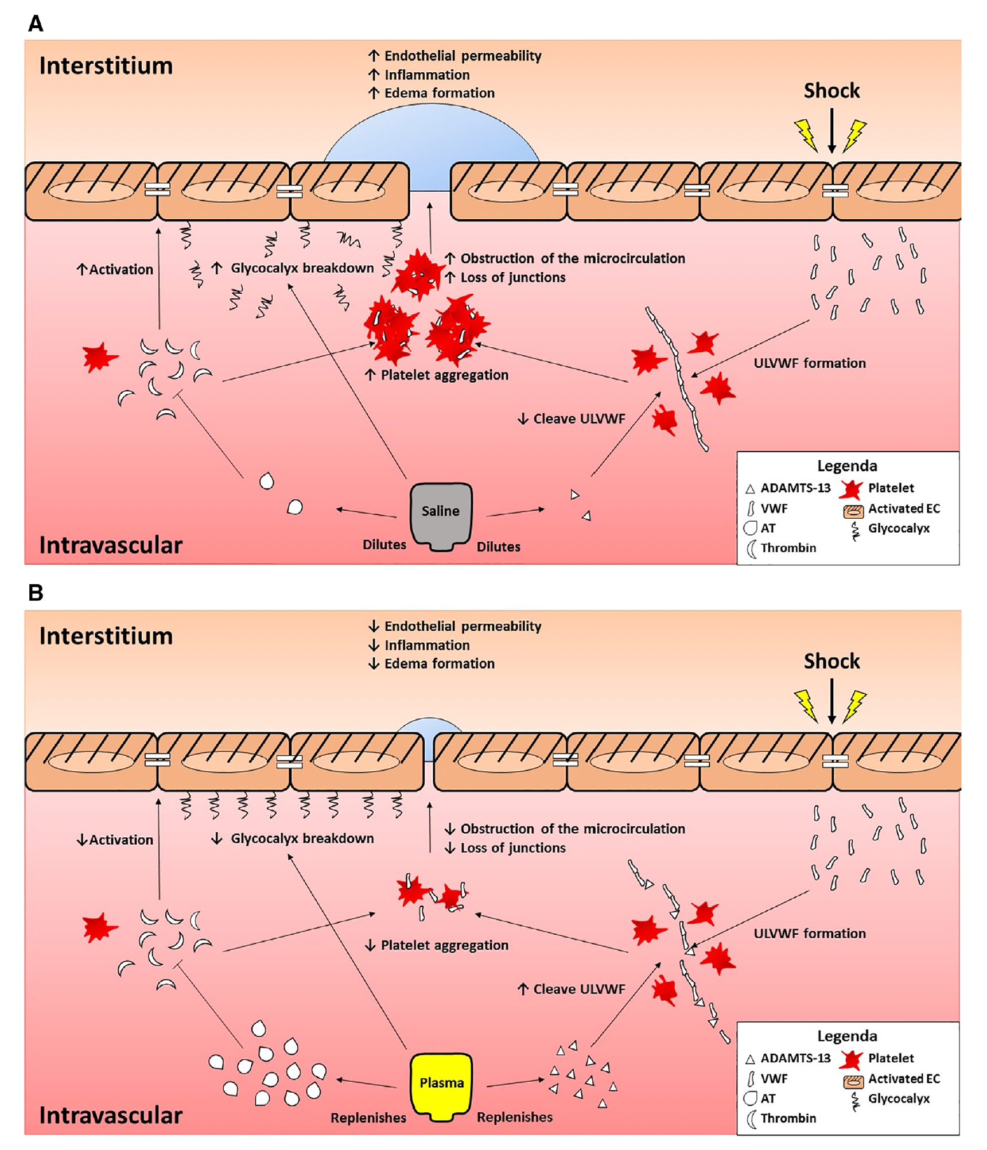

Slide 25
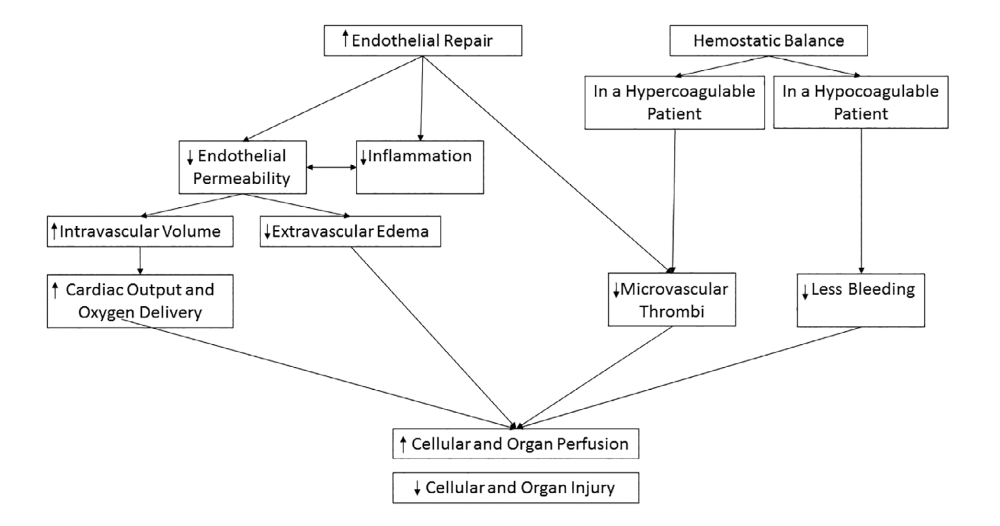
Plasma Effects Relative to Crystalloids
van den Brink, DP. et al. Transfusion. 2021

Slide 26
 | Normal Saline | Lactated Ringers | Plasma Lyte-A | Human Plasma | Fresh Frozen Plasma
pH | 5.5 | 6.6 | 7.4 | 7.4 | 7.4
Sodium (mEq/L) | 154 | 130 | 140 | 140 | 172
Chloride (mEq/L) | 154 | 109 | 98 | 104 | 73
Calcium (mEq/L) | 0 | 3 | 0 | 2.3
Potassium (mEq/L) | 0 | 4 | 5 | 4 | 3.5
Protein (g/dl) | 0 | 0 | 0 | 7 | 5.5
Albumin % of protein | 0 | 0 | 0 | 60 | 60

Slide 27
Potential Risks From Plasma
Concern that plasma can be inflammatory and immune suppressive, increase organ failure.
No assessment of crystalloid volumes given
Only FFP studied
Data primarily in patients without hypovolemic shock
These studies are confounded by indication bias and are not supported by any specific mechanistic data.
No therapy is without risk – especially in critically ill
Goal is to use therapy with most benefit and least risk
Crystalloids?
Plasma?

Slide 28
Risks of Therapies
Plasma should not be given to patients
Prophylactically
Not in shock
DON’T GIVE IT FOR HANGOVERS!
Crystalloids should not be used when not needed either

Slide 29
Plasma Safety Advances
Increased plasma safety profile with pathogen reduction
Solvent detergent treatment reduces the risk of immunologic reactions
Pooling process
Filtering at 0.2 microns
Disappearance of TRALI and the reduction of plasma related transfusion reactions in countries where SD plasma has been implemented
A recent prospective observational study in children indicated that SD plasma may improve survival compared to standard frozen plasma
Camazine M and Spinella PC et al. Ped Crit Care Med. 2017 18(5):e215-e223

Slide 30
Prospective observational study of 419 patients
PELOD-2 (illness severity score) similar between groups
7 (5-10) vs 7 (5-9)
ICU mortality
FFP- 29.1%
SD plasma- 14.5%
Adjusted OR (95% CI), 0.4 (0.16-0.99)
Camazine M and Spinella PC et al. Ped Crit Care Med. 2017 18(5):e215-e223

Slide 31
Dried Plasma
Dried plasma products will allow for immediate availability
Currently available in Europe and South Africa
Soon to be licensed in the US (hopefully)
Dried plasma and dried SD plasma demonstrated to have similar protective effects on the endothelium and immune system
Watawa K, et al. TRANSFUSION Vol 53, January 2013 Suppl. 53:80S-90S

Slide 32
Knowledge Gap
What is the optimal product for volume resuscitation for patients in septic shock?
Are outcomes associated with different resuscitation fluids endotype specific?

Slide 33
Crystalloids vs Plasma Hypotheses
Crystalloids
Plasma
Oxygen Delivery
(HR x stroke volume) x (Hb x SaO2 x 1.34)+PaO2(0.003)
Preload
Myocardial Contractility
Afterload
Bone Marrow
Hemolysis
Uptake
Pulmonary Gas Exchange Function
Microvascular Perfusion
Hydrostatic Pressure
Oncotic Pressure
Capillary
Leak
Microvascular Thrombi Inflammation

Slide 34
Salt Water for Septic Shock?
Hypovolemic
Endothelial Injury
Pro-inflammation
Hypercoagulable
Hypocoagulable (DIC)

Slide 35
Plasma Resuscitation of Septic Shock (PRESS) Study
Hypotheses
Plasma-based resuscitation of septic shock compared to control/standard of care (crystalloids)
Improve clinical outcomes (Effectiveness)
Not increase adverse effects (Safety)
Mechanisms will include increased oxygen delivery, and improvement in hemostasis, immune and endothelial function
Improve cost effectiveness

Slide 36
Aims
To compare effectiveness and safety of plasma to crystalloids for IV bolus volume replacement for septic shock
Effectiveness
Total volume of bolus fluids, fluid balance 24/72 hrs
Lactate clearance, organ support free days
28 day mortality
Safety
SAE, transfusion related AE
Thrombotic events

Slide 37
Aims
To compare mechanisms of plasma to crystalloids for IV bolus volume replacement for septic shock
Mechanisms
Multi-omics platform
Functional hemostatic and immune assays
To compare cost effectiveness
Cost and outcomes

Slide 38
Plasma REsuscitation for Sepsis Study (PRESS) Team
MPI
Phil Spinella and Christopher Seymour
Co-I
Alexandria Weissman, MD
Mark Yazer, MD
Jisnu Das, PhD
Joyce Chang, PhD
Octavia Peck Palmer, PhD

Slide 39
PRESS Steering Committee
Derek Angus, MD MPH (CCM)
Don Yealy, MD (EM)
Clif Callaway, MD PhD (EM)
David Huang, MD MPH (CCM and EM)
Jason Sperry, MD (Surgery)
Matthew D. Neal, MD (Surgery)
Tim Billiar, MD (Surgery)

Slide 40
PRESS- Methods
Start as single center with a run-in phase
100 patients
Multicenter, Randomized, unblinded, controlled trial
Adaptive design
800-1200 patients estimated
Exception for Informed Consent

Slide 41
PRESS -Eligibility
Inclusion Criteria
18-90 years of age
Concern for sepsis with antibiotics ordered
IV fluid boluses ordered in ED for hypotension/poor perfusion

Slide 42
PRESS Trial-Eligibility
Exclusion Criteria
Futility
Known allergic response to plasma products
Known IgA deficiency
More than 2L of any crystalloid given as bolus dosing

Slide 43
PRESS Trial-Methods
Intervention
Bolus IV of Standard care crystalloid
LR or Plasma-Lyte
Bolus IV of Plasma (FP-24 or FFP)
Plasma in emergency release fridge
No maximum of plasma

Slide 44
PRESS Trial-Methods
Intervention period – 12 hrs
Dosing for IV bolus
Physiologic response
Instruction to reassess hemodynamics after every ordered IV bolus
Maintenance fluid is standard care

Slide 45
PRESS Trial-Methods
Primary Outcome
28 day organ support free days
Number of days without organ support for 28 days after enrollment
Death = 0 organ support free days

Slide 46
Secondary Outcomes
28 day mortality
Total volume fluids and fluid balance
Lactate clearance
AKI and ARDS

Slide 47
Safety Outcomes
SAE
Transfusion AE
Hemolysis
Thrombotic events

Slide 48
Cost Effectiveness Outcomes
Hospital costs post enrollment per life year gained

Slide 49
Mechanistic Data
Baseline, 12, 48 hrs
Complete blood count, C-Reactive Protein, PT/PTT/INR, fibrinogen, TEG
Lactate, Thrombin generation
Microfluidic assessment of hemostasis
Plasma and PBMCs for Multi-OMICS

Slide 50
Multi-OMICS Platform
Determine endotypes of patients at baseline
Examine effect of each intervention on survival in each endotype relative to
Oxygen delivery, endothelial, immune, hemostasis parameters

Slide 51
Implementation Science
Incorporate collecting data that are perceived as
Facilitators
Barriers
Focus groups-key stakeholders
Goal of accelerating implementation once trial is complete

Slide 52
Human Protections
EFIC
Very short time between eligibility and need to start intervention
Peds sepsis trial obtained EFIC from FDA
DSMB
Medical Monitor

Slide 53
Funding
Single Center (Run in phase)
Pittsburgh Precision Medicine Institute
Internal funding
Multicenter
BARDA
DoD
NIH

Slide 54
Future Directions (Expansion to Multicenter)
Stratify randomization by center
Platform trial - options
Dried plasma
Solvent detergent treated plasma
Balanced crystalloids
Response adaptive randomization
Enrichment
Children

Slide 55
Adult Trials
Adult pilot RCTs are underway comparing plasma to crystalloids for patients with severe sepsis
Jacob Stensballe – complete
Houston – paused due to COVID

Slide 56
Questions?
Plasma is for Shock,
Salt water is for cooking pasta!

Slide 57
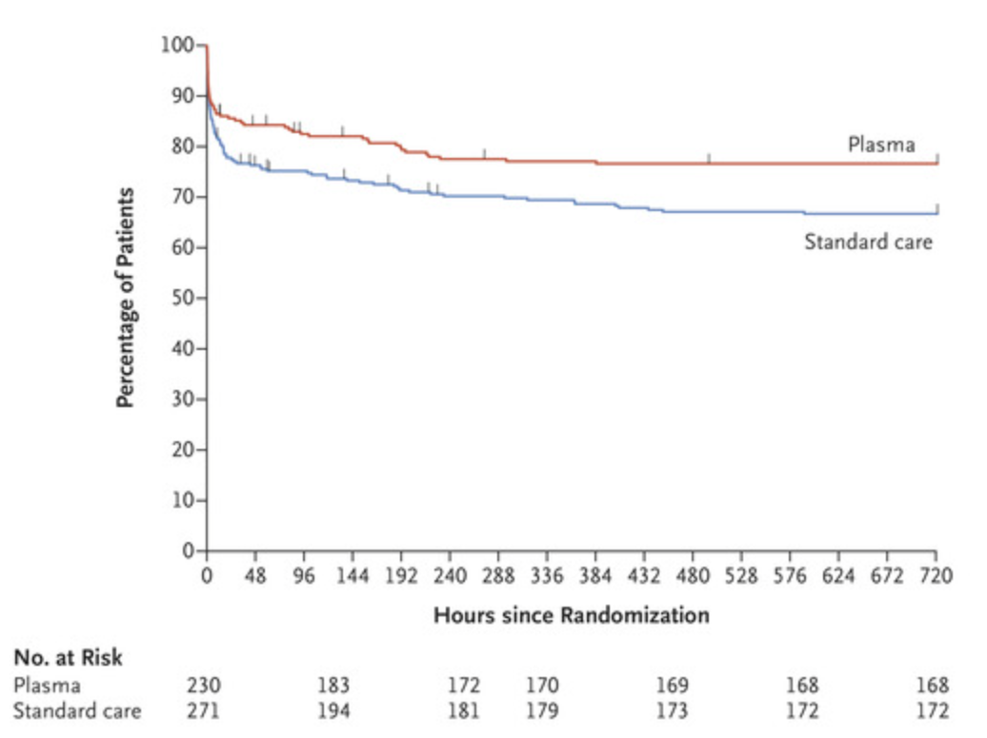
Early Plasma Improves Survival in Trauma
Sperry JL. PAMPER. NEJM. 2018

Slide 58
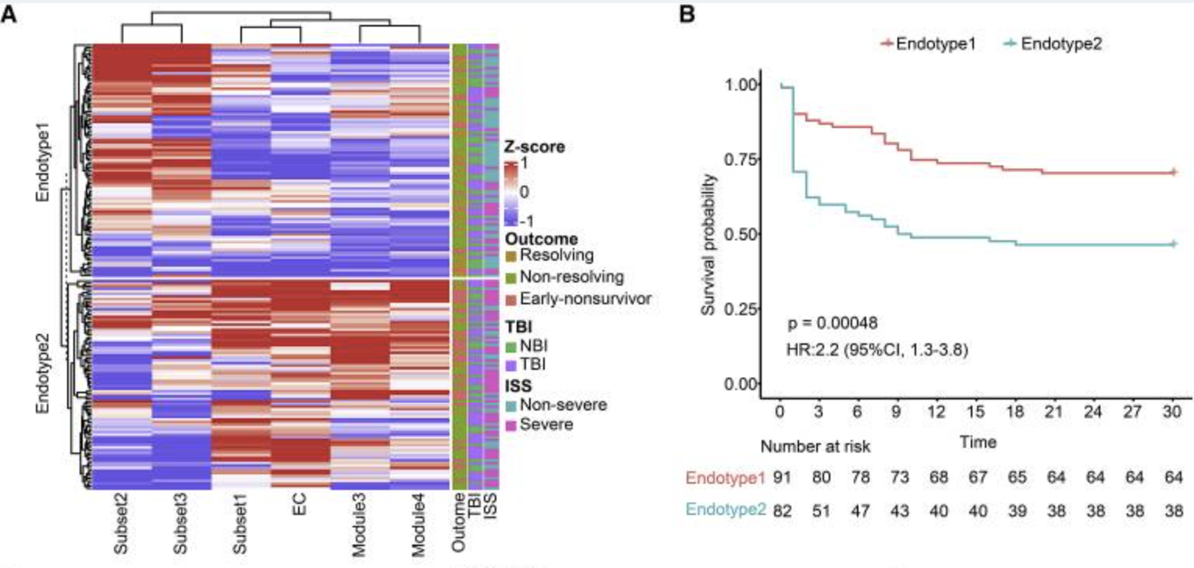
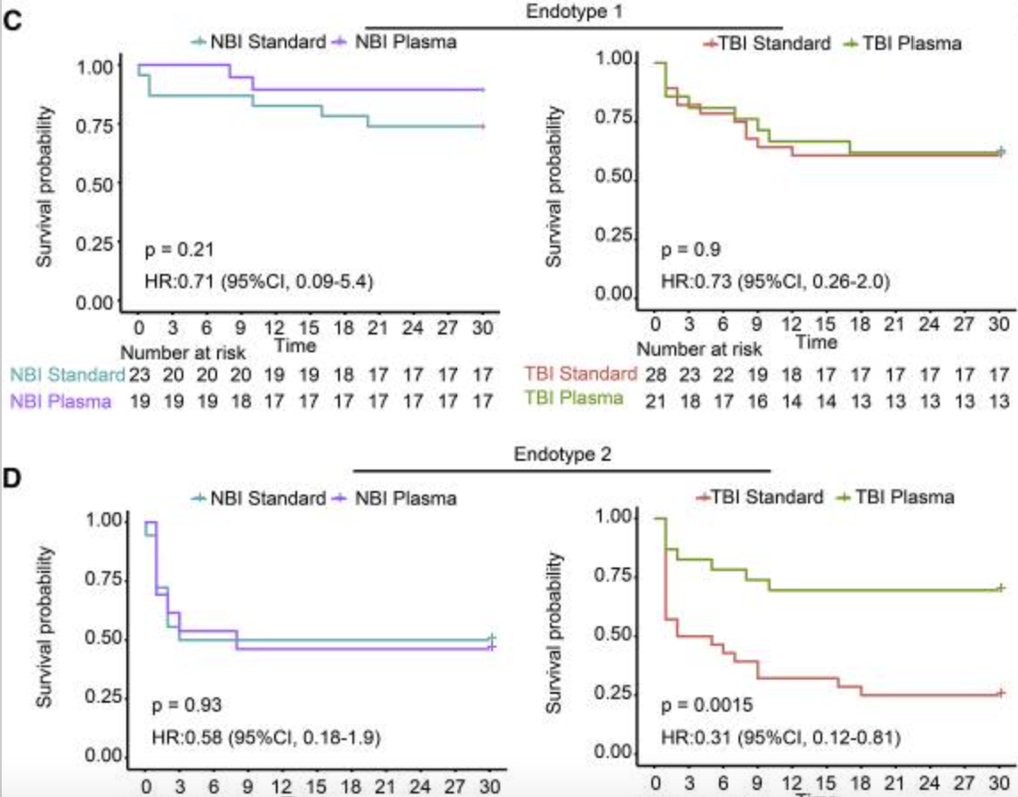
Wu J Cell Rep Med. 2021 Dec 21; 2(12)

Slide 59
Precision Plasma Resuscitation for Septic Shock
Plasma beneficial for all patients with shock?
More effect in some endotypes than others?
Might only be beneficial for some endotypes?

Slide 60
References
Alobaidi, R. et al. JAMA Pediatr. 2018;172(3):257-268.
Alam HB, et al. Surg Clin N Am 87 (2007) 55–72.
Cardenas JC, et al. SHOCK, Vol. 45, No. 2, pp. 166–173, 2016
Chang R et al. Choice of fluid therapy in the initial management of sepsis, severe sepsis, and septic shock Shock. 2016 Jul; 46(1): 17–26.
Chang R. Plasma resuscitation improved survival in a cecal ligation and puncture rat model of Sepsis. Shock. Publish ahead of print. 2018 DOI:10.1097/SHK.0000000000000918
Kendrick CL, et al. J Trauma Acute Care Surg. 2015;79: S110YS115.
Nelson et al. Intensive Care Medicine Experimental (2016) 4:6 DOI 10.1186/s40635-016-0080-7
Pati S, et al. J Trauma Acute Care Surg. 2016;80: 576–585
Peng Z, et al. SHOCK, Vol. 40, No. 3, pp. 195-202, 2013
Torres et al. Critical Care (2017) 21:160
Watawa K, et al. TRANSFUSION Volume 53, January 2013 Supplement. 53:80S-90S

Slide 61
PROCESS Trial Definition of Septic Shock
Sepsis was suspected with 2 or more criteria for SIRS
AND
Refractory hypotension or a serum lactate level of > 4 mmol/L
Refractory hypotension= SBP that either < 90 mm Hg or
required vasopressor therapy to maintain 90 mm Hg after an
IV fluid challenge (>1L over 30 min).
Patients did not have to be in shock on arrival in the emergency department but had to be enrolled in the study in the emergency department within 2 hours after the earliest detection of shock and within 12 hours after arrival.

